Slide 1
Empowering Europe’s youth

Slide 2
Introducing EYCA
38 member organisations
7 million
Youth Cards
36 countries

Slide 3
Empowering Europe’s Youth
Our vision
A Europe where all young people are mobile and active.
Our mission
EYCA member organisations work together to help more young people to be socially, culturally, educationally and economically mobile by:
delivering quality European Youth Card services
contributing to better policy on youth mobility and active citizenship.

Slide 4
European Youth Card
70,000
Discounts in Europe
Information & Opportunities
Travel
Accommodation
Culture
Services
Products
Mobility
Participation
Employability
Entrepreneurship
Culture

Slide 5
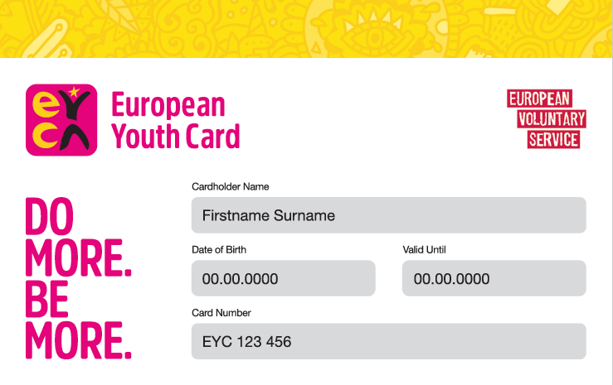
The diverse roles of the card
National entitlements & rewards card
National student card: Hungary, Greece, Portugal, Sweden, Spain.
Youth organisation membership card
Culture card
Regional/municipality/city card
Bank card
Discount card
Travel and health insurance card

Slide 6
European Youth Card reach
>1 million
followers on social media
13 million
web visitors/year
52 million page views/year
>2.5 million
app downloads

Slide 7
Membership

Slide 8
European partnerships

Slide 9
Council of Europe
EYCA-Council of Europe Partial Agreement
on Youth Mobility through the Youth Card
Since 1991, we have been working with the Council of Europe to support youth mobility in the framework of the Partial Agreement on Youth Mobility through the Youth Card (PA).
21 Council of Europe Member States contribute to the PA. Each year we deliver a PA work programme that connects Council of Europe Member States with EYCA member organisations and helps them work together to develop more effective policy and practice responses to youth mobility
Notes:
Montenegro, Croatia, Serbia, Bosnia and Herzegovina, Slovakia. Encourage other members to take part. Albania, Italy, Explain the seminars. Brain Drain, Radicalization, Acces to rights, youth work, democratic participation

Slide 10
Council of Europe
EU-CoE Youth Partnership
EYCA is part of the steering group of the European Platform on Learning Mobility, an EU-CoE Youth Partnership initiative.
No Hate Speech Movement
EYCA was also part of the steering group of the No Have Speech Movement and an early supporter of the campaign. During the campaign, EYCA members issued special No Hate editions of the European Youth Card and organised dedicated events.

Slide 11
European Commission
EU Youth Dialogue
EYCA has been a long-standing partner and supporter of the EU Youth Dialogue called in the past Structured Dialogue with Youth (SD) - a process that gives young Europeans the opportunity to influence youth policy in the EU.
EYCA members support this process and, as a result of their work, many of the young people involved in this are European Youth Cardholders.
To further increase our impact, we have partnered up with European Youth Forum, committing to working together to help more young voices shape national and European policy.

Slide 12
European Commission
EVS European Youth Card
For the past 20 years we have been working with the European Commission to issue a special EVS edition of the European Youth Card to all young people in the European Voluntary Service for free. Over 100,000 EVS European Youth Cards have been distributed so far.
The card is a thank you for the admirable work these amazing young people do, dedicating their time to improving communities abroad.
The card helps them experience and explore more in their host country and take full advantage of their time with the EVS.

Slide 13
European Commission
European Solidarity Corps
EYCA is supporting the European Solidarity Corps and is working with the European Commission to develop a special edition of the youth card dedicated to young volunteers of the Solidarity Corps.

Slide 14
ETHICAL BUSINESS PARTNERSHIPS

Slide 15
CSR Europe & the European Pact for Youth
We believe a cross-sector approach is the only way to truly have a positive impact in terms of boosting young people’s employability and entrepreneurship. To achieve this, we teamed up with CSR Europe, the leading European business network for Corporate Social Responsibility, and are working together to develop joint projects for the benefit of young people.
We are also part of the European Pact for Youth, a cross-sector initiative where companies, schools and universities, youth organisations and European institutions work together to fight youth unemployment and give young people a real chance of reaching their full potential.

Slide 16
ERYICA & Eurodesk
After years of informal cooperation with ERYICA and Eurodesk, we formalised our partnership through a Memorandum of Understanding signed in September 2016.
The highlights of the new partnership include:
a joint position paper to inform the next EU Youth Strategy
a training for youth workers from the organisations
a collection of good practice from across the three networks.
More joint projects are in the pipeline.

Slide 17
EYCA YOUTH PANEL

Slide 18
For young people, with young people
In 2018, we introduced a new advisory body to the EYCA Board – the EYCA Youth Panel.
10 cardholders from across Europe are working together to:
Advise the EYCA Board on the priorities, interests and concerns of young Europeans;
Help to co-design European Youth Card programmes and services;
Receive support from EYCA for the activities they want to develop in their communities and at the European level.
Notes:
We have one member from Serbia, Slovenia

Slide 19
EYCA YOUTH ACTIVATION CAMPAIGN

Slide 20
EYCA Youth Activation Campaign
Implemented with the help of EYCA members in EU member states, the campaign aims to increase young voter turnout in the upcoming EU elections. The campaign will feature:
26 young activists organising local and national events with support from EYCA members;
Strong social media dimension;
European events such as youth exchanges;
Post-election meeting between young activists and newly-elected MEPs.
Notes:
Croatia, Slovenia are taking part. Democratic participation. Special edition of the card.

Slide 21
Cooperation with the Youth Centers
1) EYCA can promote among the 7 million card holders the network of centers with the label. An special information can be provided at the national level by the EYCA members in that territory.
2) We can explore the possibility of how EYCA members can use the centers for meetings and events.
3) In the centers that accept individual visitors we can explore the possibility to have a special discount for the young people that want to stay in the center.

Slide 22
Cooperation with the Youth Centers
4) Also and through an agreement between the center and the EYCA member in that country we can explore the possibility that the card could be issued to a young person in the center and also to have promotional materials regarding the card in the center. ( Some examples of this are already happening in Portugal and Spain).
5) A youth information point with information about the card but also about other issues related to young people can be establish between the management of the card and our EYCA national member in that territory.

Slide 23
Cooperation with the Youth Centers
6) EYCA would invite the managers of the centers to the regional meeting that EYCA members have once a year to talk about services and opportunities for young people.
7) Since EYCA has an agreement with CSR Europe we can also explore the possibilities to develop CSR programs among young people and center managers.
8) Also EYCA delivers the card for free to all the EVS people in Europe and it will be also to all European Solidarity Cops participants so that will be a great way of promoting the use of the centers by the volunteers and to promote the centers itself.

Slide 24
Thank you!

