Slide 1





European Centre on Geomorphological Hazards
Centre Européen sur les Risques Géomorphologiques
M. Nodia Institute of Geophysics
European Centre “Geodynamical Hazards of High Dams
European Centre on Urban Risks
Project 2016-2017 – Synthesis 2017
European Landslide Hazard Maps: Fostering European Harmonization of Slope Movement Hazard Assessment at various spatial scales
With contributions of:
GHHD: Zurab Chelidze, Nodar Varamashvili, Tamaz Chelidze, Victor Chikhladze
CERG: Clément Hibert, Floriane Provost, André Stumpf, Jean-Philippe Malet

Slide 2
Objectives
To finalize and critically evaluate the European Landslide Susceptibility Map ELSUS v2 developped in former APO-supported projects
To propose landslide triggering thresholds for several European regions
To integrate triggering factors (rainfall, seismic activity) in the various landslide susceptibility assessment methods (geomorphological approach, statistical/process-based models) for hazard assessment at national/global scales

Slide 3

European Landslide Hazard Maps: Fostering European Harmonization of Slope Movement Hazard Assessment at various spatial scales
CERG inputs: quantitative validation of landslide susceptibility map ELSUS v2
Andreas GUENTHER, Martina WILDE, Marta JURCHESCU, Paola REICHENBACH, Jean-Philippe MALET, Javier HERVAS

Slide 4
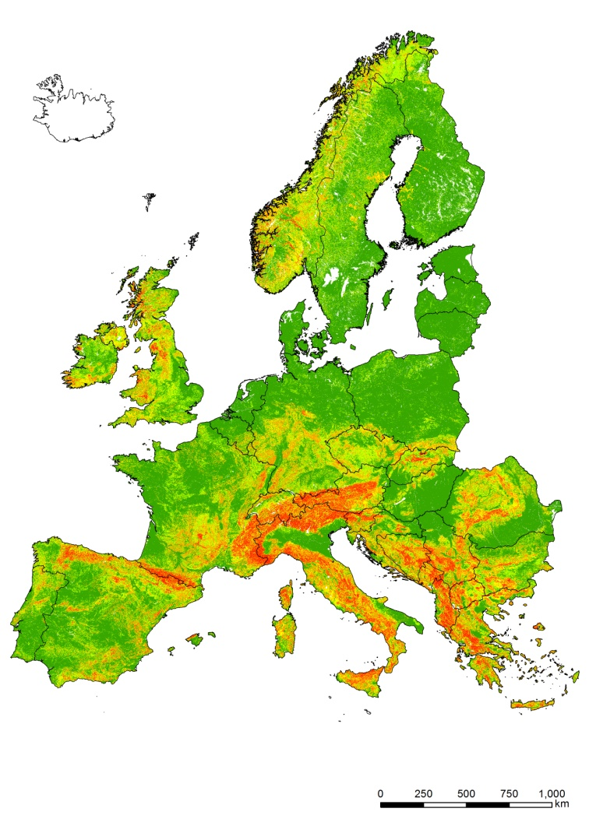
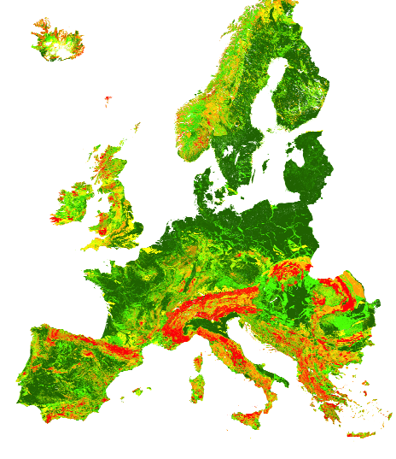
Context: Assessing landslide susceptibility at the European scale
The European Landslide Susceptibility map ELSUS
ELSUS1000 (2013)
(downloadable at JRC´s ESDAC)
Semi-heuristic (SMCE) methodology
Enriched landslide dataset (30% more data)
Exploiting new data sources for deriving
control factors: BGR IHME lithology
Improving spatial resolution (1 km → 200m)
Enlarging spatial coverage (including Iceland,
the Faroes, the Shetlands and Cyprus)
Qualitative evaluation of ELSUS1000 by
European experts incorporated
ELSUS v2
Günther et al. 2014
Wilde et al. (in press, JoM)

Slide 5
Results: Collaboration of CERG with EOEG for the validation of ELSUS v2
Setup of the methodology for evaluating the reliability/validity and usefulness of the ELSUS v2 map at national and regional levels for various European countries/regions:
Qualitatively: Questionnaire
Quantitatively:
  1) Evaluating ELSUS v2 with independent small-scale national/regional landslide inventory data from by EOEG members
  2) Evaluating ELSUS v2 with small-scale national/regional landslide susceptibility maps held by EOEG members

Slide 6
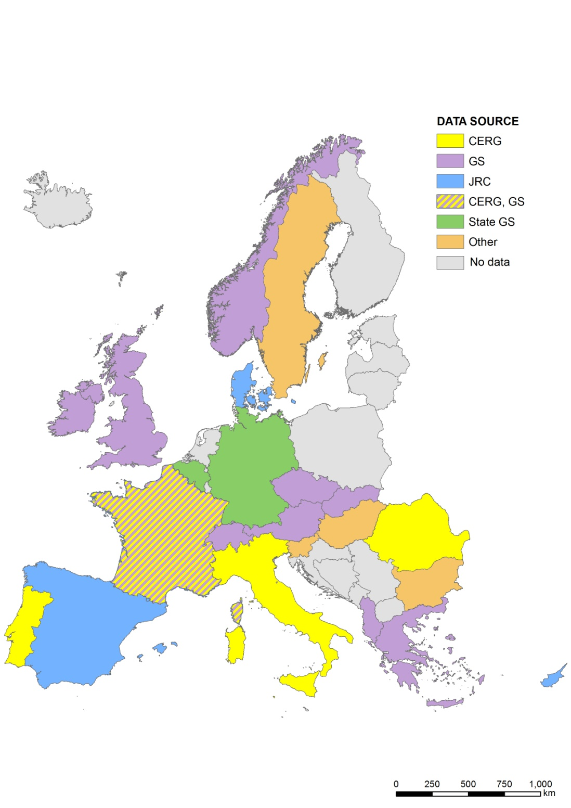
Results: Towards a European Landslide Inventory
    To improve ELSUS (e.g. v3), a more exhaustive landslide inventory is needed containing the most important attributes (location, typology, accuracy and time)?
    How to initiate this activity? As data are hosted by several types of organisms (e.g. GeoSurveys, Research institutes, Civil Protection, etc)
    How to harmonize small-scale inventories based on different sources
Sources of landslide information used for ELSUS

Slide 7
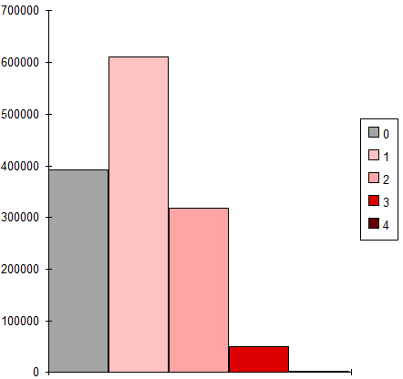
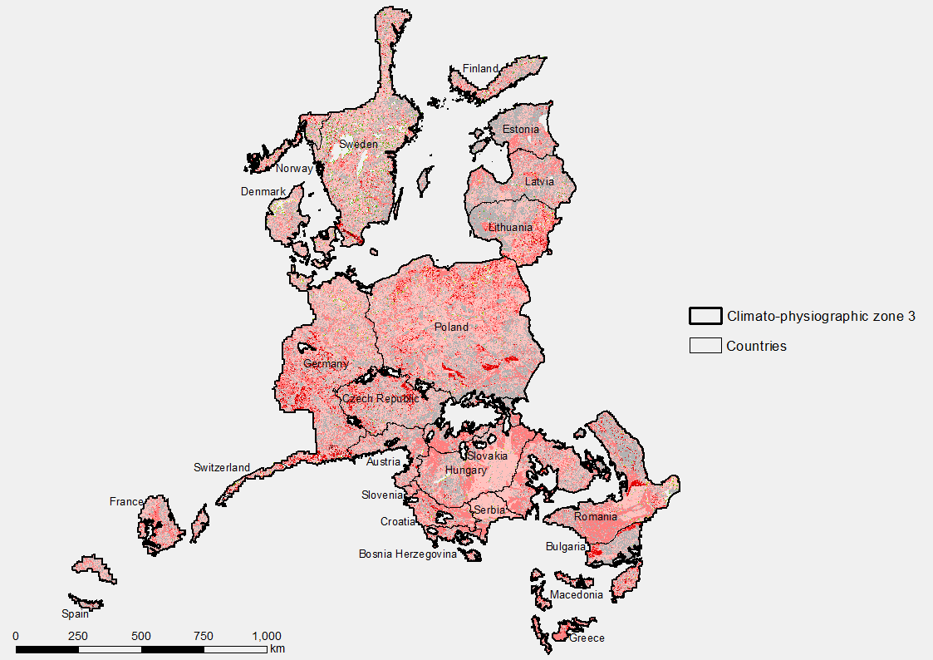
Why is it useful to get access to enhanced landslide information?
Performing a European-wide quantitative, statistical landslide assessment
Performing a typologically-differentiated assessment (slides+flows vs. falls+topples), since criteria sometimes completely differ for different types (e.g. slope values slides vs. falls)
by
organizing landslide inventory information in terms of quality (i.e. completeness, accuracy, consistency) and typology
Statistical experiment modeling in progress (one European zone)
Uncertainty map (difference in susceptibility classes between statistical map and semi-quantitative map)
Requirements for a statistical analysis:
Information on quality of data:
  Accuracy in rel. to Resolution
  Completeness
  Consistency
Information on process typology
→ Accurate, complete and typological landslide information could significantly contribute to improving the ELSUS map, enhancing the reliability of results

Slide 8
M. Nodia Institute of Geophysics
European Centre “Geodynamical Hazards of High Dams
European Landslide Hazard Maps: Fostering European Harmonization of Slope Movement Hazard Assessment at various spatial scales
GHHD inputs: landslide hazard mapping including triggering effects: fuzzy logic approach
Tamaz Chelidze, Tamo Tsamalashvili, M. Fandoeva

Slide 9
Standard approach: combination of stationary maps
The three-factor maps have been selected from the existing factor-maps dataset:
Lithology – derived from the Engendering geological map (initially 54 classes have been reworked into 8 classes)
Land use – from the Terra MODIS image (originally 16 classes have been regrouped into 7 classes)
Slopes obtained from DTM (Aster) have been reclassified into 8 classes

Slide 10
Standard stationary landslide and mudflow susceptibility maps of Georgia

Slide 11
How to integrate dynamic factors in the assessment?
This approach uses the long-term (e.g. for 100 years) local precipitation (Guzetti) or soil wetness (Baum, Godt) data as an additional quasi-stationary factor, which can be added to a standard list of factors: slope, geology, etc.
For including precipitation triggering effects we used the map of maximum 5-day (100 hours) precipitation for 100 years return period in Georgia (Atlas of geo-hazards of Georgia)

Slide 12
Development of a Fuzzy Logic approach to integrate datasets
How does FL methodology work?
Choose of the the fuzzy sets (linguistic terms )that describe the linguistic variable precipitation: very low, low, middle, high, very high.
The linguistic terms for linguistic variable hazard should be also defined, for example: no hazard, low hazard, middle hazard, high hazard, very high hazard.
The next step is to construct the IF - THEN rule bases, where IF-part includes two variables - precipitation and landslide - they are input variables, and one output variable - hazard.
The following rule - IF precipitation is middle and landslide is not so many THEN hazard is middle - is an example of such rule.
Example
If the landslide hazard of the polygon equals to 2 and precipitation of the same polygon equals to 190 mm (which belongs to the “High” group of precipitation, with the same membership function)
Landslide
2
then we get the membership function of the landslide hazard groups

Slide 13
Development of a Fuzzy Logic approach to integrate datasets

Slide 14
Results: rainfall-triggered landslide hazard map for rain event of 100 yr return period

Slide 15
Results: rainfall-triggered landslide hazard map for rain event of 100 yr return period

Slide 16
European Centre on Geomorphological Hazards
Centre Européen sur les Risques Géomorphologiques
M. Nodia Institute of Geophysics
European Centre “Geodynamical Hazards of High Dams
European Centre on Urban Risks
Project 2018-2019 – Objectives 2018
Space data in Disaster Risk Reduction: using satellite precipitation data and hydrological information for leapfrogging landslide forecasting
With contributions of:
GHHD: Zurab Chelidze, Nodar Varamashvili, Tamaz Chelidze, Victor Chikhladze
CERG: Clément Hibert, Floriane Provost, André Stumpf, Jean-Philippe Malet

Slide 17
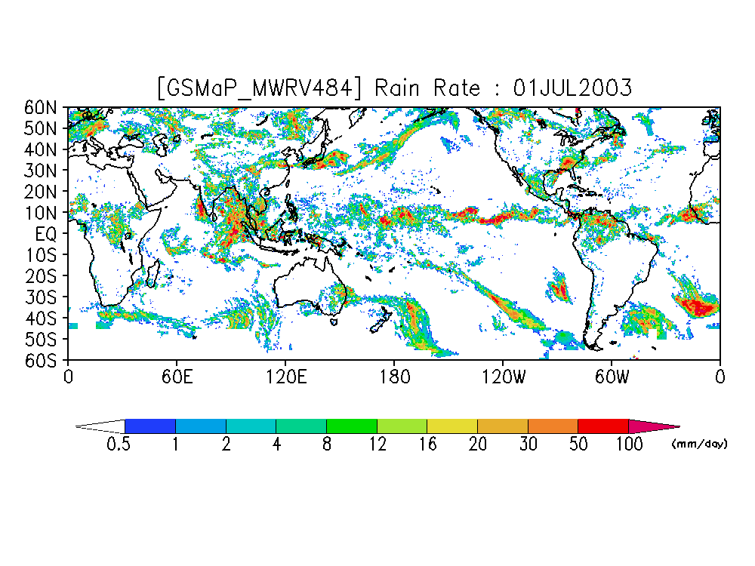
Improving the methodology for defining dynamic landslide hazard maps using hydrological information and satellite-derived precipitation forecast
Identification of the best hydrological information to integrate (e.g.; soil moisture products, etc)
Test on several regions where datasets already available and collaboration established
Analysis of extreme storm events creating landslide disasters
  → scaling laws among landslide properties (size, number, runout) and rain properties

Slide 18
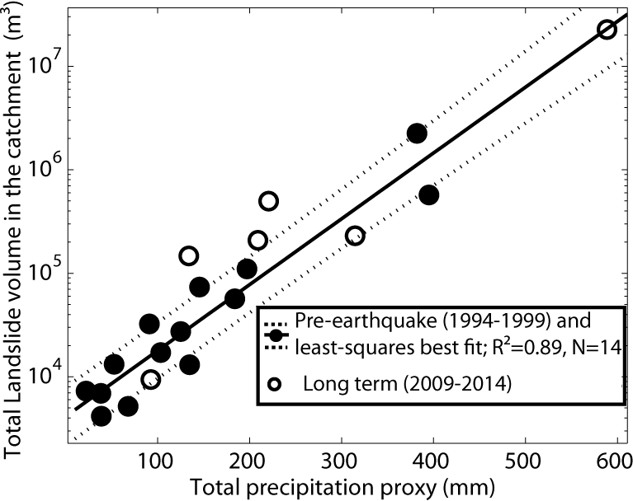
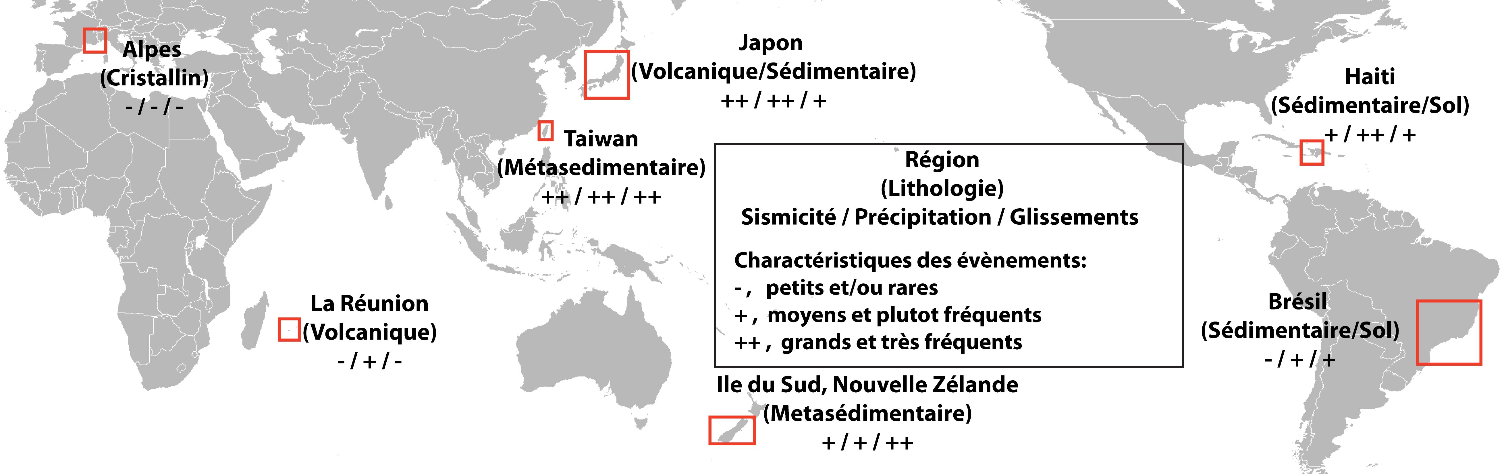
Analysis of extreme storm events creating landslide disasters
  → scaling laws among landslide properties (size, number, runout) and rain properties
Scalling lawsTaiwan.
Global appro ch:
- Diverse sites and precipitation conditions
Focus on Tropics,
Focus on sedimentary and crystalline roks
Focus on several tectonics forcings
Ethiopie
(Volcanique)
++, ++, +

Slide 19
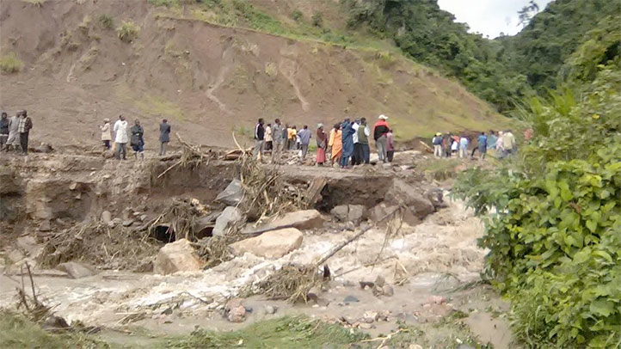
Landslide event in Freetown, Summer 2017 – Sierra Leone
Thank you!

