Slide 1
European Center for Disaster Awareness “BeSafeNet“
Demetris Christou
Director of the Specialized Center
Cyprus Civil Defence
November 2018
Zagreb, Croatia

Slide 2
What is the BeSafeNet?
The BeSafeNet is a tool for promoting risk culture among populations.
Natural and technological disasters cause great human and economic losses. We cannot prevent many of them but there is a way to minimize the risk of disaster by sharing internationally valid and reliable information on the nature, causes and consequences of natural and technological disasters.

Slide 3
Who are we?
Leader: European Centre for Disaster Awareness - Cyprus Civil Defence.
Partners:
TESEC: European Centre of Technological Safety in Kiev.
ICOD: Euro-Mediterranean Centre on Insular Coastal Dynamics in Valletta.
CERG: European Center for Seismic and Geomorphogical Hazards in Strasbourg.

Slide 4
What is the aim?
The aim of BeSafeNet is to become an educational tool in the hands of teachers, focusing at risk prevention, preparedness, immediate reaction and rehabilitation.
What our goals are?
Promote a culture of safety
Replace fear with a culture of preparedness
Enrich its content by contributions
Multilingual
Establish the website as an Interactive tool

Slide 5
What are we dealing with?
Natural Hazards
Geological Hazards
Volcanic Eruptions
Earthquakes
Tsunami
Landslides
Hydro-Meteorological Hazards
Floods
Drought and Desertification
Avalanches
Hurricanes and Storm Surges
Sea Level Rise
Technological Hazards
Chemical Emergencies
Radiological Emergencies
Dam failure

Slide 6
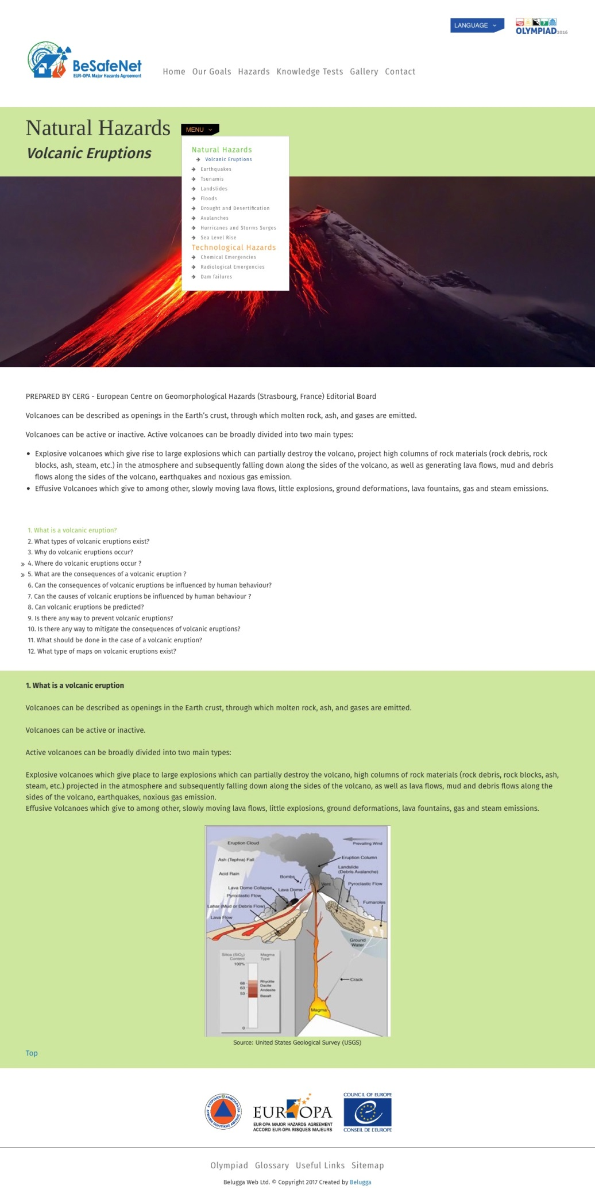
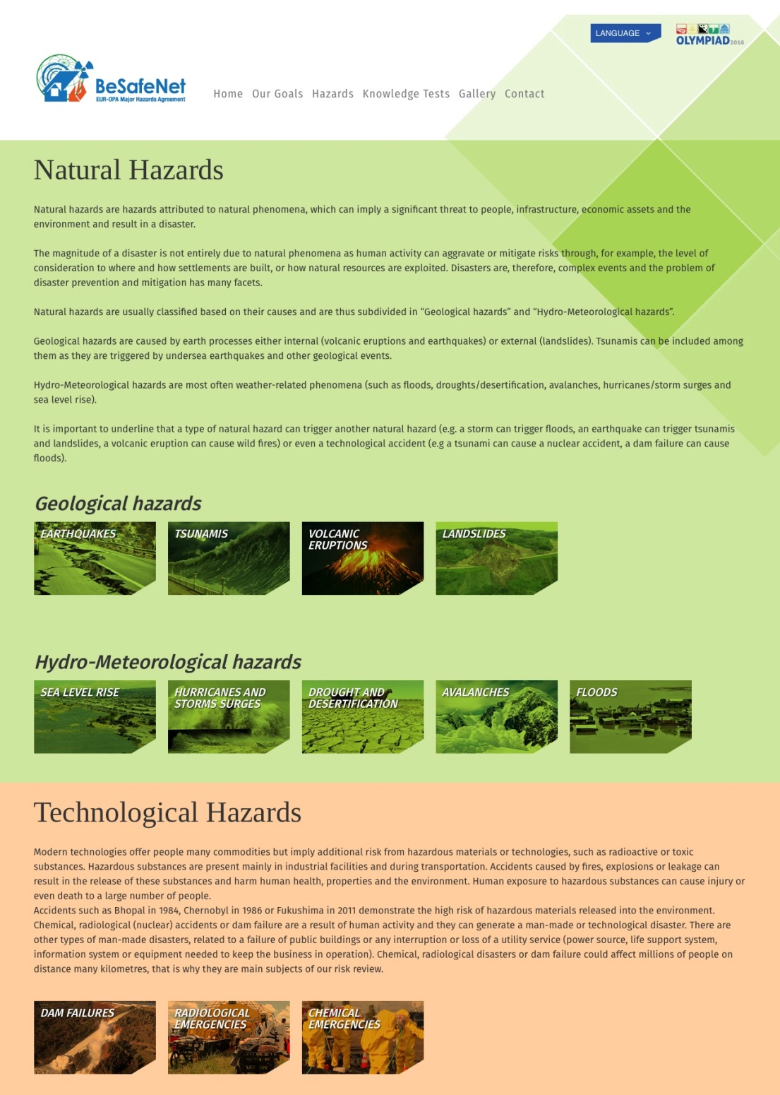
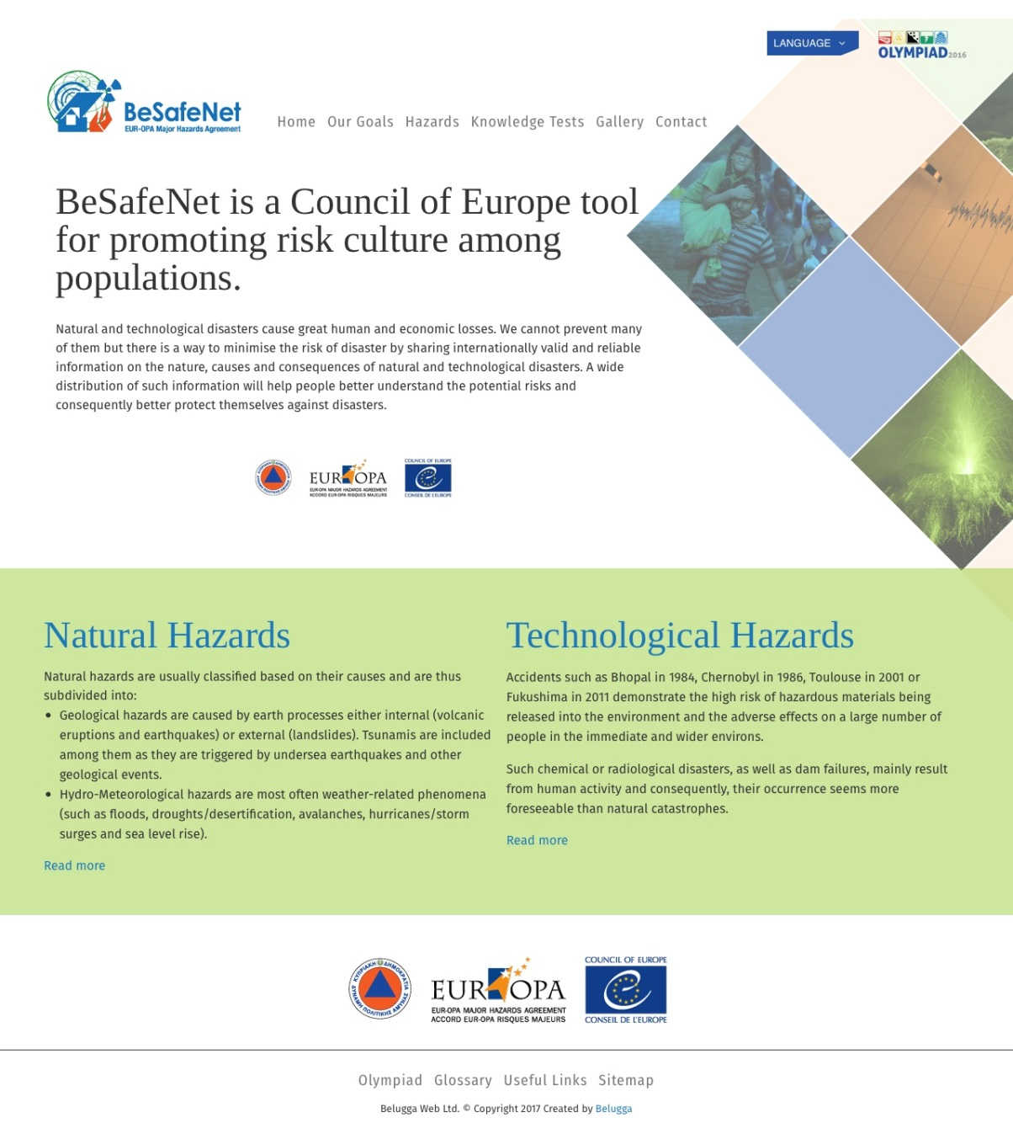
What have we done in 2018?
Finished and tested the new responsive Website

Slide 7
What have we done in 2018?
Disseminated and still disseminating Olympiad 2019 competition.
Design and print a poster promoting Olympiad.

Slide 8
What have we done in 2018?
Developed new Multiple Choice Questions for all the Hazards in Knowledge test, that are now live in our website.

Slide 9
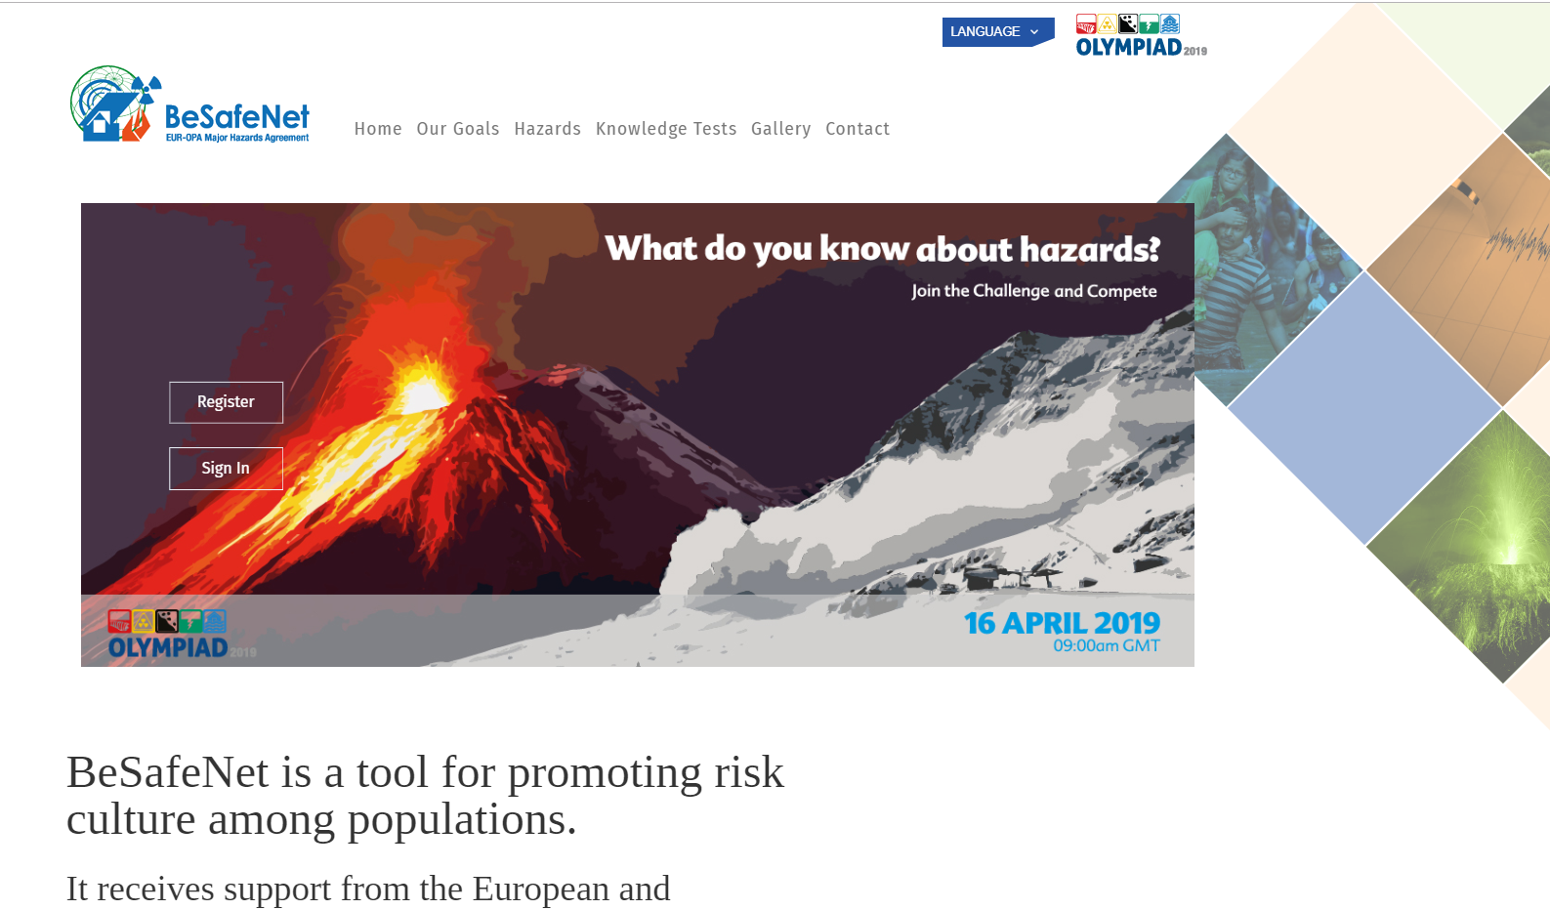
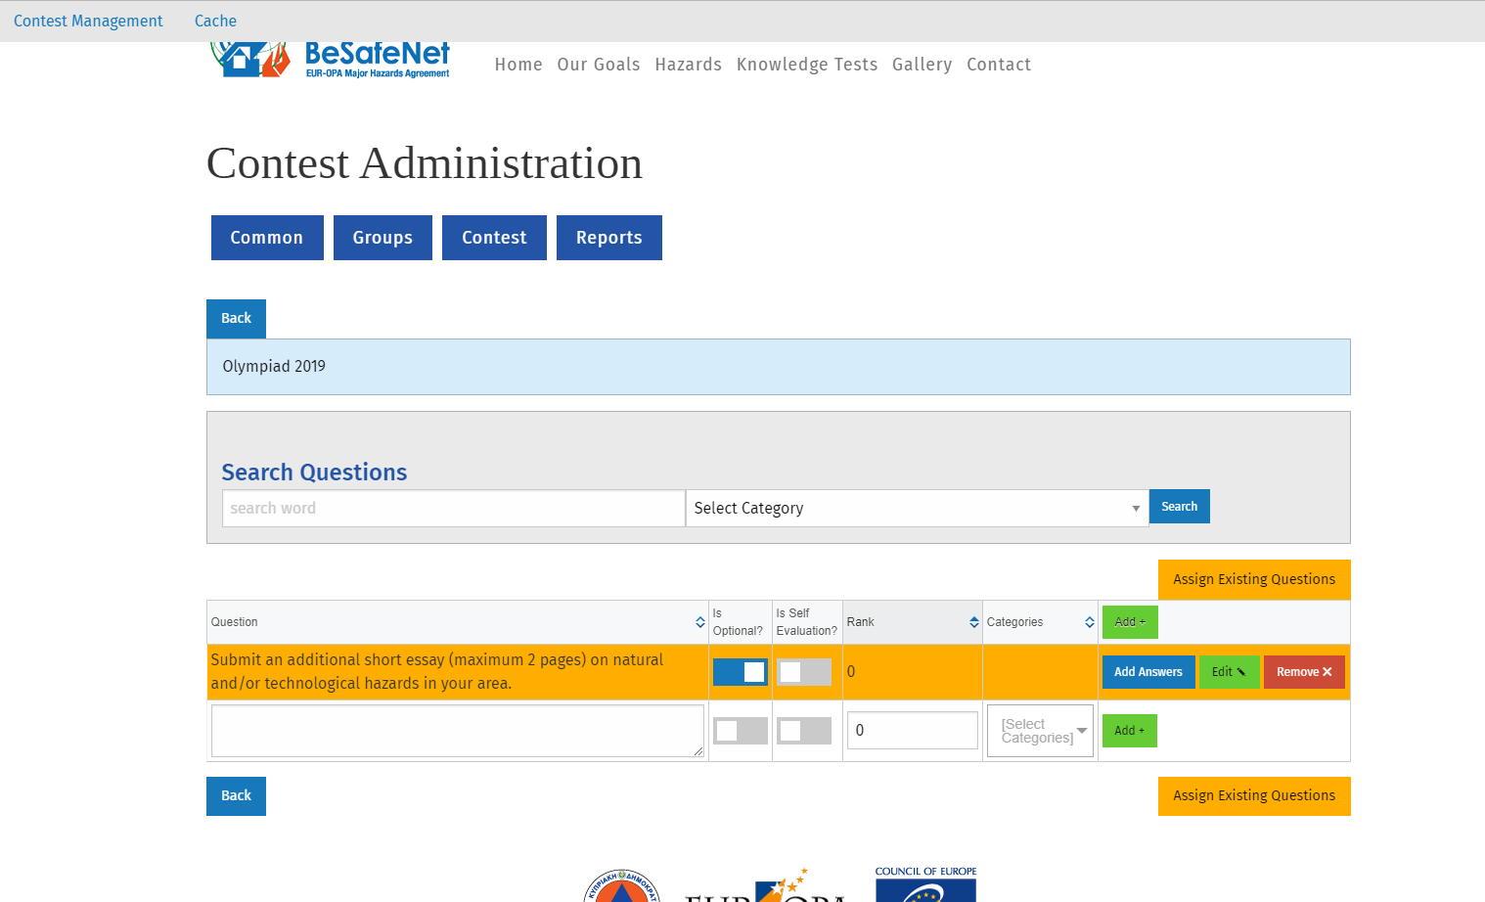
What have we done in 2018?
Created a complete background competition procedure. Now everything is automated!!!
Just create the competition,
Add the Questions and the date periods and
A new competition is ready to be launched.

Slide 10
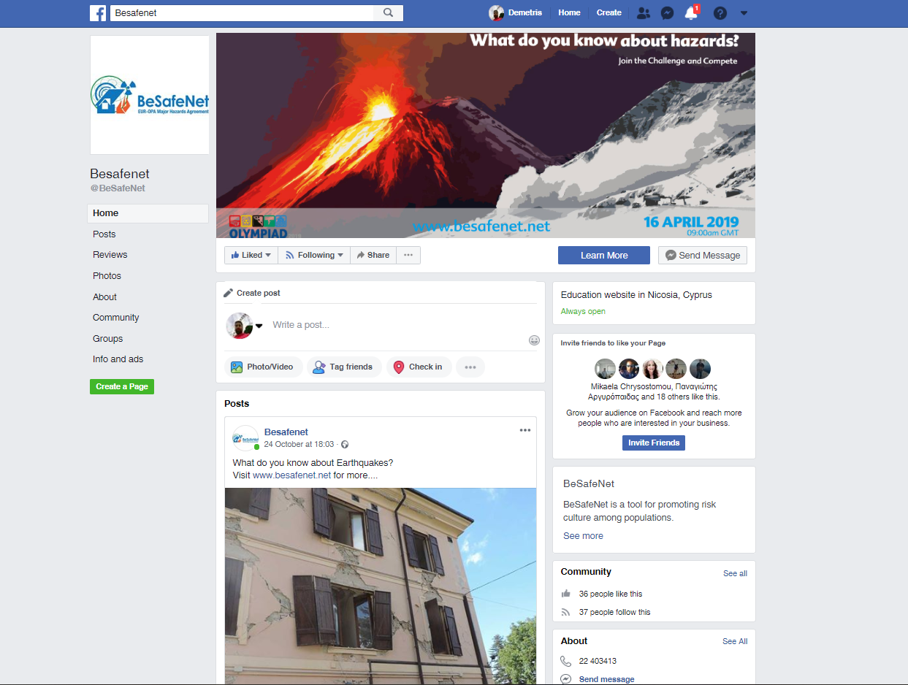
What have we done in 2018?
Created a Facebook Page in order to promote the project and the Olympiad competition
So please Like us on www.facebook.com/BeSafeNet

Slide 11
What’s next? Project Proposals 2019-2020
Q1
Foster in Promoting the Olympiad competition among the participating Countries in order to engage as many participating teams as possible.
Q2
Launch the Olympiad 2019 competition on the 16th of APRIL 2019.
Evaluation of the tests and essays with the participation of external judges.
Organize a Winners Ceremony.

Slide 12
The Olympiad competition “Better knowledge against disasters”
A competition between school classes open to students up to secondary school.
The competition includes two parts:
A Quiz concerning five hazards included in the BeSafeNet website.
An additional (optional) submission consisting of a short essay on natural and/or technological hazards in your area.
The competition will be based on English Language.
The registration of participants is now open until one week before the competition.
Participants must be organized in teams of minimum three students and should be endorsed by a teacher.
The schools of the three best teams and the team members will be awarded.

Slide 13
What’s next? (2) Project Proposals 2019-2020
Q3-Q4
Translate into 4 languages, Vegetation Fires that Johann Goldammer and his team from Global Fire Monitoring Center will provide us and upload on BeSafeNet website.
Improve the content of the website.
Update the content with new hazards occurrences.

Slide 14
You can contact us at:
BeSafeNet:
info@besafenet.net
Mikaella Mala – Committee Permanent Correspondence
mmala@cd.moi.gov.cy
Demetris Christou – Director of the Specialized Center
dchristou@cd.moi.gov.cy

Slide 15
Ευχαριστώ! Thank you!

