Slide 1
Council of Europe Platform on Ethics, Transparency and Integrity in Education (ETINED)
3° Plenary session
Prague 28 November 2019
Chiara Finocchietti
Luca Lantero

Slide 2
Survey on education fraud - The context
Circulated among delegates of the ETINED platform in Spring 2019
20 questions dealing with education fraud from different perspectives
Topics: characteristics of the phenomenon, policies and practices to prevent and fight it, legislation, cooperation among stakeholders, awareness-raising actions, use of digital solutions, policies to build a culture of ethics and transparency.
28 responses, coming from 25 countries (3 countries sent two answers from different offices/institutions)
The vast majority of respondents affirmed that statistics or a systematic collection of data on the phenomenon at a national level are not available = more a perception than concrete data

Slide 3
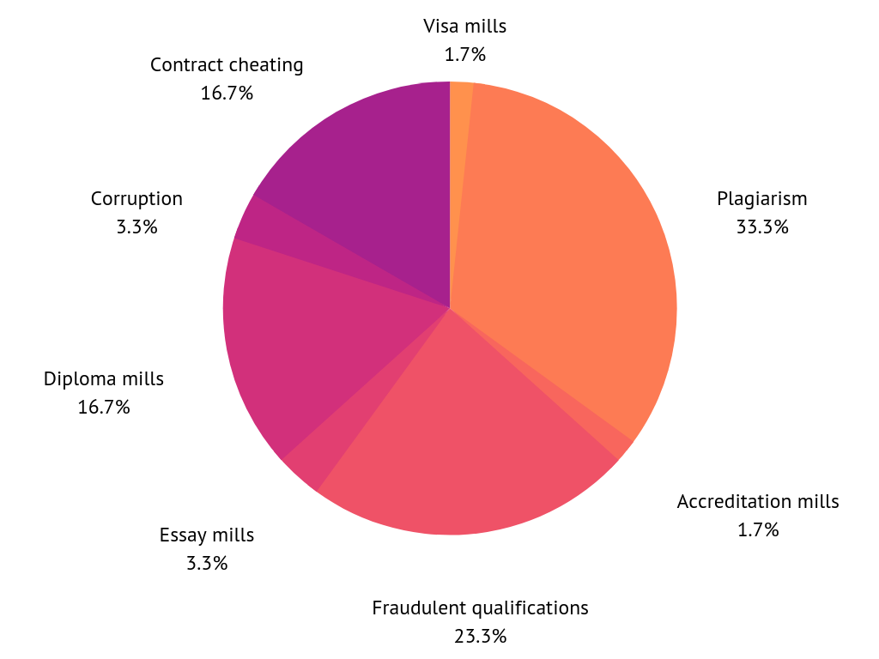
Q1. Can you specify what are the most common and the most problematic types of education fraud you have experienced?
Fig. 1 - The most common and problematic types of education fraud: plagiarism, qualification fraud, diploma mills and contract cheating

Slide 4
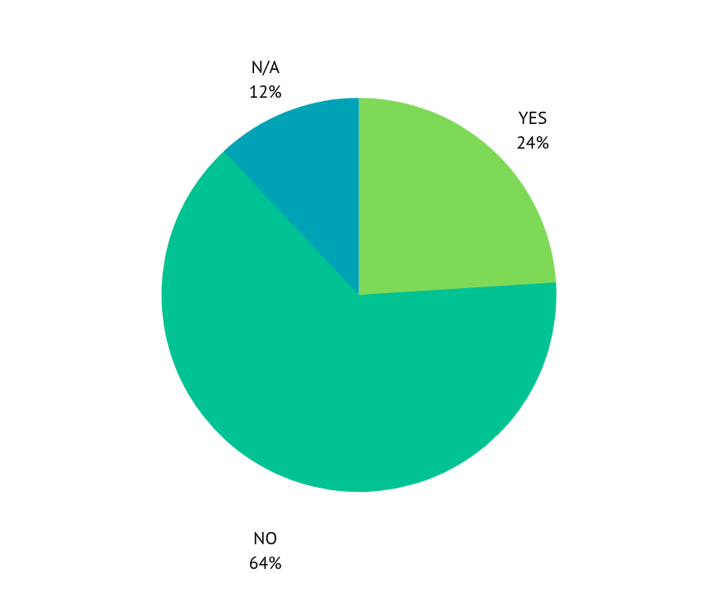
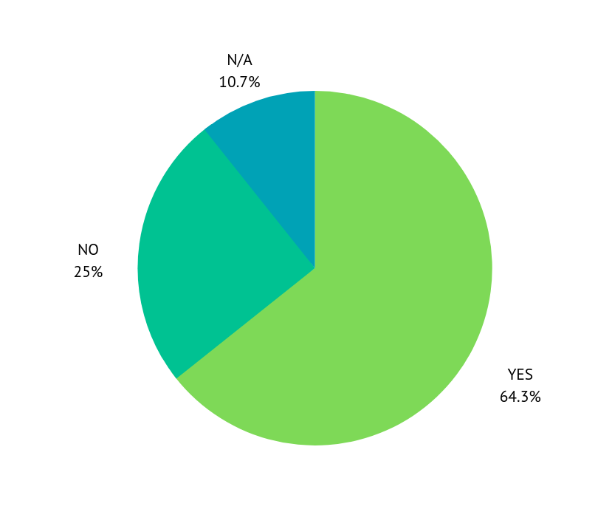
Q2. Do you have any data about the phenomena?
Q3. Do you have in your country any example of education Mills?
Fig. 2 - Collection of data about education fraud
Fig. 3 - Do you have in your country education mills?

Slide 5
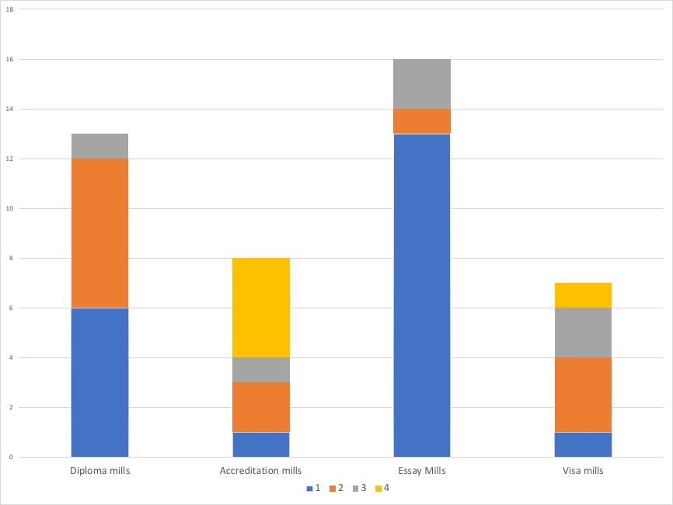
Q4. Provide details on the different categories of “mills” you have in your country.
Fig. 4 - Ranking of education mills in order of prevalence

Slide 6
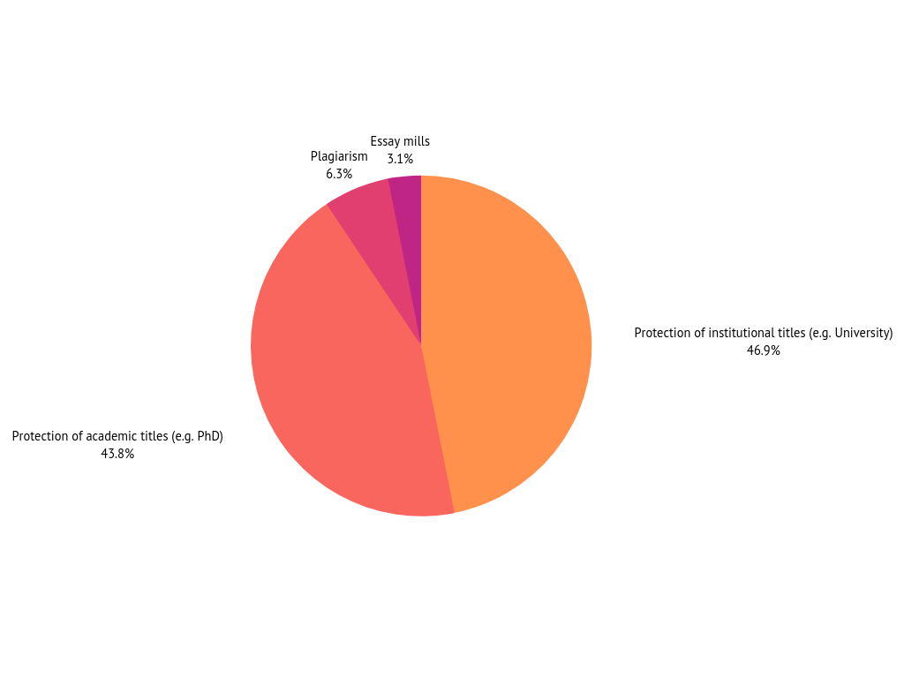
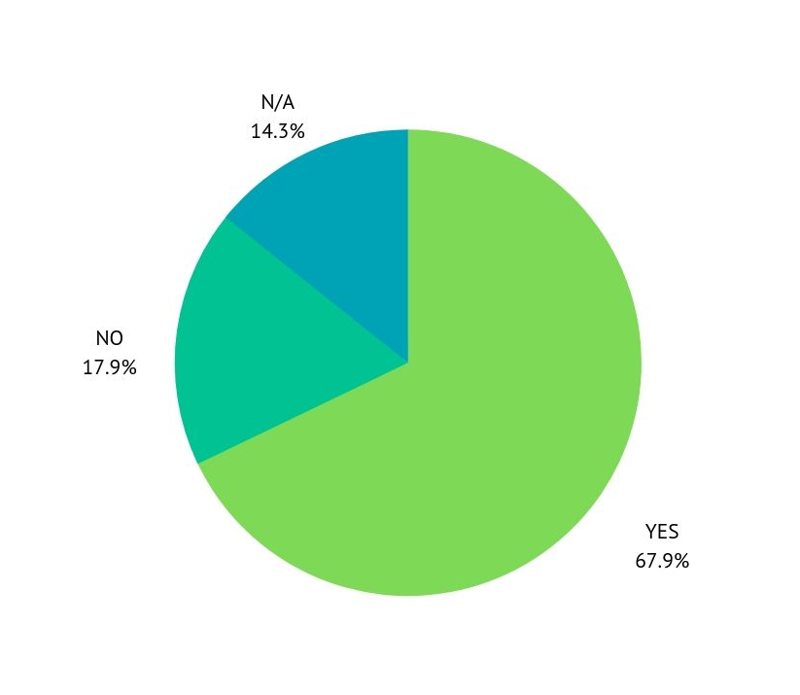
Q5. Do you have legislation in your country specific to education fraud?
Fig. 5a - Existence of legislation on education fraud
Fig. 5b - Issues tackled by national legislation to fight education fraud

Slide 7
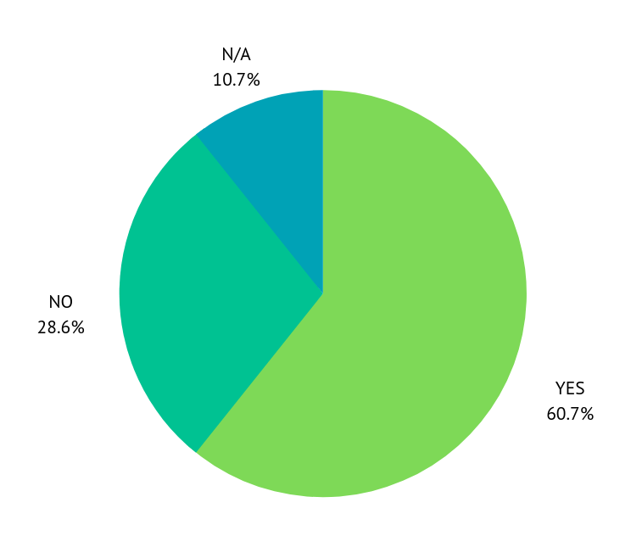
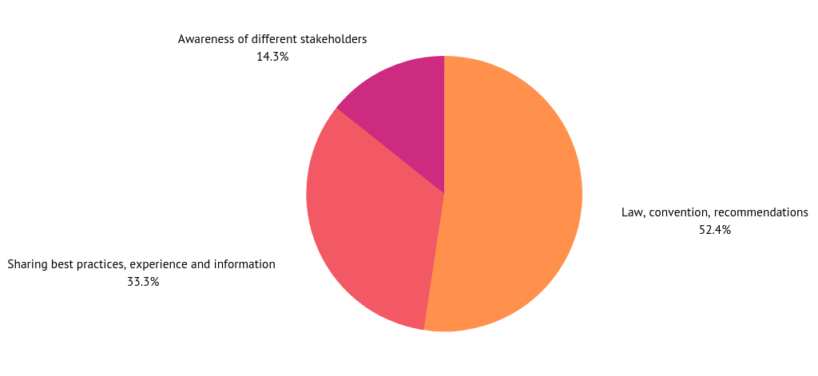
Q7-8. It is necessary to introduce or revise existing legislation on education fraud? If so, how could the Council of Europe help in this?
Fig. 7 - Do you think it is necessary to introduce or revise existing legislation
to tackle education fraud?
Fig. 8 - How could the Council of Europe help
regarding legislation to tackle education fraud?

Slide 8
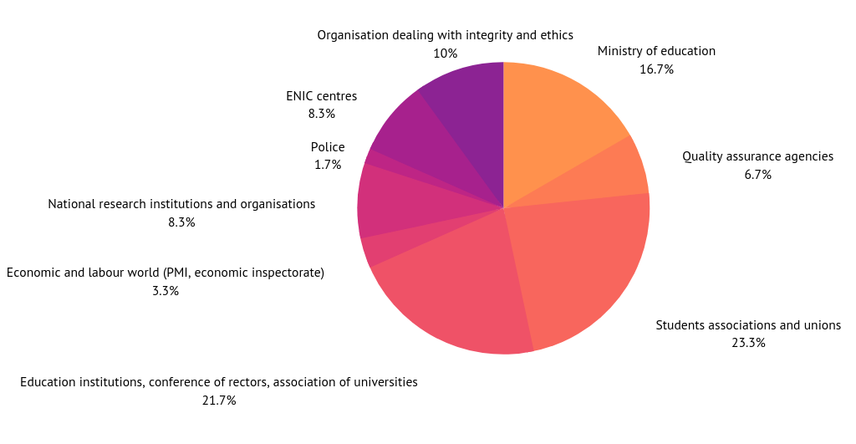
Q9. Please identify the key stakeholders in your country who support action against education fraud
Fig. 9 - Key stakeholders in your country who support action against education fraud

Slide 9
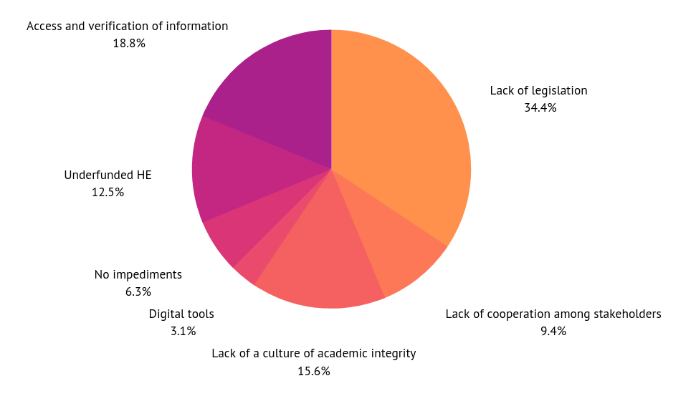
Q11. What are the main challenges and impediments that affect your procedures?
Fig. 11 - Challenges and impediments affecting procedures and limiting their efficiency and effectiveness

Slide 10
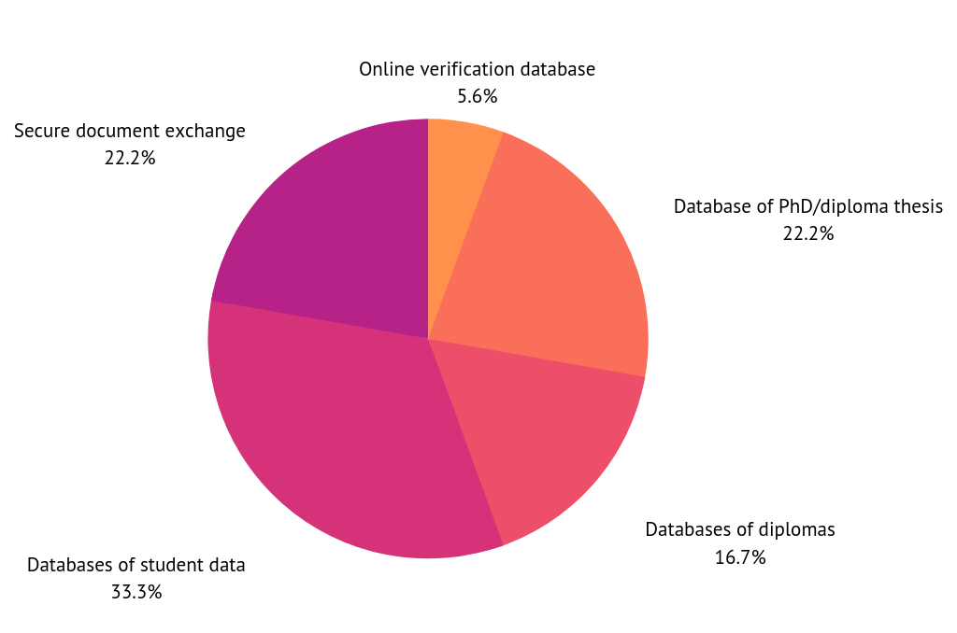
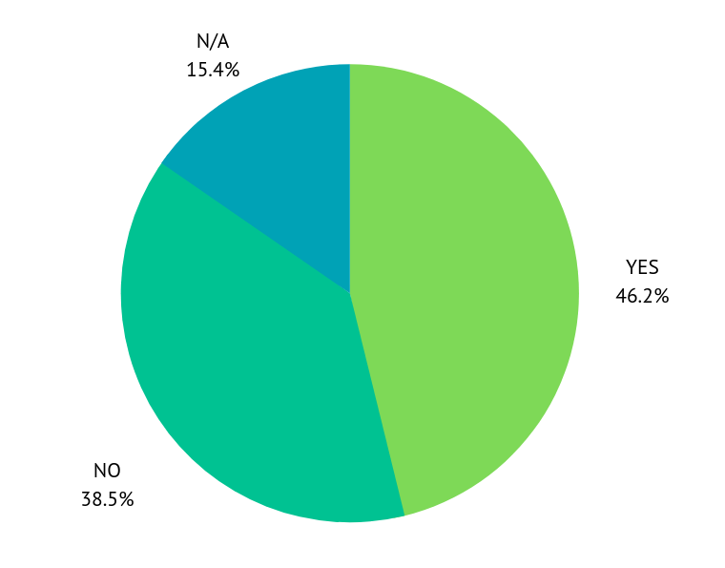
Q15. Do you have policies and/or practices related to the secure exchange of student data?
Fig. 15a - Do you have policies and/or practices
related to the secure exchange of student data?
Fig. 15b - Typologies of practices related
to the secure exchange of student data

Slide 11
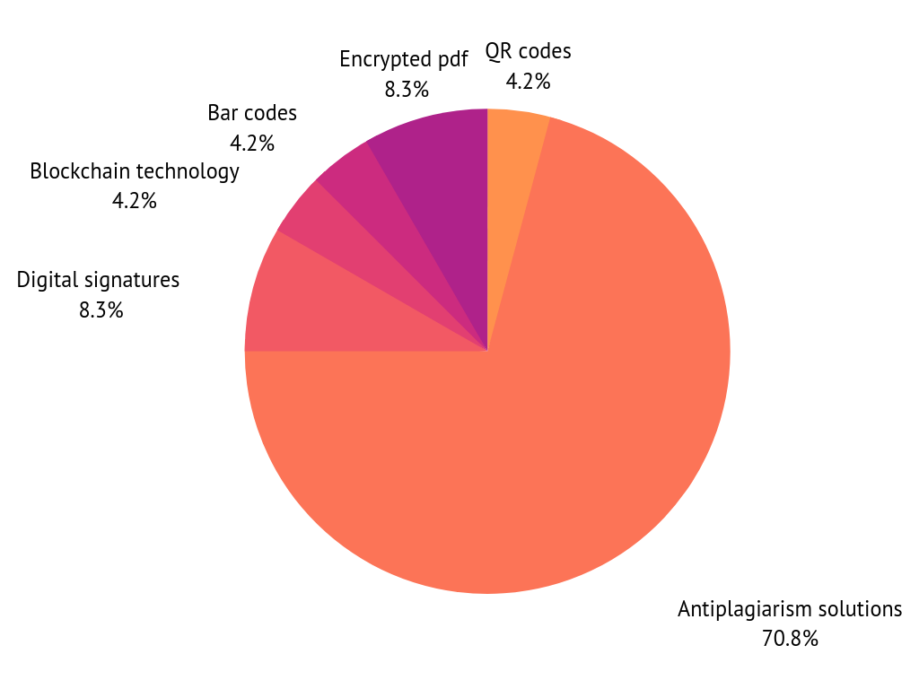
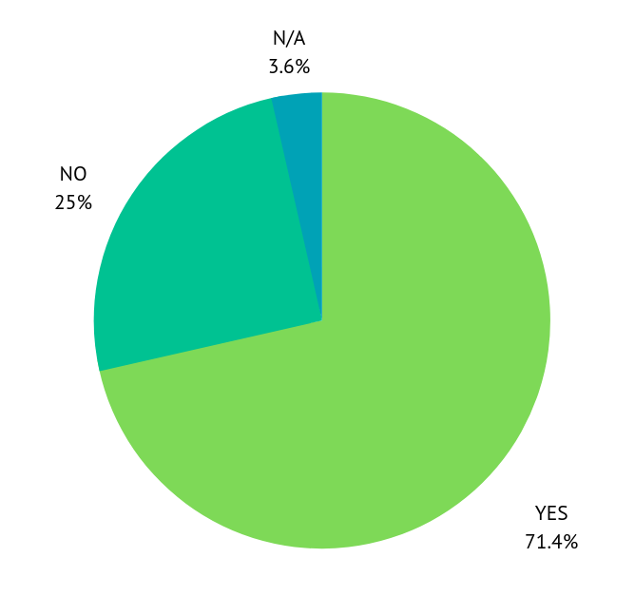
Q16. Do you use or promote the use of digital solutions to fight education fraud?
Fig. 16a - Do you use or promote the use of digital solutions to fight education fraud?
Fig. 16b - Typologies of digital solutions
used to fight education fraud

Slide 12
Main findings
Clear perception of the phenomenon of education fraud, mainly at a qualitative level; but the vision is less clear-cut when it comes to quantitative data.
Providers do exist in the majority of countries: in this order essay mills, diploma mills, visa mills and accreditation mills.
In the majority of countries, legislation dealing with one or more typologies of education fraud do exist, but lack of legislation is perceived as the main obstacle in effectively dealing with education fraud.
It is necessary to introduce legislation and tools on education fraud where this does not exist, and to revise the existing one for two reasons: I) to harmonise the practices at national level and II) to foster cooperation at international level.
The Council of Europe could support this process at (i) a policy level, mainly by providing a common policy framework; (ii) at a practitioner level, providing guidelines, exchanges of good practices, expertise and information sharing ; (iii) at a cultural level, supporting national authorities in developing and advocating for academic integrity.

Slide 13
Challenges and recommendations / 1
1. Information, data, statistics: basics for effective action
The very first challenge is the absence of statistics and quantitative data
Recommendation: explore the criteria, methodology and relevant stakeholders involved in order to collect quantitative data on education fraud.
2. Deepen the link between quality assurance and ethics, integrity and transparency in education
In quality assurance a reference to ethics and integrity in education usually exists, but is mainly only formal
Recommendation: further develop the link between the concept of quality and ethics, integrity and transparency of education, both at theoretical and practical level

Slide 14
Challenges and recommendations / 2
3. Go digital: digitalisation as part of the solution to prevent and fight education fraud
Methodologies for the secure exchange of student data and digital tools to fight education fraud are not yet fully used and developed
Recommendation: further explore policies and practices for the secure exchange of data, and further develop and test digital tools and digital solutions to fight education fraud.
4. Strengthening cooperation at national and international level
An effective strategy against education fraud requires a high level of cooperation among relevant stakeholders (i.e. students), that has not yet been reached, both at national and international level
Recommendation: strengthen cooperation, share information and adopt a comprehensive strategy

Slide 15
Challenges and recommendations / 3
5. Framework law on education fraud: a key element for effective action
The main perceived obstacle in effectively dealing with education fraud is the lack of legislation.
Recommendation: to have a comprehensive law on education fraud to deal in a systematic way with education fraud, with a strong focus on prevention and cooperation both at national and at international level.

Slide 16
Thank you for your attention!
Chiara Finocchietti
Luca Lantero
info@cimea.it
www.cimea.it
@CIMEA_Naric
https://youtu.be/020sJzh5uJs

