Slide 1
AD HOC COMMITTEE OF EXPERTS ON ROMA AND TRAVELLER ISSUES (CAHROM) VISIT TO FI ON R&T ACCESS TO JUSTICE (WITH A FOCUS ON ON WOMEN)
21 March 2018 Helsinki
ERTF – IRWN – Phenjalipe
Miranda Vuolasranta
On access to justice related priorities of IRWN-Phenjalipe Strategy on the advancement of Romani women and girls

Slide 2
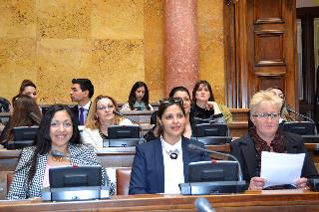
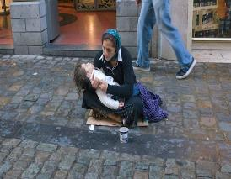
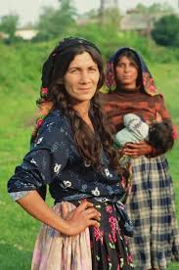
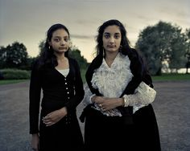
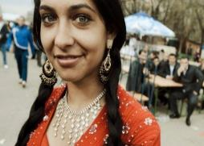
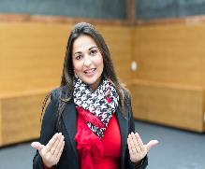
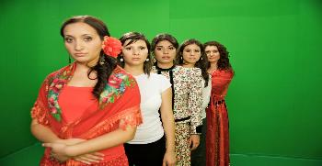
Roma and Traveller women are as heterogeneous as other Europeans
Don’t forget the heterogeneity of Roma and Traveller groups and individuals!

Slide 3
Hardening values on European policies
The most alarming signals:
Human Rights policies are NO more important and solidarity is old-fashioned
More important tasks such as: Brexits, economical crises, immigration/refugee issues, security issues, boarder security even fear of nuclear-war are putting aside the question of the preservation of our humanity, equality and democracy
What are Roma experiencing:
Increase of forced evictions of Roma communities
Since 2000, more than 1,500 Roma in Europe have been murdered because of their ethnicity, victims of ultra-nationalistic and violent anti-gypsyism
More than 115 pogroms were committed against Roma. Each and every day Roma women and children become victims of racist violence and hate mongering by the media and politicians. The number of attacks against Roma as well as the number of injured Roma is too numerous to count

Slide 4
Challenges to overcome 1 -
Roma women remain one of the most marginalised groups, having very little access to resources, or education leading to low literacy rates combined with low levels of political participation
Inadequate support for Roma women participating in political processes which is exacerbated by their limited knowledge of the frameworks which support women’s equality, inclusion, advocacy and alliance strategies, and policy making, which in turn constrains their effective participation
Limited mobilisation and understanding by Roma women in general about their rights, the political system and processes and strategies to participate, which constrain them from improving their living conditions and making the government accountable and

Slide 5
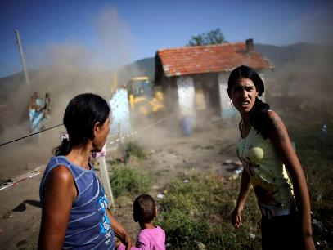
Challenges to overcome 2
Negative perceptions of Roma women due to ethnic discrimination amongst the general public and government officials
Removal of children from Roma women to the municipal custody has become more common again - Access to Justice has become and issue for Roma mother's also in Scandinavian countries (Roma women conference in Stockholm 22.-23.3.2018)
Without strategic interventions to address these problems, it is very likely that Roma/Traveller women will remain side lined in decisions and processes that affect their lives

Slide 6
6th International Roma Women Conference “Women and Political Representation”
promote minorities’ participation, including Roma and Traveller women’s, in elections, including through the inclusion of quotas
Electoral systems and the geographical boundaries of electoral constituencies matter
To promote minority participation, the legal threshold for parties under proportionate representation systems should be low enough
Voting mechanisms should be designed to provide the possibility for Roma and Traveller women to be voted all over the country in those countries where the minorities are scattered

Slide 7
The Case of Roma and Traveller Women
Funding should be made available for Roma and Traveller women
Measures should be put in place to encourage Roma and Traveller women to enter the world of politics, through training, mentorship, career advising and peer networking
International organisations, governments, civil society, practitioners and academics should invest in the capacity building of Roma and Traveller women
Women’s organisations and feminist parties should examine their own agendas and practices to ensure that Roma and Traveller women’s issue are included in the women’s movements and political agenda

Slide 8
The Case of Roma and Traveller Women
Action should be taken to train leaders and executives of political parties
Participation of Roma and Traveller women should be promoted in all decision-making bodies and administrative structures that affect their lives, including national and local government structures, law enforcement bodies and the judiciary
Good practices of Roma and Traveller women’s participation should be supported, in particular mediators at community level
Participation of Roma and Travellers, especially young people and women, as voters should be increased in order to act as a powerful electoral constituency

Slide 9
The Case of Roma and Traveller Women
One way to support Roma and Traveller’s political participation, in particular women, is to support the education/training of voters and sensitisation campaigns targeting women
There is a need to take actions against vote manipulation and vote buying
Action needs to be taken to eradicate obstacles facing Roma and Travellers, including women, to fully exercise their electoral rights, by ensuring that all Roma and Travellers have identity documents and are included in the voters’ registration list
Roma and Traveller women candidates should also be supported after their election

Slide 10
The Case of Roma and Traveller Women
Measures to increase Roma and Traveller women’s political participation should be embedded in a larger gender equality strategy for Roma and Traveller women, which should also include actions to overcome gender stereotypes in society and in Roma and Traveller communities
There is still a pressing need to collect gender-disaggregated data about Roma and Traveller women’s participation in political life.
Awareness should be raised among the media and the general public about the importance of having balanced participation in political and public decision-making
Awareness should be raised among political parties, media and the general public on the importance of language in reproducing, but also in countering racist and sexist mind-sets

Slide 11
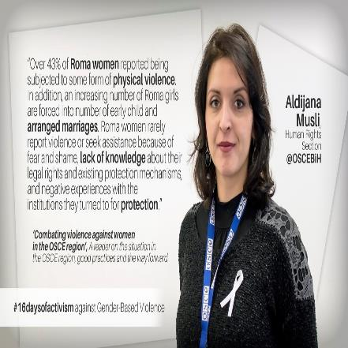
Awareness rising and training brings political and other kind of participation

Slide 12
The Case of Roma and Traveller Women
International organisations, governments, political parties and civil society should design actions aimed at engaging Roma and Traveller women girls so that they consider political careers, including through role models and networking
Partnerships and co-ordination between and within governments, civil society, international organisations, media, political parties, practitioners and researchers are critical to the success
All decision makers, including those in government and political parties, should make a strong commitment to gender equality and balanced participation in political and public decision-making from a gender and minority perspectives, leading to appropriate measures in legislation, policies and practice. Therefore, all political parties/groups in Europe should sign the “Pledge on political representation of Roma and Traveller women” launched at the Council of Europe’s 6th International Roma Women Conference in Strasbourg on 6-7 November 2017 (available online at: https://www.coe.int/en/web/portal/roma-women/

Slide 13
Who are the beneficiaries of women’s participation
Increasing the participation of Roma women in these countries provides a sustainable way of ensuring that their needs and concerns are included in government’s efforts towards the achievement of inclusion, poverty eradication and gender equality. Intended changes are:
(a) Increased awareness and community advocacy for Roma women’s participation by 2020;
(b) Increased cooperation with national political parties on the issue of Roma women participation and as a result having at least one Roma women candidate at the next local/national or/and European elections; and
(c) Improved effectiveness and organisational sustainability of ERTF/IRWN/ Phenjalipen to lobby and advocate on Roma women’s issues
As the number of Roma women participating increases, combined with increased effectiveness, they will be able to better influence policy debates from a gender and development perspective. Therefore the ultimate beneficiaries will be the citizens of the targeted countries, particularly disadvantaged Roma women who will stand to benefit from gender sensitive and pro-poor policies.

Slide 14
Policy perspectives 2018 and beyond..
International Institutions thematic policies year 2018
Council of Europe:
Focus on Roma womens political participation
Access to Justice
Promoting the Cultural Heritage of Roma and Travellers
European Union/European Commission:
Inequalities in the living conditions and their impact on the Roma health
How to approach the issues of relevance in the areas of housing and health, being both very broad and complex
Roma political participation with the focus on the electoral matters; link with the upcoming election to the EP, ongoing/upcoming elections in Member States

Slide 15
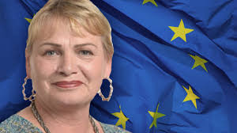
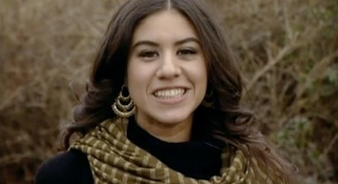
We need more Roma and Traveller women to change the future!
THANK YOU – NAJIS TUMENGE - BARIKIBA

