Slide 13
WHY DID WE SUCCEED?
well working and trustable networks
annual meetings and common strategies
support measures for young people with fewer opportunities
We all share the values of Council of Europe and work for equal rights for each and every one

Slide 14
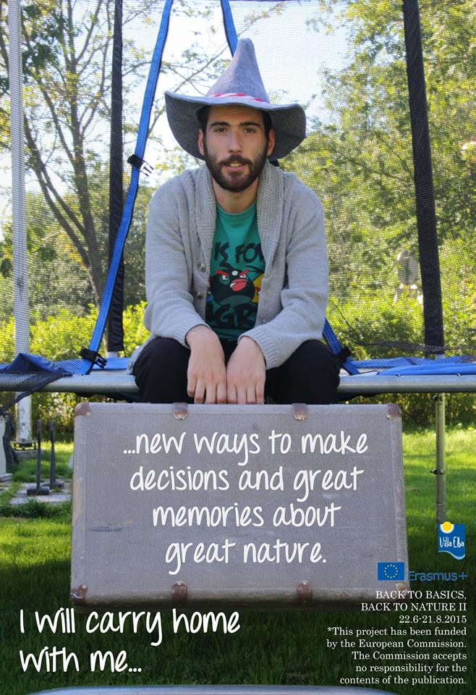
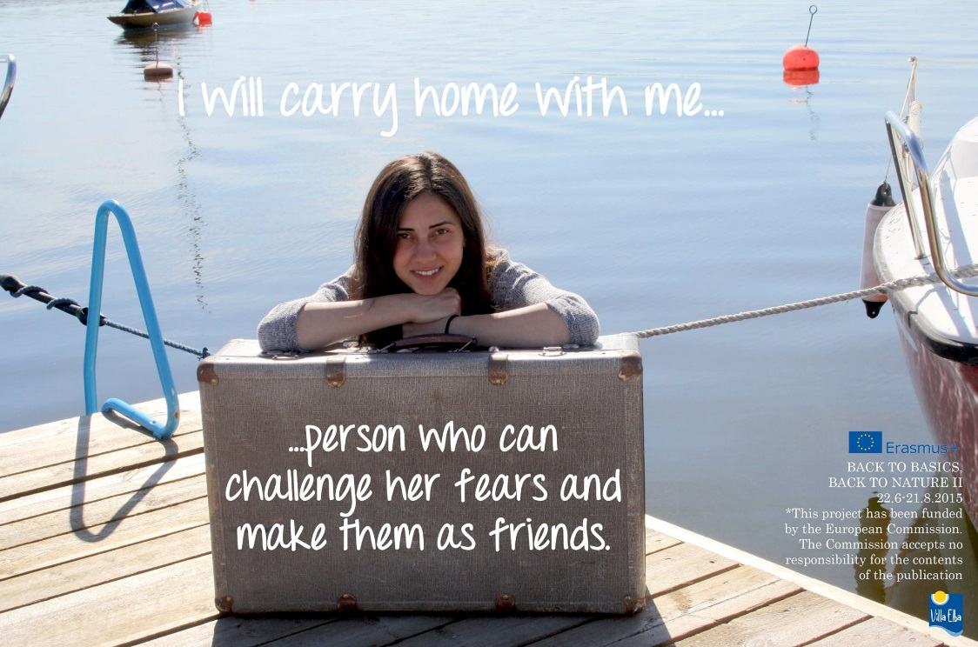

Slide 16
MORE INFORMATION:
www.villaelba.fi
EUROPEAN NETWORK OF YOUTH CENTRES
www.eycn.org

