Slide 1
The Enter! Recommendation

Slide 2
Council of Europe
800 million Europeans
47 countries
1949, Strasbourg
Human rights, democracy, rule of law
- Social rights (European Social Charter)
Standard setting, monitoring, co-operation
- Recommendations

Slide 3
Council of Europe
Article 1 of the statute
The aim of the Council of Europe is to achieve a greater unity between its members for the purpose of safeguarding and realising the ideals and principles which are their common heritage and facilitating their economic and social progress.
This aim shall be pursued through the organs of the Council by discussion of questions of common concern and by agreements and common action in economic, social, cultural, scientific, legal and administrative matters and in the maintenance and further realisation of human rights and fundamental freedoms.

Slide 4
Different things
Convention – binding – mechanism of implementation
Recommendation – non binding – review
Article 15 of the Council of Europe statute
a. …the Committee of Ministers shall consider the action required to further the aim of the Council of Europe, including the conclusion of conventions or agreements and the adoption by governments of a common policy with regard to particular matters. …
b. In appropriate cases, the conclusions of the Committee may take the form of recommendations to the governments of members, and the Committee may request the governments of members to inform it of the action taken by them with regard to such recommendations.

Slide 5
Social Rights (from ESC)
Freedom from discrimination
Health
Employment and work
Housing
Participation
Quality education
Participation
Information

Slide 6
The Enter! project

Slide 7
Recommendation process
From PRACTICE to POLICY
PRACTICES collected from…
Local projects by the participants in the LTTC
Thematic seminars
Input of experts in youth and social policy and youth work

Slide 8
Enter! Recommendation
A recommendation from the Council of Europe to its 47 members states
Includes proposed measures to be included in local policies
Includes an aspect of advocacy for the role of youth work and non-formal education in social inclusion processes

Slide 9
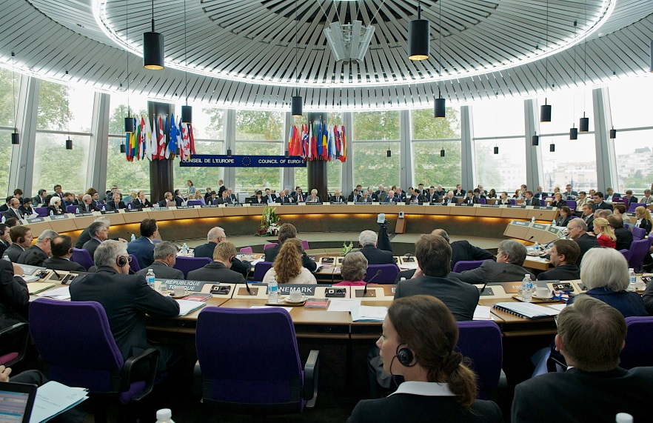
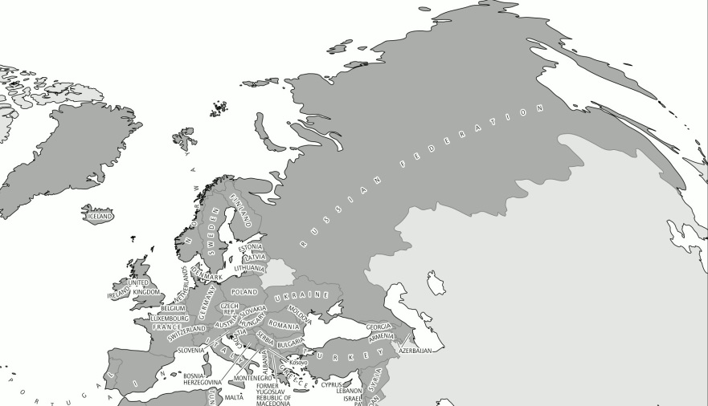
Committee of Ministers
Member States

Slide 10
The CM recommends governments to...
Recommends that the governments of the member States develop and implement sustainable, evidence-based public policies that take into consideration the specific situations and needs of young people from disadvantaged neighbourhoods. These policies should aim at preventing and eradicating the poverty, discrimination, violence and exclusion faced by such young people through efforts to:
a. improve the living conditions
b. measures to work towards abolition of the segregation
c. measures for participation
d. combat discrimination
e. recognise the role of non-formal education and youth work
f. develop gender-sensitive approaches to youth policies

Slide 11
The Committee of Ministers
2. Recommends that the governments of the member States take into consideration the measures proposed in the appendix to this recommendation when formulating and implementing policies and programmes and encourage local and regional authorities to do the same;
3. Recommends that authorities responsible for youth in the member States ensure that this recommendation, including its appendix, is translated and disseminated as widely as possible, in particular among young people using youth-friendly means of communication

Slide 12
Areas I
A. Improving the living conditions of young people in disadvantaged neighbourhoods
i. Education and training
ii. Employment and occupation
iii. Housing
iv. Health
v. Information and counselling
vi. Sport, leisure and culture
B. Breaking down segregation and the promotion of social inclusion

Slide 13
Measures …
… while helpful for all young people …, may have greater impact on young people from disadvantaged neighbourhoods
… need to be contextualised, not all at the same time, not all relevant for all disadvantaged neighbourhoods or some already in place

Slide 14
Areas II
C. Promoting meaningful participation opportunities in the planning and management of their living environment
D. Ensuring that all young people are fully able to exercise their role as active citizens without discrimination
E. Recognising and supporting non-formal education, youth work, youth organisation and youth workers in disadvantaged neighbourhoods
F. Improving gender equality of young people living in disadvantaged neighbourhoods
G. Preventing all forms of violence in disadvantaged neighbourhoods

Slide 15
The Recommendation and policy

Slide 16
The Recommendation and you(th)
Understand the situation
Undertake research
Identify the key stakeholders
Start creating your story
Devise a plan of action
Take action
Link up with other groups and movements
Support people in need
Training and peer education
Lobbying and campaigning
…

Slide 18
A guide for you…

