Slide 1
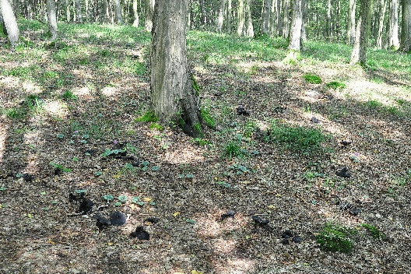
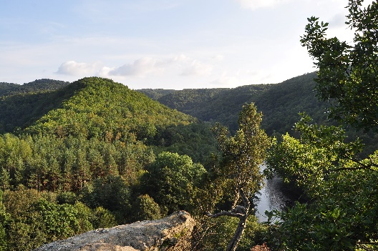
A Vision for the European Diploma for Protected Areas

Slide 2
A suggested Vision:
By 2030, the community of holders of the European Diploma for Protected Areas:
Is recognised internationally …
Serves people’s aspirations …
Demonstrates to all sectors of society …
Supports the enjoyment …
and that the Diploma is recognised as Europe’s most prestigious award.

Slide 3
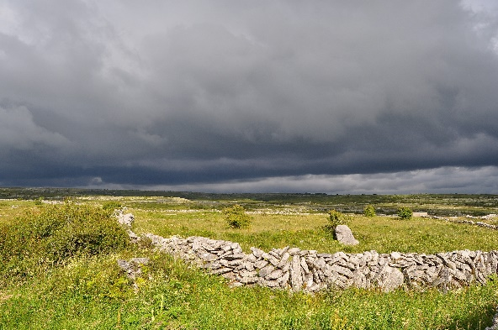
How do we get from here to fulfilling the vision?
Do we want:
A strategy
A road map
Or what is the way forward?

Slide 4
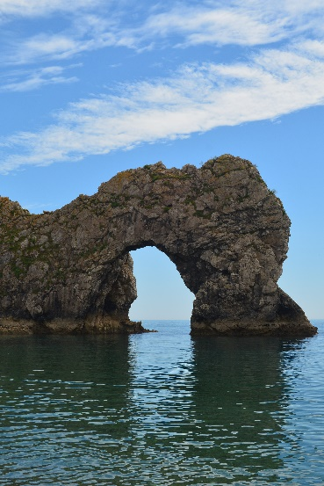
Implementing the Vision
2. Communication Strategy
3. Making Information more Widely Available

Slide 5
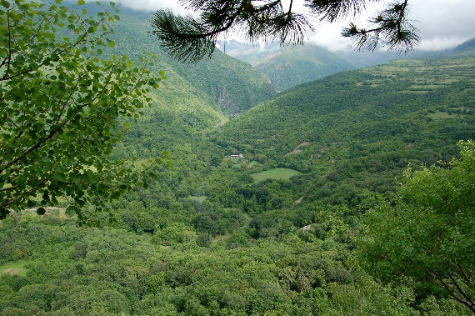
Implementing the Vision
4. Focussing the PISA declaration

Slide 6
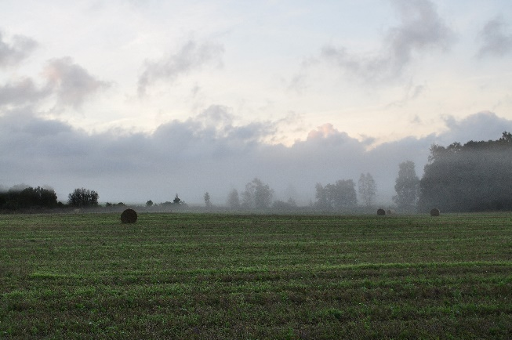
Implementing the Vision
5 Topical Meetings
6. Anniversary Meeting

Slide 7
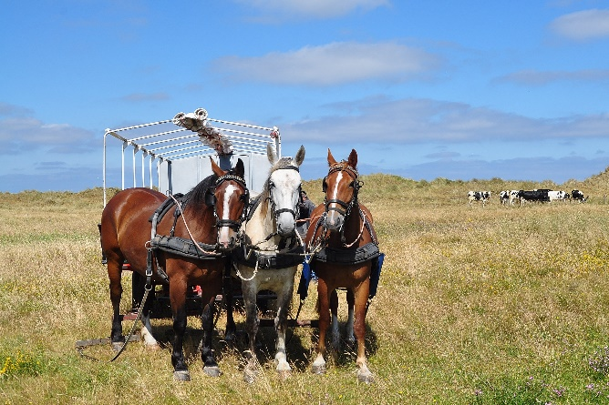
Implementing the Vision
7. Growing the community of EDPAs
8. Re-branding the EDPA

Slide 8
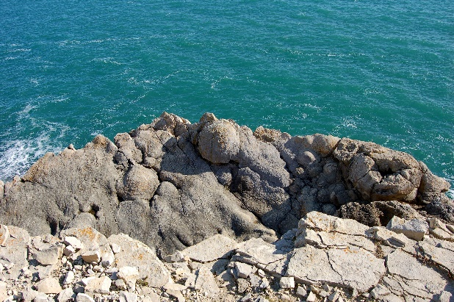
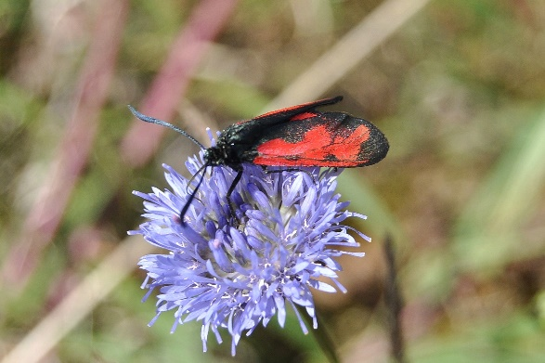
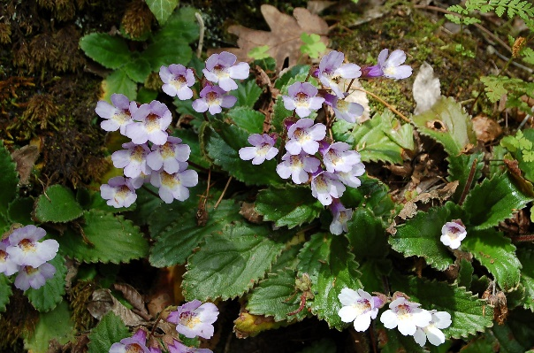
Conclusion -
Agree a Vision
Agree a way forward
Implement

