Slide 1
Information concerning Weltenburger Enge
In the last month clear cuts were made both within the ED area and the area recommended as ED extension
The clear cuts are currently stopped
According to the forest MP more interventions are foreseen
The Weltenburger Enge was recently declared as Natural Monument of national Importance (NNM).
NNM: Navigation and watersport activities are allowed
New ships cause ecological problems, NGOs said

Slide 2
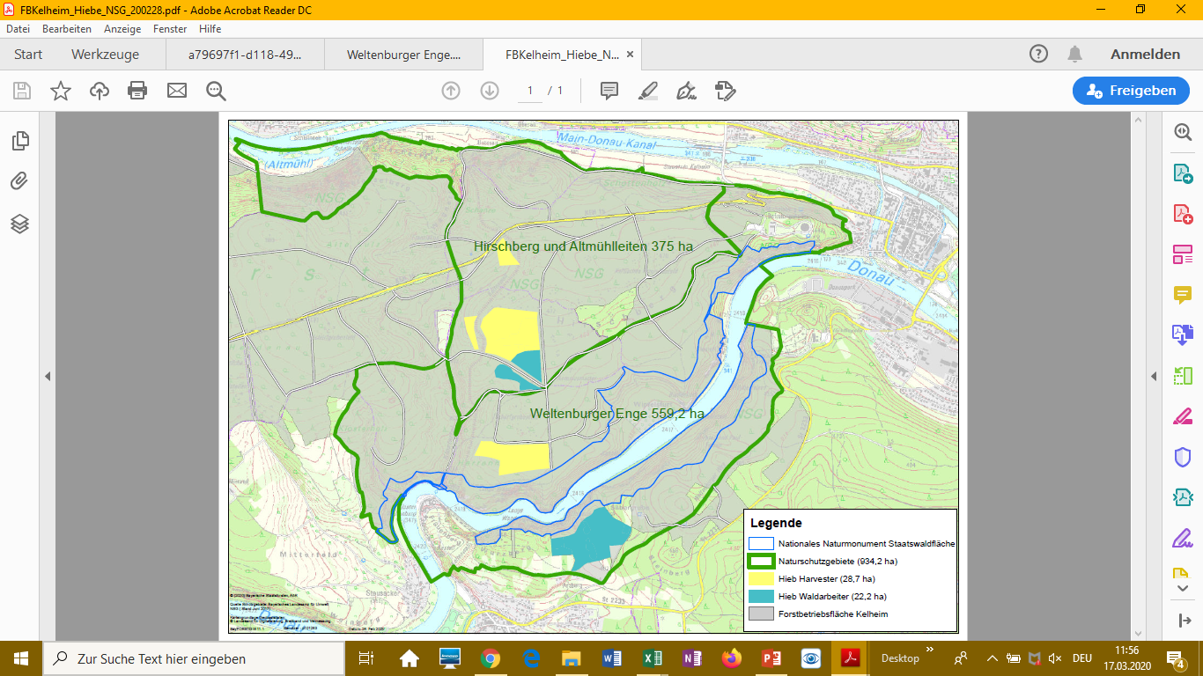
The ED area is the lower part (Weltenburger Enge).
The northern part is recommended to be included in the ED
The yellow areas were harvested with heavy machinery
The blue areas were cut by foresters
The blue line is the border of the Natural Monument of National Importance
Source: NGOs

Slide 4
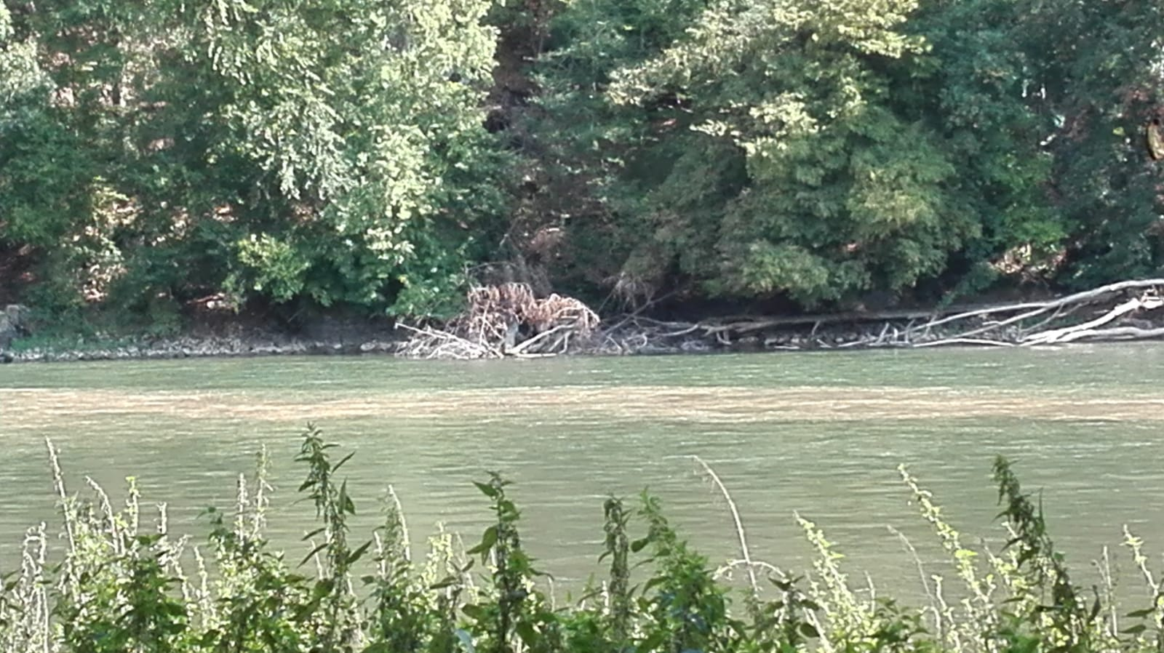
I recommend an extraordinary visit to the Weltenburger Enge

Slide 5
Wurzacher Ried
The last appraisal recommends to
Consider the overall impression of the entirety of the landscape around the basin of Bad Wurzach and avoid the construction of technical infrastructure on the hills and hilltops in the visual range of the Wurzacher Ried.
The visibility of the planned PV plant is not fully clear.
I recommend to ask the responsible authorities in Germany (Baden-Wurttemberg) to abstain from a immediate decision and to provide more and detailed information, including maps and if possible a visualisation of the construction

