Slide 1
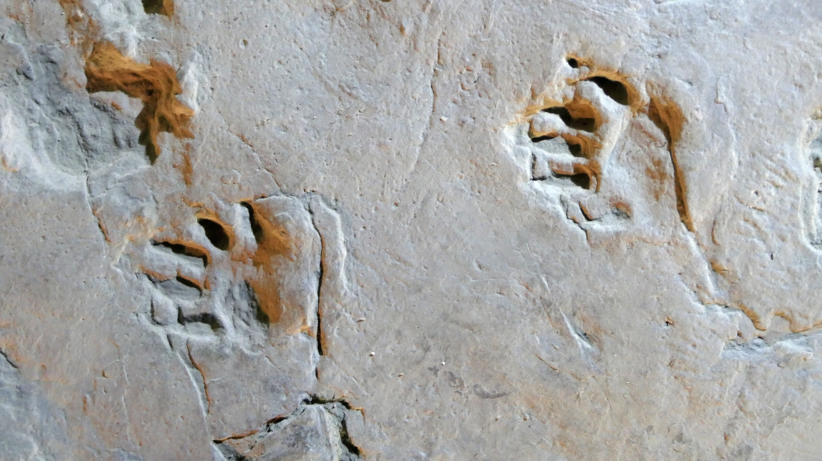
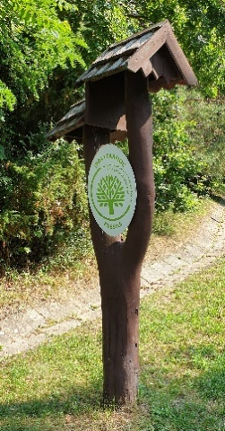
Renewal EDPA, expert report 4th renewal Ipolytarnóc Fossils Nature Conservation Area (Bükk National Park, Hungary)
Prof. Dr. Maurice Hoffmann
www.inbo.be

Slide 2
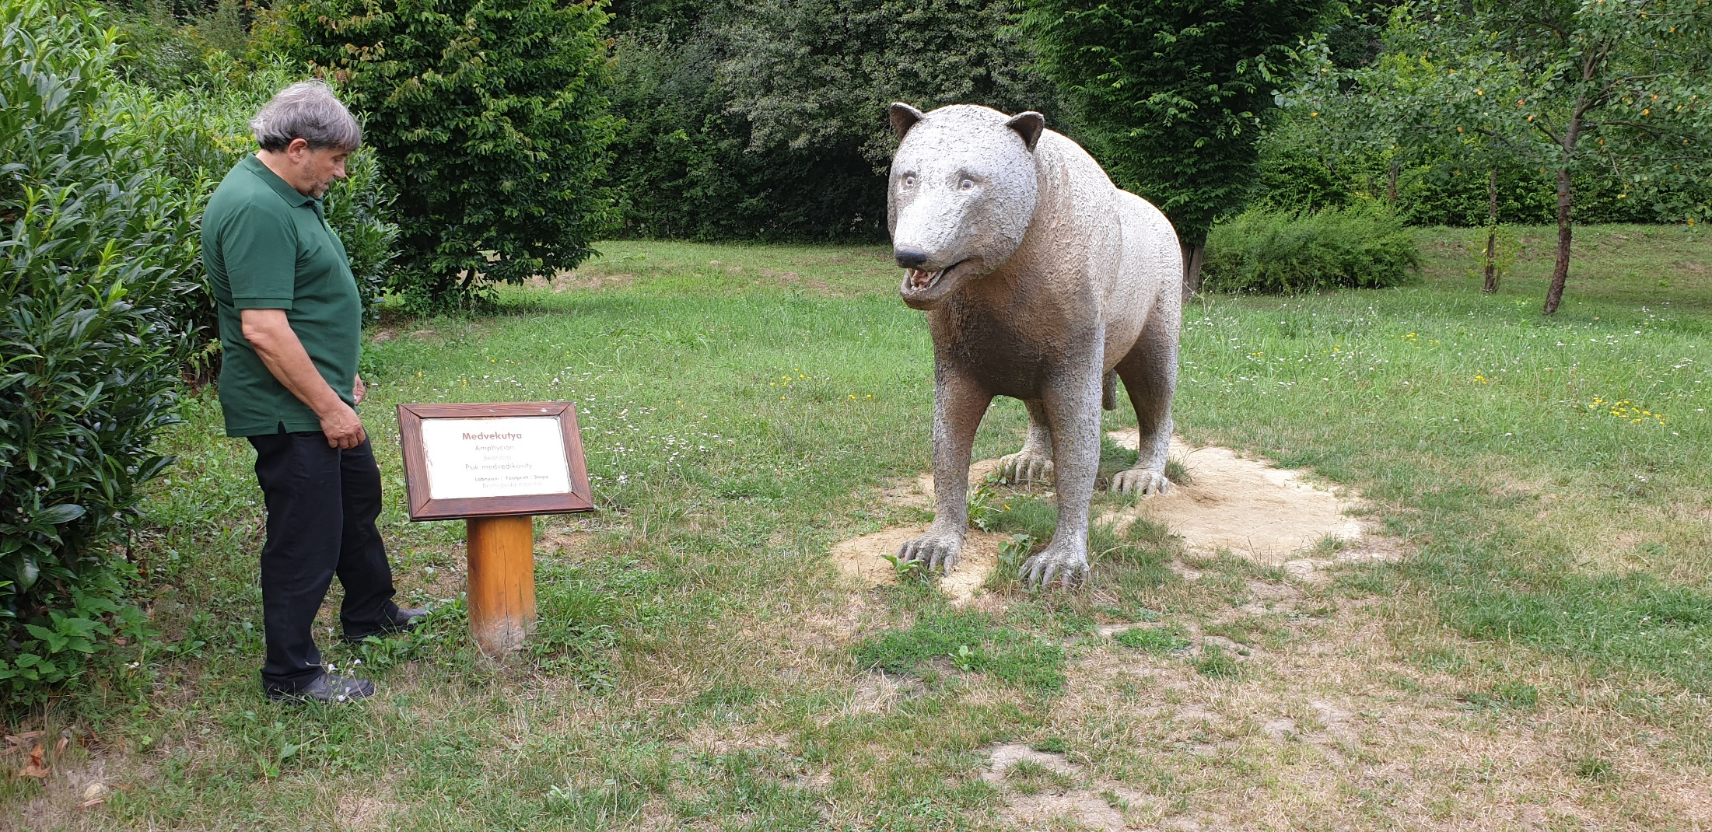
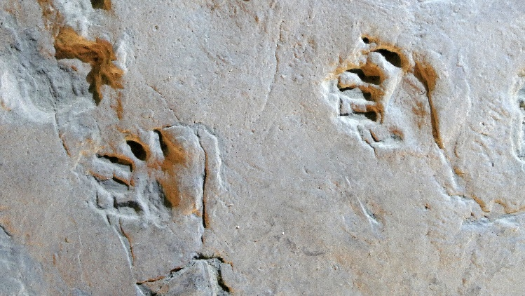
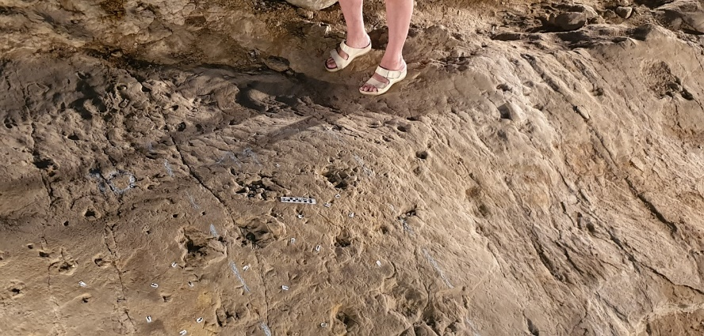
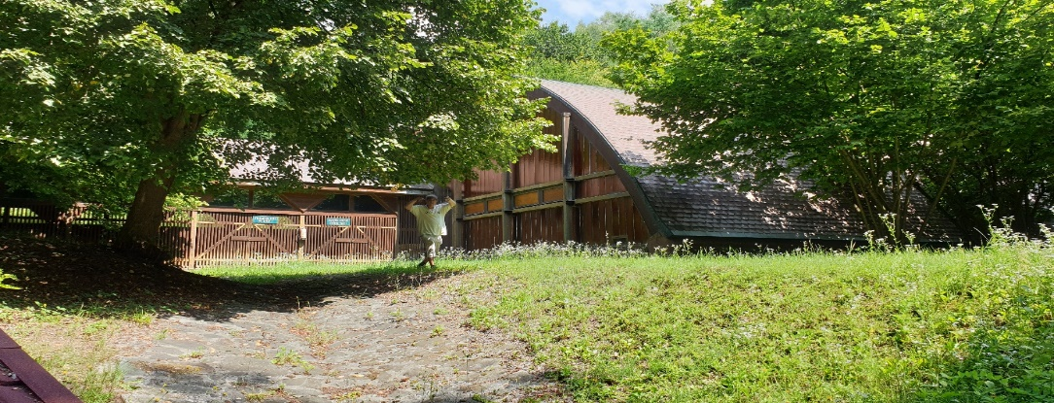
Ipolytarnóc Fossils Nature Conservation Area
© Jasja Dekker, aerial view of the marshland area of the Nature Reserve Oostvaardersplassen

Slide 3
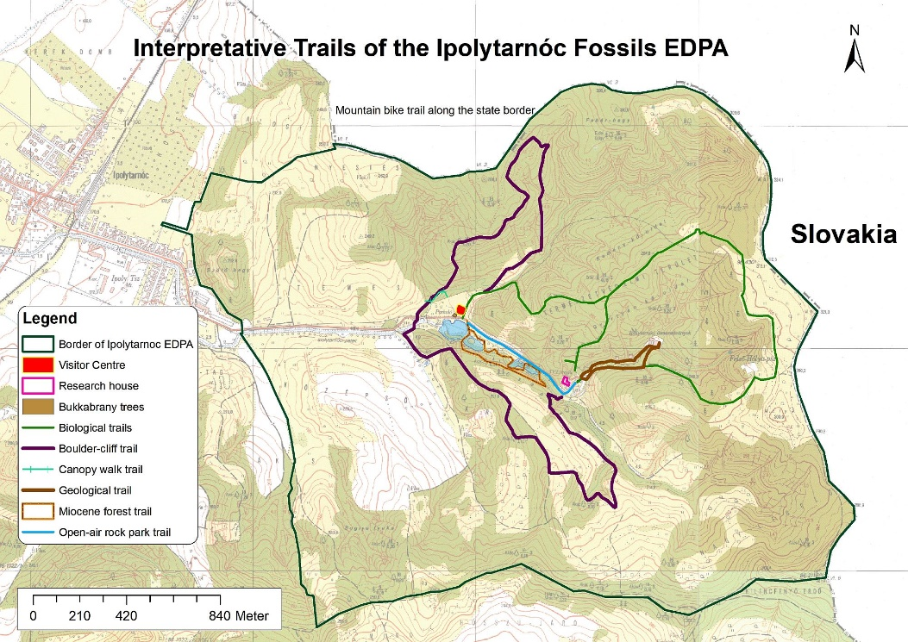
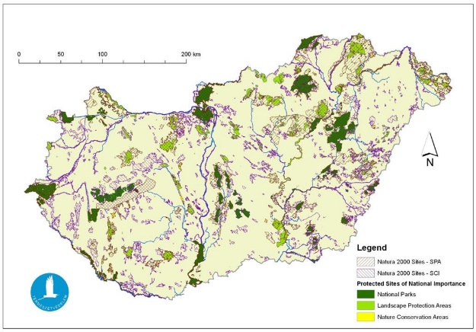
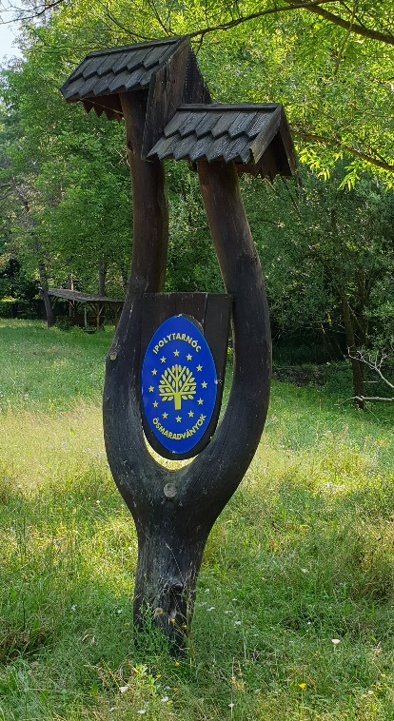
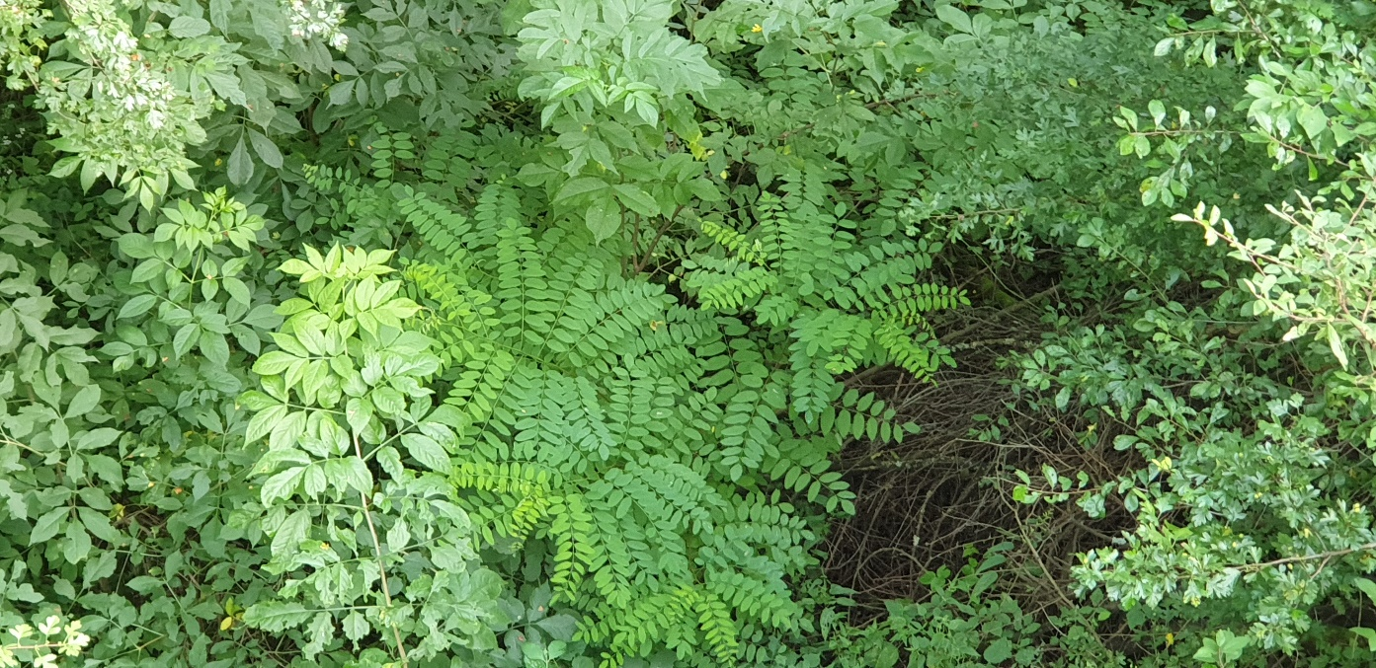
Ipolytarnóc Fossils Nature Conservation Area

Slide 4
IFNCA in short
Northern Hungary, along the Slovakian border
Ca. 500 ha
Prior reason of being an EDPA: unique Lower Miocene fossils of megafauna and other biota
Hilly area, criss-crossed by ravines with brooks in the valleys, in which springs are abundant
The main mother rocks are sandy sea sediments of 24-21 my of age and younger terrestrial and volcano-sediment strata.
The brown forest soil type regolith's top zone is partly eroded with outcrops of fossil rich strata in some places”
The area protects a globally unique heritage of earth history. Thanks to sheltering layers that resulted from a volcanic catastrophe (ca. 18 million years ago), it holds an exceptionally well preserved Lower Miocene paleohabitat.
Tectonics and natural erosion exposed the fossil-holding strata to the surface, fossil findings from outcrops instigated scientific excavations.
www.inbo.be

Slide 5
IFNCA, Recommendations 2010
3rd renewal – recommendations, resolution CM/ResDip(2010)15
1. recognising the site’s high potential for further discoveries of geological interest, research – especially the palaeontological excavations – should continue; all appropriate measures should be taken to preserve and, if possible, exhibit the natural resources; the results of scientific research should be made publicly available; 2. the site should take an active role in the management of the Slovak-Hungarian transborder Novohrad-Ngrd Geopark, in order to preserve and interpret the natural assets of the region and to become a focal, multilingual information point for geo-tourism; 3. the entrance to the protected area should have an appropriate gateway displaying information in order to control tourism within the site and the buffer zone; the buildings along the geological trail should be further integrated into the landscape; the power line that runs between the village and the visitor centre should be replaced with an underground cable; 4. gradual replacement of the exotic trees with indigenous species should be continued by assisting the natural succession process through ecologically sensitive land management practices; the control of game – causing considerable damage to vegetation and protected animal species – should be continued; 5. the balance between open spaces and wooded areas on the western side of the conservation area, close to the nearby settlement, should be maintained to preserve the mosaic structure of the landscapes there.

Slide 6
IFNCA – have recommendations of 2010 been met with?
During the visit, a lot of attention was given by the managers to the measures that were taken to meet as good as possible with the recommendations given in 2010
Some of those recommendations were comparable to those given in 2005 and 2000, indicating that some of them were not yet entirely met with.
The same general impression remains after the field visit in 2019, although the local managers do their utmost best to manage the area as appropriate as possible, but some issues seem to last very long and difficult to resolve.
Therefore, some of the recommendations of 2010 remain valid, and would best be further taken care of.

Slide 7
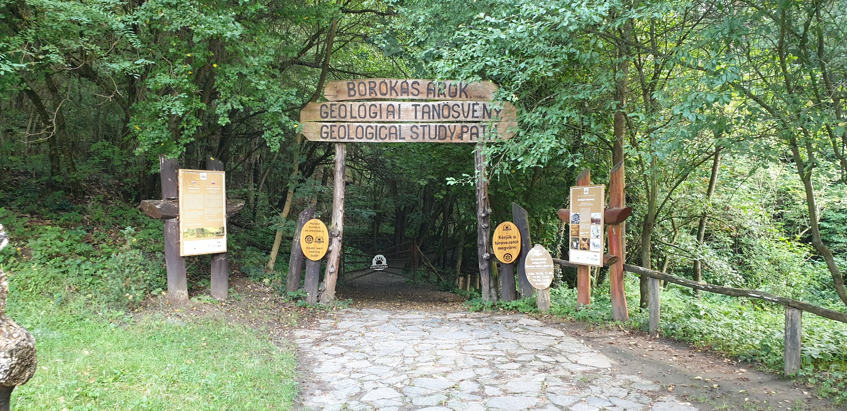
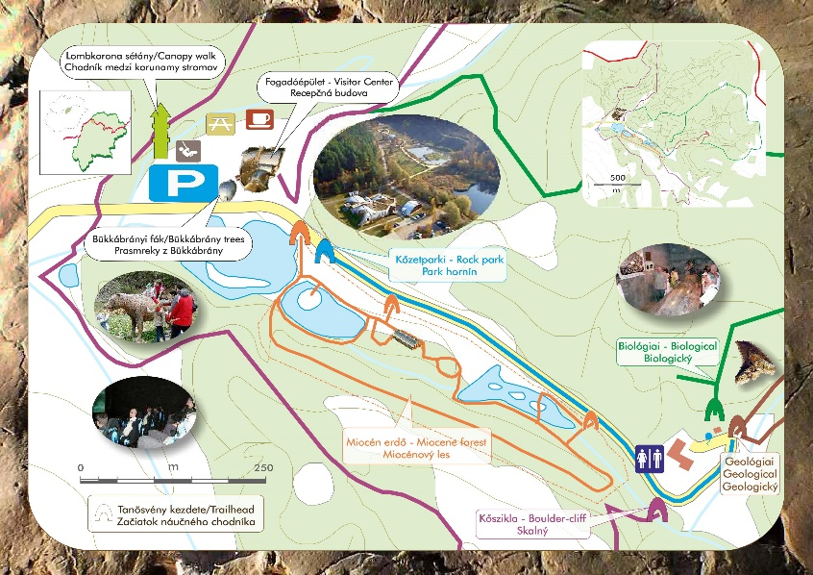
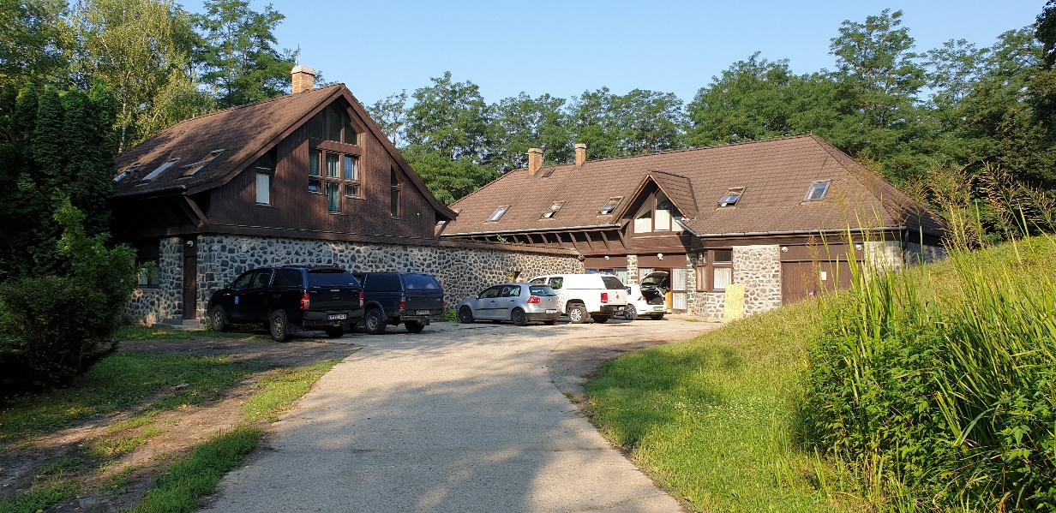
IFNCA - Conditions and recommendations 4th renewal
www.inbo.be

Slide 8
IFNCA, recommendation 1
Further explore the site’s high potential for discoveries of geological interest, research – especially the palaeontological excavations. It would be of significant added value if further promotion of INTERNATIONALISATION of research activities would take place by making the results of scientific research publicly available;
www.inbo.be
Researcher and management facilities at Ipolytarnóc Fossils Nature Conservation Area.

Slide 9
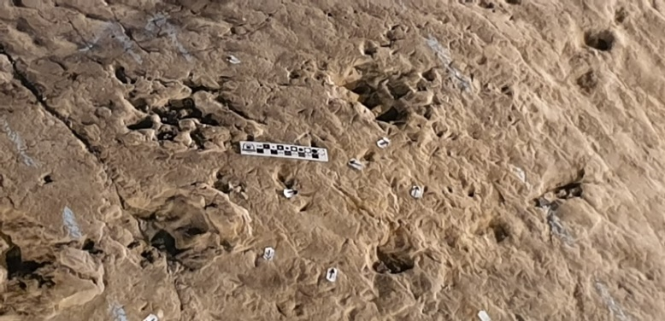
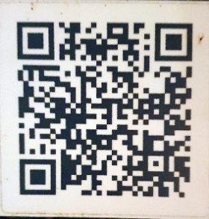
IFNCA, recommendation 2
Take all appropriate measures to preserve and, if possible, exhibit the geological and paleontological resources. By 2025 engage in a careful renovation/replacement of buildings, primarily the exhibition halls along the geological trail (maximally respecting geological and paleontological features). Additionally, renovate the visitor’s centre and other visitor’s facilities during the renewal period of ten years;
www.inbo.be

Slide 10
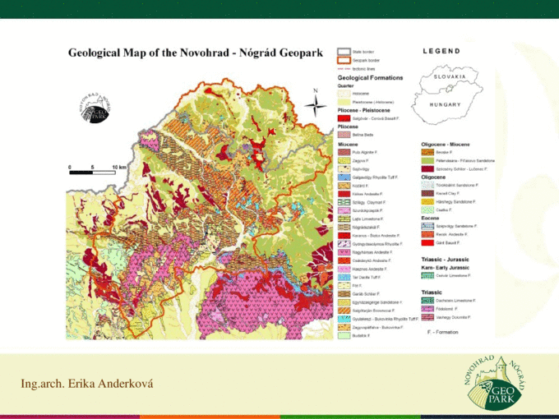
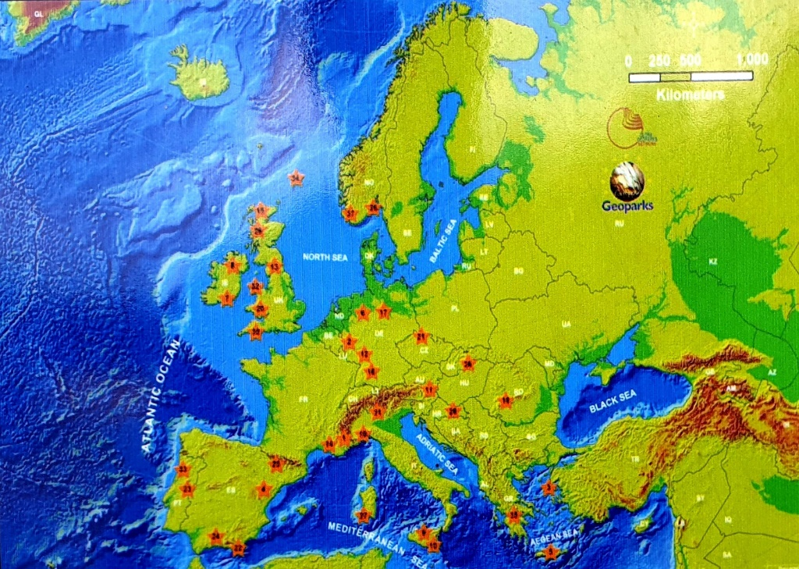
IFNCA, recommendation 3
The site should further explore the possibilities of a central and active role in the integration in the Slovak-Hungarian transborder Novohrad-Ngrd Geopark, in order to preserve and interpret the natural assets of the region and to further develop the focal, multilingual information point for geo-tourism;
www.inbo.be

Slide 11
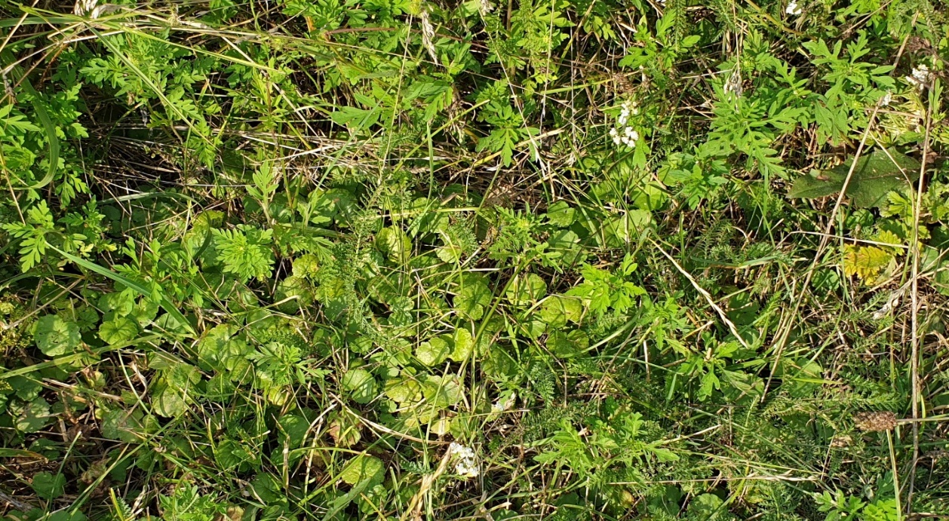
IFNCA, recommendation 4
Continue the gradual replacement of non-indigenous tree species, in particular Robinia pseudacacia and regionally non-indigenous Pinus species with indigenous deciduous tree species (Quercus and others) by assisting the natural succession process through ecologically sensitive land management practices. Also take measures to control herbal non-indigenous, invasive species such as Ambrosia artemisiifolia.Continue the control of game, causing considerable damage to vegetation and protected animal species;
www.inbo.be

Slide 12
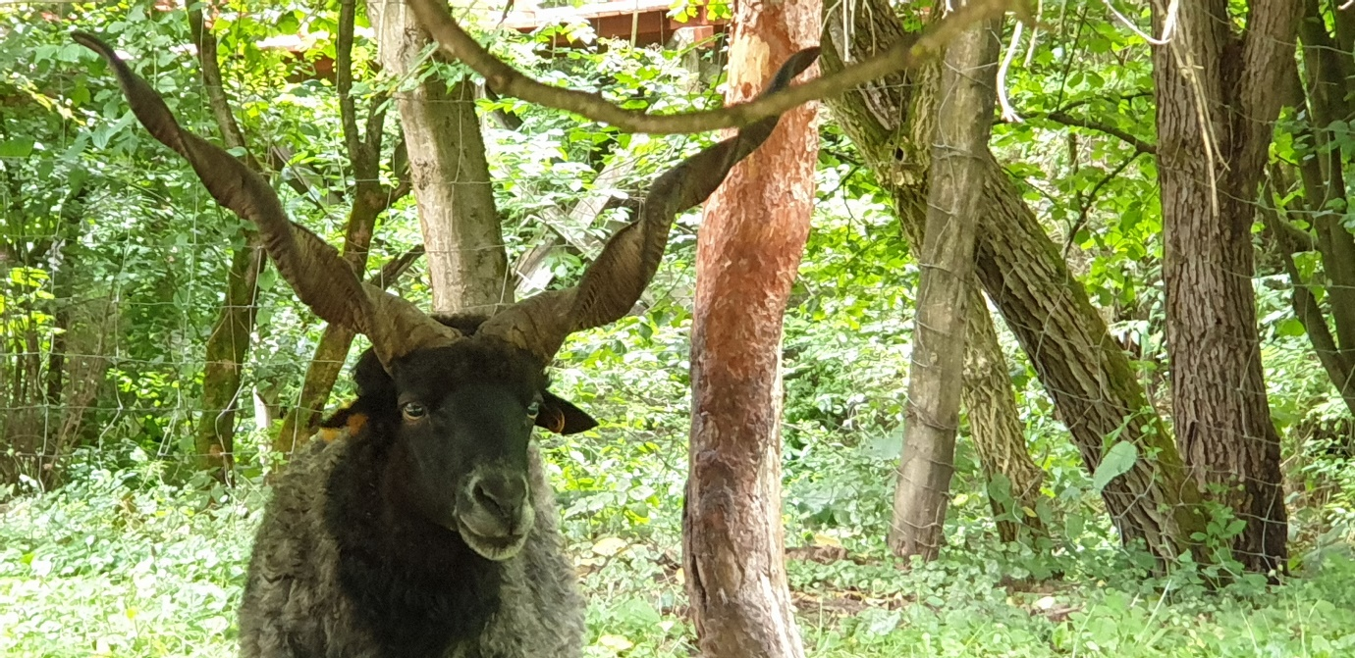
IFNCA, recommendation 5
Maintain the balance between open spaces and wooded areas on the western side of the conservation area, close to the nearby settlement to preserve the mosaic structure of the landscapes there. Maintain the use of the regional breed of Racka sheep because of its added value from a historical husbandry point of view, and also to increase structural diversity in the herb-dominated vegetation. For agropastoral reasons, maintaining hay-cutting by local farmers and/or NGOs should be thrived at. Limiting management of open habitats to the use of sheep grazing alone would change the landscape into a mosaic of woody and herbal plant communities (so-called woodland), which would not comply with earlier recommendations (2010);
www.inbo.be

Slide 13
IFNCA, recommendation 6
Replace the power line that runs between the village and the visitor centre by an underground infrastructure, respecting the current landscape and exhibitions;
www.inbo.be

Slide 14
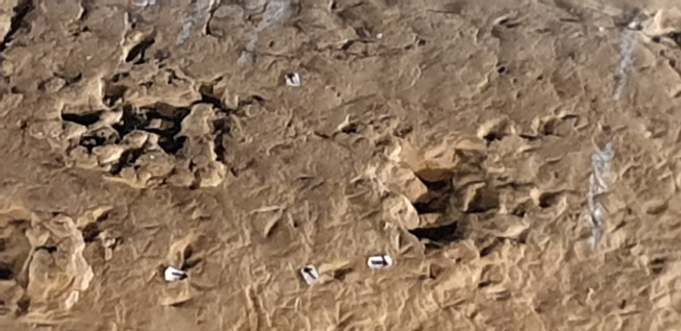
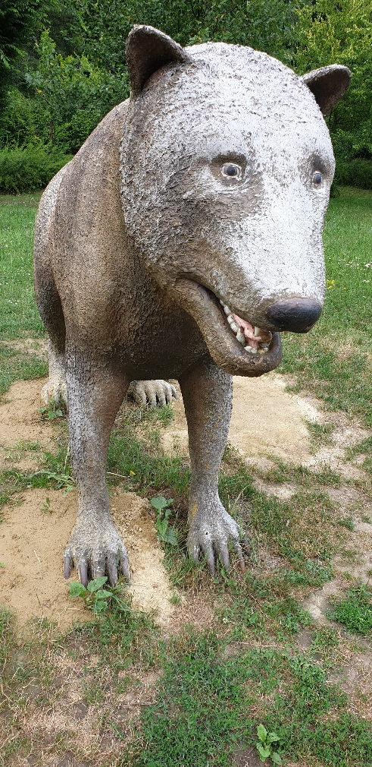
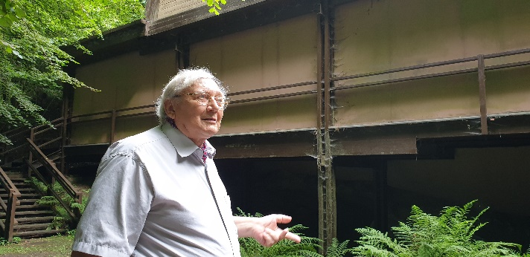
IFNCA, recommendation 7
Explore the feasibility of a video presentation or documentary film on the scientific, evidence-based process of paleontological science (paleotaxonomy as well as paleo-ecology and ecosystem reconstruction). Particularly, the way of reasoning of palaeontologist that seem to be able to reconstruct whole animals based on ‘simple’ footprints is astonishing and will interest the general public and colleague scientists in life sciences;
www.inbo.be

Slide 15
IFNCA, recommendation 8-12
As is already partly realized in the Rock Park, further develop visualisations that make links between present (Anthropocene) and past (Miocene) ecosystems;
Better document/report on management measures results through structured monitoring, also of public response (numbers of visitors, appreciation), etc;
Further enlarge local, regional and transnational public involvement and administrative cooperation, e.g. on the transnational N-N Geopark (to be realised by the Bukki NP authorities rather than the Ipolytarnóc management);
Consider Citizen Science projects in order to increase and strengthen involvement and engagement of non-scientific people;
Make better and systematic use of the logo and slogan of the European Diploma.
www.inbo.be

Slide 16
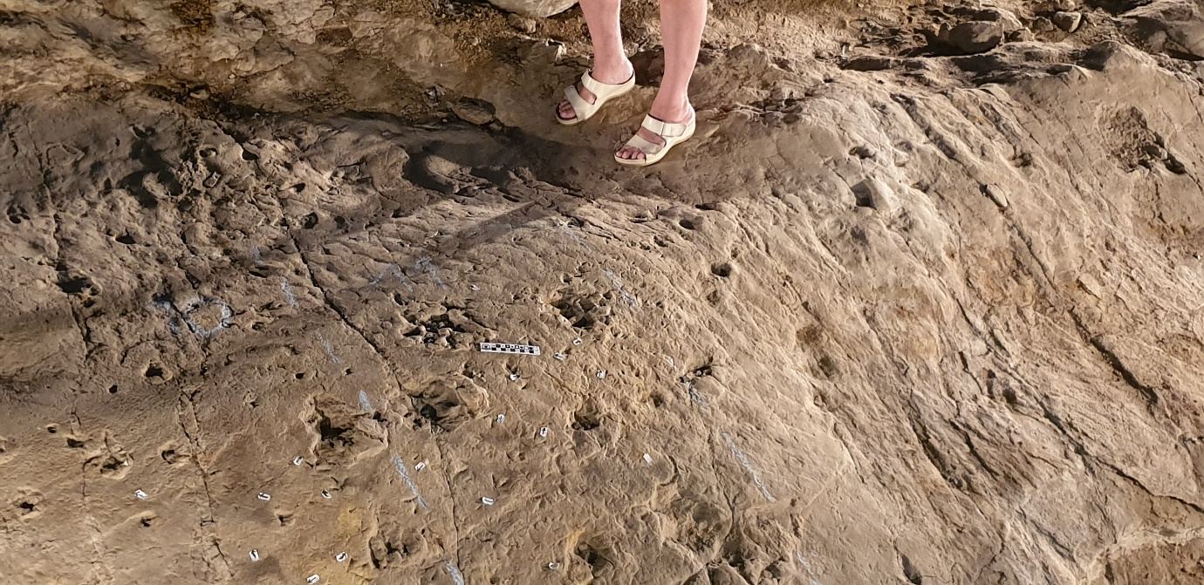
Thanks for your attention
The EDPA Ipolytarnóc Fossils Nature Conservation Area, where man’s footprints meet fossil animal footprints.

