Slide 1
An adventurous journey to Fair Isle
S
N
25 August – 1 September 2019

Slide 2
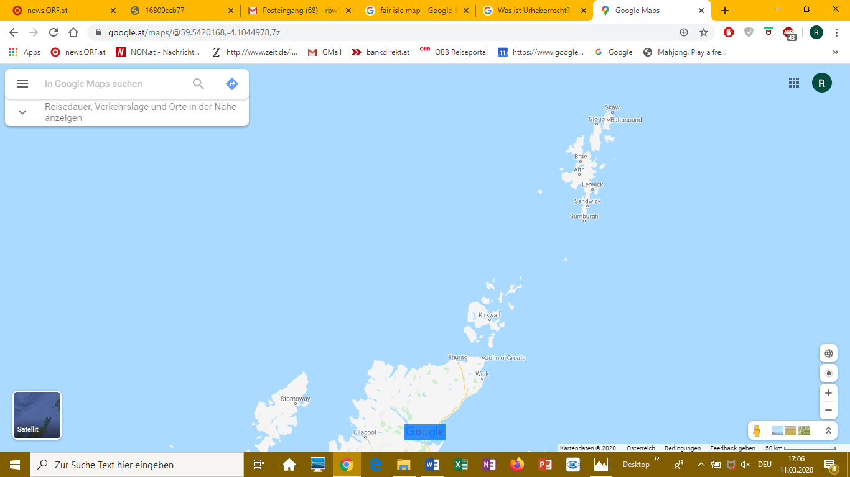

Slide 3
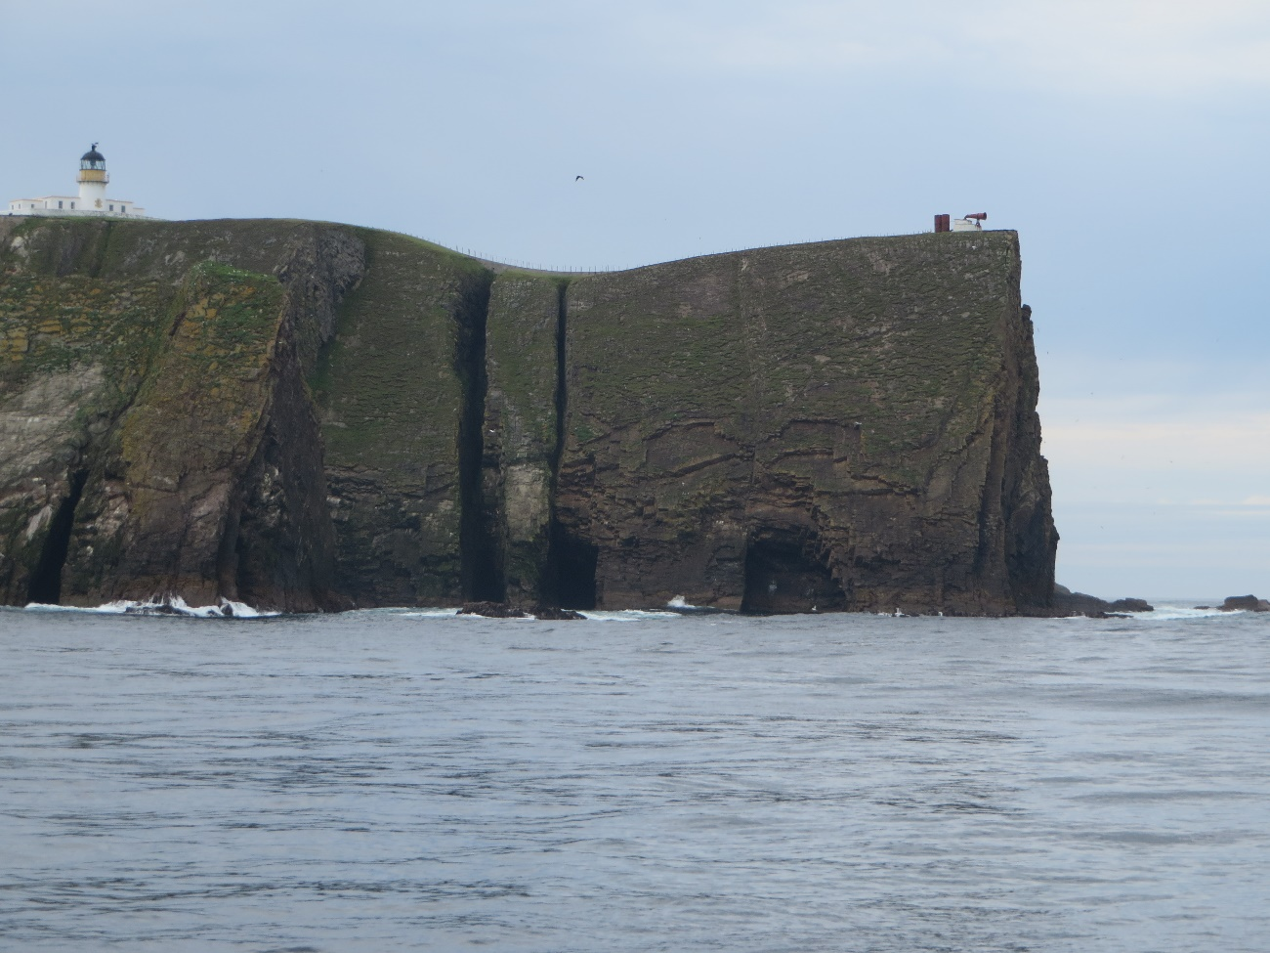
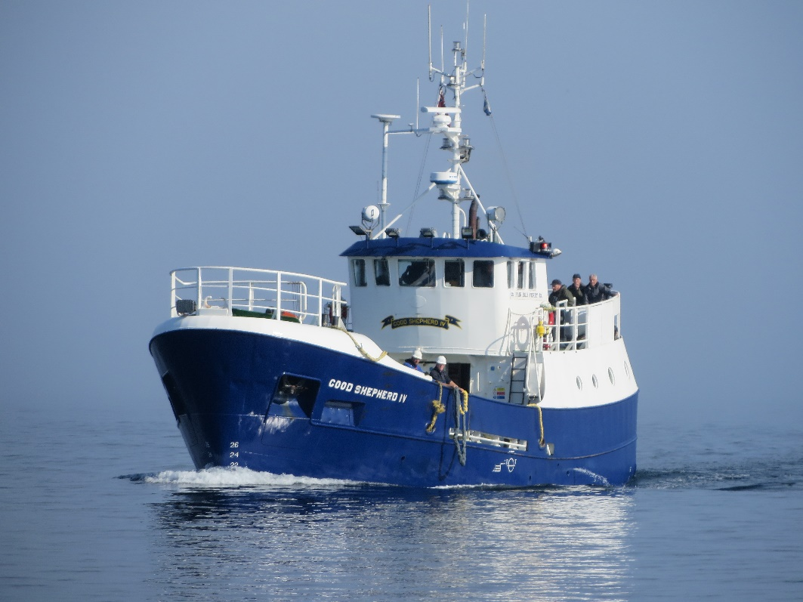
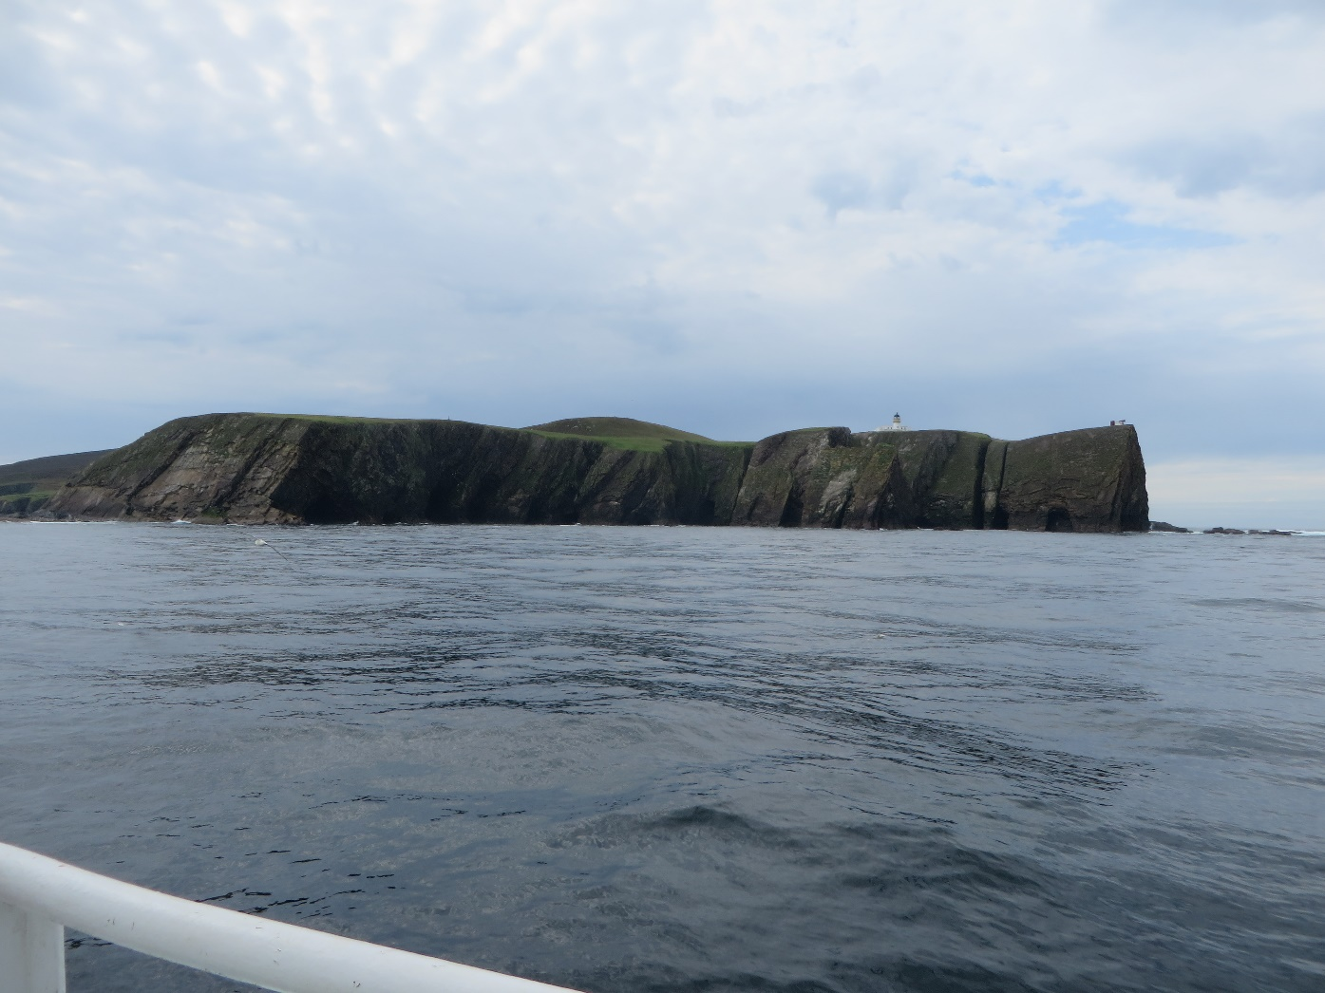
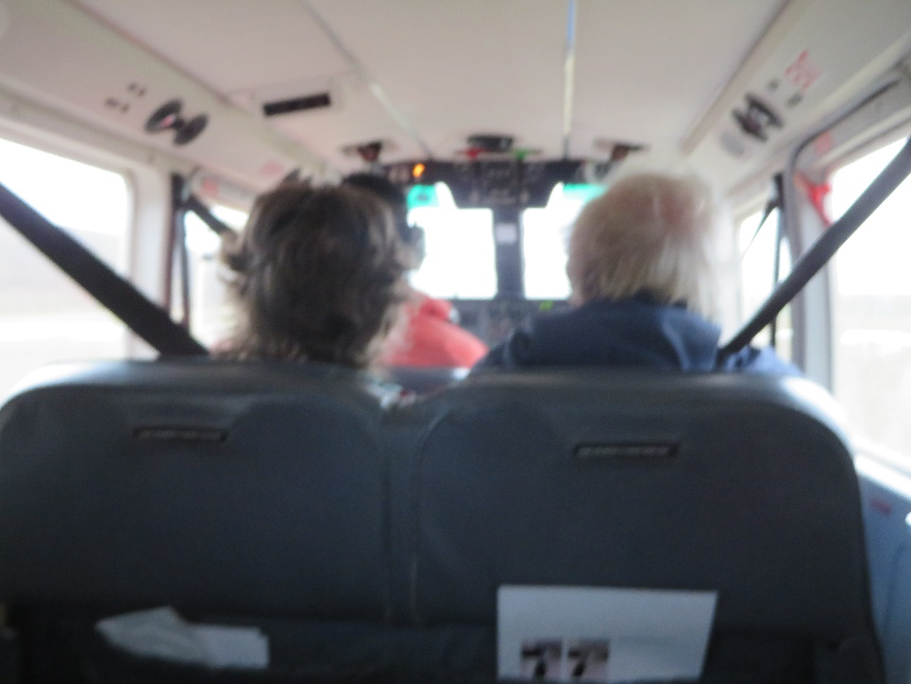

Slide 4
A few data:
Situated halfway between Orkney and Shetland
770 ha, of which 560 ha are Natura 2000 site
Marine protected area since 2016
55 to 60 inhabitants, of which are four children in the primary school
Cool summers and mild winters
Economy based on sheep farming, fishing, tourism and knitting
Landowner: National Trust for Scotland
Famous bird observatory, founded 1948, burnt down 2019
(Ir)regular flights to Lerwick and boat to Sumburgh

Slide 5
Land use on Fair Isle
Crofting:
As the whole island is owned by the National Trust for Scotland, the inhabitants are tenants to the NTS. The majority of the of the island falls under crofting tenure. Crofting is a system of landholding which is unique to Scotland and is an integral part of life in the Highlands & Islands. A croft is a relatively small agricultural land holding which is normally held in tenancy and which may or may not have buildings or a house associated with it. Crofts range in size from less than 1/2 hectare (ha) to more than 50ha but an average croft is nearer 5 ha.

Slide 6
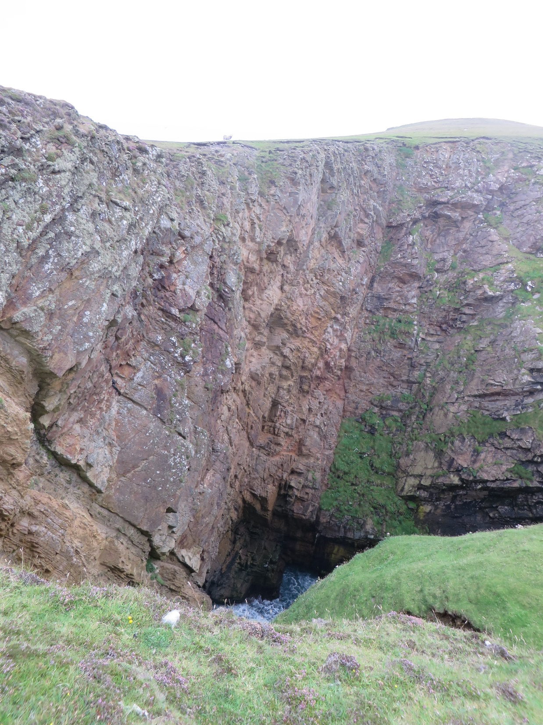
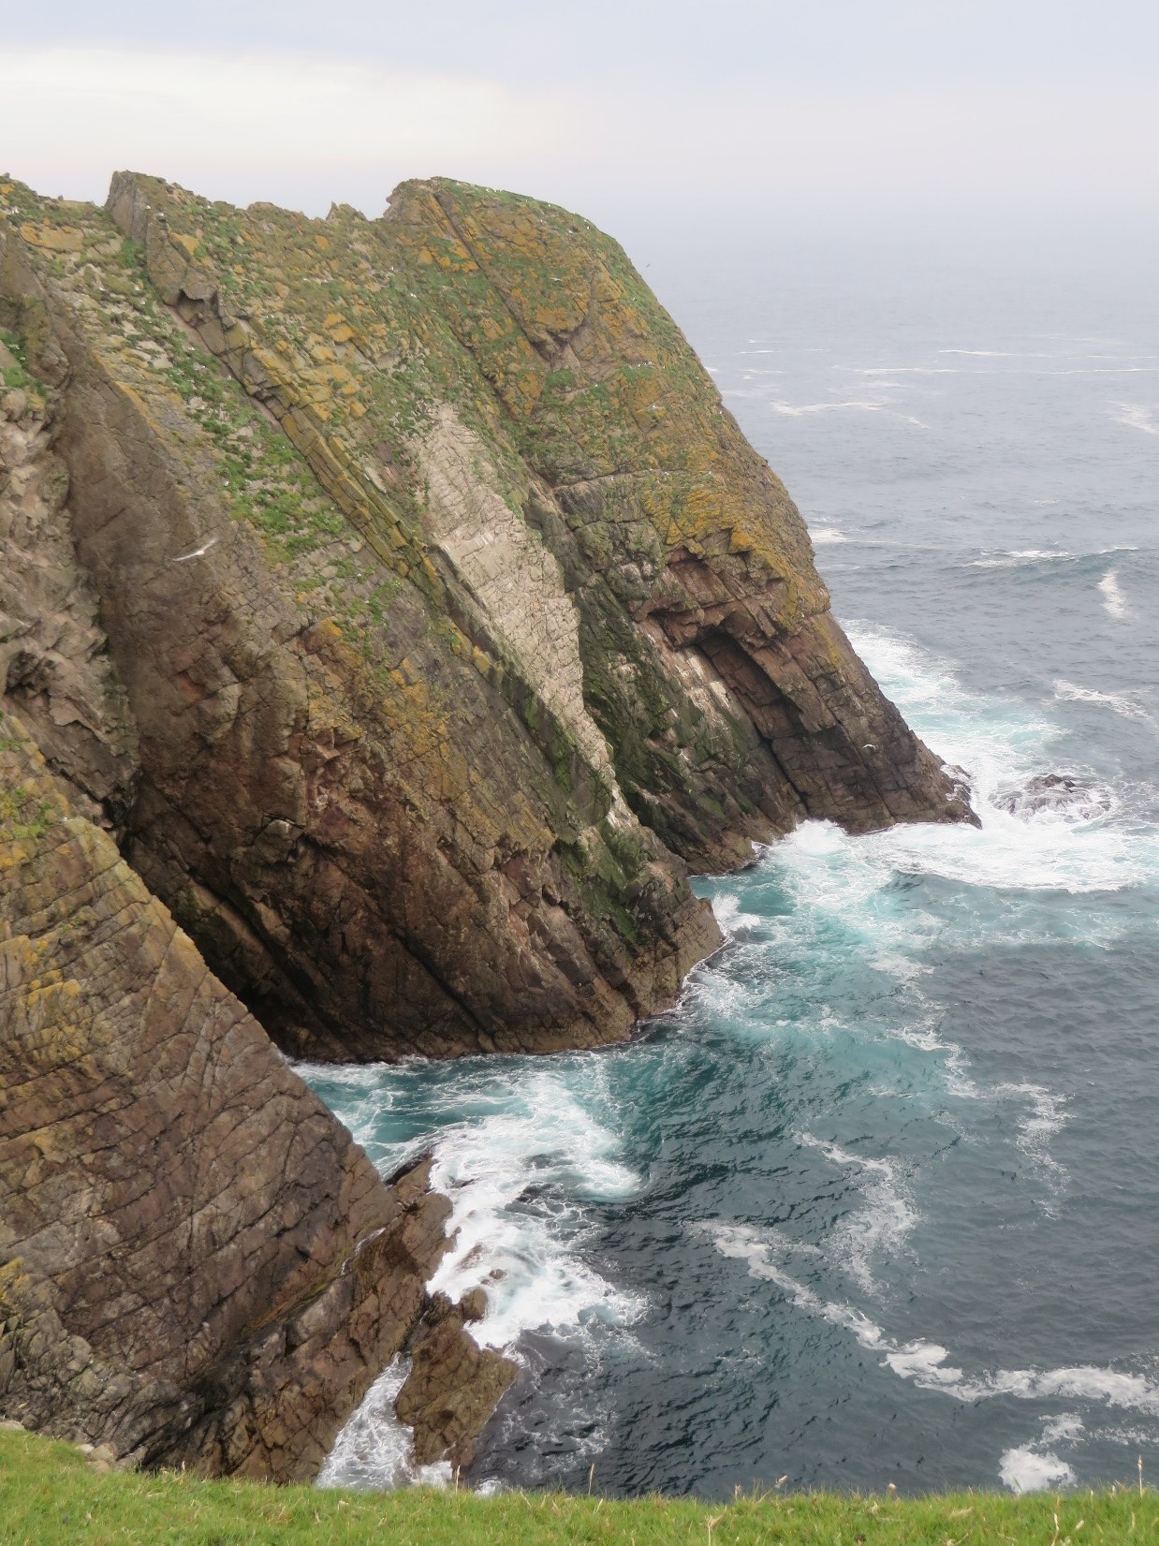
Nature ……

Slide 7
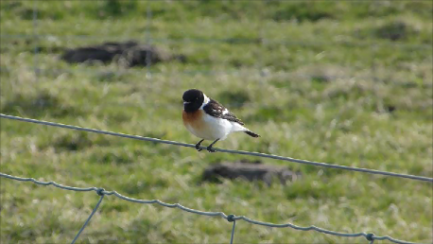
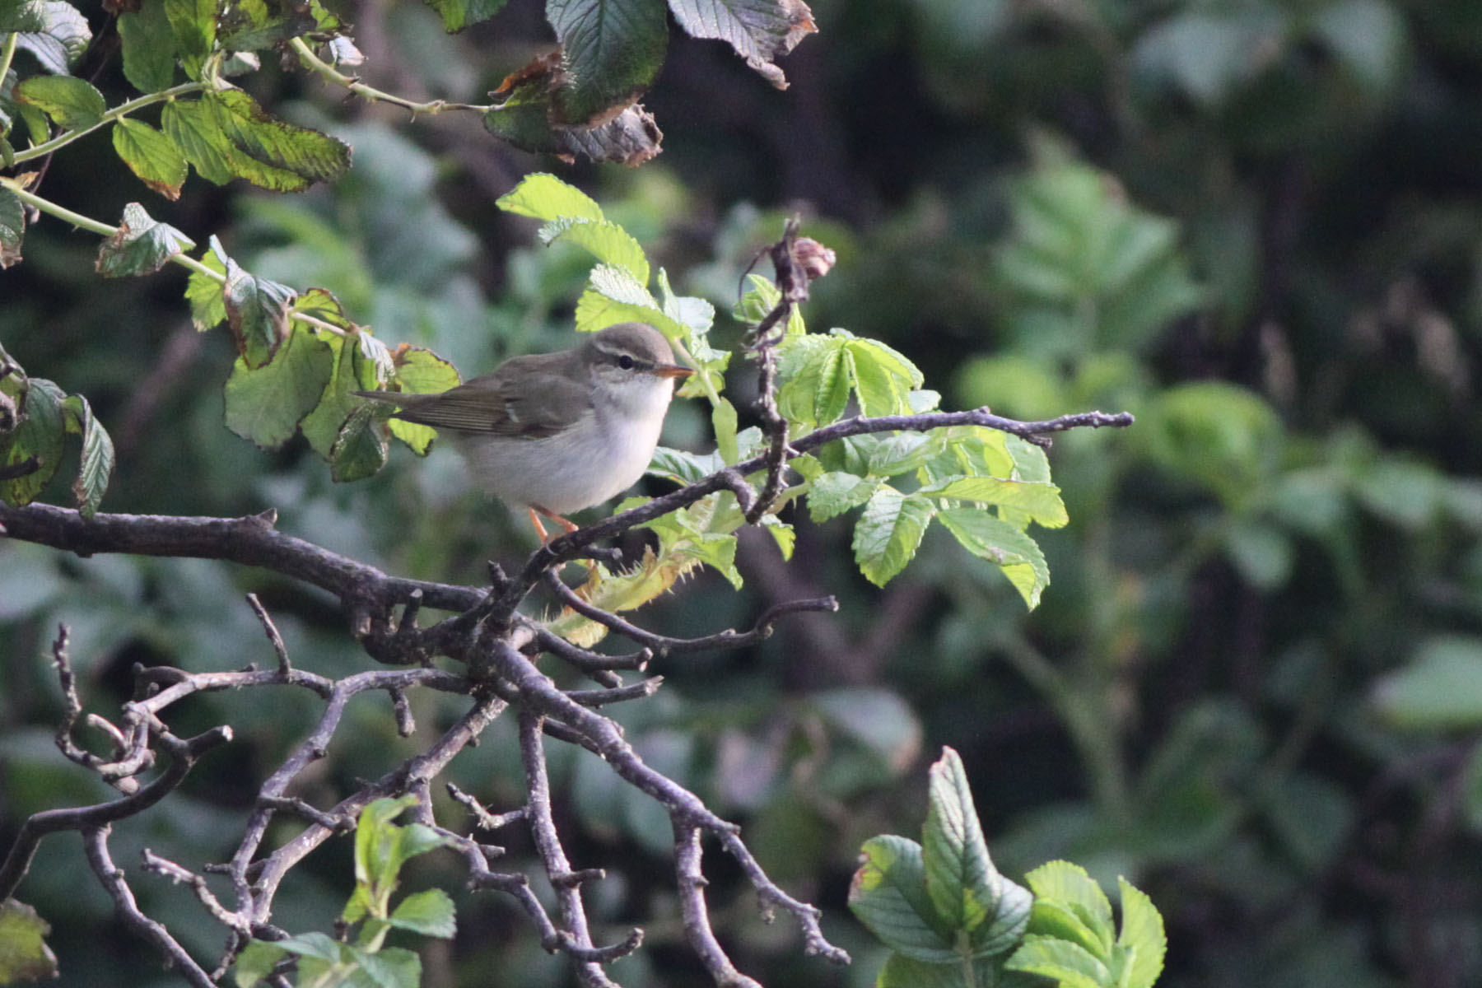
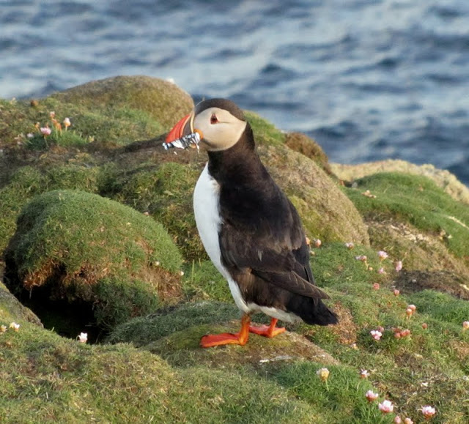
Caspian stonechat (FIBO)
Arctic Warbler (Nick Riddiford)
Birdlife ……
Puffin (FIBO)

Slide 8
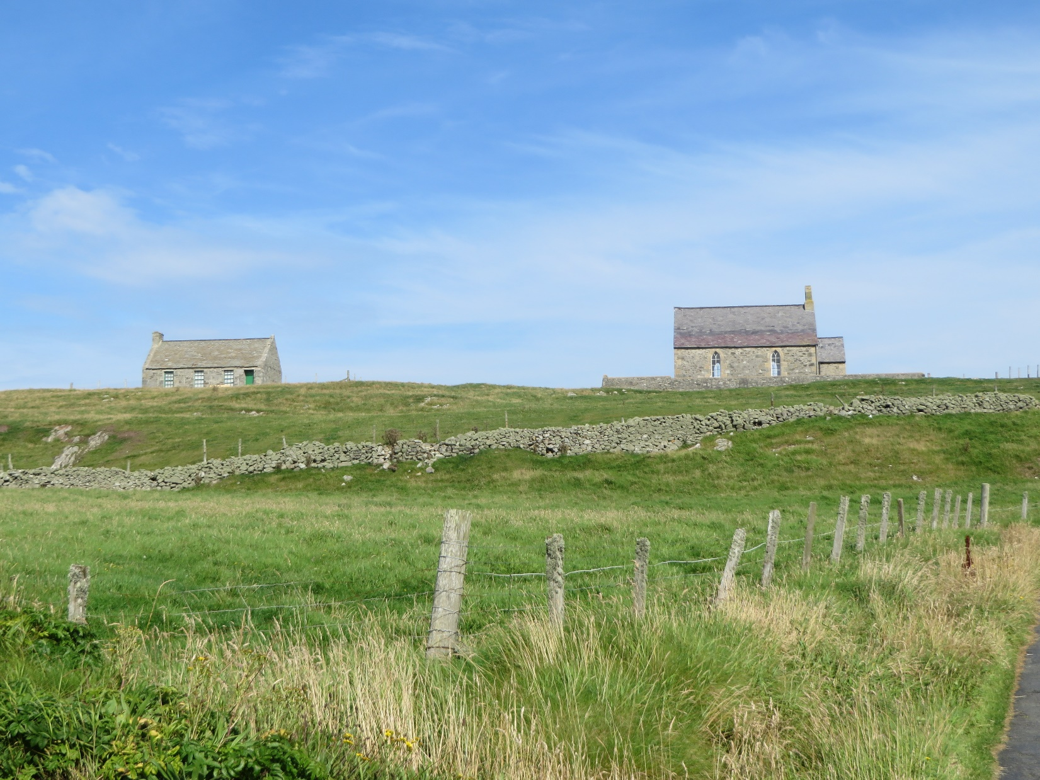
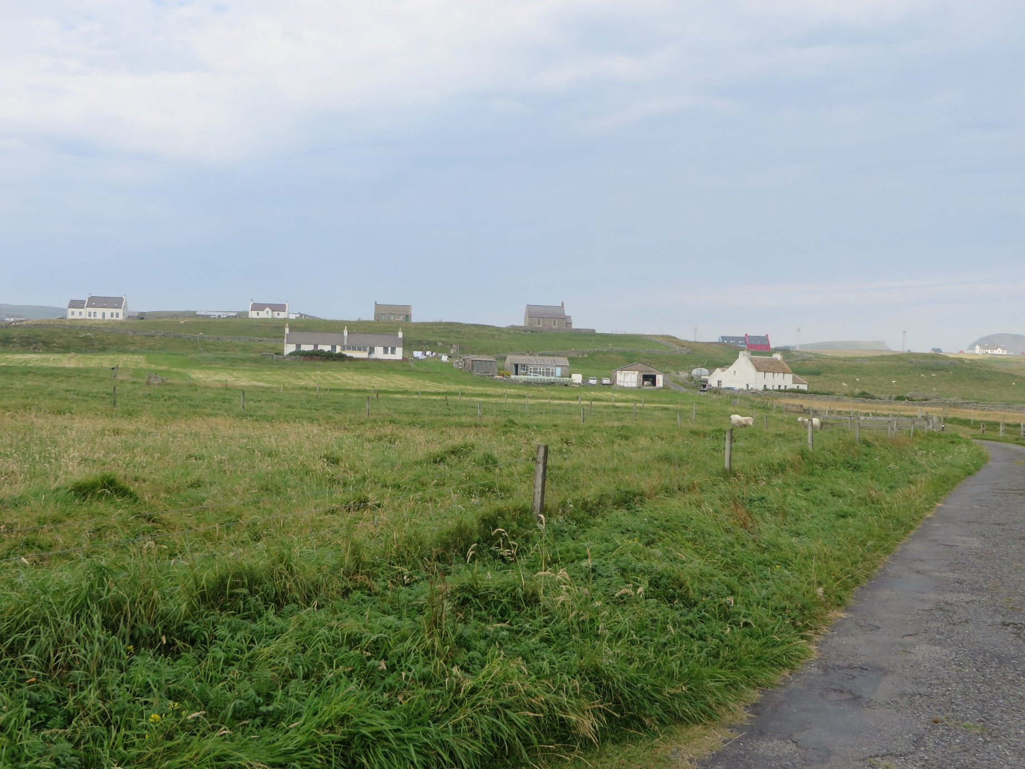
The island ……

Slide 9
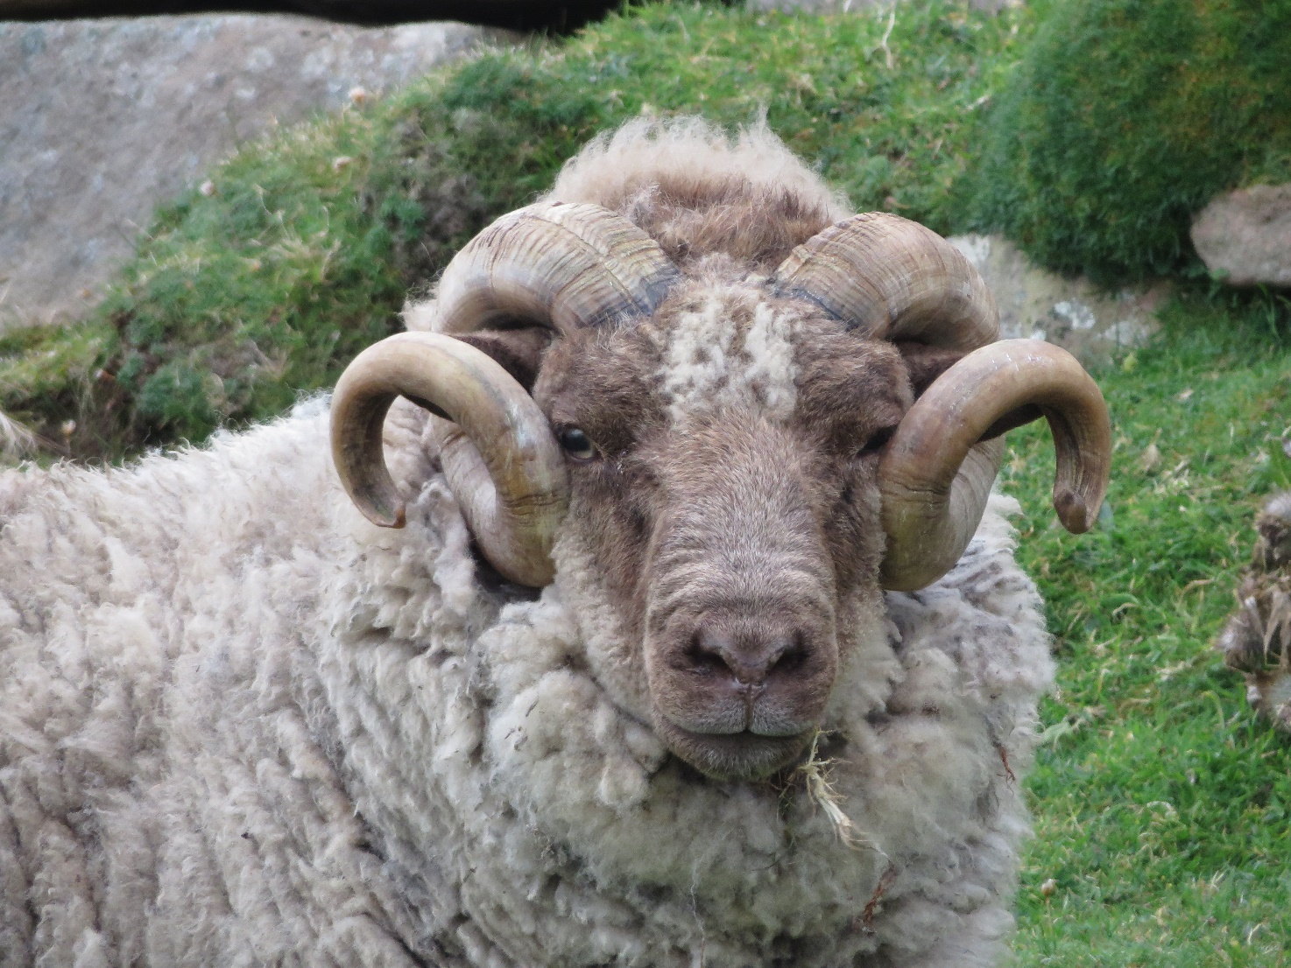
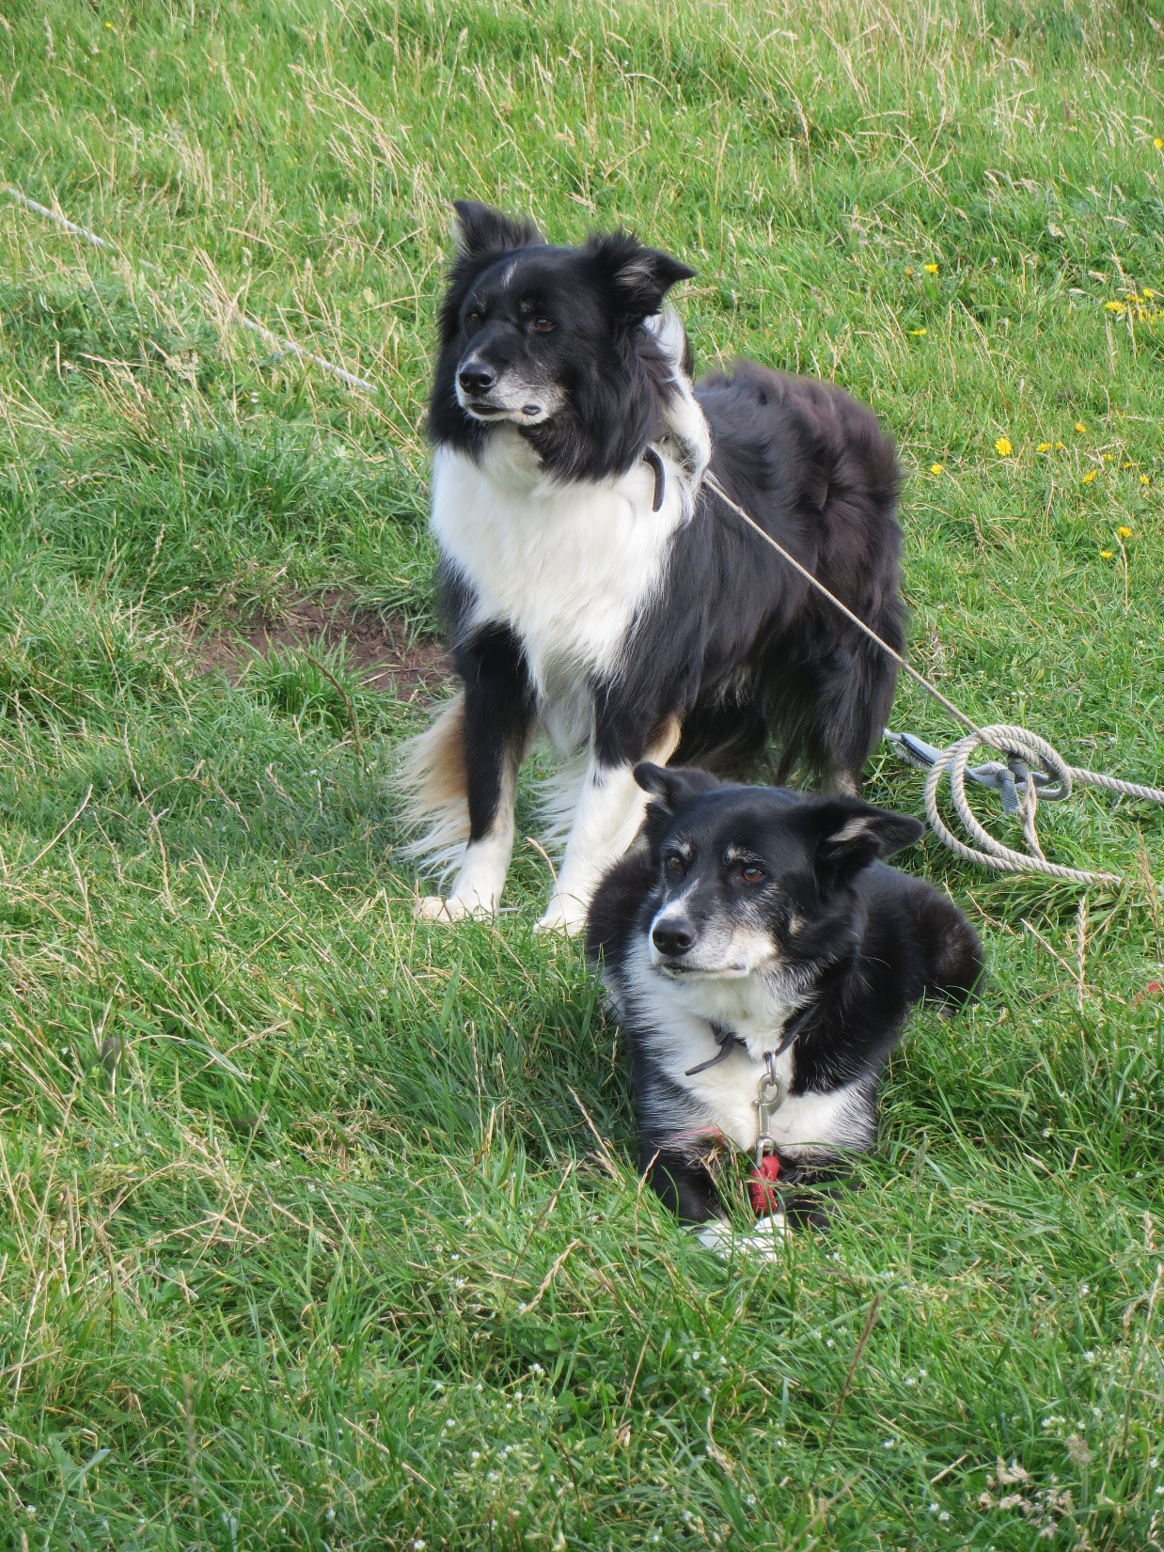
Sheep farming ……

Slide 10
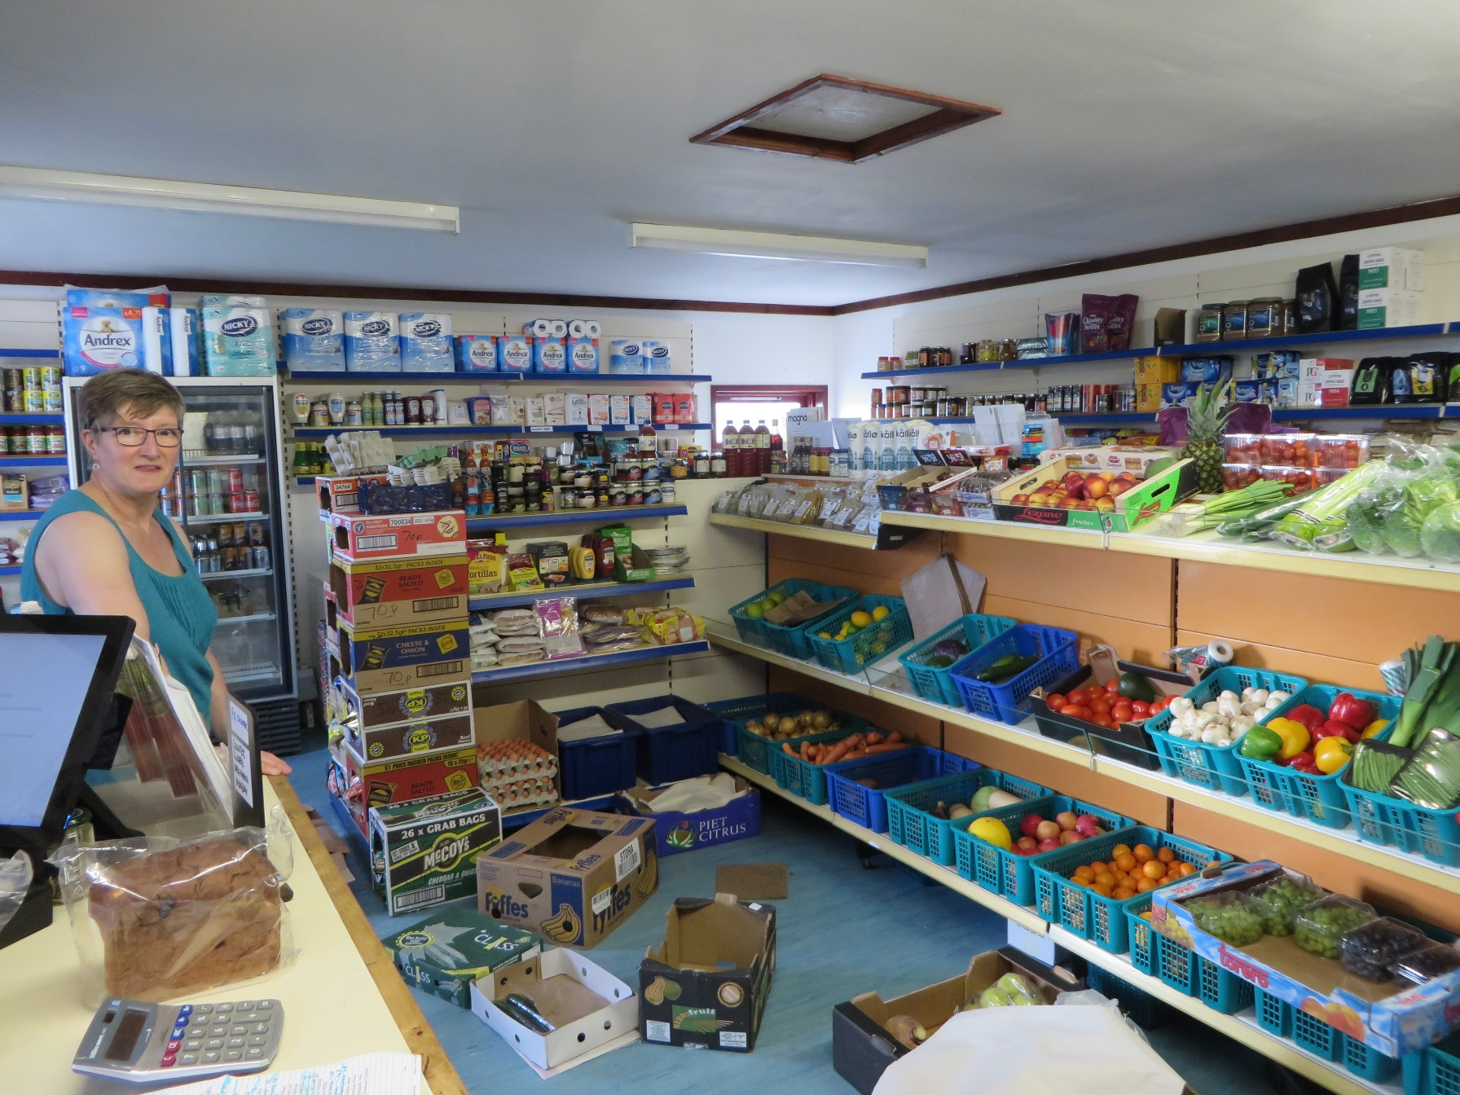
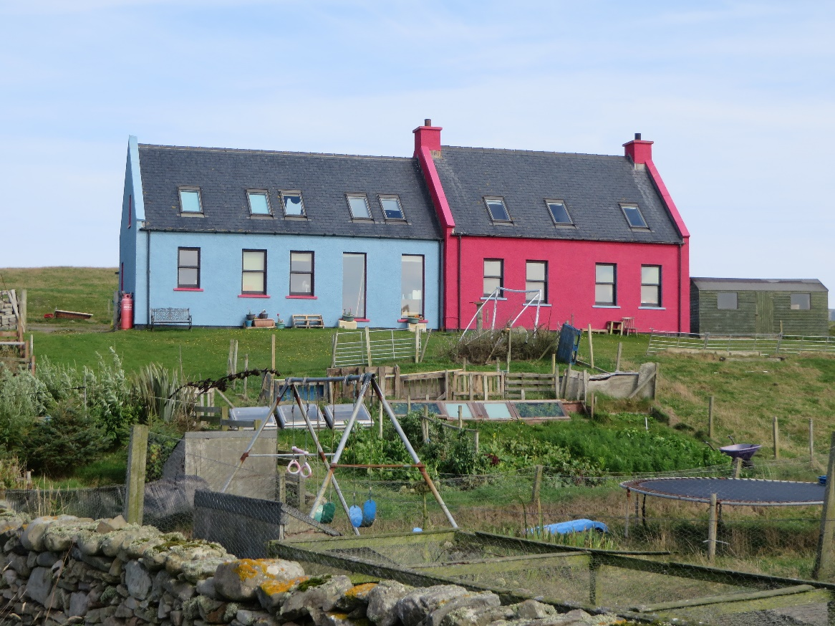
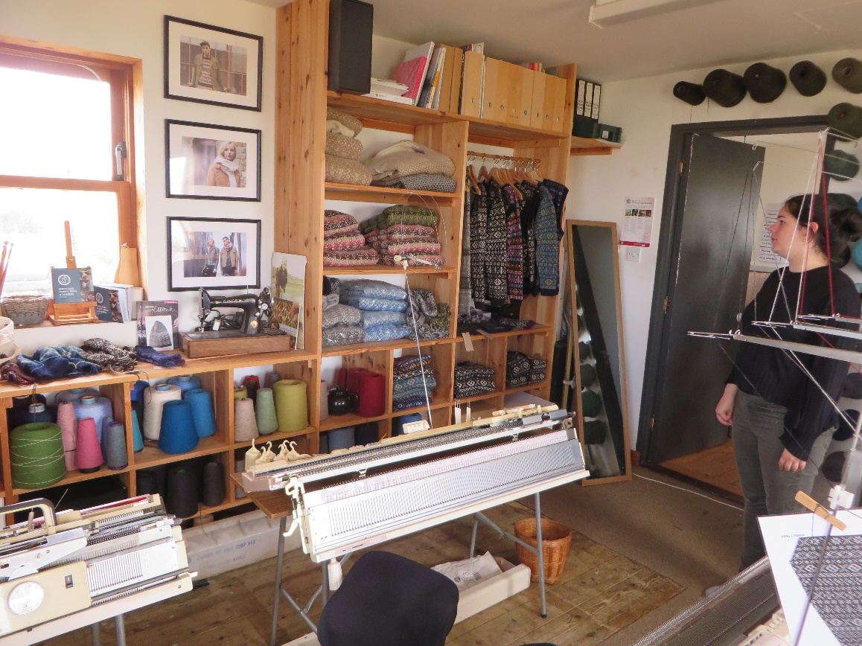
Living on the island ……

Slide 11
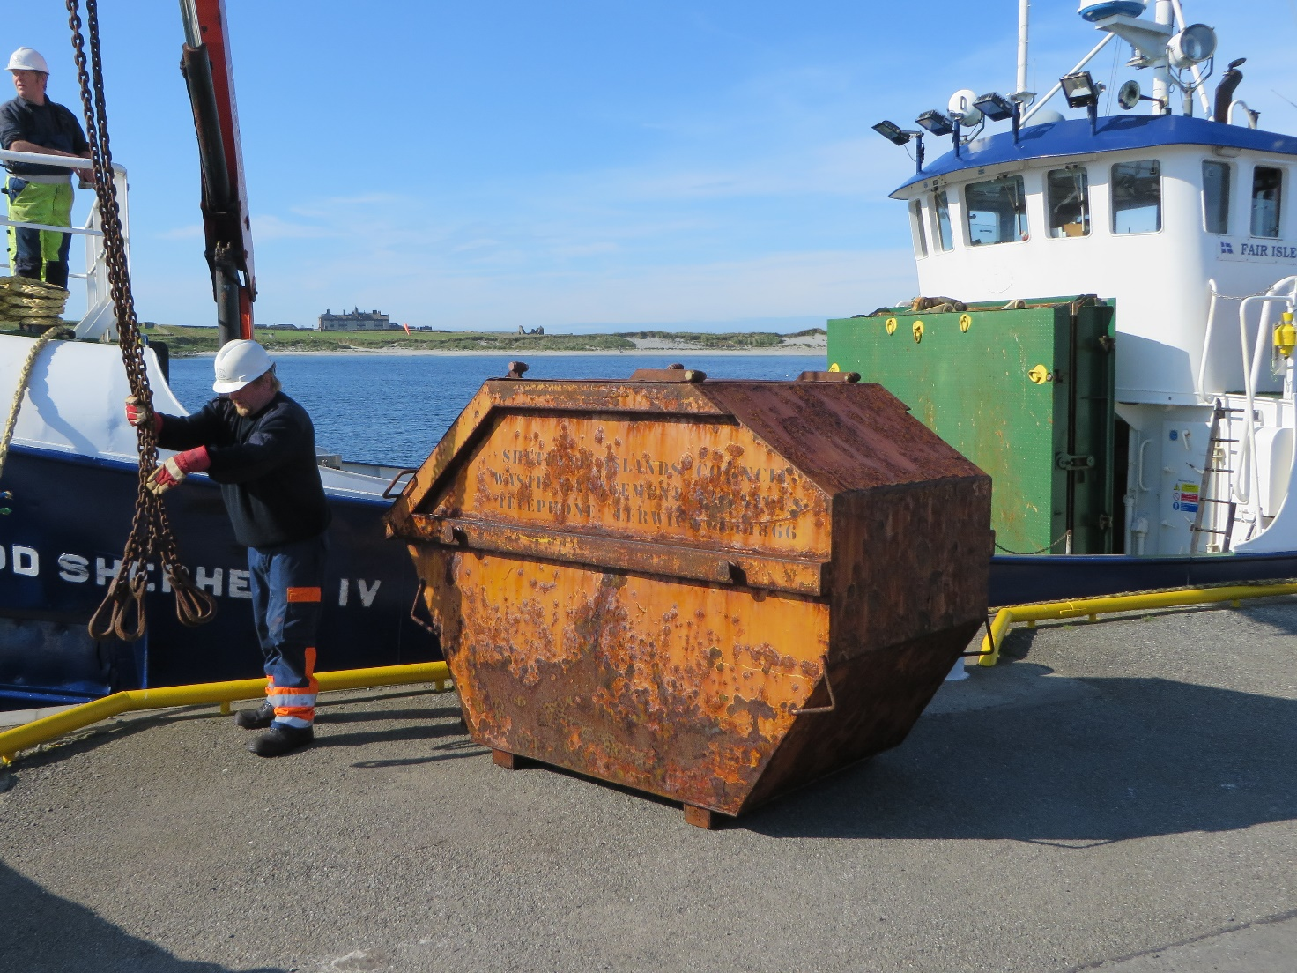
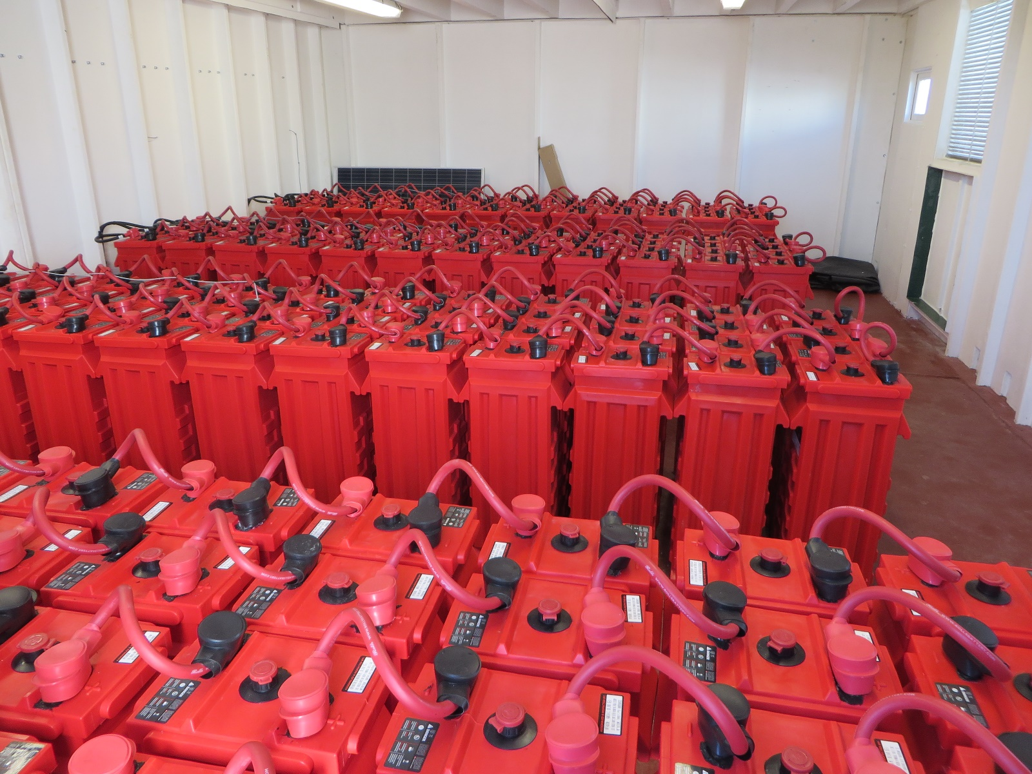
Sustainability …..

Slide 12
Worth to mention:
Important birdlife, but remarkable decline in number of individuals (because of decreasing food source sandeel due to rising sea temperature)
Cross road of the North-South flyway to Scamdinavia and a landfall for vagrants from Siberia and North-America
Some nationally scarce or endemic species under threat because of climate change
Lobster fishing still ongoing, but data unavailable
Rabbits and stray cats cause damages to the habitats and to birdlife

Slide 13
Comments on 2010 conditions and recommendations
Condition 1: in recognition of the internationally important seabird colonies and associated marine environment currently experiencing severe pressure, …………. to establish the protected marine area which has been called for in successive diploma renewals. A new protected marine area should be in conformity with the Fair Isle Marine Action Plan (FIMP);
With the decision to establish a Demonstration and Research Marine Protected Area (D&R MPA) in October 2016, the condition was fulfilled.

Slide 14
Recommendation 1: the needs and aspirations of the local community, as detailed in the FIMP, should be fully taken into account, as should the fragile socio-economic situation;
Remarkable progress was made through the Fair Isle Unified Low Carbon Electricity Storage and Generation Project to provide clean and sustainably produced energy to the households. Efforts were made to improve the communication to the 4g standard. School (four children) and health service are well established.
Recommendation 2: all efforts should be made to solve the problem of the disposal of plastic in general and agricultural baling plastic in particular.
Whereas waste treatment is handled perfectly, the biggest problem is the plastic waste in the landscape and on beaches. An annual cleaning, the Voar Redd Up event is organised.

Slide 15
Two Conditions for the renewal 2020 -2030
Review the 2010-2019 management plan as was foreseen for 2018 and elaborate a new management plan as soon as possible to secure a continuous development and management of the Fair Isle Scenic Area, considering the conditions and recommendations of this appraisal report and including specific provisions dedicated to climate change and how to address this issue in relation to the long-term conservation of endemic and bird species.
Make more intensive use of the European Diploma logo in all information material and brochures and explain the relevance of the Diploma wherever useful.

Slide 16
Recommendations for the renewal 2020 -2030
Consider a ban of fishing and catching of lobster within the Development and Research Marine Protected Area or at least in a scientifically defined area;
Consider the inclusion of the Marine Protected Area into the European Diploma site;
Improve the housing-related quality of life through appropriate measures, mainly concerning renovation and restauration and consider the peculiar conditions of the local business and improve working conditions through installation of appropriate manufacturing locations;
Give the European Diploma a prominent place in or at the new bird observatory.

Slide 17
Under these conditions and recommendations
I advocate to renew the European Diploma for
Fair Isle Scenic Area 2020 to 2030.
Robert Brunner

