Slide 1
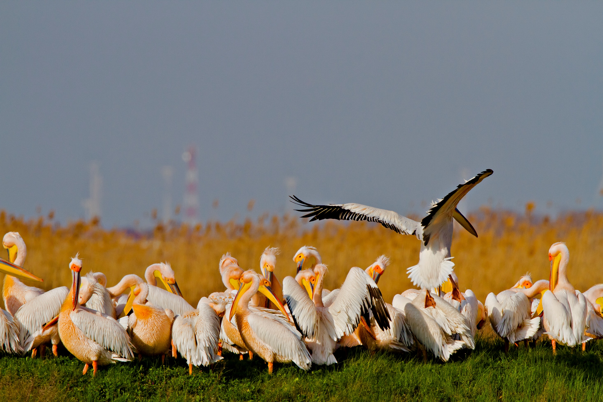
Danube Delta Biosphere Reserve
8 – 11 July 2019

Slide 2
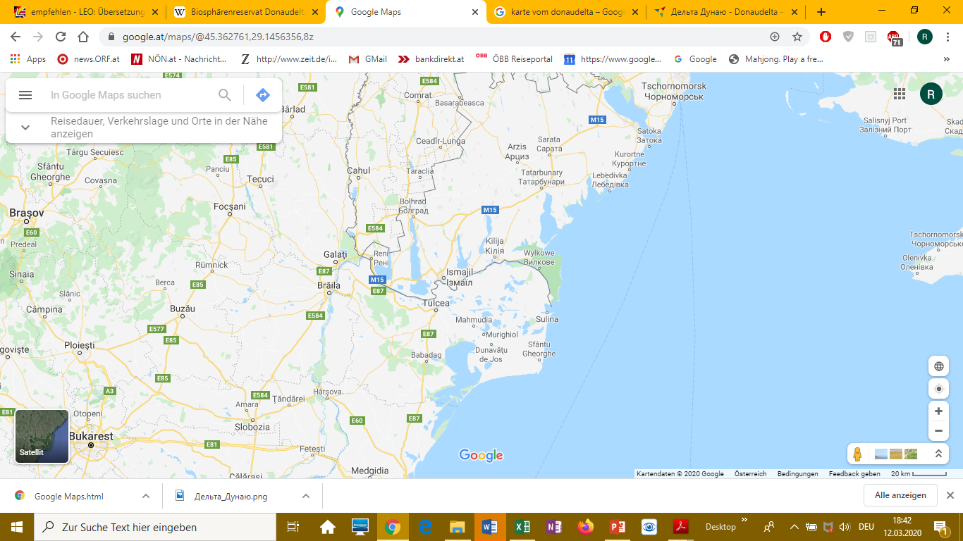
Sodmy - Eigenes WerkOpenstreetmap, CC BY-SA 3.0, https://commons.wikimedia.org/w/index.php?curid=25500420

Slide 3
Facts:
Biosphere Reserve, total area 580 000 hectares
(50 600 ha core zone, 223 300 ha buffer zone, 306 100 ha transition zone )
Additional 100 000 ha in Ukraine
82 % public domain of national interest, less than 1 % private
61 000 ha agricultural land
Sulina arm is the main navigation route
Second largest delta in Europe (after the Volga)
Largest reed belt worldwide
Over 9 500 fauna and flora species, 30 types of ecoystems
Access only by boat except villages close to Tulcea

Slide 4
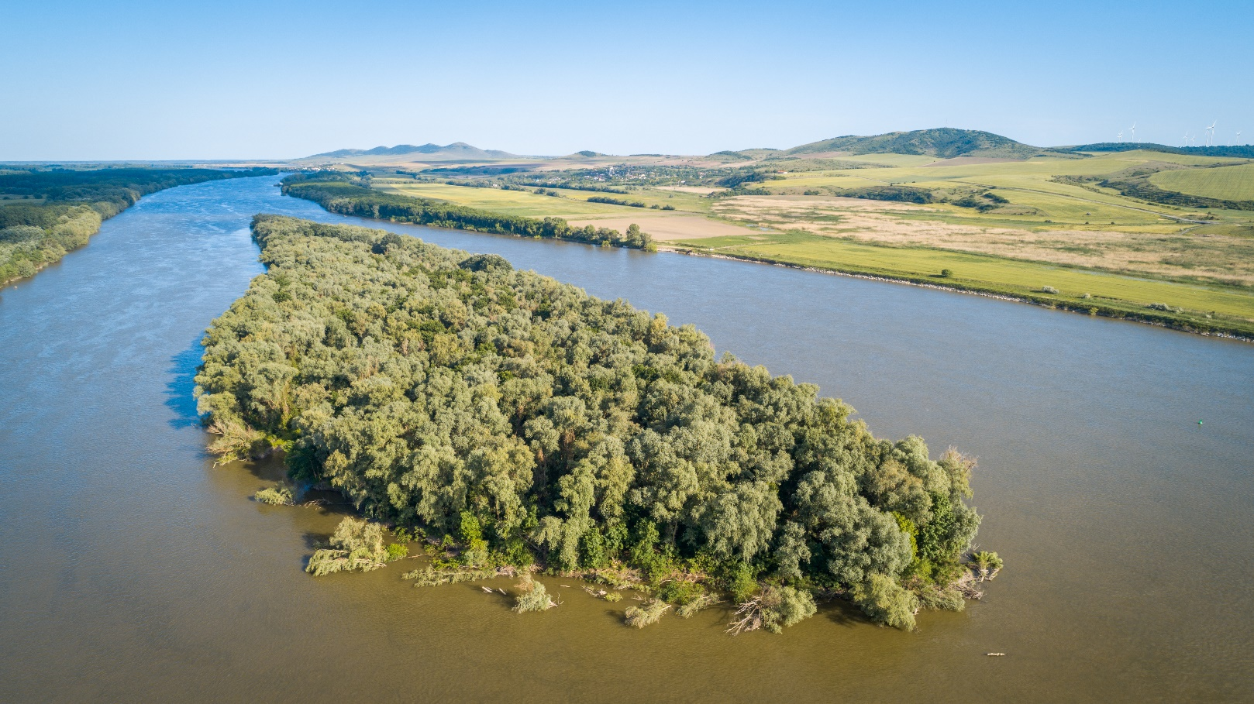
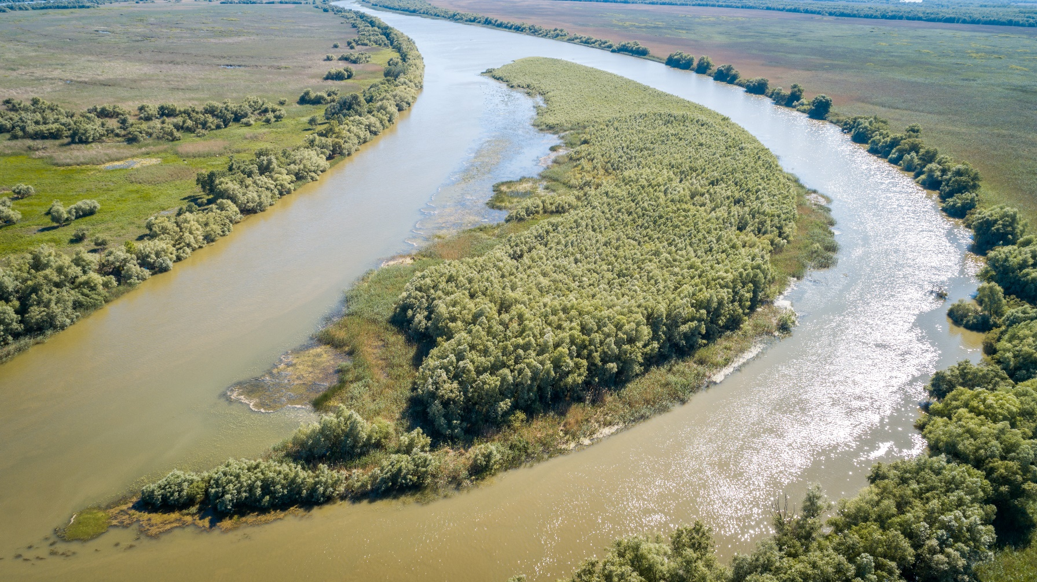
Pollution from navigation and from the Danube itself

Slide 5
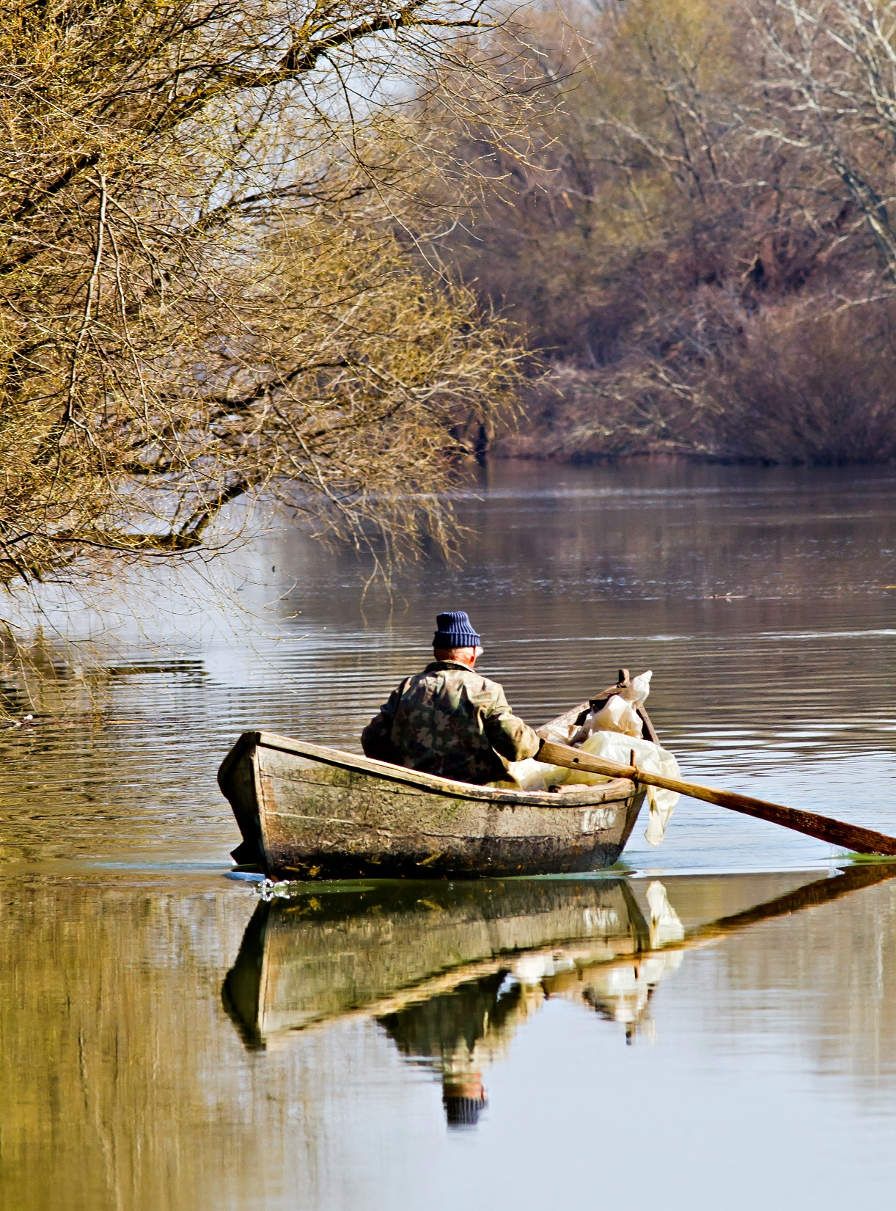
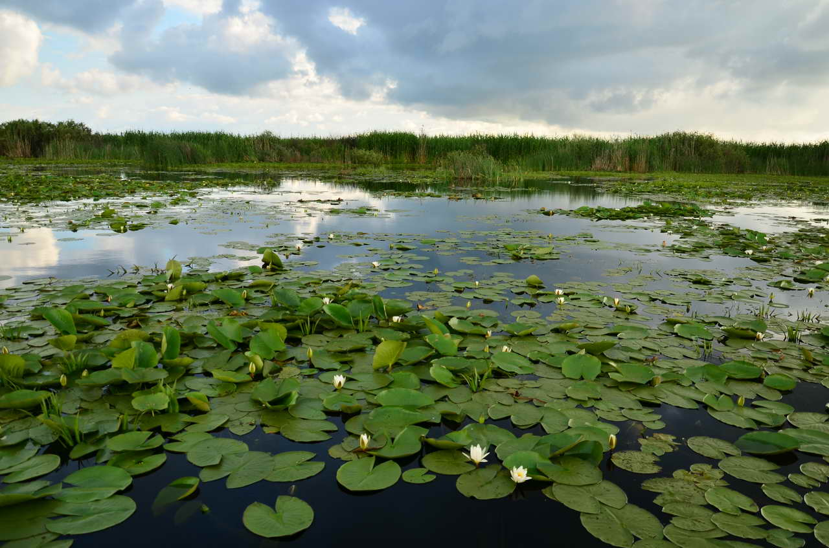
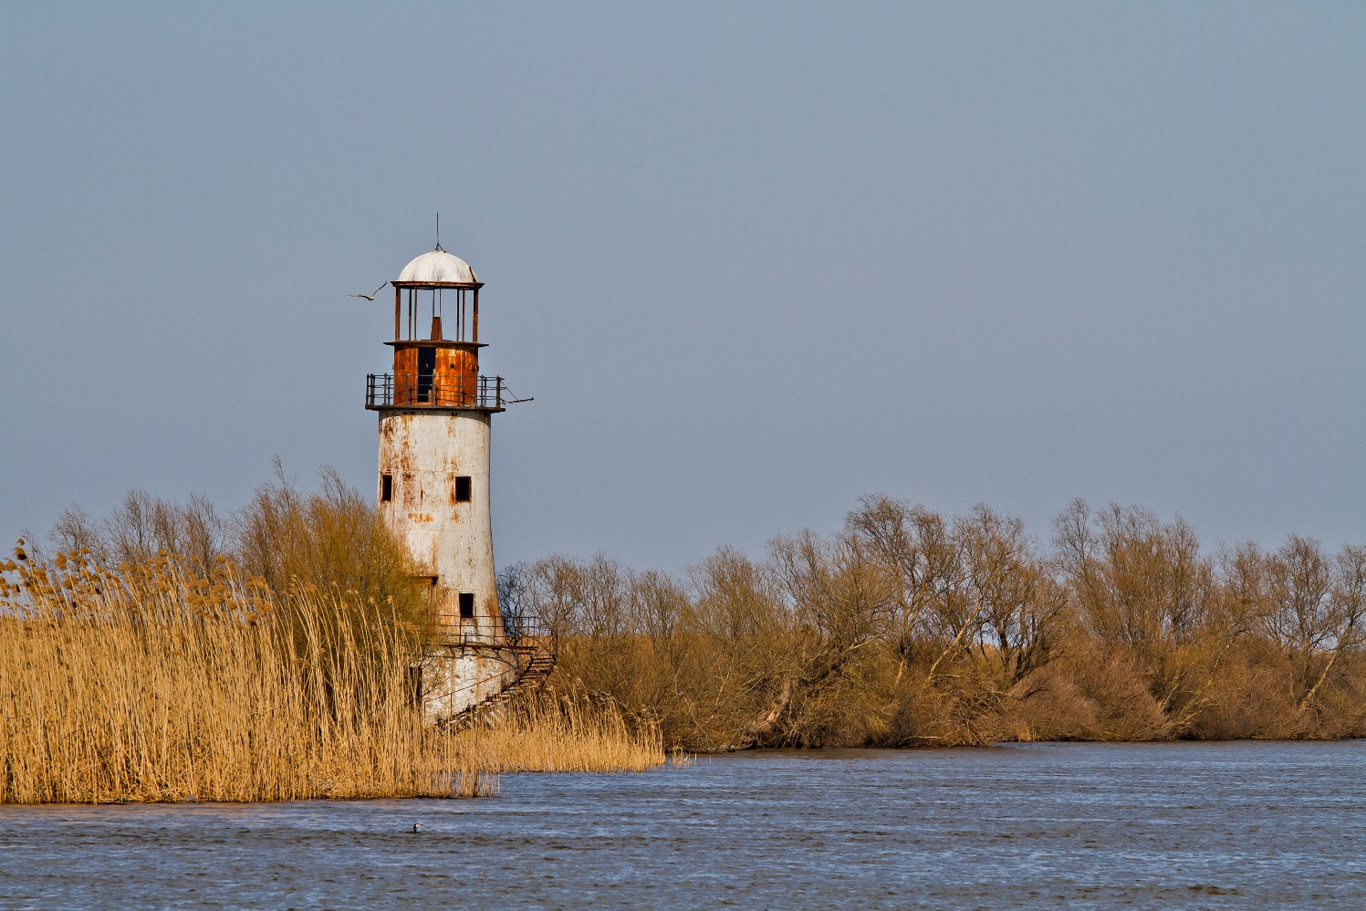
Fisherman (left)
Waterlilies (above)
Sulina (below)

Slide 6
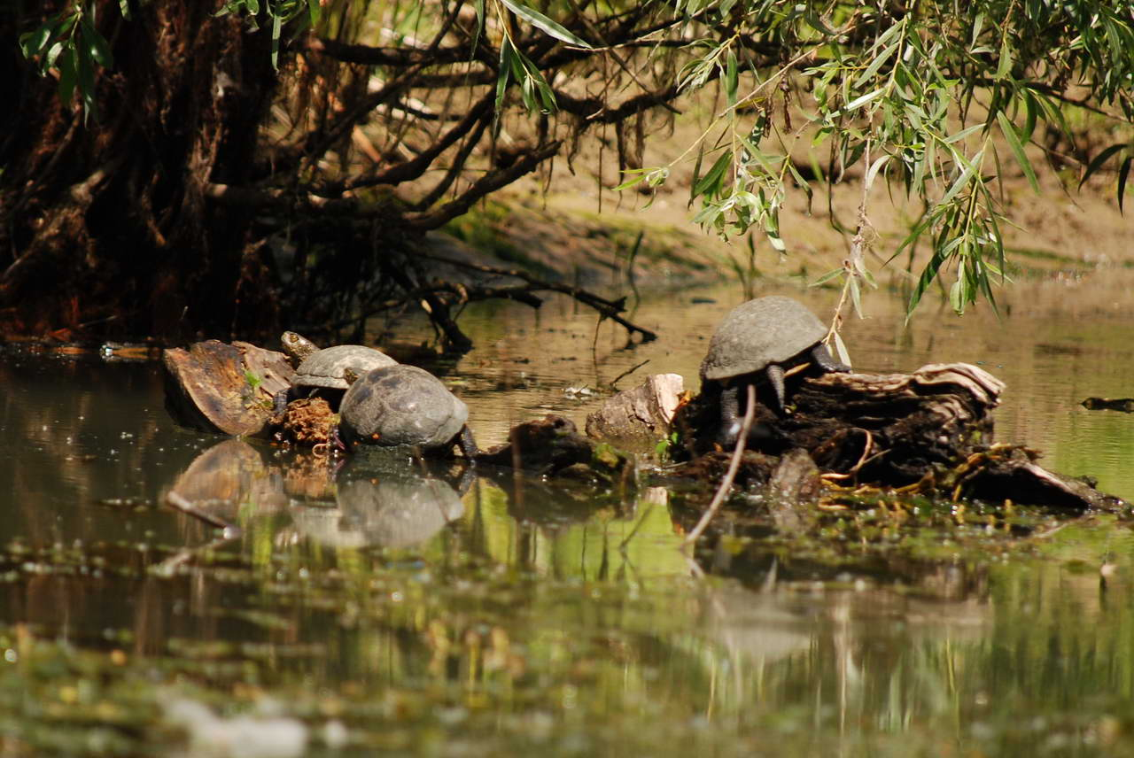
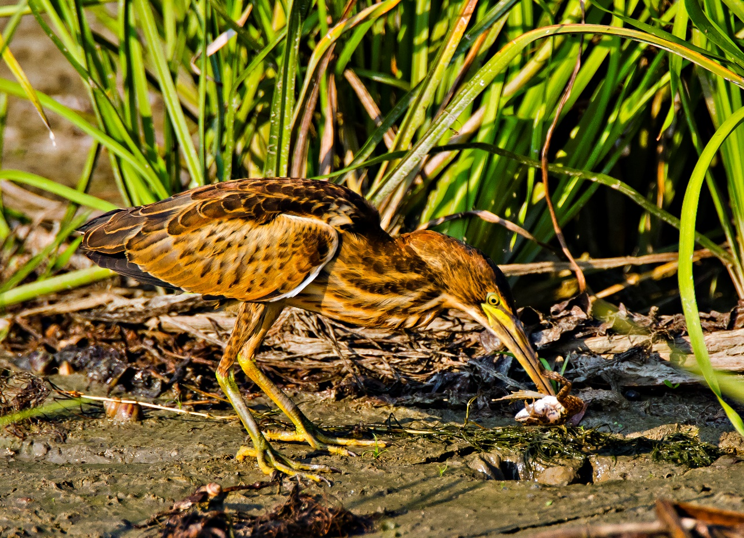
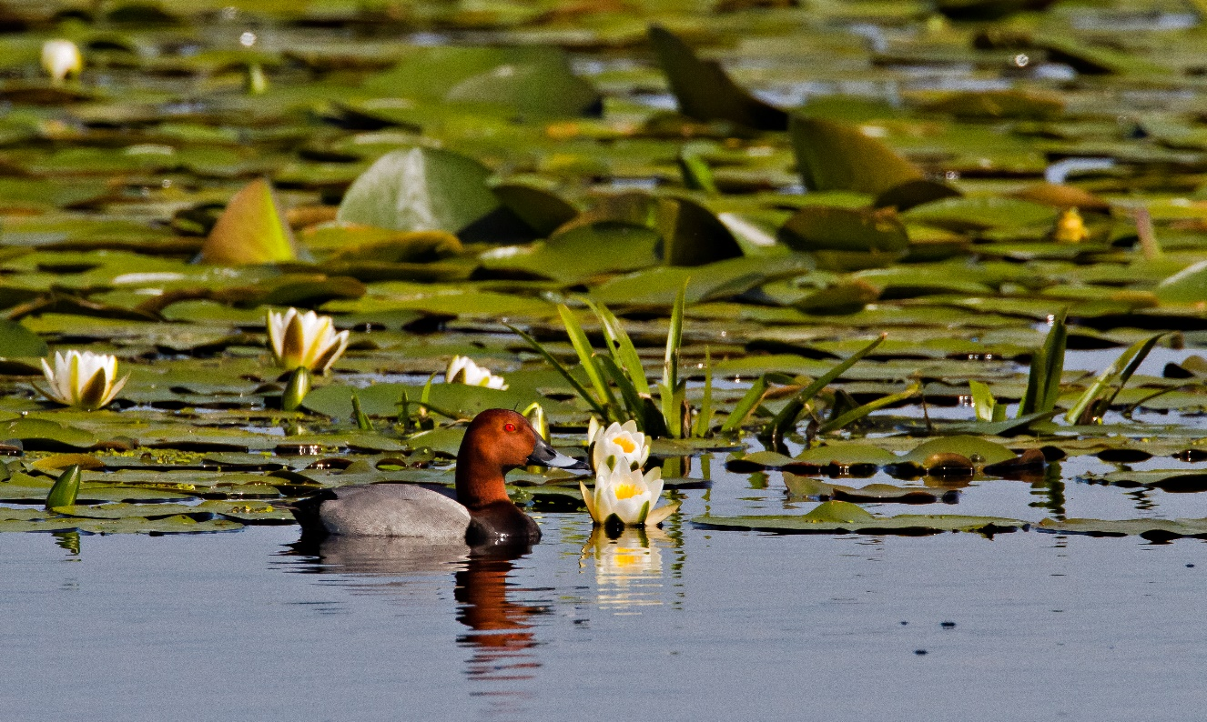
More than 300 bird species
Kingfisher (Alcedo athis)
European pond terrapin
Pochard (Aythya ferina)
Little bittern (ixobrychus minutus)

Slide 7
Fishing and hunting:
The key fish species is the sturgeon (Acipenser Baerii)
Alltogether 45 freshwater fish species
A ban on fishing sturgeon was extended to 2021. Although some poaching is evident, the ban is generally observed. But it is always a point for discussion and is expected to be lifted in 2021. A detailed programme for the protection and rehabilitation of the sturgeon has been developed at international level.
Commercial fishing, family fishing, sport/recreational fishing
In 2018 in total 3064 tons of fish harvested
Hunting is generally forbidden, except to fight diseasies

Slide 8
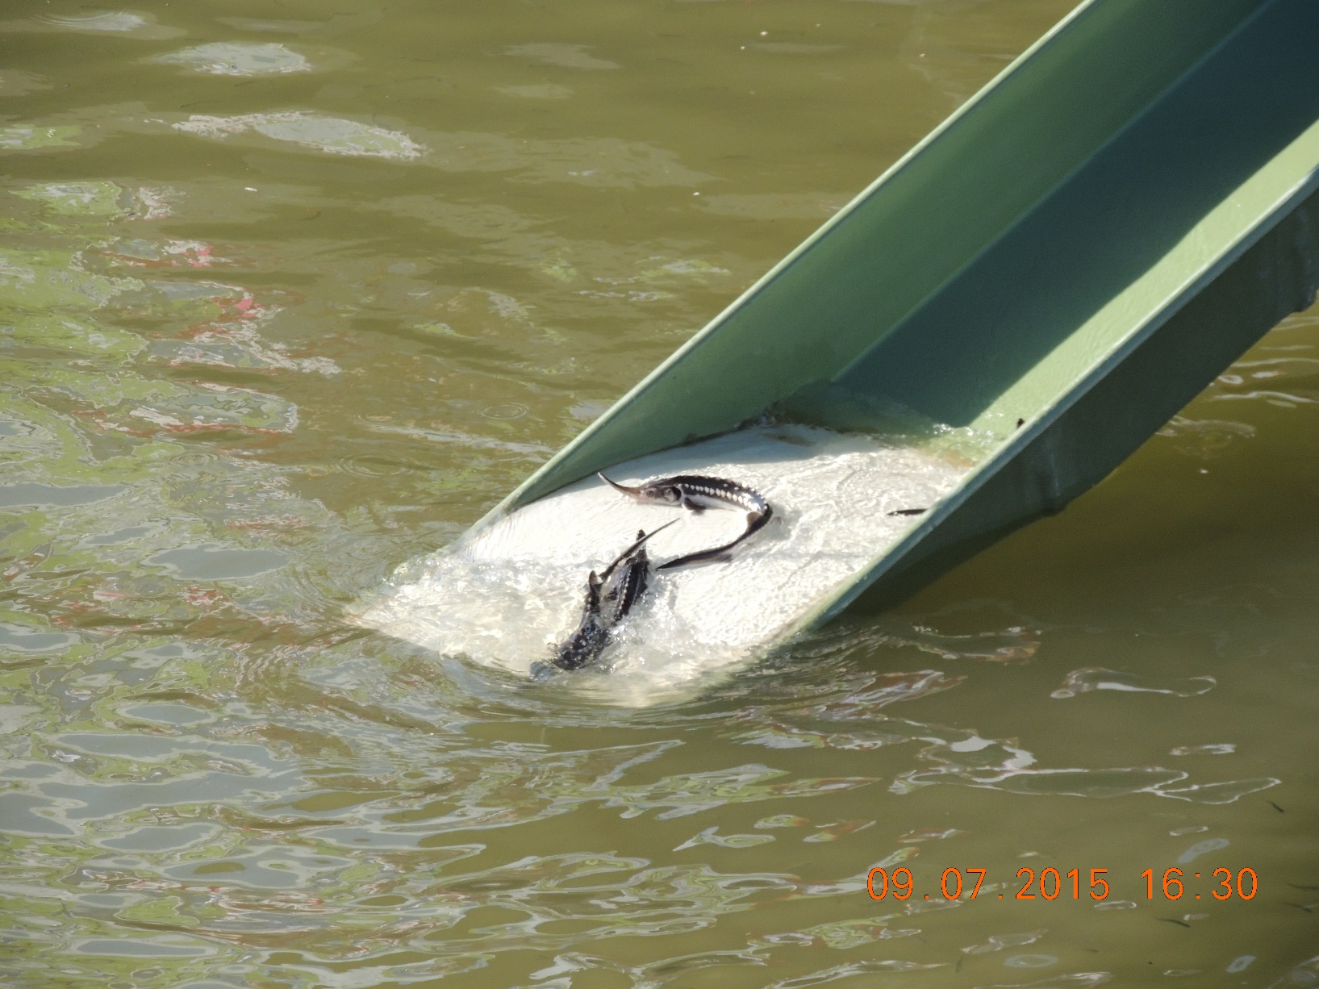
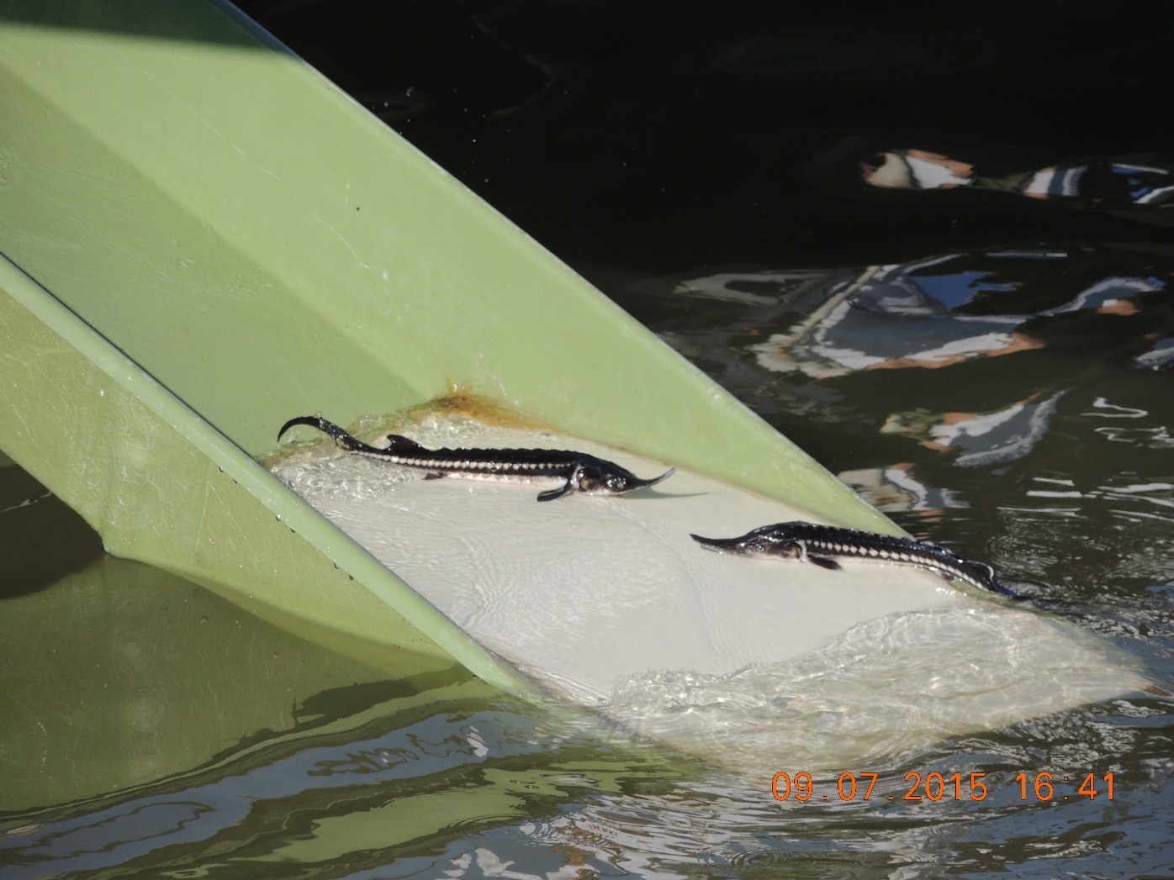
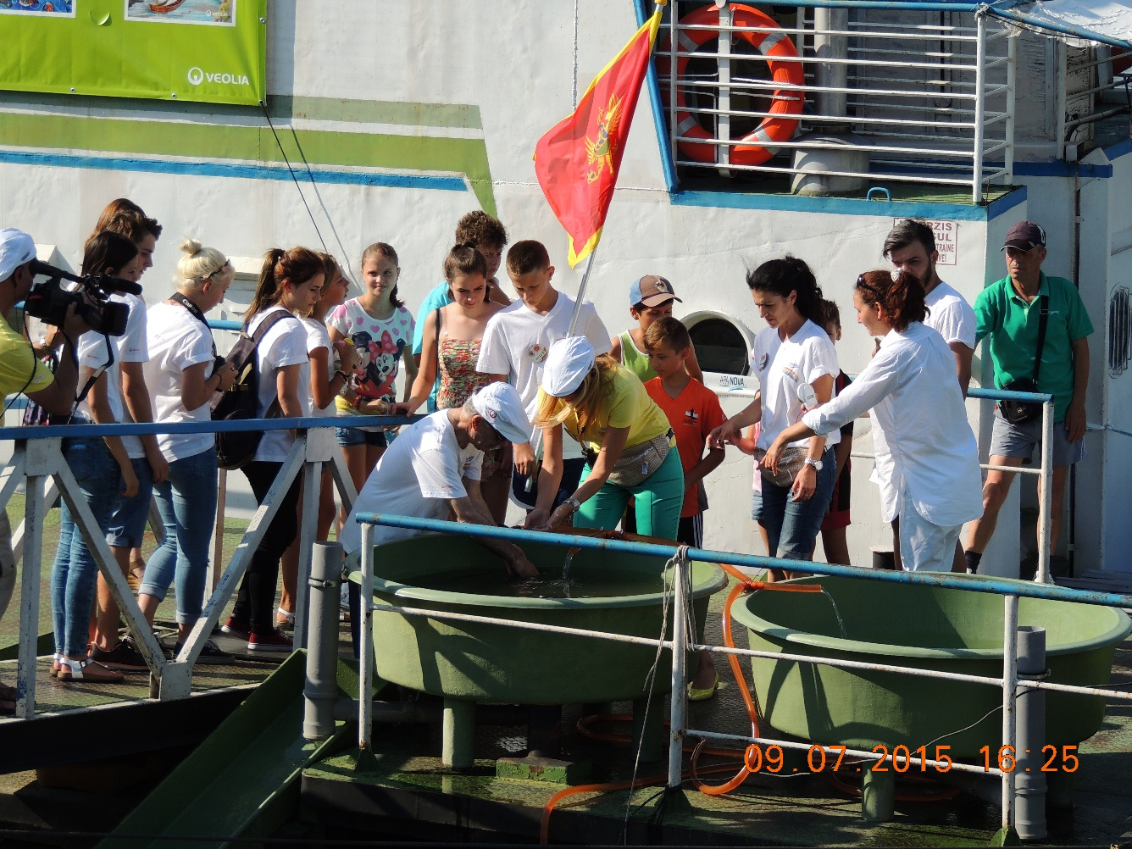
Stocking sturgeons

Slide 9
Land use
Reed harvest:
Reed is a natural resource which is harvested under defined criteria. In the season 2018/2019 5 377 tons from an authorized quota of 5 950 tons were harvested.
Tourism:
In 2018 the number of tourists reached 92 500 (22 % foreigners)
Most important tourist destination are St. Gheorghe and Sulina
Settlements and Inhabitants
Important towns are Sulina and St. Gheorghe
Population slightly decreasing (11 663 in 2018 = - 3% since 2011)

Slide 10
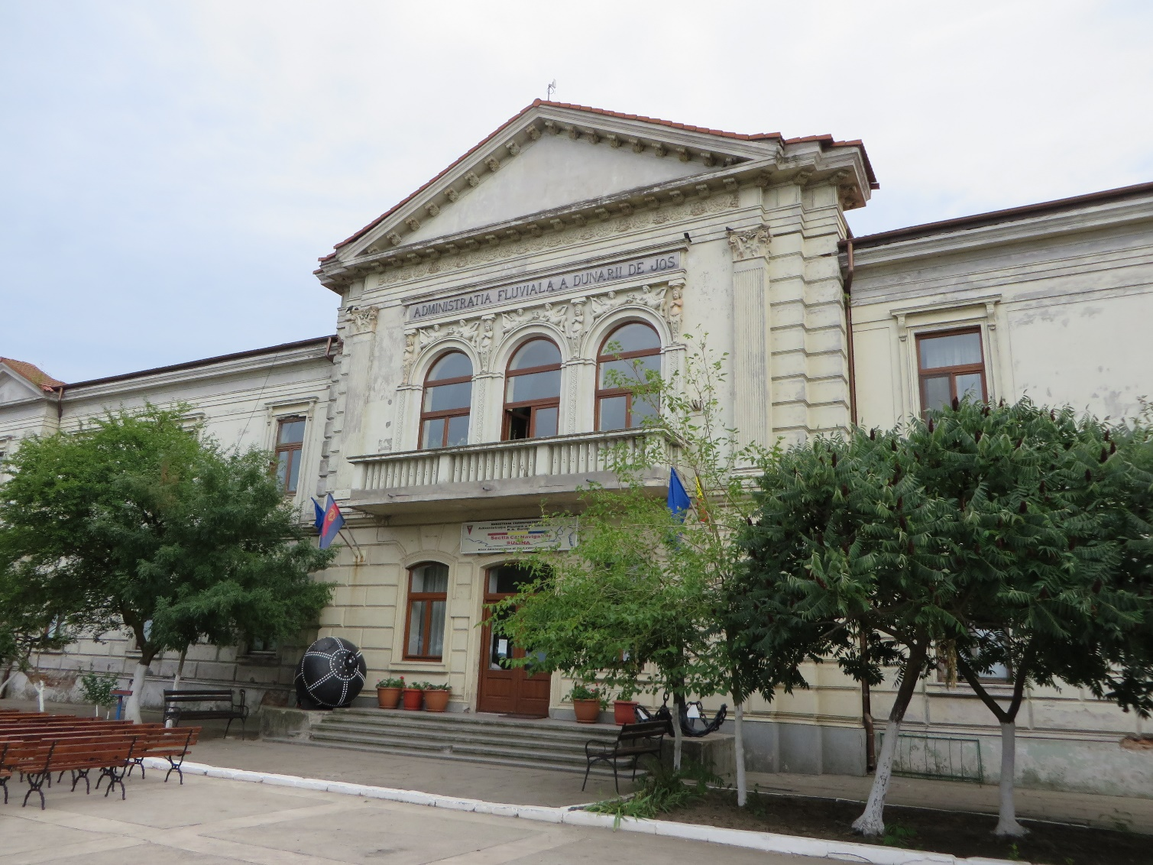
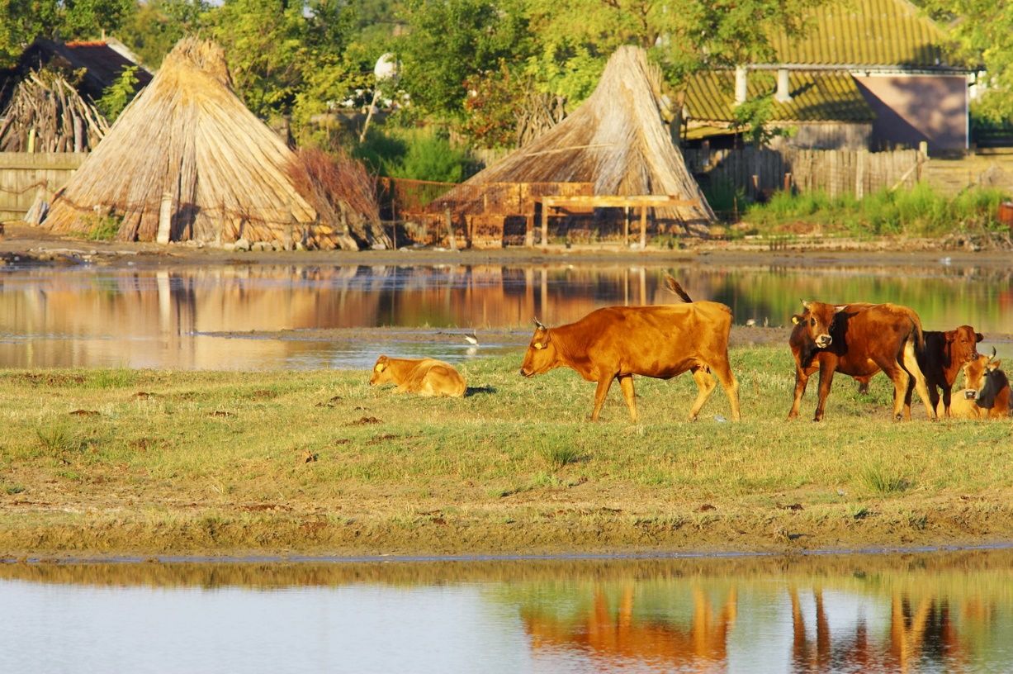
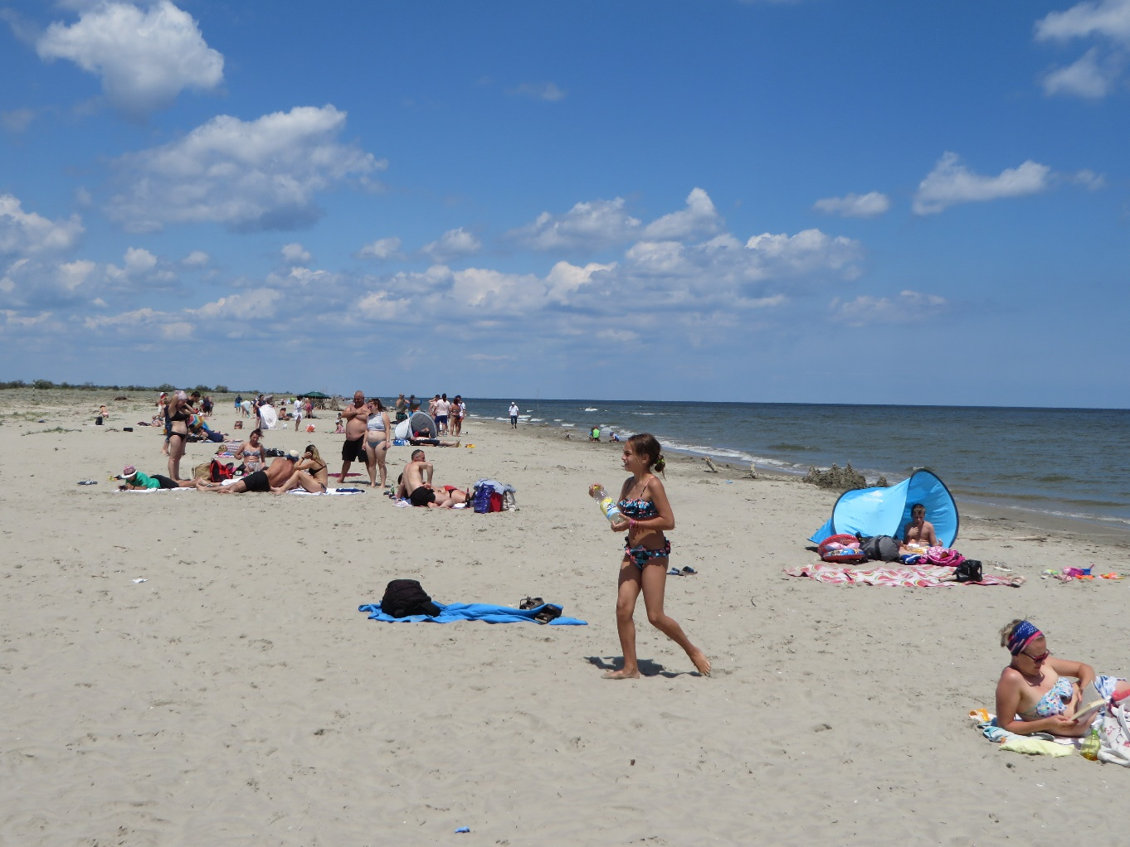
Letea village (left top)
Black Sea coast at St. Georghe (left bottom)
Former headquarter of the European Danube Commission (right)

Slide 11
Staff and Finances:
Number of staff less than the defined maximum
1 headquarter, 7 field posts, 6 visitor centres
High turn-over of the governors (directors); no continuity
High variation in the budget, which comes from the State and from project funds
Tendency to substitute regular budget through project funds

Slide 12
Selected recommendations 2010 (no condition):
(1) Coordinate the management of DD with Moldova and Ukraine
(3) Monitor ecological and socio-economic services in the reserve
(4) monitor potential external threats (e.g. Bystroe canal)
(6) better management of fishery resources for local people
(7) inform the public about access of boats to vulnerable parts
(9) Restauration programm of buildings to be continued (material)
(10) External review of the DDBR Conservation Strategy to be organised
(12) Adoption of the legal framework should be accelerated
(13) carefully analyse the request for new wind farms close to the reserve

Slide 13
Recommendations 2019 (no condition):
1. When the ban on sturgeon fishing ends, to implement a monitoring system to assess the development of the sturgeon population in the Delta.
2. The responsible Ministry to raise the number of staff to the maximum limit foreseen to enable efficient work and add part-time contracts whenever needed for additional projects.
3. To secure a basic budget for the DDBRA to sufficiently fulfill the administrative tasks of the authority and allocate projecto funds fully to the project itself.
4. The responsible authorities to work out a master plan for wind farms in the perimeter of the protected area to prevent any impact on the bird life in the Danube Delta and consider the participation of the DDBRA in this process

Slide 14
Recommendations 2019 (no condition):
5. To evaluate the rising number of permits for car and boat traffic and public access and define a maximum number of permits, which should only be exceeded under exceptional circumstances.
6. To review the appointment system for the management/Governor with regard to a minimum length of a working period to enable the managers to develop and guide mid- and long-term strategies for the further development of the DDBR.
7. To make intensive use of the European Diploma logo and explain the relevance of the Diploma in the information centres and in all information material provided to the tourist sector (boat excursions, accommodations, etc.).

Slide 15
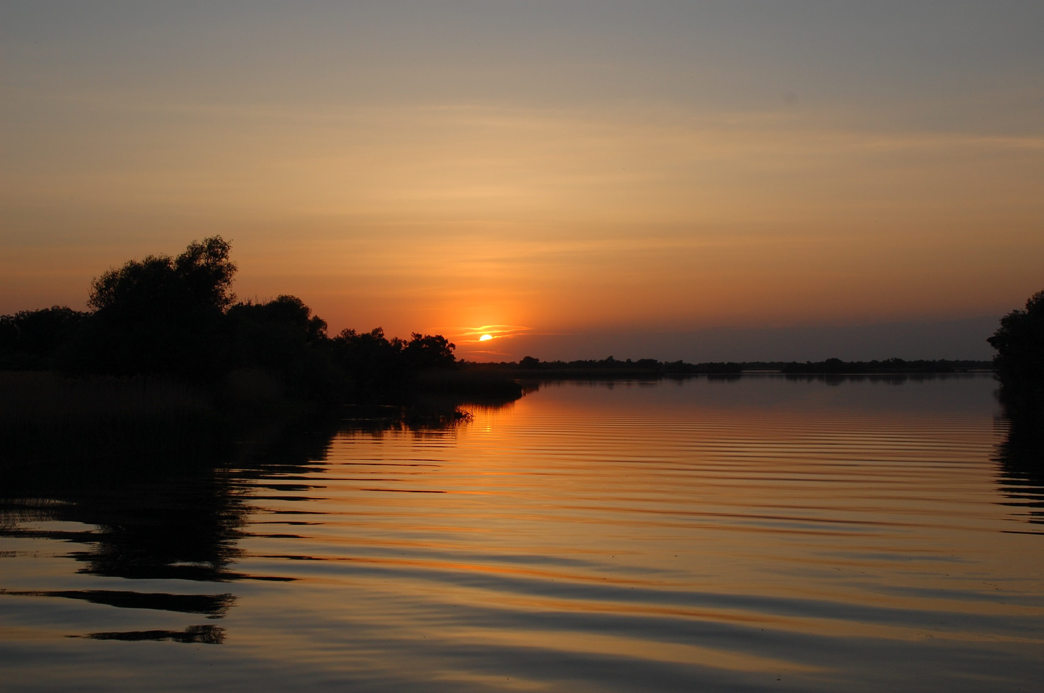
It is recommendes to renew the European Diploma for the Danube Delta Biosphere Reserve for the period 2020 – 2030, taking into consideration the above mentioned recommendations.
Robert Brunner
Photos Courtesy of Danube Delta Biosphere Authority

