Slide 1
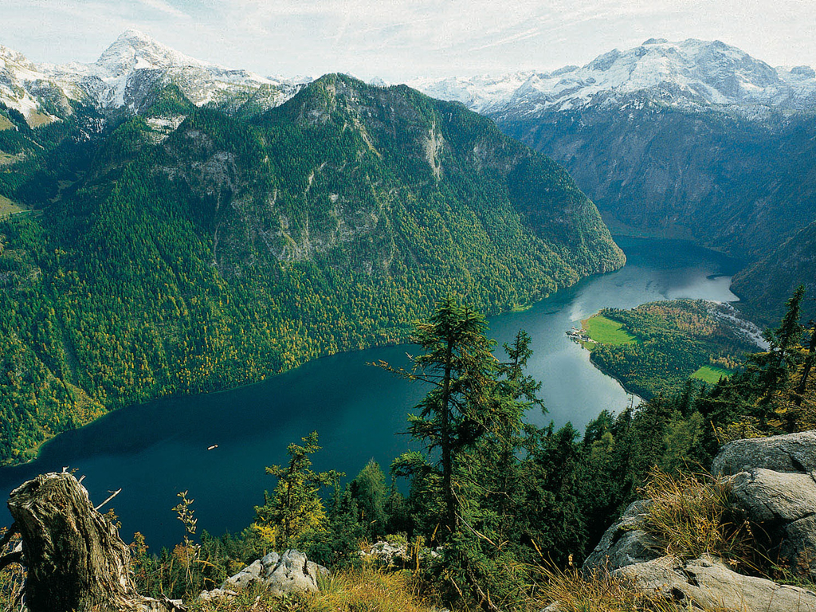
Nationalpark Berchtesgaden
21 – 23 October 2019

Slide 2
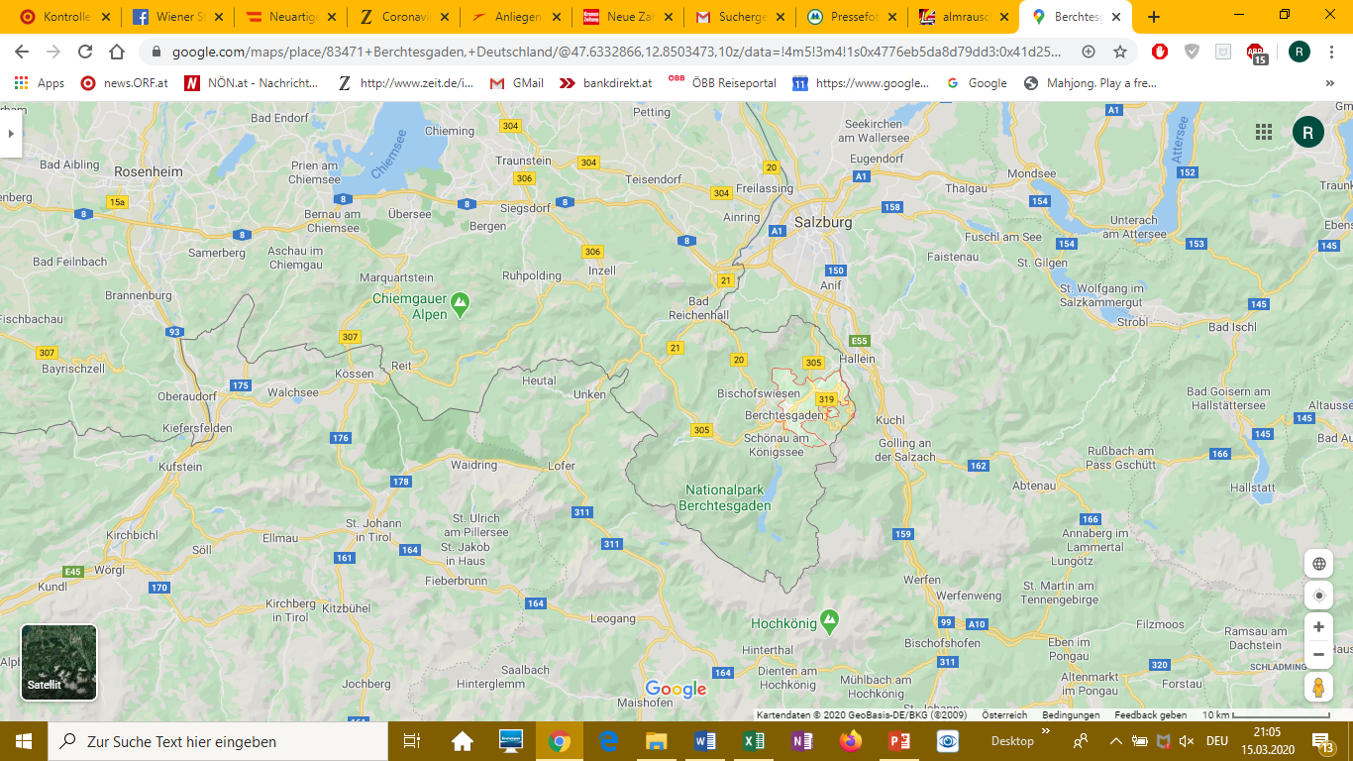
Facts:

Slide 3
Facts:
Founded 1978, National Park, IUCN category II
Size 20 808 hectars
Highest peak Watzmann (2713 m), vertical gradient 2300 m
44 % forest, 21 % alpine grassland, 19 % rocks
Zoning: 75 % core zone (non intervention), 25 % managemant zone
Main tourist attraction: Königssee with the hamlet St. Bartholomä
Biosphere reserve (46 000 ha) with the NP as core and buffer zone
Natura 2000 nomination
The adjoining Austrian border area designated as nature reserve

Slide 4
Fauna and Flora:
About 50 mammal species, high population of roe & red deer and chamois
100 breeding, 40 migrating bird species
Ibex eradicated, but reintroduced
Otter (lutra lutra) has resettled
Large carnivores extinct mid 19th century
No reintroduction of large carnivores
Up to 700 m beech forest dominates
Up to 1400 m mixed mountain forest
From 16 century exploitation of forests for firewood and stingers for the saltmines

Slide 5
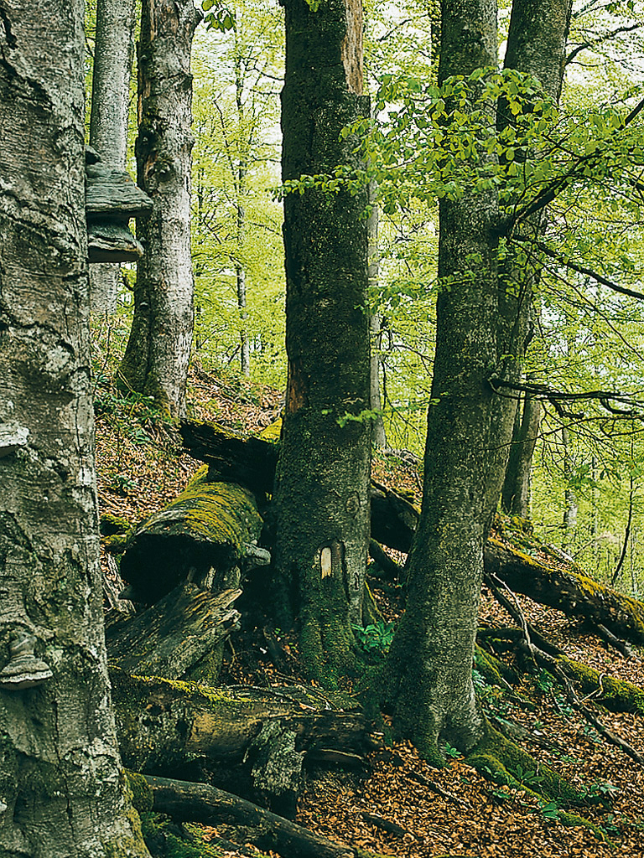
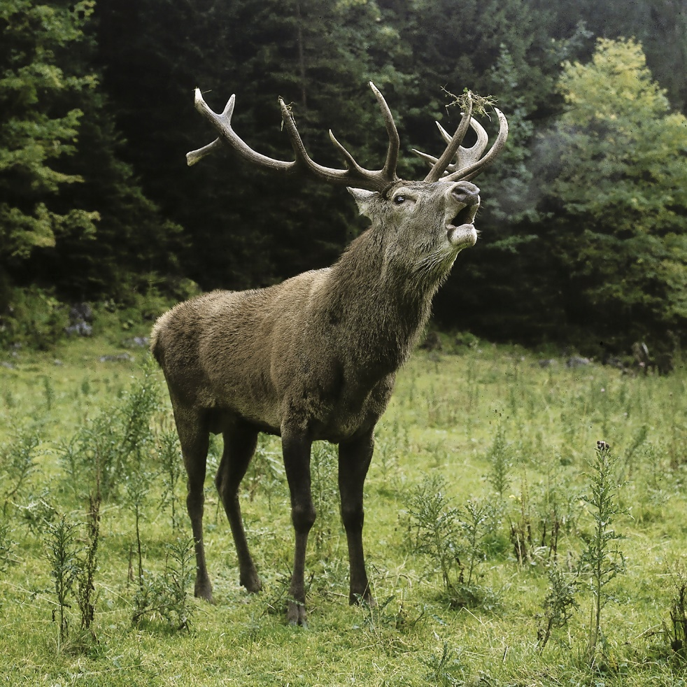
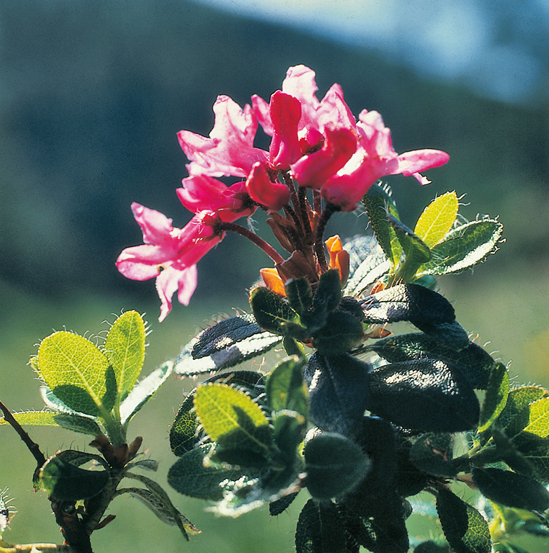
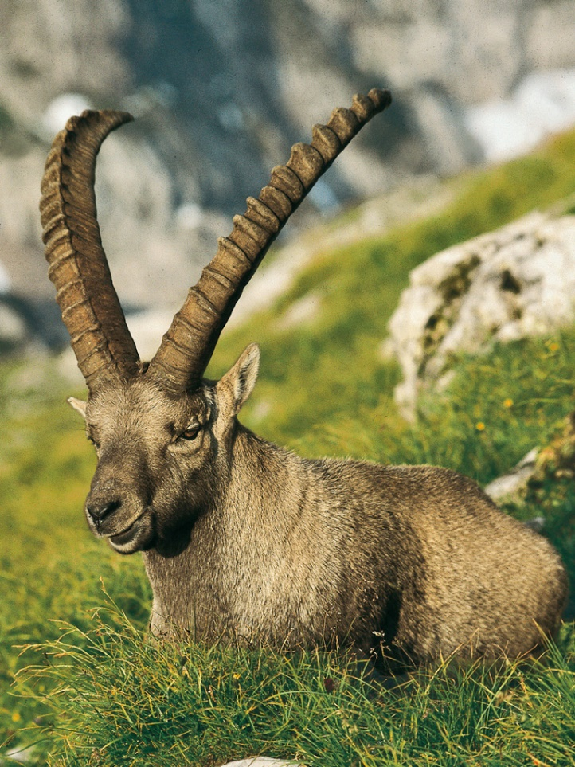
Clockwise:
Deciduous forest
Roe deer
Ibex
Alpine rose

Slide 6
Boundaries, zoning and management:
Integration of the temporary management zone into the core zone
Transition zone of the biosphere reserve = buffer zone
Management zone includes bark beetle control zone (1260 ha)
80 % of management zone are forests
2/3 of the boundary = state border to Austria (see map next slide)
No current management plan (current MP 2001 to 2010)
Management plan for the National Park and for the Natura 2000 site under preparation

Slide 7
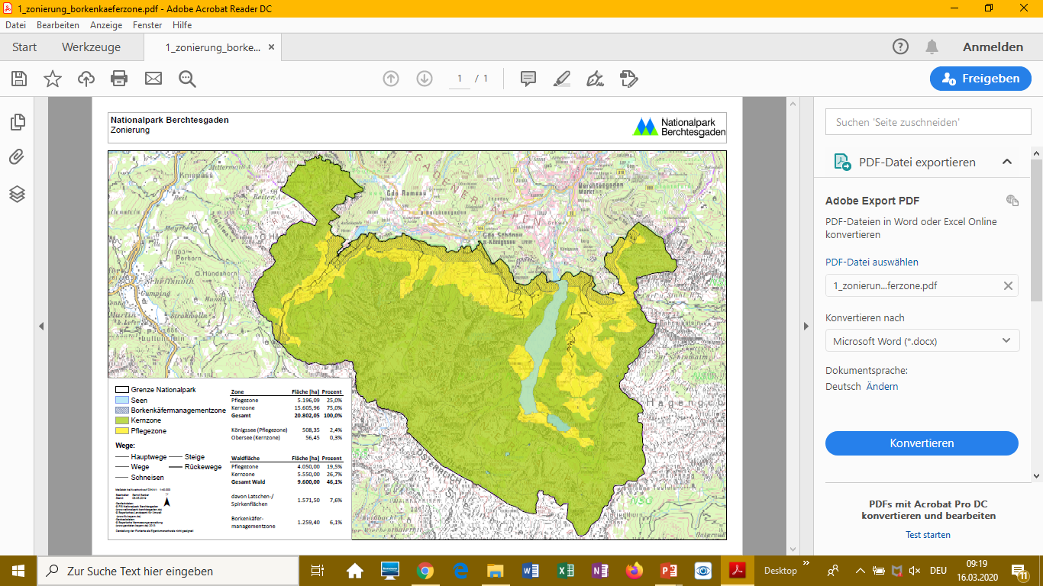
Boundaries and zoning:

Slide 8
Human occupation:
Within the park a police training centre was establish in the 1970ies
Enlargement under consideration (unconfirmed)
Extension would require aaditional (technical) infrastructure
Disturbance through noise and traffic
No mandatory argument to have it within the park
Several mountains huts within the park boundaries
Enlargement stopped for review
New sewage system and water pipe opposed by the park administration

Slide 9
Uses and socio-economic activities:
Grazing:
A number of forest pastures replaced by light pastures
Hunting:
A high number of roe and red deer demands human intervention
Winter enclosures in the management zone to reduce bark stripping
Fishing:
1 license for commercial fishery in the Königssee
Fish stock from local breeds only
Population of lake trout decreasing, reasons unknown

Slide 10
Other facts
Human resources and finances:
With the „Haus der Berge“ visitor centre the number of staff is on minimum level (74 persons in 2019)
Annual budget 2019 € 8.2 Mio, annual increase since 2005 3 %
Research:
A specific cooperation started with the Technical University Munich
Involvment of the public;
Advisory board (40 members) under the chairmanship of minister

Slide 11
2010 recommendations
Most of the 2010 recommendations can be considered as fullfilled
The management plan is delayed but in a final stage now
(3) Sectoral plans for various topics will be represented in the MP
(4) The temporary management zone is integrated and
(5) the bark beetle control secured without enlarging the zone
(6) The strategy for natural return of large carnivores follows the Bavarian strategy (no resettlement))
(9) Public transport is improved and promoted but could not fully change the tourists‘ behaviour

Slide 12
2019 condition (1)
Accelerate the finalisation of the management plan currently in preparation and attach a scientific research programme to it. The Council of Europe shall be informed upon completion and approval of the document, which should be effective no later than 18 months after the renewal of the Diploma.

Slide 13
2019 recommendations (11)
Include in the management plan currently in preparation specific provisions dedicated to climate change and how to address this issue in relation to the long-term conservation of rare species.
Abstain from any extension of forest and mountain roads and consider dismantling roads as well as abstain from additional infrastructure in the Park, including waste water pipes. If no alternative solution exists, infrastructure shall be built in existing forest roads;
Continue negotiating the replacement of forest grazing by light grazing
Search together with the competent authorities for alternatives for the police training centre, or at least abstain from further expansions, and continue negotiations with the army to reduce the impacts of the army training ground to a minimum;

Slide 14
2019 recommendations (11) cont.
5. Conduct a scientific study on the red deer population and game regulation, including the plausibility of winter enclosures to gain enough data for the future management;
6. Conduct a study on invasive species and develop a strategy on how to react in the face of invasive species
7. Maintain the competency of hunting authority to the park administration at regional level;
8. Secure an adequate budget and staffing for the park administration to enable an effective and efficient management
9. Limit the spotlights of the Jenner cable car to reduce light pollution and consider the construction of a path accessible for people with disabilities and a viewpoint next to the mountain station of the Jenner cable car;

Slide 15
2019 recommendations (11) cont.
10. Pursue consequently the conversion of spruce forests into mixed forests, using natural processes and disturbances e.g. bark beetle and wind fall areas as foreseen in the new conceptual framework, without enlargement of the bark beetle control zone.
11. Make more intensive use of the European Diploma logo in all information material and brochures, and explain the relevance of the Diploma wherever appropriate, first of all in the visitors’ centre and on the website.

Slide 16
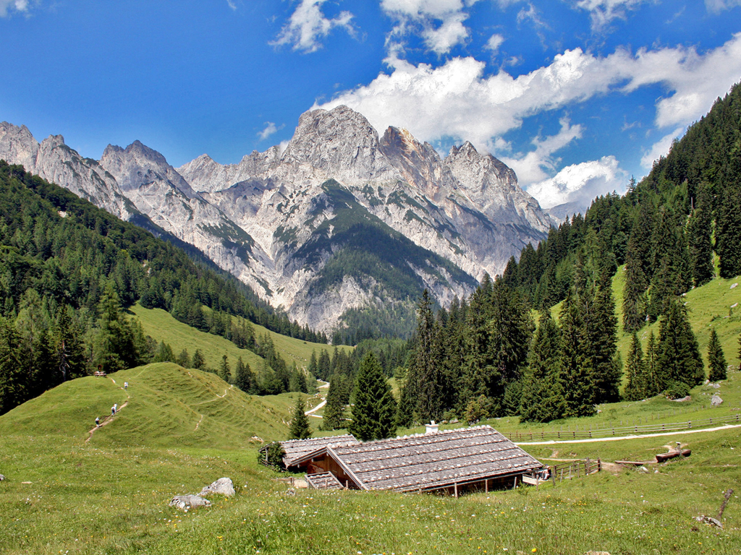
With consideration of the listed condition and recommendations I advocate the renewal of the European Diploma to the National Berchtesgaden for the period 2020 to 2030
Robert Brunner
Photos courtesy of
National Park Berchtesgaden

