Slide 1
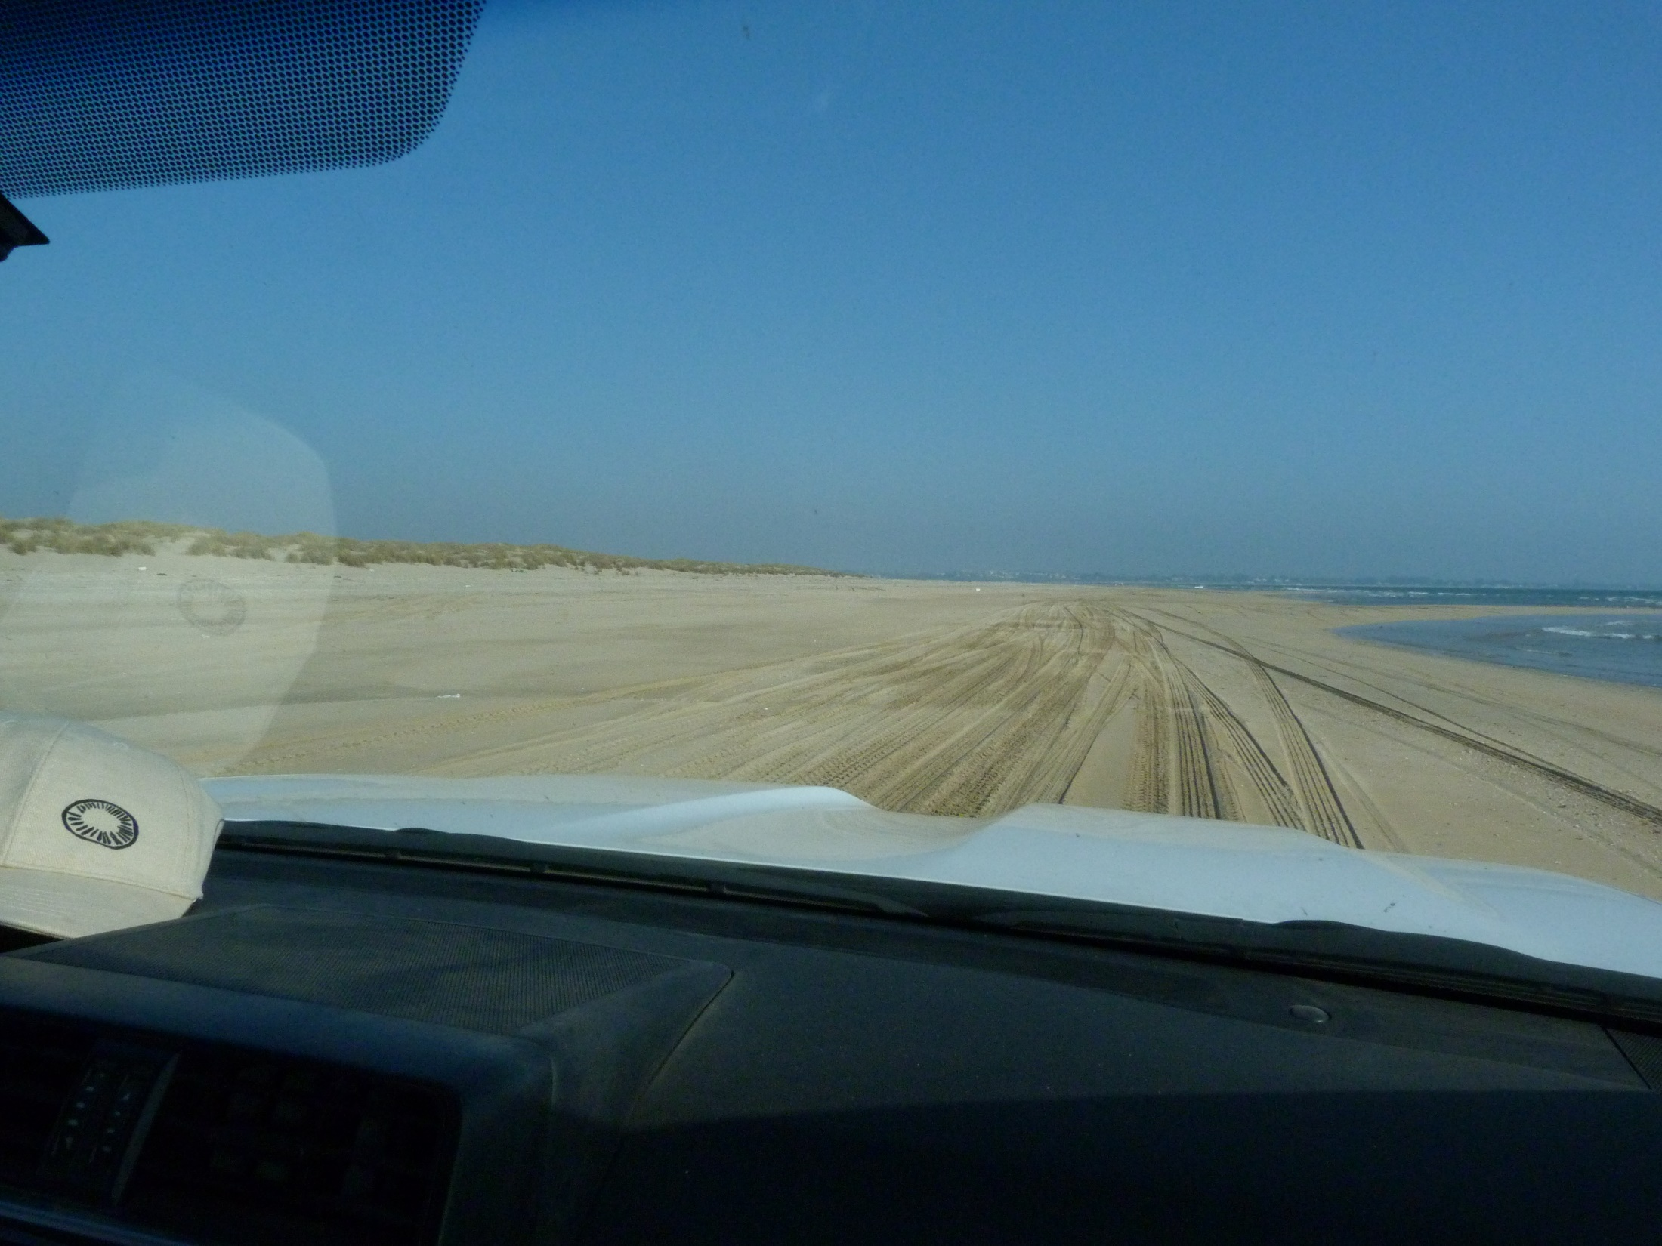

Slide 2
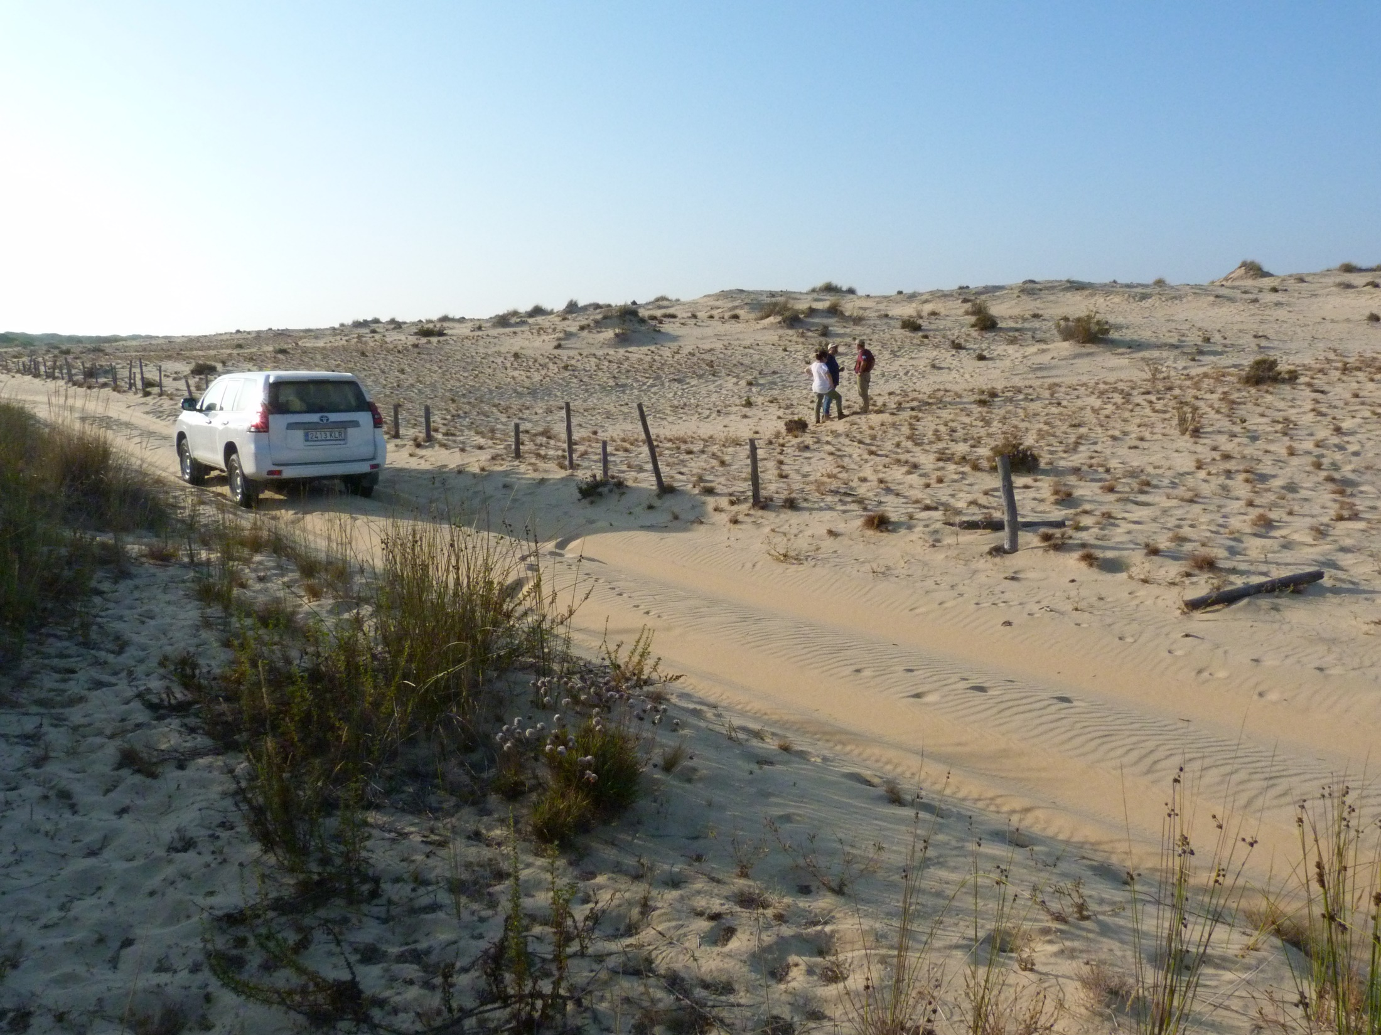

Slide 3
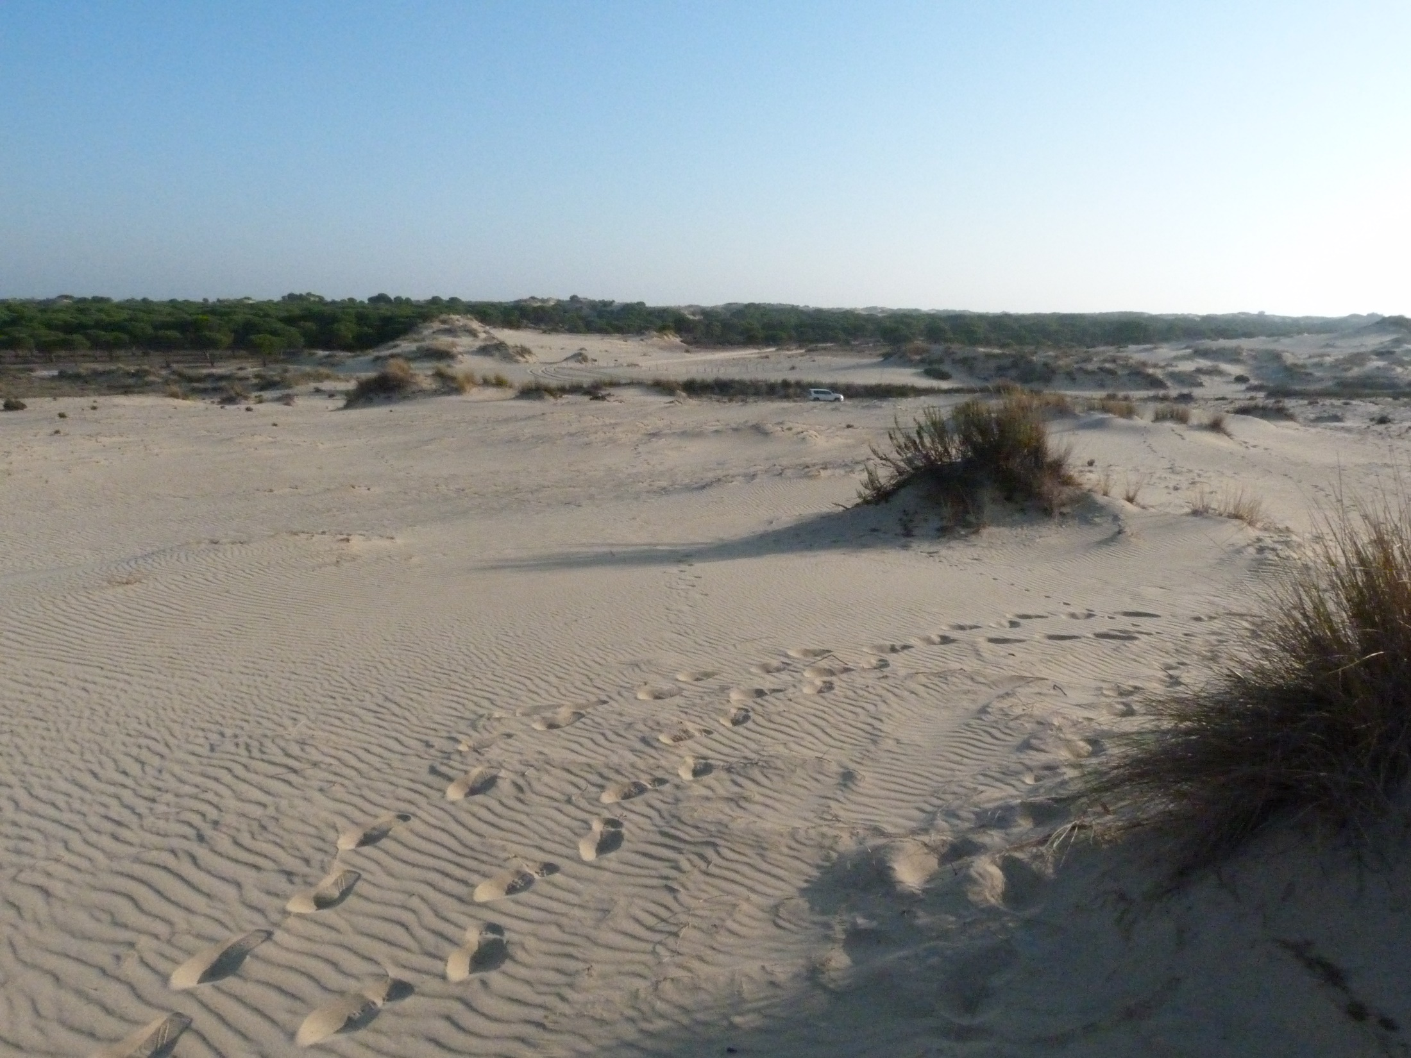
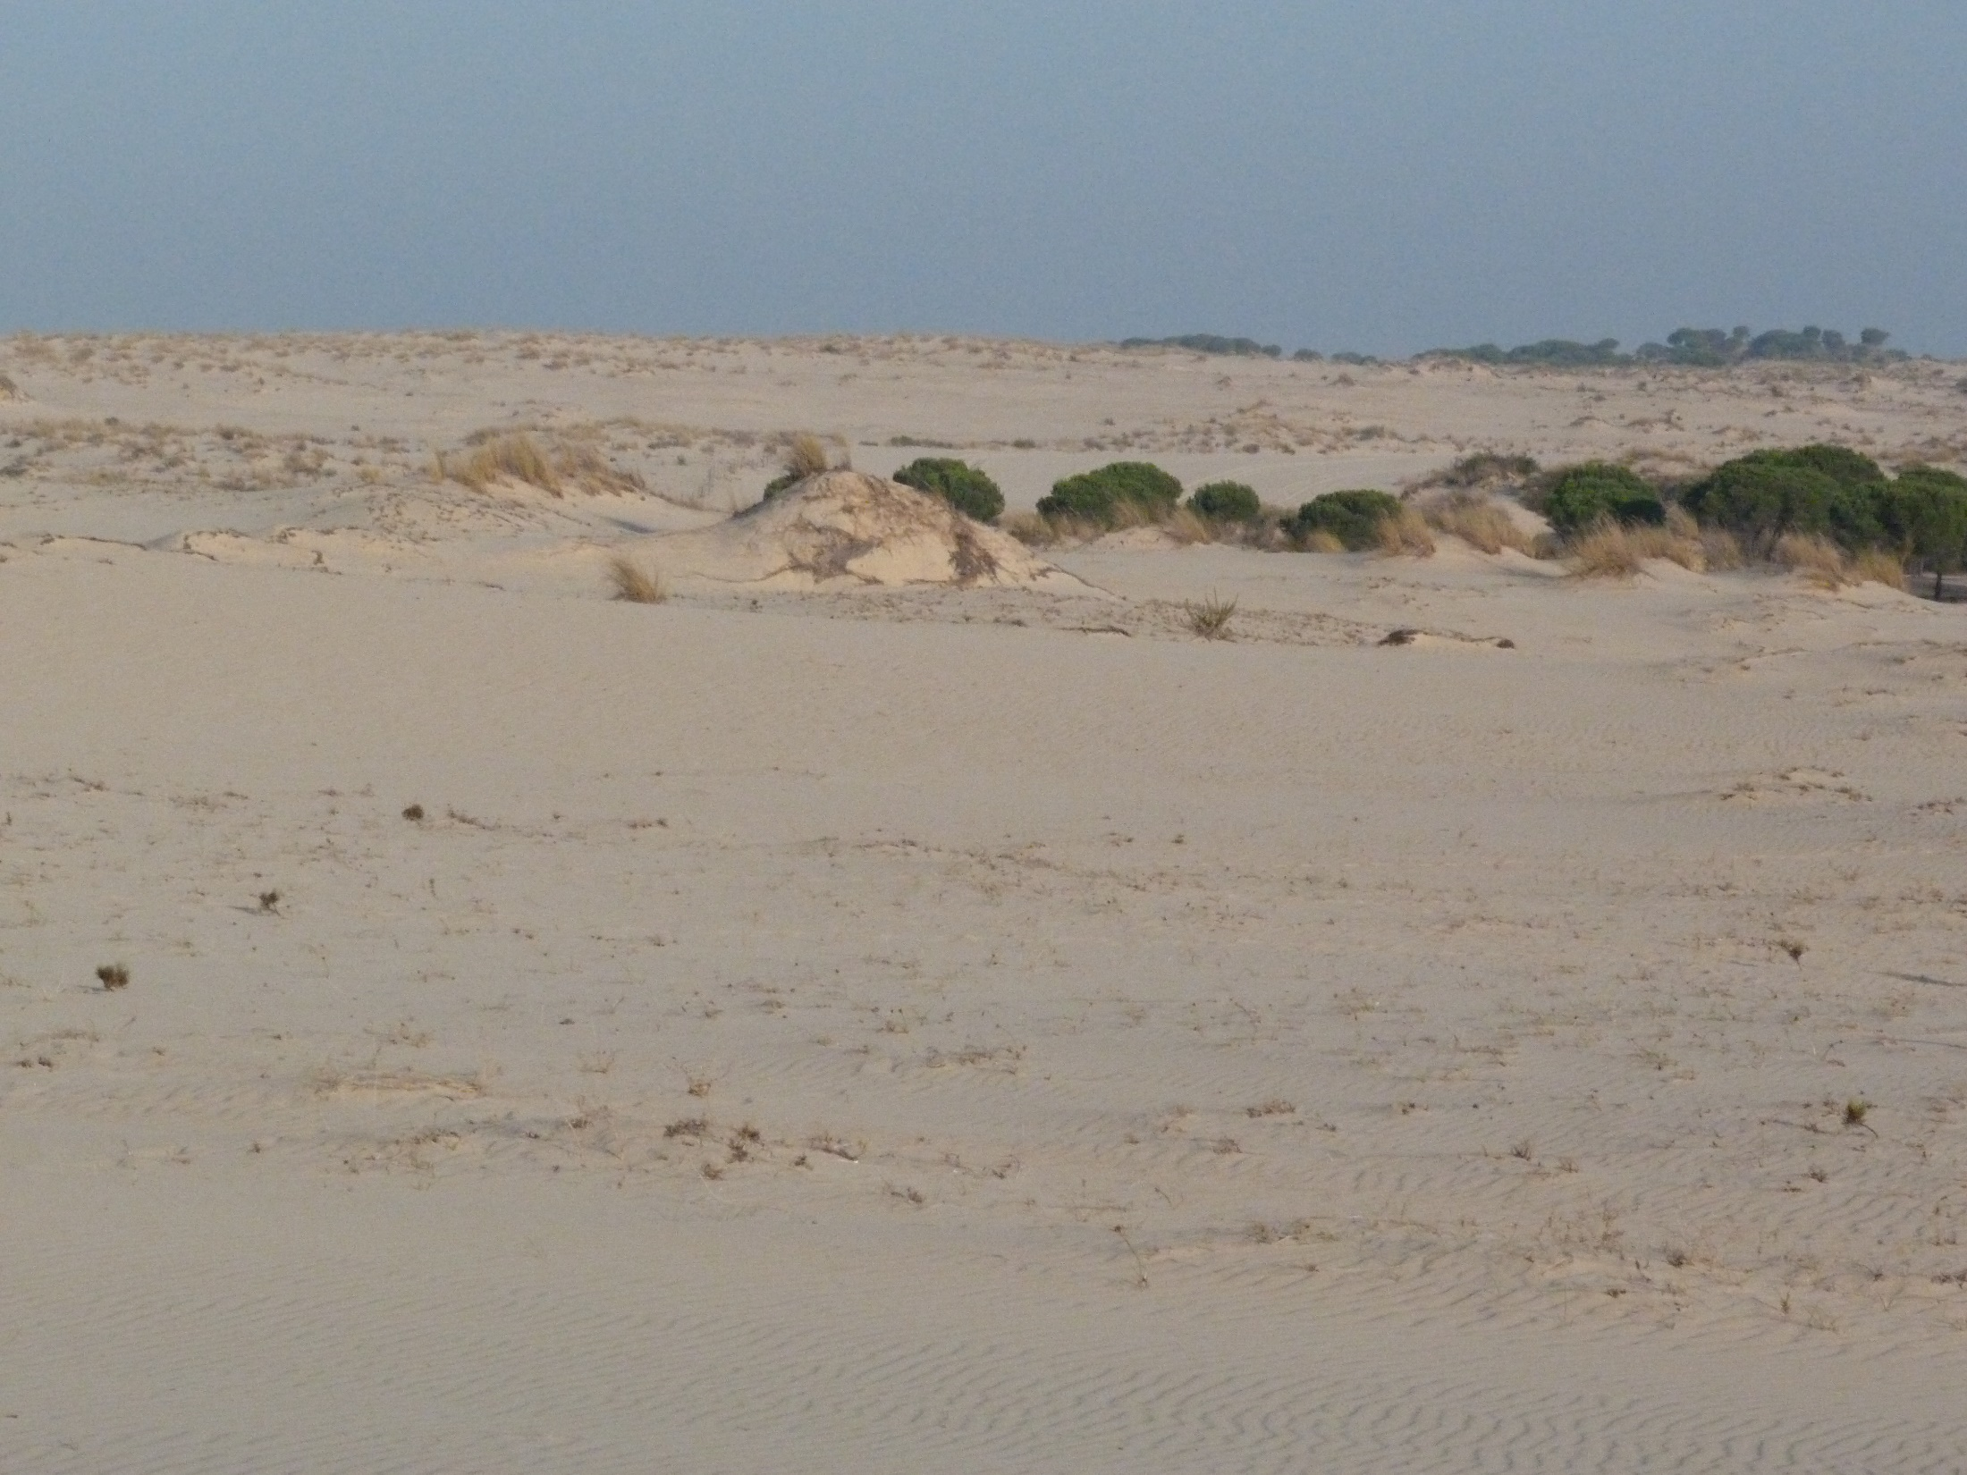

Slide 4
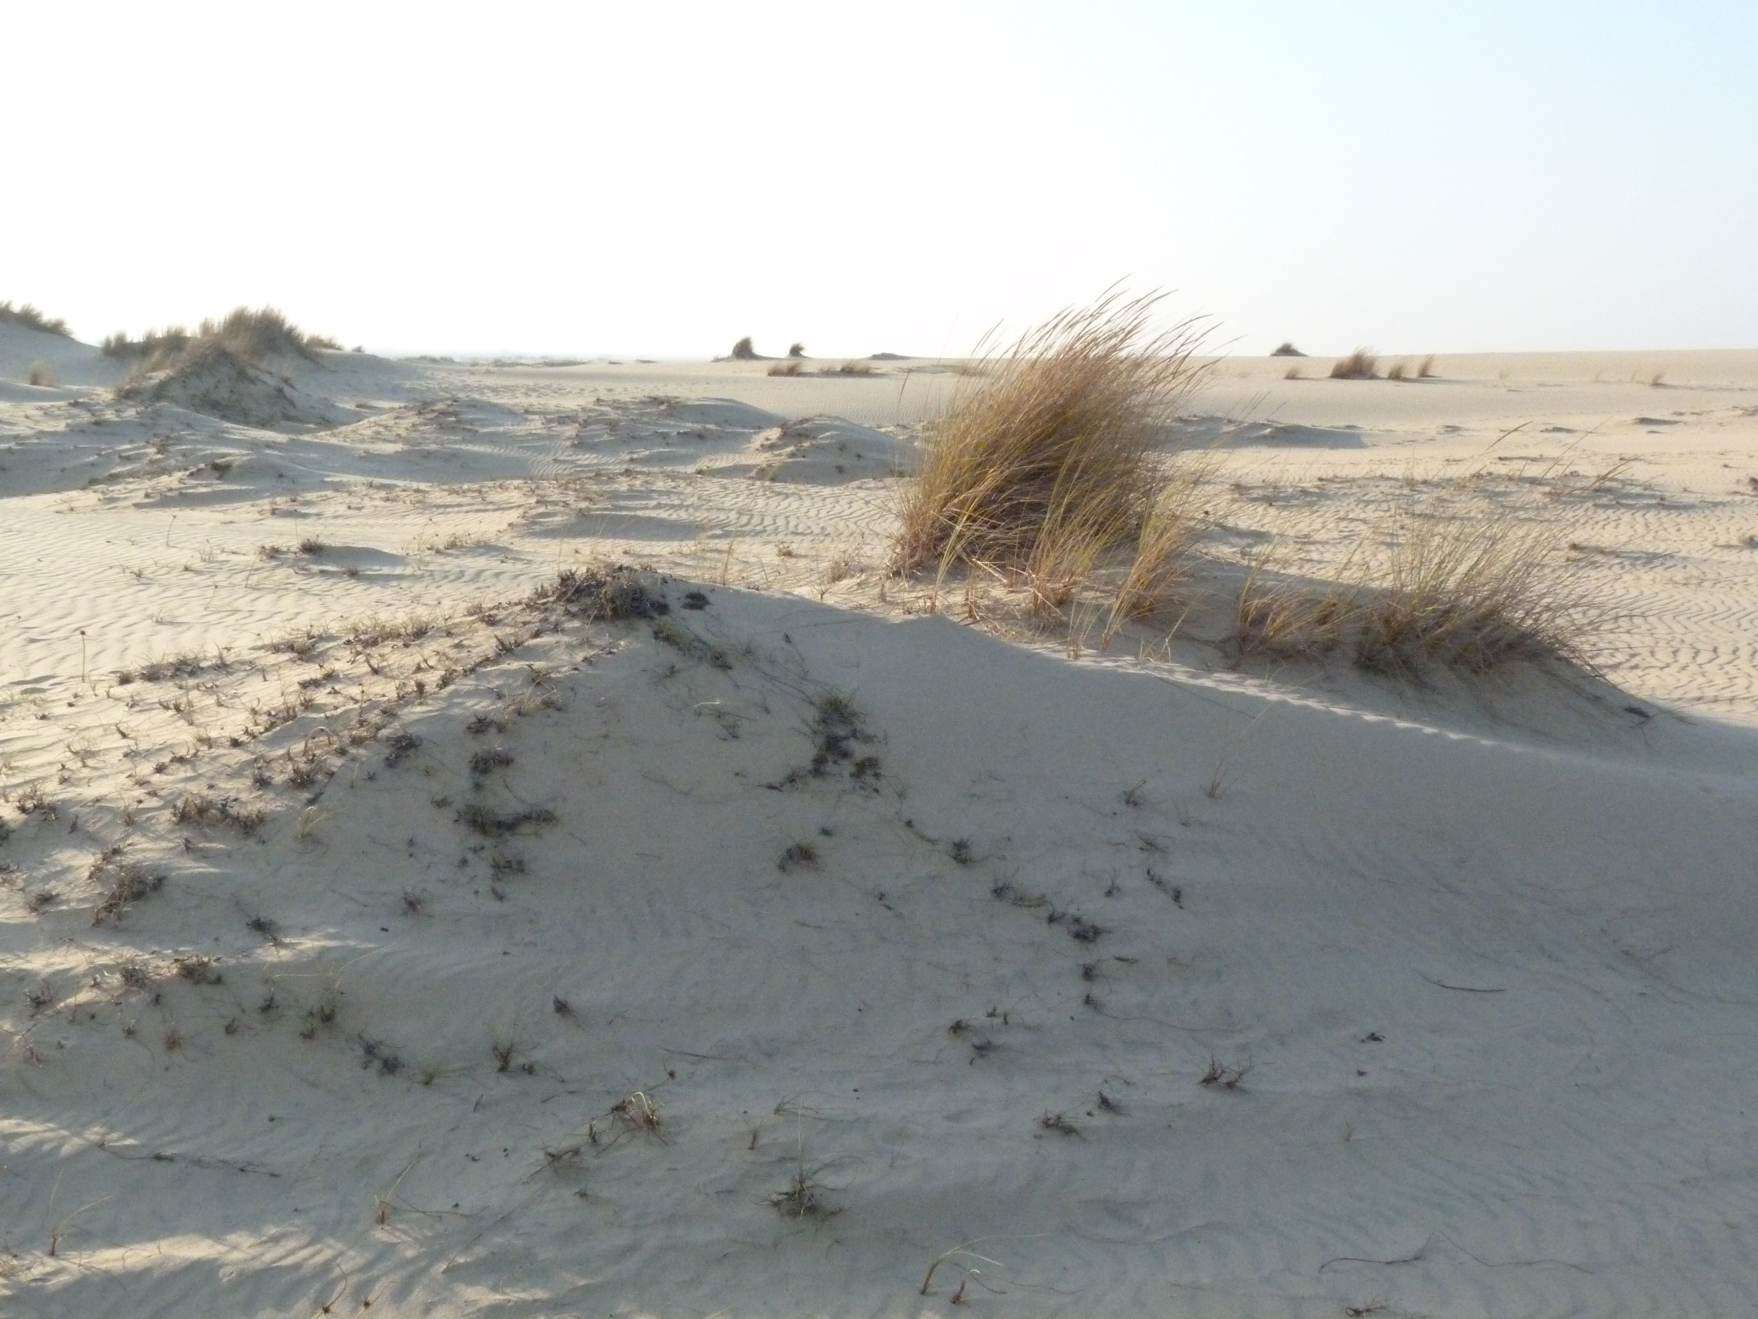

Slide 5
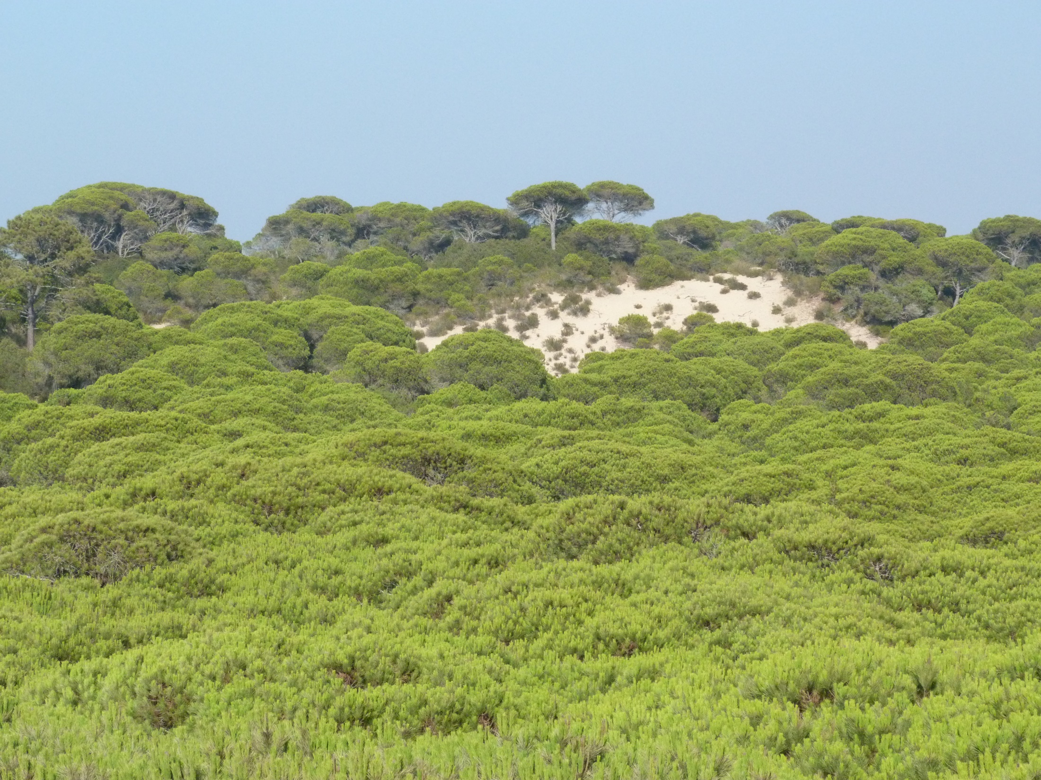

Slide 6
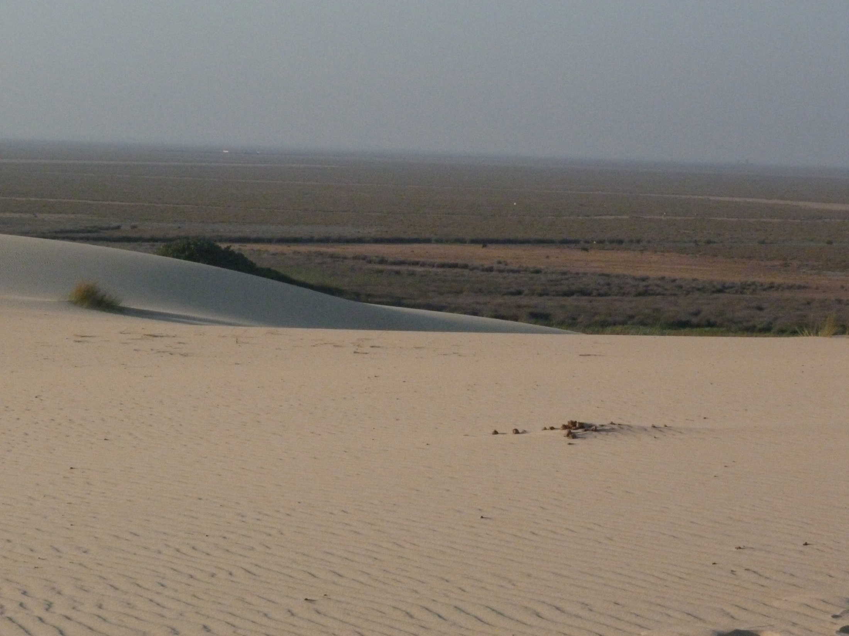

Slide 7
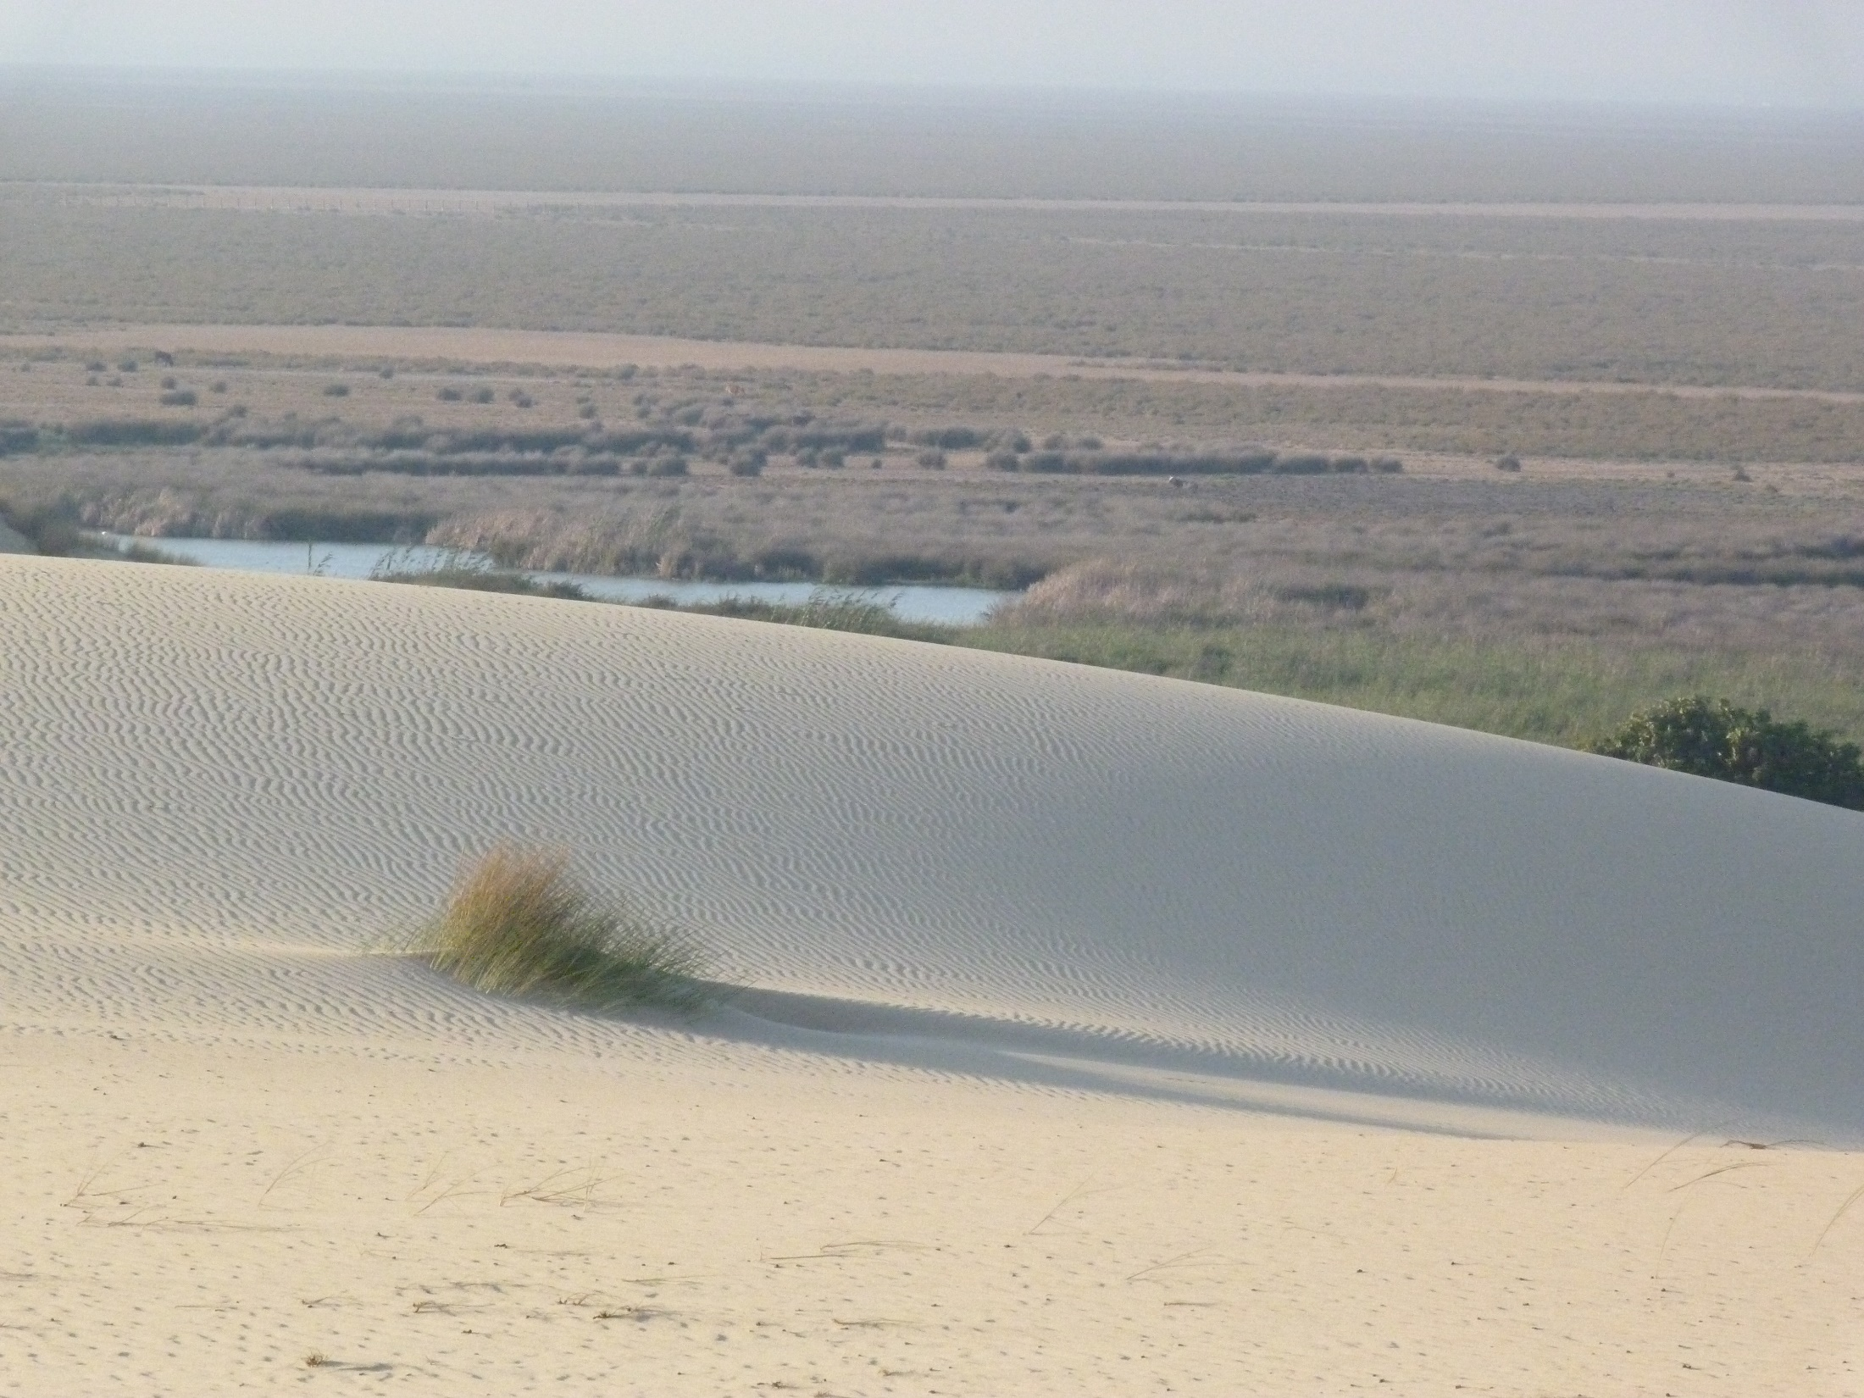

Slide 8
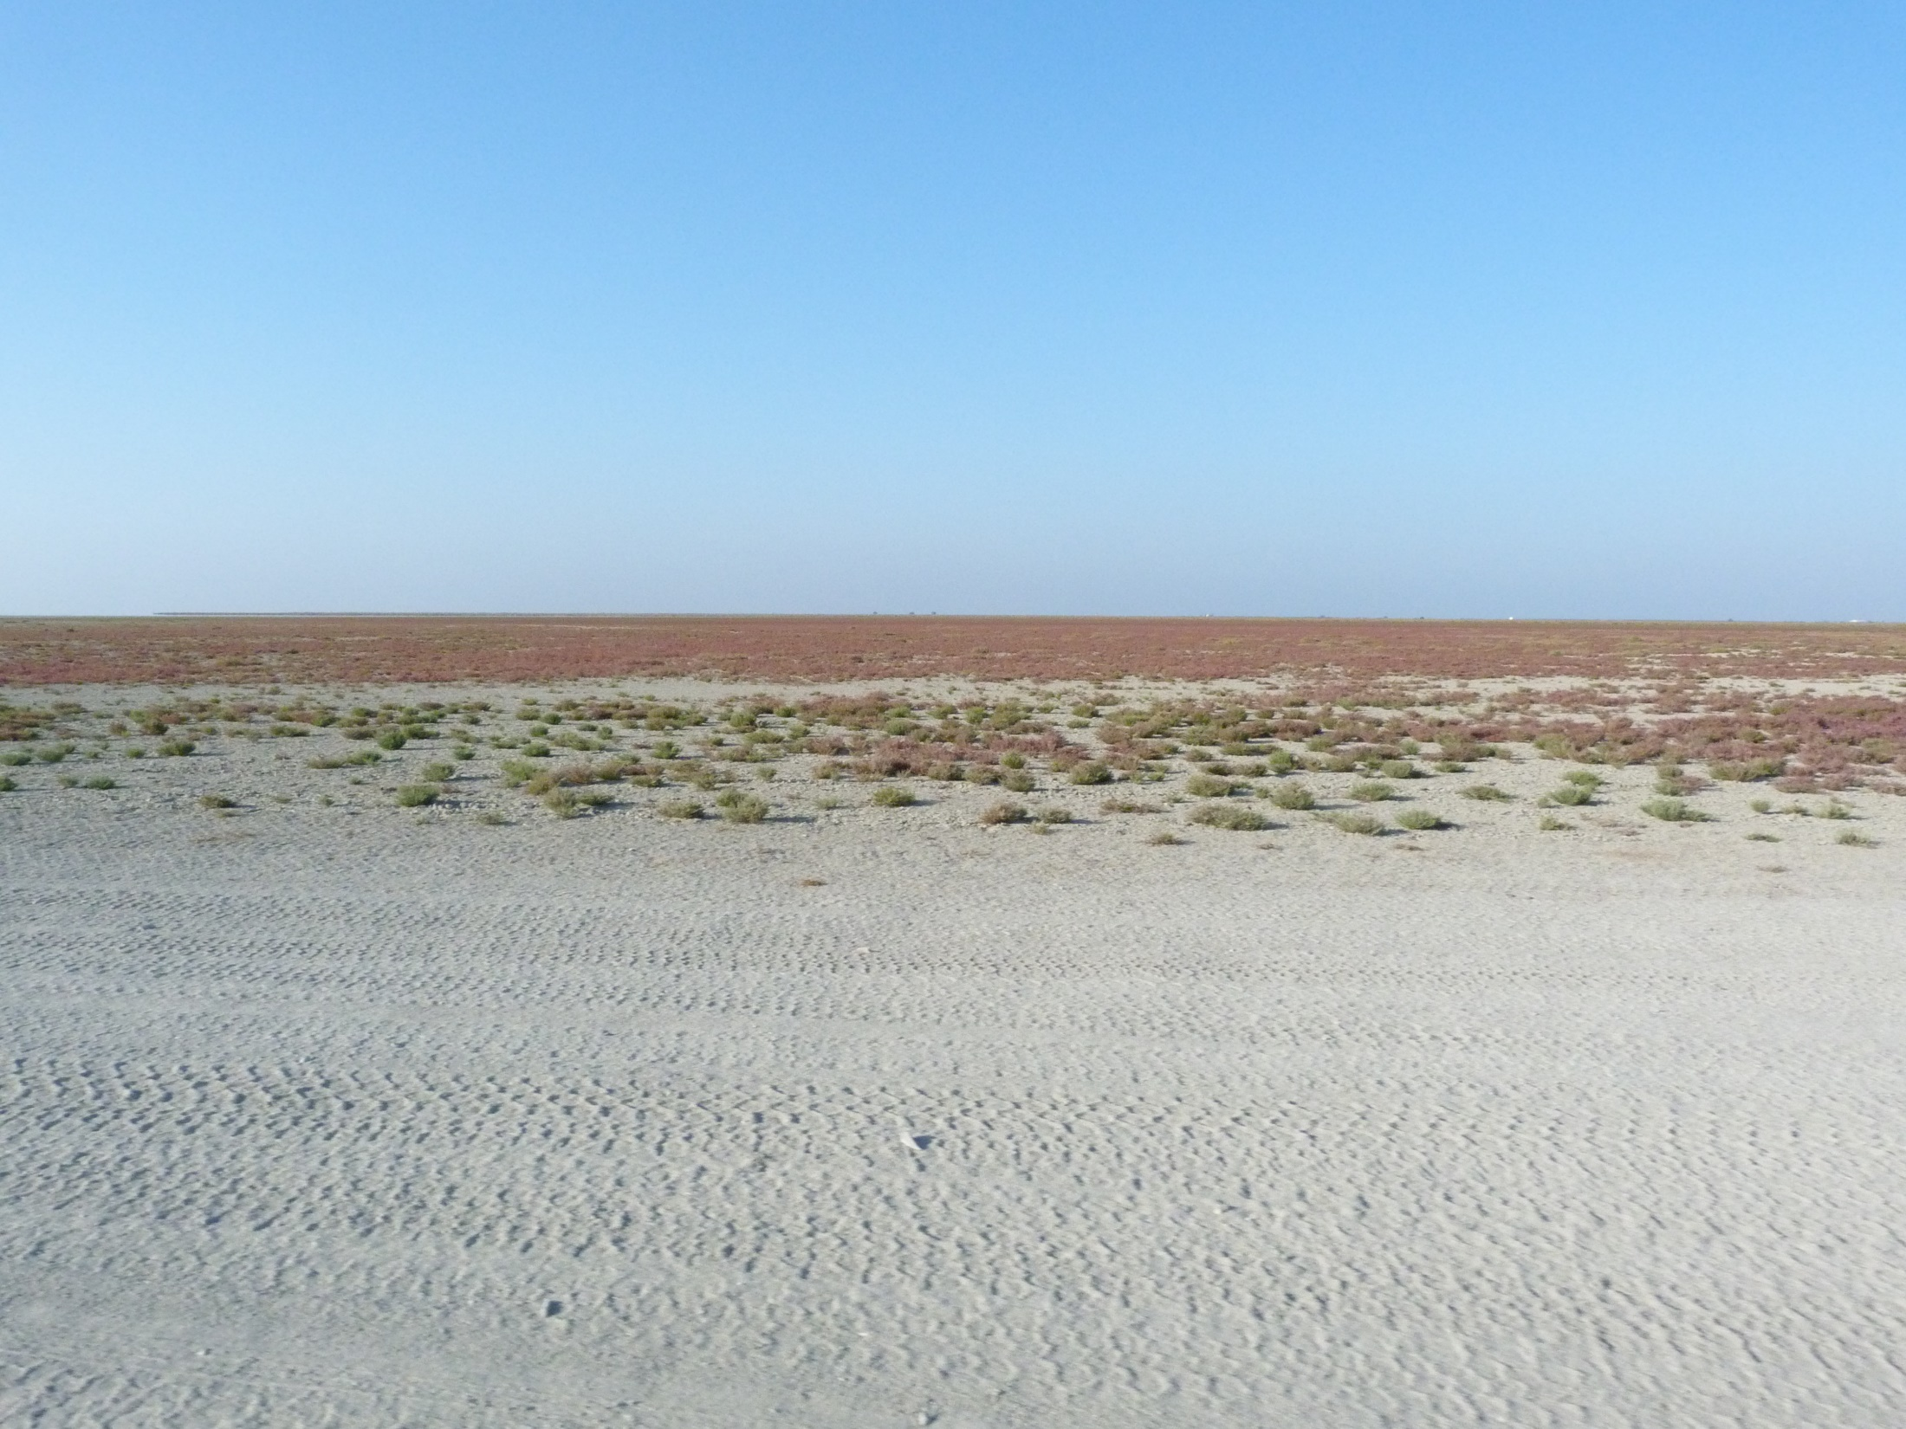

Slide 9
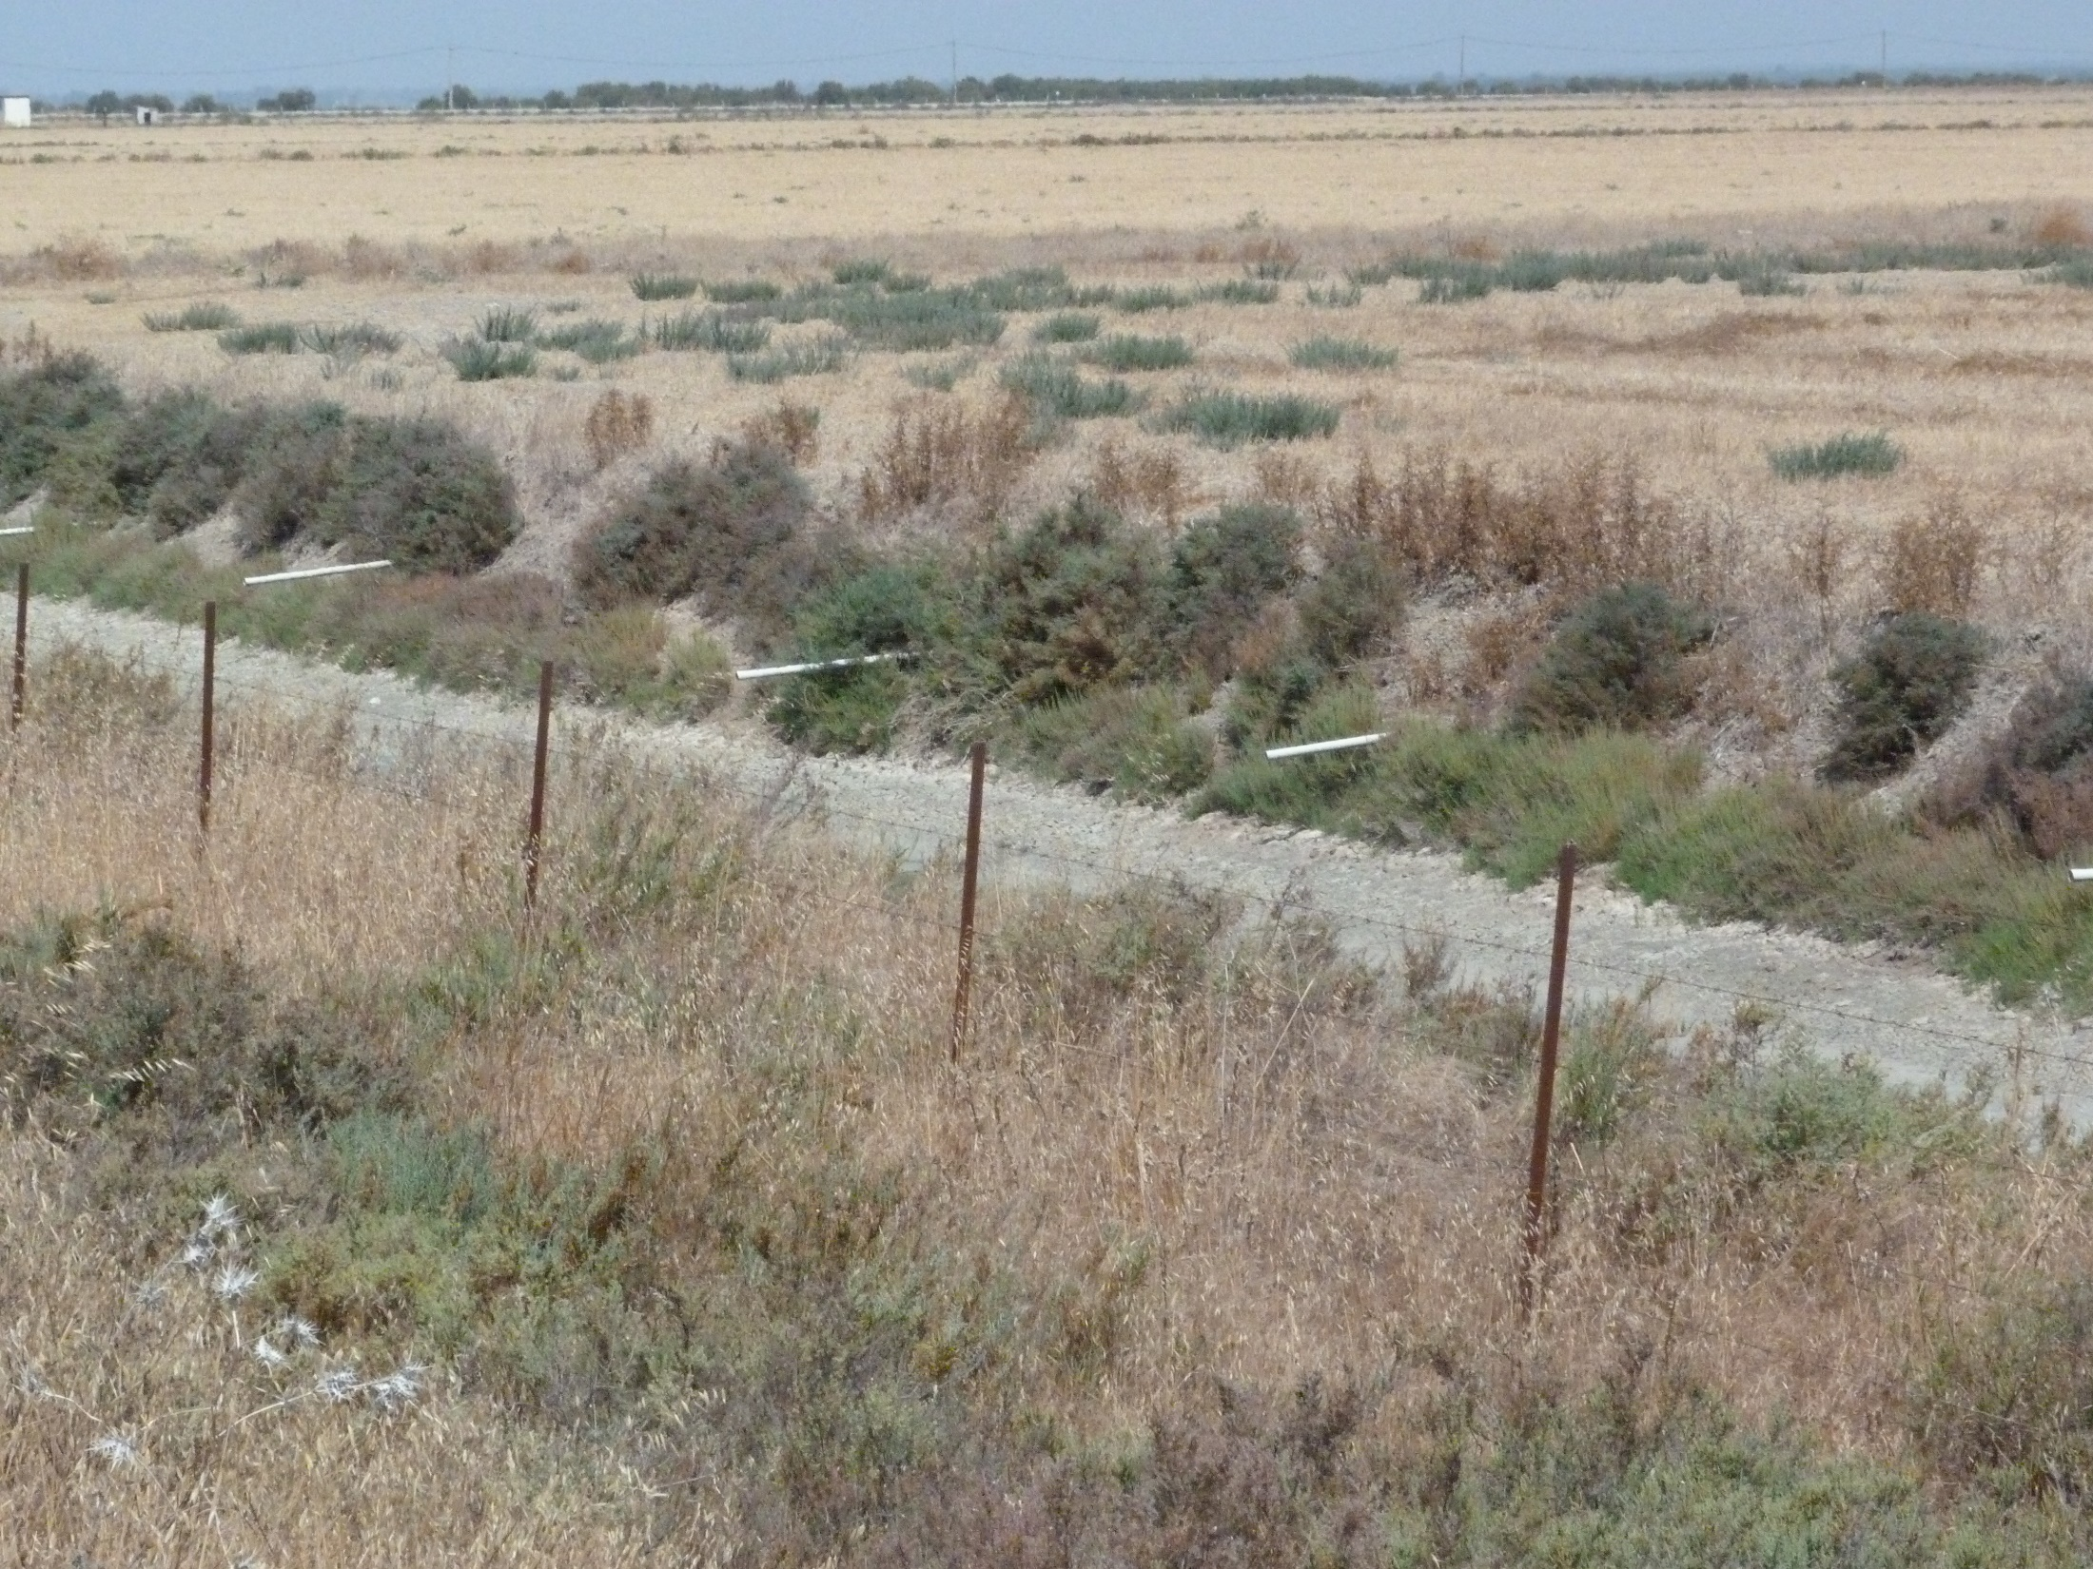

Slide 10
Proposed recommendations:
1. Continue to monitor the identified risks of possible damages to Doñana from known sources in the closer and wider surroundings of the Espacio Doñana (agriculture, urbanisation development of infrastructure), potential risks (from Pyrit mine at Aznalcóllar or other mining activities, Port of Seville, gas storage, military projects) as well as from climate change;

Slide 11
2. Watch closely the results of the monitoring of the quantity and quality of ground and surface water in Doñana with the aim of evaluating whether the implementation of the Plan Especial de Ordenación de Regadíos” (PEORNCFD) adequately follows the conclusions from the water monitoring;

Slide 12
3. Pursue the projects leading to a better conservation of ecosystems within the Espacio Doñana, in particular through the implementation of the management plan (PRUG);

Slide 13
4. Continue implementing the action plans for threatened species (in particular for the Lynx and the Imperial Eagle, including the recovery or reinforcement of the rabbit population) and develop and implement further action plans as needed for other species (including Marble Teal, Red Kite and Dragonflies Odonata);

Slide 14
5. Inform the Council of Europe on all these issues in each yearly report;

Slide 15
6. Advertise for the European Diploma wherever possible and sensible with its logo.

