Slide 1
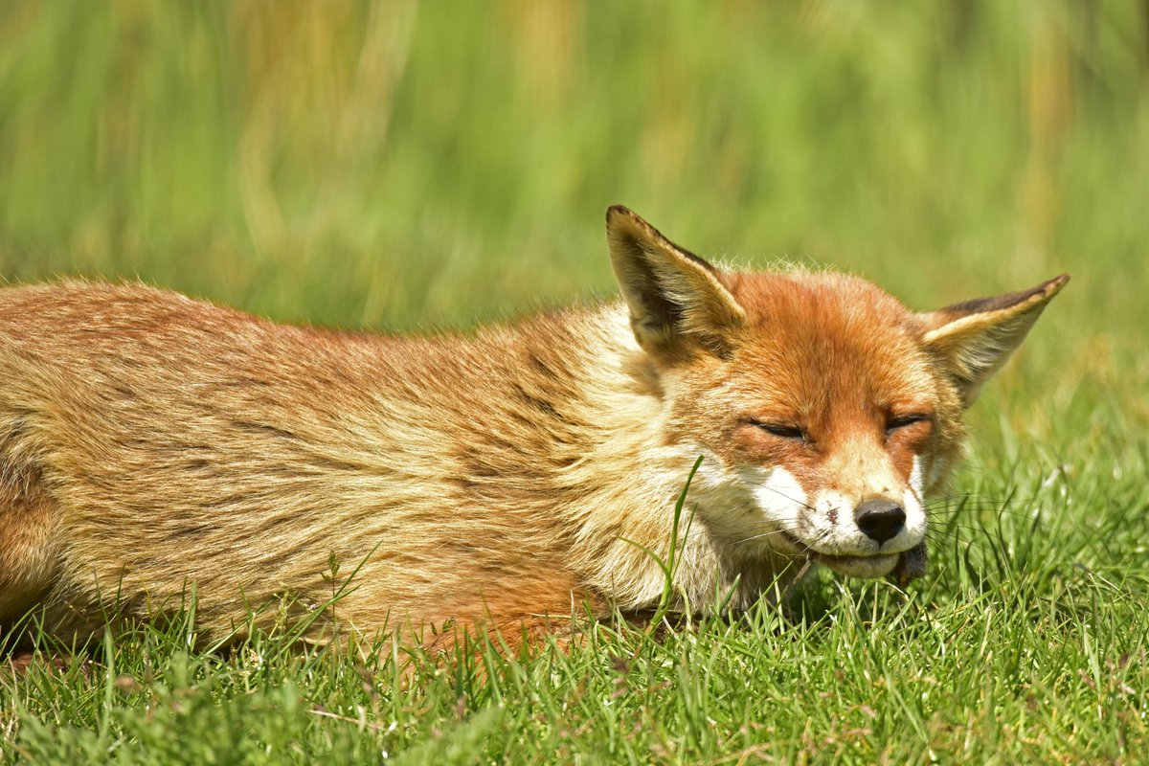
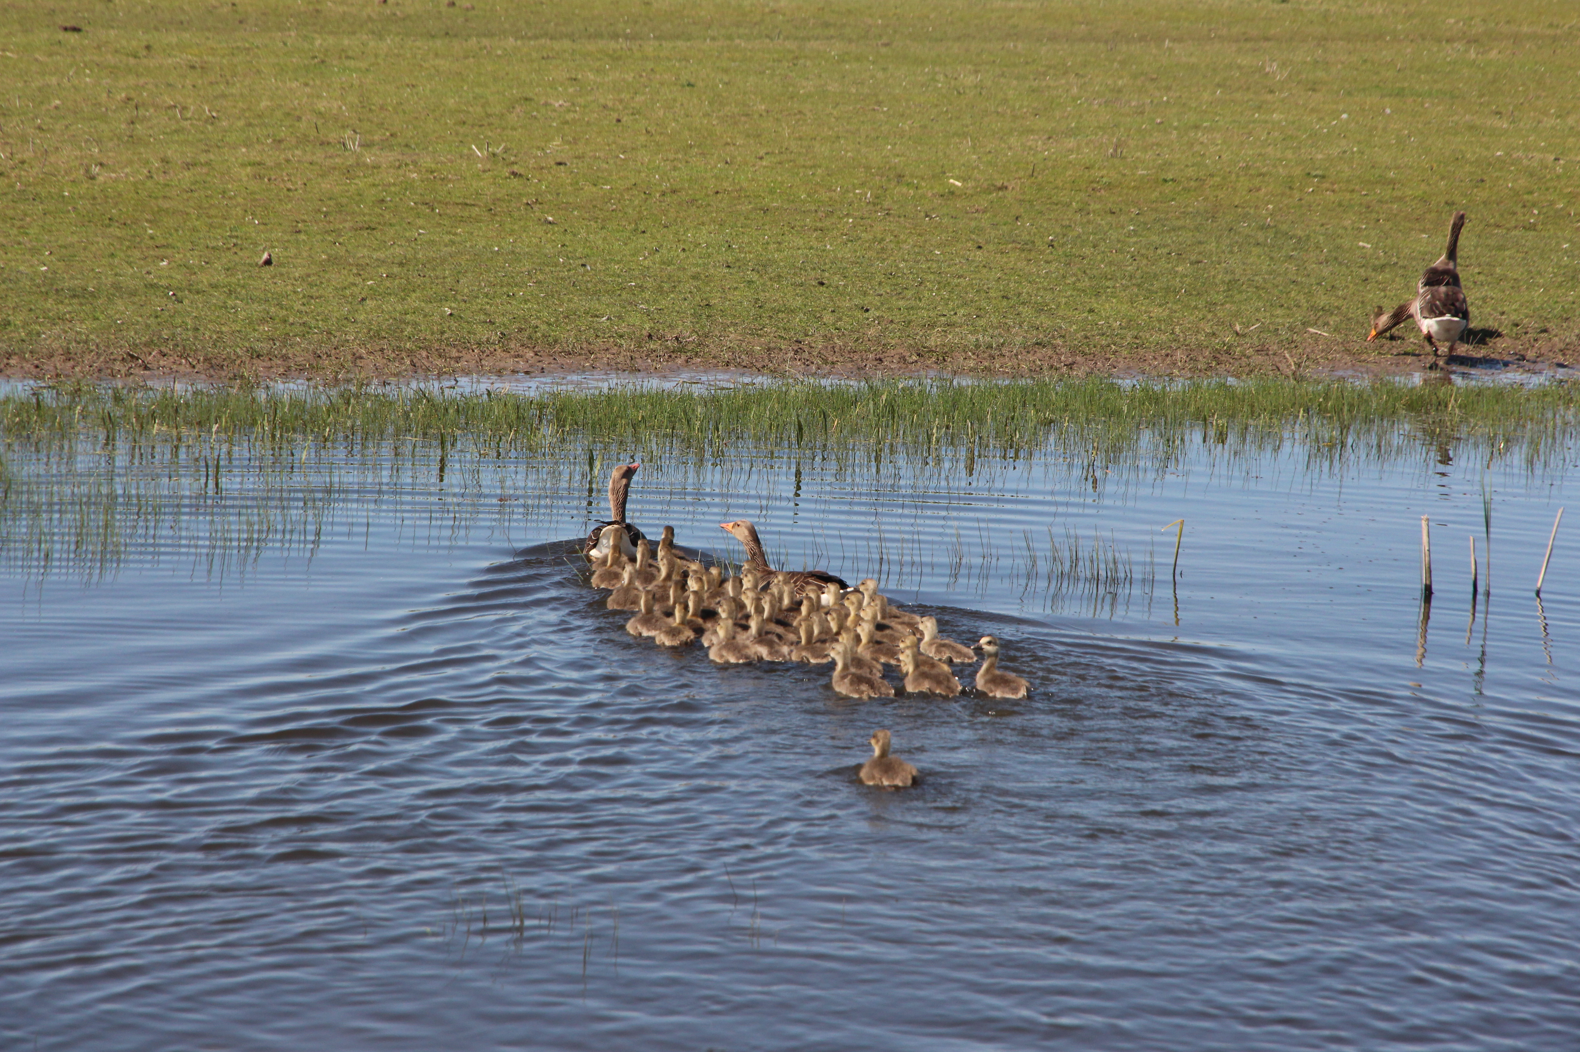
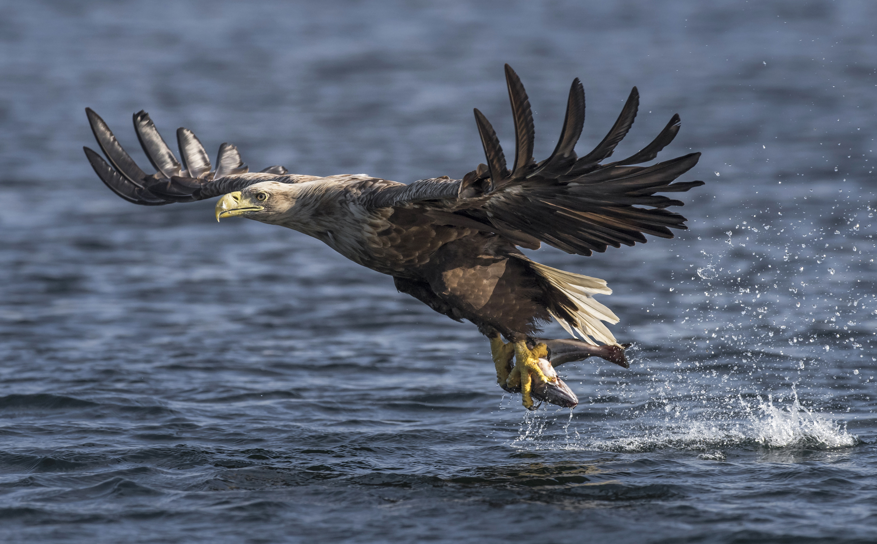
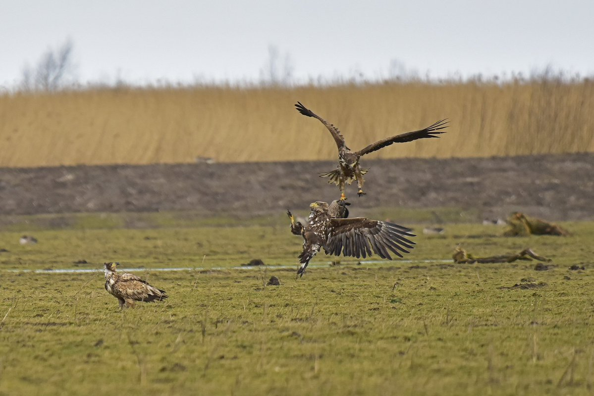
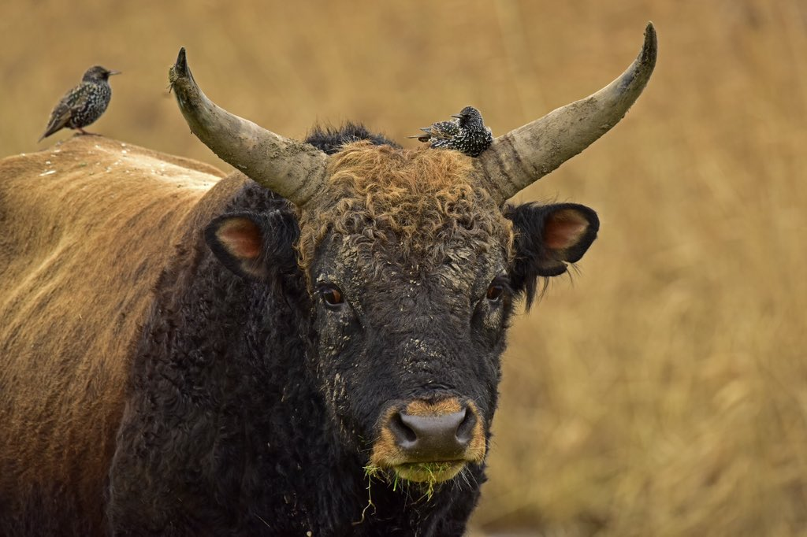
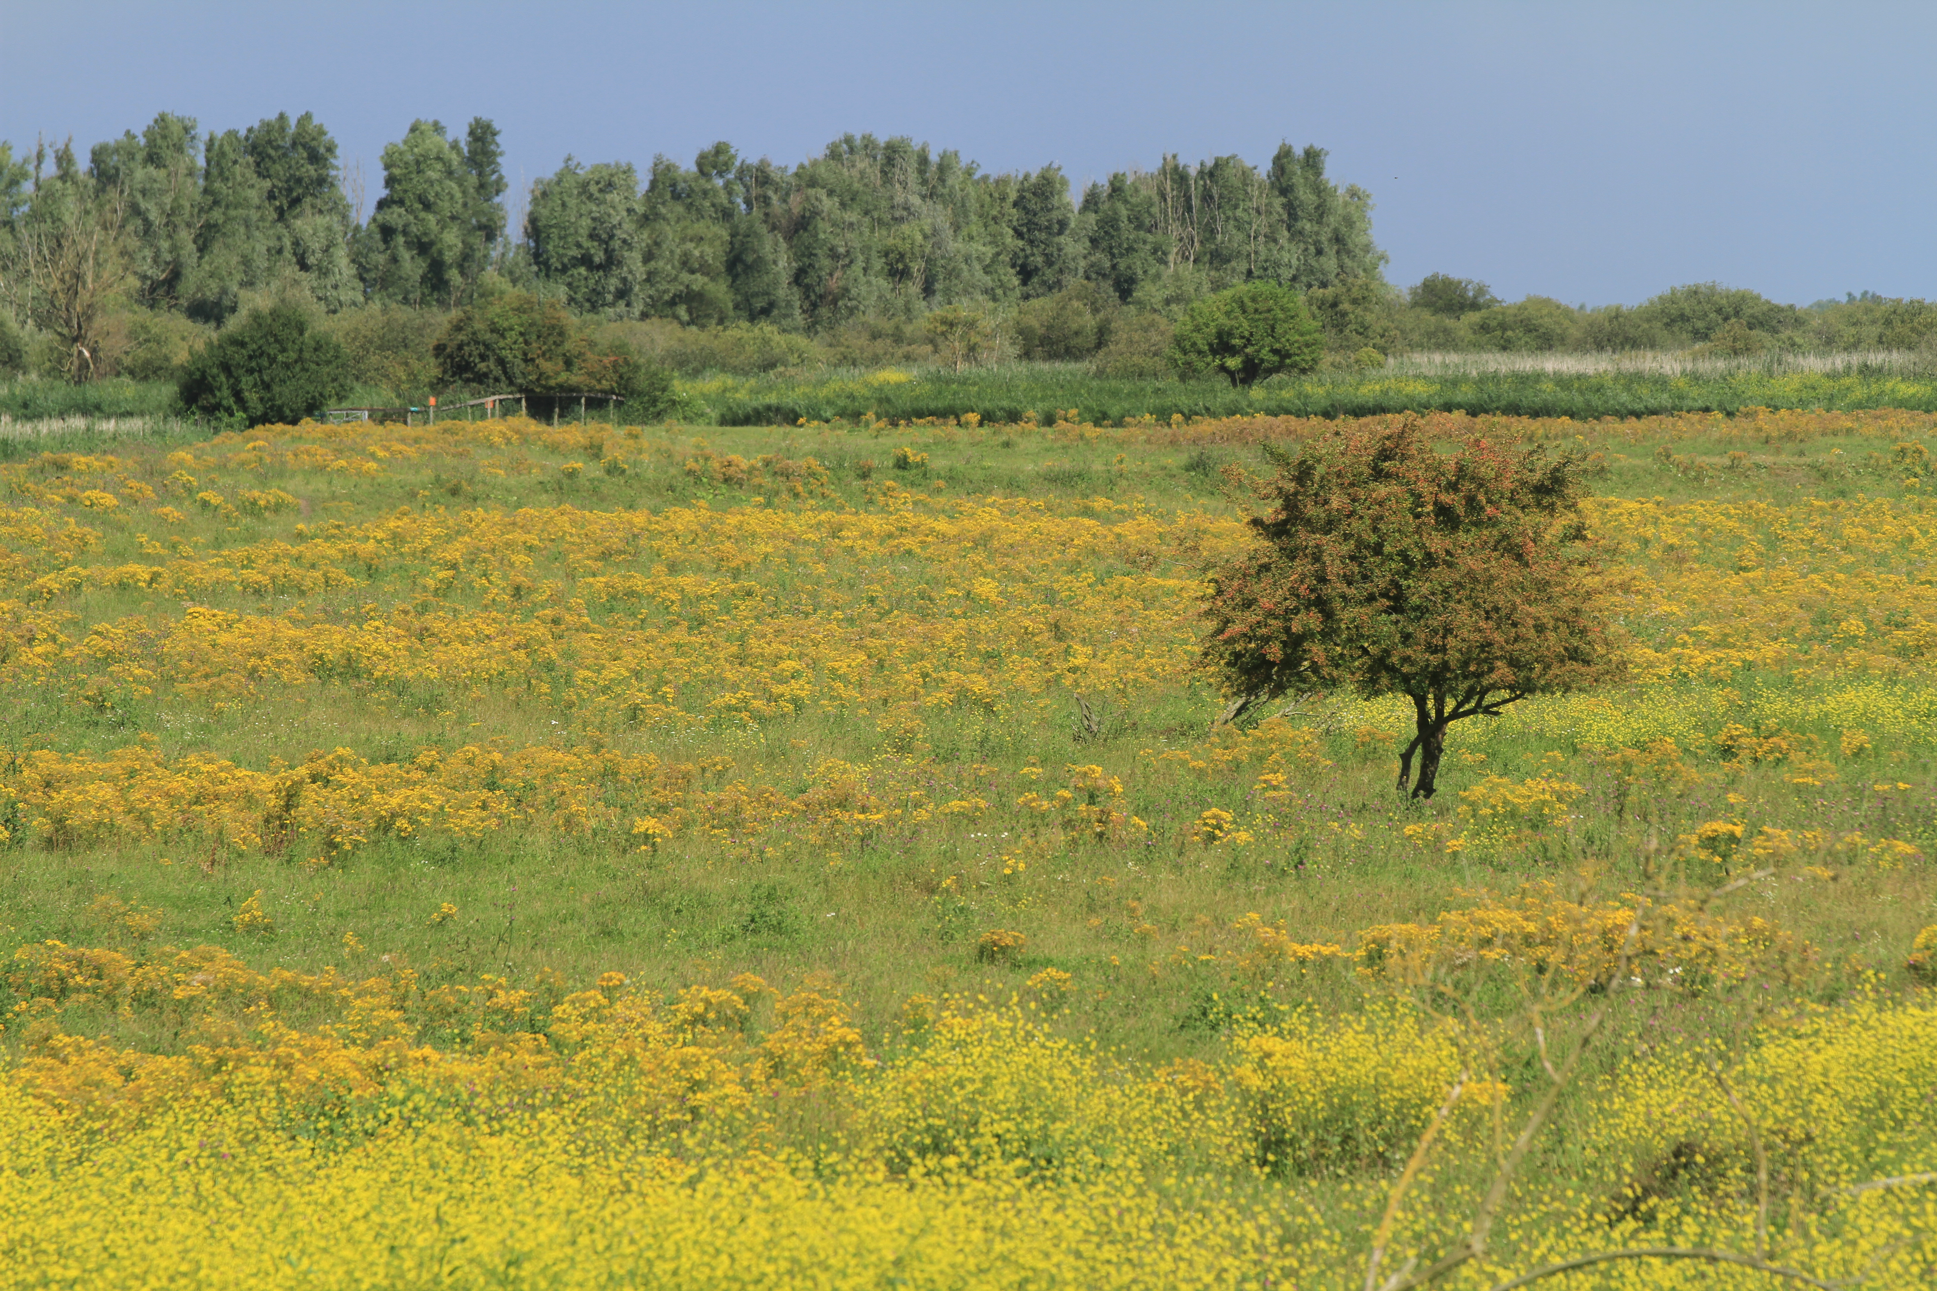
Renewal European Diploma for Protected Areas Oostvaardersplassen

Slide 2
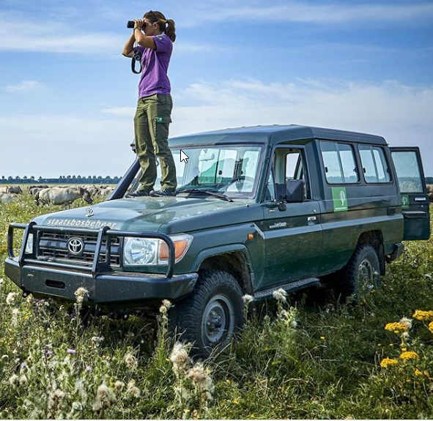
Renewal European Diploma for Protected Areas Oostvaardersplassen
Presentation Staatsbosbeheer
March 18th Group of Specialists EDPA
Introduction
Aim and vision Oostvaardersplassen
Response to condition 2
Criteria European Diploma and future
Notes:
We haven’t had the opportunity

Slide 3
Introduction

Slide 4
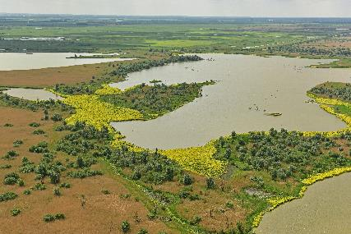
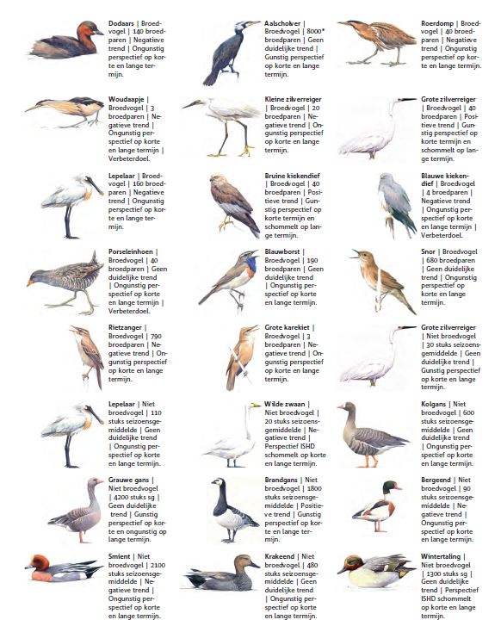
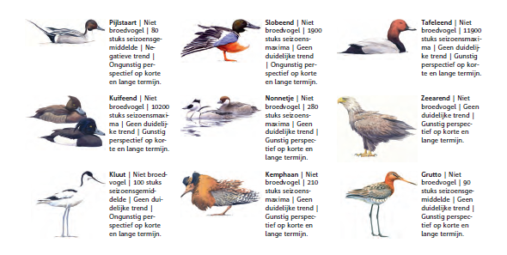
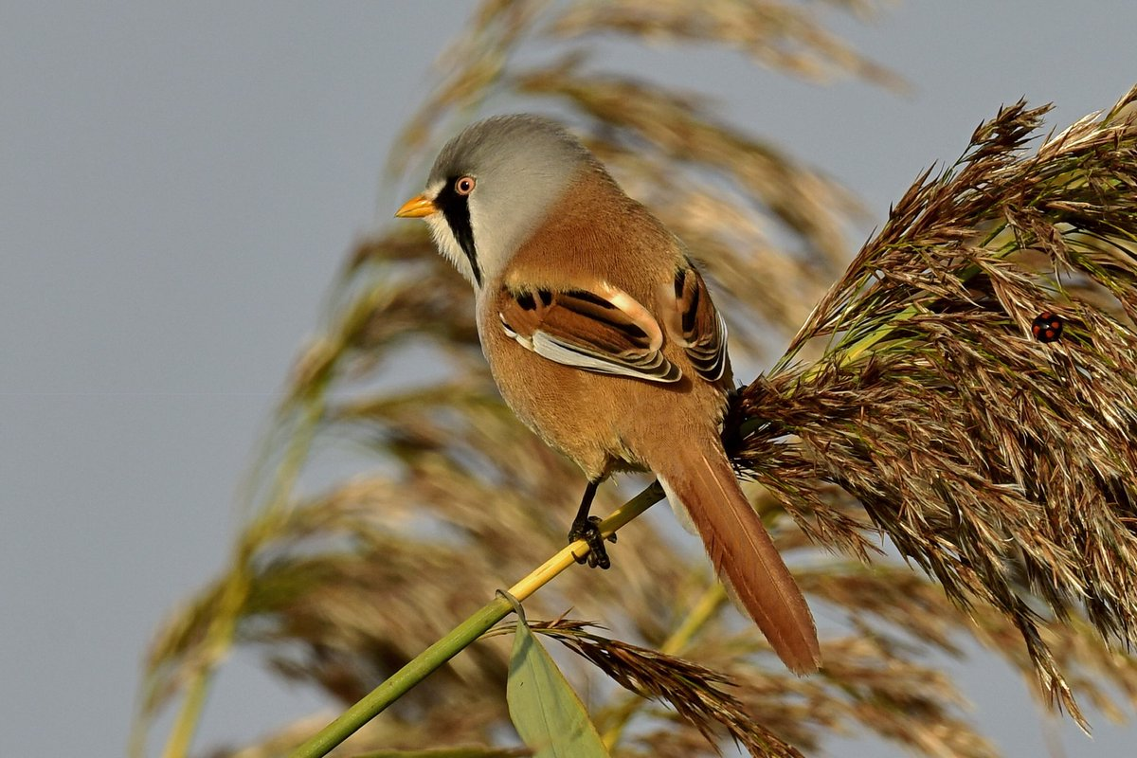
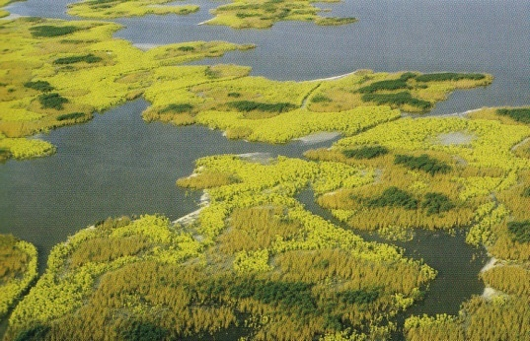
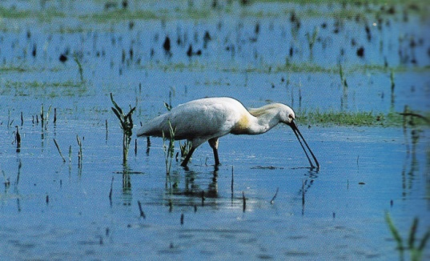
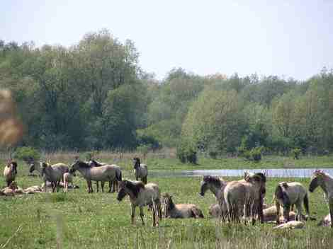
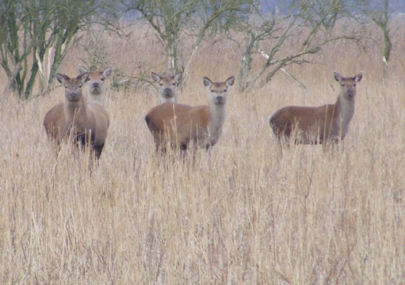
Aim and vision
Conservation of the wetland – Natura 2000, Bern Convention, Ramsar
Room for natural processes

Slide 5
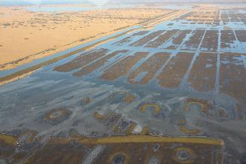
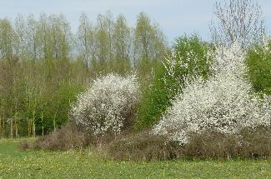
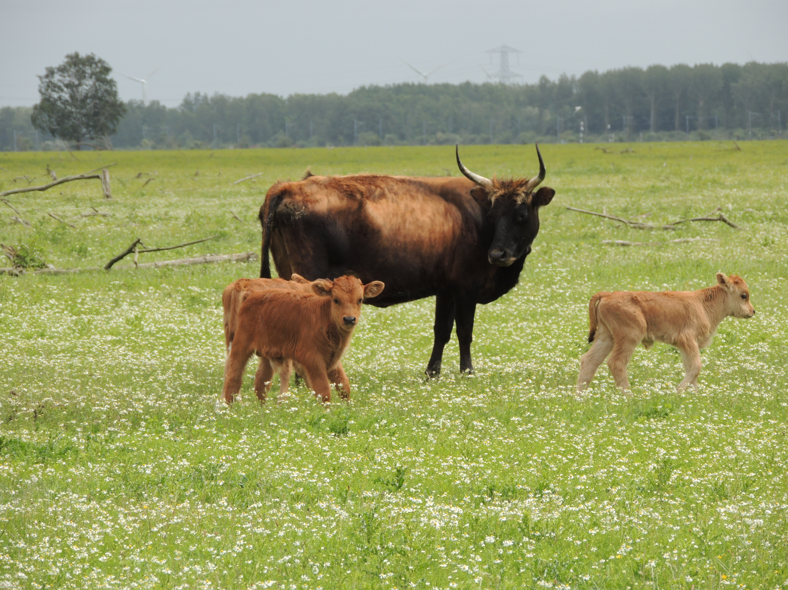
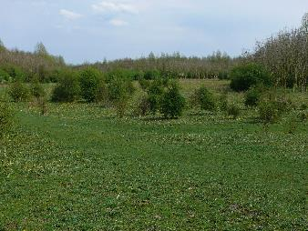
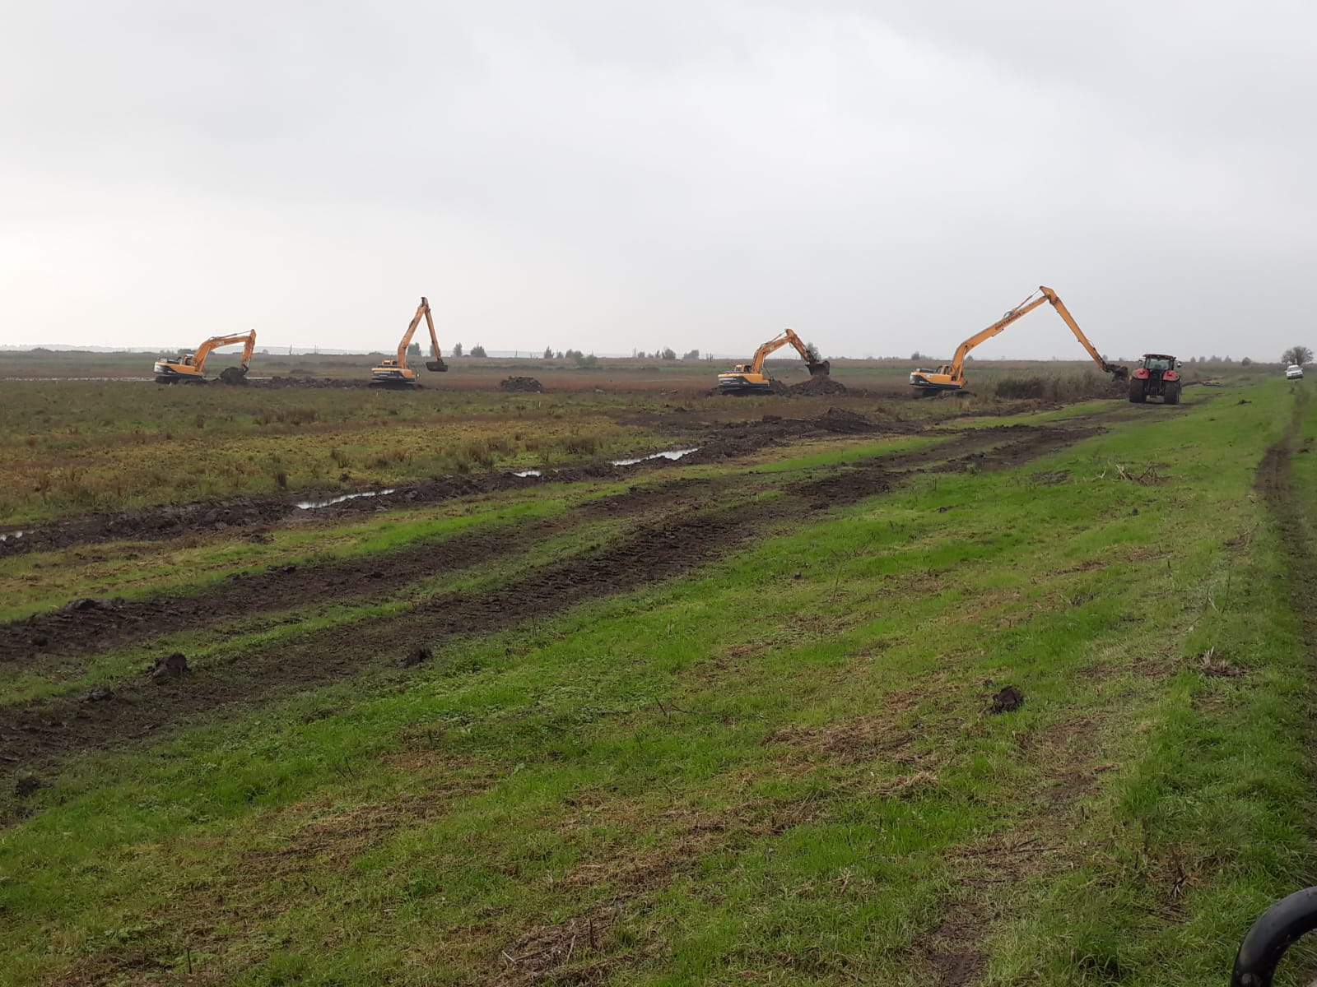
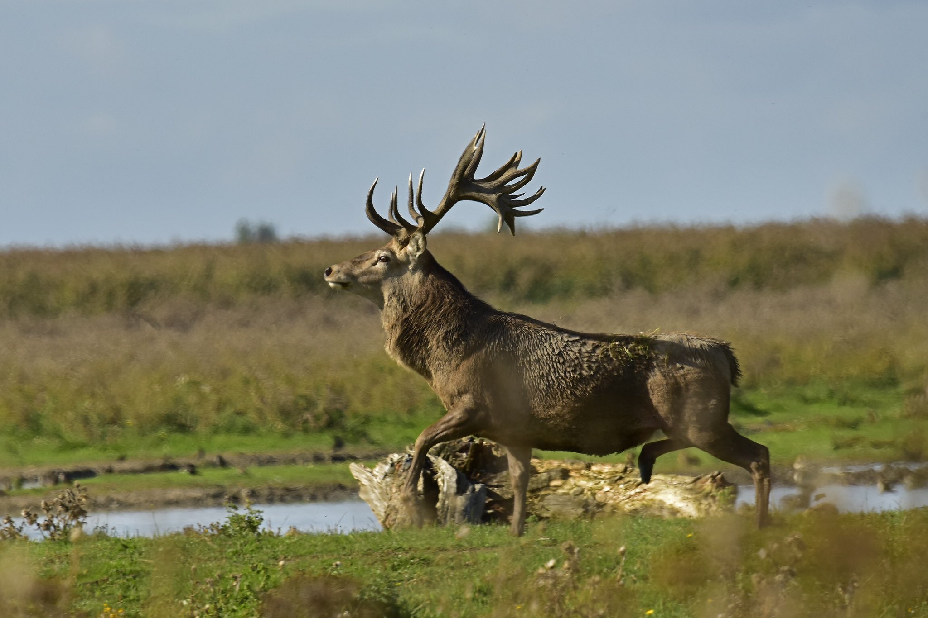
Natural processes vs intervention
Natural processes that help to create spontaneous outbursts of nature and a dynamic landscape that benefits biodiversity
Examples of natural processes: water level dynamics; sedimentation and erosion; energy and nutrient cycling; herbivory
However:
Far from complete natural system (predation, migration,
water level dynamics)
Intervention is needed

Slide 6
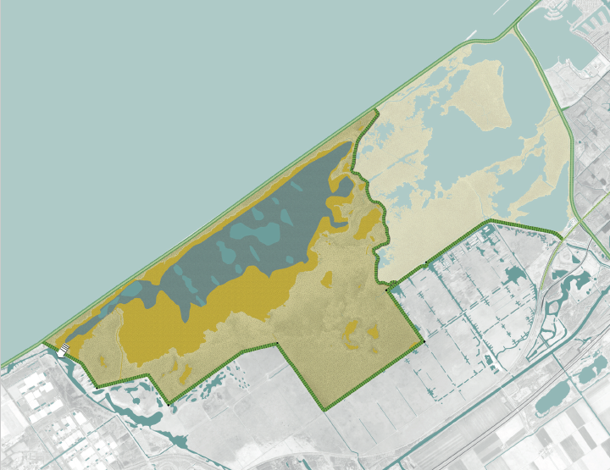
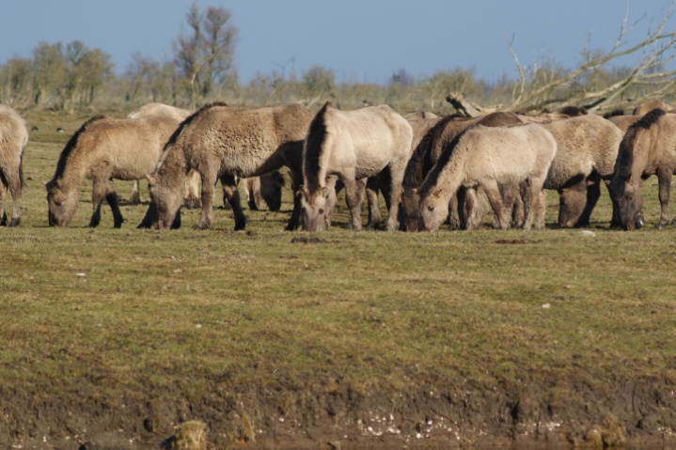
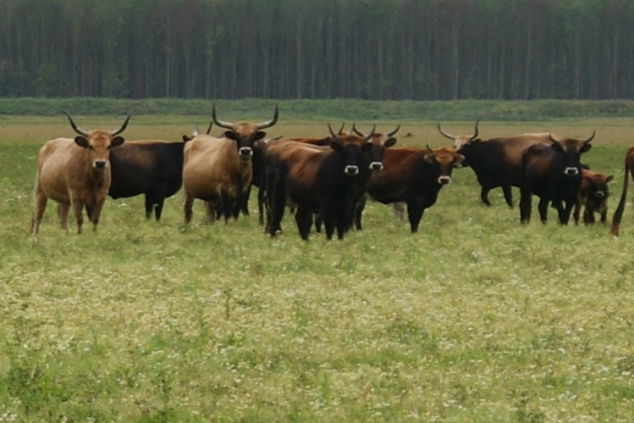
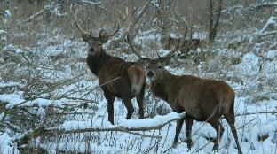
Needed interventions
‘Marsh – reset’:
Lowering water level several years to increase
reed vegetation for N2000 species
Herbivore management:
Lowering herbivore numbers and simulate population dynamics to obtain a more diverse and dynamical landscape and thereby increase biodiversity (flora and fauna, especially bird species)

Slide 7
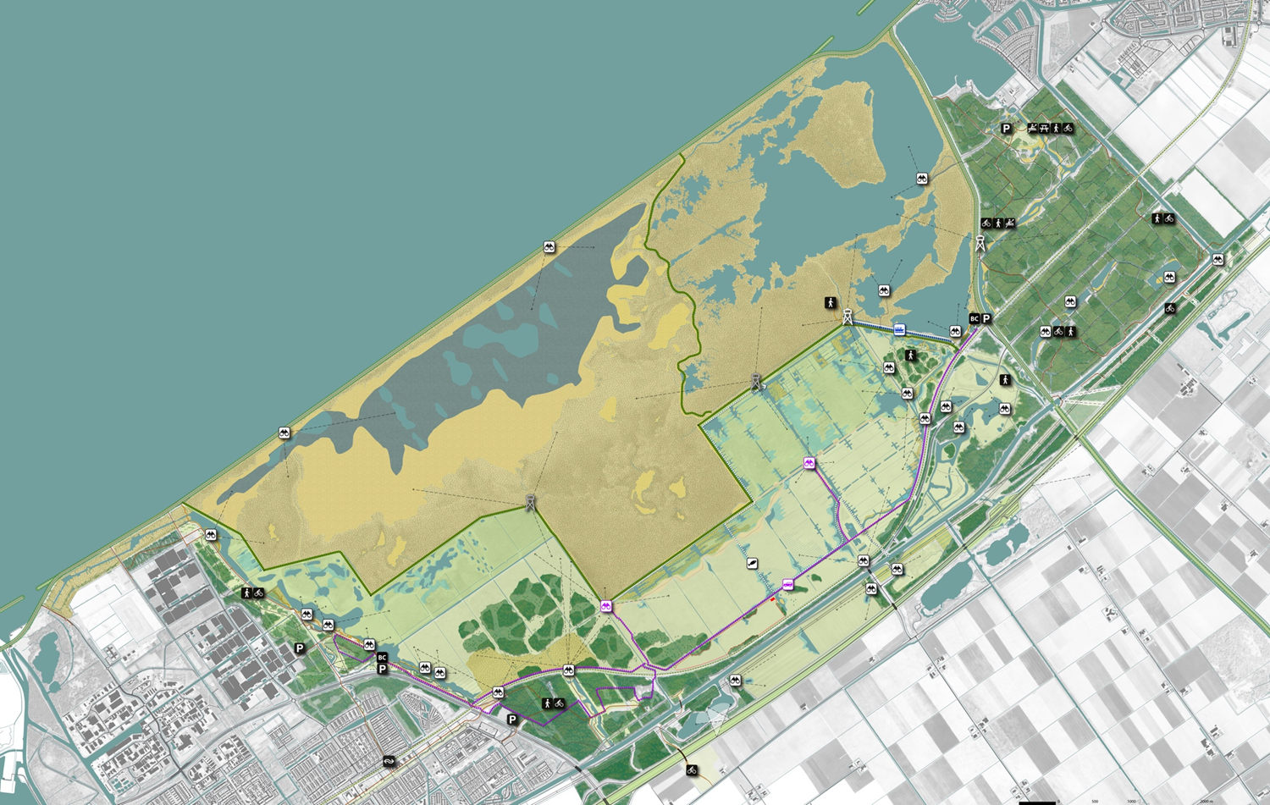
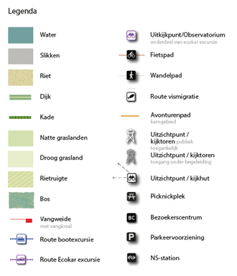
‘A unique example of successful large-scale wetland development in a densely populated country’

