Slide 1


European Centre for Vulnerability of Industrial and Lifeline Systems
ECILS
North Macedonia
European and Mediterranean Major Hazard Agreement
(EUR-OPA)
Joint meeting of the Committee of Permanent Correspondents and Directors of Specialized Centres
17-18 November 2022
project 2022-2023 – ECILS (coordinator), ECPFE (partner)
Seismic Vulnerability Assessment of the Skopje Old Bazaar
activities realized in 2022
EUR-OPA
Joint meeting of the Committee of Permanent Correspondents and Directors od Specialized Centres, 17-18 November 2022
Dr. Veronika SHENDOVA
Director
European Centre for Vulnerability of Industrial and Lifeline Systems, ECILS

Slide 2
2022-2023 Project- Seismic vulnerability assessment of Skopje Old Bazaar
Priority for action plan: Using scientific and technological knowledge to better assess evolving risks and adapt accordingly the resilience strategies
Coordinator Centre: ECILS, Skopje, North Macedonia
Partner Centre: ECPFE, Athens, Greece
Title of the Project: SEISMIC VULNERABILITY ASSESSMENT OF THE SKOPJE OLD BAZAAR
Implementation period: February 2022 - November 2023
Grant by Council of Europe: ECILS – 6000 euro (research/desk study) + 920 euro (per diem/travel) ECPFE – 2250 euro (research/desk study) + 850 euro (per diem/travel)
Contribution by ECILS: working space, fieldworks costs, local transport, computer calculation costs, research grant for the salary of PhD/permanent staff
Contribution by ECPFE: working space, local transport, computer calculation costs

Slide 3
2022-2023 Project – global overview
aim of the project proposal - to assess the seismic vulnerability of representative part of Skopje Old Bazaar by:
rapid visual screening using First_Level_Data_Form (developed in 2021), resulting in category for each of the surveyed buildings according to its seismic risk,
creation of Database with information from the screening,
harmonization of the ranking and re-evaluation of identified vulnerable buildings based on evaluation of structural parameters
performing the relevant structural analysis for one or two representative buildings to verify the proposed methodology
defining possible key structural interventions for the buildings’ seismic upgrading based on findings from relevant structural analysis

Slide 4
2022-2023 Project – planned and realized activities for 2022
ECILS | ECPFE
A1: Preparatory work: providing mandatory permission for access to the buildings, setting up the survey teams and introducing them with seismic screening methodology, desk study and remote data collection
A2: Rapid visual outside/inside screening of selected 30 buildings using First_Level_Data_Form followed by preliminary seismic risk rating of the buildings
A3: Hold of first joint meeting in Skopje Old Bazaar with participation of the responsible people and the representatives from ECPFE, (in case of the pandemic via videoconference) | A4: Participation to the first joint meeting in Skopje Old Bazaar (In case of the pandemic via videoconference)
A5: Harmonization of evaluation criteria and re-evaluation of the ranking based on detailing and evaluation of structural parameters | A6: Contribution to the harmonization of evaluation criteria and re-evaluation of the buildings ranking, based on own expertise and previous experience
A7: Fill-in the database with the final results and create the vulnerability map of selected part of Skopje Old Bazaar
A8: Selection of two representative buildings for further structural analysis

Slide 5
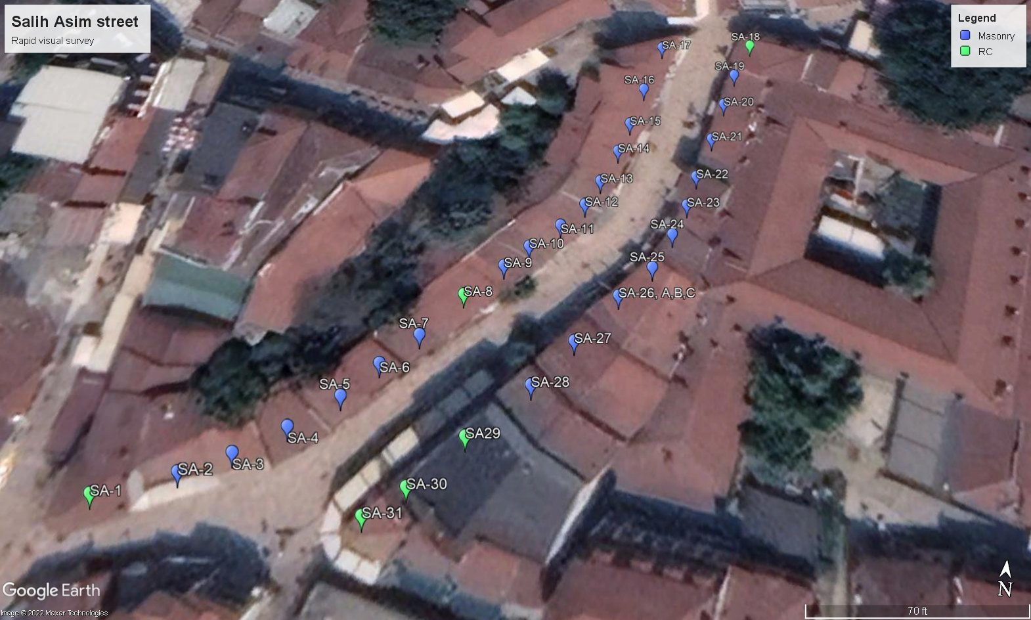
Selection of representative street in Old Bazaar - Salih Asim street

Slide 6
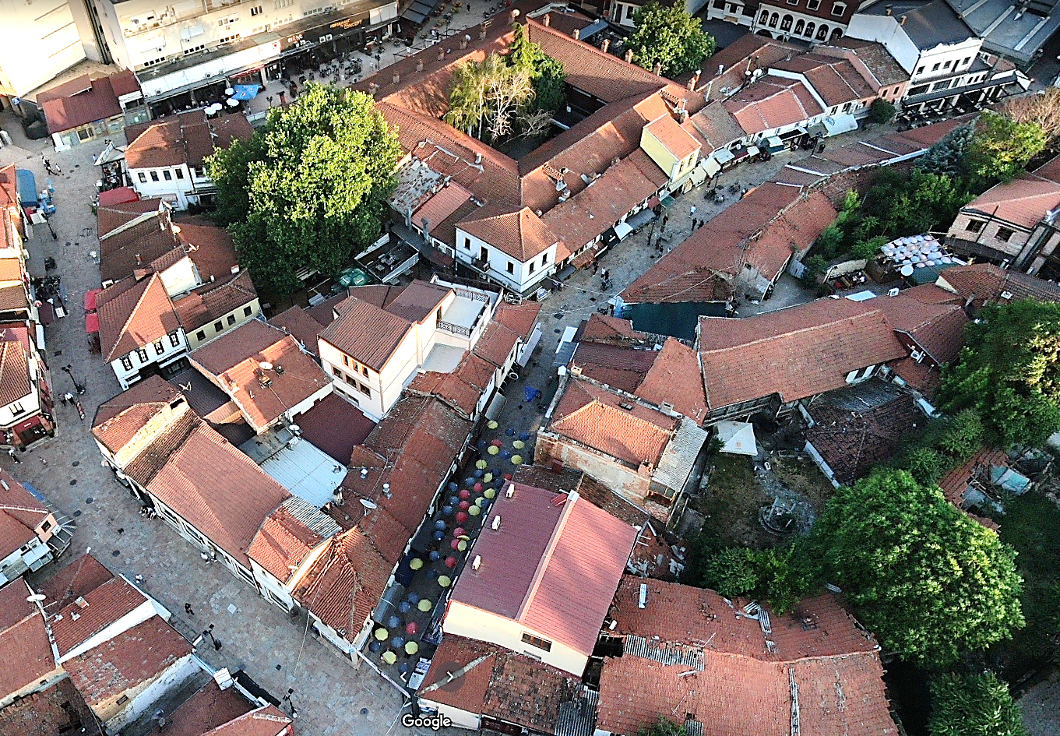
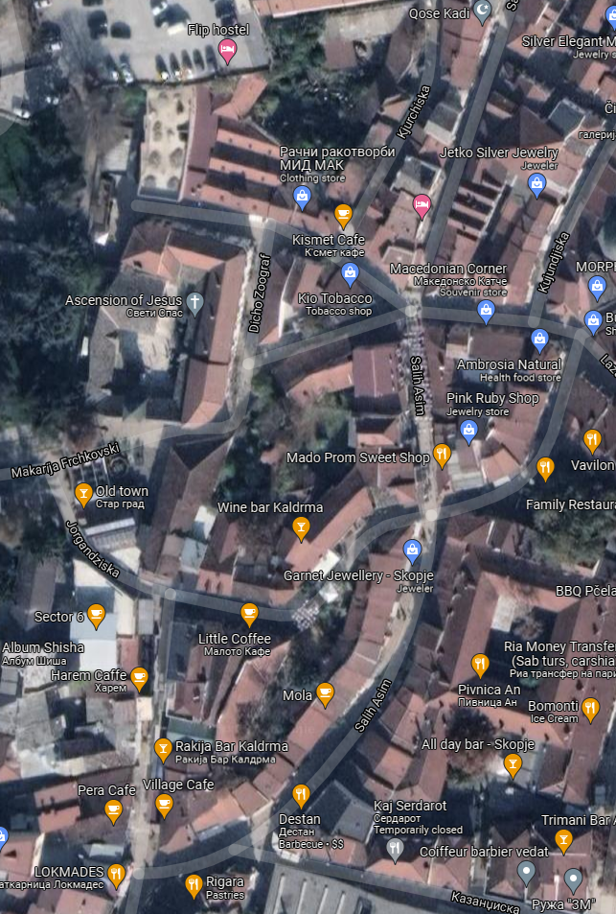
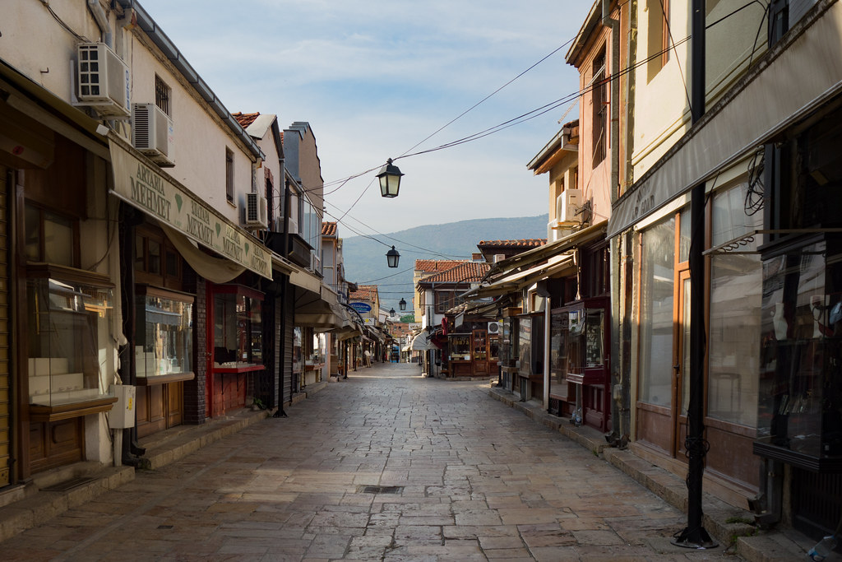
2022 Project – realized activity A1, A2
ECILS
A1: Preparatory work: providing mandatory permission for access to the buildings, setting up the survey teams and introducing them with seismic screening methodology, desk study and remote data collection
A2: Rapid visual outside/inside screening of selected 30 buildings using First_Level_Data_Form followed by preliminary seismic risk rating of the buildings
  preparing of the First_Level_Data_Form for rapid visual survey
  desk study and remote data collection on the Skopje Old Bazaar buildings
  selection of 30 buildings
  defining the work plan and staffing
  Rapid visual seismic screening
main Salih Asim street

Slide 7
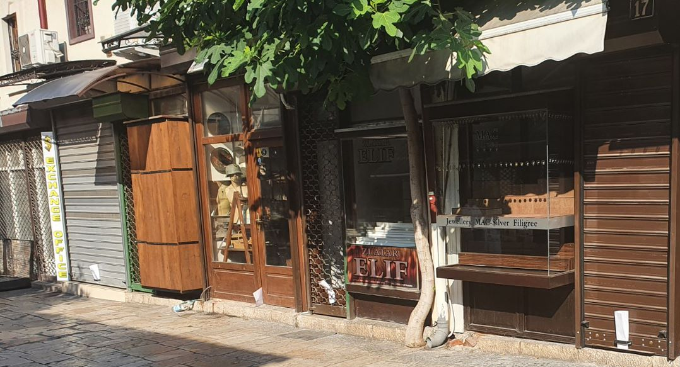
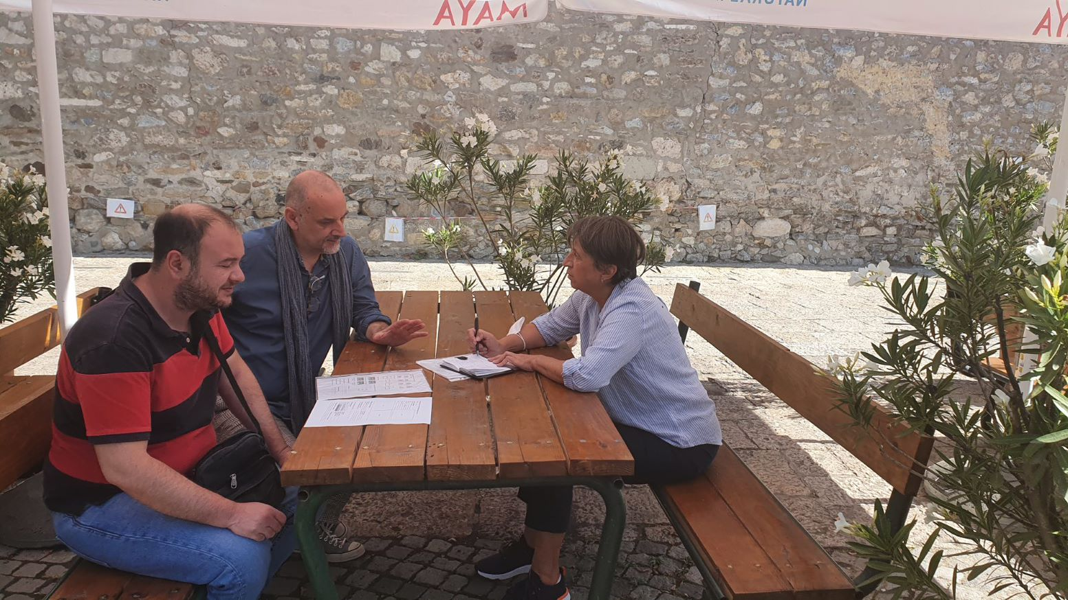
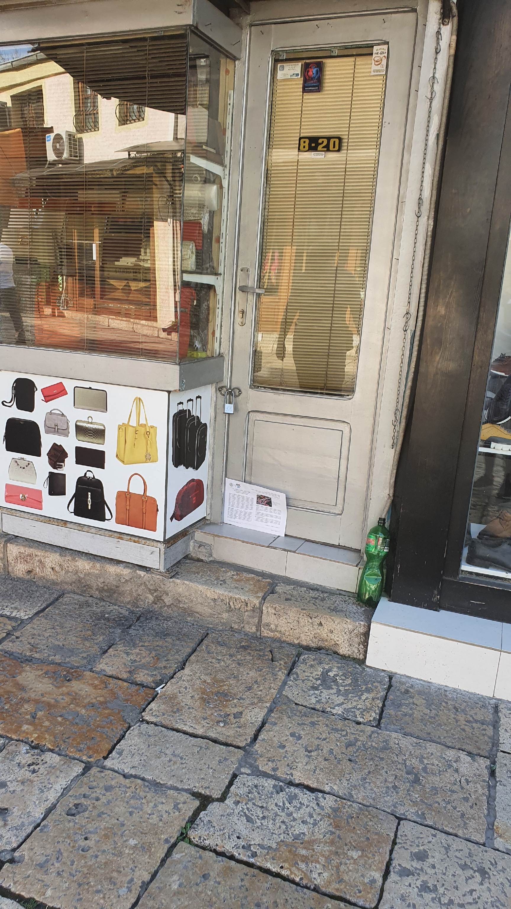
Salih Asim street – preparation for Rapid Visual Screening
initial meetings, provide permission, work plan, info-flyer …

Slide 8
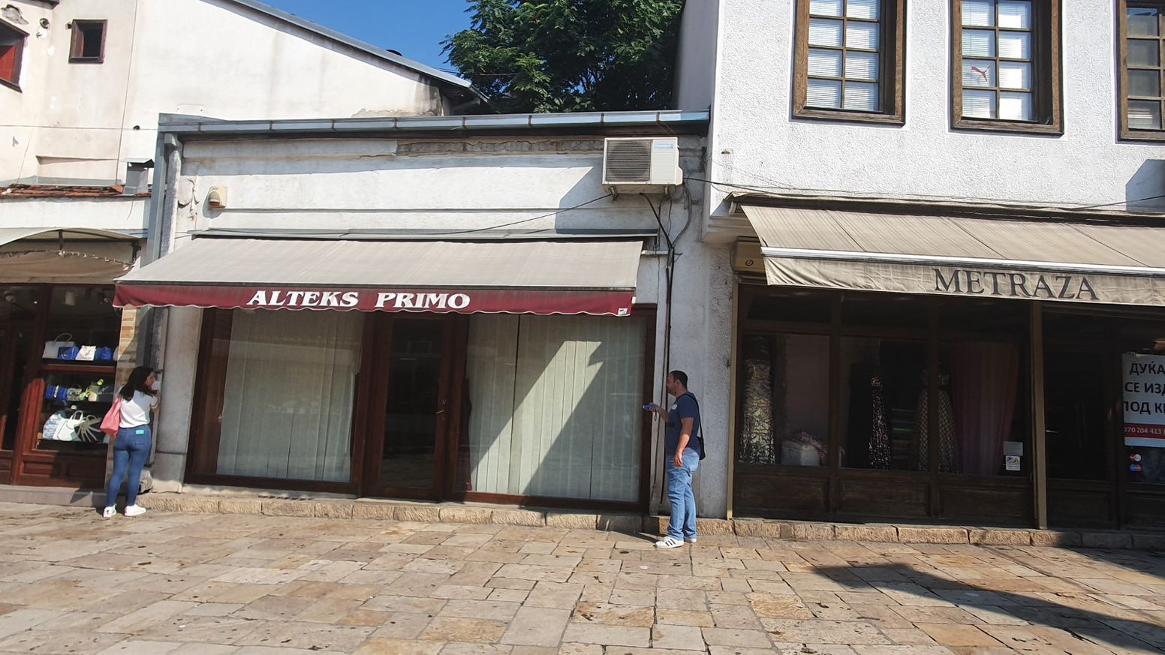
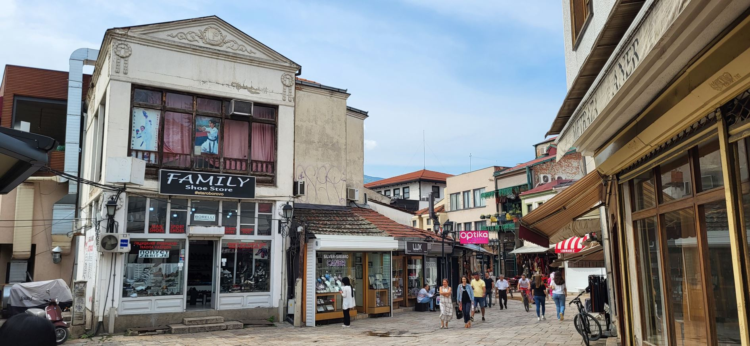
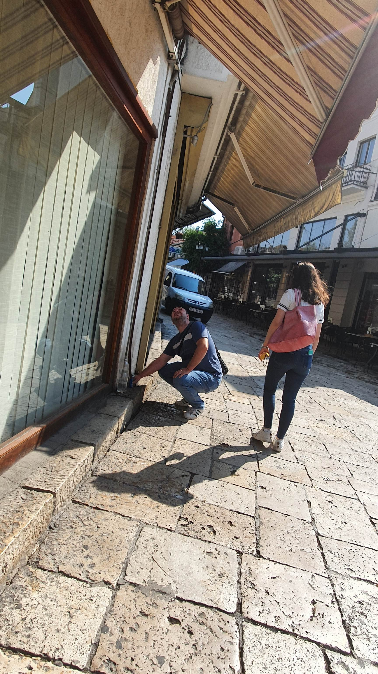
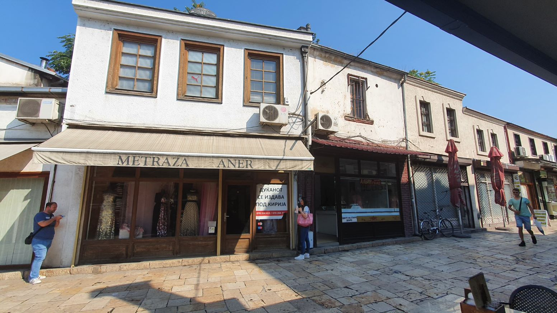
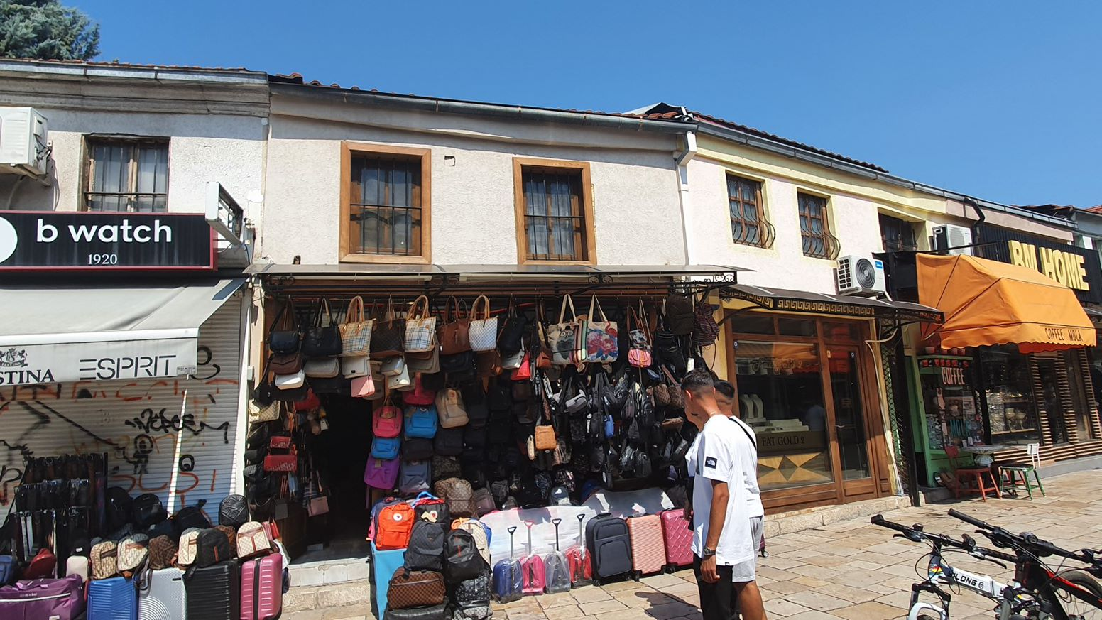
Salih Asim street – Rapid Visual Screening
labeling, photography, measuring, interview,
filling data form

Slide 9

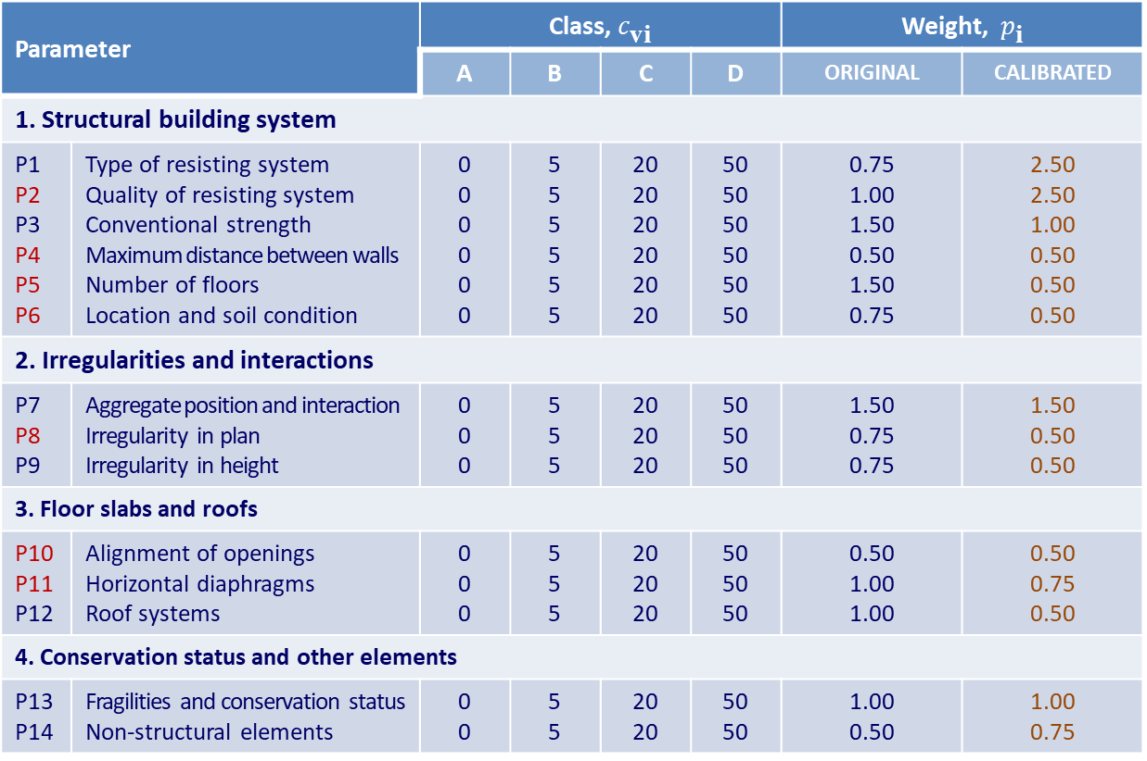
Salih Asim street – Vulnerability assessment methodology
Parameter
 |  | A | B | C | D | ORIGINAL | CALIBRATED
1. Structural building system
P1 P2 P3 P4 P5 P6 | Type of resisting system Quality of resisting system Conventional strength Maximum distance between walls Number of floors Location and soil condition | 0 0 0 0 0 0 | 5 5 5 5 5 5 | 20 20 20 20 20 20 | 50 50 50 50 50 50 | 0.75 1.00 1.50 0.50 1.50 0.75 | 2.50 2.50 1.00 0.50 0.50 0.50
2. Irregularities and interactions
P7 P8 P9 | Aggregate position and interaction Irregularity in plan Irregularity in height | 0 0 0 | 5 5 5 | 20 20 20 | 50 50 50 | 1.50 0.75 0.75 | 1.50 0.50 0.50
3. Floor slabs and roofs
P10 P11 P12 | Alignment of openings Horizontal diaphragms Roof systems | 0 0 0 | 5 5 5 | 20 20 20 | 50 50 50 | 0.50 1.00 1.00 | 0.50 0.75 0.50
4. Conservation status and other elements
P13 P14 | Fragilities and conservation status Non-structural elements | 0 0 | 5 5 | 20 20 | 50 50 | 1.00 0.50 | 1.00 0.75

Slide 10
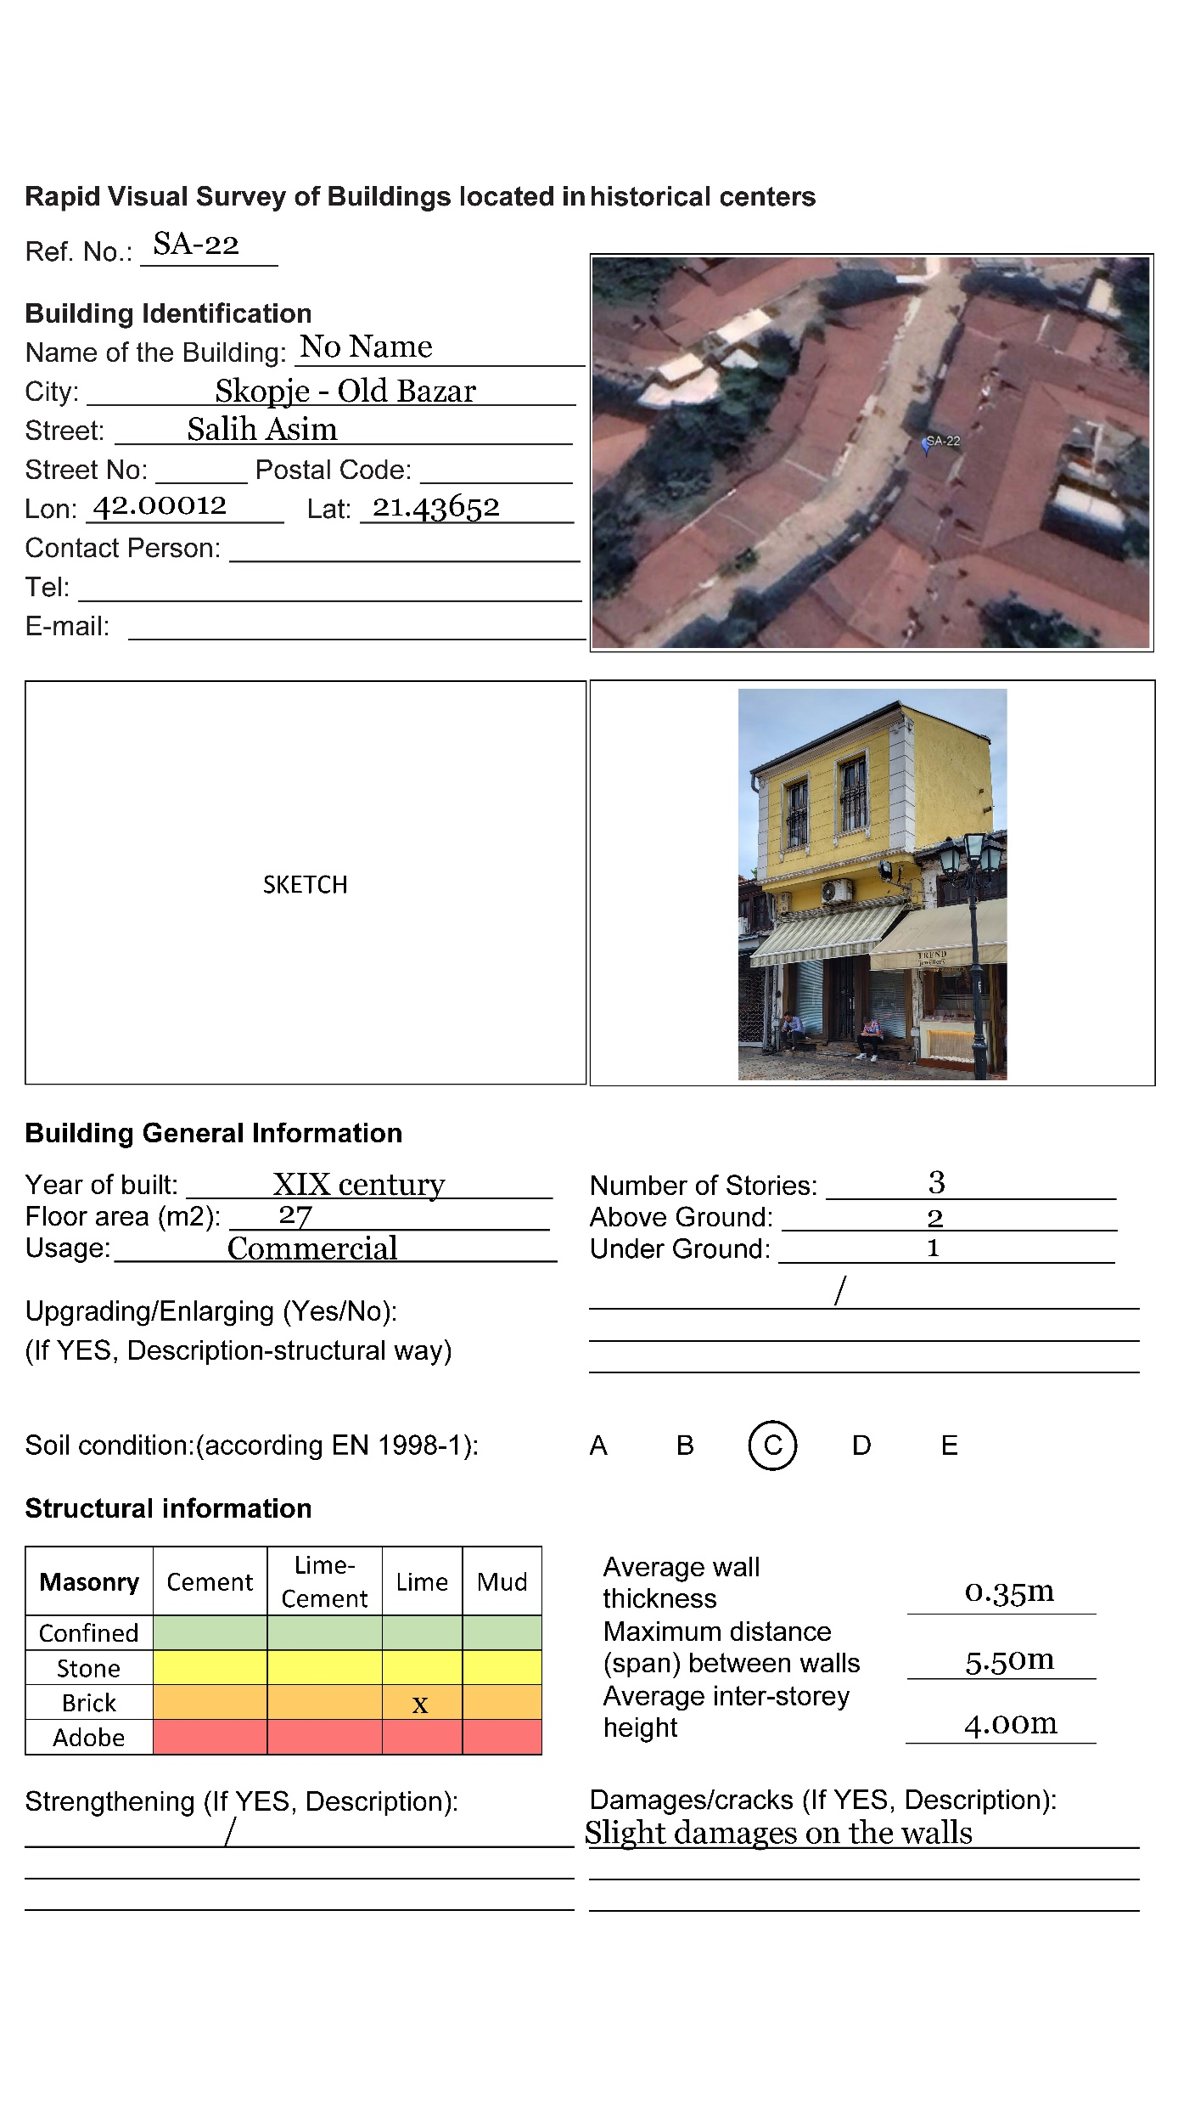
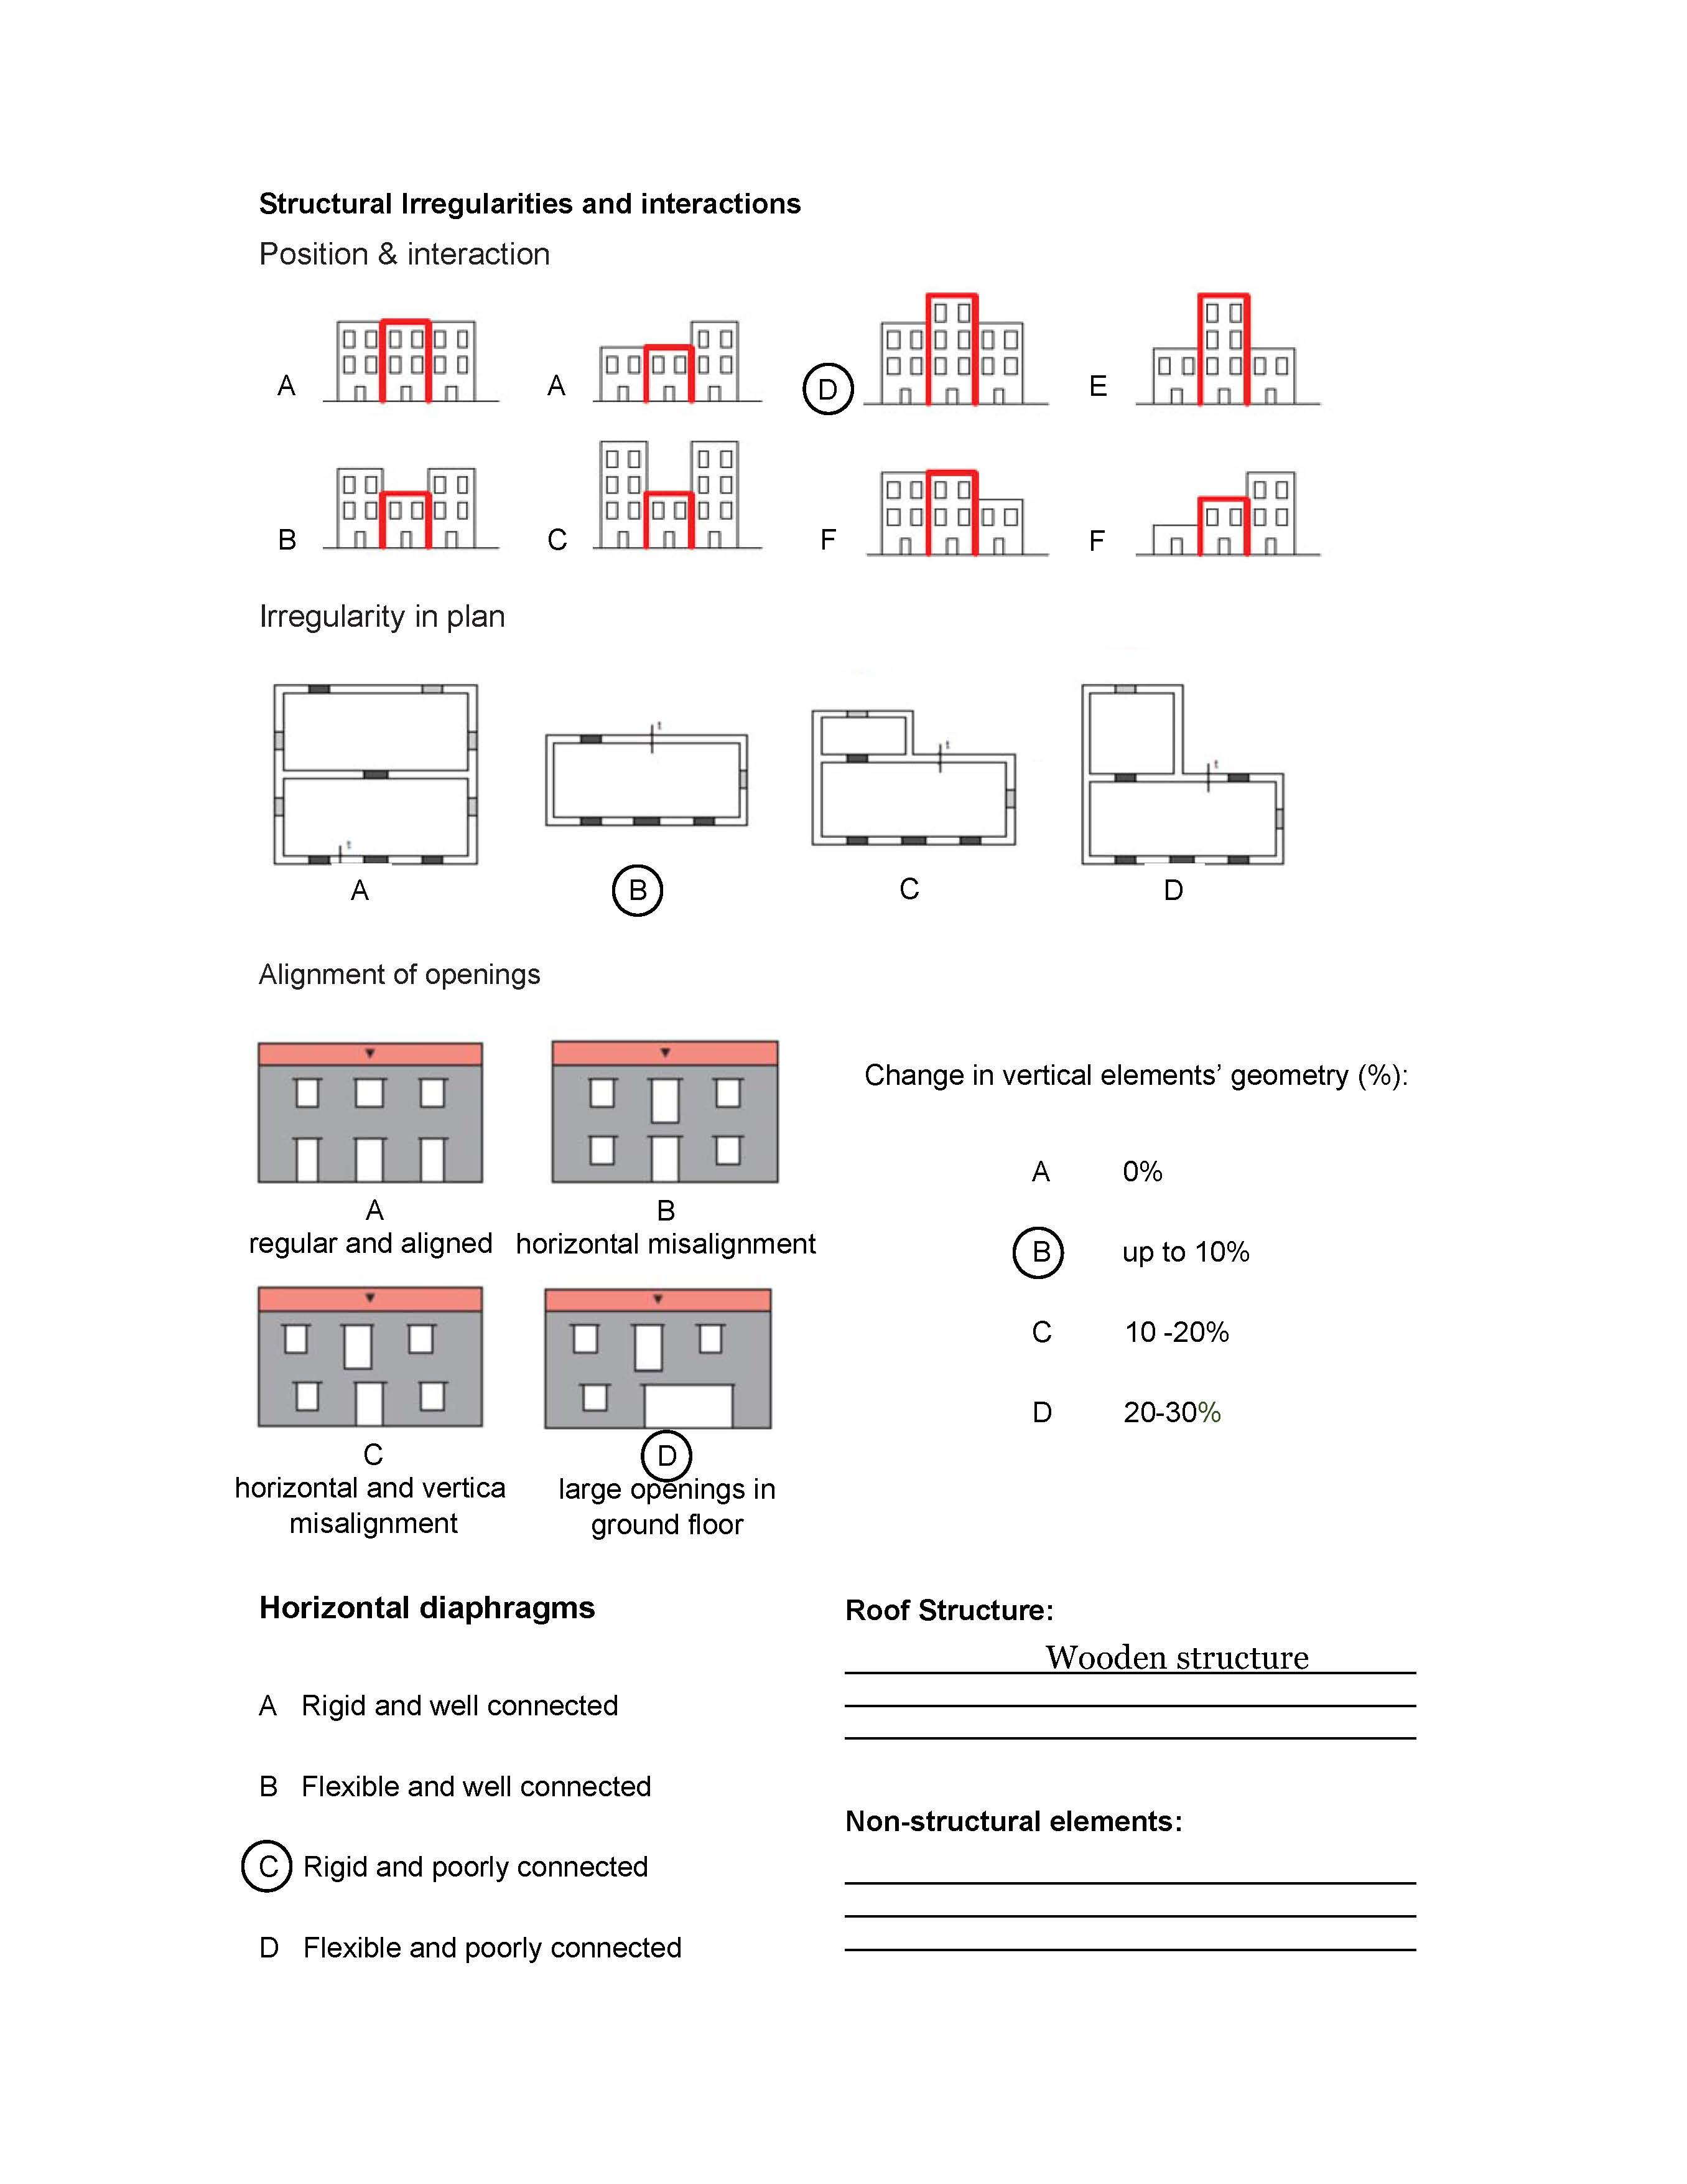
Salih Asim street – filling the data form (SA-22)
Class C_{vi} | P1 Resisting system | P2, Quality of resisting system | P3, P13 Cracked stiffness
 |  | Mortar
A | Confined masonry | Cement | 1.00
B | Brick/stone masonry | Lime/cement | 0.83
C | Brick/stone masonry | Lime | 0.67
D | Adobe masonry | Adobe mud | 0.50
Class C_{vi} | P4 Wall thickness: | P5 Number of floors | P6 Soil condition (EN 1998-1)
A | 0.60 m | 1 | A
B | 0.50 m | 2 | B
C | 0.40 m | 3 | C
D | 0.30 m | enlarging/ upgrading | D, E
Class C_{vi} | P7 | P8 | P9 change in vertical elements’ geometry
A | Figure 4, a | Figure 5, a | 0%
B | Figure 4, b | Figure 5, b | up to 10%
C | Figure 4, c, d | Figure 5, c | (10 -20) %
D | Figure 4, e, f | Figure 5, d | (20 – 30) %
Class C_{vi} | P10 Alignment of openings | P11, P12 Horizontal diaphragms (Roof structures)
A | Figure 6, a, regular and aligned | Rigid and well connected
B | Figure 6, b, horizontal misalignment | Flexible and well connected
C | Figure 6, c, hor. and vert. misalignment | Rigid and poorly connected
D | Figure 6, d, large openings in ground floor | Flexible and poorly connected
Class C_{vi} | P10 Alignment of openings | P11, P12 Horizontal diaphragms (Roof structures)
A | Figure 6, a, regular and aligned | Rigid and well connected
B | Figure 6, b, horizontal misalignment | Flexible and well connected
C | Figure 6, c, hor. and vert. misalignment | Rigid and poorly connected
D | Figure 6, d, large openings in ground floor | Flexible and poorly connected
Ivf = V = 285

Slide 11
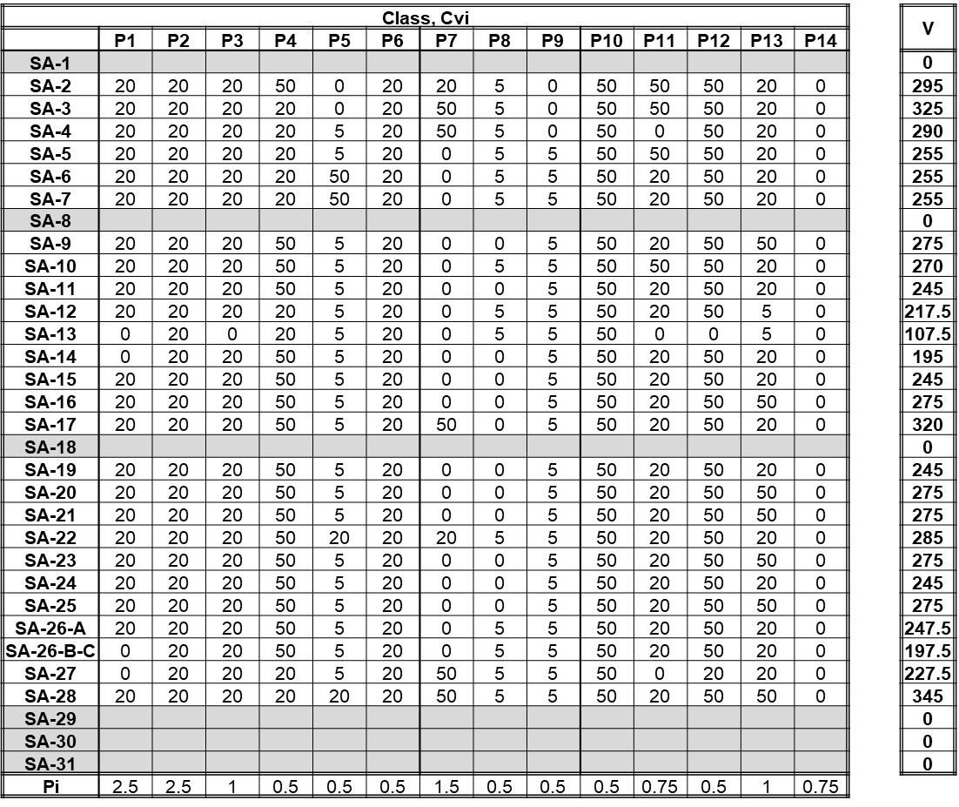
Salih Asim street – Vulnerability assessment resulting score

Slide 12
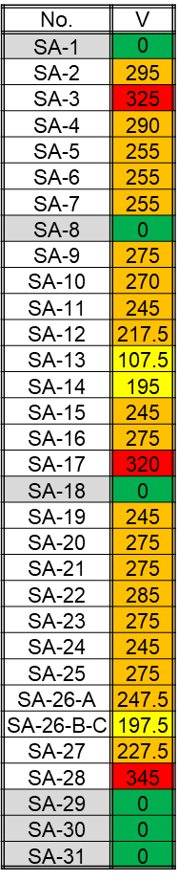
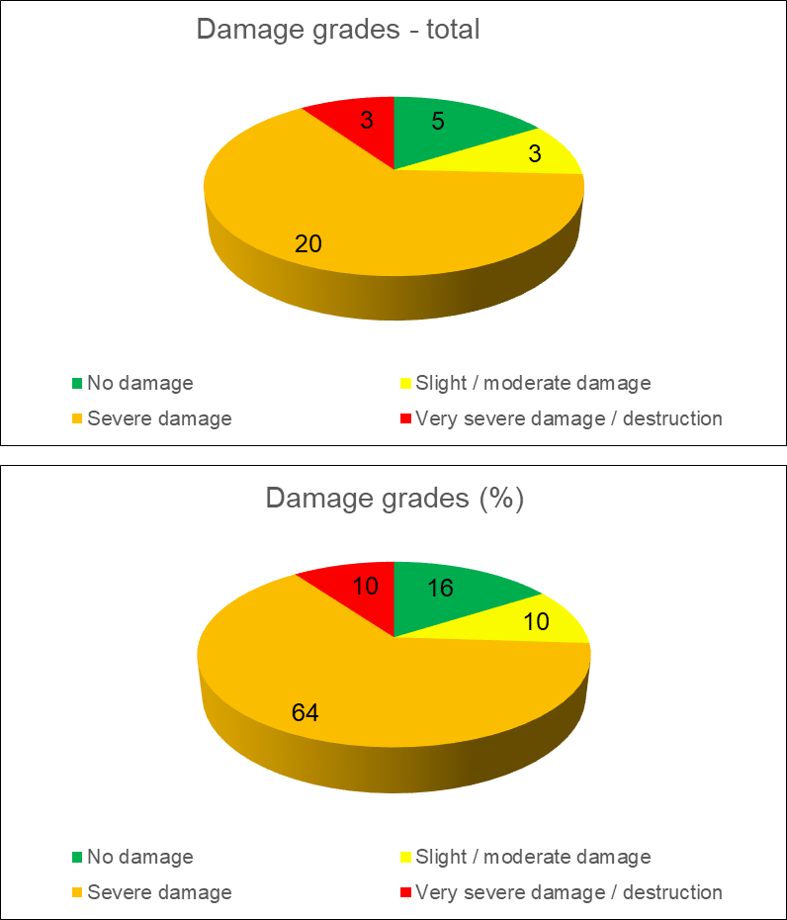
Salih Asim street – damage grade (according vulnerability)
Damage - Intensity IX - MSC
 | V=0-100 - No damage
 | V=101-200 - Slight / moderate damage
 | V=201-300 – Moderate / severe damage
 | V>300 – Very severe damage / destruction

Slide 13
2022 Project – realization of activity A3-A7
ECILS | ECPFE
A3: Hold of first joint meeting in Skopje Old Bazaar with participation of the responsible people and the representatives from ECPFE, (in case of the pandemic via videoconference) | A4: Participation to the first joint meeting in Skopje Old Bazaar (In case of the pandemic via videoconference)
A5: Harmonization of evaluation criteria and re-evaluation of the ranking based on detailing and evaluation of structural parameters | A6: Contribution to the harmonization of evaluation criteria and re-evaluation of the buildings ranking, based on own expertise and previous experience
A7: Fill-in the database with the final results and create the vulnerability map of selected part of Skopje Old Bazaar
ECILS – ECPFE joint meeting in Skopje, 4-6 October 2022
ECILS representatives ECPFE representatives: Veronika Shendova Linda Pelli
Vlatko Sesov Gabriella Zagora
Aleksandar Zlateski
Aleksandar Zurovski
Goran Jekic, Elena Delova

Slide 14
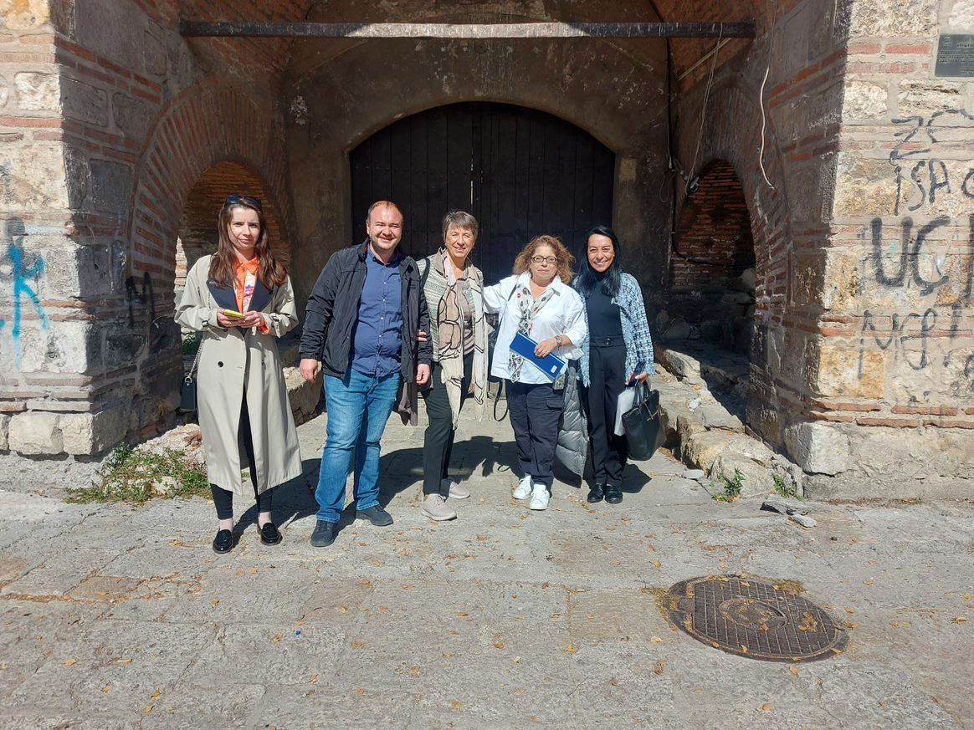
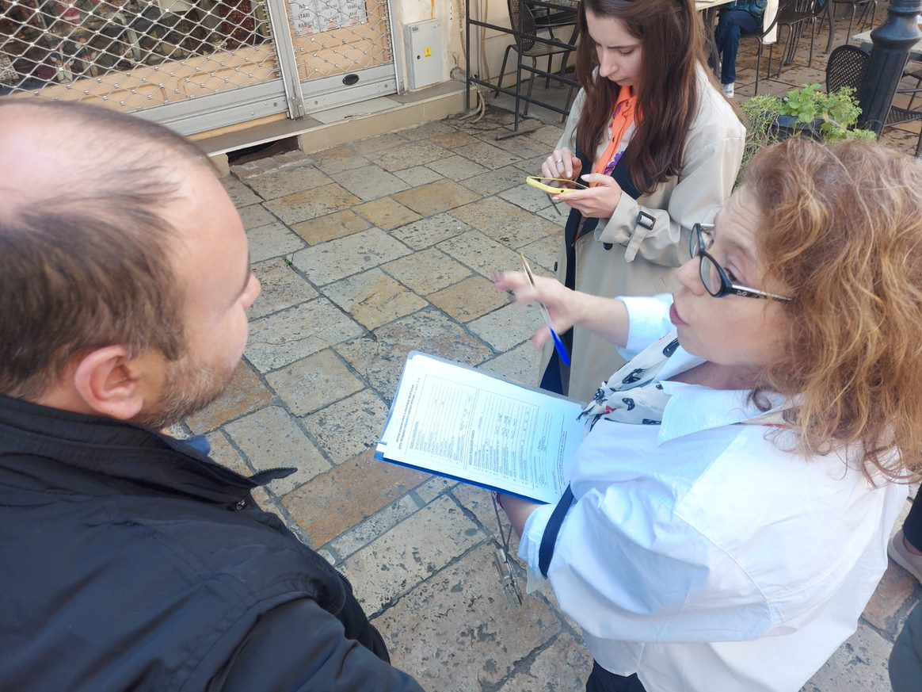
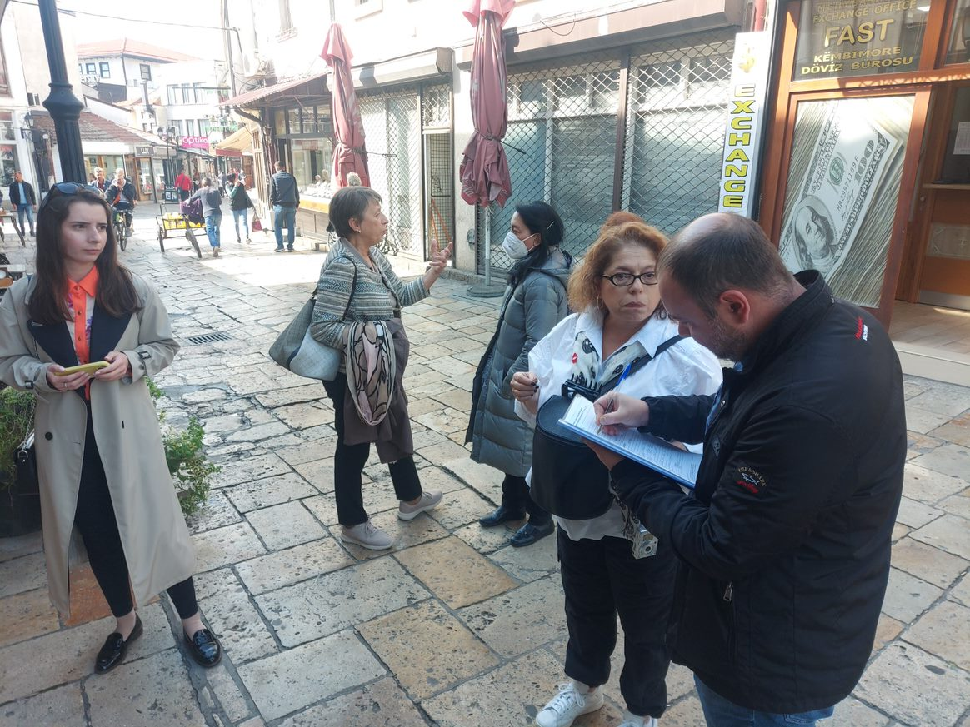
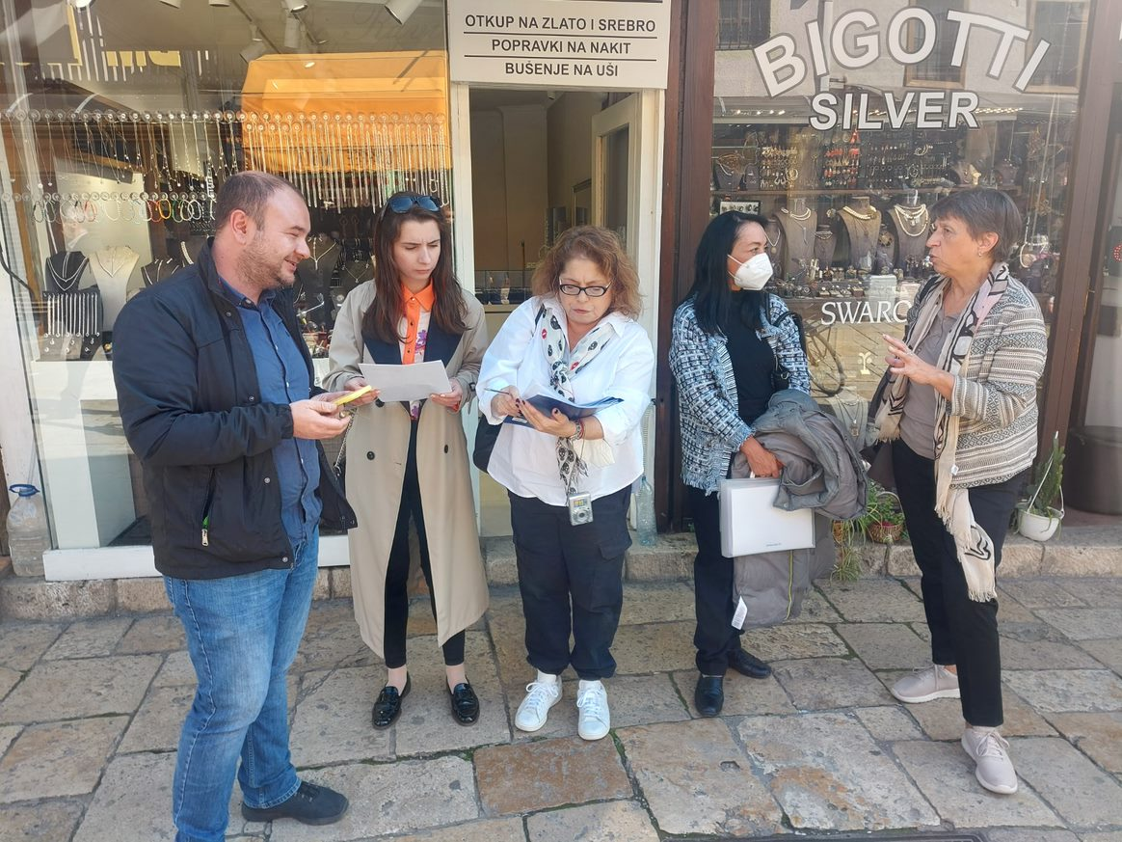
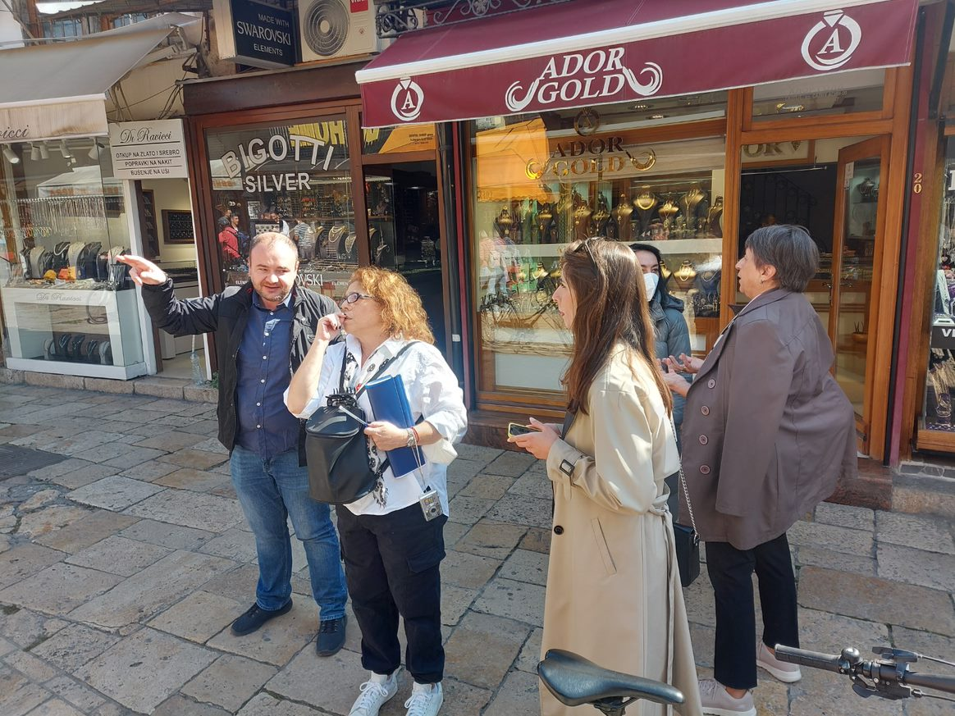
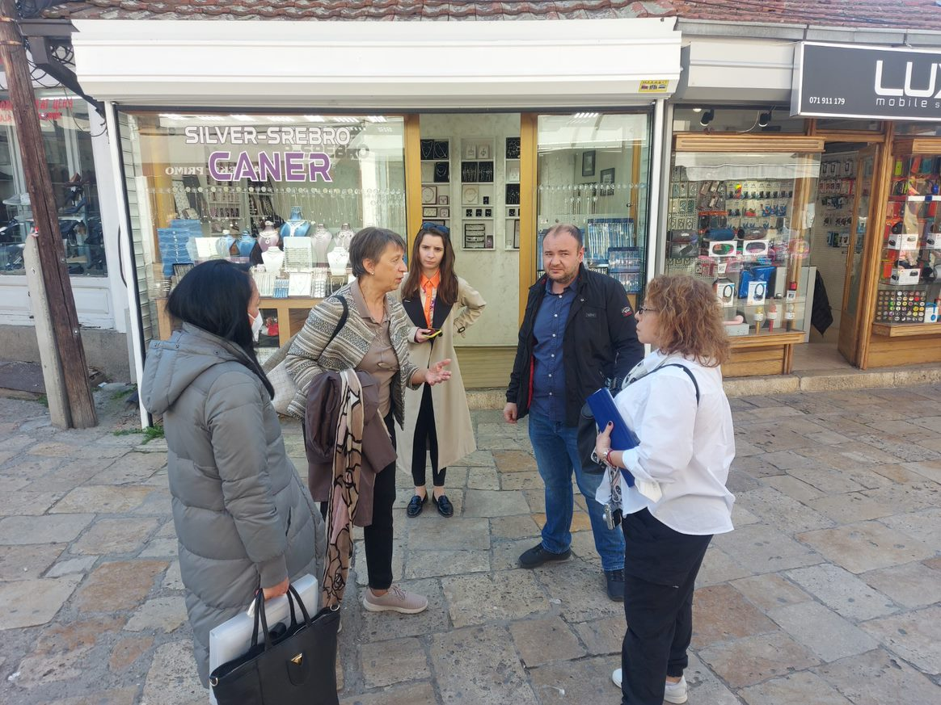
2022 Project – ECILS – ECPFE joint meeting, Skopje, 4-6 October 2022
Skopje Old Bazaar joint sightseeing and visual survey of Salih Asim street
Filling in the ECPFE’ First-degree pre-earthquake inspection form for three representative structures: SA-13, SA-22, SA-17

Slide 15
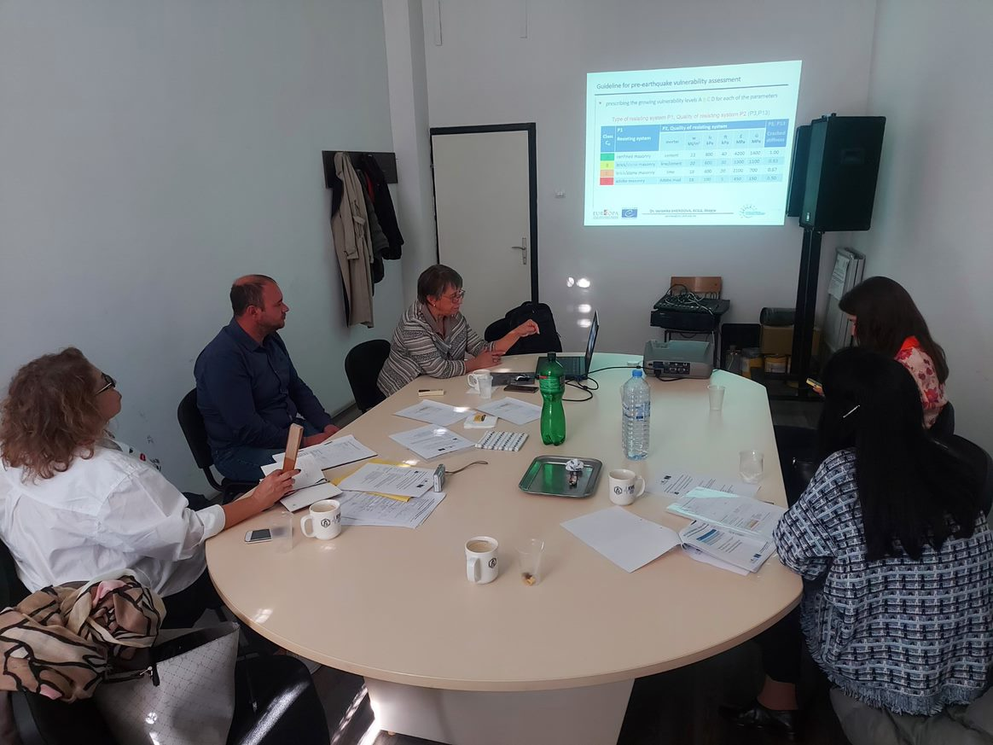
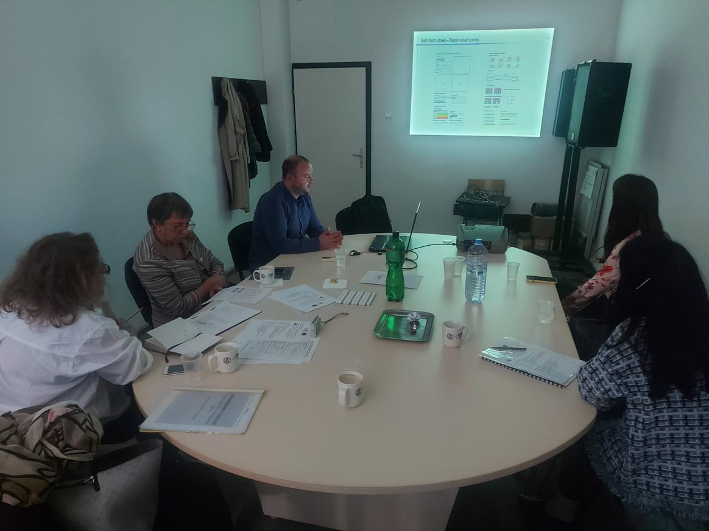
2022 Project – ECILS – ECPFE joint meeting, Skopje, 4-6 October 2022
Presenting of ECILS’ methodology for seismic vulnerability assessment of urban historic assets and resulting seismic score for 30 buildings in Salih Asim Street

Slide 16
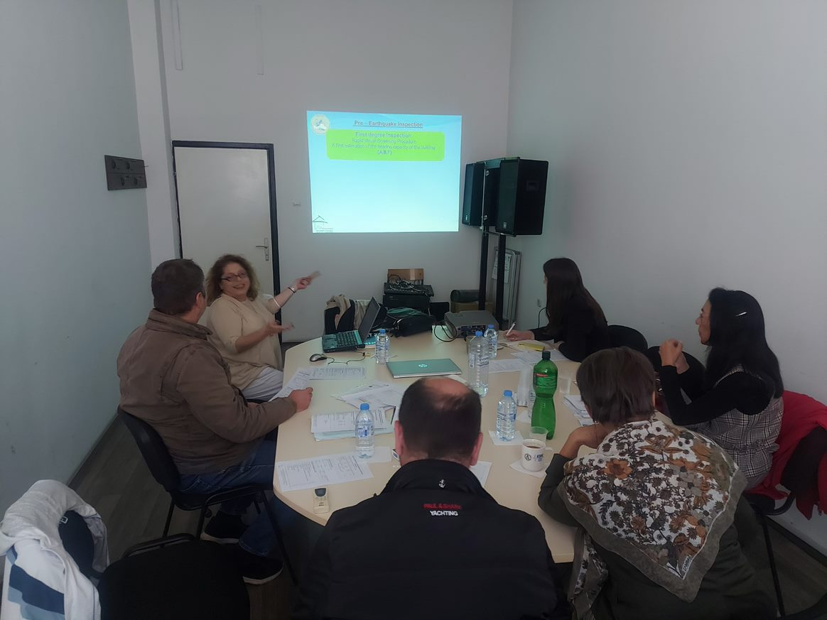
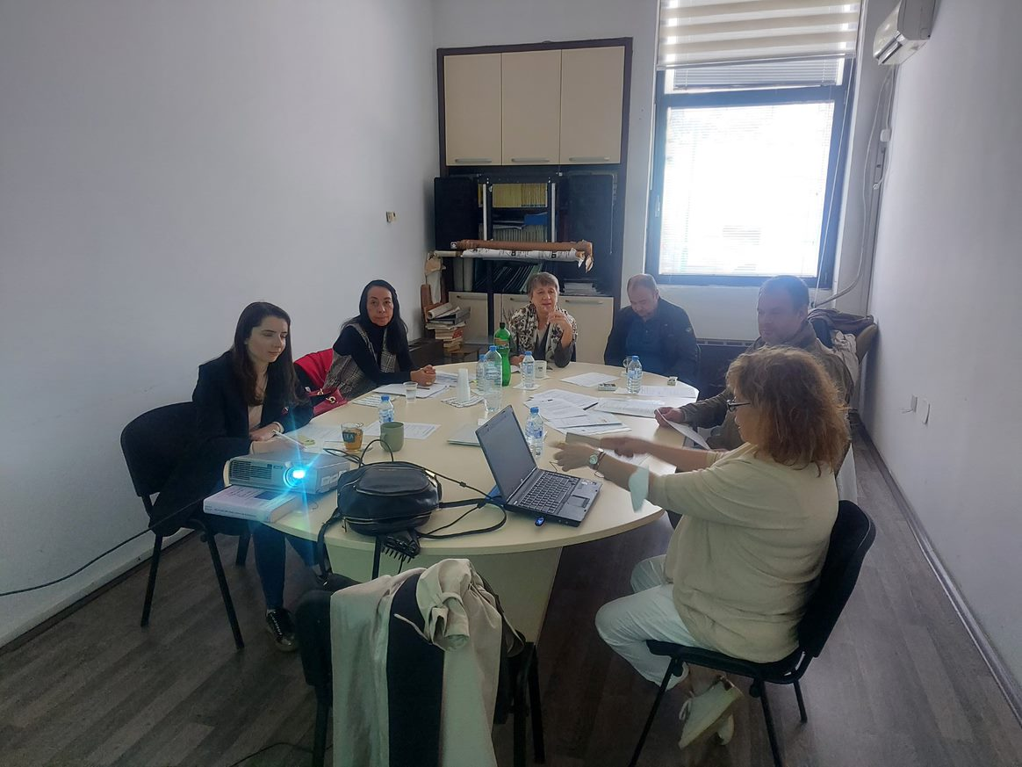
2022 Project – ECILS – ECPFE joint meeting, Skopje, 4-6 October 2022
Presenting of ECPFE’ methodology for determination of priorities for further detailed inspection, and resulting seismic score for 3 representative buildings SA-13, SA-17 and SA-22

Slide 17
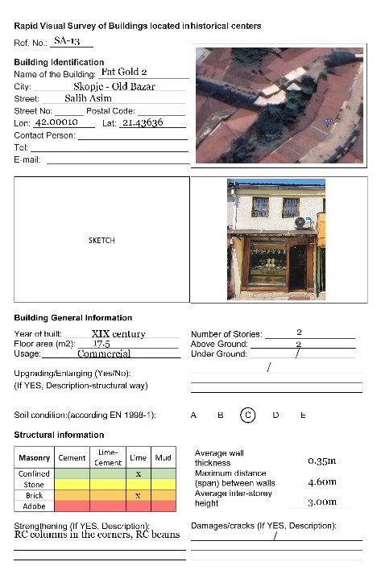

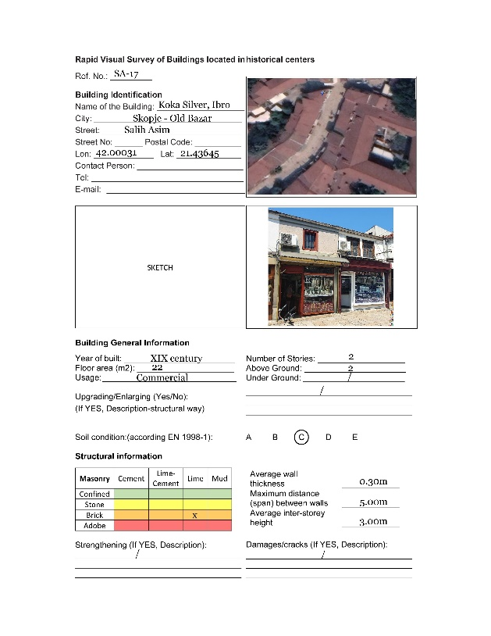
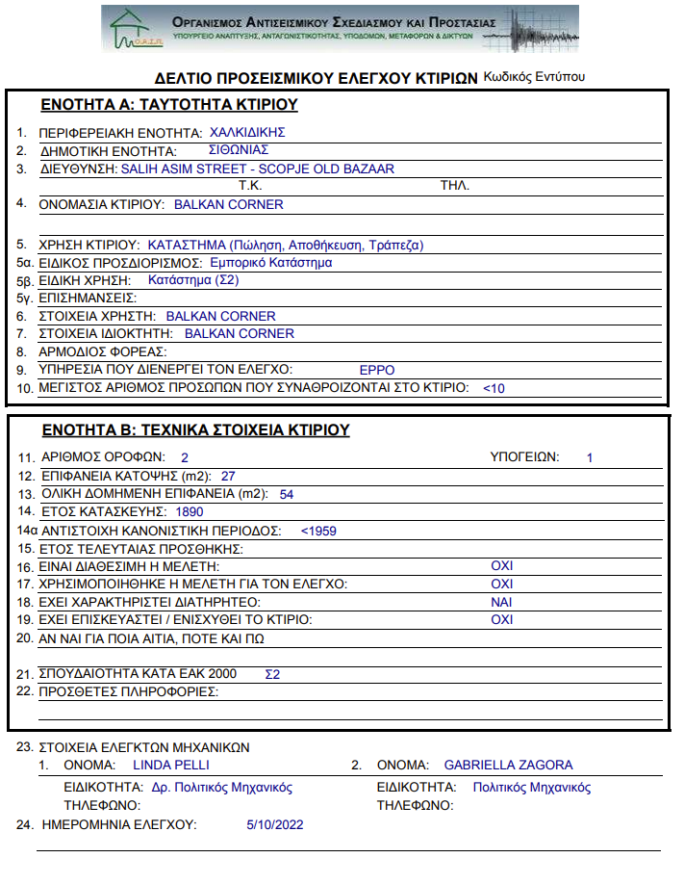
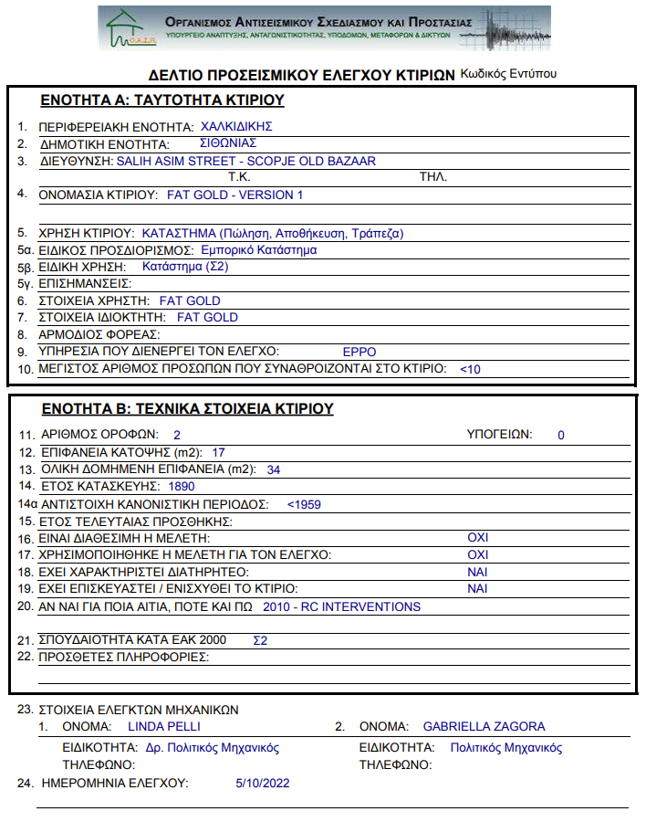
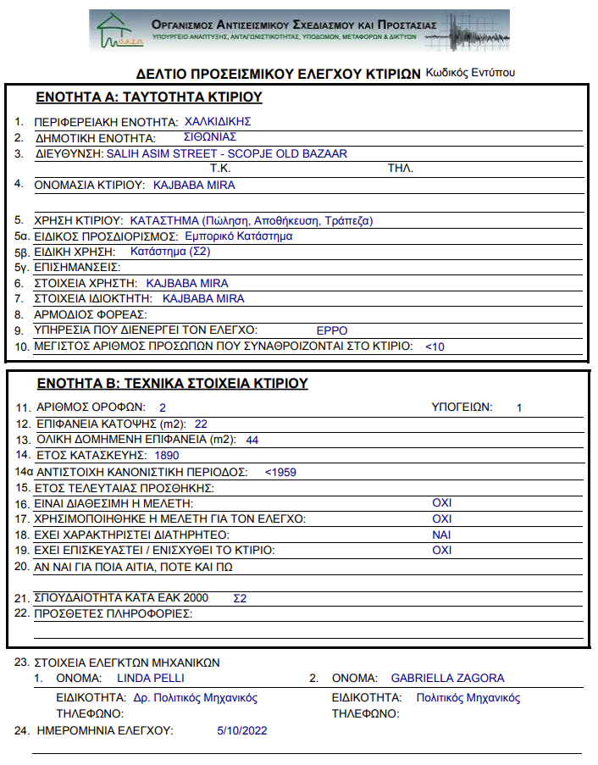
2022 Project – ECILS – ECPFE joint meeting, Skopje, 4-6 October 2022
Comparison of the two methodologies - resulting in similar scoring/priority
SA-13
ECILS
V=107
ECPFE
S=1.4
SA-22
ECILS
V=285
ECPFE
S=2.9
SA-17
ECILS
V=320
ECPFE
S=4.9

Slide 18
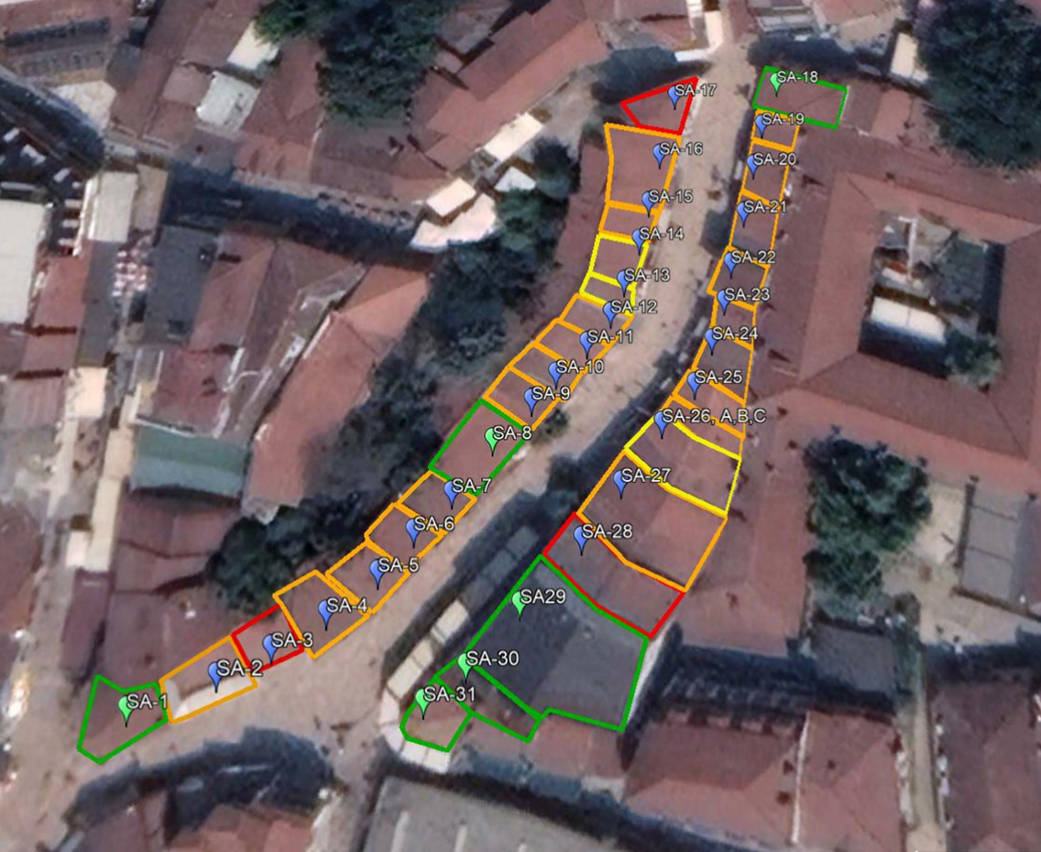
Salih Asim street – resulting vulnerability map (final seismic rating)
for Intensity IX - MSC
 | no damage
 | slight / moderate damage
 | moderate / severe damage
 | very severe damage

Slide 19
2022 Project – main results
ECILS methodology and the resulting seismic vulnerability map for selected street was verified using a ECPFE methodology that has been in use for many years in neighboring Greece for inspection of public facilities
meetings with the authorities and interviews with the owners provided raising of awareness about possible earthquake consequences in the case of Skopje Old Bazaar
mutual acquaintance with the characteristics and good practices related to the old city cores in neighboring countries enable getting know better each other and create conditions for future cooperation in similar projects, thus enhancing the overall cooperation between Greece and North Macedonia
the project achievements in 2022, together with the results from the proposed continuation in 2023 will provide basis for the decision makers to reduce post-earthquake urban and human losses and make the Skopje Old Bazaar more resilient historic urban centre

Slide 20
2023 Project - continuation and competition activities
ECILS | ECPFE
A9: Providing the necessary information to the partner ECPFE as the input data for the phase of dynamic analysis (if necessary, by repeated on-site inspection)
A10: Performing bearing and deformation capacity analysis of the structures of the selected buildings | A11: Performing relevant dynamic analysis for one or two representative models concerning the dominant typology of the Old Bazar
A12. Participation to the second joint meeting in ECPFE premises in Athens. In case of the pandemic via video-conference | A13: Holding the Joint meeting in Athens. In case of the pandemic via video-conference.
A14: Comparing/commenting on the results from the dynamic and bearing and deformation capacity analyses | A15: Report concerning the above and Proposals for amelioration
A16: Proposing the possible key structural intervention for seismic upgrading of the buildings identified as most vulnerable
A17: Preparing the final report

Slide 21
European Centre for Vulnerability of Industrial and Lifeline Systems
ECILS
North Macedonia
European and Mediterranean Major Hazard Agreement
(EUR-OPA)
Joint meeting of the Committee od Permanent Correspondents and Directors of Specialized Centres
17-18 November 2022
thank you for your attention !
EUR-OPA
Joint meeting of the Committee of Permanent Correspondents and Directors od Specialized Centres, 17-18 November 2022
Dr. Veronika SHENDOVA
Director
European Centre for Vulnerability of Industrial and Lifeline Systems, ECILS

