Slide 1
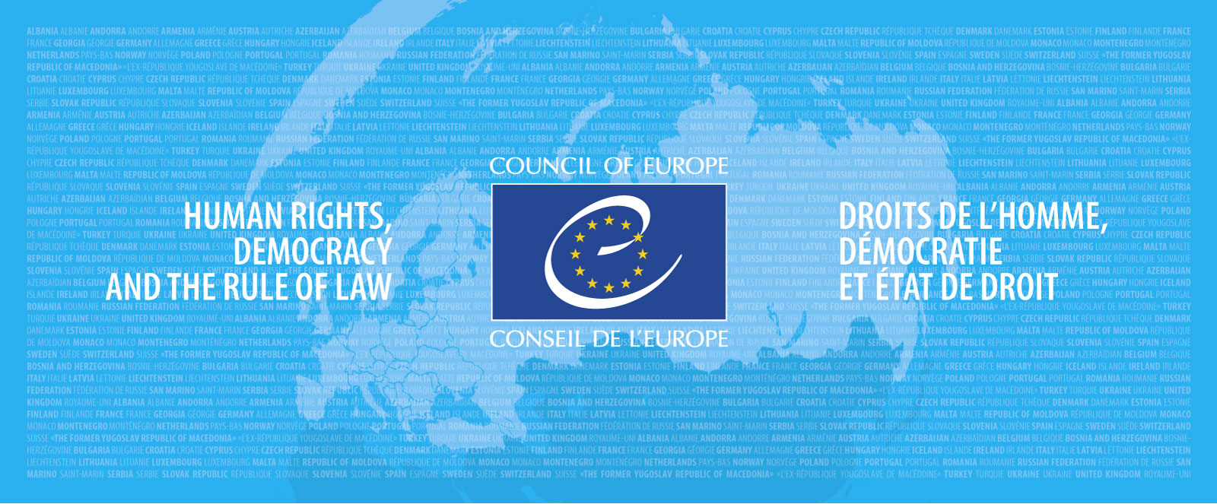
HELP Courses Radicalisation Prevention International Cooperation in Criminal Matters
Eva Massa

Slide 2
EU-CoE HELP ‘Radicalisation Prevention, Judicial Response to Terrorism & International Cooperation in Criminal Matters’
©bbc

Slide 3
EU-CoE HELP RP-TERR-ICCM (2020-2021)
TARGET AUDIENCE
Judges, Prosecutors, Prison & Probation staff.
Aditional participants – policymakers, psychologists, law enforcement officers, lawyers.
Other participants in courses open on the HELP e-learning platform.

Slide 4
QUANTITATIVE RESULTS
801
Participants
5200
Users Self-learning courses
25
EU MS

Slide 5
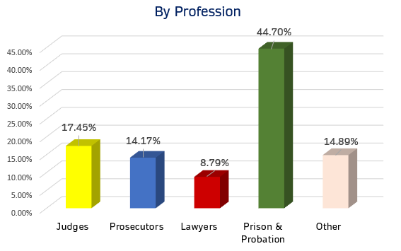

Slide 6
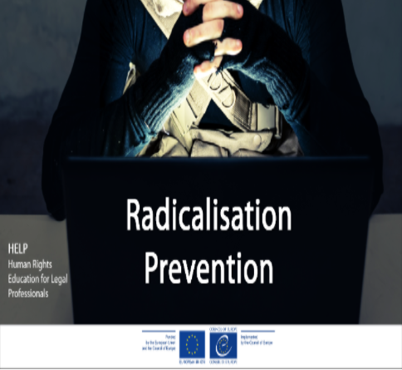
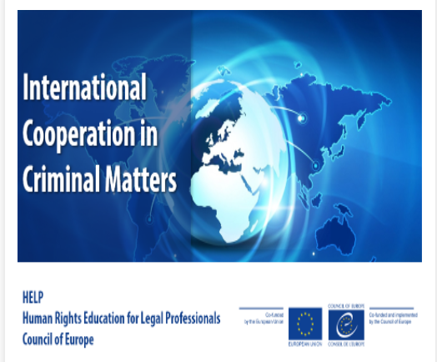
Courses
Notes:
ECHR + ESC + CoE legislation + EU law for EU
+ EU Charter and EU law for EU countries

Slide 7
13 COURSE LAUNCHES
(Course on Radicalisation Prevention
Course on International Cooperation in Criminal Matters)
437 Participants

Slide 8
Both courses include legislation and case-law from:

Slide 9
Notes:
ECHR + ESC + CoE legislation + EU law for EU
+ EU Charter and EU law for EU countries

Slide 10
Experts

Slide 11
Course Structure
Introduction: Overview and Concepts
International & European Legal Framework
Judges & Prosecutors
Concerning issues related to criminal procedure
Generic for Prison & Probation staff on Radicalisation Prevention
Specific for Prison Staff
Judges & Prosecutors
Gathering and use of evidence in counter-terrorism cases
(HELP in the EU)
Specific for Probation Staff
Managing Foreign National Prisoners (EuroPris)
10-15 hours
©bbc

Slide 12
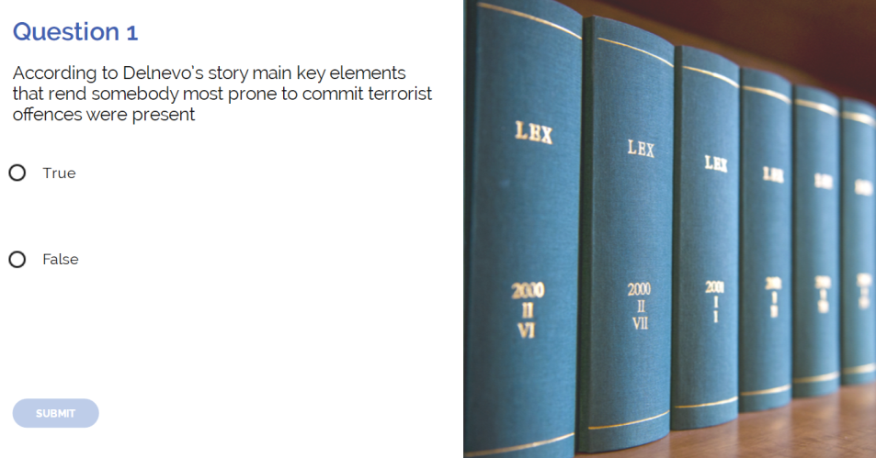
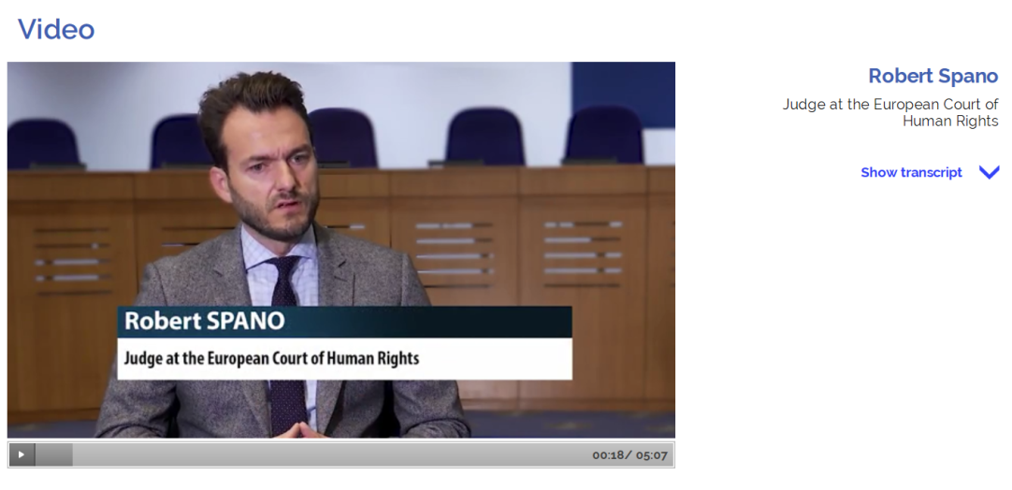
Introduction to the ECHR and the ECtHR
Notes:
Judge Spano speaks about different situations between sporadic terrorist acts and sustained ones.
Secondly, need to apply a cronological analysis
Finally, we should avoid the normalisation of emergency laws

Slide 13
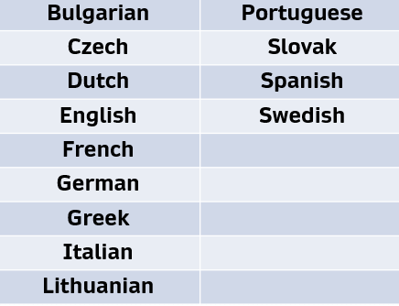
Available in 13 languages

Slide 14
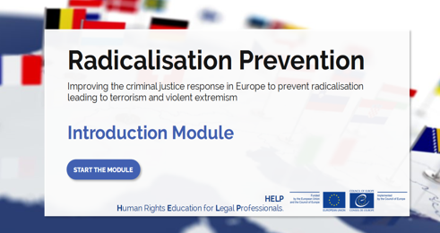
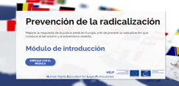
©bbc
©bbc

Slide 15
©bbc

Slide 16
Course structure
(11 hours)
1. Introduction
2. Extradition and surrender
3. Mutual legal assistance
4. Transfer of sentenced persons
5. Transfer of Proceedings, International Validity of Criminal Judgments, and Supervision of Offenders
6. Seizure and Confiscation of Proceeds of Crime

Slide 17
1. Introduction
Key concepts & general principles of ICCM.
What ICCM entails: actors, processes and mechanisms for judicial cooperation.
Human rights implications.

Slide 18
2. Extradition and surrender
What is extradition? What is surrender?
Procedure based on the EAW
Review of international instruments & how to use them in practice.
Toolbox for legal practitioners.

Slide 19
3. Mutual legal assistance
MLA procedure – drafting a MLA request; competent authorities to deal with MLA.
Joint Investigation Teams.
Legal instuments: European Convention on Mutual Assistance, European Investigation Order, e-evidence, etc.

Slide 20
4. Transfer of sentenced persons
Humanitarian considerations.
Transfer as a means of cooperation to prevent and combat crime.
Benefit for the Administering State and for the Sentencing State.
How does it work in practice?

Slide 21
5. Transfer of Proceedings, International Validity of Criminal Judgments, and Supervision of Offenders
Legal instruments.
Transfer as an alternative to extradition; as a solution for conflicts of jurisdiction.
International validity of judgments – challenges.
Supervision of offenders who leave the territory of a State after a conditional sentence.

Slide 22
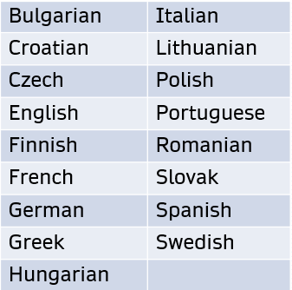
Available in 17 languages

Slide 23
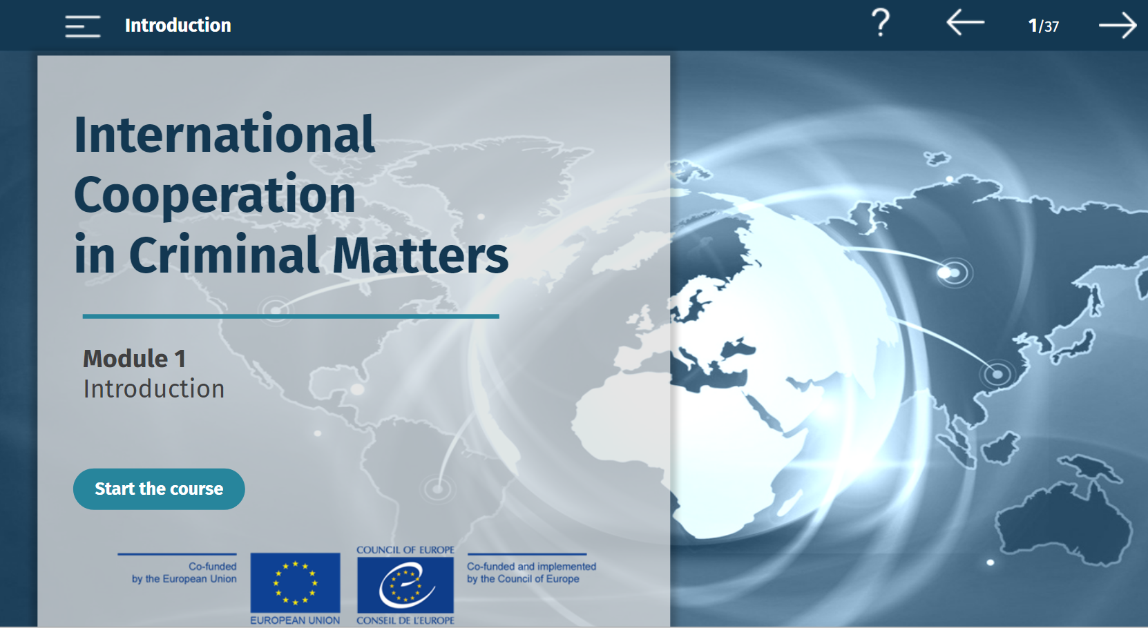
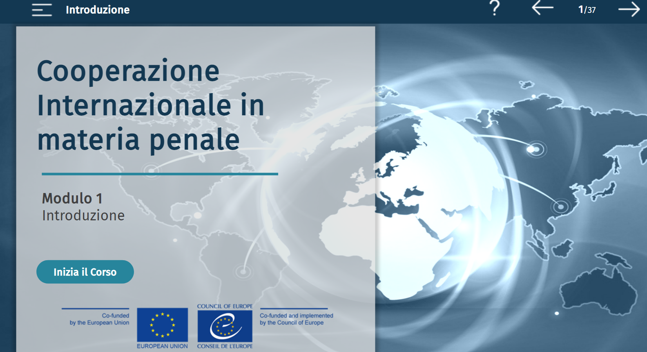
Translated into 16 languages.

Slide 24
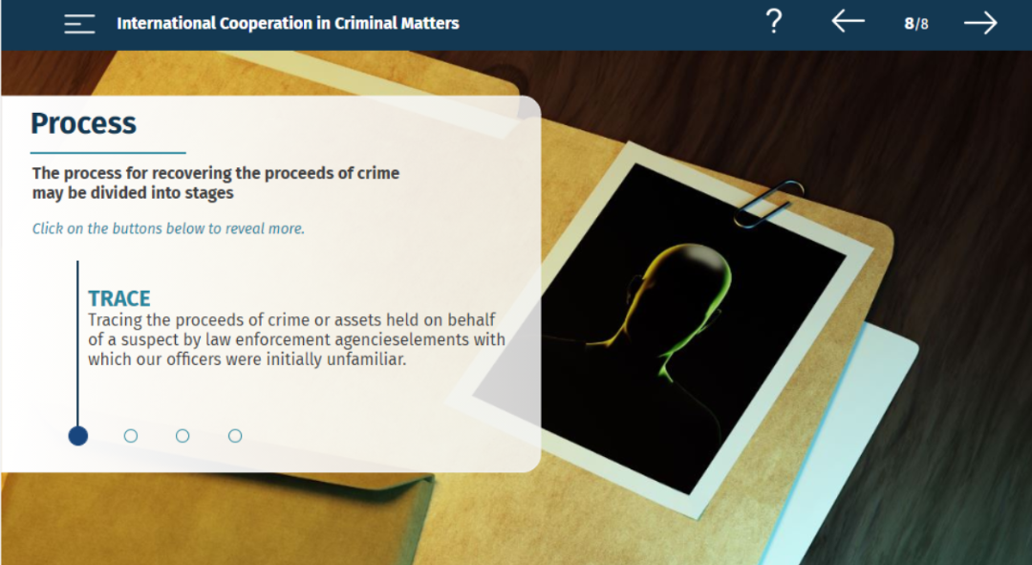

Slide 25
https://help.elearning.ext.coe.int/

