Slide 1
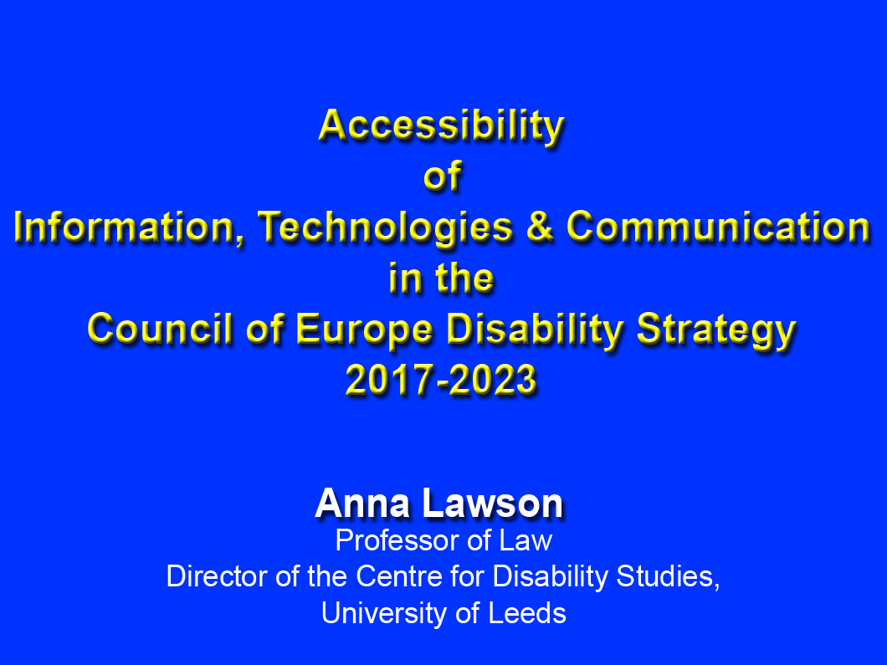

Slide 2

What will be Covered
Why it matters
What Governments (and others) can do
How the Council of Europe can help

Slide 3
Why it matters
(Sections 1 and 2 of the Report)
To disabled people
To the whole of society

Slide 4
Why it matters
(Sections 1 and 2 of the Report)
As a ‘priority area’ of the new Strategy
To the other priority areas in the Strategy
To the cross-cutting themes in the Strategy

Slide 5
Why it matters
(Sections 1 and 2 of the Report)
Relevant CRPD Standards
– Article 9
– Article 21
– Article 5
– Article 4

Slide 6
Why it matters
(Sections 1 and 2 of the Report)
CRPD Committee Guidance
– General Comment No 2
– Nyusti & Takács
– F v Austria

Slide 7
What Governments (and Others) Can Do
(Sections 3 and 5 of the Report)
Involve Disabled People’s Organisations
eg French Inter-Departmental Observatory on Accessibility and Universal Design

Slide 8
What Governments (and Others) Can Do
(Sections 3 and 5 of the Report)
Strategic Engagement and On-going Monitoring
– Distinction between existing and not-yet-existing products and systems
– Inclusive of all impairment types
– eg National Strategy for e-Inclusion, Former Yugoslav Republic of Macedonia

Slide 9
What Governments (and Others) Can Do
(Sections 3 and 5 of the Report)
Accessibility Standards and Guidelines
– Importance of international collaboration and consistency
– eg EU, Mandate 273 on design for all in ICT for older and disabled People and Mandate 376, accessibility of ICT in public procurement
– eg UK, NHS England’s Accessible Information Standard

Slide 10
What Governments (and Others) Can Do
(Sections 3 and 5 of the Report)
Embedding Accessibility in Legislation
– Licencing and inspection regimes
– Equality and non-discrimination laws
– eg Norway’s Universal Design Law

Slide 11
What Governments & Other Organisations Can Do
(Sections 3 and 5 of the Report)
Embedding Accessibility into
the Spending of Public Funds
– Procurement
– Grants
– International aid
– eg Ireland:-
Disability Act 2005 and
National Disability Authority’s Accessibility Toolkit

Slide 12
What Governments & Other Organisations Can Do
(Sections 3 and 5 of the Report)
Research and Data Gathering
– Specific research concerning accessibility
– Embedding accessibility into research on new ICTs

Slide 13
What Governments (and Others) Can Do
(Sections 3 and 5 of the Report)
Training, Awareness-Raising and Knowledge Sharing
– Mainstreaming accessibility into formal academic and professional training for IT specialists
– Mainstreaming accessibility into formal training for non-IT expert service providers
– Awareness-raising, guidance and training, including for disabled people

Slide 14
What Governments (and Others) Can Do
(Sections 3 and 5 of the Report)
Training, Awareness-Raising and Knowledge Sharing
Examples
Malta, Foundation for Information Technology Accessibility
European Agency for Special Needs and Inclusive Education, Guidelines for Accessible Information
France, ‘Plus Belle la Vie’
Estonia, ‘Be Here: Access for All’
Vodafone Foundation, Smart Accessibility Award
European Commission, Access Cities Award

Slide 15
What Governments (and Others) Can Do
(Sections 3 and 5 of the Report)
Relationship between those 7 points
ITU and G3ICT, eAccessibility Policy Toolkit

Slide 16
How the Council of Europe can help
Model of good practice
Disseminator of good practice and international standards and collaboration
Promoting human-rights oriented research on accessibility and the impact of its absence
Recommendations, Guidance and Jurisprudence

Slide 17


Slide 19


