Slide 1


Success of Ukrainian National Paralympic Team- as an Example of National Proud

Slide 2

History
1989
Sport movement of the disabled in Ukraine was started. That was the time when physical culture, sport and rehabilitation clubs for the disabled started to form; later on they became the basis for formation of national federations of sport for the persons with different types of disability: troubles of locomotor apparatus, vision, hearing and mental disabilities.
The four federations united in National Sports Committee for the Disabled of Ukraine. At the moment this Committee represents Ukraine in the International Paralympic movement; it plays the role of National Paralympic Committee and contributes to the participation of Ukrainian sportsmen in Deaflympics.
The specialized institution, Invasport, Ukrainian centre for physical culture and sport for the disabled was formed by resolution of the Government of Ukraine. Activities of this Centre in close cooperation with National Sports Committee for the Disabled of Ukraine ensure appropriate environment for implementation of national policy in area of physical culture and sport for the disabled, their physical culture, sport and other types of rehabilitation.
1992
1993

Slide 3
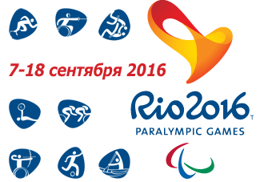
INVASPORT SYSTEM OF INSTITUTIONS OF PHYSICAL CULTURE AND SPORT FOR THE DISABLED UNITES:
2
25
district Invasport centres of physical culture and sport for the disabled
3
regional Invasport centres of physical culture and sport for the disabled
municipal Invasport centres of physical culture and sport for the disabled
112
23
3
4
clubs working in area of physical culture, rehabilitation and sport for the disabled
sport schools for disabled children and youth
specialized schools for disabled children and youth of Paralympic and Deaflympic reserve
departments dedicated for sports for the disabled are opened under the roof of sport schools for children and youth

Slide 4
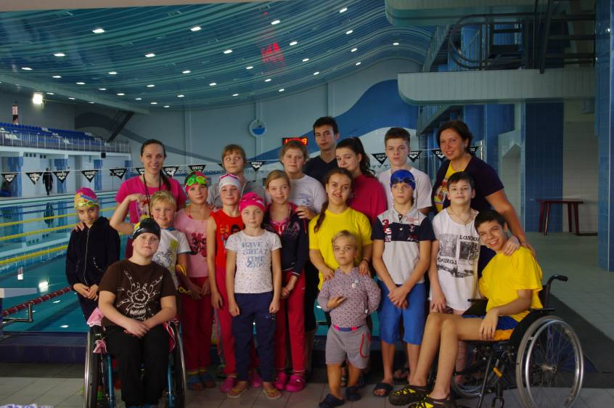
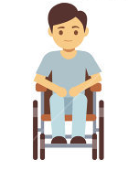


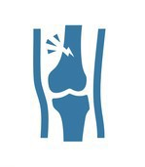


DIFFERENT FORMS OF PHYSICAL CULTURE, REHABILITATION AND SPORT ACTIVITIES
IN UKRAINE:
Over 5 thsnd children with disability are involved in Ukraine in physical culture and sport activities in sport schools for the disabled children and youth, in the departments of sport for the disabled working in the sport schools for children and youth.
40
Кinds of sports
for the persons:
40 000
of the disabled persons
are involved
14
28
3
27
with
Vision disability
with locomotor disability
with mental and physical disability
with hearing disability

Slide 5
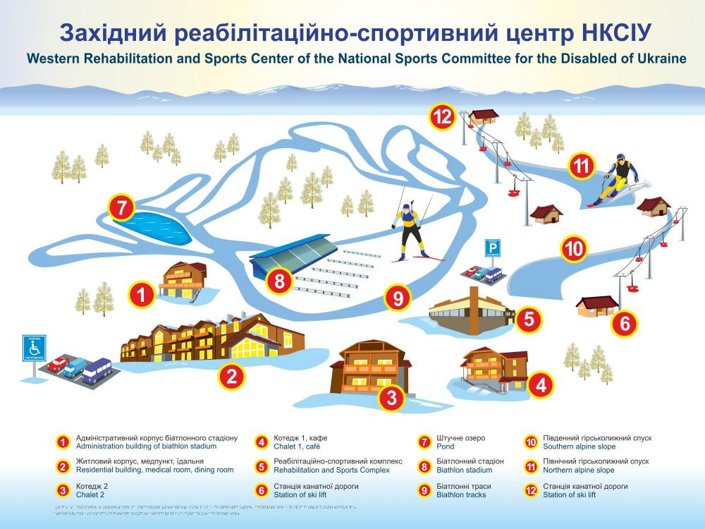

Slide 6
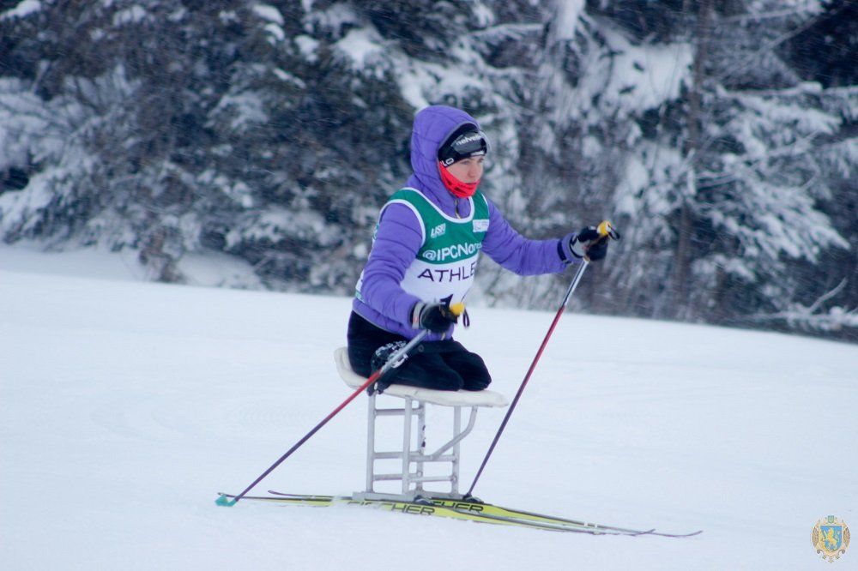
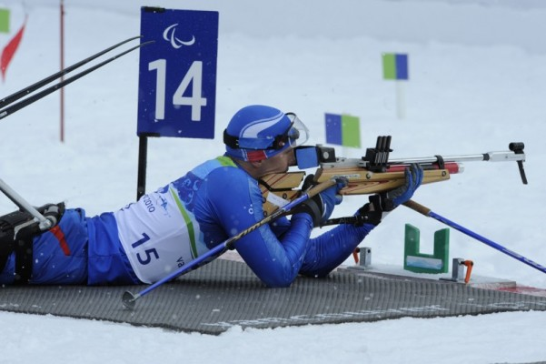

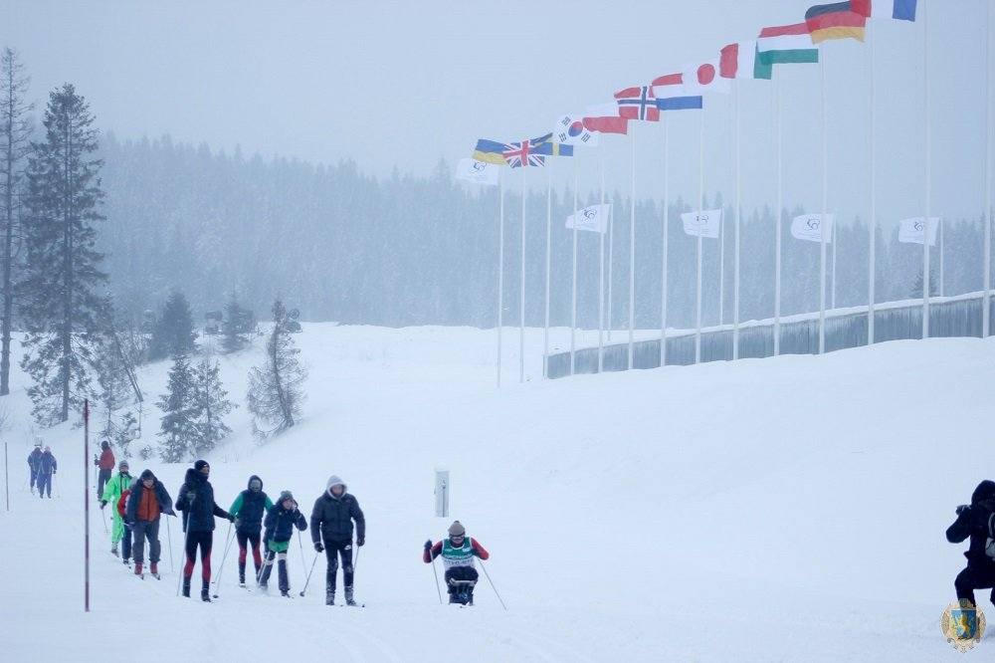
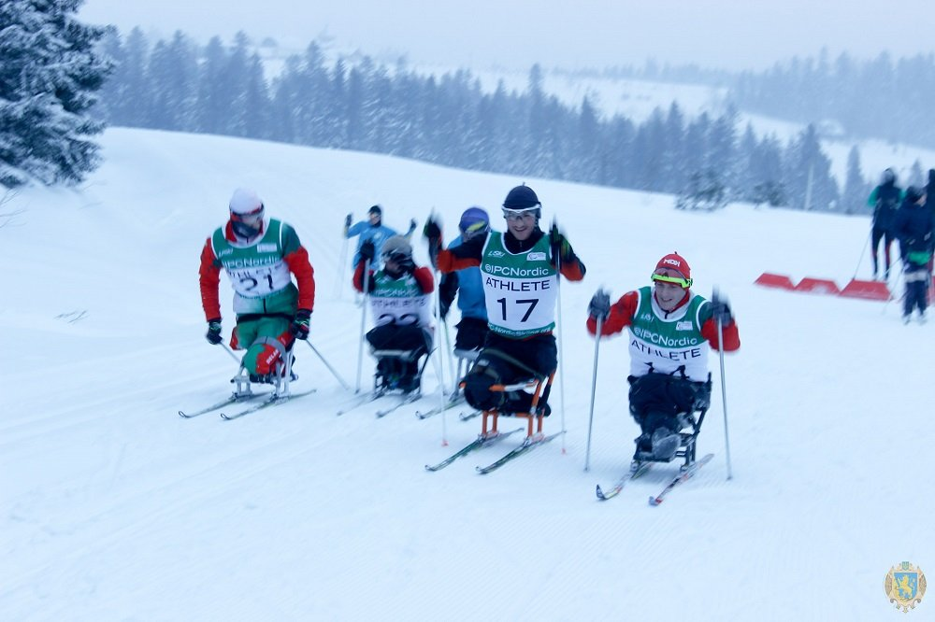
HOLDING ОF THE WORLD SKI RACE AND BIATHLON CUP - 2017

Slide 7





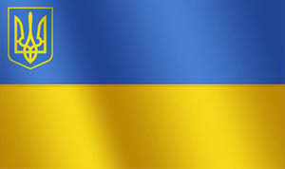





PARTICIPATION
OF UKRAINIAN TEAM IN PARALYMPIC MOVEMENT
1996
1998
2004
2000
2002
7
9
37
12
55
PARALYMPIC
UKRAINIAN TEAM
2006
2008
2010
2012
2014
25
74
19
84
25

Slide 8
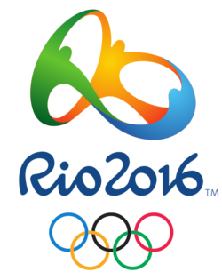




Ukrainian team won:
Our team held the successful third position in Paralympics-2016
41
37
39
gold
silver
bronze
Ukrainian Paralympic sportsmen got the exciting results:
117
85
109
85 sportsmen (taking into account team playing and sport games) of total number of 172 sportsmen participating in the XV-th summer Paralympics won the high awards of different levels
Ukrainians set up 109 records
(22 world records, 33 Paralympic records and 54 European records)

Slide 9
IN 2016 WERE HELD:
67
246
18
all-Ukrainian competitions
educational and training practice sessions in Ukraine
educational and training practice sessions abroad
13
European Championships
1
16
World Championships
Global chess Olympic game *
Participated
in 73
international
competitions
13
*won
525 medals
(227 golden,
153 silver,
145 bronze)
World Cups
30
International competitions

Slide 10
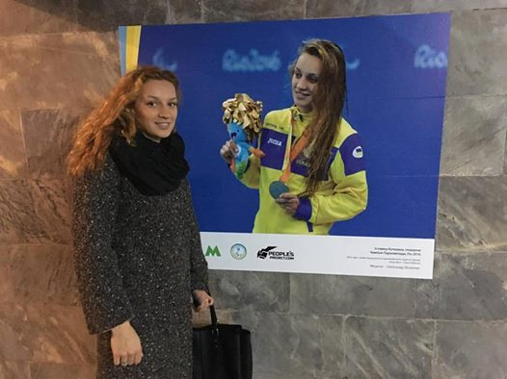
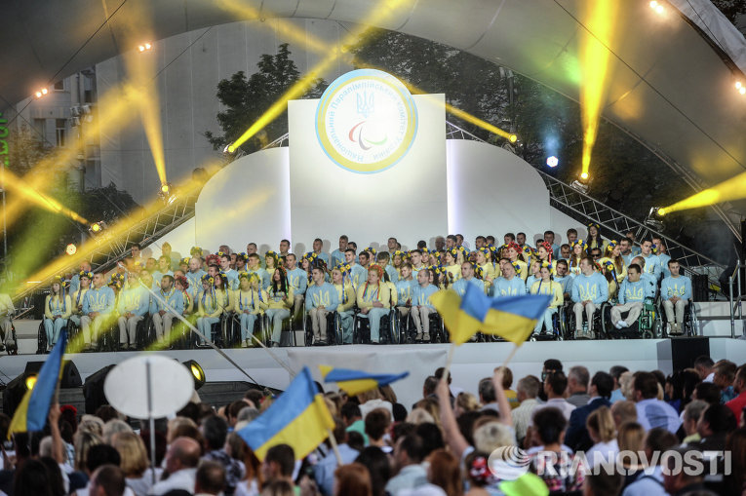
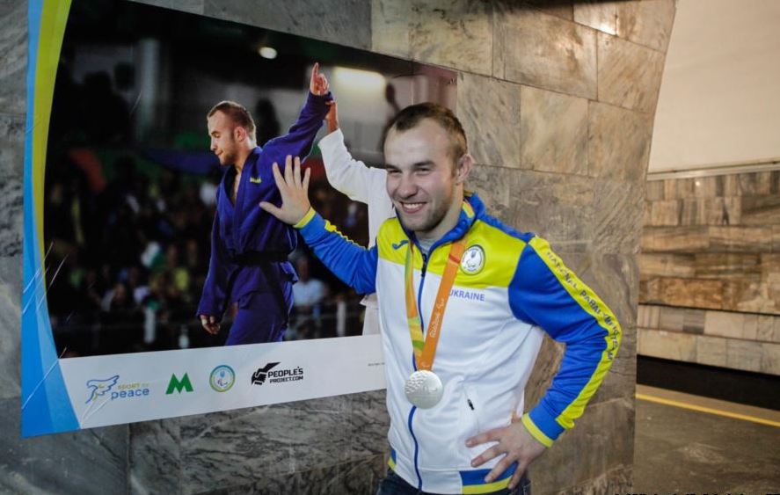
Photo-exhibition "Champion in everybody", placed on the "Olympic " station’s platform of Kiev Metro
Ukrainian athlete
Еkaterina Istomin.
Paralympic champion
in Rio-2016, swimming.
Celebration of the Ukrainian team wires at the Paralympics-2016
Ukrainian sportsmen Dmitry Solovey.
Winner of the Paralympic Games
in Rio-2016, judo.

Slide 11
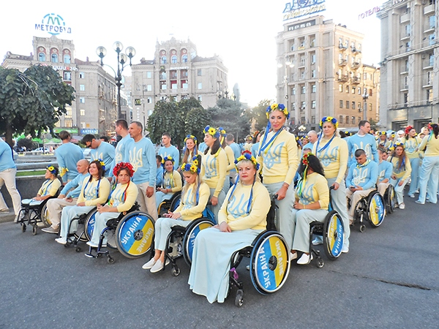
When you are with us -we are the winners !

