Slide 1
AT and (e)Accessibility:
Public Private Partnership a.Univ.-Prof. Dr. Klaus Miesenberger
Universität Linz; Altenbergerstrasse 69; A-4040 Linz
E-Mail: klaus.miesenberger@jku.at
WWW: http://www.integriert-studieren.jku.at
Tel.: +43-732-2468/9232; Fax: .../9322
Public – Private - NGO - Partnership PPNP
Notes:
THE LAST: I’m technologist (DIGITAL AND eACC DINASOR- dating parties Nurds – therefore decorative PICTURES – WCAG 1.2
ICT focussed – today PPP
THANK YOU for Strategy – very important
PPP Never been so important: INCLUSION AND PARTICIPATION IS CLAIMING FROM MAINSTREAM
UNCRPD: REACHING OUT, asks for PPP
AND NOT ENOUGH: PPP; P – NGO – P - P
IT IS PRIVATE – NGO – PUBLIC: mediated what makes it difficult: not a real market (not consumer buys, not real public, as inclusion demands mainstreaming

Slide 2
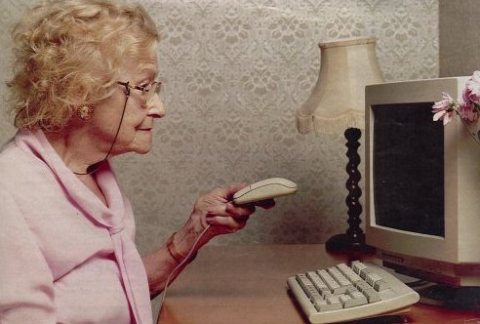
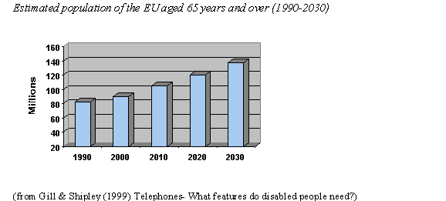
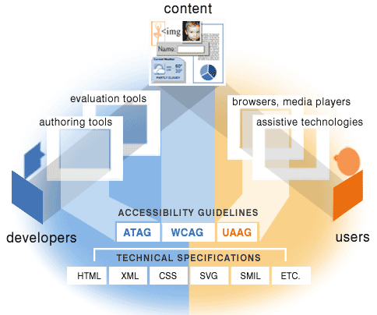
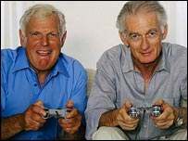
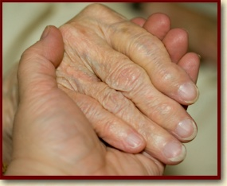
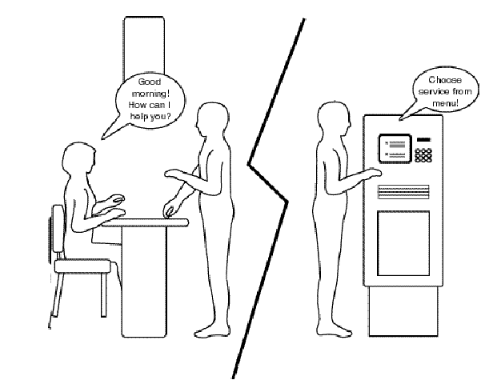
We have all ingredients for all stakeholder!
UN-Convention,
Web-Accessibility Directive,
M376, M473,
Disability Strategy
Individual
Demographics
Politics
Legislation
Technical
Business
Care and support
Social-economic
Anti-
Discrimination
Legislation
Notes:
I heard so much – good today; feel understood: summarize benefits – for all, in PPP
We all know, we have all facts the need of PPNP for all stakeholdres
All stakeholders benefit: PPP if done properly will be a WIN-WIN:
INDIVIDUAL: also labour, edu,
LEGISLATION: BUT NOT ENFORCED

Slide 3
But uptake is lacking behind!
It is still more charity and cosmetics than fundamental human right investment / business / change management
Notes:
Potential grows faster than uptake. And also PPNP does not take up
Still more AT charity, acc more cosmetic and „best practice“ than basic
There are many resistances
not only by mainstream and market
also INNER residencies– protecting own business model: happy with it, secret curriculum making them reluctant to change
VERY MUCH RELATED: NOT A MARKET (if we like it or not: we are in a market driven society)
STILL MORE PUBLIC PATRONANCE, not independent consumers

Slide 4
7 domains for PPNP
Assistive Technology
eAccessibility
USER
AT
HCI
System/Service
Notes:
No time to talk about potential of Acc, in particular of ICT CYBORG NANOBOTS mass.
Let me say: UNCRPD in almost all § refers to this as a driver -
WHERE IT BECOMES VIVIT – WHEN USER BECOMES ACTIVE: Often said: CONTROL; BUT ALL TALKED ABOUT IT
– in the hands of users them selves: INDEPENDEND SELF DETERMINED
2 issues of PPNP:
AT to become a market: PwD consumers: reasonable price, quality, right to select best tool and service (NGO, public funding and charity role)
Not only sector, it is implementing accessibility and that is by somebody else. We have to have PPNP!

Slide 5




1. Accessibility and ATs a MUST
“the new normal”
EU
M376: Public Procurement
M420: Build Environment
M473: Standardization
M392: Domestic Appliances
M371: Services – Tourism, Transport
European Disability Act
Disability Strategy
USA
ADA
508
ACAA
→ Human right and market
Notes:
PPNP: If it is a human right then execute it – will make it business beneficial ...
LEGISLATION in EU IS THERE: BUT NOT ENFORCED
Impact: ALL WE HAVE HERE IN EUROPE IS IMPORTED (smart phone, desktop) – WHY, IT IS ENFORCING LEGISLATION – WELLS FARGO
In Europe: „reasonable accom“ – leads to reasonable exclusion; DOES NOT MAKE A MARKET IN THE PPNP
First legal, but become business benefit:
It is about you that you demand it and do it

Slide 6
2. Keep the standard interface (HCI) simple & universal stable accessible adaptable inclusive
Notes:
PPNP – YESTERDAY Acc, eAcc; most important because biggest potential
WHAT EVER THE NEW TECHNOLOGIES WILL BE
Industry will follow it, why: otherwise you loose users (painful case of nordic mobile phone industry when HCI entered into mobile)
ACCESSIBILITY HAS TO BE PART OF IT: NGOs demand it, parents don’t buy, public sector must not buy, …
TO NAME ONE EXAMPLE: Why do governments arround Europe buy inaccessible learning materials? Why buildings not accessible (since 60ies standards)
THE RIGHT PPP: Buy accessible. M376
Same with building and other standards – all intervoven
HAS TO BE REFERENCED IN STANDARDS

Slide 7
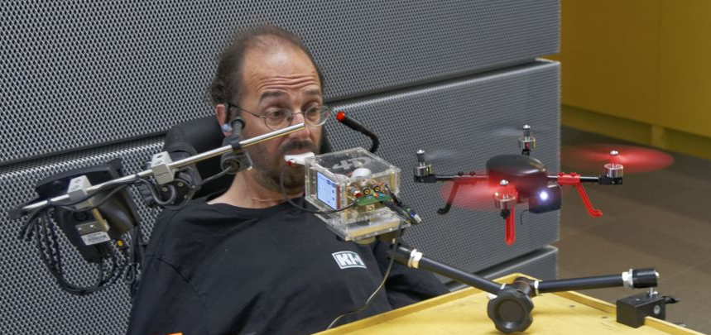
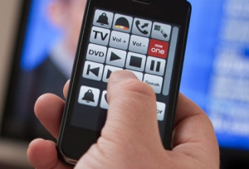
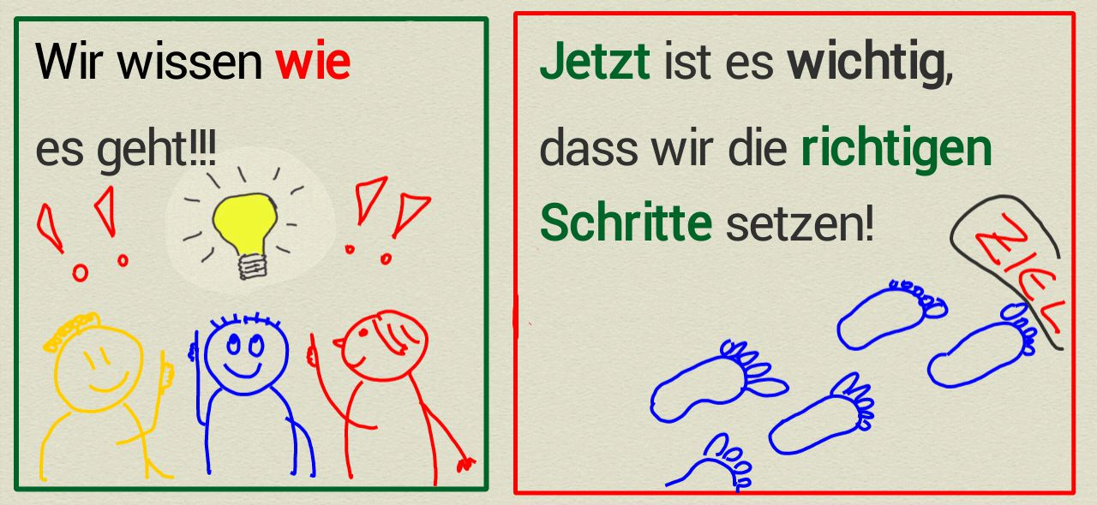

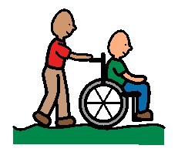
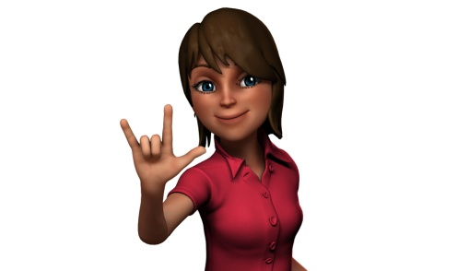
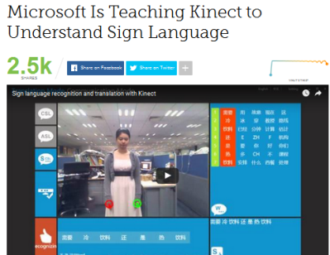
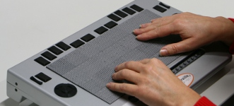
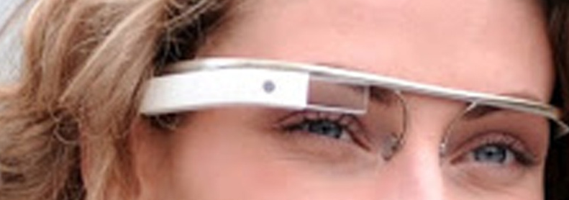
3. Support adaptability and personalization
Notes:
NEED RESEARCH – NOT BY ACCIDENT
Who has a smart phone? Compare with you neighbour – not one is the same „if you show me yours, I show you mine“
But we handle all the same apps … VIDEO RECOREDER
WE MAKE IT PERSONAL AND ADAPT to be done AT THE PERSON
What we have is imported – EU proud of R&D, but implemented US
PPNP NEEDED make it a market; get it in your hand and do it yourself – your business JOBS

Slide 8
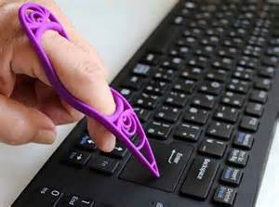
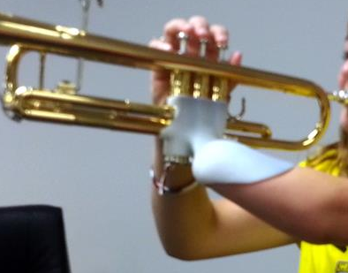

4. Support individual products / AT
“batch size one”
https://3dprint.com
www.pinterest.com
Notes:
RESEARCH – AND NEW ROLE FOR SERVICE PROVIDERS
PPNP make it a market: Industry produces based on personal requirements – defined by users with their NGOs WHAT THE PERSONAL AT IS: technicians do not know, but users with their service/care givers – they have to do it
3D printing, persnalised medication, personalised services, YES: Cyborgs

Slide 9

5. Digitization (IoT)
Use the potential and minimize risks
https://enterprisersproject.com/
Notes:
PPNP NEEDED: IoT and WoT will go on
Huge potential but also RISK to become barrier
FOR MOST APPLICATIONS IT IS A GADGET, FUN
For PWD first time independent and self determined access
MIGHT SAY: Privacy, security, saftey – yes, but first we also want to have the same problem.

Slide 10
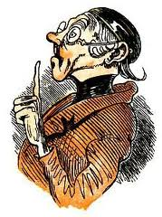
6. AT and Accessibility to become part of education
Towards our own domain:
People with Disabilities
Rehabilitation
Service/Care Providers
(Inclusive) Education
Toward mainstream:
ICT
Design
Architecture
Management
Law
Administration
Curriculum Initiative!
Notes:
PPNP
What is important is in the curriculum, not an add on or voluntary – basic education

Slide 11

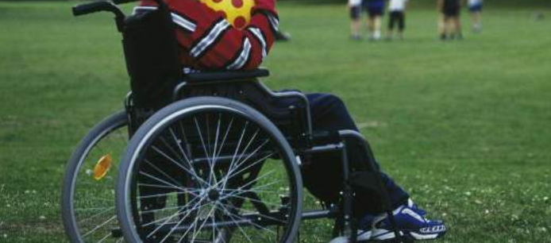

7. AT/Accessibility remain a social issue
Technology is never the solution in itself
“Change Management”
http://www.kunst-fuer-alle.de
Notes:
PPNP
STAYS A SOCIAL ISSUE – NO TECHNICAL MAGIC, no excuse – needs a human-social environment to be benefical and not a TECH GETTHO
It starts from that it is normal to be different
Attribution, prejudices, stigmatisation, mobbing, ... This social challenge will include AT and accessibility
We can not not cummunication disabiity

Slide 12


Notes:
PPNP
IT IS NOT THE TIME WHEN STRUCTURES GET FLUENT, BULIDNG NEW ENVIROMENTS AND WITH IT
AN INCLUSIVE UNDERSTANDING OF DISABILITY

