Slide 1


Human Rights: A Reality for All
Public-Private Partnerships
Elena Bombis
Panel 6
28 March 2017, 2:15 PM

Slide 2
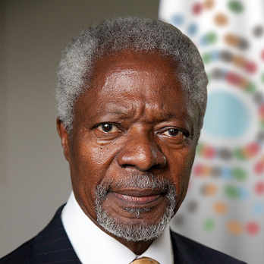
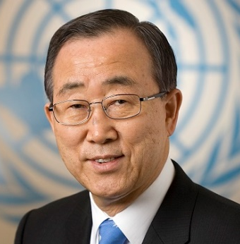
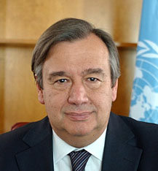
“I propose that you, the business leaders … and we, the United Nations, initiate a global compact of shared values and principles, which will give a human face to the global market.”
How It All Began
H.E. Kofi Annan
H.E. Ban Ki-moon
H.E. António Guterres

Slide 3
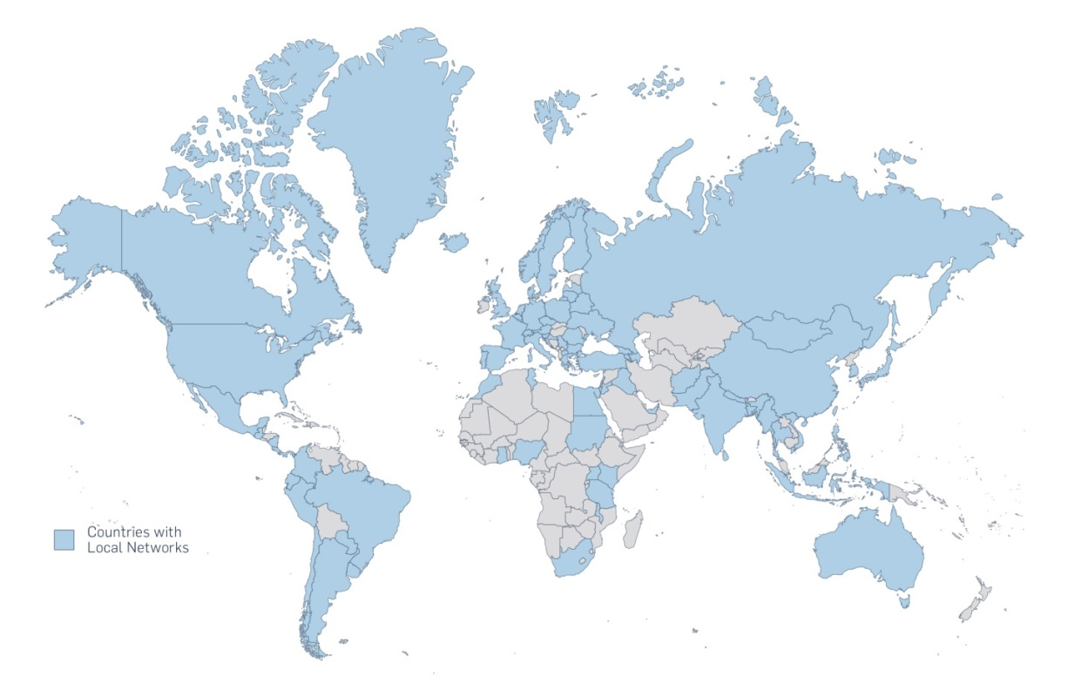
The Global Compact at a Glance
13,000+ Signatories
63 mil Employees
165+ Countries
85+ Local Networks

Slide 4

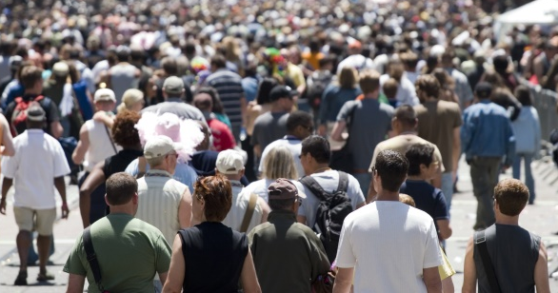
The Vision of the UN Global Compact
“Mobilize a global movement of sustainable companies and stakeholders to create the world we want”

Slide 5
Human Rights
Principle 1: Businesses should support and respect the protection of internationally proclaimed human rights; and
Principle 2: make sure that they are not complicit in human rights abuses.
Labour
Principle 3: Businesses should uphold the freedom of association and the effective recognition of the right to collective bargaining;
Principle 4: the elimination of all forms of forced and compulsory labour;
Principle 5: the effective abolition of child labour; and
Principle 6: the elimination of discrimination in respect of employment and occupation.
Environment
Principle 7: Businesses should support a precautionary approach to environmental challenges;
Principle 8: undertake initiatives to promote greater environmental responsibility; and
Principle 9: encourage the development and diffusion of environmentally friendly technologies.
Anti-Corruption
Principle 10: Businesses should work against corruption in all its forms, including extortion and bribery.
UN GLOBAL COMPACT
TEN
PRINCIPLES

Slide 6
Agenda 2030 and the Sustainable Development Goals

Slide 7

Business and the
CRPD
Article 20
Personal Mobility
Article 27
Work and Employment
Article 24
Education
Article 26
Habilitation and Rehabilitation
Article 19
Living Independently and being included in the community
Article 5
Equality and non-discrimination
Article 21
Freedom of Expression and Opinion, and Access to information
Article 8
Awareness-raising
Article 9
Accessibility

Slide 8

Business and Disability
Approximately 10% of the world’s population lives with a disability
An estimated 15-20% of the world’s poorest people are disabled.
An estimated 80% of people with disabilities live in developing countries
An estimated 386 million of the world’s working-age population have some kind of disability
Persons with disabilities tend to experience higher unemployment and have lower earnings
Claims for disability benefits are surging up to 600% in industrialized countries
Only 5-15% of people with disabilities can access assistive devices in the developing world
45 countries have anti-discrimination and other disability-specific laws to promote employment

Slide 9

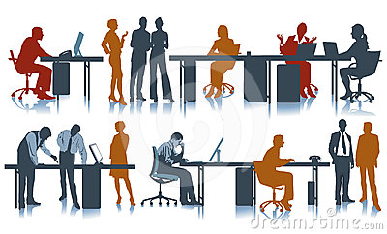
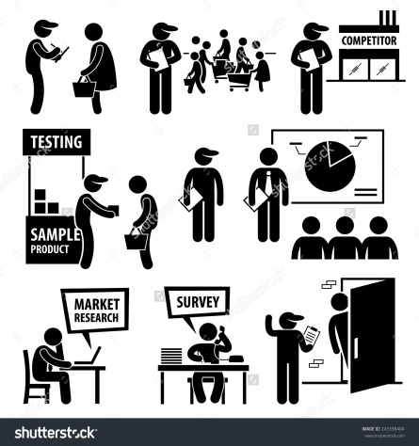
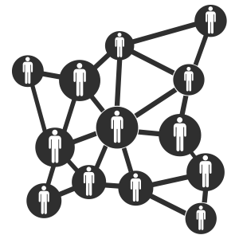


Guide for Business on the Rights of Persons with Disabilities
WORKPLACE
MARKETPLACE
COMMUNITY

Slide 10
Objectives of the Guide
Explain the role business can play in advancing the rights of persons with disabilities, in alignment with relevant UN Conventions and frameworks
Identify how the rights set out in the Convention on the Rights of Persons with Disabilities are relevant to business activities and fit within a company’s wider human rights strategy
Illustrate through company examples how business can respect and support these rights in the workplace, marketplace, and community, and
Demonstrate how, by taking such action, business can also contribute to the advancement of the UN Sustainable Development Goals.

Slide 11
Methodology
and
Stakeholders
UN
Business
Expert Group
Methodology
Good Practice Examples
Civil Society
International Organizations
Global Public Consultation
Government

Slide 12
…..
A Few Examples…….
Driving Innovation
An Australian chain of supermarkets has introduced new shopping carts at their stores for children with disabilities. The carts provide parents and caregivers a viable option to transport a child through a store while grocery shopping without having to manoeuvre a wheelchair and a traditional grocery cart at the same time.
Creating Employee Networks
A Swiss healthcare company has created employee resource groups for employees with disabilities that provide them the opportunities to network, exchange views, create innovative business-focused solutions and continue professional growth and development.
Promoting Inclusion in the Supply Chain
An American consultancy services company has created a management consulting pro-bono asset that provides guidance and methodology to the company’s clients and vendors on how to facilitate inclusion of persons with disabilities in the workforce of a company.
Promoting Equal Opportunity in the Community
A group of organizations have developed a free mobile app in China, which combines remote and manual assistance from volunteers to help visually impaired persons overcome challenges through picture/text message support, audio/visual support and accompanying services.

Slide 13
What’s Next
Share your Feedback
Provide written feedback on the draft Guide by 31 March – contact crdpguide@unglobalcompact.org for draft
Making Global Goals Local Business, India
The Guide will be showcased at the “Putting Human Rights Into Practice” session on 27 April at this flagship UN Global Compact event. For more information, please visit our website.
Launch at the Conference of State Parties to the CRPD
The Guide will tentatively be launched at a side-event organized during the Conference of State Parties between 14-16 June 2017.
Engage with the UNGC Business for Inclusion Action Platform
Collaborate with like-minded peers and experts to explore the spectrum of ways that business can help end discrimination, promote equal opportunity and support tolerance and understanding between people and communities.

Slide 14

THANK YOU!
For more information about the Guide:
crpdguide@unglobalcompact.org
For more information about the Business for Inclusion Platform:
gulal@unglobalcompact.org

Slide 15


