Slide 1




Human rights: a reality for all
Council of Europe Disability Strategy 2017-2023
Recognizing Abuse of Persons with Disabilities
Human rights: a reality for all
Council of Europe Disability Strategy 2017-2023
Filoxenia Conference Centre, Nicosia, Cyprus, 27-28 March 2017
Professor Dr. Marios Constantinou, Senior Officer
Department for Social Inclusion of Persons with Disabilities
Ministry of Labor, Welfare, and Social Insurance
Cyprus
ΚΥΠΡΙΑΚΗ ΔΗΜΟΚΡΑΤΙΑ
ΥΠΟΥΡΓΕΙΟ ΕΡΓΑΣΙΑΣ, ΠΡΟΝΟΙΑΣ
ΚΑΙ ΚΟΙΝΩΝΙΚΩΝ ΑΣΦΑΛΙΣΕΩΝ
ΤΜΗΜΑ ΚΟΙΝΩΝΙΚΗΣ ΕΝΣΩΜΑΤΩΣΗΣ ΑΤΟΜΩΝ ΜΕ ΑΝΑΠΗΡΙΕΣ
DEPARTMENT FOR SOCIAL INCLUSION OF PEOPLE WITH DISABILITIES

Slide 2
The Social Model in Defining Disability
Impairment and Disability are Separate Entities according to the Social Model.
An impairment is an injury, illness, or congenital condition that causes or is likely to cause a loss or difference of physiological or psychological function
Disability is the interaction of the impairment with the environment, the social and physical restrictions.
  The society and its organization (not the impairment) excluded disabled people from full participation in society
  The exclusion could be due to: negative attitudes, limited social support, inaccessible transportation, organizational policies, lack of services etc.
  Around the world on average 6% of children are associated with impairment compared to 16% of working age adults and 45% of adults in their pension age.

Slide 3
Defining Abuse
Incident or pattern of incidents of controlling, coercive or threatening behavior, violence or acts of aggression.
  This could be (but not limited to): psychological, physical, sexual, financial, and emotional.
  It could be one incident or prolonged periods of abuse
  Controlling other is also abuse: control that is designed to make a person subordinate or dependent, isolating a person from sources of support, exploiting their resources and capacities, depriving them the means for independence, regulating their everyday behavior.
  Coercive behavior is an act or pattern of assault, threats, humiliation and intimidation used to harm, punish, or frighten the victim

Slide 4
Abuse in Disabilities
Highly underreported for aforementioned reasons and:
  Institutions are not prone to report
  Families are not prone to report (to cover other members of the family)
  Victim may not be able to communicate the abuse

Slide 5
Women, Children, and Senior Citizens with Disabilities
Women (and girls) with disabilities are significantly more likely to experience abuse (domestic or otherwise) than men (and boys) with disabilities
Women (and girls) with disabilities are more likely to experience frequent acts of abuse than men (and boys) with disabilities
However, both men and women with disabilities have a higher risk of experiencing abuse than the general population
Children with disabilities are more likely to experience abuse than adults
Senior citizens with disabilities are more likely to experience abuse than other adults

Slide 6
People with Disabilities are Significantly More Likely
To be threatened with violence
To be physically abused
To be sexually assaulted
Experience physical, sexual, emotional, and financial abuse

Slide 7
Risk Factors for Abuse in People with Disabilities
Lower Income (lower than average income). The lower the income the higher the possibility for abuse
Lower Education
Experiencing or Witnessing Violence as a young child or teenager
Social and Cultural Views (i.e. religion, local views, cultural views, etc.)
Isolation from the Health System and Social Welfare Systems
Frequent Interactions with Institutional or Medical Settings
Higher needs (e.g. more help for mobility) creates higher rates of abuse by the home care takers or medical/institutional settings
Communication Difficulties
Inability to move away or lack of choices (e.g. changing housing or divorcing)
Past Abuse (past abusive relationships etc.)

Slide 8
Impact of Abuse on People with Disabilities
The impact of abuse is much higher in people with disabilities and could be disability-specific sometimes
It could lead to:
  Injuries
  Chronic pain
  Neurological Symptoms
  Gastrointestinal Symptoms
  Sexual Reproductive Symptoms
  Mental Health Issues
  Death

Slide 9
Signs and Symptoms of Abuse
Signs (as observed by others); Symptoms (as reported by person)
Isolation
Unexplained Bruises, Cuts, Scrapes
Avoidance of certain people in family or medical center
Unhealed sores and pressure marks
Reduction in Communication Skills
Overcompliance and excessive will to please others
Reluctance to visit medical doctors
Fear and withdrawal from activities that used to be enjoyable
Extreme passivity
Genital Pain (in sexual abuse), bleeding, itching, infections
Inappropriate expression of affection (e.g. in sexually abused children)
Oversensitive
Chemical Abuses (alcohol, drugs etc.)
Malnutrition
Unkempt Appearance
Self-Harm
Wearing Long Clothing

Slide 10
Actions and Prevention
Encourage Multiple Personal Assistance Service Providers
Fight Poverty of People with Disabilities
Encourage Higher Education
Allow people to choose their personal assistants or housing
Provide Emergency Contacts
Train Professionals/Family/Other Friends to Screen for Abuse
Improve Self-Advocacy and Appropriate Representation
Provide Sexual, Physical, Aggressive Abuse seminars to people with disabilities
Provide 24-hour lines of communication
Provide interpreters at every contact of the person or as needed
Frequent unexpected visits to institutions and medical centers
Offer optional counseling services
Encourage and teach financial independence
EDUCATE ALL

Slide 11
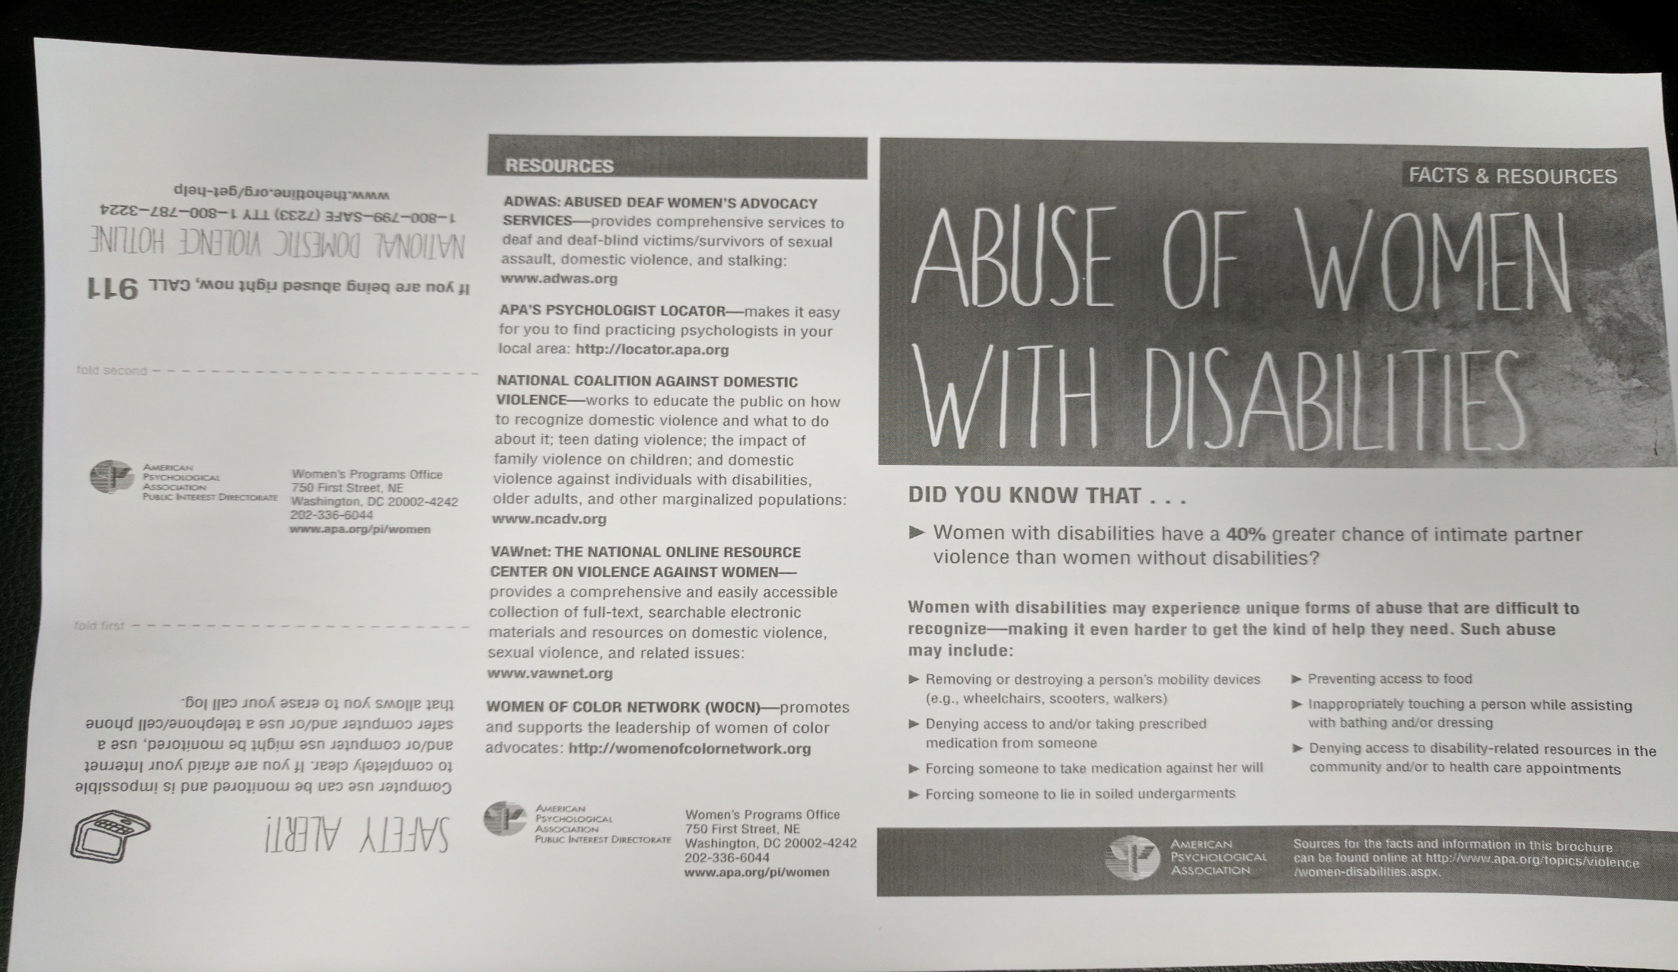
Example from APA, USA

Slide 12
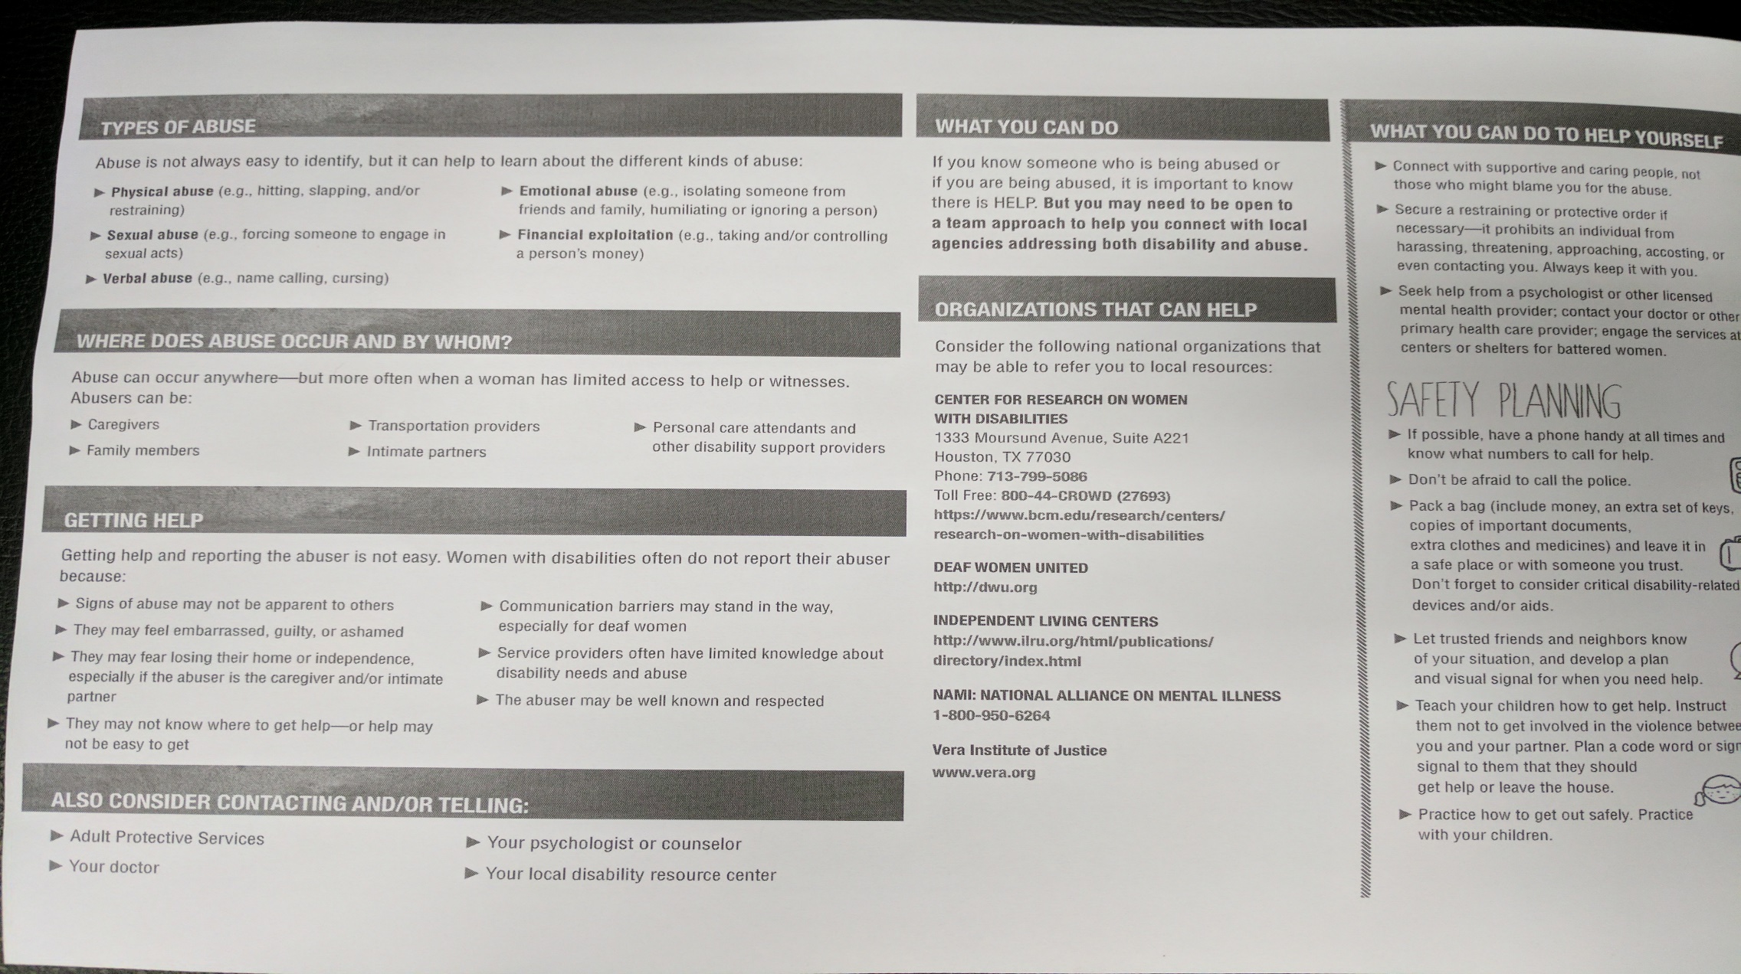
Example from APA, USA

