Slide 1
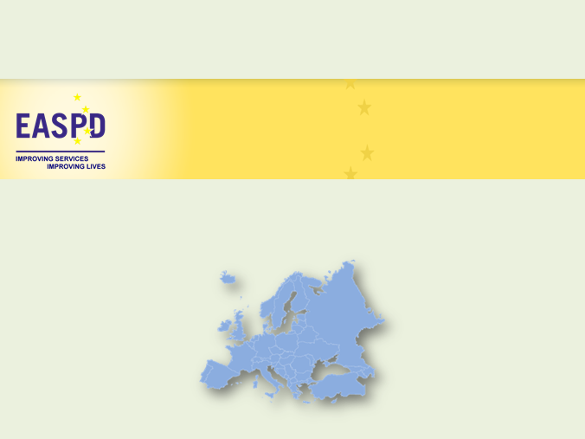
Equal recognition before the law
Luk Zelderloo
Secretary General
EASPD
Cyprus, 27-28/03/2017
www.easpd.eu

Slide 2
About EASPD
European non-governmental umbrella organisation
Active in the disability sector since 1996
Representing over 15.000 European social and health support services for persons with disabilities from 33 different countries
Key role at European level as a representative of disability service providers
Our principles:
Co-production as the key principle in service delivery
Focus on accessibility, availability, affordability and adaptability of services
Our objectives:
The full implementation of the UN CRPD
The provision of high quality, user-centred services run in an accountable, efficient and effective way
Fair working conditions and lifelong learning opportunities for staff employed in services

Slide 3
Service providers as human rights enablers
Availability & provision of quality services is essential
  To fulfil obligations of the UNCRPD
  To ensure full enjoyment of rights of persons with disabilities
Services must be person-centred
  User-led
  Individualised
  Adaptable
CHALLENGE for service providers: to work within national legal frameworks that are not in line with the UNCRPD

Slide 4
The implementation gap
UNCRPD
National legislation
Actual situation

Slide 5
Stuck in the paradox of guardianship
Guardianship, on the one hand, ...
  restricts / denies the legal capacity of a person
  poses significant barriers to accessing justice.
Guardians, on the other hand, may provide an avenue for achieving justice for PwID under existing law, by...
  initiating court proceedings
  reporting abuse and exploitation
  undertaking personal advocacy
  supporting PwID during legal proceedings
  etc.
  IF they are trained in line with the UNCRPD principles and they are adhering to supported decision-making approaches, etc

Slide 6
The role of service providers
Service providers can act as human rights enablers fostering access to justice, IF:
  The rights of PwID and the UNCRPD are known
  The human rights model of care is applied in practice
Service providers accompany PwID in their daily lives. They can support them by:
  Being sensitive to and identifying human rights violations
  Supporting PwID in their access to justice
  Acting as support to communicate with judicial staff and being heard
    Guardians, speech therapists, personal assistants, etc.
  Advocating and lobbying with and for them to close identified implementation gaps

Slide 7
Supported decision-making
From guardianship and substituted decision-making to supported decision-making
“Every person has a will and is capable of making choices”

Slide 8
Supported decision-making
Sliding scale of support (not just capacity/incapacity)
Fluctuating needs = fluctuating support
Avoiding conflict of interests

Slide 9
Examples of support
Support networks of family and friends
Personal ombudsperson
Community responsibility
Personal assistance
Peer support
Advance planning
Support to individuals complements accessibility measurers in information and communication, government and legal system and services of all kinds
Supported decision-making service

Slide 10
Community responsibility
Appropriate where community ties are strong
Community should take responsibility for well-being of all its members and extend solidarity to support people with disabilities
  Need to ensure that people with disabilities are equal partners and lived expertise is respected
Such work of the community should be funded by the central government

Slide 11
Conclusion
Almost all member States and social services struggle with articles 12-13
Legal capacity is key for:
- Enjoyment of human rights
- Community living
- Access to quality education and labour market
Supported decision-making is the way forward
New mechanism… risk = conflict of interest

Slide 12

Thank you!
EASPD
Rue de Commerce 72
B – 1040 Brussels
Tel +32 2 2337720
www.easpd.eu
luk.zelderloo@easpd.eu
With the financial support from the European Union Programme for Employment and Social Innovation “EaSI” (2014-2020)

