Slide 1

Supported decision-making in practice: results of pilot project and lessons learned
Ieva Leimane-Veldmeijere,
Director of RC ZELDA

Slide 2
Legal capacity laws’ reform in Latvia (since 01.01.2013)
Plenary guardianship has been abolished
Lasting power of attorney (sort of advance directive)
    Can be issued only by sworn notary
    For certain situations in future
    Appointment of specific person
Temporary guardianship
    No legal capacity restrictions
    Only if:
      Person doesn’t actively participate in community life
      Acute necessity in the interests of the person
      Disability is temporary
      Applicable for maximum of 2 years
Partial legal capacity restrictions
    Personal non-material rights cannot be restricted
    Different guardianship regimes (include co-decision making)

Slide 3
Pilot project of ZELDA on supported decision-making (01.09.2014-30.06.2016)
Developed proposals to introduce alternatives to legal capacity restrictions, including supported-decision making
Raised awareness among family members and stakeholders on the rights and interests of people with disabilities from social model perspective
Developed and tested the model for supported decision-making – direct support was provided to 28 persons and consultative support to 55 family members
The support has been provided also after the project was completed

Slide 4
What is supported decision-making?
Person makes decisions by him/herself
There should be trustful relationships between person and supporter
Support person can be:
  Natural supporter – friend or relative chosen by person to be supported (trustful relationships)
  Professional support provider:
    If there are no relatives or friends;
    If person does not want to receive support from relatives, but wants professional supporter
Suggestions made by support persons are not legally binding
Supporter helps the person to understand information, to make decisions, based on persons wishes and to communicate them to other persons, agencies, etc.
Practices differ, in some countries the authorization by court is
needed in some countries not.

Slide 5
Principles of supported decision-making:
We have respectful attitude towards all involved;
Our work is based on person-centred thinking and planning approach;
We try to discover, understand and clearly describe unique; characteristic features of the person we support;
We first see the person and not his/her disability.
Support is provided in a way that:
The person would have positive control over his/her own life;
The person would be valued member of local community (in past, currently and in future);
The person would receive support from support network in its preferable environment from natural supporters and/or professional (paid) supporters.

Slide 6
Support areas:
ZELDA provides support in decision-making in 5 areas:
Legal issues;
Financial issues;
Daily life and care issues;
Health care issues (till the door of doctor’s office)
Creation of support network
! Support in decision-making does not replace social services person needs.

Slide 7
Agreement in supported decision-making
Proved to be positive instrument for:
Empowerment and agency;
Reducing hierarchy;
Taking responsibility;
Communication with other organizations, institutions; State service providers.
There was no agreement between the individual and the natural supporter.

Slide 8
Persons we support directly
28 persons – 8 females/ 20 males; 14 persons have intellectual disability; 13 persons have psychosocial disability and 1 person has behaviour problems.
7 persons live in institution; 10 persons live with parents; 4 persons live in group homes; 7 persons live independently.
Most common aims of support plans:
To finish school and to obtain profession («to stand on own legs»)
To move out of institution to live in community
To regain legal capacity
To learn new skills (languages – English, Latvian, Russian; photography, cooking, reading, writing, counting, etc.)
To develop support network
To find suitable job

Slide 9
Some examples of decisions where support was needed
Legal issues:
Preparing of applications; documents
Reading of documents and understanding them ;
Preparing applications to court;
Assistance in changing of documents (disability card; bicycle driver’s licence);
Assistance in process of review or renewal of legal capacity status;
Support of victims of crime, while communicating with police;
Support in communicating with employer.
Finance issues
Assistance in preparing application for police on fraud;
Assistance in communication with municipality on property tax debts;
Learning to plan daily/weekly/monthly budget;
Learning to count.

Slide 10
Some examples of decisions where support was needed
Daily life skills
Communication through learning to cook
Support in communicating with staff of institution
Support in learning skills (read, write, languages, sign);
Support in changing place of residence, finding more suitable services;
Assistance in searching for education opportunities;
Support in communication with family;
Support in searching for job and communication with Employment agency
Health care issues
- Support in communication with psychiatrist;
Assistance in finding specialist;
Support in communication with National health service on
compensation of medicines; support while person is at
hospital

Slide 11
Intensity of support
Despite widespread stereotypes about people with disability that underlie the guardianship concept, the support was not needed 24/7 with equal intensity, however maintaining contact with a person (phone calls or meetings) was needed for building trustful relationships.
Based on person-centred planning principles, SDM process was oriented towards acknowledgement of strengths, talents and hopes of the supported people, not on deficits or disabilities, therefore people were empowered for more independent life.
We also acknowledged the abilities to live independently and make own choices in life that already are present.

Slide 12
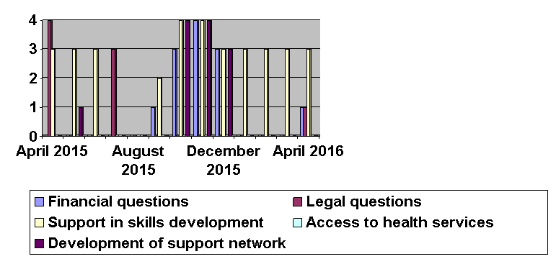
Intensity of support scale of 1-5
Story of Sofia

Slide 13
Story of Victoria
During the project Victoria made an important decision to give birth to a baby and to have a family. Moving towards this aim she had also to make minor and major decisions with the help of the support workers – social worker and lawyer: ending violent relationships, changing her living place, developing parenting skills, getting help with planning budget and managing finances, dealing with acute crises situations. Victoria is now living in a safe place with her small child and receives necessary support from her support workers.

Slide 14
What we have learned?
1) Building trustful relationships takes time
2) While supporting natural supporters and individuals, it is important to have trustful relationships with both of them, though individual is always a priority
3) Support plan is not static, situations in life of a person is changing and that can change support needs and areas
4) The person has a right to make risks and to make ‘wrong’ decisions
- Who has a right to say that decision made is ‘wrong’?
5) It is challenge to help to develop support network for a person who does not have natural supporters
Notes:
Examples of ‘wrong decisions’ : to move back to institution; to decide not to pay bank loan; to decide not to keep promises made to their family; to lie rather than tell the truth about plans or intentions

Slide 15
Thank you for the attention!
Ieva Leimane-Veldmeijere (RC ZELDA director) – ieva@zelda.org.lv
RC “ZELDA”: Mārupes street 4-31, Riga, LV – 1002, Latvia
Phone: +37167442828; www.zelda.org.lv; zelda@zelda.org.lv
More on ZELDA supported decission making project you can find in our handbook:
http://zelda.org.lv/wp-content/uploads/ZELDAS_bro%C5%A1%C5%ABra_EN_WEB.pdf

