Slide 1
MODULE 24 – EQUAL OPPORTUNITIES AND GENDER BALANCE
Stage 3 – Leadership for Capacity Building

Slide 2
Module Overview
Learning Objectives
To know the tools and legal frameworks available for ensuring equal access to opportunities to all.
To become aware of gender perspectives as key factors determining eventually good governance at local level.
To understand the role of leadership in ensuring equal opportunities and representativeness to all, at local level.
Learning Outcomes
Participants are aware of the existence of the relevant convention and charters promoting equality and can understand their potential if implemented at local level.
Participants understand the importance of gender mainstreaming and have the opportunity to identify strengths and weaknesses of their organisations in this regard.
Participants can assess the level of performance of their organisation with respect to ensuring equal opportunities and representativeness to all.

Slide 3
Module Structure
Interactive Introduction
Individual Exercise – Understanding Gender Mainstreaming
Group Exercise 1 – Gender Equality – an Empirical Perspective
Group Exercise 2 – Matching Good Governance Principles With the European Charter for Equality
Group Exercise 3 – Actions for Ensuring Gender Equality

Slide 4
Working Definitions
Gender Mainstreaming (as opposed to gender Blindness or Neutrality)
Mainstreaming a gender perspective, as defined by the ECOSOC in 1997, implies assessing the different impacts for women and men of any planned action, legislation, policies or programmes. It ultimately aims at integrating insights, needs and perceptions of women, as well as of men, in all political, economic and societal spheres. While this definition still applies, the boundaries of gender have in the last decades expanded to encompass much more than a male/female differentiation. According to Istanbul Convention “Gender shall mean the socially constructed roles, behaviours, activities and attributes that a given society considers appropriate for women and men”.
For the purpose of LAP, gender mainstreaming is understood as a way of achieving equal opportunities of access to services, justice, work, etc. to ALL, according to their needs (ref. for details the definition of Equality).
Gender Blindness or Neutrality
Gender blindness refers to policies, strategies and actions ignoring or failing to address the gender dimension. This also implies that differential positive or negative impacts of such policies, strategies and actions are not taken into account for different categories (in this case referring to gender but it could also be extended to different physical abilities or economic capacity to access services, etc.). For LAP, gender blindness equals a “one-size-fits-all” approach, that is ultimately an obstacle for the achievement of good governance.
Gender Equality
“Gender equality means an equal visibility, empowerment and participation of both sexes in all spheres of public and private life. Gender equality is the opposite of gender inequality, not of gender difference, and aims to promote the full participation of women and men in society. It means accepting and valuing equally women and men and the diverse roles they play in society. Gender equality includes the right to be different. This means taking into account the existing differences among women and men, which are related to class, political opinion, religion, ethnicity, race or sexual orientation. Gender equality means discussing how it is possible to go further, to change the structures in society which contribute to maintaining the unequal power relationships between women and men, and to reach a better balance in the various female and male values and priorities (CoE, 2016)

Slide 5
EXERCISES

Slide 6
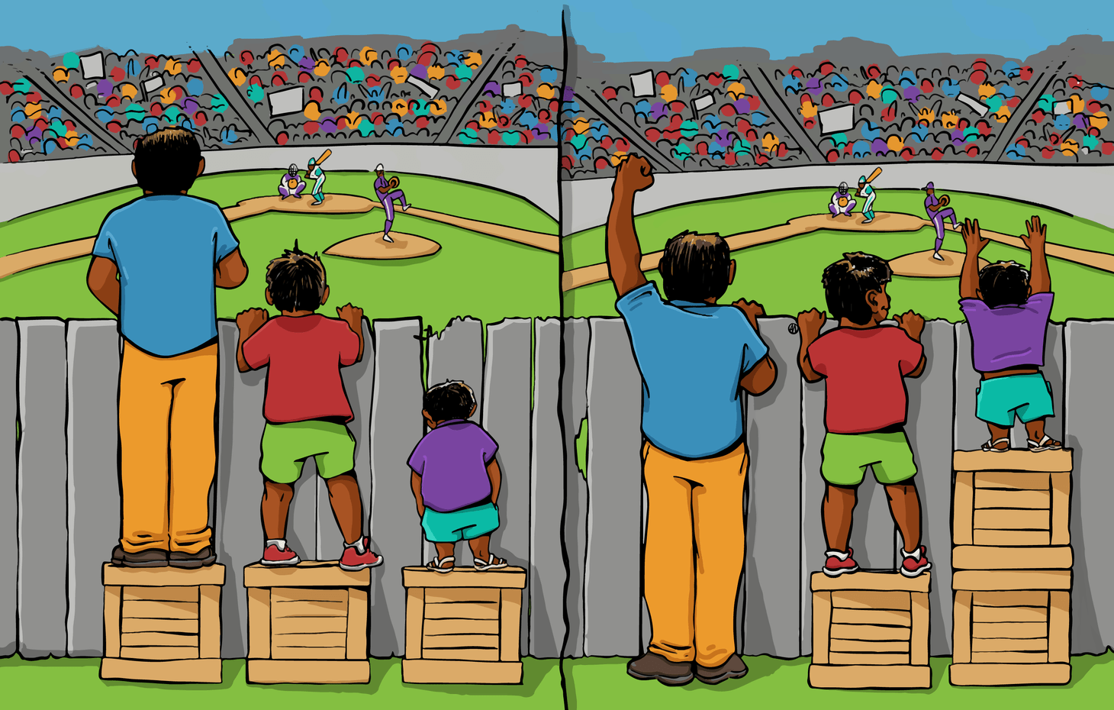
Exercise 1
Interactive Introduction
What is the difference between the two? Give a title to each image.
Source: Interaction Institute for Social Change | Artist: Angus Maguire

Slide 7
Exercise 2
Individual Exercise – Understanding Gender Mainstreaming
Work individually to fill in Section 5.2 Table

Slide 8
Exercise 3
Group Exercise 1 - Gender Equality – an Empirical Perspective
Work in small groups to identify in your own experiences (personal or within your organisation) the circumstances in which the lack of gender perspectives determined discrimination.

Slide 9
Exercise 4
Group Exercise 2 – Matching Good Governance Principles With the European Charter for Equality
Individually read the articles of Part III of the Charter;
work in groups to match articles of the Charter with the Principles of Good Governance to which they may pertain;
Share insights from your work in plenary session.

Slide 10
Exercise 5
Group Exercise 3 – Actions for Ensuring Gender Equality
Work in groups to identify possible action to be implemented at organisation level so to ensure gender equality;
Share insights from your work in plenary session.

