Slide 1
MODULE 19 - ETHICS MANAGEMENT (Advanced)
Stage 3 – Leadership for Capacity Building

Slide 2
ETHICAL DILEMMAS
Stage 3
Module 19 – Ethics Management (Advanced)

Slide 3
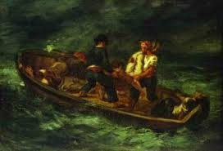
THE STORY OF MIGNORETT
Stage 3
Module 19 – Ethics Management (Advanced)

Slide 4
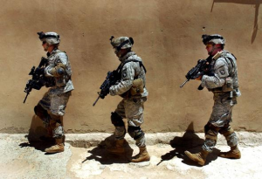

SOLDIERS ON MISSION IN AFGANISTAN
© Michale j. Sandel
Stage 3
Module 19 – Ethics Management (Advanced)

Slide 5
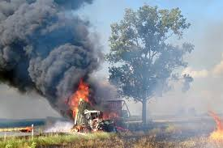
CHEMICAL TRUCK OVERTURNED ON COUNTRY ROAD
Untrained and unequiped local volunteer emergency service
WHAT SHOULD THEY DO?
HELP OR WAIT?
Stage 3
Module 19 – Ethics Management (Advanced)

Slide 6
REFLECTING ON THE SITUATION
During the discussion of the dilemma we heard three types of reasons:
  What is our moral duty? What would be ethical?
  How should we act according to the rules?
  What are the consequences? What would be effective?
Value-based arguments
Duty/rule-based arguments
Consequence-based arguments
Stage 3
Module 19 – Ethics Management (Advanced)

Slide 7
GO/NO-GO DECISION MODEL
Lewis-Gliman (2012): The Ethics Challenge in Public Service
For legitimate decisions public leaders need to reflect:
  Is the decision legal?
  Is the decision ethical?
  Is the decision effective?
Stage 3
Module 19 – Ethics Management (Advanced)

Slide 8
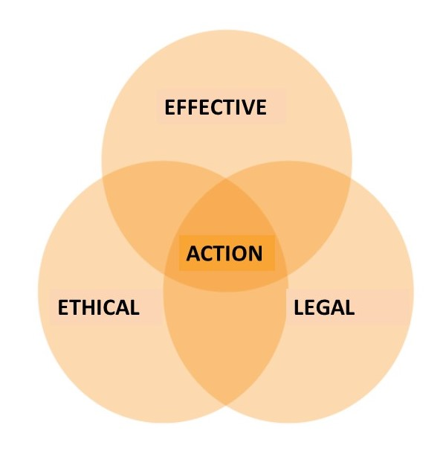
GO/NOGO
DECISION MODEL
Lewis-Gliman (2012):
The Ethics Challenge in Public Service
 | ETHICAL | UNETHICAL
ILLEGAL | NO ACTION Pursue change in law? | NO ACTION
LEGAL AND INEFFECTIVE | NO ACTION Innovative redesign? | NO ACTION
LEGAL AN EFFECTIVE | ACTION | NO ACTION
Stage 3
Module 19 – Ethics Management (Advanced)

Slide 9
ETHICAL DILEMMAS IN LOCAL GOVERNANCE

Slide 10
WHAT are the most ubiquitous challenges in public service?
Stage 3
Module 19 – Ethics Management (Advanced)
Notes:
Not enogh money, time pressure, multiple lojalties
Accountability self defence
Multiple values and objectives,
Clashing values and considerations – dilemmas and trade offs

Slide 11
PUBLIC SERVICE
Stage 3
Module 19 – Ethics Management (Advanced)
Notes:
Legal: no question according to law, predictable, trustworthy
Effective: prudent use of resources entrusted
Ethical: trustworthy, legitimacy

Slide 12
GOOD GOVERNANCE (GG)
GG is principled, and implements the public values but
  pursuit of a value can compromise or limit the pursuit of other values (eg. efficiency vs. effectiveness, or responsiveness vs. equality)
GG need to balance among:
  inevitably clashing consequences of different values and
  contradictory standards and regulations
Stage 3
Module 19 – Ethics Management (Advanced)

Slide 13
Survey of municipal Mayor, 2 elected officials, 6 managers and 10 civil servants IN A DUTCH LOCAL GOVERNMENT
RESULT OF THE RESEARCH OF GRAAF & HUBERTS, 2014
Clashing consequences of considerations of:
  Proper governance
  Responsive governance
  Performing governance
Stage 3
Module 19 – Ethics Management (Advanced)

Slide 14
Number of particular value conflict in the municipality
GRAAF & HUBERTS, 2014
Stage 3
Module 19 – Ethics Management (Advanced)

Slide 15
COPING STRATEGIES IN PRACTICE on the basis of Graaf- Hubert 2014
FIREWALLS:
departments made responsible for the realization of different values (different built-in biases)
  Multi-departmental issues solved at upper level
BIAS:
some values are no longer recognized as important
CASUISTRY:
officials make decision for each particular value conflict based on similar experiences
Pressure on professionals → need for support
Ethics/integrity management is a systematic effort
Stage 3
Module 19 – Ethics Management (Advanced)
Notes:
After causistry before sub bullets: is this good? Any risk?
Who decides? 1.tenet of trad AC that discretion should be minimalized
At the same time discretion is necessary but risky

Slide 16
Ethical dilemmas
IMPORTANCE OF OPENING DISCUSSION OF ETHICAL DILEMMAS
IN ORDER TO MAKE TENSIONS EXPLICIT AND DISCUTABLE AND
SUPPORT RESPONSIBLE DECISION-MAKING
Stage 3
Module 19 – Ethics Management (Advanced)

Slide 17
Ethics management
Intended to ensure ethical behavior among members of an organization/community

Slide 18
A tool for ethical decision making
Terry Cooper: The Responsible Administrator

Slide 19
Ethical decision making tool
Terry Cooper (2012)
Describe the situation
Define the problem in ethical terms
Identify alternatives for possible actions
Reflect on possible scenarios projecting the possible consequences of each alternative
Choose from the alternatives
Stage 3
Module 19 – Ethics Management (Advanced)

Slide 20
Ethical decision making tool
Terry Cooper (2012)
1. Describe the situation
  The first step is to reflect on the situation. Look with openness and from multiple perspectives, collect information and make a detailed analysis that is as objective as possible.
2. Define the problem in ethical terms
  Identify and understand the underlying values and analyse the situation through the lens of the different values. Identify what you understand from the perspective of different values. Attempt to define the situation as a tension among values.
Stage 3
Module 19 – Ethics Management (Advanced)

Slide 21
Ethical decision making tool
Terry Cooper (2012)
3. Identify alternatives for possible actions
  Identify as many possible action as you can. Take those possibilities as well that seem awkward, or unrealistic at the first sight. It is important to be free and creative at this point and move beyond the obvious alternatives (the obvious good and bad response), as solutions may be engendered from different insights. You may not pursue later on all, but allow time to collect all alternatives.
Stage 3
Module 19 – Ethics Management (Advanced)

Slide 22
Ethical decision making tool
Terry Cooper (2012)
4. Reflect on possible scenarios projecting the possible consequences of each alternative
  Use your imagination to reflect on possible scenarios for the selected alternatives. You need to see the scenario as a story that evolves, rich in details. This should be a free and creative process of storytelling that is followed by moral reflection on each story that has been created.
Stage 3
Module 19 – Ethics Management (Advanced)

Slide 23
Ethical decision making tool
Terry Cooper (2012)
5. Choose from the alternatives
  For choosing the best alternative you need to make the underlying values explicit and weight the alternatives according to these values. Before making the final choice attempt to defend it against opponents, and imagining how you would feel as a consequence.
Stage 3
Module 19 – Ethics Management (Advanced)

Slide 24
CORRUPTION ANALYSIS

Slide 25
THE FRAUD TRIANGLE – THE SOCIAL ENVIRONMENT © DONALD CRESSEY
INSTITUTIONAL
VULNERABILITY
OPPORTUNITY
CORRUPTION
RATIONALIZATION
MOTIVE
SOCIAL CONTEXT
HUMAN FALLIBILITY
(greed, duress, force)
Stage 3
Module 19 – Ethics Management (Advanced)

Slide 26
WHAT CAN BE DONE?

Slide 27

WEAKNESSES OF THE CONTROL SYSTEM
OF THE LOCAL GOVERNMENT
OPPORTUNITY
Absence of controls, or inefficient controlls
HARD CONTROLS
CORRUPTION
SOFT CONTROLS
SOFT CONTROLS
JUSTIFICATION
Personal, in terms of corporate culture
MOTIVATION/PRESSURE
Personal, financial, work-related
Stage 3
Module 19 – Ethics Management (Advanced)

Slide 28
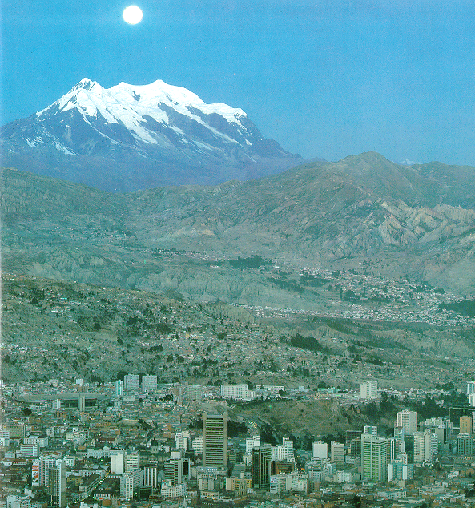
LET US SAVE LA PAZ!

Slide 29
BOLIVIA IN 1985
Administrative center of the poorest country in South America
About 1 million inhabitants
Bad infrastructure, economic crisis
Democratic elections
New civilian President
„Economic adjustment program”
Stage 3
Module 19 – Ethics Management (Advanced)

Slide 30
LA PAZ
Democratic election for Mayor after 40 years
Ronald MacLean-Abaroa takes office in 13 September, 1985
Hyperinflation and collapse of city revenues
Salary erosion for city employees
The local government wide spread systemic corruption
Opposition party but donor support
Stage 3
Module 19 – Ethics Management (Advanced)

Slide 31
THE STAFF
The cashier was:
  a fifth-class bureaucrat with a minimal salary but best car
  friend and “lender” to all (including the former Mayor)
Extremely low salaries,
  many employees were „anxiously seeking alternative sources of income” to bring home
Stage 3
Module 19 – Ethics Management (Advanced)

Slide 32
FINANCES
100 different taxes and complexity of the system
  „negotiations”, particularly with the rich
  Difficulty to pay the tax
Huge construction company
  Huge costs on capital, gasoline, spare parts
  Low productivity, time delays and huge cost overruns
  Location of works affected by bribes
Payroll 160% of LG revenues
Hyperinflation
Stage 3
Module 19 – Ethics Management (Advanced)

Slide 33
PROCUREMETN, PERMITS, LICENCES
Over-regulation of permits and licences
  Many permits and licenses are required
  “Negotiations” in the corridors of City Hall
  Delays
  Corruption
Complicated procurement procedures
  26 steps for minor purchases
  Collusion
  Kickbacks
  delays, poor quality, high costs, cynicism
Stage 3
Module 19 – Ethics Management (Advanced)

Slide 34
WHAT CAN BE DONE?

Slide 35
WHAT WAS THE STRATEGY OF MAC LEAN ABAROA
IN LA PAZ?

Slide 36
WHAT DID HE DO?
Diagnosis
Strategy
Implementation
BUT HOW?
Stage 3
Module 19 – Ethics Management (Advanced)

Slide 37
WHAT DID HE DO?
Diagnosis
  Participatory diagnosis involving staff
    Awareness, information (institutional knowledge), commitment and cooperation
  Professional technical and process support
Strategy
  Transparent framework
  Involvement of stakeholders
  Continuous sharing of information
Mobilisation and coordination
  a strong leader, not an autocratic
  changing institutional culture
Stage 3
Module 19 – Ethics Management (Advanced)

Slide 38
STRATEGY
Participatory change management
  Framework that all understand
  Involve employees in diagnosis and development of strategy
  Widening circles of involvement
  Maintain momentum by action and communication
Stage 3
Module 19 – Ethics Management (Advanced)

Slide 39
IMPLEMENMTATION
Fry the big fish otherwise, the culture of impunity persists
Help your employees before “attacking” them
  working conditions, merit based sytem and payment
  New blood („Young Bloivia”)
Fix processes and re-invent the role of LG
Pick low-hanging fruit = early easy successes
Ally with favorable institutional forces
  “Ride the wave” of reform
Stage 3
Module 19 – Ethics Management (Advanced)

Slide 40
RESULTS BASED ON
PPT OF MACLEAN-ABAROA
Dramatically increasing revenues (especially property taxes)
Investment in public works up by 10 times
International creditworthiness
Corruption down
Re-elected 1995 for fourth term
Stage 3
Module 19 – Ethics Management (Advanced)

Slide 41
RELEVANCE:
WHAT IS IMPLEMENTABLE IN YOUR CONTEXT?
Symbolic message
Mobilizations and coordination
Participatory analysis and planning
Changing organizational culture
New blood + senior staff
Systemic reforms
Reduction of monopoly and discretionary decisions
Strengthening transparency and accountability
Changing of the risk-benefit ratio
Stage 3
Module 19 – Ethics Management (Advanced)

Slide 42
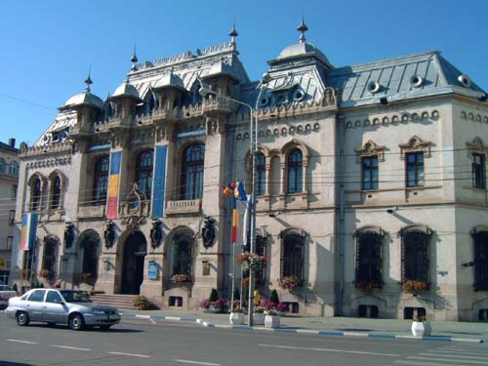
THE CASE OF CRAIOVA (Romania)
Slides of
ANA VASILACHE AND
NICOLE RATA

Slide 43
INTERVENTION GOAL
Craiova Local Government received FPDL anticorruption practitioners support to elaborate an Anticorruption Strategic Plan, through a participatory process
Stage 3
Module 19 – Ethics Management (Advanced)

Slide 44
Strategic:
  focused on changing corrupt organizational systems not (only) corrupt individuals;
  identified the most dangerous forms of corruption;
  went through the strategic planning process steps, from diagnosis to solutions.
Participatory:
  Leaders, managers and staff, and outside stakeholders involved
  In order to dissolve fear, shame and defensiveness corruption demystified through analysis
Stage 3
Module 19 – Ethics Management (Advanced)

Slide 45
The goal was, beyond curing and preventing corruption:
to strengthen Local Government integrity, efficiency, transparency and accountability in order to gain citizens’ trust and respect
Stage 3
Module 19 – Ethics Management (Advanced)

Slide 46
ASSUMPTIONS/TRUST
leaders, managers and staff:
  are capable, motivated human beings, knowledgeable about their organization
  are able to identify their own solutions, if they work together in a open and positive environment
  can be supported to take responsibilty to implement changes (confidence , org.culture and management training imbedded into planning process)
Stage 3
Module 19 – Ethics Management (Advanced)

Slide 47
WORK PROCESS IN CRAIOVA
FPDL Experts
Secretary
Group responsible for the process
Guiding Coalition
The organization
Working Groups
Stage 3
Module 19 – Ethics Management (Advanced)
© Ana Vasilache and Nicole Rata

Slide 48
STRATEGIC PROCESS IN CRAIOVA
Planed Change/Problem-Solving/Planning Process
Agreement with the Mayor
Build the Guiding Coalition
Monitor and Evaluate
General and In-depth Diagnosis
Solutions elaboration
Implement the solutions
Stage 3
Module 19 – Ethics Management (Advanced)
© Ana Vasilache and Nicole Rata

Slide 49
GENERAL DIAGNOSIS
Identifying the most vulnerable activities to corruption
2 aspects of 33 de activities have been evaluated
Level of vulnerability to corruption
Level of impact on citizens’ lives and municipality’s future if corrupt activities would take place
Stage 3
Module 19 – Ethics Management (Advanced)

Slide 50
15 identified as vulnerable to corruption
6 ACTIVITIES SELECTED
TO BE THE FOCUS OF THE ANTICORRUPTION STRATEGIC PLAN
A1: Issuing urban certificates, building permits
A2: Control of discipline in construction works
A3: Public assets management
A4: Public procurement
A5: Properties registration
A6: Human Resources Management
Stage 3
Module 19 – Ethics Management (Advanced)

Slide 51
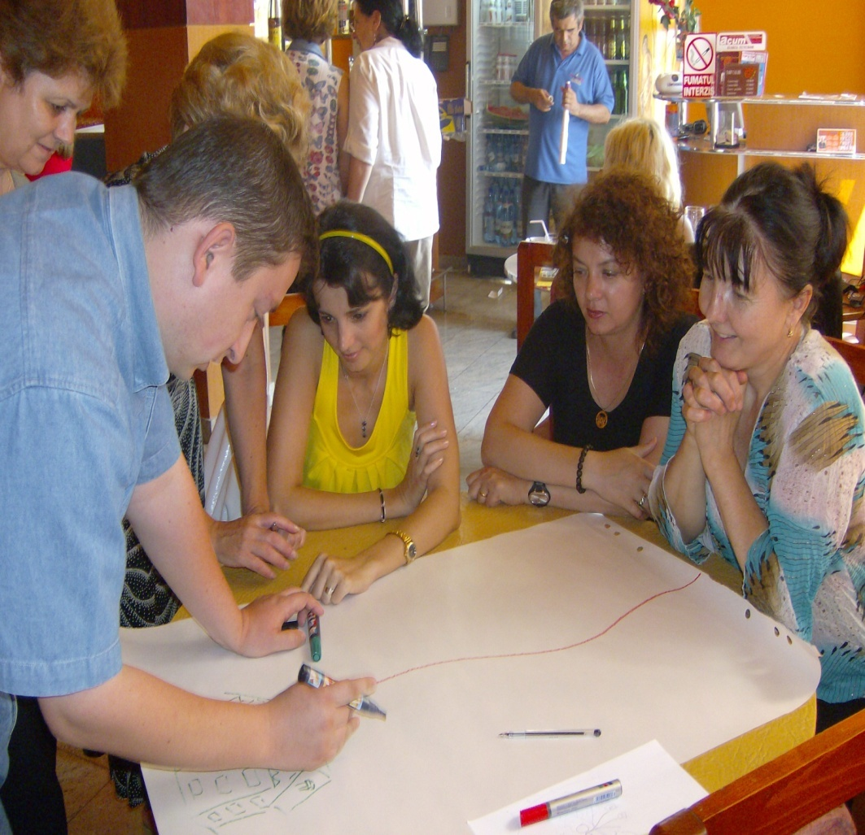
IN-DEPTH DIAGNOSIS
Answering the following questions for each vulnerable activity:
What
Who
Why (Causes)
Stage 3
Module 19 – Ethics Management (Advanced)

Slide 52
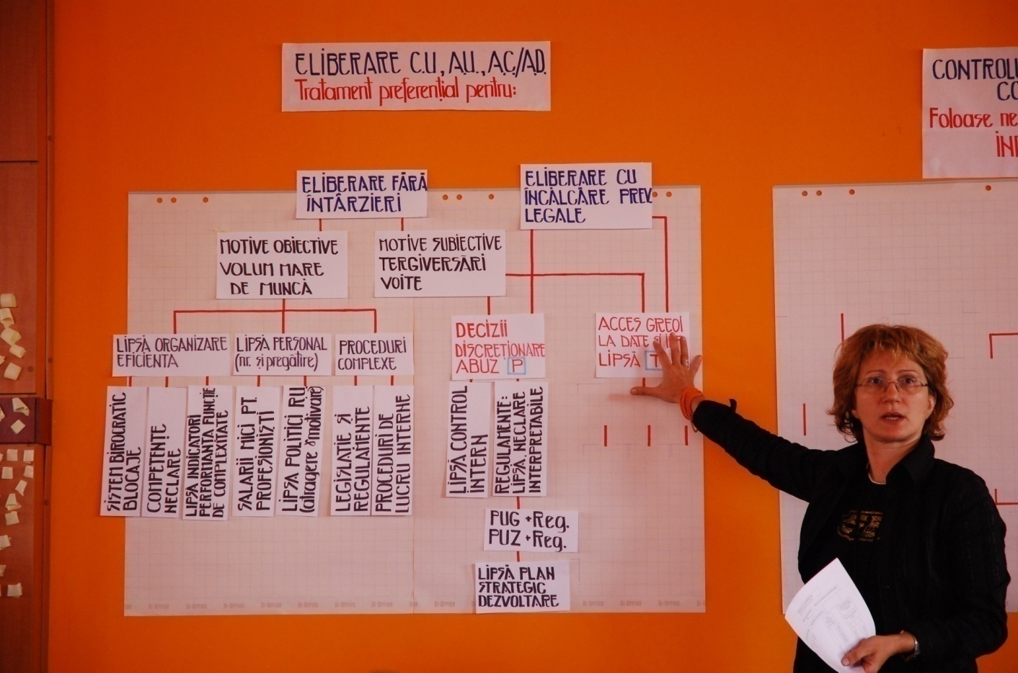
IN-DEPTH DIAGNOSIS
Causes Analysis for each activity
Stage 3
Module 19 – Ethics Management (Advanced)

Slide 53
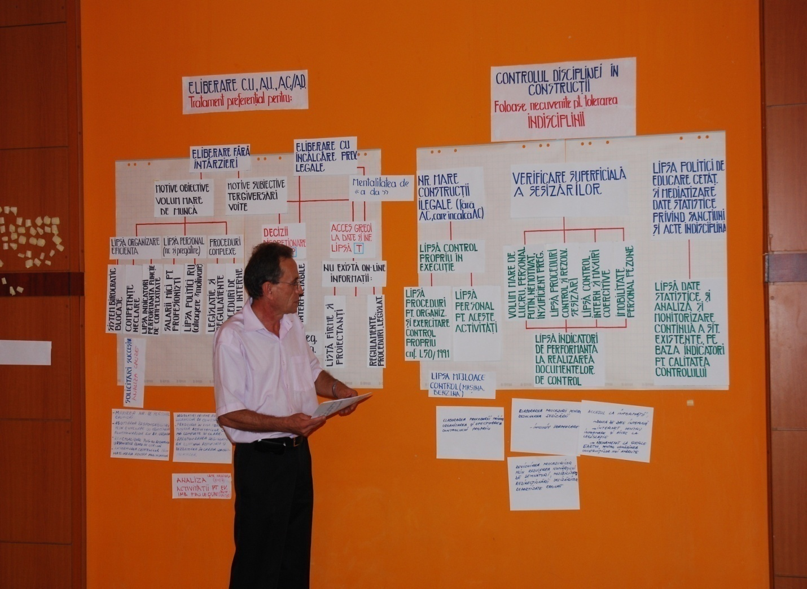
Solutions Elaboration
Working Group members elaborated ideas for solutions to address the causes
Stage 3
Module 19 (Advanced) – Ethics Management

Slide 54
STRATEGIC PLAN STRUCTURE
Vision
Objectives
Strategies
Actions
Stage 3
Module 19 – Ethics Management (Advanced)

Slide 55
5 STRATEGIC OBJECTIVES
O1: Improve the responsible management of public funds and public assets
O2: Consolidate the Quality Management System
O3: Increase activities transparency
O4: Implement a modern Human Resource Management system
O5: Improve internal control mechanisms
Stage 3
Module 19 – Ethics Management (Advanced)

Slide 56
STRATEGIES AND ACTIONS
Each strategic objectives achieved through 3-5 strategies
Each strategy achieved through
Actions
Time table
Who is responsible
With whom he/she will work
Stage 3
Module 19 – Ethics Management (Advanced)

Slide 57
              DECREASING DISCRETION
              IN DECISION MAKING
(1) Improving/clarifying procedures for:
Monitoring public works from contracting till finalization
Monitoring discipline in constructions
Communicating of information among departments
Simplifying documents travel in the city hall
(2) Making order in properties registration (land and buildings)
(3) Making order in urban planning documents and finalizing city digital map
Stage 3
Module 19 – Ethics Management (Advanced)

Slide 58
          INCREASING ACCOUNTABILITY
          TRANSPARENCY
(1) Toward citizens
Improving website structure
Offering more complete information (issuing building permits, public works, civil servants and councilors declaration of assets)
Improving citizens annual survey questionnaires
(2) Toward elected officials
Reporting to Municipal Council about public works status
(3) Toward civil servants
Preventive role of ethical advisor on conflict of interests situations
Stage 3
Module 19 – Ethics Management (Advanced)

Slide 59
RELEVANCE:
WHAT IS IMPLEMENTABLE IN YOUR CONTEXT?
Commitment of the leadership
External facilitation
Participatory analysis and planning
Strengthening transparency and accountability
Changing of the risk-benefit ratio
Reduction of monopoly and discretionary decisions
Changing institutional culture
Stage 3
Module 19 – Ethics Management (Advanced)

Slide 60
PUBLIC ETHICS MANAGEMENT
STRATEGIES AND INSTRUMENTS FOR BUILDING INTEGRITY AND TRUST IN GOVERNMENT

Slide 61
ETHICS AND INTEGRITY
  Personal ethical standards and behaviour is important but stakeholders’ trust hinges on outcomes as well
  Integrity is a concept of consistency of values, actions and outcomes.
  Persons and organizations "have integrity" to the extent that they act according to the values and principles they claim to hold.
  The role of leaders is to strengthen the integrity of local governance
Stage 3
Module 19 – Ethics Management (Advanced)

Slide 62
PUBLIC INTEGRITY
The public organization operates
  according to democratic principles and
  effectively uses the powers and resources entrusted to it
  for the implementation of the officially accepted purposes and justified public interest
Characteristics that together improve trustworthiness to internal and external stakeholders.
Stage 3
Module 19 – Ethics Management (Advanced)

Slide 63

„Integrity management can be seen as a complex and never-ending balancing exercise
between the rules-based and the values-based approaches” OECD
RULES AND PROCEDURES
SUPPORTING
CULTURE AND VALUES
IMPLEMENTATION OF THE ENTRUSTED
PUBLIC PURPOSES AND SERVICES
INTEGRITY MANAGEMENT
Stage 3
Module 19 – Ethics Management (Advanced)

Slide 64
INTEGRITY MANAGEMENT FRAMEWORK
© OECD, 2009
 | Instruments | Processes | Structures
Core measures | Codes, rules, guidance, ethics and integrity training and advice, disclosure of conflict of interest, etc. | Overall continuous integrity development process, continuous development processes for individual instruments, one-off projects to introduce or change instruments, etc. | Integrity actor, management
Complementary measures | Integrity as criterion in personnel selection and promotion, integrity aspects of procurement procedures and contract management, including integrity in the quality assessment tool, etc | Processes in personnel management, procurement and contract management, financial management, etc. | Personnel management, contract management, financial management, etc.
Stage 3
Module 19 – Ethics Management (Advanced)

Slide 65
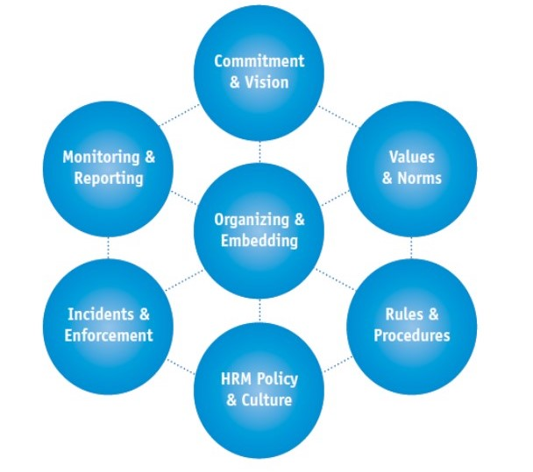
The Dutch Integrity Framework
Hoeakstra-Huberts 2016
Stage 3
Module 19 – Ethics Management (Advanced)

Slide 66
CONCLUSIONS
Traditional leadership tools, like more elaborate control system and harder sanctions do not necessarily secure improvement → risk of
  normative complexity, inconsistency and unclarity
  „strait jacket” and loss of motivation
Commitment and cooperation of stakeholders is key to effective, efficient, legitimate operation
WHAT REALLY MATTER IS THE
  Balance of rule-based and value-based instruments
  Processes and structures
  A holistic and systemic approach
Stage 3
Module 19 – Ethics Management (Advanced)

