Slide 1
MODULE 4 – LEADERSHIP VALUES
Stage 1 – Leadership for Organisations

Slide 2
Module Overview
Learning Objectives
To identify the role of values in shaping attitudes and behaviours.
To identify the individual values stimulating leadership and, in turn, good governance.
Learning Outcomes
Participants understand the individual leadership values on which effective public service is based.
Participants identify the current values that shape their organisation.
Participant identify ways to elicit the development of leadership-oriented values in their organisation and potential challenges.

Slide 3
Module Structure
Interactive Introduction
Group Exercise 1 – Value-Driven Organisation Behaviour
Group Exercise 2 – Linking Values to 12 Principles
Individual exercise – Value-Driven Organisation Assumptions - Contextualization

Slide 4
Working Definitions
Principle
A "principle" is defined as the acceptance of something as a truth, assuming that a certain standard or rule is not to be challenged.
There are individual principles, but principles can also be collectively agreed upon. For the LAP purpose, the reference standard are the 12 Principles of Good Governance (ref. Module 1).
Value
The concept of “value" indicated a strong personal belief. Values are often developed based on principles (i.e. principle-driven values). A value is neither inherently right nor wrong. It is an individual or group's perspective on a topic or issue.
Attitude/Behaviour
For the purpose of LAP attitudes and behaviours are those that within an organisation embody specific values, as an endorsement of the 12 Principles.

Slide 5
EXERCISES

Slide 6
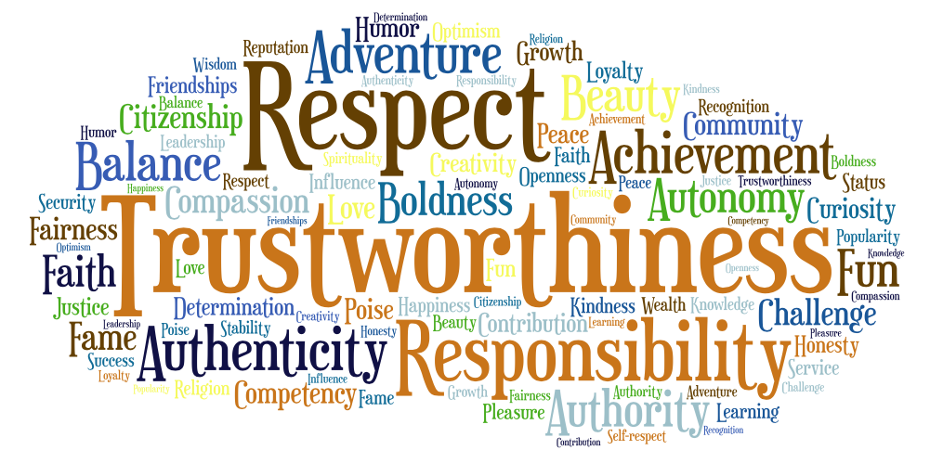
Exercise 1
Group Exercise 1 – Value-Driven Organisation Behaviour
In groups (3-4 people) fill in the table “Value-driven organisation behaviour”:
What personal values are at the base of the following behaviours?

Slide 7
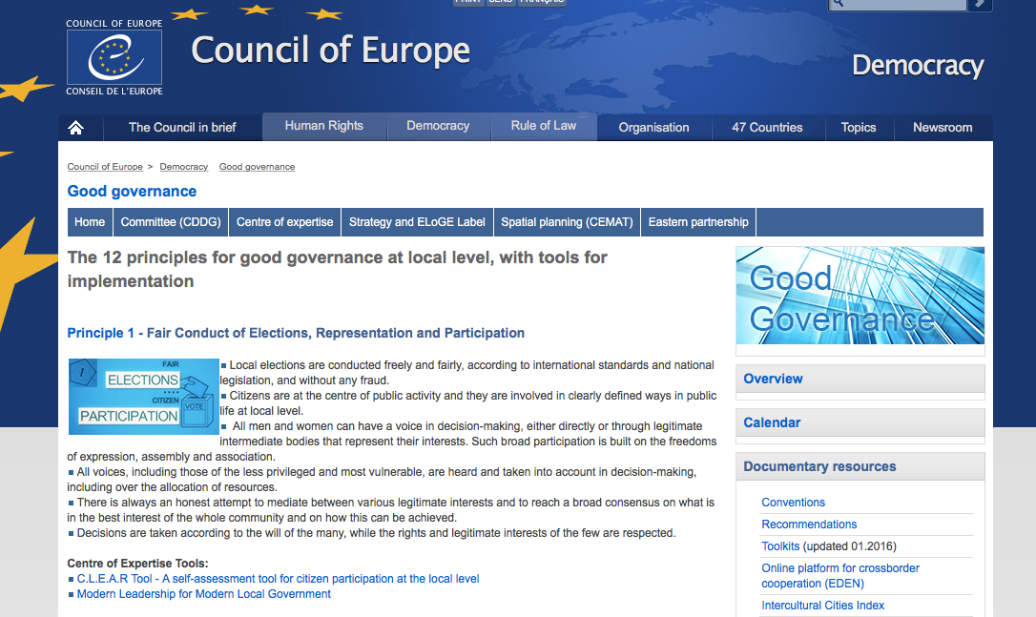
Exercise 2
Group Exercise 2 – Linking Values to 12 Principles
Identify (in groups of 3-4 people) connections between identified values and the 12 Principles of Good Governance.

Slide 8
Exercise 3
Individual exercise – Value-Driven Organisation Assumptions - Contextualization
Filling in the table “Value-Driven Organisation Assumptions”
Please indicate, for each assumption:
How much is this felt in your organisation? (Scores range between 1 and 10, where 1=not felt at all; 10=completely endorsed)
For those scoring lower than 7, try to imagine actions aimed at further endorsing the development of such assumption in your organisation
For those identified above, try to imagine what might be the main obstacles in doing so

Slide 9
VALUES (previous materials)

Slide 10
Values (1)
Determining actions
Values are the most powerful motivator
Individual or group conceptions of the relative desirability of things
Shaping behaviours
Vs
PRICE
Influencing attitudes
different levels of generality or abstraction
(may be) in conflict with one another
hierarchically arranged
explicit and implicit in varying degrees

Slide 11
Values (2)

Slide 12
Values (3)

Slide 13
12 Principles of good local governance
Fair Conduct of Elections, Representation and Participation
Responsiveness
Efficiency and Effectiveness
Openness and Transparency
Rule of Law
Ethical Conduct
Competence and Capacity
Innovation and Openness to Change
Sustainability and Long-term Orientation
Sound Financial Management
Human rights, Cultural Diversity and Social Cohesion
Accountability
www. http://www.coe.int/t/dgap/localdemocracy/Strategy_Innovation/12principles_en.asp

