Slide 1
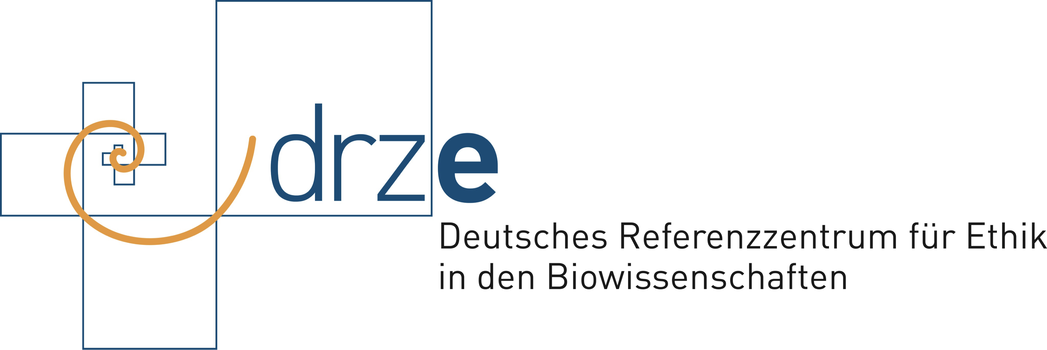
Council of Europe: HORIZON SCANNING EVENT 3 April 2024 Paris »Research Ethics: New Challenges«
Prof. Dr. Dirk Lanzerath
University of Bonn

Slide 2
Challenges
New Complexity of interaction
Need for different ethical advice
Stakeholder participation
Data sharing
Integration in civil society
Society as a lab
Research ethics governance

Slide 3
Complexity of interactions
research is changing the entire world profoundly; this requires ethical reflection already in the research and development phase
science as a social practice within a social practice
broad responsibility of research(ers):
“Respect for colleagues, research participants, society, ecosystems, cultural heritage and the environment.“ (ALLEA European Code of Conduct, (rev. ed. 2023, p. 5)
stronger normative interaction between science and society = promoting TRUST
How can environmental ethics and sustainability issues be integrated into the research process, rather than at a later stage when the technologies are applied?

Slide 4
Increasing need for ethical advice due to new threats
human dignity/human rights as frame of research ethics
long ethical tradition in biomedical research: RECs
spoken words can also be risky, may even traumatize people (i.e. interviews…)
the knowledge or dissemination of personal data can harm people, especially in a data-driven research
research funders and scientific journals feel they have a duty here and often demand ethical approvals before funding is approved or data published
effect: more RECs outside biomedicine
focus on shared responsibility, sensitivity and awareness for research ethics, not another tick-box exercise

Slide 5
Stakeholder participation
proactive task for researchers
but: connecting science and society is not just the task of scientists, it is (also) the task of politicians
stakeholder driven research may risk freedom of research
stakeholder involvement needs to be managed sensitively, which means listening to the most relevant and vulnerable
In medical RECs, the layperson, who is often a patient representative, is a mandatory member. Other ethics committees are considering similar models
© https://www.tixxt.com/de/stakeholder-engagement

Slide 6
Data sharing (1): Consent and Trust
biobanks and other repositories strive to have their own ethics governance and ethics committees to mitigate the uncertainties of broad consent or opt-out strategies
structures such as BBMRI, but also other database networks, are working towards harmonisation

Slide 7
Data sharing (2): Continuum of different degrees of data robustness governance. A decision corridor
© Dirk Lanzerath
Consent
level
Explicit consent - broad consent - opt-out - general release
Optional inclusion of
Trustees/ethics bodies or similar
Explicit inclusion of
Trustees/ethics bodies or similar
Trust
mechanism
Data
Sensitivity
High potential for stigmatization/discrimination
Low potential for stigmatization/discrimination
HIV infections
Psychiatric illnesses
Mental disorders
Data from childhood and adolescence
Group-specific data for group-specific research (e.g. best oncological data)
Billing data
Anonymizable epidemiological data
Data for which re-identification is virtually impossible
Examples

Slide 8
Data sharing (3): Common Good/Solidarity
data donation may have a collective benefit
But what about the researcher's sense of solidarity?
When it comes to the use of research results – e.g. medicines or vaccines – it is often no longer the idea of the common good that determines business, but the forces of the markets.
Gap of equity: in particularly between the global North and the global South.
concept of access and benefit sharing: cf. Nagoya Protocol on using genetic resources in natural areas
© https://www.bdkj.de/

Slide 9
Integration in civil society
fundamental relationship between science and the living world
Science should provide clear rules as to which judgment can be considered truthful and how they can be verified.
Fight against fake news
But: “follow the science”?
Integrate science!
© Getty Images / DigitalVision Vectors / smartboy10

Slide 10
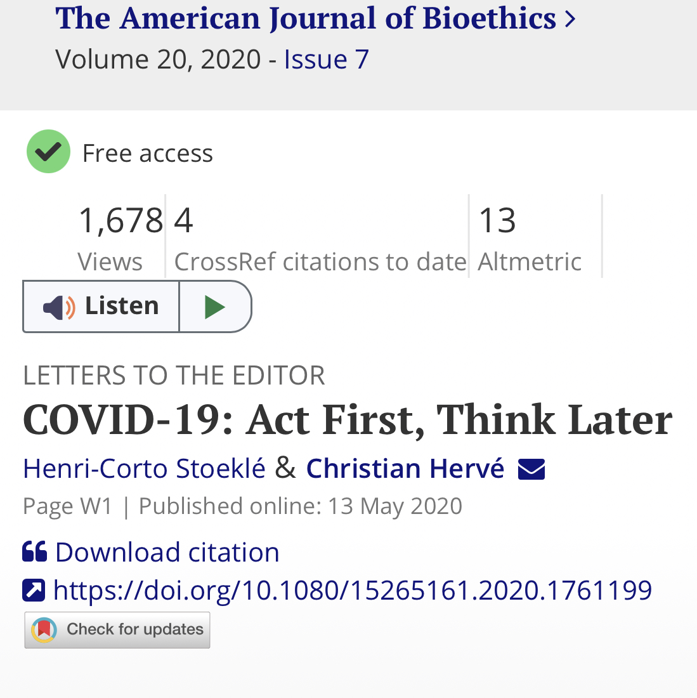
“COVID-19: Act First, Think Later”
“In France, the Ministry of Health has requested the intervention of the national ethics committee (CCNE) in the face of the COVID-19 epidemic. However, now really isn’t the time for ethical reflections. The CCNE is composed of doctors, philosophers, and scientists who deal with the ethical issues posed by various medical and scientific advances. Ethics is only really useful if you have the time, and right now, time is exactly what we do not have.”

Slide 11
Society as a lab
The side effects of medicines are tested on larger numbers of cases, technical devices, medical products and health apps - many of which are also AI-based - are delivered in a semi-finished state and are followed by update after update.
laboratories and research institutions are a protected space with clear rules, including ethical rules. These are watered down outside this space.
If society itself is increasingly becoming a laboratory, we need new ideas and procedures for this new scenario, including ethical ones.
© Stock-Fotografie-ID:468937316

Slide 12
Research ethics governance
Research institutions need awareness-raising at various levels. The management of a research institution must support and set up ethical bodies and boards and also facilitate training.
Only joint ethics governance can have a protective effect here. Institutions and individuals must work together systematically.
public/academic vs privat/ommercial research
many companies now have their own ethics boards, but the overall situation is confusing and non-transparent, and lacks of independence. It’s therefore desirable, to see more research ethics governance structures also in non-academic research.

