Slide 1





March 21, 2018, Helsinki
Dilyana Giteva, JUSTROM National Coordinator for Bulgaria

Slide 2



JUSTROM IN BULGARIA
Raising awareness about discrimination, gender based violence, trafficking in human beings:
– more than 1470 people were informed personally
- and thousands during the awareness raising meetings and through media

Slide 3
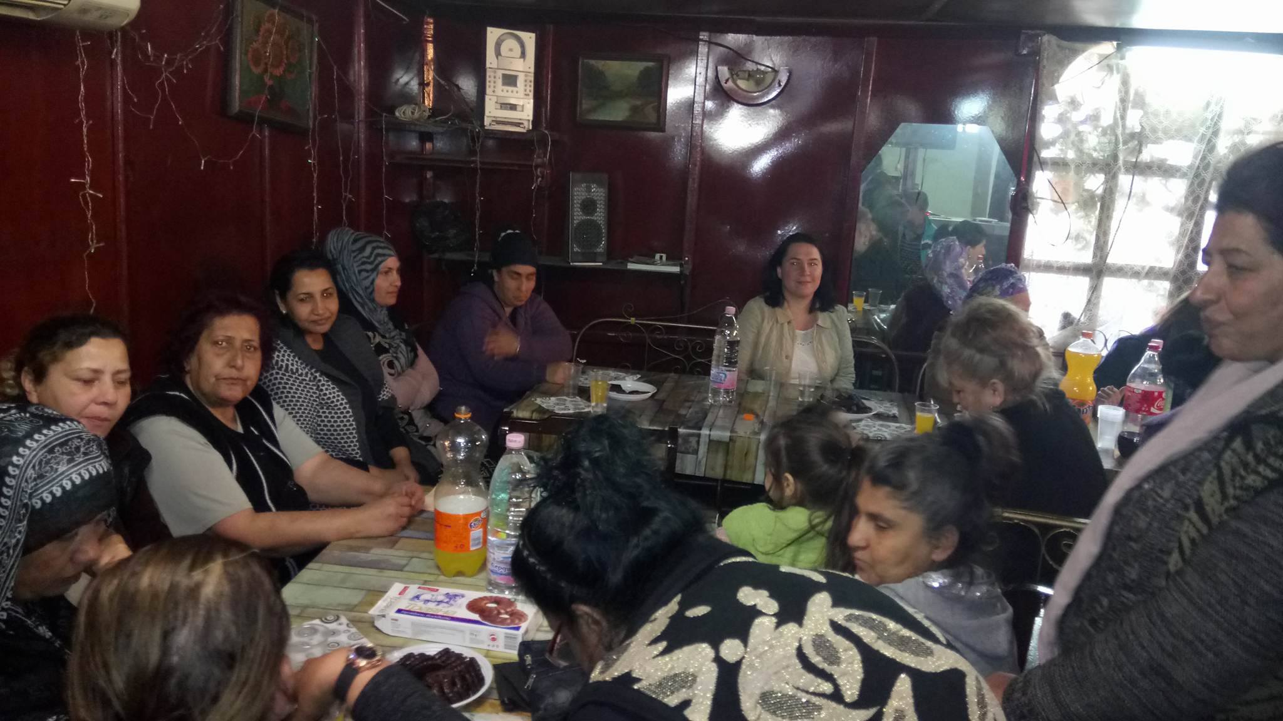
Awareness raising meetings

Slide 4
More than 1200 people received legal consultations (3/4 women and 1/4 man)
More than 1100 consultations were provided

Slide 5
‘The ordinary citizen needs a little help when she is in need. Thank you for paying me attention!’
Roma women from the town of Zlataritsa, Veliko Tarnovo region

Slide 6
‘… of course I am satisfied with the assistance, which I received, but what was the most important for me was the attitude, understanding and respect.’
                Roma women from Stolopinovo neighbourhood in Plovdiv

Slide 7
‘Many people do not know their rights, not only because are illiterate, but also because there is not accessible and comprehensible information about it’
Roma women from Strajitsa,
Veliko Tarnovo region

Slide 8
Empowering Roma women to report
 | men | women | total
No of cases referred to the legal aid | 1 | 29 | 30
No of cases filed to court | 21 | 62 | 83
No of applications sent to the police | 9 | 16 | 25
No of applications sent to the prosecutor | 1 | 7 | 8
No of applications sent to the ombudsman | 11 | 13 | 24
No of applications sent to the child protection | 0 | 3 | 3
No of letters sent to local or national authorities | 21 | 39 | 60
Total no of complaints filed | 71 | 218 | 298

Slide 9
some data
Indebted households | 131
Criminal Liability Issues | 84
Administrative Issues | 230
Divorce/Abandoned by spouse: | 82
Child recognition | 56
Children’s rights and family issues | 68
Healthcare | 18
Property Issues | 83
Inheritance issues | 21
Employment | 25
Social benefits and welfare | 93
Religious rights | 6

Slide 10
Achievements
Type of cases | men | women | total
No of civil cases | 168 | 556 | 724
No of discrimination cases | 19 | 9 | 28
No of gender violence cases | 2 | 195 | 197
No of administrative cases | 21 | 27 | 48
No of criminal cases | 25 | 71 | 96

Slide 11
Achievements
The case of X. from V.T.
The case of D. from P.
The courts issued protection orders

Slide 12
X (30-years-old), her daughter Y (14-years-old), son H (9-years-old) and her mother F (56-years-old) were victims of systemic domestic violence. X. decided to leave her husband who has been torturing her for 15 years.
X. comes from a conservative Roma family and reacted after many years of being deprived of her rights after an early marriage at the age of 15.
There was probability the 14 years old daughter also to be forcibly married.

Slide 13
Threats were directed both to the victim of the domestic violence and her mother (and grandmother of the children).
The children were witnesses of the violence.
The grandmother initiated a procedure under the Law for Protection against Domestic Violence on behalf of X.
A lawyer, specialized in family law, was provided. The court granted immediate protection to X. and her children. The mother and the children were placed in protected house. Before the final decision about the protection measures the victim withdraw the complaint against her husband and returned home.

Slide 14
STAKEHOLDERS
National Legal Aid Burau
Municipality of Veliko Tarnovo and other municipalities in the region
Veliko Tarnovo BAR
Municipality of Plovdiv
Plovdiv BAR
Commission for Protection against Discrimination
NGOs

Slide 15
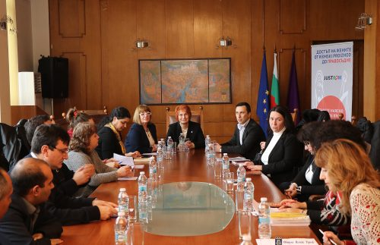
Stakeholders meetings

Slide 16
activities envisaged in the second phase and where need more direct or greater co-operation with institutions

Slide 17
THANK YOU!

