Slide 1
„Access to Justice for Women Victims of Violence”
Regional conference of the PGG Regional Project
“Strengthening Access to Justice for Women Victims of Violence in the Six Eastern Partnership Countries”
18-19 October 2018
Strasbourg, France

Slide 2
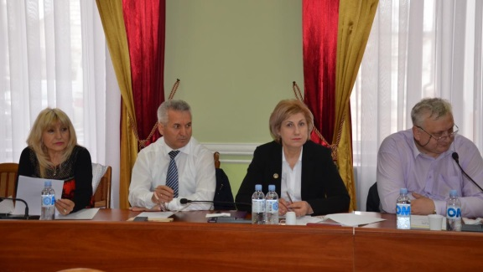
3 training seminars "Women's rights and their access to justice. Accession to the legal profession ",
organized at the National Institute of Justice, with the support of the Council of Europe
within the project "Improving women's access to justice in five Eastern Partnership countries“.
Experts :
Diana Scobioală, Director of NIJ, PhD
in Law, Associate Professor, NIJ trainer;
Olga Dorul, PhD in Law, Associate Professor, NIJ trainer;
Iustina Ionescu, Anti-discrimination Expert;
Corina Voicu, Director of the Legislation, Documentation and Contentious Division of the Superior Council of Magistracy of Romania;
Raluca Popa, Program Manager, Department
of Equality, Gender Equality Unit of the Council
of Europe.

Slide 3
The project "Improving Women's Access to Justice in The
Eastern Partnership Countries"
1
05-06.04.2016 - Women's rights. Access to justice. The Legal Profession accession.
Participants: judges – 14
prosecutors – 14
2
08-09.06.2016 - Women's rights. Access to justice. The Legal Profession accession.
Participants: judges – 25
prosecutors – 10
3
26-27.09.2016 - Women's rights. Access to justice. The Legal Profession accession.
Participants: judges – 4
prosecutors – 15
NIJ staff - 5

Slide 4
The main beneficiaries of the on-going training seminars in the area of
Women's Rights and their access to justice. Accession to the legal profession
85 beneficiaries
43
judges
39
prosecutors
3
NIJ staff

Slide 5
24-25 October, 2016
Regional Conference organized by the NIJ
in partnership with the Council of Europe
The next steps on integrating issues such as women's rights, gender equality and equal access to
justice in the training plan of professionals in the justice sector have been discussed during the
conference. The training manual entitled "Ensuring women's access to justice" was also presented.

Slide 6
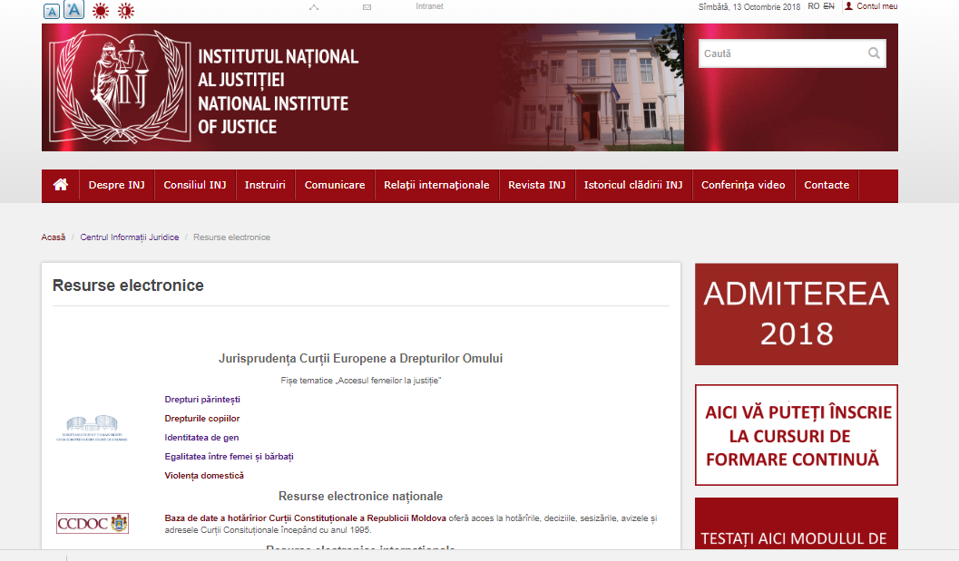
Online resources. National Institute of Justice

Slide 7
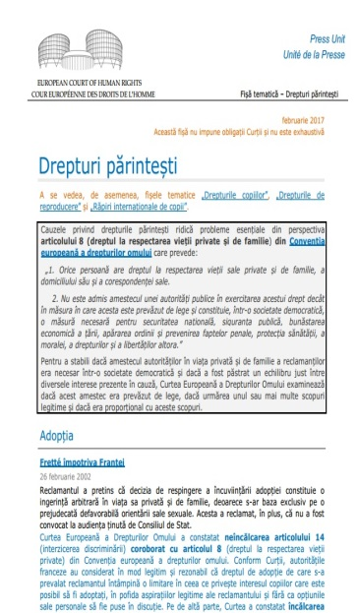
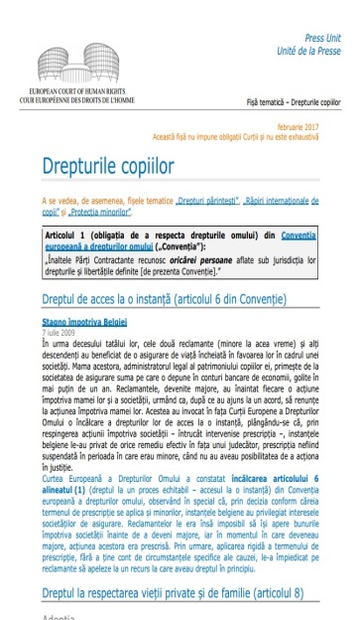
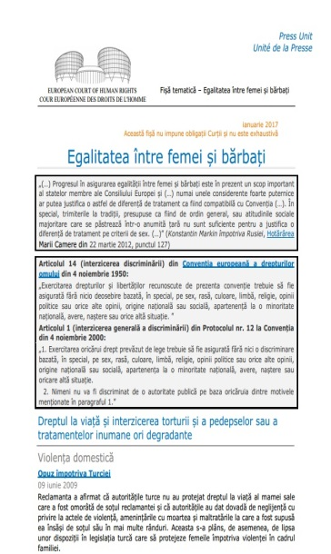
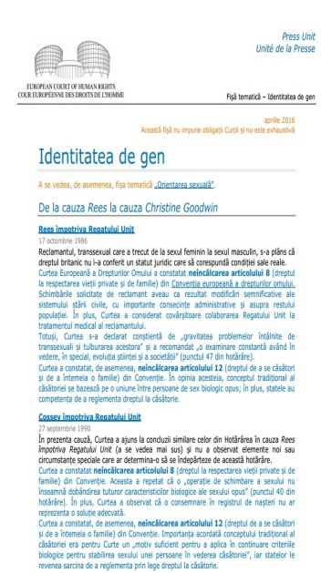
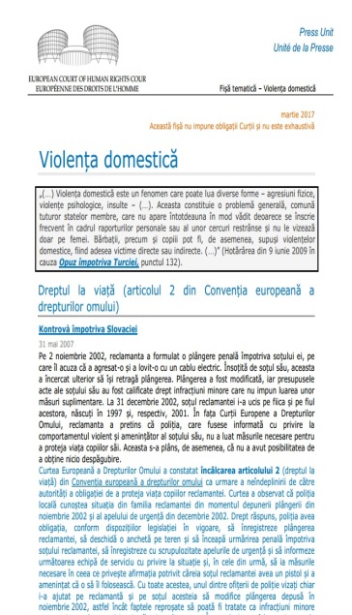
Online resources. Library. National Institute of Justice

Slide 8
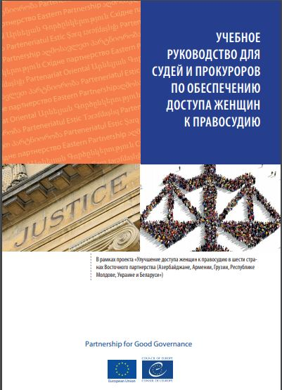
Ensuring women's access to justice
Training manual for judges and prosecutors

Slide 9
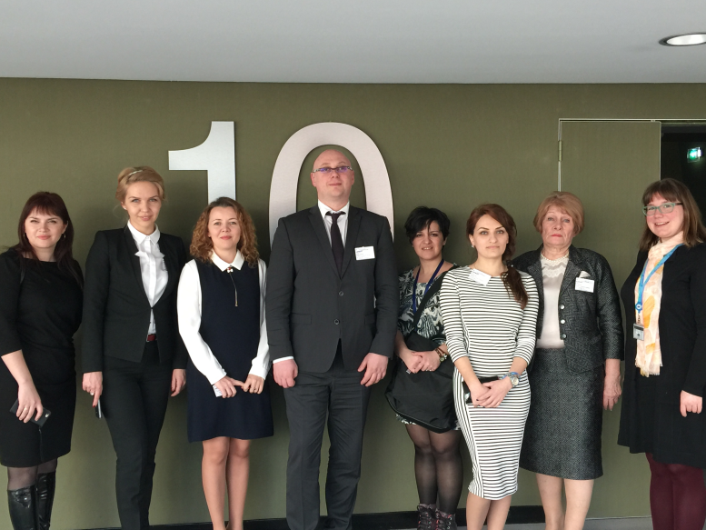
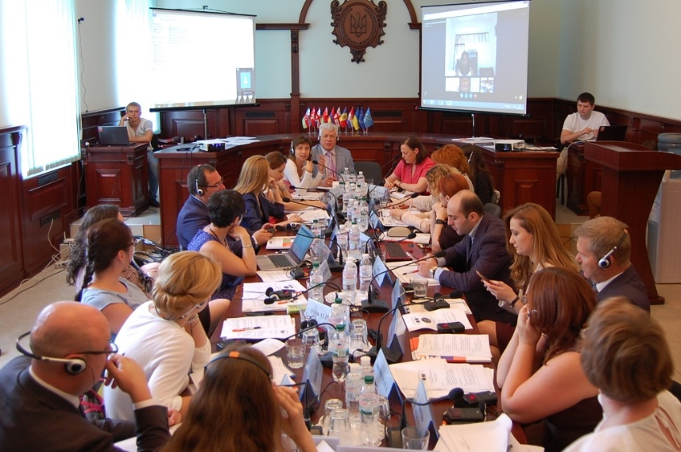
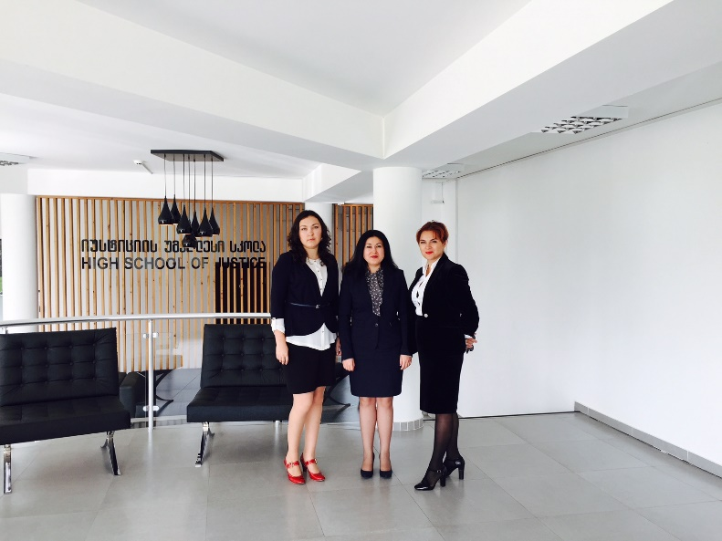
Workshops in Strasbourg, Kiyev,
Tbilisi

Slide 10
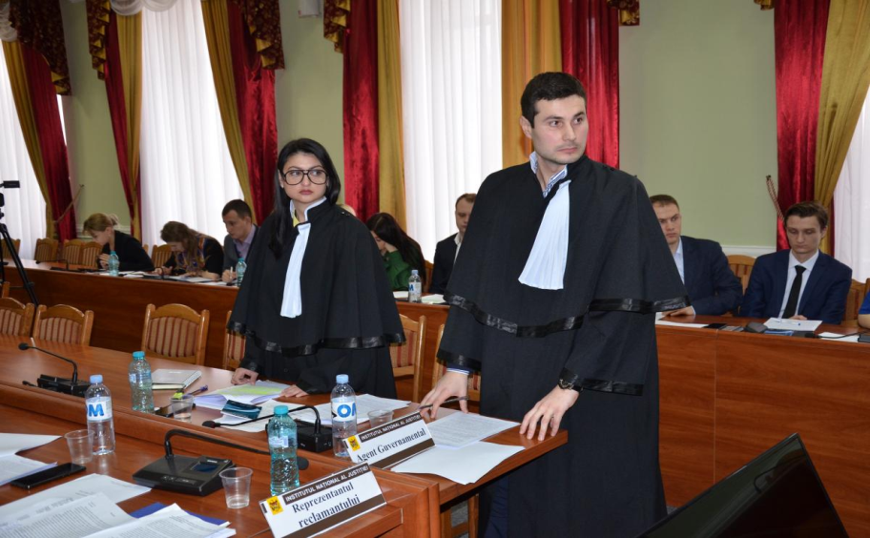
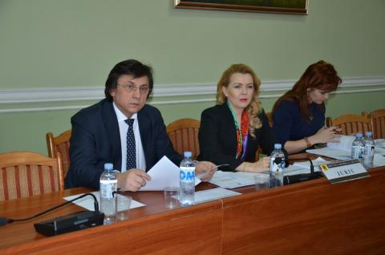
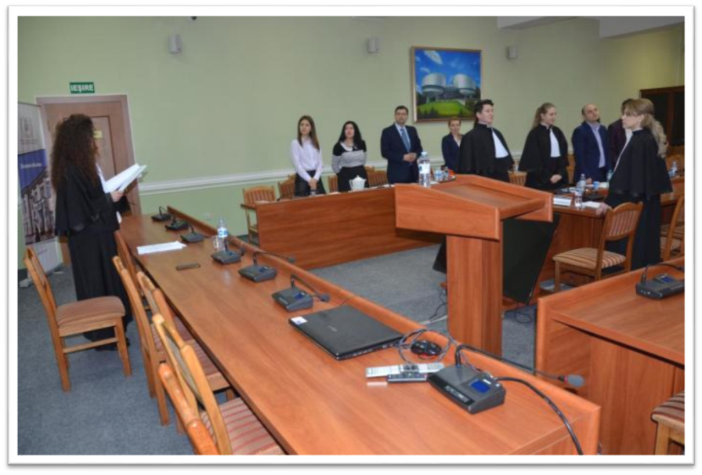
The simulation of the moot court

Slide 11
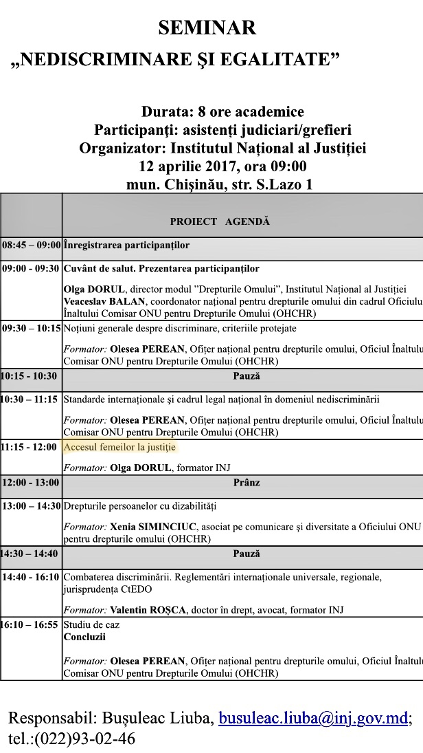
On-going training
2016-2018
12 seminars
220 beneficiaries

Slide 12
Cooperation with NGOs
Women’s Law Center
2016 – 2018: 16 Trainings
447 trained persons – judges, prosecutors, lawyers,
police officers, court staff
Research: Guide on the implementation of legislation on prevention and punishment of domestic violence
Concept and forms of violence
Myths and realities
International standards
Civil aspects
Criminal aspects
Procedural law

Slide 13
Thank you for
Your attention!

