Slide 1
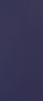
EURO-MEDITERRANEAN CENTRE ON INSULAR COASTAL DYNAMIC (Malta)
Presented by Dr Belinda Gambin
(obo Professor Anton Micallef)
Paris, November 6-7, 2017

Slide 2
Coordinator: Anton Micallef, ICoD, Malta Partners: CERG / University of Normandy (UNICAEN), France & University of Modena (UNIMORE), Italy
2017 - Project 1
Developing Geomorphological mapping skills and datasets in anticipation of subsequent Susceptibility, Vulnerability, Hazard and Risk Mapping

Slide 3
2017 - Project 1
Specific objective
Development of geomorphological maps for selected coastlines in Normandy & Malta.
Expected results & deliverables
Phase 2 field surveys & development of geomorphological maps for selected coastlines in Normandy & Malta.
Associated activities
Phase 2 field surveys in Normandy by CERG/UNICAEN & in Malta by UNIMORE & ICoD.
Development of geomorphological maps for selected coastlines in Malta & Normandy.

Slide 4
2017 RESULTS
Publication of 2016 output in the Geophysical Research Abstracts of the European Geosciences Union (EGU)

Slide 5
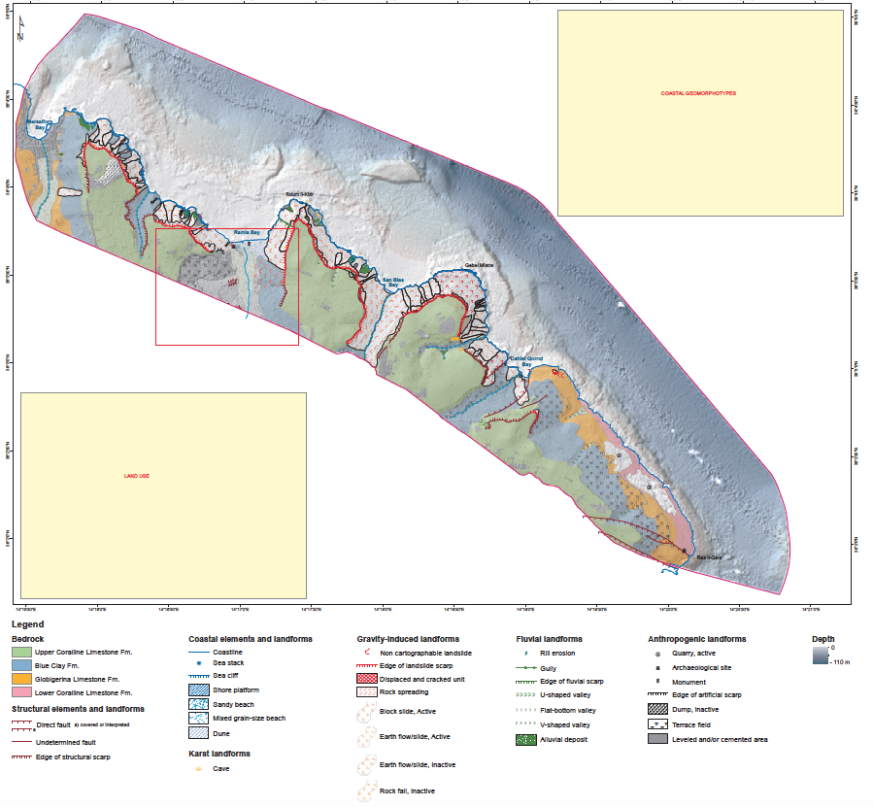
2017 RESULTS Project 1
Geomorphological map for selected coastlines in Malta (NE coast of Gozo)

Slide 6
2017 RESULTS Project 1
Geomorphological map for selected coastlines in Malta (NE coast of Gozo)

Slide 7
2017 RESULTS Project 1
Geomorphological map for selected coastlines in Malta (NE coast of Gozo)

Slide 8
2017 RESULTS Project 1
Geomorphological map for selected coastlines in Malta (NE coast of Gozo)

Slide 9
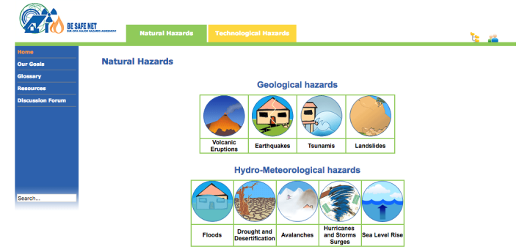
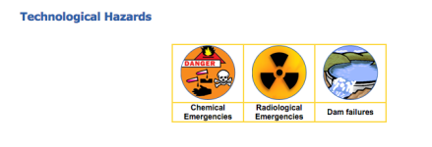
Partner: ICoD
2017 - Project 2
BeSafeNet

Slide 10
2017 - Project 2
Specific objectives:
Improve BeSafeNet website material.
Improve awareness & use of BeSafeNet initiative.
Activities to be carried out:
Improve text & presentation; complete website material. (storm surges, sea-level rise & Tsunamis)
Preparation for organisation of BeSafeNet Olympiad competition. (on major natural & technological hazards)
Preparation of MCQs for use in Olympiad.
Expected results & deliverables:
Completed website modules on storm surges, sea level rise & Tsunamis.
Completed MCQs.
Improved readiness for organisation of Olympiad competition.

Slide 11
2017 - Project 2 Outcomes
Completed website modules: storm surges, sea level rise & Tsunamis.
Completed MCQs for 2018 Olympiad for coastal hazard modules.
Improved readiness for organisation of Olympiad competition. (BeSafeNet meeting Cyprus: 10-11 October 2017)
Proof-read & corrected English text for all BeSafeNet website material. (12 questions / answers x 9 natural + 3 tech. hazards)

Slide 12
Coordinator: Anton Micallef, ICoD, Malta
2018/9 – Project 1 Proposal
‘Hazard and Vulnerability Assessment:
The Path to Identifying Risk’
Relevance to EUR-OPA Medium Term Action Plan:
Integrating disaster risk reduction into other areas.
Focus Area 2: ’Climate change, environment and risk management’.
Project Partners:
CERG / University of Normandy, France.
University of Modena, Italy.

Slide 13
2018/9 – Project 1 Activities
2018
Susceptibility & hazards mapping in selected coastal areas of Malta & Normandy.
Building on 2016/17 programme.
2019
Evaluation of potential methodologies for estimation of social, economic & physical coastal vulnerability to coastal erosion & / or sea level rise.
Field application of chosen methodology (mapping).

Slide 14
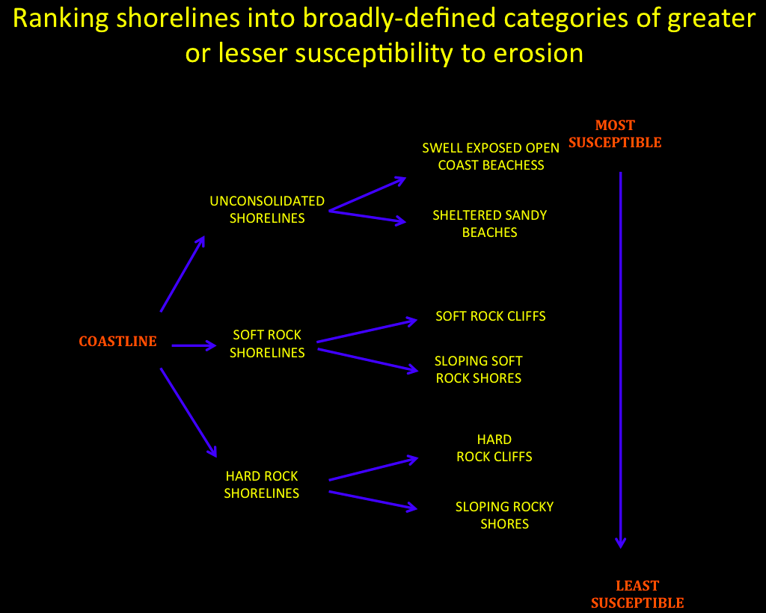
2018/9 – Project 1 Activities (example)

Slide 15
2018/9 – Project 1 Expected Results
2018
Production of susceptibility & hazards maps for selected coastal areas of Normandy, Malta & Gozo.
2019
Organisation, in Caen (France), of an expert workshop on coastal hazard vulnerability & consequences assessment.
Field data collection on coastal vulnerability on selected coastlines in Normandy & Malta.

Slide 16
2018/9 – Project 2 Proposal
‘Beach and Coastal Resorts Risks’
Relevance to EUR-OPA Medium Term Action Plan:
Using scientific & technological knowledge to better assess evolving risks & adapt (accordingly) the resilience strategies.
Promoting risk culture among the population. (children, adults & groups with special vulnerability)
Fostering the population’s active participation in DRR. (as individuals & as community)
Project partner - ICoD

Slide 17
2018/9 – Project 2 Activities
2018
Desk study on identification of Tsunami Ready Hotel & Tsunami Ready Beaches. (local requirements & identification of relevant actors)
Holding of seminar addressed to lifeguard associations, beach management entities & tourism professionals on risk culture, mitigation & dissemination to present Tsunami Ready concept & requirements.
2019
Preparation & dissemination of TRB leaflets & beach signs aimed at raising beach user awareness.
Holding a project seminar to present & discuss works carried out by all project partners.

Slide 18
2018/9 – Project 2 Expected Results
2018
Involvement of local population, associations & authorities on dissemination of tsunami & other beach risks, & on implementation of mitigation measures.
2019
Preparation & dissemination of TRB leaflets & beach signs aimed at raising beach user awareness.
Holding a project seminar to present & discuss works carried out by all project partners.

Slide 19
2018/9 – Project 2 Deliverables
2018
Report on desk study on identification of TRB local requirements & identification of relevant actors.
Report on seminar addressed to lifeguard associations, beach management entities & tourism professionals on risk culture, mitigation & dissemination to present Tsunami Ready concept & requirements.
2019
TRB leaflets & beach signs aimed at raising beach user awareness.
Report of seminar to present & discuss works carried out by all project partners.

Slide 20
Thank you
Notes:
TRB: Tsunami Ready Beaches

