Slide 1
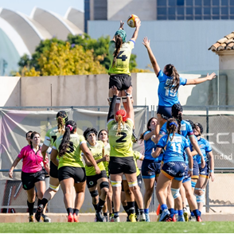
Women and girls participation in sport
EPAS Breakfast Roundtable, 6 March, Strasbourg
Marie Denitton, Gender Equality Rapporteur, EPAS CC

Slide 2
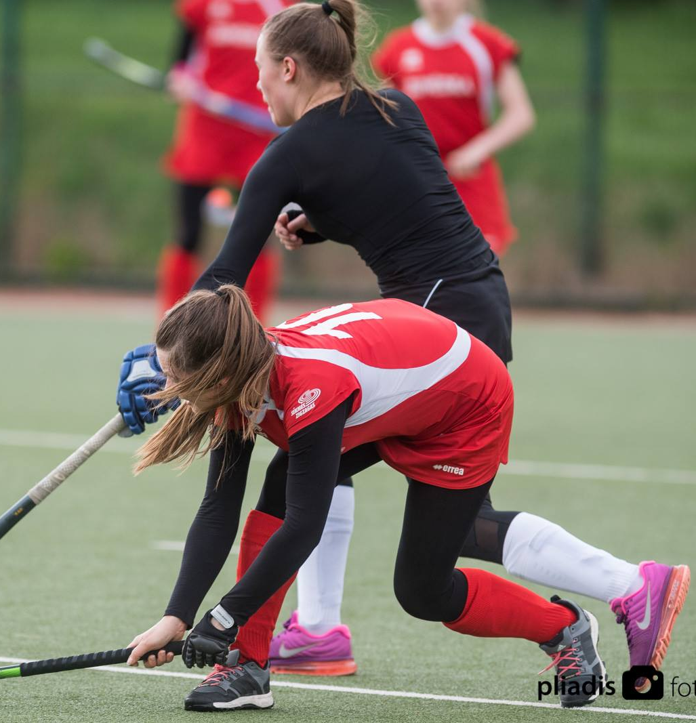
All In + project – for greater gender equality
21 jurisdictions from all over Europe, collected data from 36 different sports.
Indicators Leadership Coaching and officiating Participation (grassroots to elite) Gender-based violence in sport Media and communication Gender equality policies & programmes

Slide 3
Some statistics of participation in All In +
12% of sports federations have a female president
29% have a female Vice President or board member
23% of coaches are women
31% of members in organised sports federations are women or girls
23% of all registered coaches are women.
32% of sports officials are women.
(but in some countries the share is extremely low, only 8%.)
Gender‑based violence policies increased from 25% (2019) to 39% (2023)

Slide 4
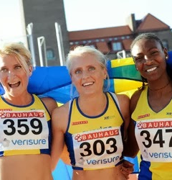
Experiences from Sweden
32 federations participated in the data collection
* 45% female presidents
* 41% female vice presidents
* 49% female board members.
In 2017 the 70 member federations decided about a direction for gender equality. All federations must meet all goals until the General Assembly in May 2025.
One goal was: Women and men should have equal influence in decision-making and advisory bodies. Neither gender should be represented by less than 40 percent.
Det här fotot av Okänd författare licensieras enligt CC BY

Slide 5
How All In+ is rolled out in the EPAS Strategy
Gender equality becomes part of EPAS cross‑cutting principles in the strategy for 2026-2027.
EPAS also plans to:
Develop new tools using All In+ data as a basis
Support new countries that wants to implement gender equality recommendations
Use collected data to shape Council of Europe standards and ministerial conference priorities
EPAS will continue and expand All In+ deliverables, making them part of their long‑term programmes.

Slide 6

ENGSOs contribution
Equality embedded in the daily work
Support members in strenghtening their work with gender equality
Lots of activities and events where gender equality is discussed
Research in 2023 about Womens participation in Sport across Europe
Contributing to European projects
Coordinates the women and sport network in Europe
Developing a mentoring program for female leaders in sport
Encourage organisations to sign the Brighton Helsinki Declaration
Equal sports is not mainly about men and women, it is a prerequisite for successful sports development!

