Slide 1
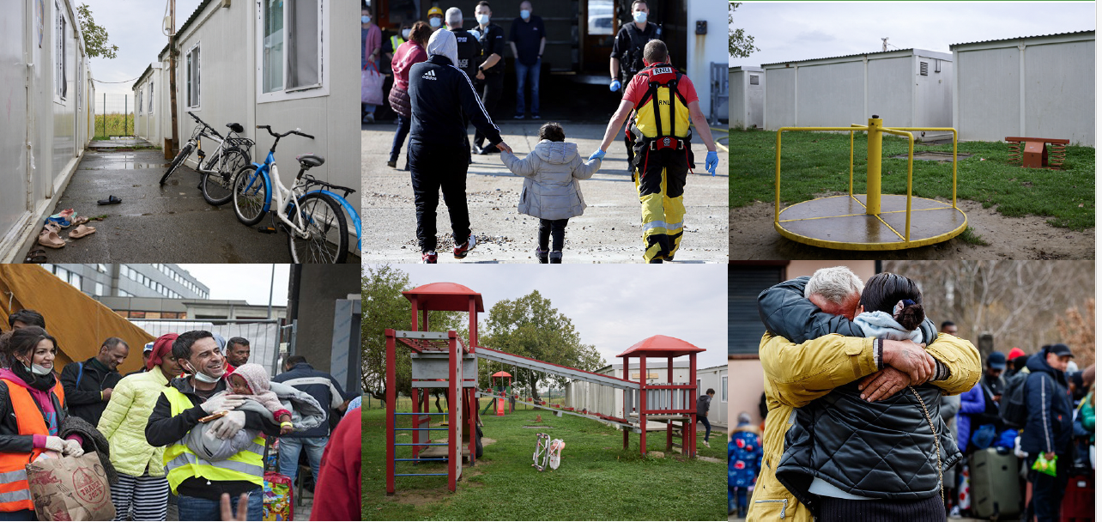

Vulnerability of migrants, asylum seekers and refugees:
Council of Europe and European Union standards
Lilian Tsourdi/Professor & Jean Monnet Chair in EU Migration Law and Governance, Faculty of Law, Maastricht University
Catherine Warin/Lawyer (Luxembourg Bar) & Associate Professor (University of Lille)

Slide 2
Background and Aim of the Thematic Paper
Council of Europe Action Plan on Protecting Vulnerable Persons in the Context of Migration and Asylum in Europe (2021-2025).
Action Plan: “vulnerable persons in the context of migration and asylum” are persons who have been found to have special needs following individual evaluation of their situation and who are entitled to call on states’ obligation to provide special protection and assistance.
Provides a concise mapping of the major Council of Europe and European Union (EU) instruments and the case law of the two European courts concerning vulnerability.
Migrants, asylum seekers, refugees, stateless persons and trafficked persons with a migration background.

Slide 3
Vulnerability as a legal concept
Increasing recognition in international, regional and national legal systems that certain groups face additional barriers to exercising their rights due to sex, gender, “race”, colour, language, religion, political or other opinion, national or social origin, association with a national minority, property, birth, sexual orientation, gender identity and expression, sex characteristics, age and development, state of health, disability, marital status, migrant or refugee status, or other status.
Intersecting layers of vulnerability: e.g. unaccompanied minor refugee

Slide 4
EU Law Standards for Addressing Vulnerability in Migration and Asylum
Screening Regulation
Asylum Procedures Directive (2013) Asylum Procedures Regulation (2024)
Dublin Regulation (2013) & Asylum & Migration Management Regulation (2024)
Qualification Directive (2013) & Qualification Regulation (2024)
Asylum Reception Conditions Directive (2013: in force and 2024: in transposition)
Family Reunification Directive (2003)
Anti-Trafficking Directive (2011: in force and 2024: in transposition)
Legal migration acquis (Single Permit Directive 2024, Seasonal Workers Directive 2014, Victims Rights Directive 2024)
Return Directive (2008) & new Regulation under negotiation
CJEU case law

Slide 5
Identification of vulnerable asylum seekers
2013 Recast Directive, Arts. 21, 22
open-ended list of vulnerable individuals (some additions e.g. victims of THB)
‘persons with special reception needs’ = sub-category of vulnerable persons
identification of vulnerability implicit (in order to effectively implement Article 21)
‘assessment’ of special reception needs
assessment may be integrated in an existing national procedure; need not take the form of an administrative procedure
findings on special reception needs ‘without prejudice’ to the asylum procedure

Slide 6
Vulnerability: 2024 RCD-Art. 24
  Obligation to take to account the specific situation of applicants with special reception needs
  In order to effectively implement Article 24, Member States shall, as early as possible after an application for international protection is made, individually assess whether the applicant has special reception needs, using oral translation where necessary
  Lengthy indicative list of applicants that are ‘more likely to have special reception needs’
  New concretised training obligations for personnel and obligation to refer to medical personnel

Slide 7
Treatment of vulnerable groups (Articles 23-25 RRCD)
Special treatment foreseen for minors, UAMs and victims of torture
Minors (Art. 23 RRCD) Best interests of the child as a primary consideration + guidance on how to assess them incl. the views of the minor (new) Ensure a standard of living adequate for the minor’s physical, mental, spiritual, moral and social development (new) Access to leisure activities within the premises of accommodation centers (new)
Unaccompanied minors (Art. 24 RRCD) Enhanced wording on the representatives: perform duties in accordance with the best principles of the child; have the necessary expertise Obligations for family tracing + with the assistance of international or other relevant organisations (new) Training obligations for personnel working with UAMs

Slide 8
Treatment of vulnerable groups (Articles 23-25 RRCD)
Special treatment foreseen for minors, UAMs and victims of torture
Victims of torture and violence (Art. 25 RRCD) Strengthened language: “shall ensure…that they receive the necessary treatment” In particular access to appropriate medical or psychological treatment or care Training obligations for personnel working with victims of torture (new)

Slide 9
CoE standards on vulnerability in migration and asylum: opportunities and challenges
A rich and broad array of sources
‘variable geometry’ of applicability and justiciability
Need to map out the existing instruments AND the connections between the various instruments (+ EU law)

Slide 10
Convention standards: norms, case law and good practices
ECHR: NOT an asylum instrument BUT acknowledges migration background as factor of vulnerability
  Most ECHR provisions can be relevant in migration cases
  Cumulation of vulnerability factors (e.g. refugees as vulnerable persons in the context of family reunification proceedings; children in migratory context, trafficked persons with a migratory background…)
  Open list! E.g. gender increasingly recognized as a vulnerability factor

Slide 11
Other Council of Europe treaties
Treaties directly relating to migration
  Statelessness (UN treaties) complemented by CoE Convention on Nationality and CoE Convention on the Avoidance of Statelessness in relation to State Succession
  European Convention on the Legal Status of Migrant Workers
  Migrants in detention: European Convention for the Prevention of Torture
Other CoE instruments relevant for migration
  European Social Charter
  Children’s rights instruments
  CoE Anti-trafficking Convention
  Istanbul convention – Ch VII focus on migration + asylum and implications for victims of gender-based violence

Slide 12
Council of Europe ‘soft law’: Resolutions, Recommendations and Action Plans
Resolutions of the CoE Parliamentary Assembly on migration and asylum
CoE Committee of Ministers recommendations on inclusion and combating discrimination
CoE Action Plan on Protecting Vulnerable Persons in the Context of Migration and Asylum in Europe

Slide 13
Good practices in national systems
Overarching, holistic approach to vulnerability in reception systems (Italy)
Case management-based alternatives to detention in 7 European countries
Dedicated funds to combatting sexual violence, incl. funding for a coordinating office on advice and support (Austria)

Slide 14
Conclusions and recommendations
Attention to ongoing legal developments and to interactions between legal systems and sources
A co-operative and evolutive approach to vulnerability
Addressing migrant vulnerabilities throughout administrative processes
Monitoring mechanisms and remedies

Slide 15
Focus on two vulnerable groups
Children
Victims of trafficking in human beings
For each: CoE framework, EU framework, Good practices

Slide 16
CoE framework on Children in migration
UN Convention on the Rights of the Child
‘general’ Council of Europe treaties (e.g. ECHR, European Social Charter)
Specific instruments (e.g. Lanzarote Convention targeting sexual exploitation, Istanbul Convention targeting violence against women and domestic violence)
Children consistently recognised as a vulnerable group, especially in migration contexts (ECtHR A.C. and M.C. v. France, App. No. 4289/21)
Unaccompanied or separated children even more vulnerable
Risks: detention, violence, and abuse
Detention of migrant children should be exceptional, only as a last resort

Slide 17
CoE Strategy for the rights of the child
Highlights children in vulnerable situations, including:
Roma and Traveller children
Children with a migration background
Children deprived of liberty (incl. immigration detention)
Children affected by migration and forced displacement
Emphasises the concept of “children on the move” (more inclusive and less stigmatising term, covers migrant, refugee, and asylum-seeking children)

Slide 18
EU framework on Children in migration: Reception Conditions Directive and Asylum Procedure Regulation
Reception: Children (minors) explicitly recognised as a vulnerable group
Unaccompanied minors receive specific protection measures
individual assessment of each child’s special reception needs, and tailored support
Detention of children requires very strong justification: Must meet necessity and proportionality requirements, should be discontinued if needs are not met
a flexible, case-by-case approach rather than fixed categories
Procedure: Tailor-made, individualised support for children’s procedural needs
Concept of special procedural needs , requires an individual (case-by-case) assessment and then provision of adequate support
Unaccompanied minors receive specific procedural safeguards
Children (and other vulnerable applicants) may be exempt from accelerated or border procedure, especially if their needs cannot be properly met in those procedures - BUT: Exemption is not automatic, Applicants must prove their needs cannot be accommodated (difficult evidentiary burden in practice)
Staff are trained to identify vulnerability in children

Slide 19
EU framework on Children in migration: Screening and Management Regulations
Unaccompanied minors and vulnerable children must receive specific information and additional support where they have special needs
In assessing the best interests of unaccompanied minors, states must consider additional vulnerabilities, The need for stability and continuity in social and educational care, Children’s equal access to education, regardless of migration status
Transfers between States: Health data and special needs of children must be shared, The receiving state must ensure these needs are properly addressed
Screening stage: vulnerability and health checks, must involve specialised and trained personnel, with possible involvement of child protection authorities, Support from medical staff and NGOs
When vulnerabilities are identified: timely and adequate support, must consider both physical and mental health; support must be child-friendly and age-appropriate, delivered by trained professionals in cooperation with child protection services
Key concern: In practice, there may be limited access to specialised services and trained staff, especially in remote border areas

Slide 20
Good practices: focus on measures for Unaccompanied minors
Extended data retention (Poland):
Records of unaccompanied minors kept longer (12 → 36 months)
Helps ensure continued access to education benefits after turning 18
Faster procedures (Belgium):
“Fast-lane” system to quickly assess age claims in asylum applications
Improved identification and tracing (France):
Creation of a database for unaccompanied minors suspected of offences
Facilitates identity verification and tracking
Better age assessment practices:
Bulgaria: Guidance to avoid unnecessary medical exams
Cyprus: Development of standard operating procedures
Sweden: Updated processes for accuracy and consistency
Reduced administrative barriers:
Belgium: Easier access to health insurance without waiting for a guardian
Greece: Simplified registration procedures for health coverage
Child-centred approach:
Measures aim to support the best interests of the child
Focus on efficiency, fairness, and access to essential services

Slide 21
CoE framework on victims of THB
ECtHR emphasises the particular vulnerability of trafficked persons, especially those with a migratory background, and the heightened obligations of national authorities to identify and protect them. Authorities must avoid re-traumatisation and criminalisation (ECtHR, V.C.L. and A.N. v. UK, App. Nos. 77587/12 and 74603/12)
Key legal instrument: 2005 Anti-Trafficking Convention
Vulnerability at the core of trafficking definition - Includes situations where a person has no real alternative but to submit to abuse; covers physical, psychological, social, and economic vulnerability
Examples of vulnerability: Irregular or insecure legal status, Economic dependence, Poor health or hardship, Situations leading to exploitation and loss of dignity
State obligations under the Convention: Prevent trafficking, Identify vulnerable persons and victims, Provide assistance and protection
Monitoring mechanism: GRETA (Group of Experts) evaluates implementation by states
Groups at higher risk: Asylum seekers and refugees, Irregular migrants, Unaccompanied children, Migrant workers and persons with disabilities
Guidance and recommendations: GRETA issues reports and guidance notes, CoE provides recommendations to states

Slide 22
EU framework on victims of THB: the THB Directive
Key instrument: EU Anti-Trafficking Directive, amended in 2024, to be implemented by 2026
Core focus on vulnerability: Reducing victims’ vulnerability is a central objective, integrated throughout the directive; Vulnerability as part of the definition of the crime: Trafficking includes abuse of a position of vulnerability; Defined as having no real or acceptable alternative but to submit
Rights of victims: All victims are recognised as vulnerable, Right not to be prosecuted (strengthened in 2024), Right to assistance and support tailored to individual needs (including health care, support for disability, assistance for victims of violence or trauma)
Heightened protection for certain groups: Stronger penalties when victims are “particularly vulnerable”, Including at least all children, + Other factors: gender, health, pregnancy, disability
Specific safeguards for children: Access to education, Dedicated psychosocial support, Improved standards for safe accommodation and shelters
Broader EU measures: Residence rights for trafficking victims, EU Anti-Trafficking Coordinator to ensure cooperation, Ongoing monitoring and strategy development to strengthen implementation

Slide 23
EU framework on victims of THB: the New Pact
Victims of THB as part of ‘profiles’ with special needs
Screening Regulation: vulnerability checks involvement, where appropriate, of
national child protection authorities and agencies responsible for identifying victims of trafficking in human beings or equivalent mechanisms
Reception Conditions Directive: Art. 28 specifically refers to victims of trafficking in human beings establishing the obligation of MS to provide them with the necessary medical and psychological treatment and care, including rehabilitation and counseling when needed.

Slide 24
Good practices: victims of THB in tools for identifying vulnerable migrants – e.g. Italian Vulnerability Handbook 2023
Recognition as a vulnerable group: Victims of trafficking explicitly identified as requiring special reception support
Access to specialised reception pathways and facilities for tailored support
Targeted identification & referral mechanisms: Use of guidelines and procedures to identify victims and ensure referral to protection services
Specialised assistance projects (e.g. NGOs): Programmes (e.g. in Rome) conduct interviews to detect trafficking/violence and provide direct support or referral to specialised services
Integrated support services to provide psychological support, social assistance, integration measures
Health-based and vulnerability assessments: early and ongoing assessments
Possibility to obtain a special residence permit for protection and recovery

Slide 25
Conclusion on good practices within a complex, multi-level legal framework
Intersectionality (cumulation of vulnerability factors) - Attention to interplay and interrelevance of different legal systems and sources (e.g. Istanbul convention: migrant women, children, victims of THB…)
Administrative processes – flexibility for individualized solutions depending on the needs
Training

