Slide 1
National selection of the
Landscape Award in Latvia
Mrs Dace Granta
Spatial Planning Policy Division
Department of Spatial Planning
Daugavpils, 2018

Slide 2
Basis
The Ministry of Environmental Protection and Regional Development has organised the National Selection of the Landscape Award of the European Council since 2010.
There have been four national selections.
The national selection, ending in October 2018, is currently taking place for the fifth time.

Slide 3
Evaluation of applications
In order to make the applications available to the general public, all submitted applications have been published on the website of our Ministry.
Since 2014, applications have been evaluated by an inter-institutional evaluation committee that includes representatives from different ministries and NGOs (for example, the Association of Latvian Local Governments and the Latvian Landscape Architects’ Association)

Slide 4
Criteria of evaluation
Each project is first evaluated in accordance with the four criteria set out in the Resolution of the Council of Europe.
The National evaluation committee has decided that these criteria should be supplemented by specific criteria for Latvia: from this 2018 all applications will be evaluated in the context of landscape planning.
Each member of the evaluation committee has the right to assign one additional point to the project with a specific contribution in the field represented by the member of the commission.

Slide 5
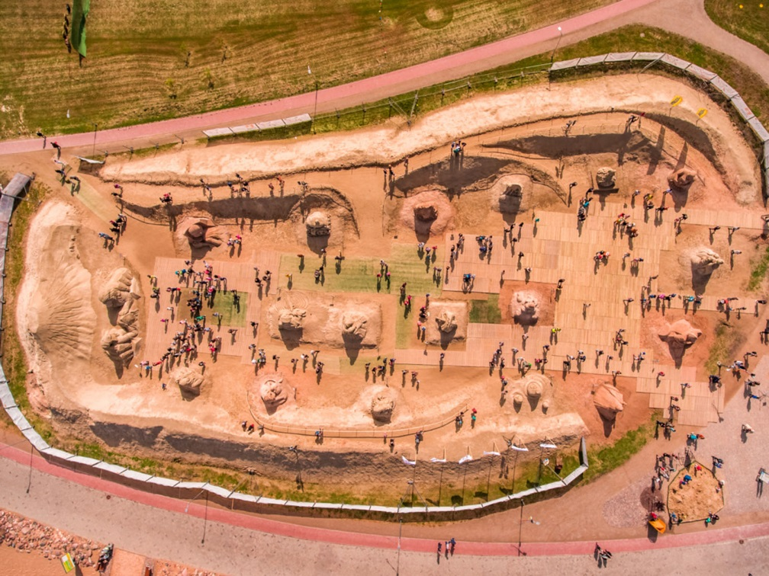
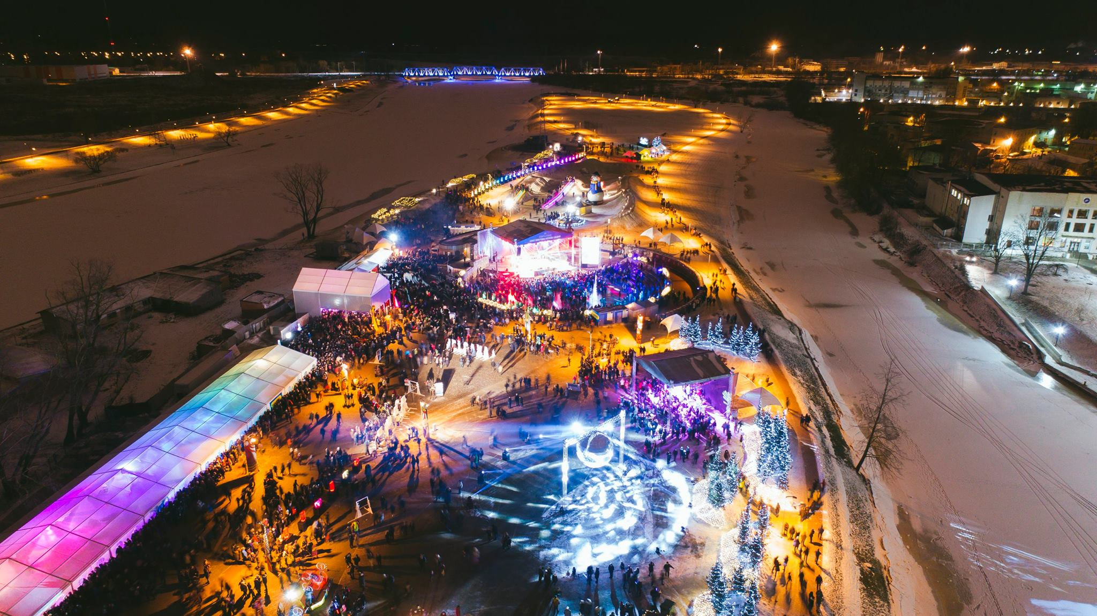
Application for national selection in 2018
Pasta island reconstruction
Jelgava/Zemgale planning region

Slide 6
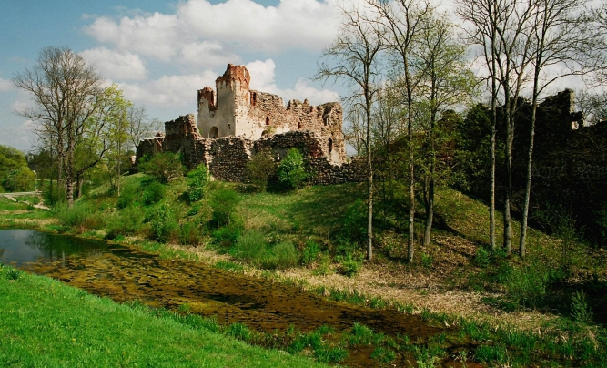
Application for national selection in 2018
Improvement of the right bank of the Bērze river next to the Livonian Order castle ruins
Dobele/Zemgale planning region

Slide 7
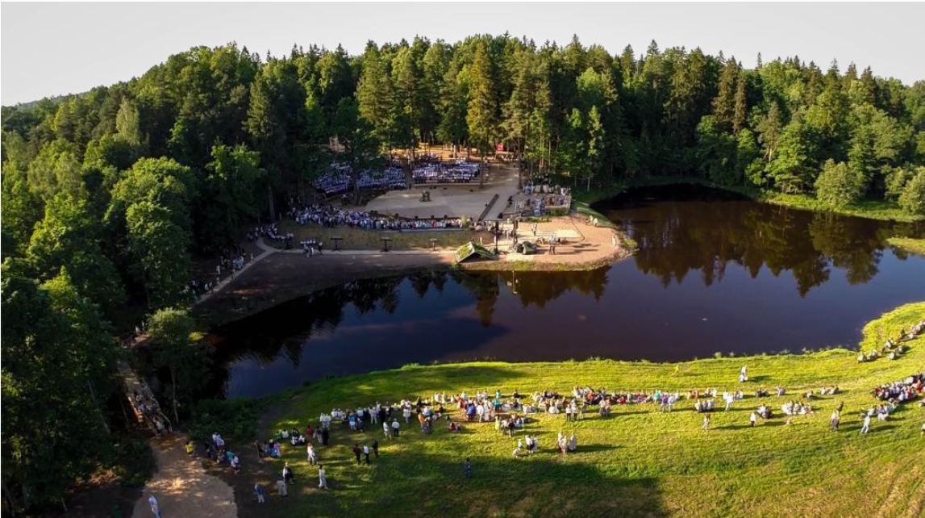
Application for national selection in 2018
Neikena Nature Concert Hall
Kocēni/Vidzeme planning region

Slide 8
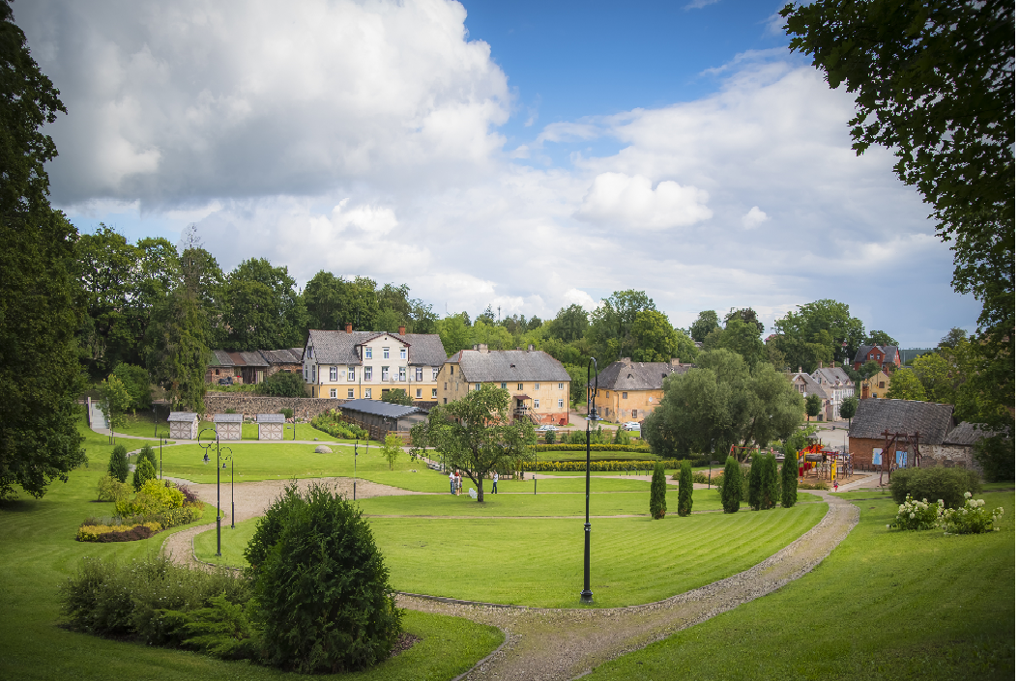
Application for national selection in 2018
Restoration of the Kandava old town centre and the development of infrastructure
Kandava/Riga planning region

Slide 9
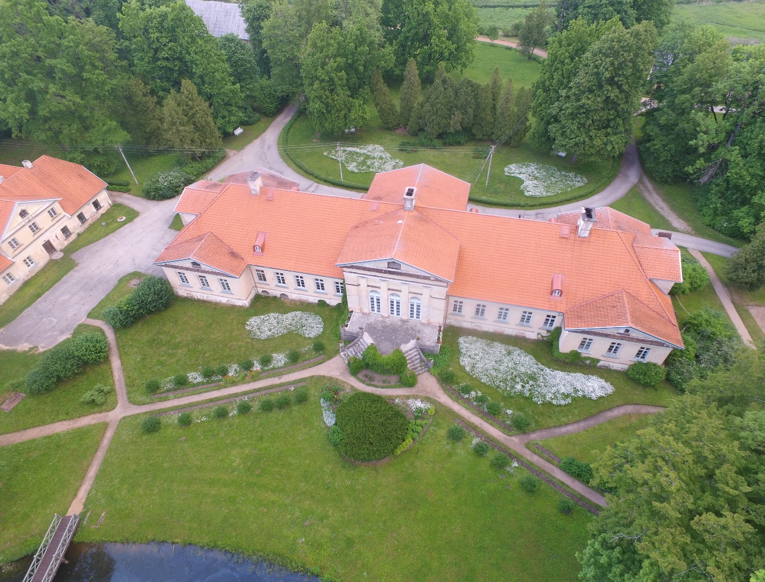
Application for national selection in 2018
Jaunauce park improvement
Jaunauce/Kurzeme planning region

Slide 10
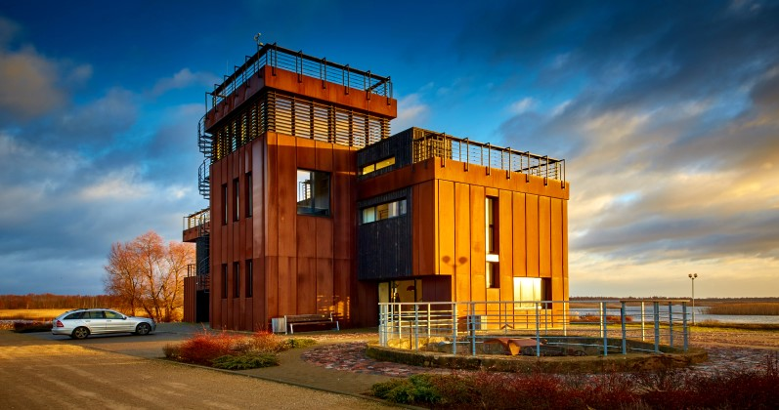
Application for national selection in 2018
Water tourism development centre “Bāka”
Rēzekne municipality/Latgale planning region

Slide 11
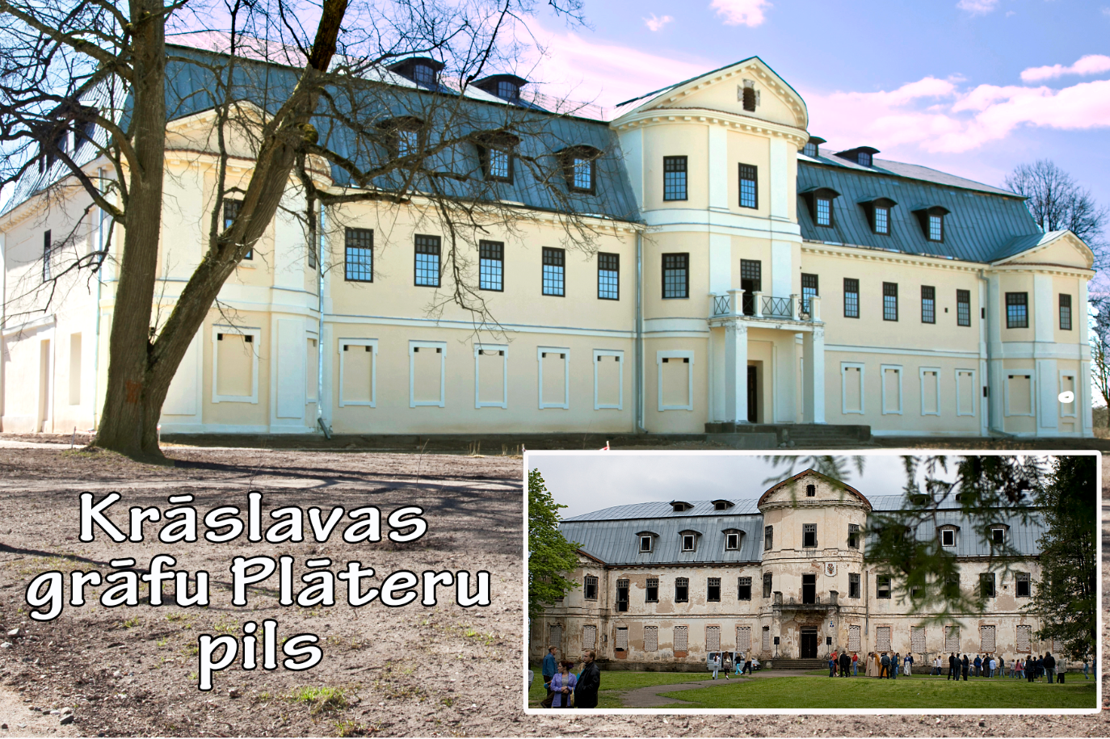
Application for national selection in 2018
Restoration of Kraslava castle complex
Krāslava municipality/Latgale planning region

Slide 12
Thank you very much for your attention!
Dace.Granta@varam.gov.lv

