Slide 1


CONGRESS OF LOCAL AND REGIONAL AUTHORITIES
CONGRÈS DES POUVOIRS LOCAUX ET RÉGIONAUX

Slide 2
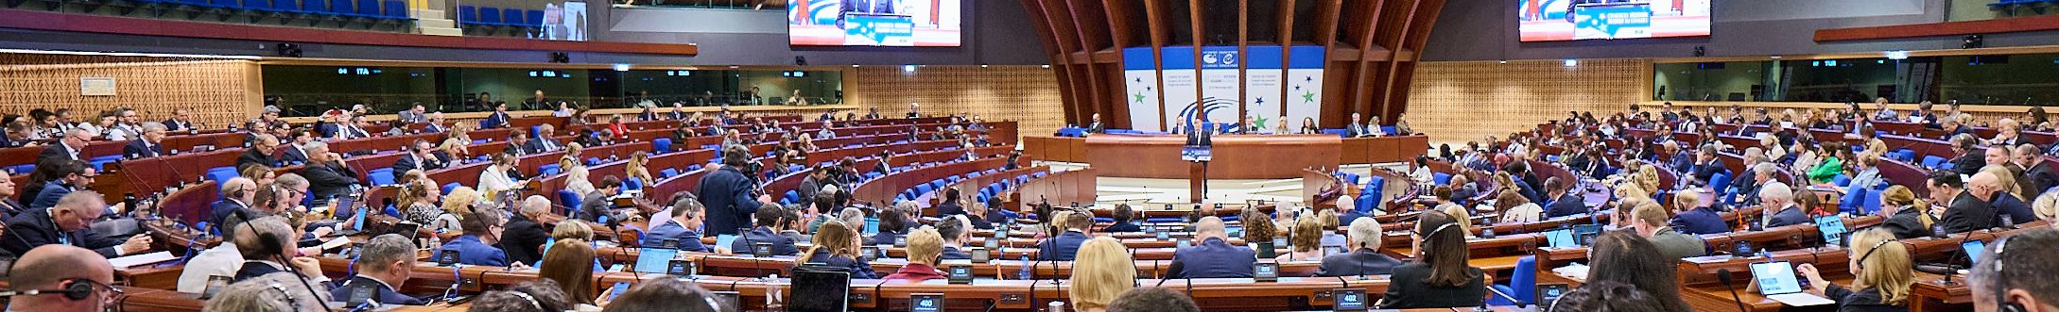
CONGRESS OF LOCAL
AND REGIONAL AUTHORITIES
CONGRESS OF LOCAL AND REGIONAL AUTHORITIES
POLITICAL ASSEMBLY
REPRESENTING
PROMOTING
CONTRIBUTING
612 local and regional elected representatives (mayors, governors, councillors, etc.)
130 000 local and regional authorities from all 46 Council of Europe member states
the local and regional dimension of the Council of Europe values: Human Rights, Democracy and Rule of Law
to the development of legal instruments in the field of territorial democracy
www.coe.int/congress

Slide 3
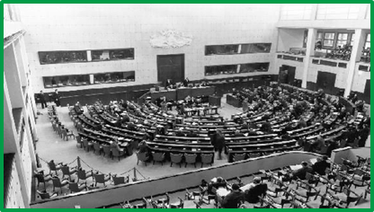
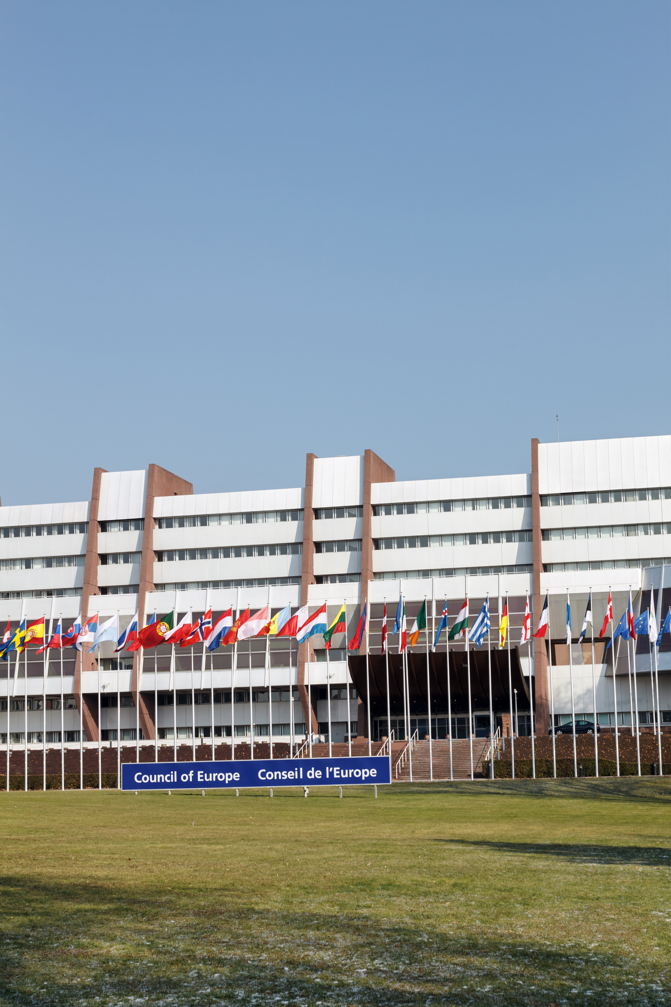
TIMELINE
CONGRESS OF LOCAL AND REGIONAL AUTHORITIES
CONGRÈS DES POUVOIRS LOCAUX ET RÉGIONAUX
1952
| 26 September – Creation of a Special Committee on Municipal and Regional Affairs within the Parliamentary Assembly
1957
| 12 January – 1st session of the "European Conference of Local Authorities" in Strasbourg
1975
| 19 February – Becoming the "Conference of Local and Regional Authorities of Europe”
1985
| 15 October – Opening for signature of the European Charter of Local Self-Government
1994
| 14 January – Set up of Congress of Local and Regional Authorities in current format
2003
| 21 May – Adoption of the Revised European Charter on the Participation of Young People in Local and Regional Life.
2013
| 23 October – Ratification by the European Charter of Local Self-Government by all Council of Europe member States.
2023
| 16 – 17 May The Council of Europe Summit in Reykjavik gives a renewed and stronger mandate to the Congress
2009
| 16 November
The Additional Protocol on the right of citizens to participate in the affairs of local authorities is opened for signature
www.coe.int/congress

Slide 4
POLITICAL ROLE OF THE CONGRESS
CONGRESS OF LOCAL AND REGIONAL AUTHORITIES
Political Dialogue with Council of Europe Institutions
One of two political assemblies and advisory body of the Council of Europe
Giving a voice to the concerns of 130 000 local and regional authorities and providing them with guidance for responses to topical challenges
Addressing topical challenges in plenary debates and other meetings and identifying possible solutions to shared political and societal problems
Implementing standards for good governance and social inclusion through co-operation activities and strategic partnerships
National governments
Debates and guidance
Co-operation and capacity-building
Local and regional governments
www.coe.int/congress

Slide 5

PARTNERSHIPS ACROSS EUROPE
CONGRESS OF LOCAL AND REGIONAL AUTHORITIES
The Committee of the Regions of the European Union
National associations of local and regional authorities
International associations of local and regional authorities
Committee of Ministers
Decision-making body
Parliamentary Assembly
Forum for debates and proposals
www.coe.int/congress

Slide 6
STRUCTURE OF CONGRESS BODIES
CONGRESS OF LOCAL AND REGIONAL AUTHORITIES
CONGRÈS DES POUVOIRS LOCAUX ET RÉGIONAUX
THE CONGRESS
THE BUREAU
Executive Body
THE STATUTORY FORUM
CHAMBER OF LOCAL AUTHORITIES
CHAMBER OF REGIONS
The MONITORING COMMITEE
The GOVERNANCE COMMITTEE
The SOCIAL INCLUSION COMMITTEE
www.coe.int/congress

Slide 7
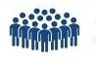
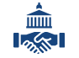



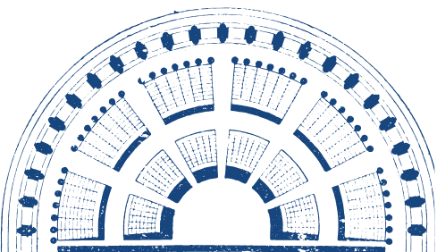


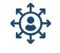
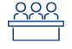
CONGRESS STRUCTURE
CONGRESS OF LOCAL AND REGIONAL AUTHORITIES
306 representatives
306 substitutes
2 chambers:
Chamber of Local Authorities
Chamber of regions
5 Political Groups
46 Delegations
46 member states
3 Committees
Monitoring Committee
Governance Committee
Social Inclusion Committee
www.coe.int/congress

Slide 8
STRUCTURE OF CONGRESS SECRETARIAT
CONGRESS OF LOCAL AND REGIONAL AUTHORITIES
CONGRÈS DES POUVOIRS LOCAUX ET RÉGIONAUX
SECRETARY GENERAL
Youth delegates programme
Table Office
European Local Democracy Action (ELDA)
Administration
communication
DIRECTOR
Civil society and national associations
Executive Secretary
CHAMBER OF LOCAL AUTHORITIES
Executive Secretary
CHAMBER OF REGIONS
PROTECTING LOCAL DEMOCRACY
PROMOTING LOCAL DEMOCRACY
Monitoring committee
Observation of local and regional elections
Centre of Expertise
Institutional partnerships and non-member states
Committee on social inclusion and
human dignity
Committee on governance, civic engagement and the environment
www.coe.int/congress

Slide 9
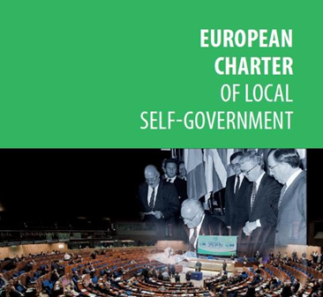
MAIN LEGAL INSTRUMENT
CONGRESS OF LOCAL AND REGIONAL AUTHORITIES
Ratified by all 46 Council of Europe member states
first treaty to lay down the principle of the transfer of competences to local communities, which must be accompanied by a transfer of financial resources → principle of subsidiarity
Monitoring visits country-by-country every five years
The Congress engages in regular, open, and constructive dialogue with Ministers and national authorities to follow up on its recommendations
Standards for protecting the rights of local authorities
www.coe.int/congress

Slide 10
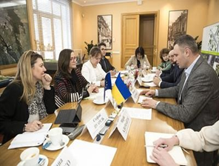
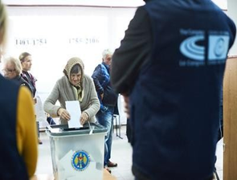
STATUTORY ACTIVITIES
CONGRESS OF LOCAL AND REGIONAL AUTHORITIES
MONITORING COMMITTEE
Regular monitoring visits (approx. every 5 years)
Monitoring the situation of local and regional democracy
Monitoring the implementation by local and regional authorities of member states of the judgments of the European Court of Human Rights
OBSERVATION OF LOCAL AND REGIONAL ELECTIONS
Complementary activity to the political follow-up process of the Charter
• Observation mission on invitation by member states
• Reports on pre-electoral situation and voting process
• Cooperation with European institutions
www.coe.int/congress

Slide 11
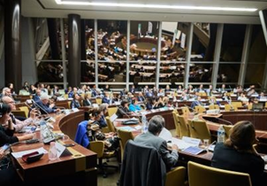

STATUTORY ACTIVITIES
CONGRESS OF LOCAL AND REGIONAL AUTHORITIES
GOVERNANCE COMMITTEE
Thematic reports, debates and activities on governance, civic engagement and environment
Governance and public ethics
Environment and climate change
Culture, cultural heritage and education
E-democracy
Citizen participation
SOCIAL INCLUSION COMMITTEE
Thematic reports, debates and activities on social cohesion, equality and non-discrimination.
Safeguarding fundamental rights such as social care, migration, human trafficking, media freedom and access to information, as well as the development of new technologies
Combating various forms of discrimination and violence against vulnerable groups
Youth participation
www.coe.int/congress

Slide 12

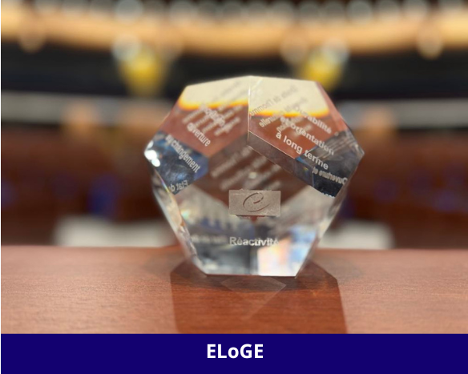
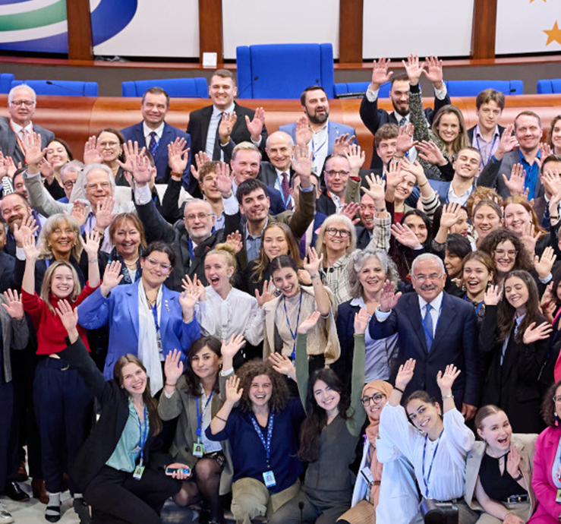
THEMATIC AND FIELD ACTIVITIES
CONGRESS OF LOCAL AND REGIONAL AUTHORITIES
European Local Democracy Action (ELDA)
ELoGE
Rejuvenating Politics
www.coe.int/congress

Slide 13
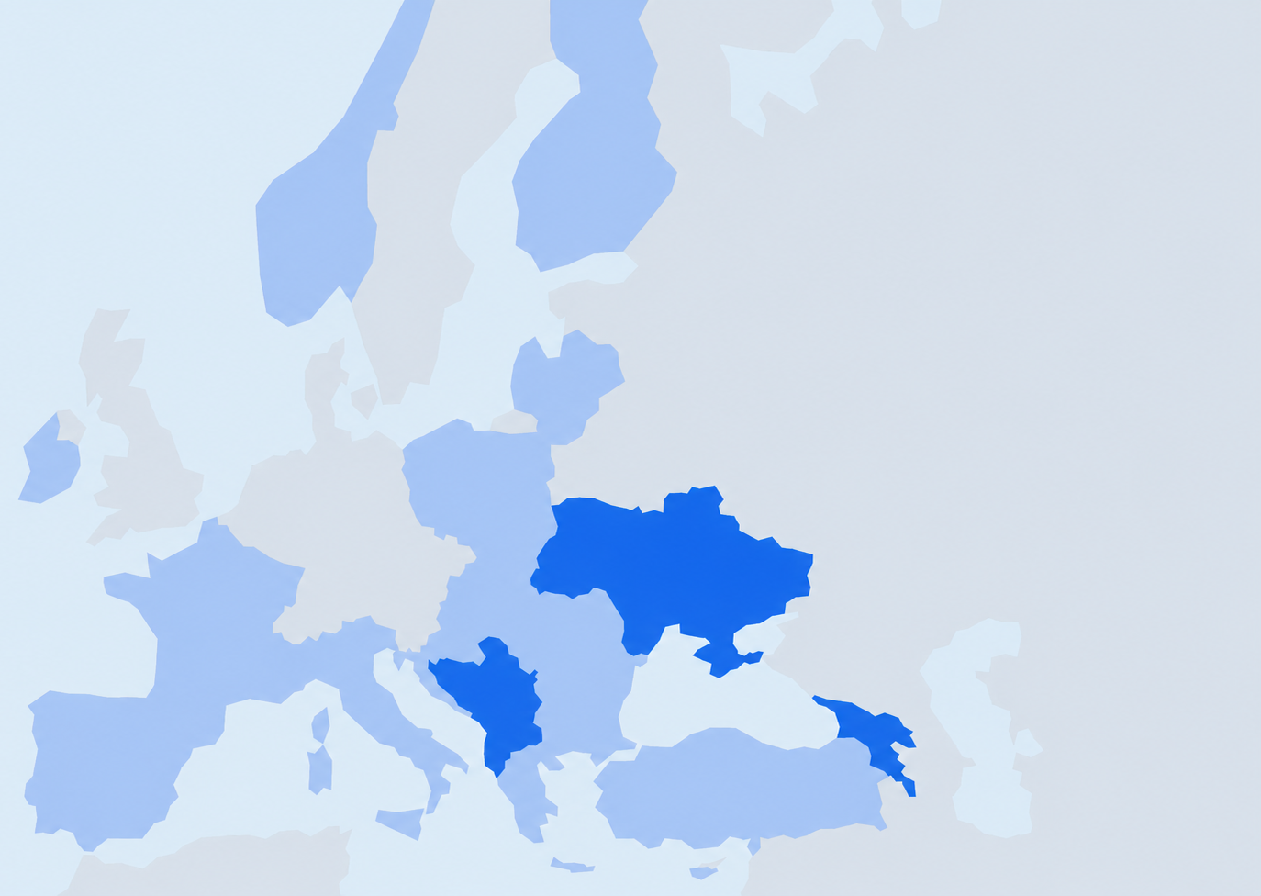


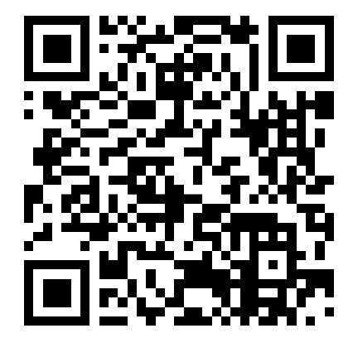
CONGRESS OF LOCAL AND REGIONAL AUTHORITIES
CONGRÈS DES POUVOIRS LOCAUX ET RÉGIONAUX
CENTRE OF EXPERTISE FOR MULTILEVEL GOVERNANCE (CEMG)
The Centre of Expertise collaborates with local, regional and national authorities, local government associations, parliamentary committees and European experts to strengthen local self-government, reform public administration, and improve multilevel governance and policy responses in Council of Europe member states.
The CEMG provides policy advice, peer reviews, benchmarking tools and technical support, based on European standards.
Key areas: Decentralisation and distribution of competences, participatory and deliberative democracy, local finances, public ethics, human resources and professional development, resilience planning
www.coe.int/congress
Notes:
Reminder
Social and Behaviour Change
Artificial Intelligence
New Democratic Pact - Multilevel Governance Conference 29 April in Chisinau, Moldova mention
ELoGE
12 Principles – Huamn Resources
How does our work at the central level land
Generation change in local government
Career path in public adminisatrtion
Also about sharing with others, results
What we try to do –
Innovative
Support
Connect

Slide 14
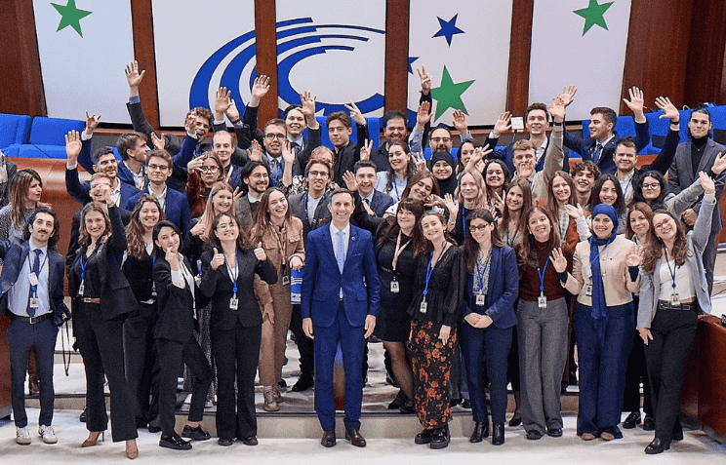
YOUTH DELEGATES
CONGRESS OF LOCAL AND REGIONAL AUTHORITIES
The Congress strongly believes in the power of youth participation for building more democratic, inclusive and sustainable societies.
We encourage local and regional elected officials to actively include youth in their policy making and to develop youth participation.
The Congress, in collaboration with the youth sector of the Council of Europe, elaborates guidelines, programs and legal instruments for the development of coherent and effective youth policies at local, national and European levels.
Youth delegates aged between 18 and 30 come from the 46 member states of the Council of Europe. They sit alongside local and regional elective representatives. Their mission is to show the perspective of young people.
www.coe.int/congress

Slide 15
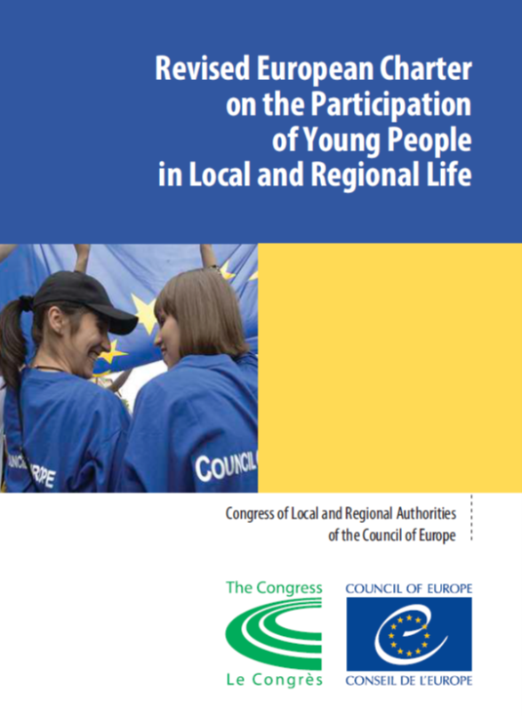
NEW EUROPEAN CHARTER ON THE PARTICIPATION OF YOUNG PEOPLE IN LOCAL AND REGIONAL LIFE
CONGRESS OF LOCAL AND REGIONAL AUTHORITIES
Youth participation is essential for a sustainable and inclusive democratic future
The Charter contains principles, best practices and guidelines to enhance youth participation at local and regional levels
Basic requirements for the youth participation, such as respect for the freedom of expression, the right to privacy, equal access to fundamental rights, freedom of assembly and association
The revised Charter is a result of a consultative process set up by the Congress and the Joint Council on youth
Enhancing meaningful youth participation at local and regional level
www.coe.int/congress

Slide 16
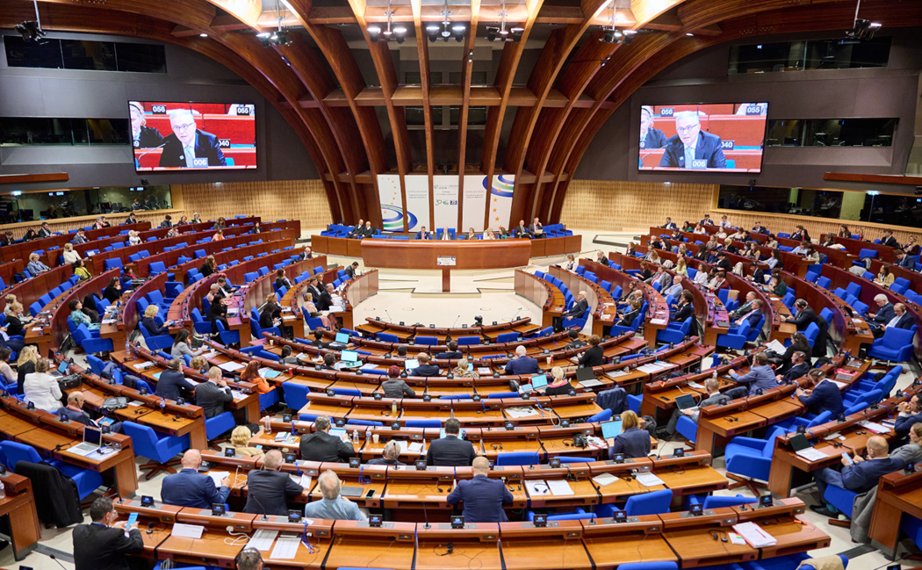





CONGRESS OF LOCAL AND REGIONAL AUTHORITIES
THANK YOU FOR YOUR ATTENTION!
STAY CONNECTED :
@COECongress
@COECongress
@coe-congress
@congress.coe.int

