Slide 1
Combating Sexism in Advertising: Ukraine from 0 to Hero
Olena Davlikanova, Program Officer, Friedrich Ebert Foundation
Iryna Lylyk, President of the Ukrainian Marketing Association
Olena Buchynska, Industrial Gender Committee on Advertising

Slide 2
IN THE NEXT 20 MIN
1
Standard of Gender Non-Discriminatory Advertising
2
Industrial Gender Committee on Advertising
3
The Law of Ukraine “On Advertising”
4
All-Ukrainian Study of the Attitude to Sexist Ads
5
Thank You! We are happy to cooperate

Slide 3
Why bother?

Slide 5
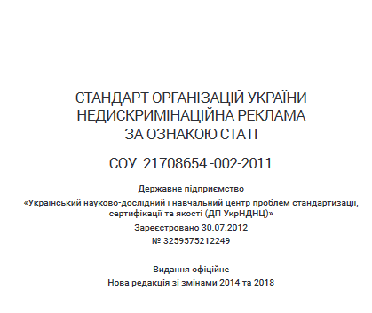
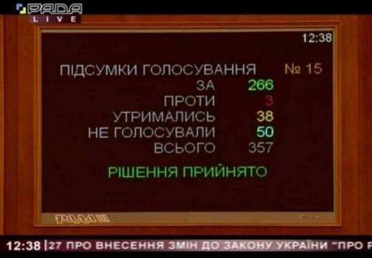
Timeline
Standard of Gender Non-Discriminatory Advertising was created and signed by key market associations
Cooperation with the State Consumer Rights Protection Service and Judges;
First administrative fines for sexist ads;
First court hearings.
All-Ukrainian Study of the Attitude to Sexist Ads
2011
2012- 2017
and on
2017
2017-2021
2021
Establishment of the Industrial Gender Committee on Advertising
Multi-vector information campaign for:
Professional community;
Advertisers;
University teachers of marketing;
Students;
General public etc.
Annual all-Ukrainian monitoring of outdoor sexist ads
Drafting, promotion and adoption of the Amendments combating sexism to the Law of Ukraine “On Advertising”

Slide 6
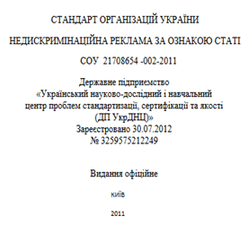
As a Result
Self-regulation
State regulation
"Gender-discriminatory advertising is an advertising containing statements and / or images about the intellectual, physical, social or other superiority of one sex over another and / or about the stereotypical role of men and women promoting a degrading treatment of either sex and human dignity;
demonstrates gender-based violence;
uses images of the human body (body parts) exclusively as a sexual object in order to attract the consumer's attention and / or references (words, sounds, images) to sexual relations that do not relate to the advertised product or method of its consumption".
The Law of Ukraine “On Advertising”

Slide 7
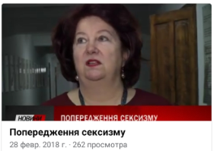
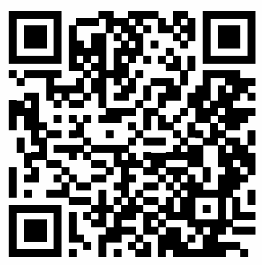
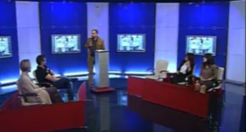
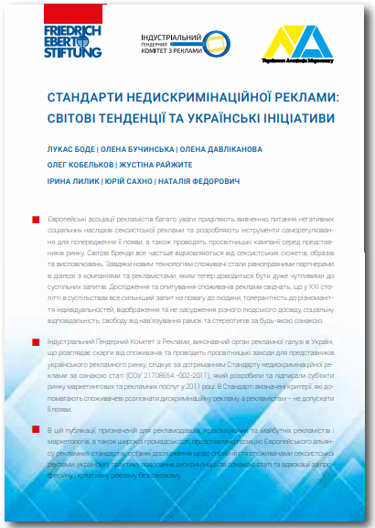
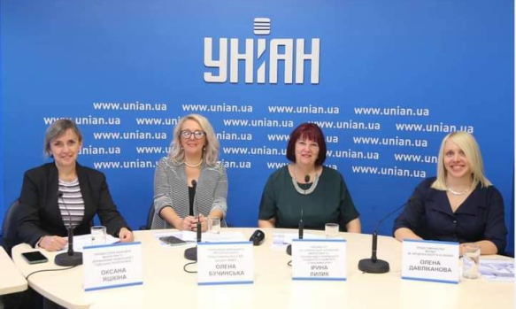
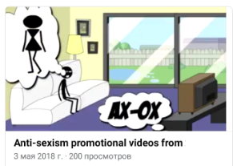
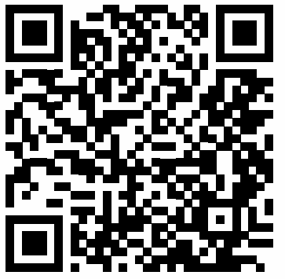
As a Result
Cartoon “Harmful Advice for Advertisers”
TV and Radio
Toolkit for Judges
Competition of Students’ Videos
“Non-Discrimination in Advertising”
Toolkit for Marketers

Slide 8
Industrial Gender Committee on Advertising
ACTIVITIES IN 2012 - 2021
 | Establishment of regional branches |  | Awareness raising campaigns for general public |  | Capacity building for state regulator, judges, etc.
 | Monitoring of sexist advertising |  | Events for marketers and ad agencies |  | Cooperation with state agencies
 | Pre-testing of Advertising |  | Events for teachers of marketing faculties in Universities |  | Membership in anti-discrimination boards
 | Expert conclusions for court hearings |  | Events for students, support of students ad fests |  | Lobbying for amendments to the Law “On Advertising”

Slide 9
Complaint review mechanism
Receiving a complaint
Step 2
Review of a complaint
If an ad is found sexist – contacting an advertiser
Step 1
Step 4
Step 3
If an advertiser terminates ad distribution – closing a case
Step 5
If an advertiser ignores recommendation – provision of an expert conclusion to a state body that fines a company

Slide 10
Statistics
2017-2021
Number of submitted complaints Number of ads found discriminatory | 876 (incl. several complaints on 1 ad from different people) 287
Number of ads changed voluntary | 54
Number of expert conclusions provided for court hearings or Ministry of Social Policy | 726 (same ad distributed in different regions require individual number of an expert conclusion letter for administrative cases and court hearings)
Fines paid by the companies | More than 4 000000 UAH (near $160 000)

Slide 11
All-Ukrainian Study «Perception of Gender-Discriminatory Advertising by Ukrainians»

Slide 12
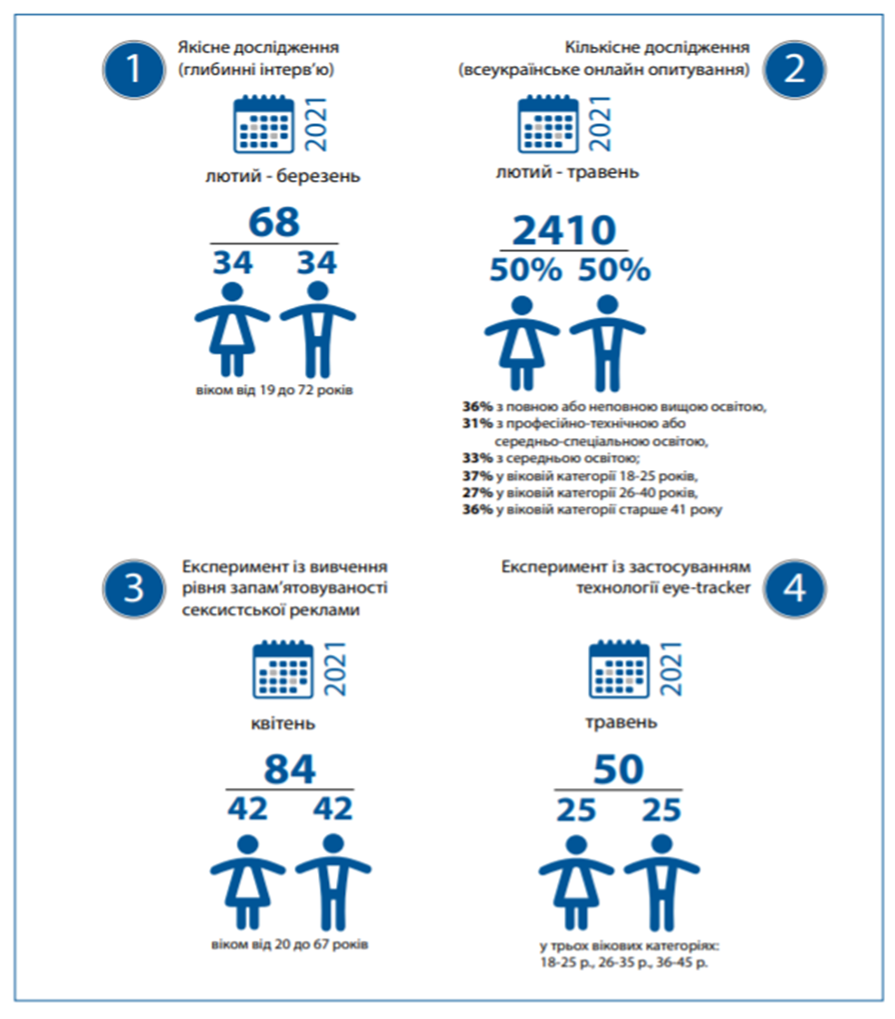
Methodology in-depth interviews (68) quantitative research (2410) an experiment on memorizing sexist advertisements (84) experiment using eye-trackers (50)

Slide 13
Main results
Trademark is remembered 3 times better in non-discriminatory ads. Often sexist ads confuse costumers who do not understand what is being advertised.
Both men and women have equally negative attitude to the excessive/aggressive objectification and images of gender-based violence.
Sexist ad weakens their desire to buy advertised goods.

Slide 14
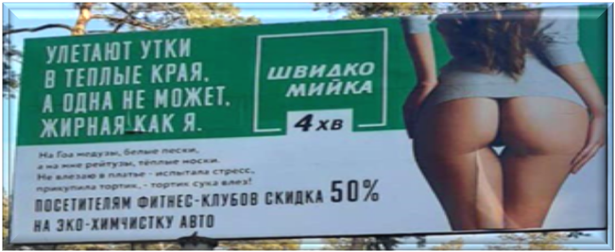
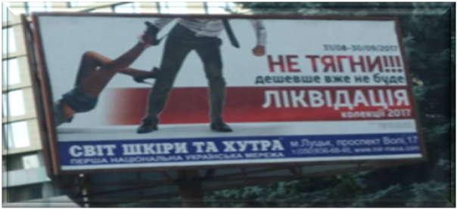
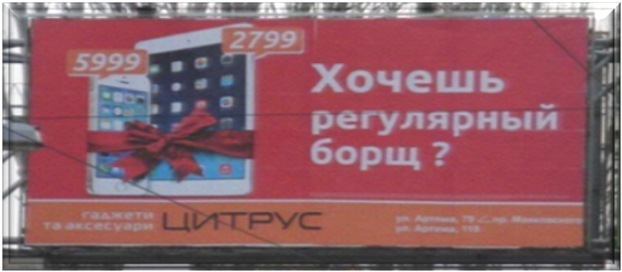

Slide 15
Main results
4. Discriminatory ads were the most often described as «stupid», «vulgar» and «humiliating human dignity».
5. Most common emotions are «disgust», «irritation», «indignation» and «shame» .

Slide 16
Main results
6. 22% of male and female customers are ready to complain on sexist advertisement. 10% have complained at least once before.
7. Least tolerant to sexism in advertising are women, youth and people with higher educatio
No specific group that has a stable positive attitude to sexist advertising
has been identified.

Slide 17
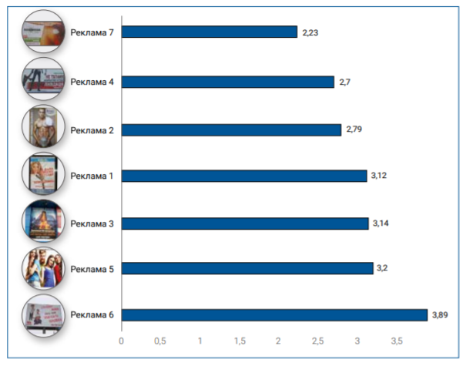
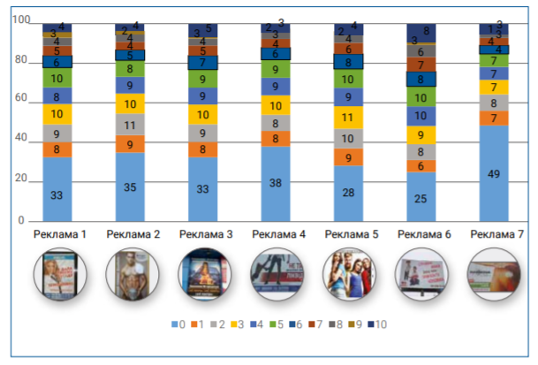
How much do you like an ad sample (on a scale from 0 to 10, where 0 - don't like it at all, 10 - really like it)?
average scores given by the respondents to the advertising samples
2,23
2,7
2,79
3,12
3,14
3,2
3,89

Slide 18
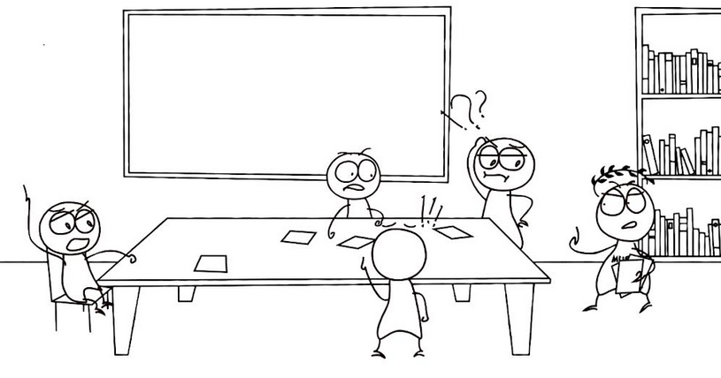
Thank You! We are happy to cooperate
OUR CONTACTS
Industrial Gender Committee on Advertising
for.good.ad@gmail.com
Facebook - Індустріальний Ґендерний Комітет з Реклами

