Slide 1
Irish Legislation to Address Cheating Council of Europe Platform on Ethics, Transparency and Integrity in Education (ETINED) Prague 28-29 November 2019 Dr. Deirdre Stritch Quality and Qualifications Ireland (QQI)
November 2019

Slide 2
Background – What is QQI?
A quality assurance body for providers of education and training in Ireland
An awarding body for learners in Ireland
New legislation passed to enhance QQI’s regulatory powers; amend / create new access routes to the NFQ and facilitate the introduction of an International Education Mark

Slide 3
New Legislation to Address Cheating
An Amendment Act passed in July 2019, which introduces changes to the Qualifications and Quality Assurance (Education and Training) Act 2012.
Section 43A provides a statutory basis for the prosecution of those who facilitate cheating by learners; who advertise cheating services and who publish advertisements for cheating services. QQI will be responsible for bringing prosecutions under this Section of the Act.
Qualifications and Quality Assurance (Education and Training) Act 2012 http://www.oireachtas.ie/documents/bills28/acts/2012/a2812.pdf
Qualifications and Quality Assurance (Amendment) Act http://www.irishstatutebook.ie/eli/2019/act/32/enacted/en/index.html

Slide 4
New Offences
Section 43A of the Qualifications and Quality Assurance Act (as amended) creates new offences to provide or advertise cheating services:
Impersonation
1. Undertaking in whole or in part any work required as part of a programme in the place of an enrolled learner, without permission from the provider;
2. Sitting an exam, or having someone else sit an exam, in place of an enrolled learner, without permission from the provider;
Provision of Cheating Services
3. Providing answers, or arranging the provision of answers, to an enrolled learner for an exam, during the course of that exam, without permission from the provider;
4. Providing, or arranging the provision of, an assignment required of an enrolled learner without permission from the provider
5. Before an exam, providing answers for, or arranging the provision of answers for, an exam for an enrolled learner without permission from the provider;
Advertising Cheating Services
6. Advertising the provision of assignments for learners where this has not been authorised by the provider
7. Advertising the undertaking of assignments (in whole or in part) on behalf of an enrolled learner or sitting an exam, or having someone sit an exam, in place of an enrolled learner, where this has not been authorised by the provider
Publishing Advertisements for Cheating Services
8. Publishing an advertisement for the provision of exam answers to learners during the course of an exam where this has not been authorised by the provider
9. Publishing an advertisement for the provision of assignments or exam answers in advance of an exam to an enrolled learner where this has not been authorised by the provider5.

Slide 5
Timelines
Bill published August 1st 2018
Bill passed and signed into law by the President on July 23rd 2019
New Section 43A commenced November 5th
Legal advice being sought on implementation

Slide 6
Notes:
www.irelandstudyhelp.com, the first answer to a Google search “essay help Ireland” is a domain registered in Jaipur, India

Slide 8
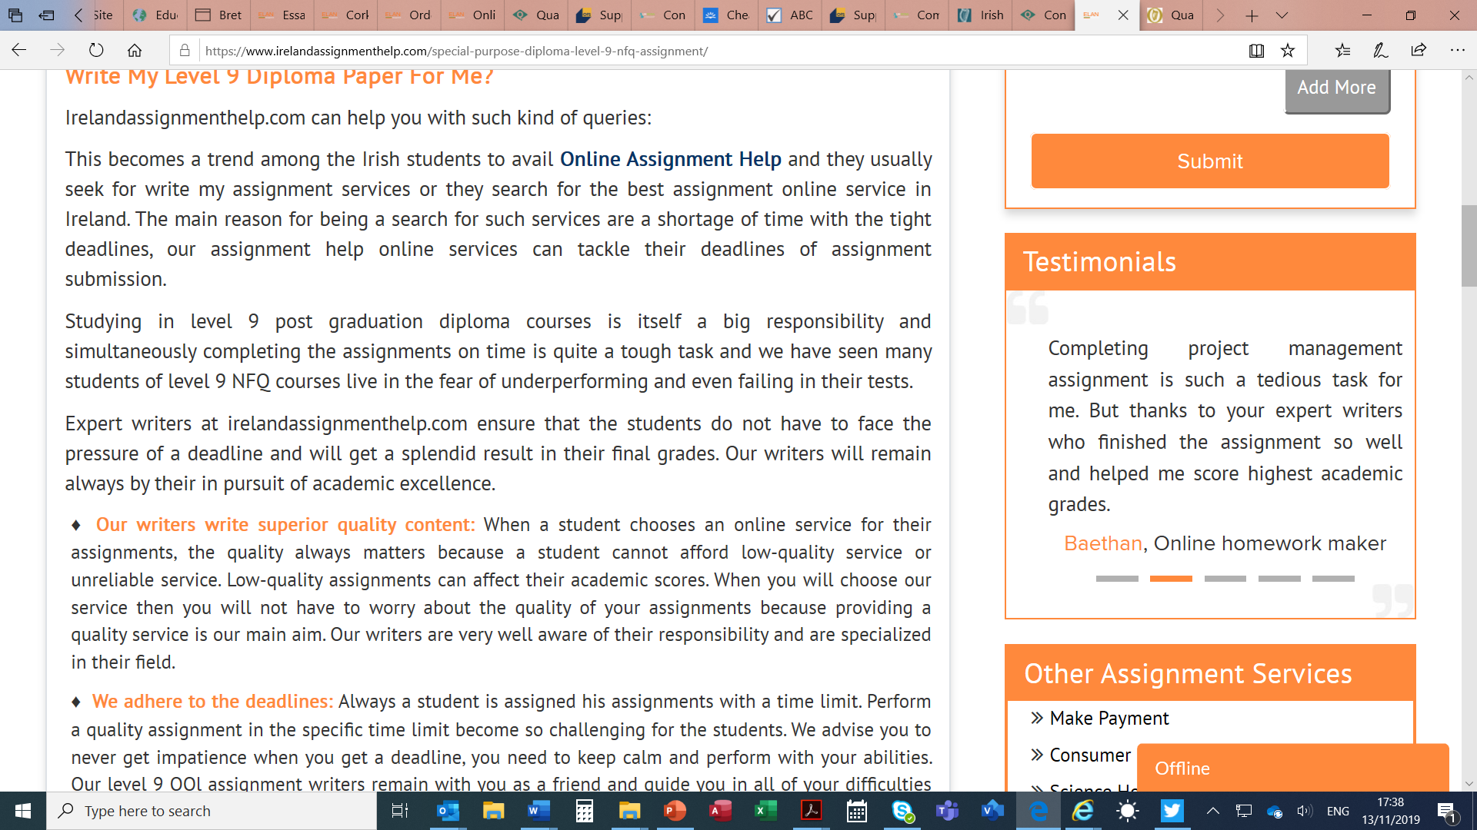

Slide 9
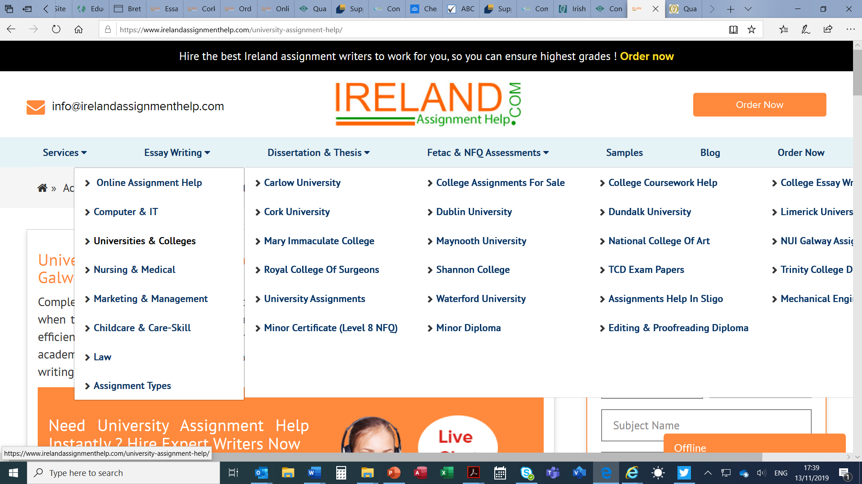

Slide 11
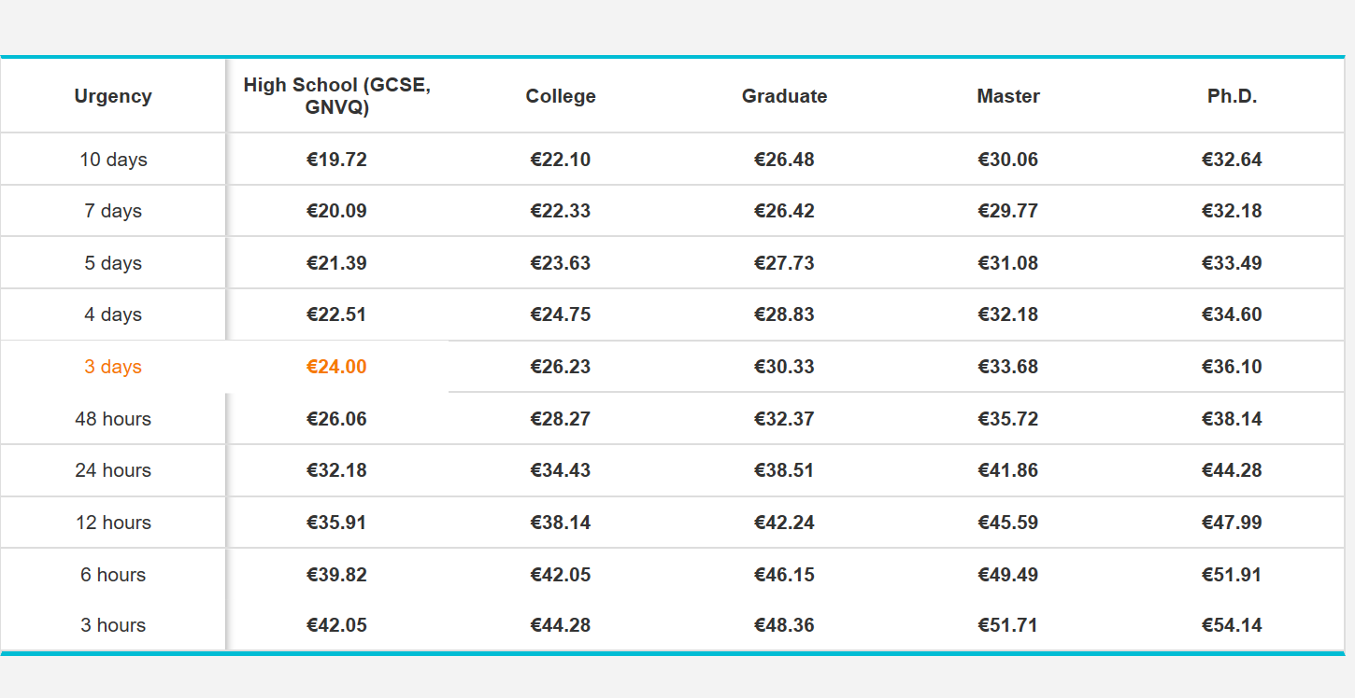

Slide 12
National Approach to Addressing Academic Fraud
QA is not designed to address criminality: QA is about networks of trust and balancing institutional autonomy with responsibility.
Threat by online academic misconduct is bigger than any one HEI; agencies must step in and ensure that HEIs are supported in understanding and addressing this activity individually and collectively.
The current QA mechanisms not designed to address emergent forms of academic misconduct. QA is not designed for combatting crime nor is it likely to be effective in doing so.
The focus will be on collaborative initiatives and communication rather than seeking prosecutions through a formal legal unit.
Online academic misconduct presents complex challenges which require new and innovative approaches and collaboration between agencies, institutions and learner representatives nationally and internationally.
First steps will focus on HE as considered highest risk (legislation applies to all levels of the NFQ).

Slide 13
National Approach to Addressing Academic Fraud (II)
Enhancement through a National Academic Integrity Network
Communication
Inform stakeholders - providers, learners and advertisers and publishers - of the new law and implications for them.
Identify their responsibilities and indicate any procedures for reporting suspected offences to QQI.
National Coordination and International Cooperation
Coordinate efforts with other State bodies to deal with advertising and publication of advertisements for cheating services: The Advertising Standards Authority for Ireland and the Department of Business, Enterprise and Innovation).
Cooperate with agencies and relevant actors within and beyond the EU.
QQI is committed to working in partnership with others to address this threat to national and international qualifications systems.

