Slide 1

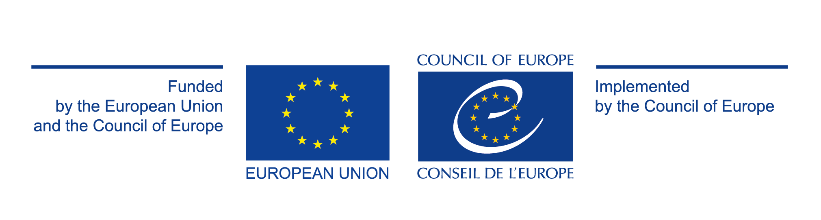
3rd ANTI-CYBERCRIME FORUM
Engaging in international cooperation on cybercrime and electronic evidence: CyberSouth to reinforce the capacities
Phoenicia Hotel, Beirut, Lebanon, 29 November 2017
Marie Agha-Wevelsiep, Project manager, Council of Europe
marie.agha-wevelsiep@coe.int
www.coe.int/cybersouth

Slide 2
Project CyberSouth
Title | CyberSouth – Cooperation on cybercrime in the Southern Neighbourhood Region
Priority countries | Algeria, Jordan, Lebanon, Morocco and Tunisia
Duration | 36 months (mid-2017 / mid-2020)
Budget | EUR 3.3 million
Funding | European Union and Council of Europe
Implementation | C-PROC ( Council of Europe Programme Office on cybercrime)
www.coe.int/cybersouth

Slide 3
Project CyberSouth
Challenges
The scale and quantity of cybercrime, devices, users and victim
The issue of electronic evidence
Availability of data
Technical challenges
Cloud computing, territoriality and jurisdiction
Mutual legal assistance
www.coe.int/cybersouth

Slide 4
Project CyberSouth
1 - Standards: Budapest Convention on Cybercrime and other instruments
“Protecting you and your rights in cyberspace”
2 Follow up and assessments
Cybercrime Convention Committee (T-CY)
3 Capacity building : C-PROC
www.coe.int/cybersouth

Slide 5
Budapest Convention
Criminalising conduct
Illegal access
Illegal interception
Data interference
System interference
Misuse of devices
Fraud and forgery
Child pornography
IPR-offences
+
Procedural tools
Expedited preservation
Search and seizure
Interception of computer data
+
International cooperation
Extradition
MLA
Spontaneous information
Expedited preservation
MLA for accessing computer data
MLA for interception
24/7 points of contact
Harmonisation
www.coe.int/cybercrime
5

Slide 6
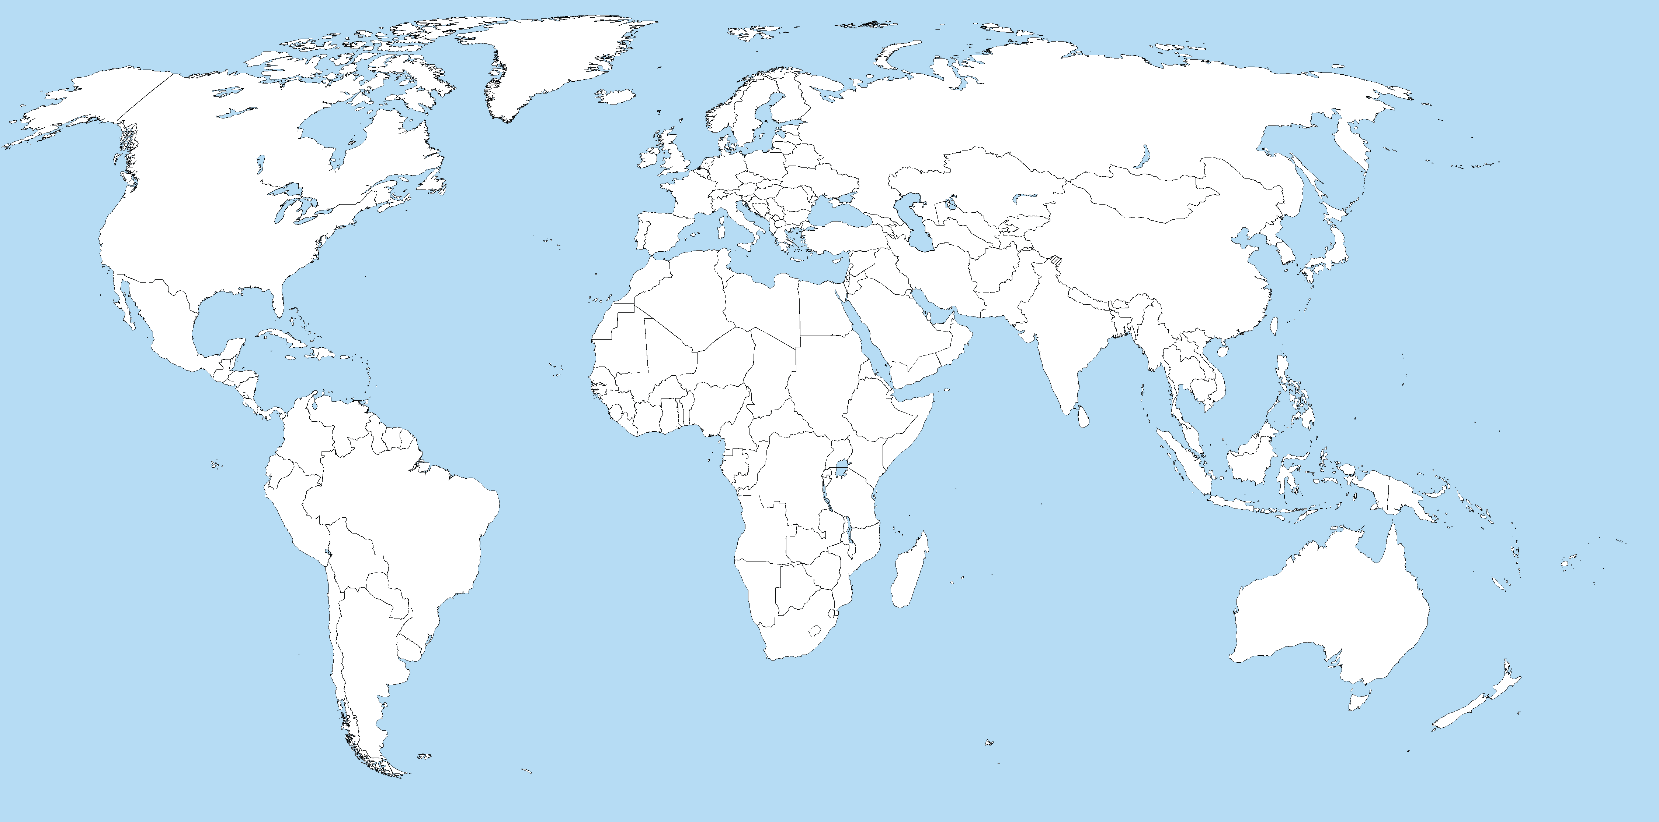
Reach of the Budapest Convention as a guideline
130+
Indicative map only
Budapest Convention
Ratified/acceded: 56
Other States with laws/draft laws largely in line with Budapest Convention = 20
Signed: 4
Further States drawing on Budapest Convention for legislation = 45+
Invited to accede: 10
= 70

Slide 7
C-PROC
In practice, how does the Budapest Convention work?
10
Case 1: Earthquake case (Romania)
App X on their Android or iOS smartphones received false alerts indicating an earthquake of 10 Richter Magnitude.
Offences committed:
  illegal access to a computer system – art. 360 of the Criminal Code
  alteration of computer data integrity – art.362 of the Criminal Code
  perturbation of the functioning a computer system (system interference) – art.363 of the Criminal Code
  dissemination of false information – art.404 of the Criminal Code
Object of the request:
  Preservation of data through the 24/7 point of contact to the responsible authorities of USA, using 24/7 Contact Point
Data preservation + use of MLAT all the data preserved and identification and prosecution of the suspect who committed the offences

Slide 8
C-PROC
In practice, how does the Budapest Convention work?
10
Case 2: ”Phishing” Case (Romania)
Unidentified perpetrators succeeded onto gaining access and transferring different sums from customers accounts of two banks in Norway and Finland to bank accounts from Romania, using the phishing method.
Romanian citizens that redraw the fraudulently transferred sums were using, at the time, the following email addresses, that were created, probably by the same person, from the same computer system: CHH@yahoo.com; dfds@yahoo.com; andreaaa774@yahoo.com
Offences committed:
  illegal access to a computer system - art. 360 of the Criminal Code
  fraudulent financial operations- art.250 of the Criminal Code
  computer related forgery – art. 325 of the Criminal Code

Slide 9
C-PROC
In practice, how does the Budapest Convention work?
10
Case 2: ”Phishing” Case (Romania)
Object of the request, data preservation for :
  Email addresses’ logs and associated accounts
  Content of any communication stored by these email addresses
  IP address/addresses of the computer system/systems that created the email addresses mentioned above
Preservation of data through the 24/7 point of contact to the responsible authorities of USA, using 24/7 Contact Point
Data preservation + use of MLAT all the data preserved regarding e-mail accounts used by the suspects and to identify and prosecute a large money mule group who caused significant financial losses (more that 3 million Euro)

Slide 10
C-PROC
In practice, how does the Budapest Convention work?
10
Case 3: “ONLINE SCAM” CASE (Romania)
Advertisement for a car on www.craigslist.com
Victim in Miami, expressed interest in the vehicle, the unknown user of the email address asked for payment with a stolen gift card.
Email account is linked by back up contact information to several other email accounts.
One of these email accounts was accessed with an Android device.
The IP address associated with the Android device was 86.124.239.xxx. The internet service provider for this IP address is RCS-RDS.
  Data associated with this IP address will assist in identifying the unknown user of the email address.

Slide 11
C-PROC
In practice, how does the Budapest Convention work?
10
Case 3: “ONLINE SCAM” CASE (Romania)
Offences committed:
  Wire fraud - Title 18, United States Code, Section 1343
  Identity theft - Title 18, United States Code, Sections 1028
Object of the request:
  The contents of any communication or file stored by or for the account and any associated accounts, and any information associated with those communications or files (source and destination email addresses or IP addresses)
  All records and other information relating to the Account and any associated accounts including: names, addresses, records of session times and durations, length of service

Slide 12
C-PROC
In practice, how does the Budapest Convention work?
10
Case 3: “ONLINE SCAM” CASE (Romania)
Request sent by US Department of Justice on September 21, 2015 to the responsible authorities of Romania, using 24/7 Contact Point.
Response received on September 30, 2015, confirming that all the data has been preserved by RCS-RDS (ISP).
    Based on the data preservation, US authorities were able to receive through MLAT all the data preserved and to identify and extradite 7 Romanian suspects, involved in online scams.

Slide 13
C-PROC
Cybercrime Convention Committee (T-CY)
10
Established under Article 46 Budapest Convention
Members
(statut November 2017):
56 Members (State Parties)
14 Observer States
10 International organisations (African Union Commission, ENISA, European Union, Europol, INTERPOL, ITU, OAS, OECD, OSCE, UNODC)
Functions:
Assessments of the implementation of the Convention by the Parties
Guidance Notes
Draft legal instruments
Etc.

Slide 14
Joining the Budapest Convention
Treaty open for accession (article 37)
Phase 1:
A country with legislation in place or advanced stage
Letter from Government to CoE expressing interest in accession
Consultations (CoE/Parties) in view of decision to invite
Invitation to accede
Phase 2:
Domestic procedure (e.g. decision by national Parliament)
Deposit of the instrument of accession
www.coe.int/cybercrime
14

Slide 15
Capacity building
Cybercrime strategies and policies
Reporting system mechanism
Legislation
Specialised services
LEA training
Training for the judiciary
Public-private cooperation
International cooperation
www.coe.int/cybersouth

Slide 16
C-PROC
Project CyberSouth
10
  CyberSouth offers capacity building to Lebanon

Slide 17
Project CyberSouth:
Benefits for Lebanon?
Legal framework on cybercrime strengthened
international cooperation facilitated
Specialised units on cybercrime strengthened: set up of standard operating procedure for electronic evidence, good practice for information exchange with service providers, access to training materials
Number of investigation on cybercrime and involving electronic
evidence increased
Judicial training on cybercrime and electronic evidence mainstreamed
reinforcement of judges and prosecutors
Reinforcement of the role of 24/7 contact point and international cooperation
Strategies on cybercrime and electronic evidence strengthened or enhanced

Slide 18
Project CyberSouth:
Benefits on international cooperation
For Lebanon
Become a member of the international community
Use of the international instrument
Benefit from the network of the other criminal justice players specialised on cybercrime
Cooperate with countries sharing common standards
Increase in the number of investigations on cybercrime and electronic evidence
For international community
Increase the Parties of the Budapest Convention
Influence of Lebanon in the region
Contribution to increase the capacities in the fight against cybercrime worldwide

Slide 19
Project CyberSouth:
Cooperation on cybercrime in the Southern Neighbourhood Region
Thank you!
marie.agha-wevelsiep@coe.int
www.coe.int/cybersouth

