Slide 1
AGEING: Engagement, Attitudes and Ethics
Sarah Cunningham-Burley
Chair, Nuffield Council on Bioethics
Professor of Medical and Family Sociology, University of Edinburgh

Slide 2
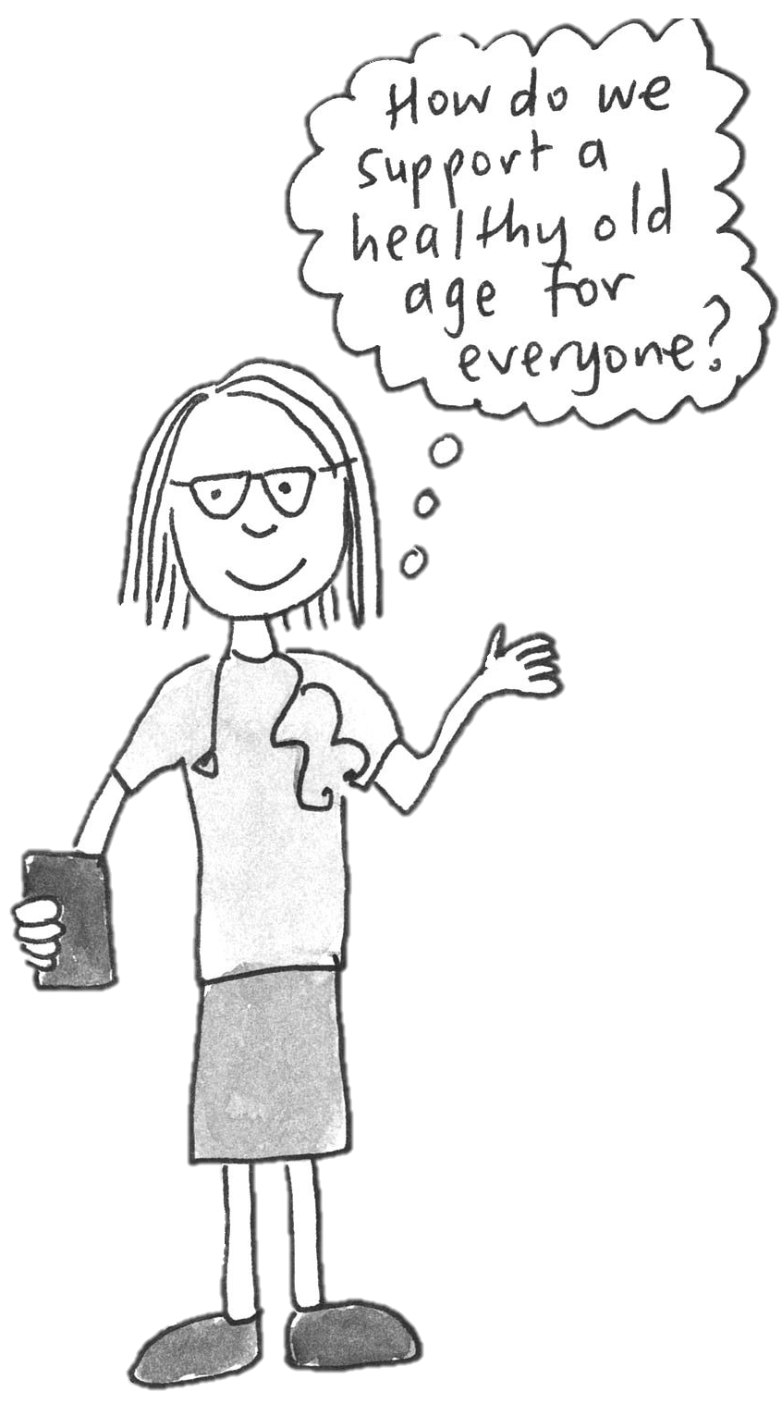
OUTLINE OF PRESENTATION
The role of science and technology in helping people live well in old age
Learning with and from public engagement
An ethical framework

Slide 3
THE ROLE OF SCIENCE AND TECHNOLOGY
Developments in geroscience
Innovation in assistive and communications technologies
Innovative predictive and diagnostic technologies
Potential future benefits for individuals and society
Ethical considerations include how ageing is perceived, how older people are valued, inequalities within and between generations and place of non-technological processes and interventions

Slide 4
LEARNING WITH AND FROM PUBLIC DIALOGUE
A deliberative dialogue to support NCOB’s work on exploring the ethics issues in relation to biomedical research and technological innovation to live well in old age
24 members of the public attended three interactive workshops including a discussion of draft recommendations
Discussion of benefits and concerns
Views on a better future for ageing

Slide 5
FINDINGS
OVERARCHING THEMES
GUIDING PRINCIPLES FOR R&I
An holistic approach to living well in older age
Feeling listened to
Working together across generations
Supporting independence in later life
Making your own decisions
Equitable access and fair distribution
Fairness including access to products and treatments
Informed choice and consent including transparency
Accountability for those involved in research including protections for participants
Safety with regulations in place to ensure the safety of medicines and treatments for end-users

Slide 6
AN ETHICAL FRAMEWORK
Demonstrating trustworthiness
Supporting flourishing in older age
Promoting equity
Shifting power
Challenging ageism
Enabling sustainability
Diagram by Lou Dunn

Slide 7
KEY RECOMMENDATIONS
Public input into policy making
Enabling inclusion to influence the research agenda and innovation process
Enabling inclusion in research and innovation
Supporting interdisciplinary research
Develop standards for promoting ethical research practices
Promote better links between research, innovation and practice

Slide 8
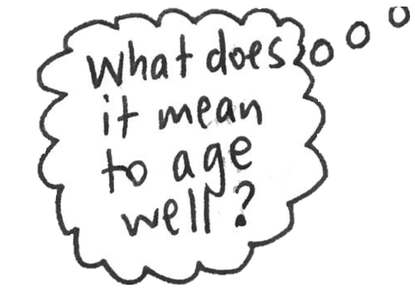
Thank you!
www.nuffieldbioethics.org/
publications/
future-of-ageing
The future of ageing:
ethical considerations for research and innovation

Slide 9
@Nuffbioethics
Nuffield Council on Bioethics
bioethics@nuffieldbioethics.org
www.nuffieldbioethics.org
Notes:
Final Slide:

