Slide 1
Council of Europe Days Visibility Project Telling the Council of Europe’s Story
22/04/2024
1

Slide 2
Council of Europe Days Visibility Project
Background
Unique multilateral international organisation
46 member states setting standards in human rights, democracy, and the rule of law within a common legal area
Final judgments of the European Court of Human Rights must be fully executed
2

Slide 3
Council of Europe Days Visibility Project
Background
Strategic triangle of standard-setting, monitoring and cooperation
Transforms lives in Europe for the better
No other continent has achieved this
3

Slide 4
Council of Europe Days Visibility Project
But there are two interlinked issues:
Our values and standards are being attacked
Too few people are aware of what is being done and impact on their daily lives
4

Slide 5
Council of Europe Days Visibility Project
Our Challenge
Tell our story more widely and ensure greater visibility in every member state
Raise awareness of how people (specific groups, professions, general public) benefit from our work and;
Build trust in the Council of Europe and its values and standards
5

Slide 6
Council of Europe Days Visibility Project
The concept
1
Member states are invited to run “Council of Europe Days” events
Built around themes that relate to how the Council of Europe’s values/standards/work has benefitted:
A specific group (e.g. women, children, LGBTI people, national or linguistic minorities)
A specific profession (e.g. protection of the media, or the legal profession)
The general public (e.g. the environment, or Artificial Intelligence)
2
3
At the national or local levels
6

Slide 7
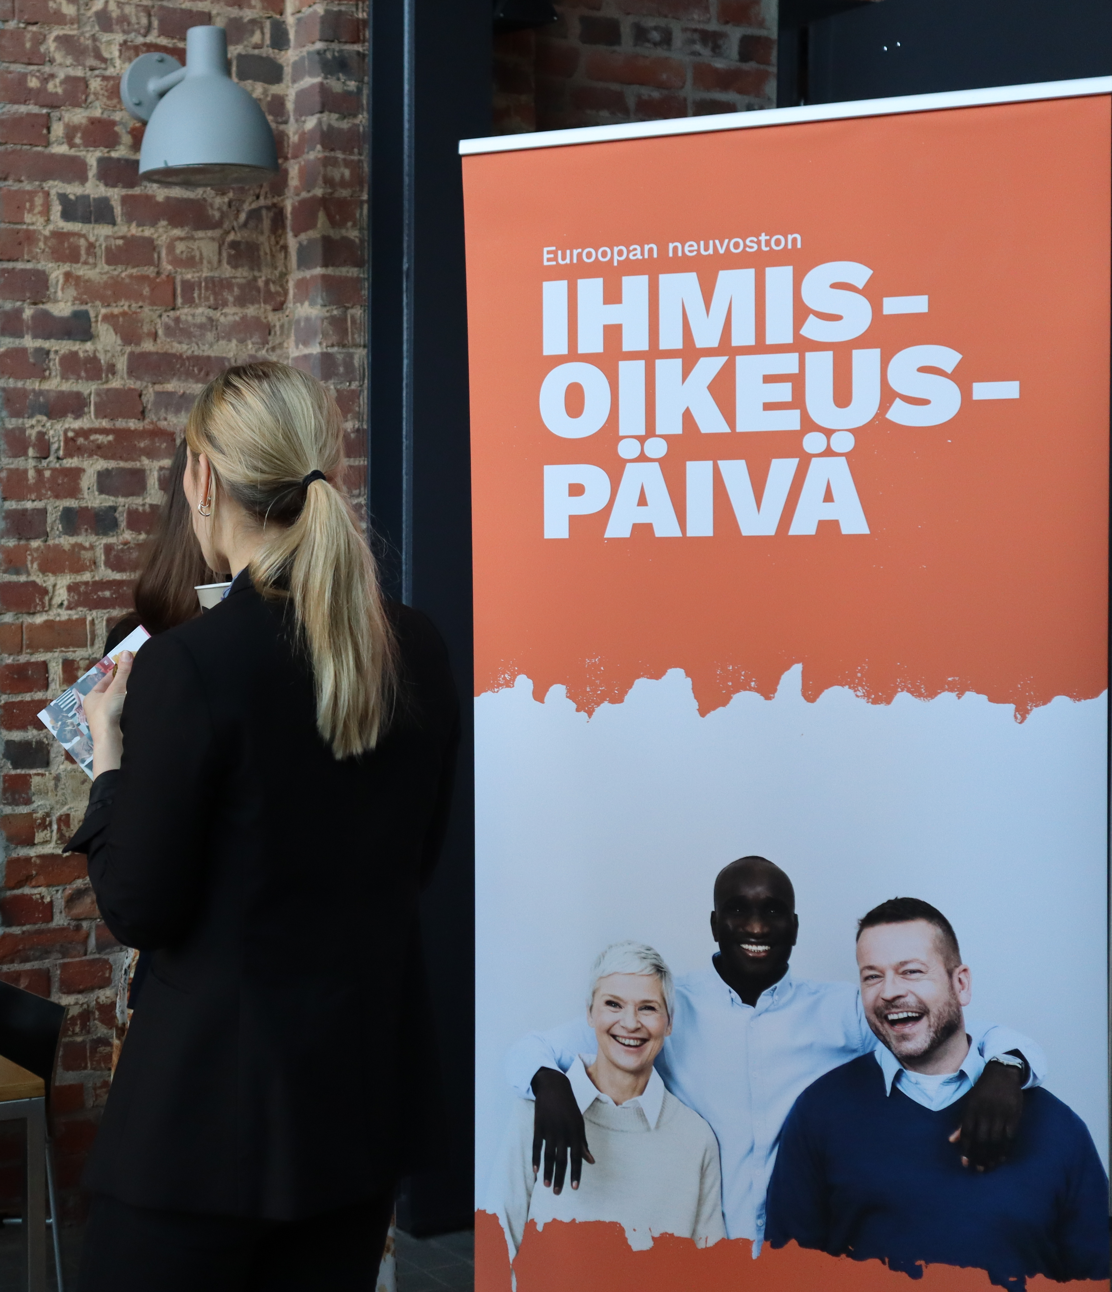
Council of Europe Days Visibility Project
Who should organise events?
Member states should organise events, ensuring that they showcase relevant achievements
Each Member State has a national Focal Point who can coordinate
7

Slide 8
Council of Europe Days Visibility Project
Who should organise events?
Permanent Representatives and ministries may also take the lead
Individual member states may bring in outside interests to coordinate / participate (e.g. universities, think tanks, NGOs)
Council of Europe external offices can also play a key organisational role
8

Slide 9
Council of Europe Days Visibility Project
What kind of events are appropriate?
This is up to each Member State
Events should be tailoured to national concerns, priorities, and achievements
Countries can use these events to show how Council of Europe membership benefits their citizens in any given area
9

Slide 10
Council of Europe Days Visibility Project
What kind of events are appropriate?
Examples from the first year include debates in parliament, university courses and lectures, training for journalists, film festivals and art displays, events around cultural routes etc.
10

Slide 11
Council of Europe Days Visibility Project
Here are three specific examples from 2023
Example 1: France – CoEMoN - The first edition of the Council of Europe Model of Negotiation inspired by the United Nations model (MUN).
Example 2: Malta – The Parliament hosted the conference ‘Combating Violence against Women: The Role of Men and Boys’ highlighting the importance and benefits of the Istanbul Convention.
Example 3: Republic of Moldova – A Council of Europe Week held events in cities, towns and villages to engage communities about work that is being done to protect their fellow citizens’ rights.
11

Slide 12
Council of Europe Days Visibility Project
France – CoEMoN
More than 200 students participated in the first ever Council of Europe Model of Negotiation, the CoEMoN, inspired by the United Nations model (MUN)
12

Slide 13
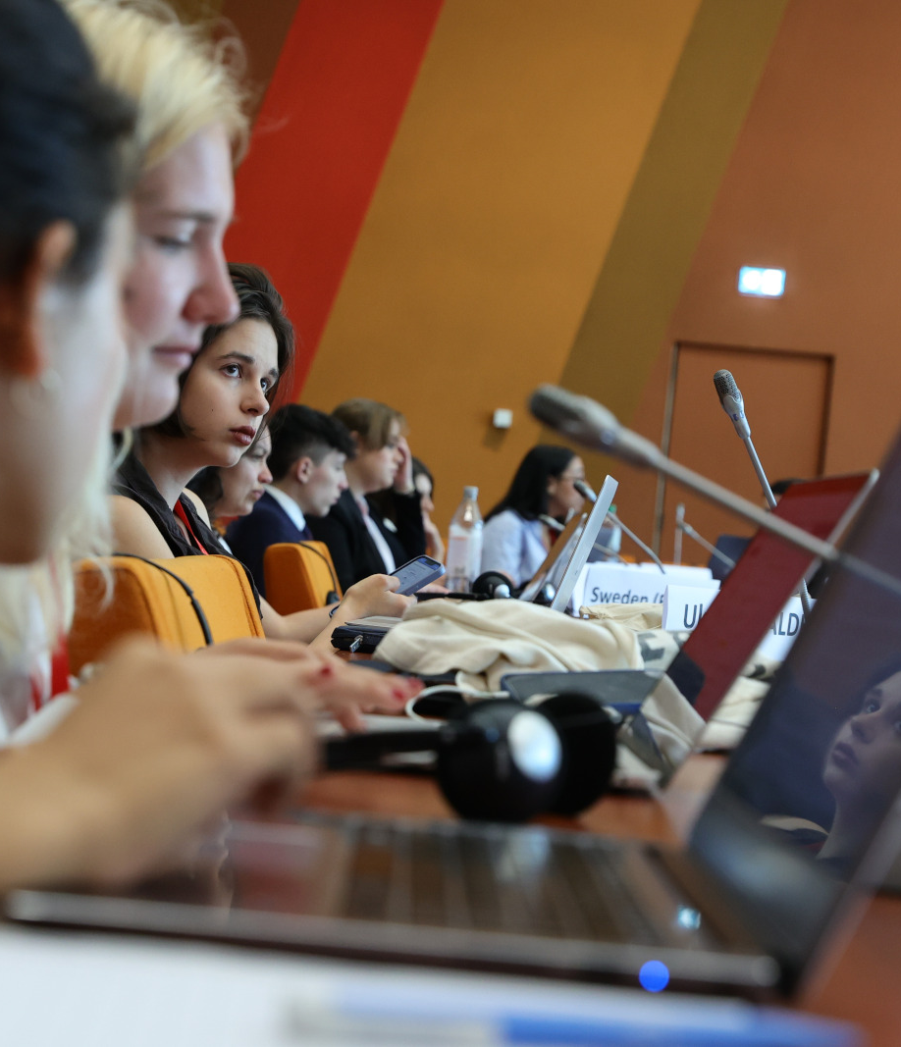
Council of Europe Days Visibility Project
France – CoEMoN
The event, held in Strasbourg, gathered political science students from more than 30 countries to play the role of parliamentarians and representatives of member states within the Parliamentary Assembly of the Council of Europe and the Committee of Ministers
13

Slide 14
Council of Europe Days Visibility Project
2. Malta – Parliamentary event on Violence against Women
The conference brought together academics and leading experts to highlight the importance and benefits of the Council of Europe Convention on preventing and combating violence against women and domestic violence (Istanbul Convention) - the first legally binding multilateral instrument of its kind – and the central role that men and boys must play in order to tackle such violence effectively.
The event was live streamed
14

Slide 15
Council of Europe Days Visibility Project
3. Republic of Moldova – Visibility Week
On the occasion of the 28th anniversary of Republic of Moldova's accession to the Council of Europe, the Office in Chisinau, together with the Ministry of Foreign Affairs and European Integration, organised a “Council of Europe Week 2023”
15

Slide 16
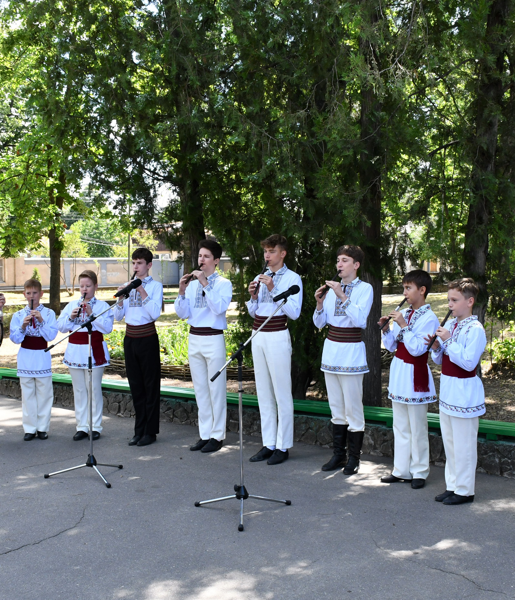
Council of Europe Days Visibility Project
3. Republic of Moldova – Visibility Week
Arts, documentary films and first-hand testimony were just some of the ways in which the Week explored key human rights themes
16

Slide 17
Council of Europe Days Visibility Project
When should events be held?
Whenever is best for the Member State concerned
Many countries chose to build events around Europe Day on 5 May
May 2024 is the Council of Europe’s 75th anniversary: a potential hook
But events can happen at any point during the year
17

Slide 18
Council of Europe Days Visibility Project
What next?
Many Permanent Representatives and National Focal Points seek inspiration for events
They – and anyone who is interested – should look at the dedicated Council of Europe Days dedicated website: Telling the CoE's story
18

Slide 19
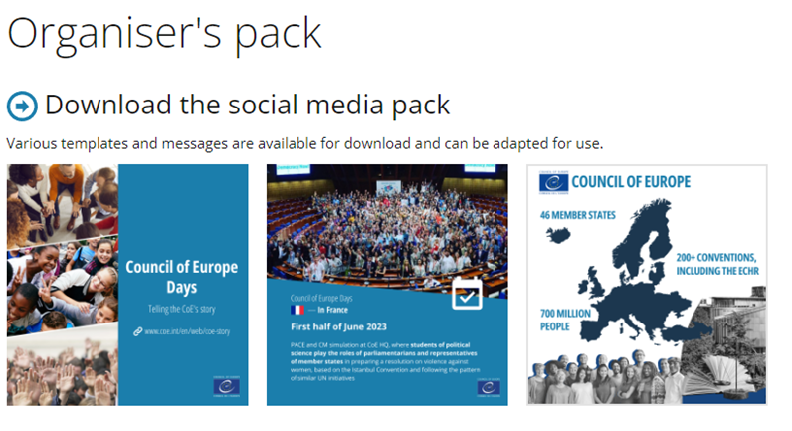
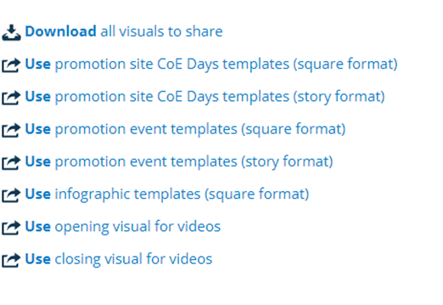
Council of Europe Days Visibility Project
What next?
Among other things, the website content includes: past events by members states, testimonials, visuals, templates, and supporting / organisers’ materials
Focal Points also have an appointed member of the Secretariat who they can consult at any point
19

Slide 20
Council of Europe Days Visibility Project
Telling our Story Together
We cannot expect people to simply know the difference that the Council of Europe makes to their lives
We need to tell them
National themes and events will vary
But we can support one another in telling it is
an investment in our future together
20

Slide 21
Council of Europe Days Visibility Project
21

