Slide 1
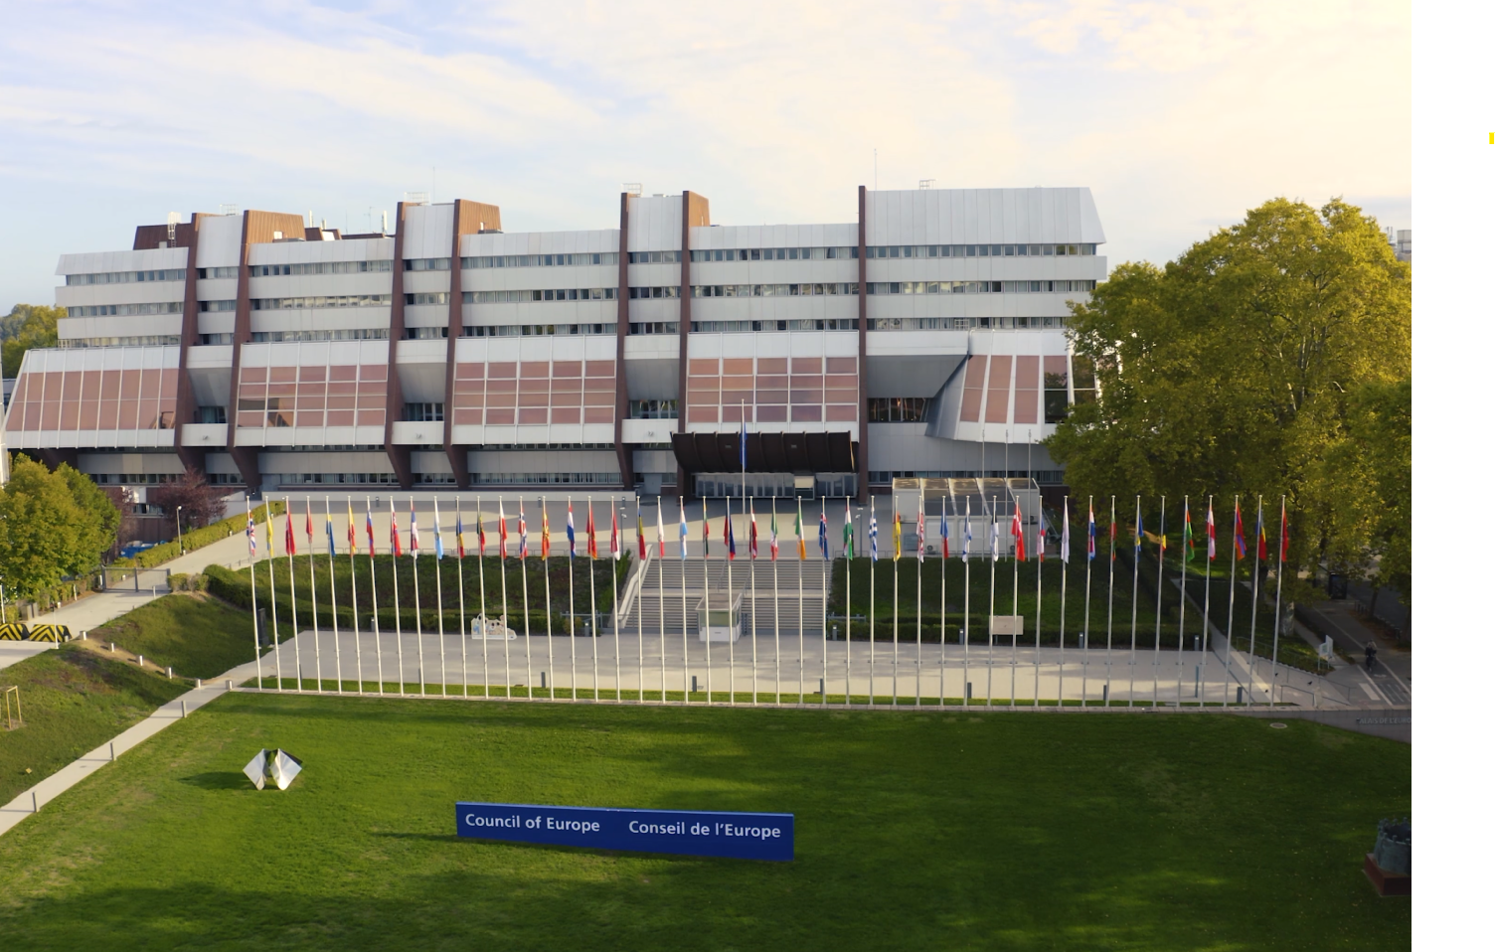

CONGRESS OF LOCAL AND REGIONAL AUTHORITIES
COUNCIL OF EUROPE

Slide 2
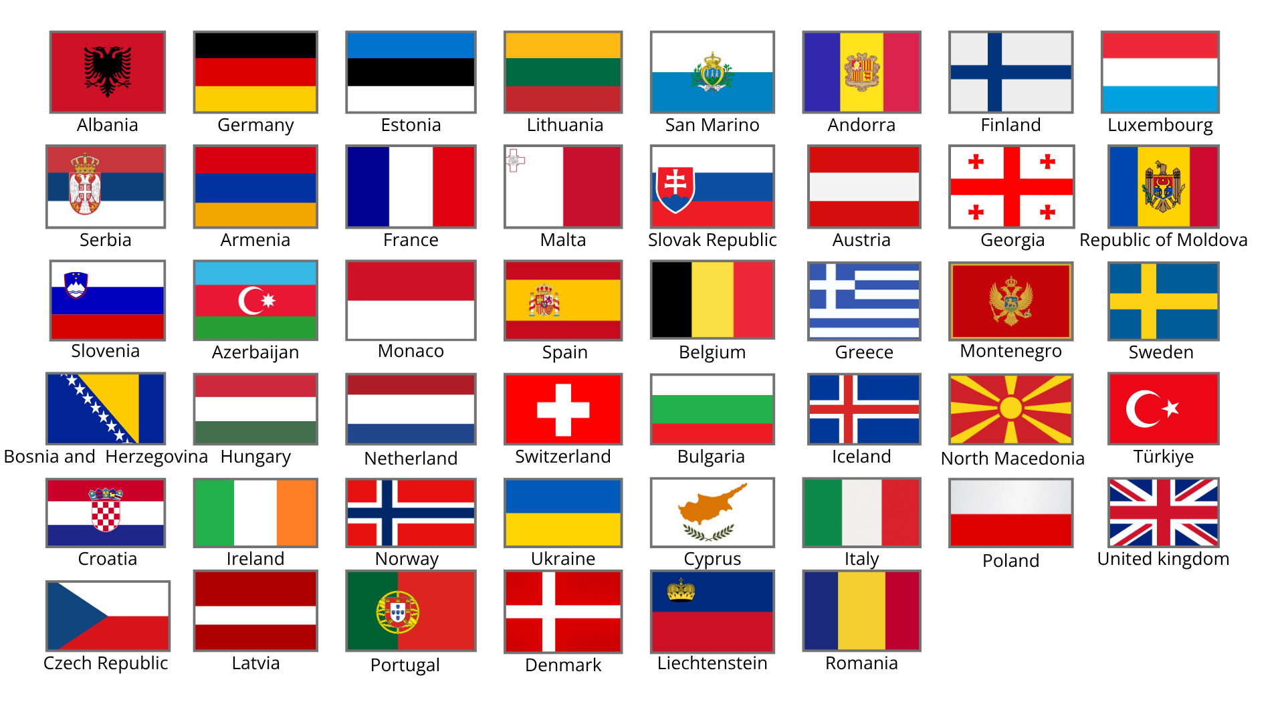
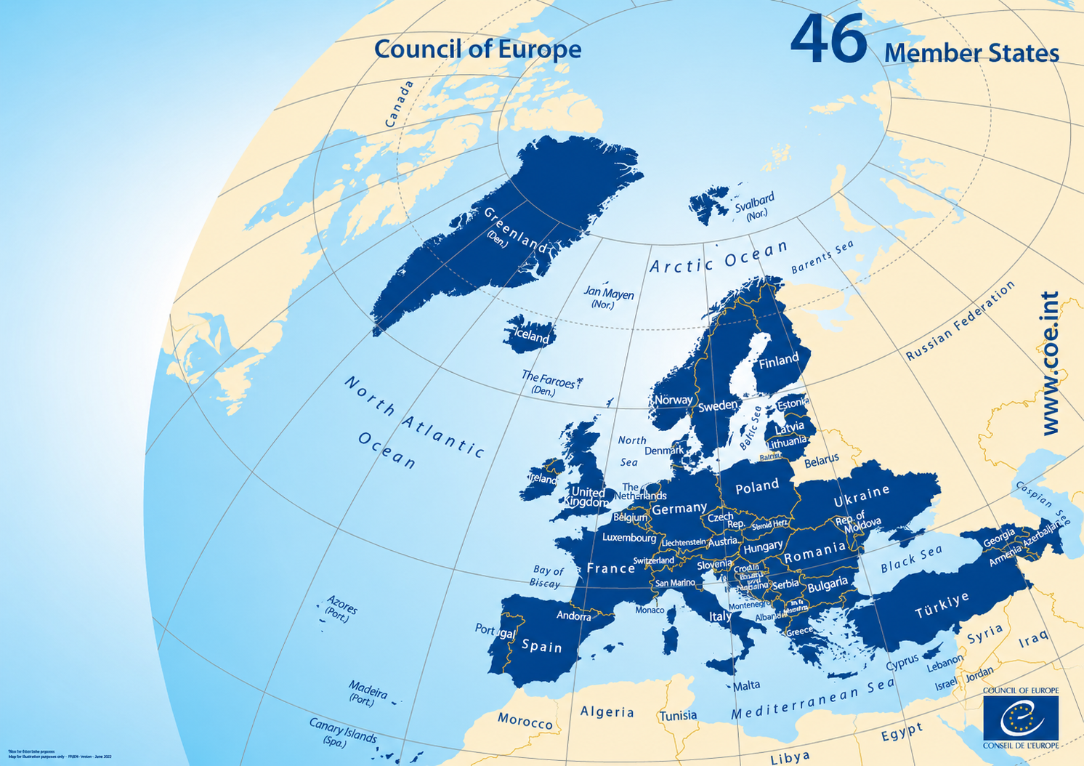
CONGRESS OF LOCAL AND REGIONAL AUTHORITIES OF THE COUNCIL OF EUROPE
INTERGOVERNMENTAL ORGANISATION
👥46 member states
including all members of the European Union + 5 observer states
🌍700 million Europeans
This represents a death penalty-free zone for more than 700 million people
📍Headquarters
In Strasbourg, France
+ 18 external offices
+ 4 liaison offices within other organisations (EU, UN etc.)
www.coe.int/congress

Slide 3
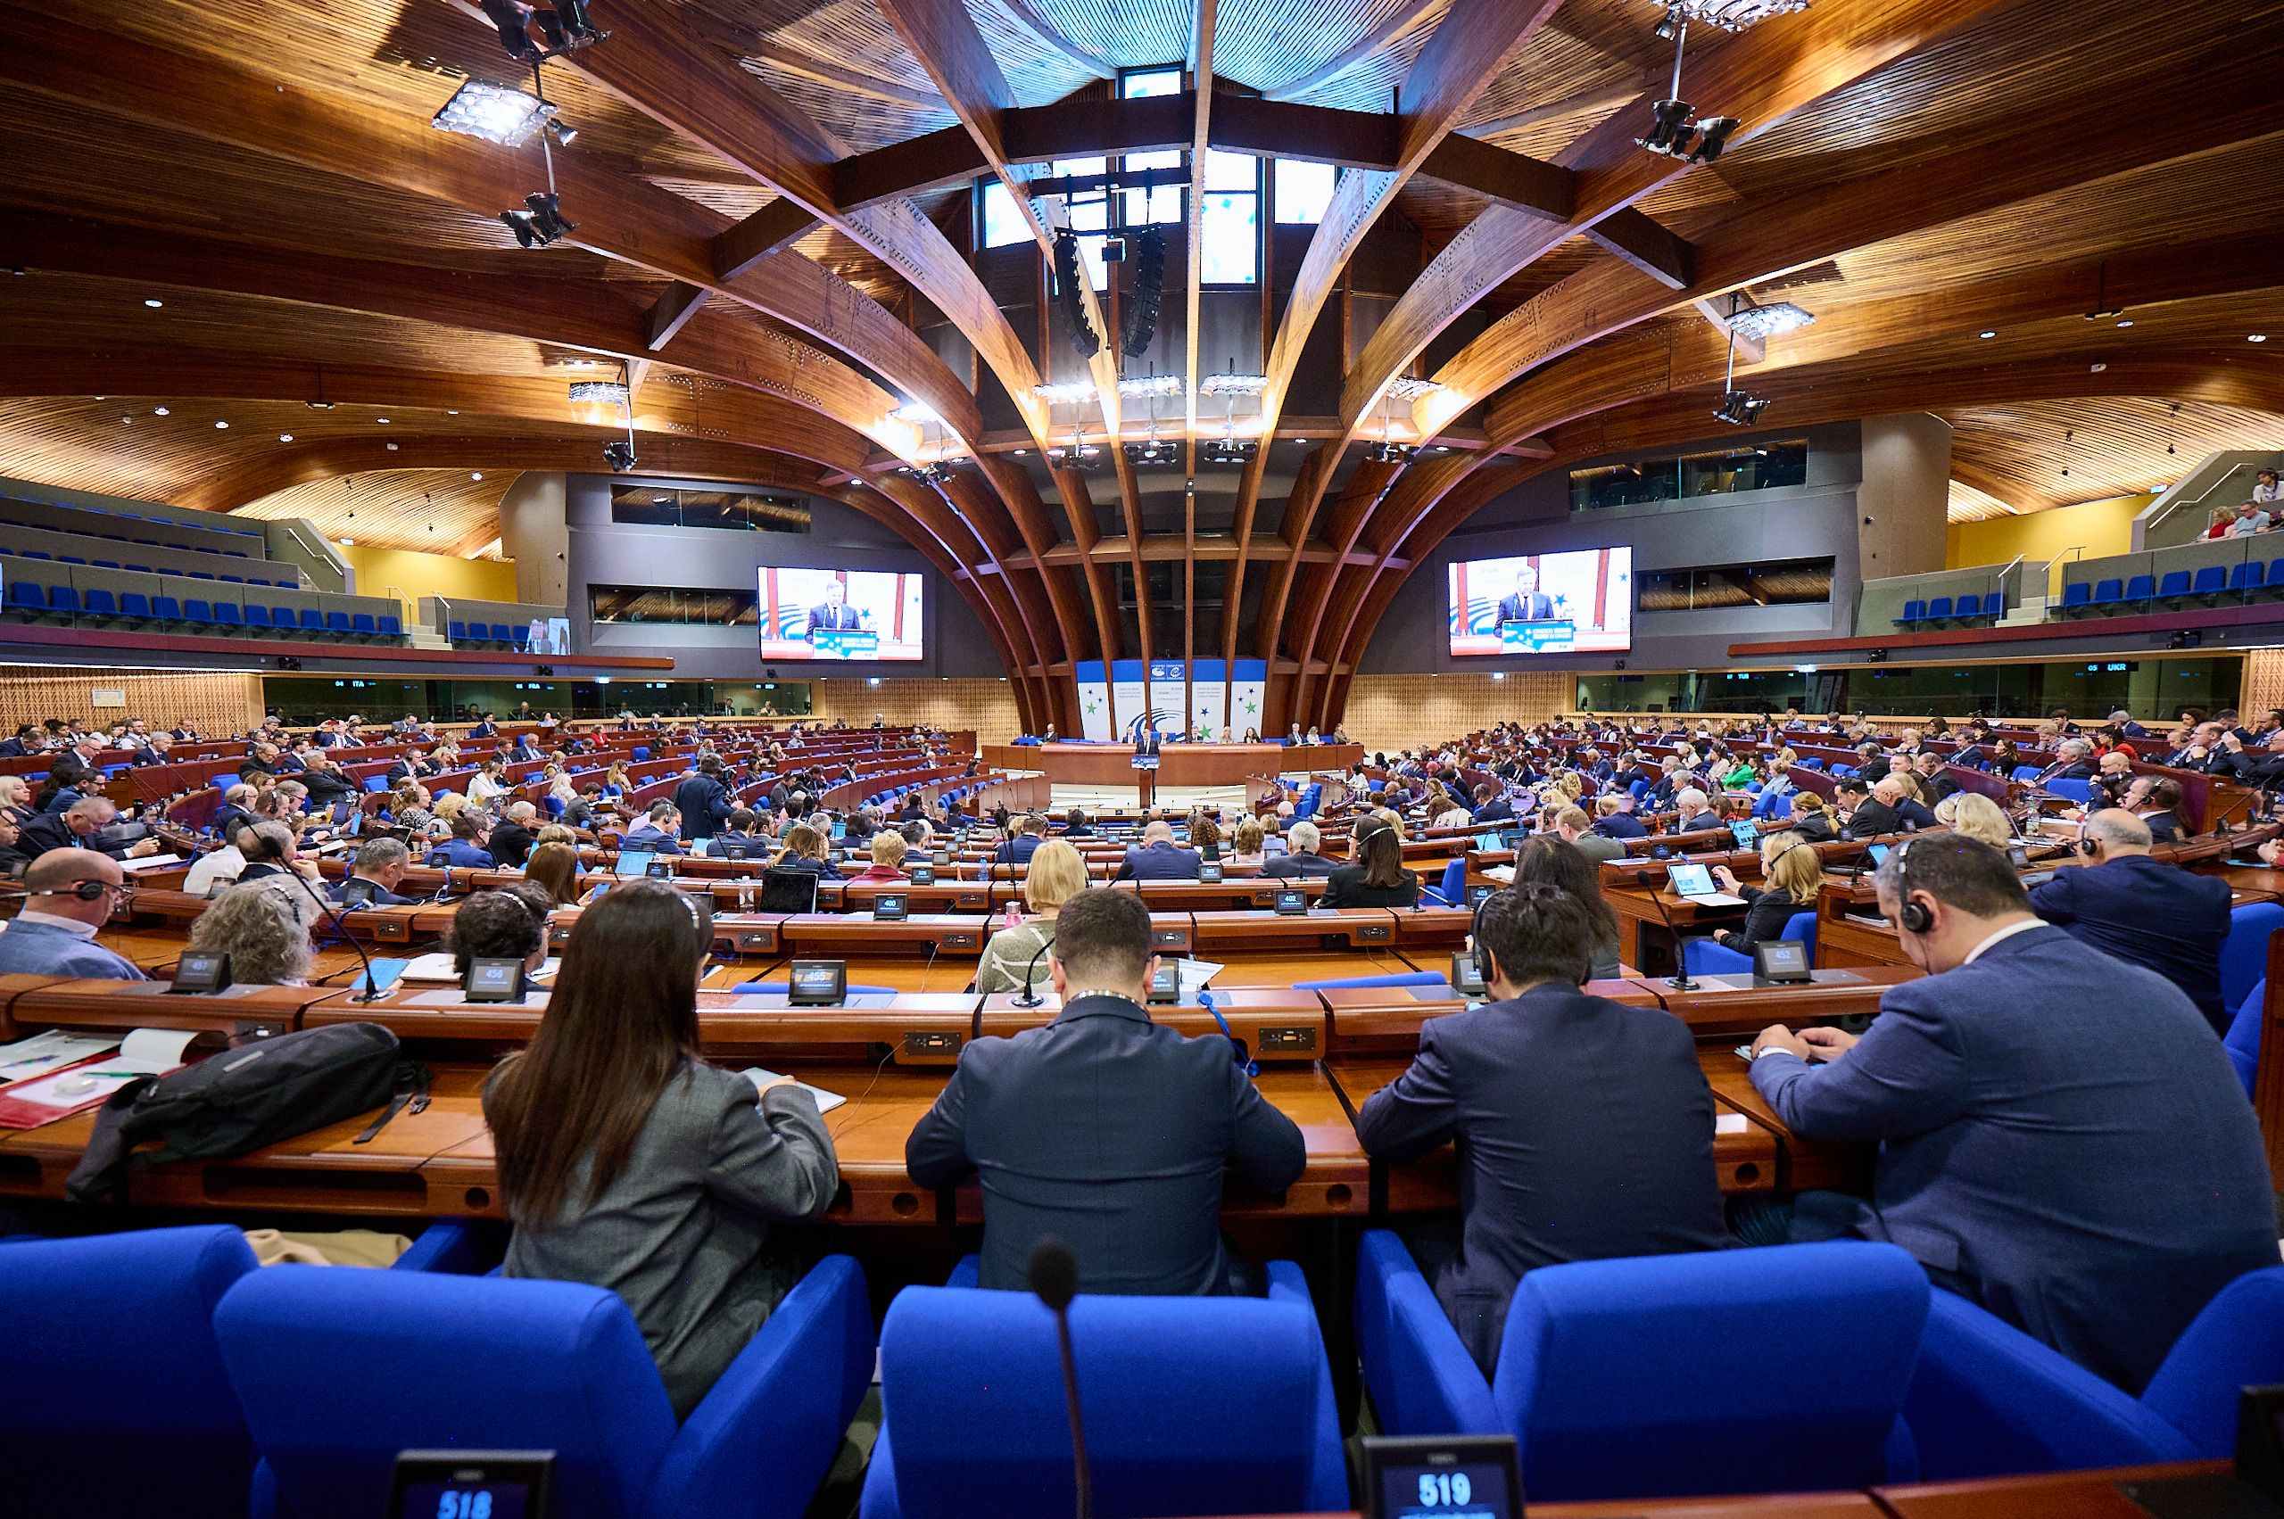
CONGRESS OF LOCAL AND REGIONAL AUTHORITIES OF THE COUNCIL OF EUROPE
📅Established on 5 May 1949 (Treaty of London) by 10 states
📍Based in Strasbourg (France)
⭐Intergovernmental political Organisation founded on three main values :
  Human rights
  Democracy
  The rule of law
🤝Its work is based on the European Convention on Human Rights
www.coe.int/congress

Slide 4
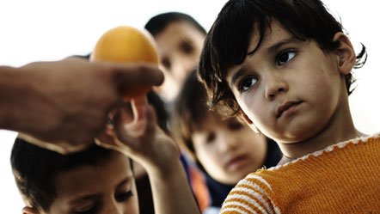

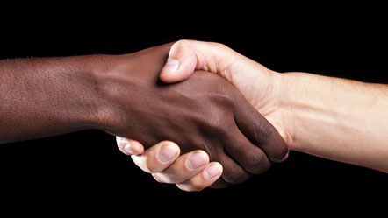
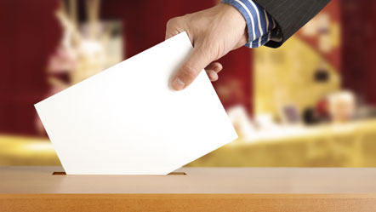
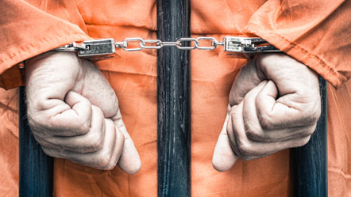
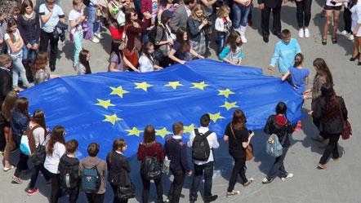

CONGRESS OF LOCAL AND REGIONAL AUTHORITIES
Defence of cultural diversity
Gender equality
Protection of children’s rights
Education in human rights and democracy
Quality of medicines and health care
Strengthening of human rights
Abolition of death penalty
Upholding freedom of expression
Fighting discrimination and racism
Election observation
www.coe.int/congress

Slide 5
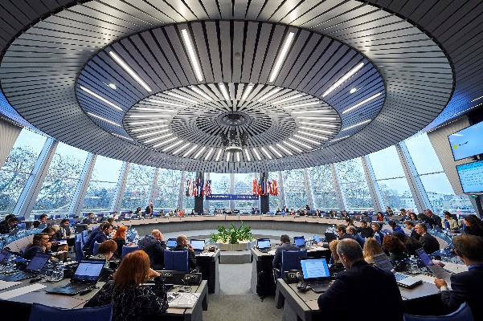
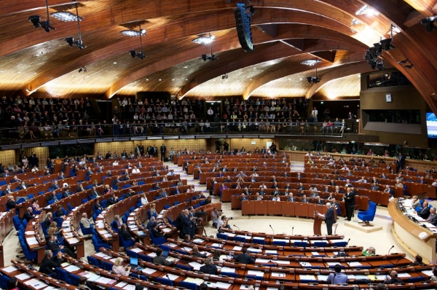
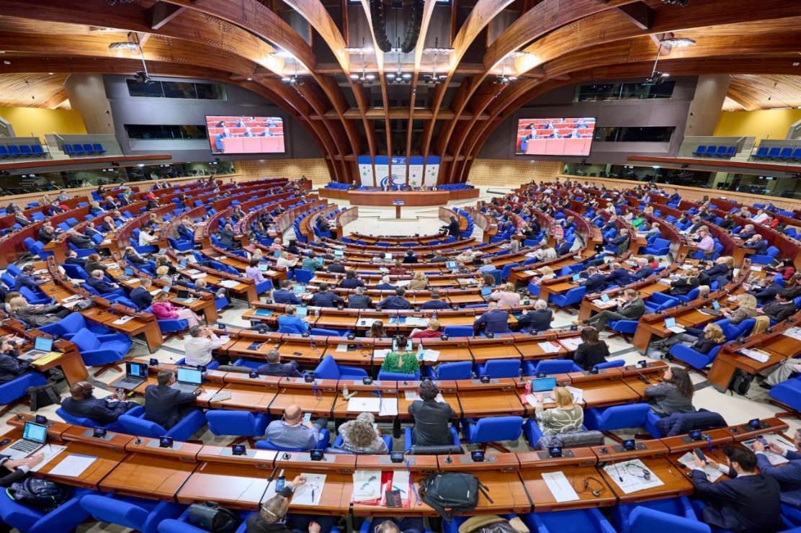
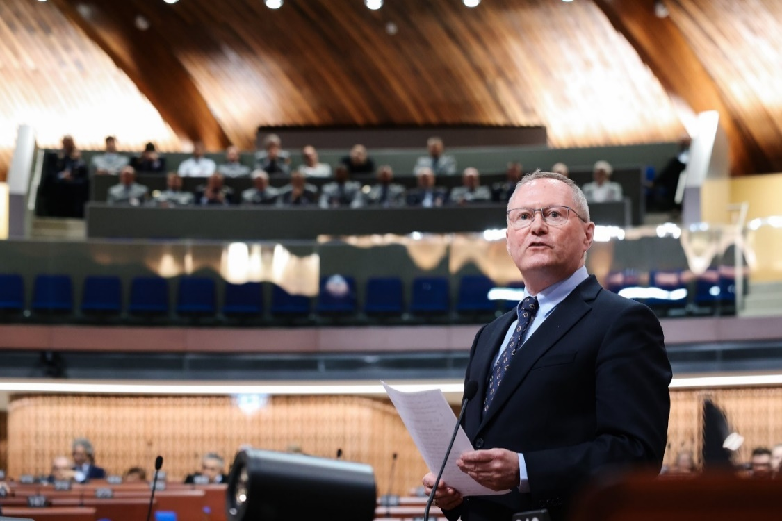

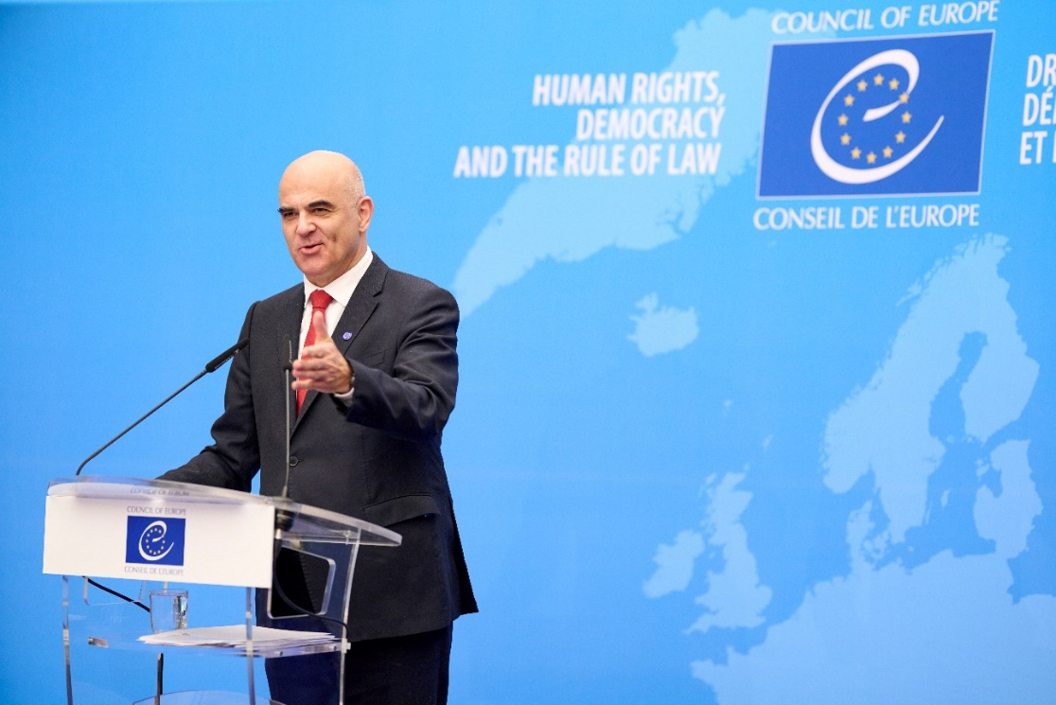
CONGRESS OF LOCAL AND REGIONAL AUTHORITIES
Institutions of the Council of Europe
Committee of Ministers
Decision-making body
Parliamentary Assembly
Forum for debates and proposals
Congress of Local and Regional Authorities
Voice of local and regional democracy
MONITORING COMMITTEE*
CENTRE OF EXPERTISE
Commissioner for Human Rights
Independent voice
Conference of INGOs
Voice of civil society
Secretary General
www.coe.int/congress

Slide 6
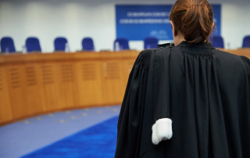
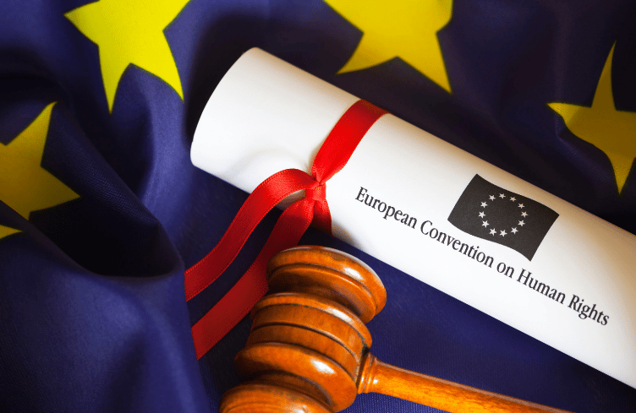
CONGRESS OF LOCAL AND REGIONAL AUTHORITIES
The European Court of Human Rights ⚖️
Judiciary body
1 judge for each member state
Accessible to individuals and governments
The European Convention on Human Rights
Signed in 1950 and ratified by all member states
✅ GUARANTEES
  The right to life
  The right to a fair hearing
  Freedom of thoughts, conscience and religion
  Freedom of expression
❌ PROHIBITS
  Death penalty
  Torture and inhuman treatment
  Slavery and forced labour
  Arbitrary and unlawful detention
  Discrimination
www.coe.int/congress

Slide 7
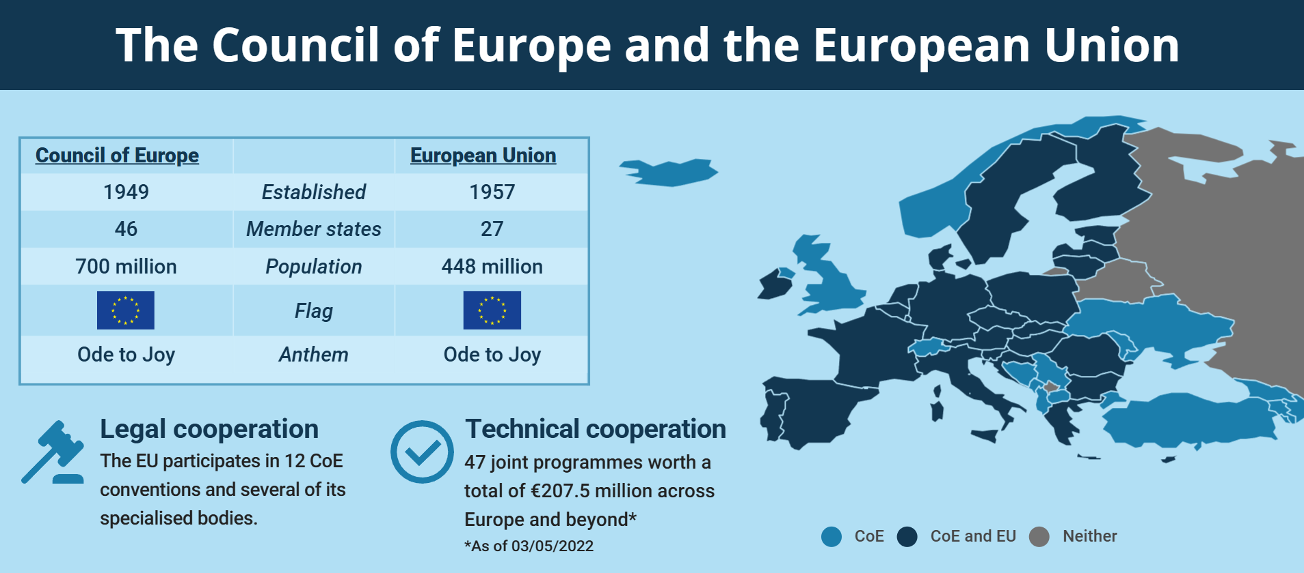
CONGRESS OF LOCAL AND REGIONAL AUTHORITIES
The Council of Europe and the European Union
The COUNCIL OF EUROPE works
together with its 46 member states
to strengthen human rights and
democracy across the continent and beyond.
The EU brings its 27 member states
closer together both economically and
politically by harmonizing legislation
and practices in certain policy areas.
www.coe.int/congress

Slide 8

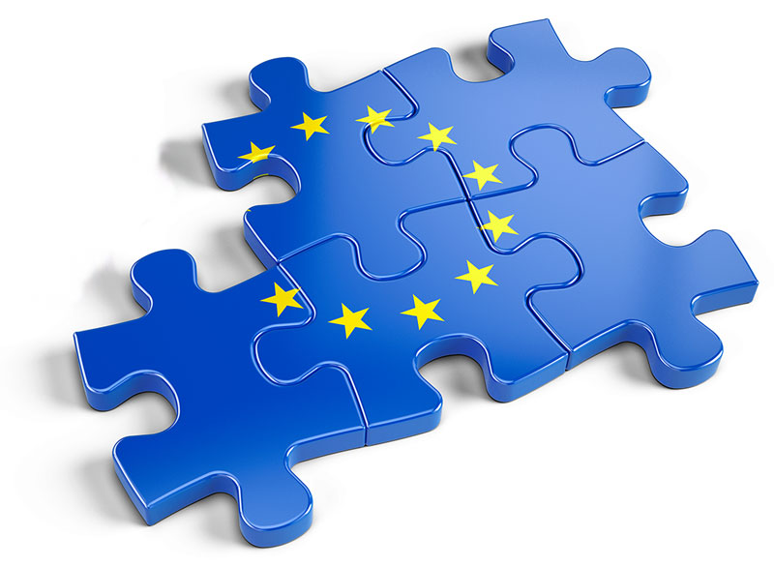
CONGRESS OF LOCAL AND REGIONAL AUTHORITIES
COMPLEMENTARY ROLES
Shared fundamental values
Close co-operation in areas of common interests
Mutual benefit
FORMS OF CO-OPERATION
  Promoting European standards
  Sharing expertise
  Monitoring compliance
  Joint programmes
CO-OPERATION IN PRACTICE
  Regular high-level political dialogue
  Co-ordination on the ground
www.coe.int/congress

Slide 9
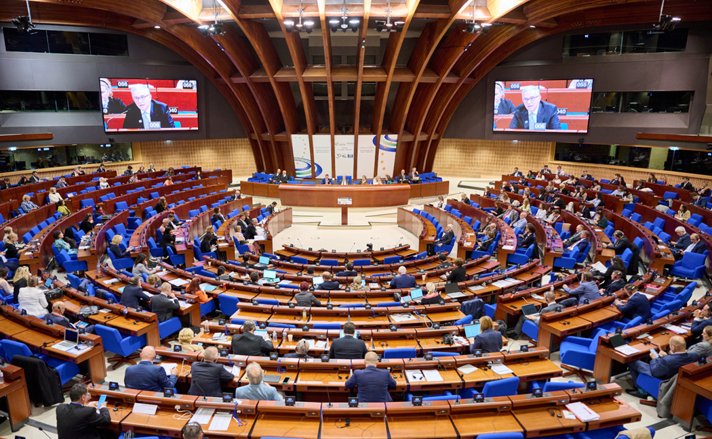
The Congress of Local and Regional Authorities
CONGRESS OF LOCAL AND REGIONAL AUTHORITIES
The Congress brings the local and regional dimension to the Council of Europe.
Its activities are based on the core values of the Council: human rights, democracy and the rule of law.
www.coe.int/congress

Slide 10
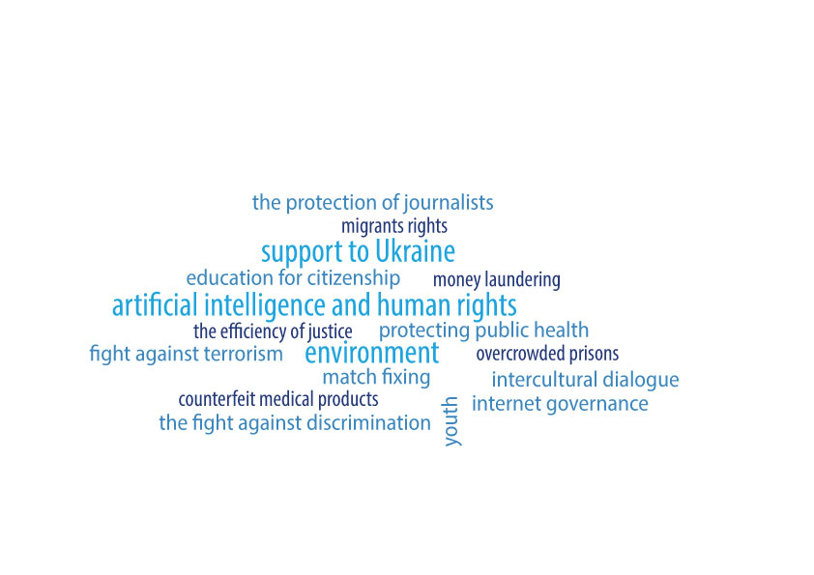
CONGRESS OF LOCAL AND REGIONAL AUTHORITIES
📅14 January 1994 - The Committee of Ministers adopts a statutory resolution establishing the Congress of Local and Regional Authorities as a body representing local and regional authorities within the Council of Europe.
📍Based in Strasbourg (France)
📢Acting as the voice of more than 130,000 local and regional authorities across Europe
  Monitoring the implementation of the European Charter
  Observing local and regional elections
  Promoting citizen participation
🤝Through its activities, the Congress helps ensure that local and regional democracy remains a cornerstone of democratic governance throughout Europe.
www.coe.int/congress

Slide 11
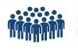
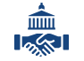



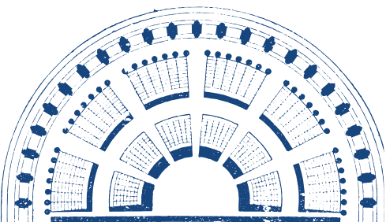


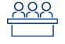
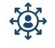
CONGRESS STRUCTURE
CONGRESS OF LOCAL AND REGIONAL AUTHORITIES
306 representatives
306 substitutes
two chambers:
Chamber of Local Authorities
Chamber of Regions
5 Political Groups
46 Delegations
46 member states
3 Committees
Monitoring Committee
Governance Committee
Social Inclusion Committee
www.coe.int/congress

Slide 12

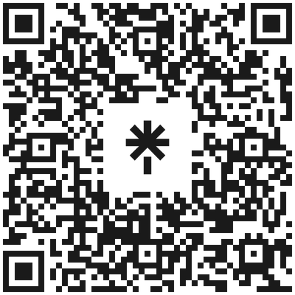



CONGRESS OF LOCAL AND REGIONAL AUTHORITIES
THANK YOU FOR YOUR ATTENTION!
STAY CONNECTED :
@COECongress
@COECongress
@coe-congress
@congress.coe.int
www.coe.int/congress

