Slide 1



Management System of Judicial Cases
Notes:
Please click to add notes

Slide 2

Abstract
  The system
  A historical perspective
  A workflow
  Some figures
  The next steps
Notes:
Please click to add notes

Slide 3

The System
CITIUS is the management system of judicial proceedings :
For the electronic delivery of documents by the different judicial operators (prosecutors, lawyers, solicitors, etc.);
For the electronic distribution of the cases;
For electronic handling of the cases by judges, prosecutors and court officials;
For electronic communication with other systems in the field of justice (statistics, enforcement, court costs, etc.)
Notes:
The Public Prosecution Service delivers an executive application and other declarative procedural pieces; There is automatic distribution in the areas provided for in the decrees 114/2008 and 280/2013
The signature is electronic and qualified

Slide 4
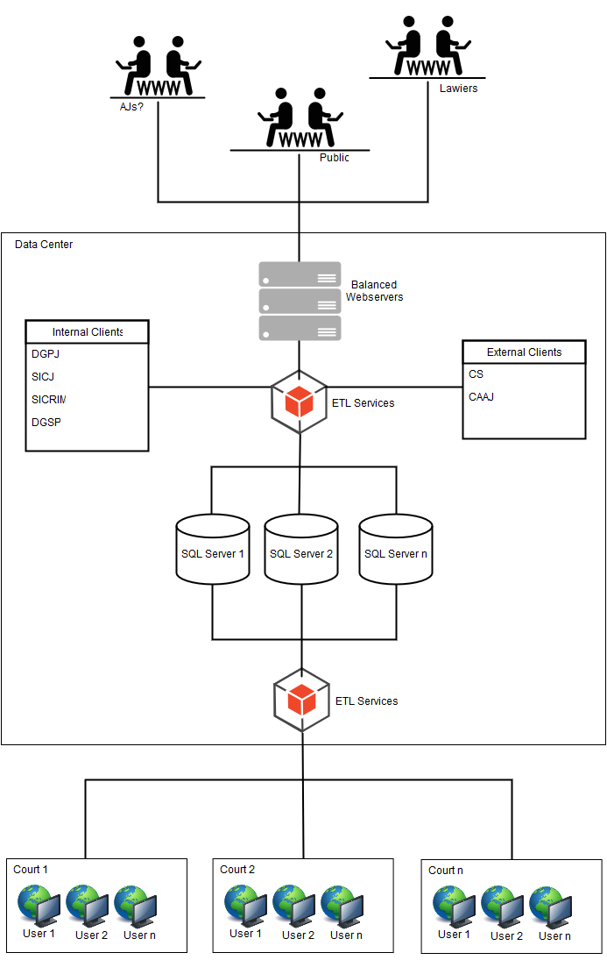
Notes:
The architecture of the solution is evolving in a service-oriented logic

Slide 5
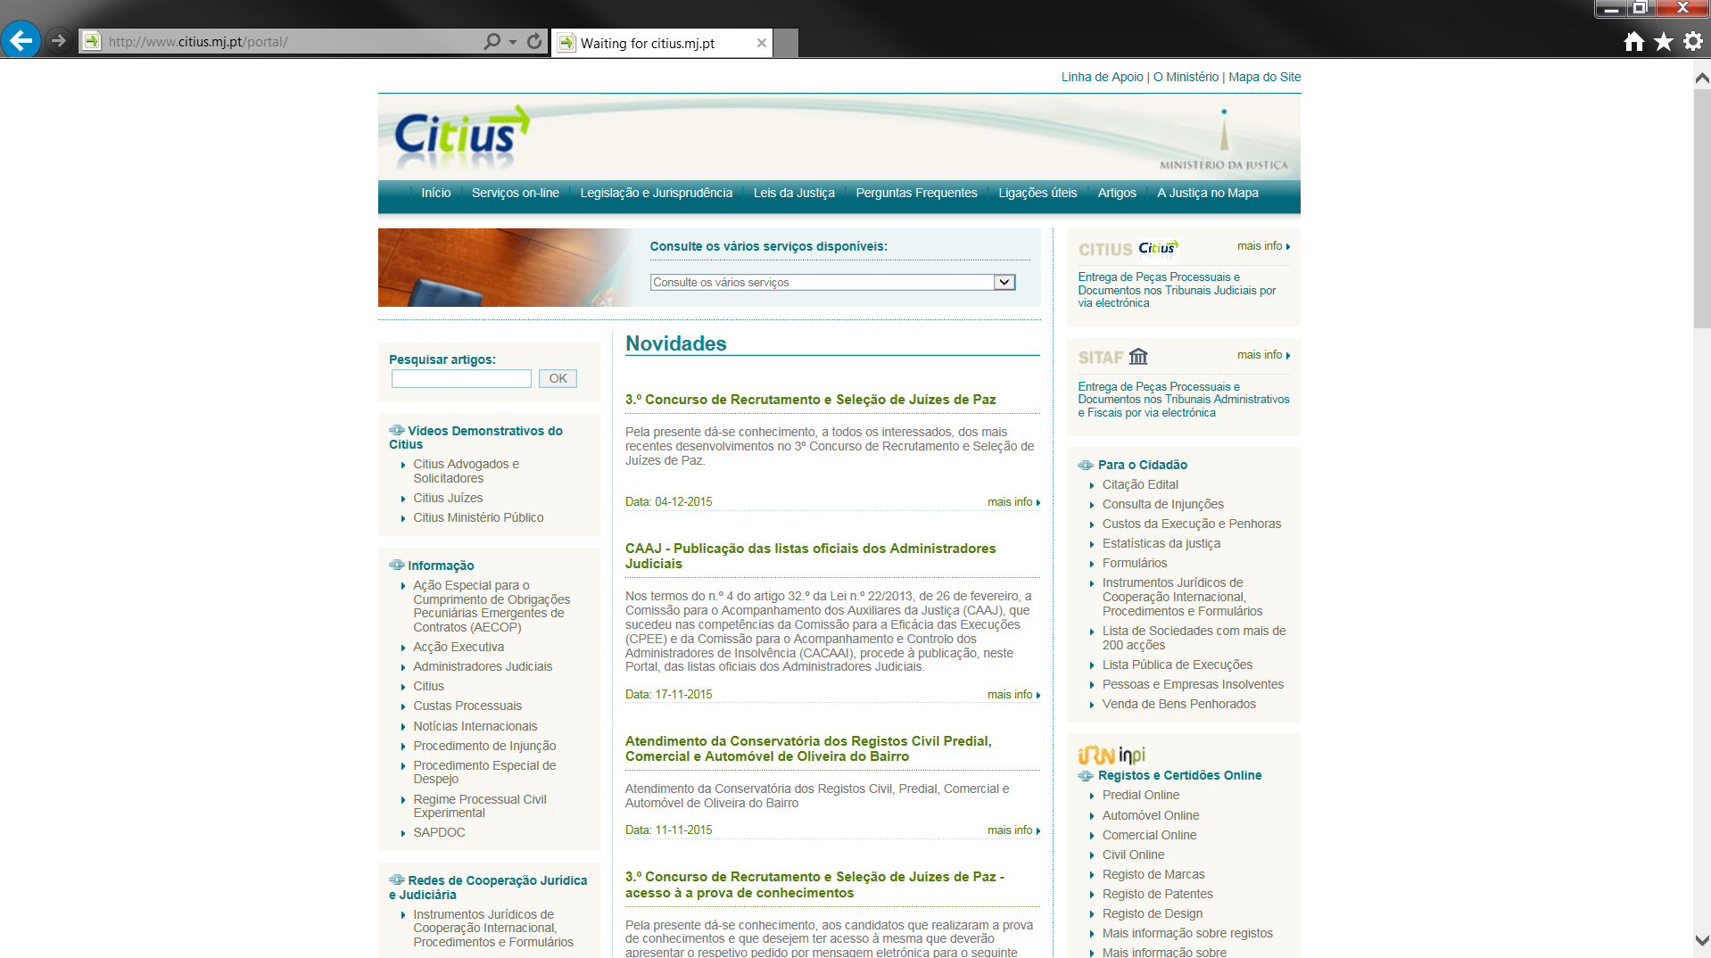
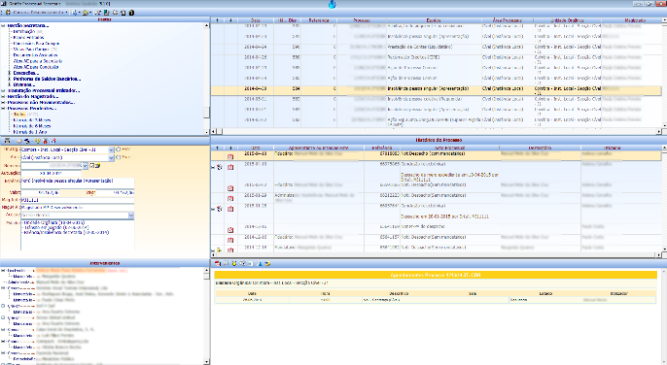
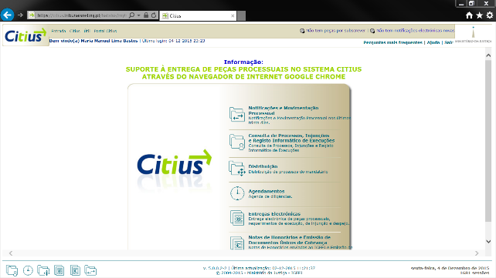
CITIUS has several interfaces for different recipients and uses:
Notes:
Portal for the citizen; Desktop application for internal users (judges, prosecutors and court officials); Web application for lawyers; Web services for other information systems

Slide 6
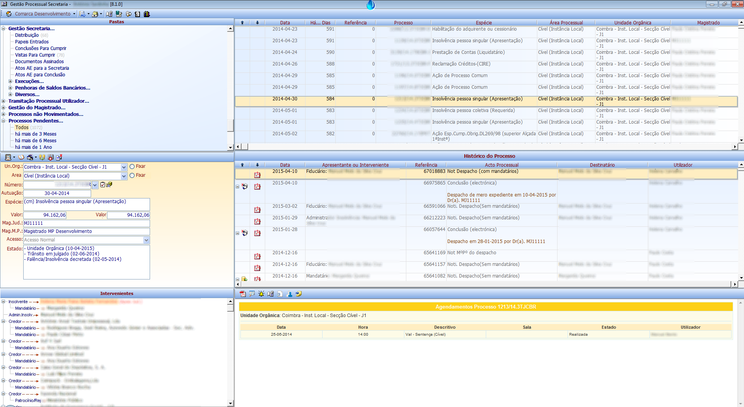
Desktop application (internal users: judges prosecutors and court officials)
Notes:
Presentation of the module of the case section (where the handling takes place)

Slide 7

Web application (external users: lawyers and solicitors)
Notes:
Presentation of the main menu of the web application (for lawyers)

Slide 8
Portal (public access to the publication of judicial information)
Notes:
Presentation of the Portal where are available online services (publication of acts and documents related to the cases)

Slide 9
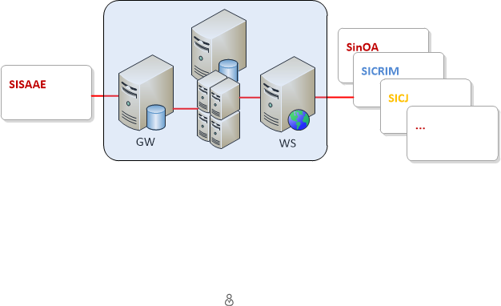
Integration and communication solutions with other systems (web services, etc.)
Notes:
Various services for integration with other systems, from the justice area and others

Slide 10
A historical perspective
After some experiments (proof of concept) as for instance the GPCivil, the project CITIUS, previously named as H@bilus, started in 2000/2001.
It resulted from a initiative of the Ministry (Directorate General for Justice Administration).
Developed and implemented by court officials.
It was initially intended to promote the standardization of procedures and documentation associated with the procedural handling of the court secretaries.
Notes:
GPCivil (end of the 90’s) had already associated some concepts of documentary management and workflows

Slide 11
Dates of release (first versions):
Desktop application (2000):
Portal (2002);
Web application (2004).
Notes:
Desktop application (habilus); Portal (habilus.net); Web application (myhabilus)

Slide 12
In January 2009 (with the entry into force of Decree 114/2008) there was a strong drive in this project. The judicial cases have began to be handled essentially in electronic form.
In 2013, the new code of civil procedure and the ancillary or additional legislation reinforced some aspects associated with the dematerialization and the electronic handling.
Notes:
In 2009 it was concluded the installation of the system in all services, in all areas and at all levels
Ancillary legislation (enforcement agents, judicial administrators, etc.)

Slide 13
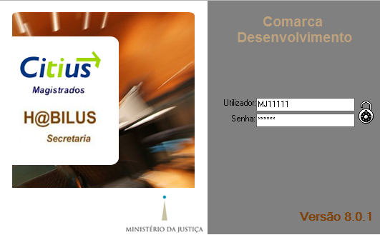
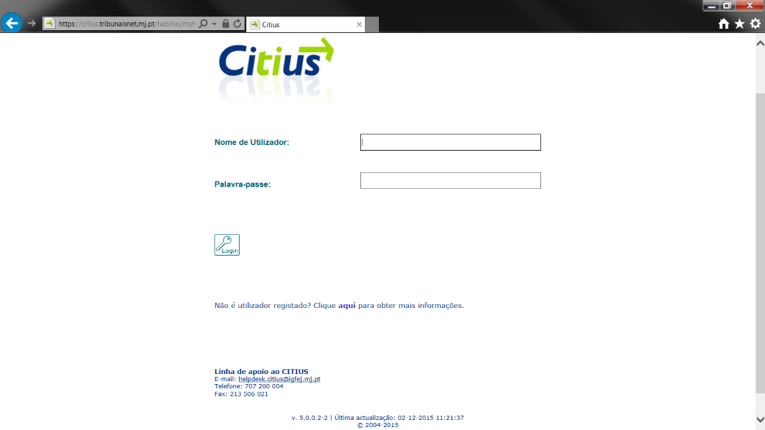
AA workflow
Showing some of the available functionalities through screen captures of the desktop and web applications, in a simple flow:
Notes:
Interaction between Court and Lawyer

Slide 14

Web application – Electronic delivery
Notes:
Lawyer’s main menu

Slide 15
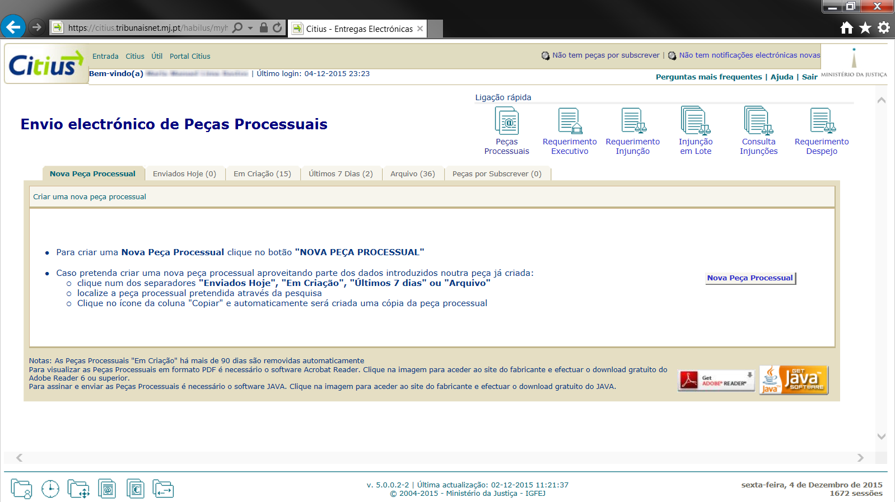
Web application – The lawyer sends the writ of summons digitally signed
Notes:
Assistant for the delivery of procedural documents (with several stages to be concluded with the digital signature and submission of the form with the annexed documents)

Slide 16
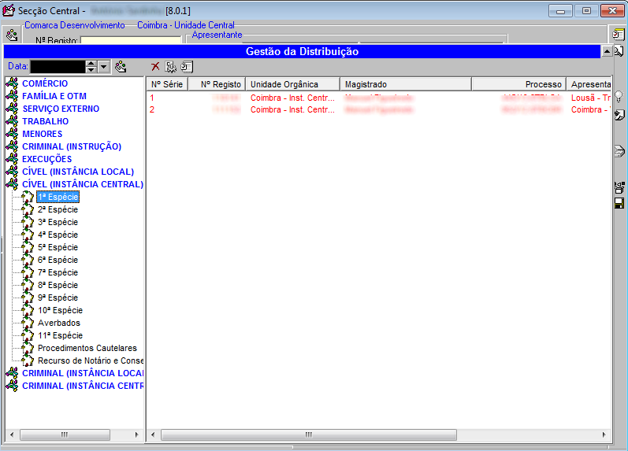
Desktop application – The court distributes the case
Notes:
View of the module of the central section and of the distribution management

Slide 17
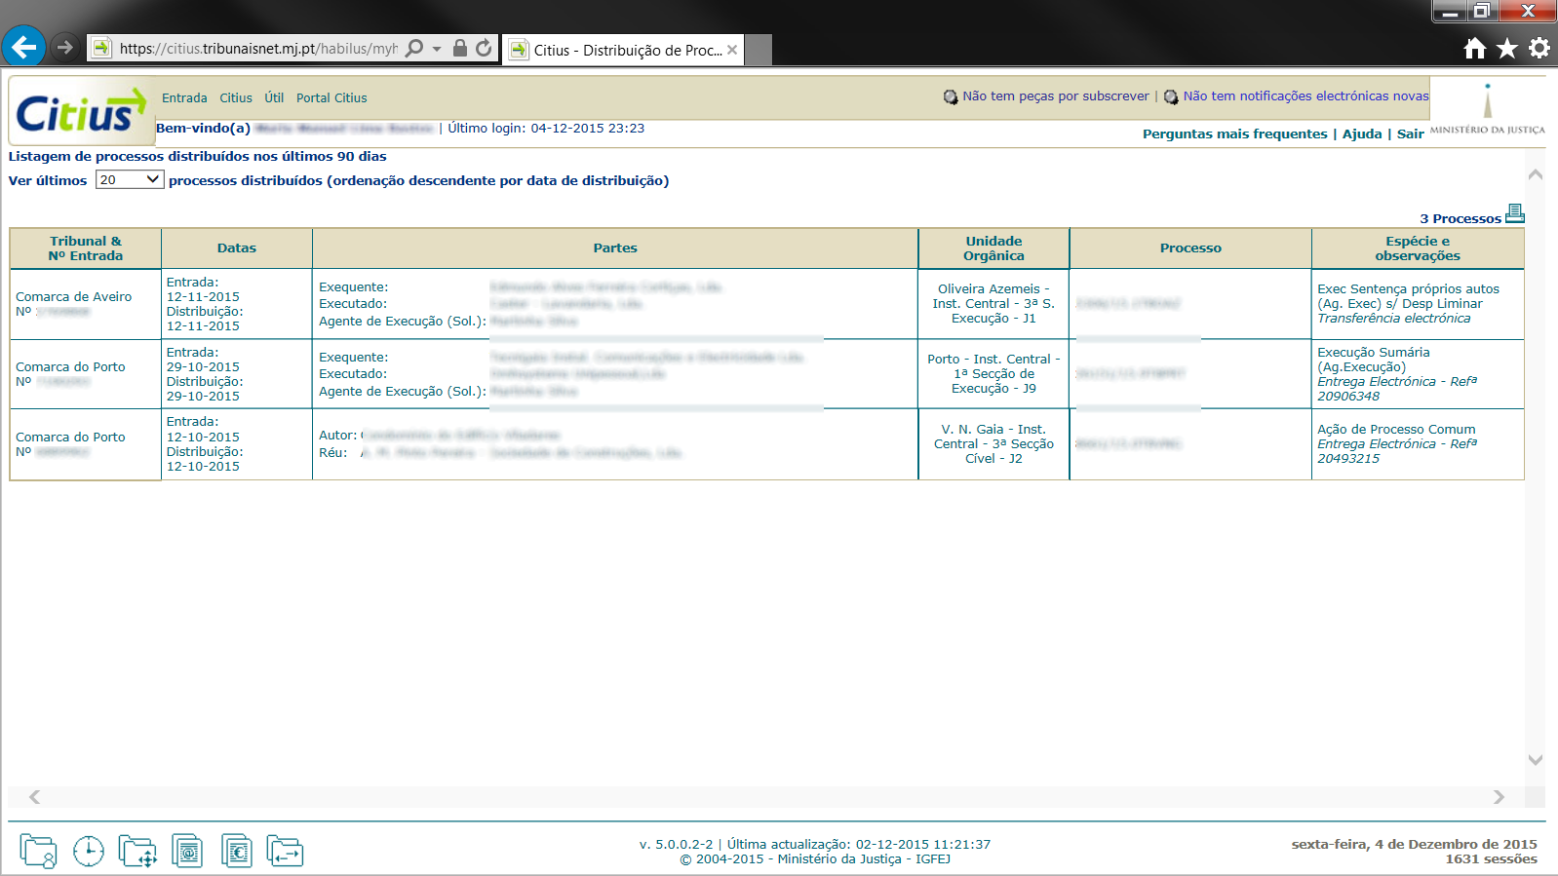
Web application – The lawyer consults the distribution
Notes:
View of the case distribution of a specific lawyer

Slide 18
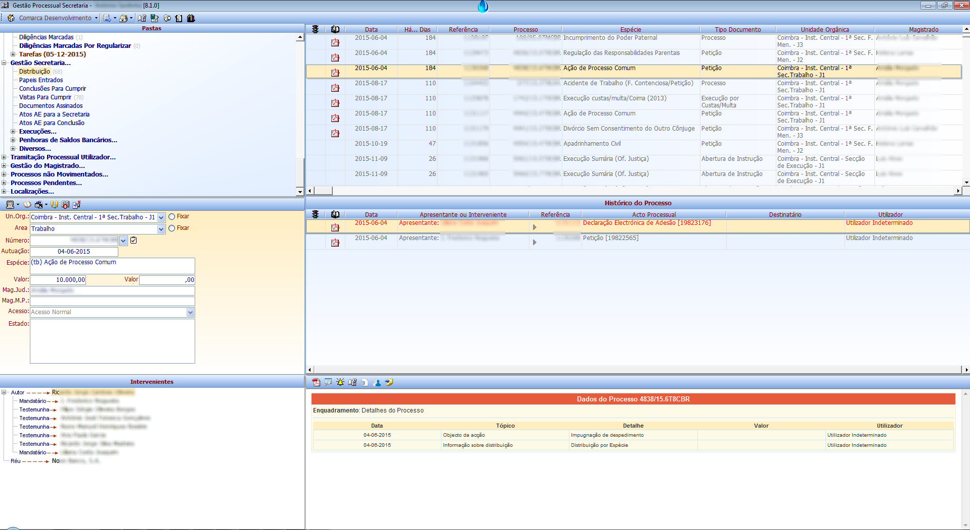
Desktop application – The court secretary receives the case
Notes:
View of the module sections and cases, namely of the distribution file (to a specific unit)

Slide 19
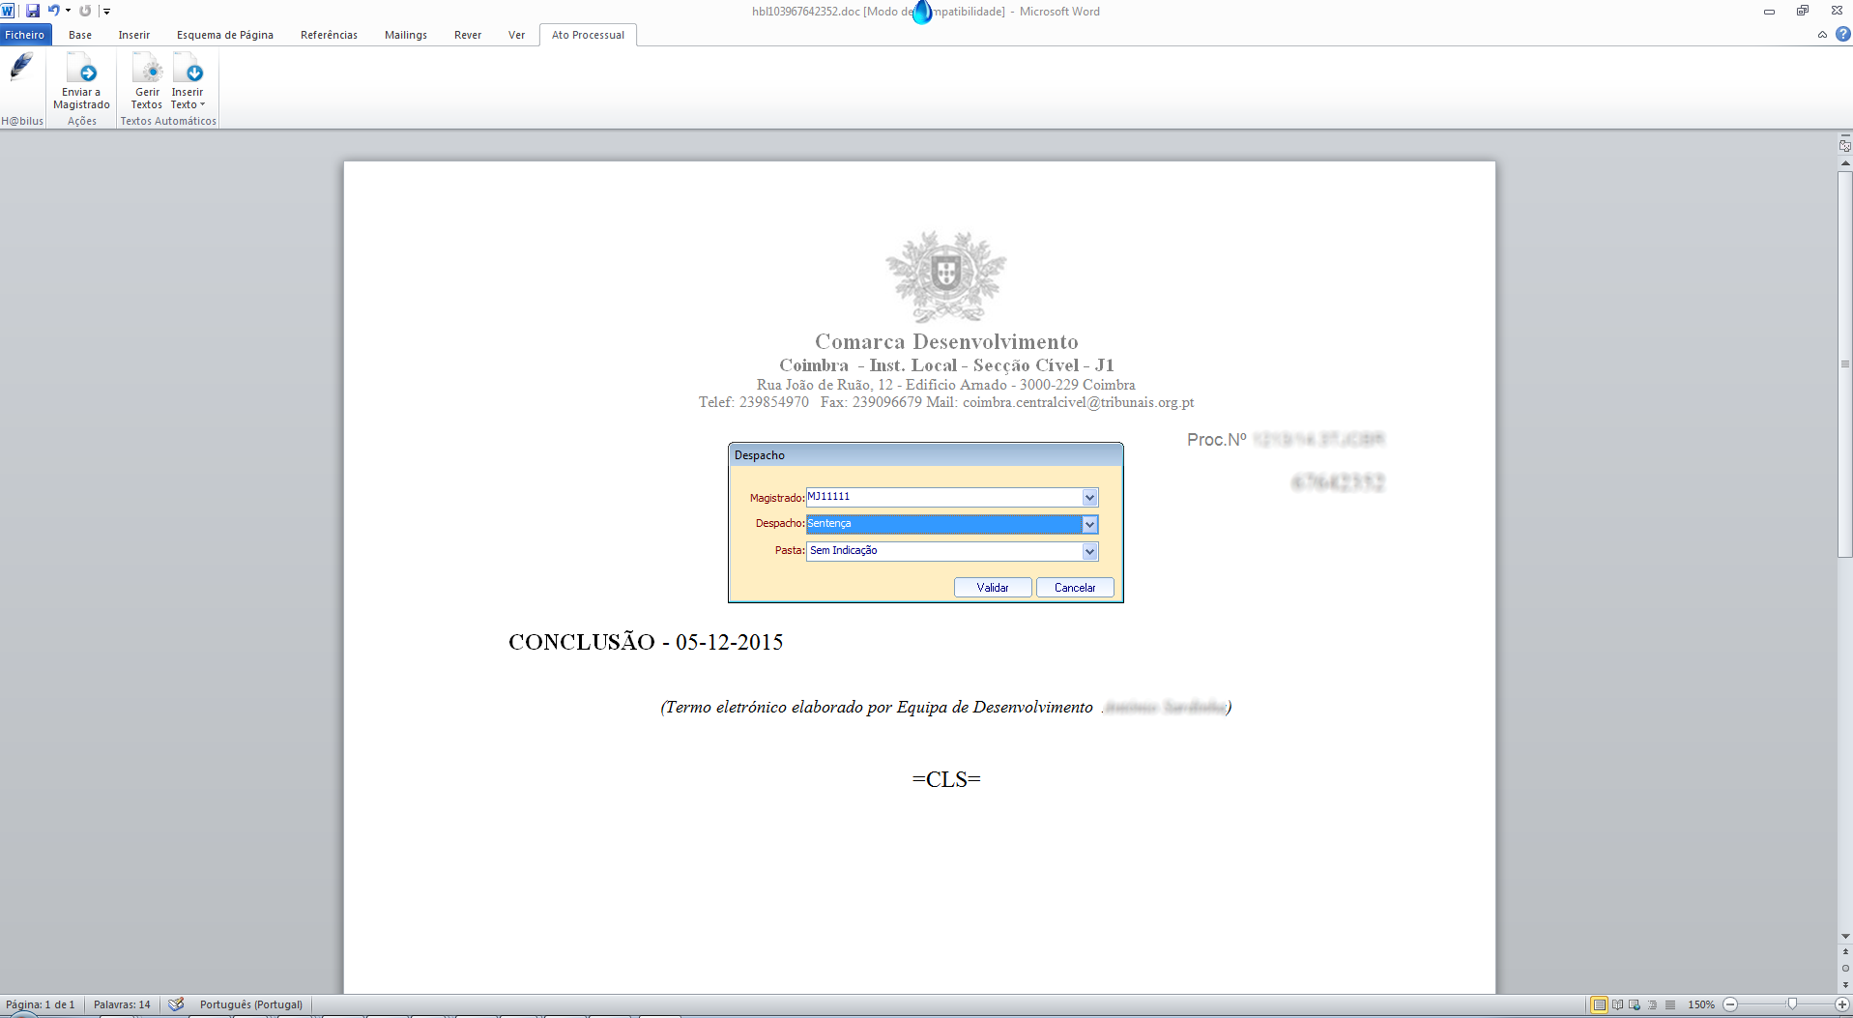
Desktop application : The court secretary sends to the judge
Notes:
Conclusion to the judge for decision (Add-in Word)

Slide 20
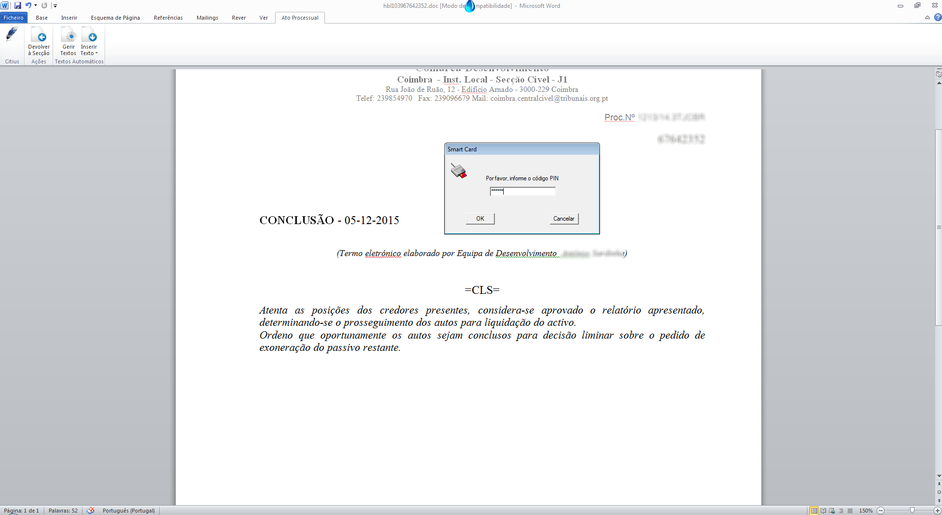
Desktop application : The judge issues the decision and signs electronically
Notes:
Decision of the judge with introduction of the PIN of the smartcard for signature

Slide 21
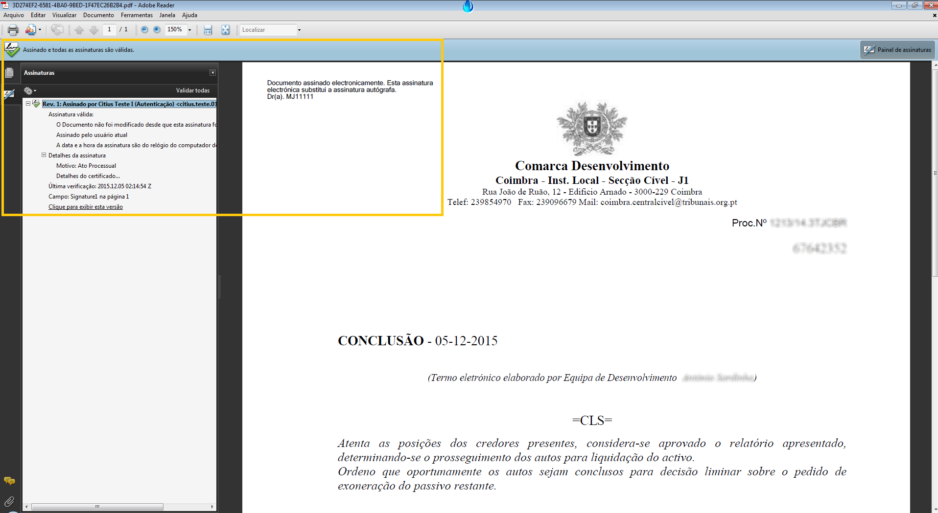
Desktop application : Decision signed digitally
Notes:
Decision signed electronically by a judge

Slide 22
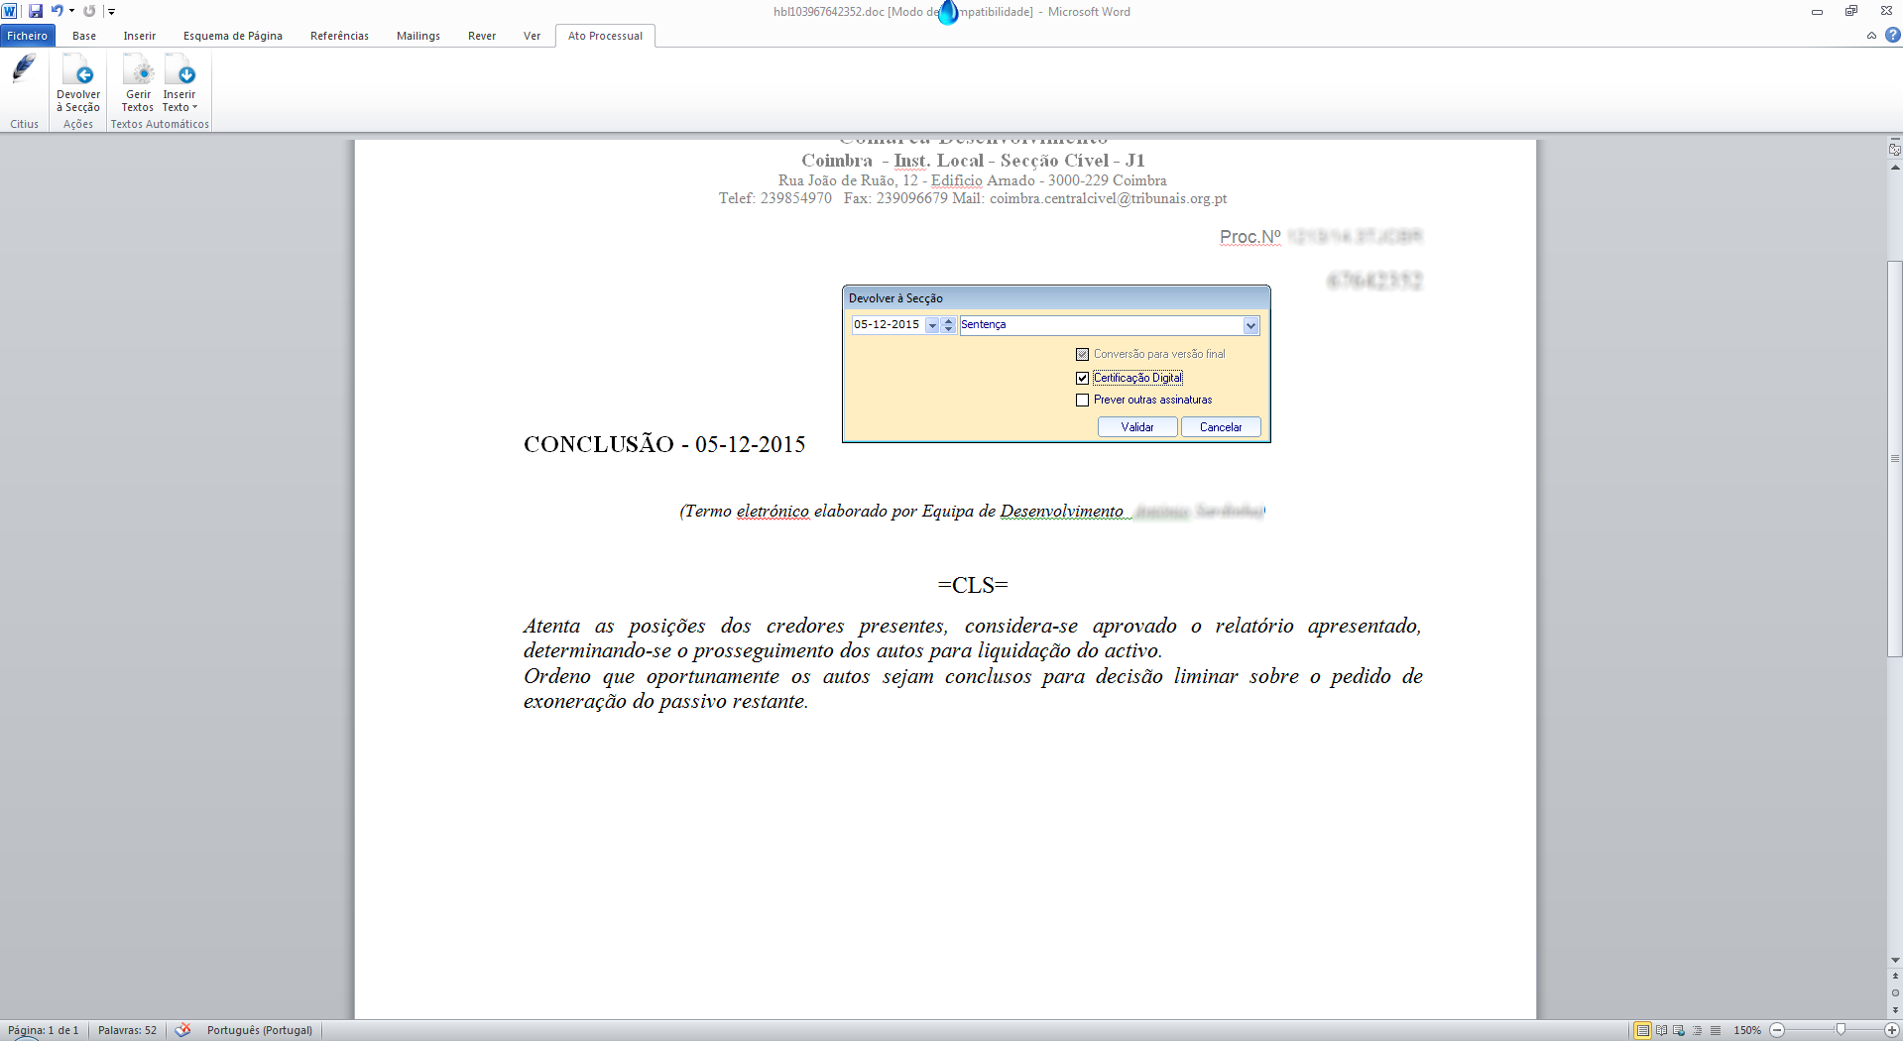
Desktop application : The judge returns it to the court secretary for notification
Notes:
Return of the case to the court secretary for the enforcement of the decision

Slide 23
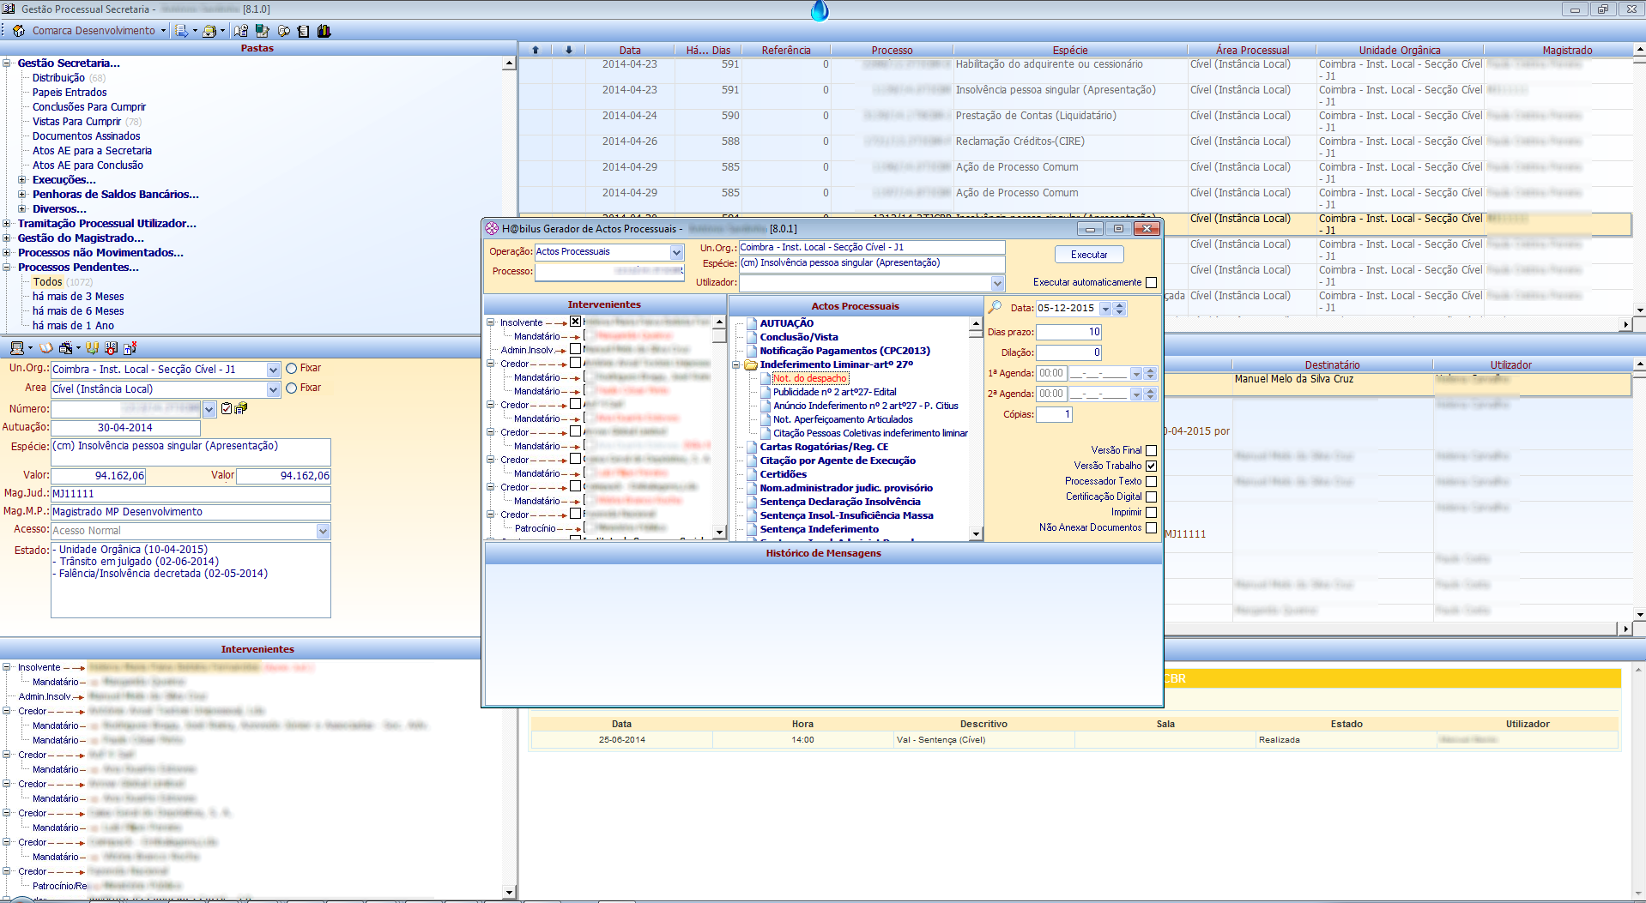
Desktop application : The court secretary enforces the decision
Notes:
The court secretary generates the procedural act

Slide 24
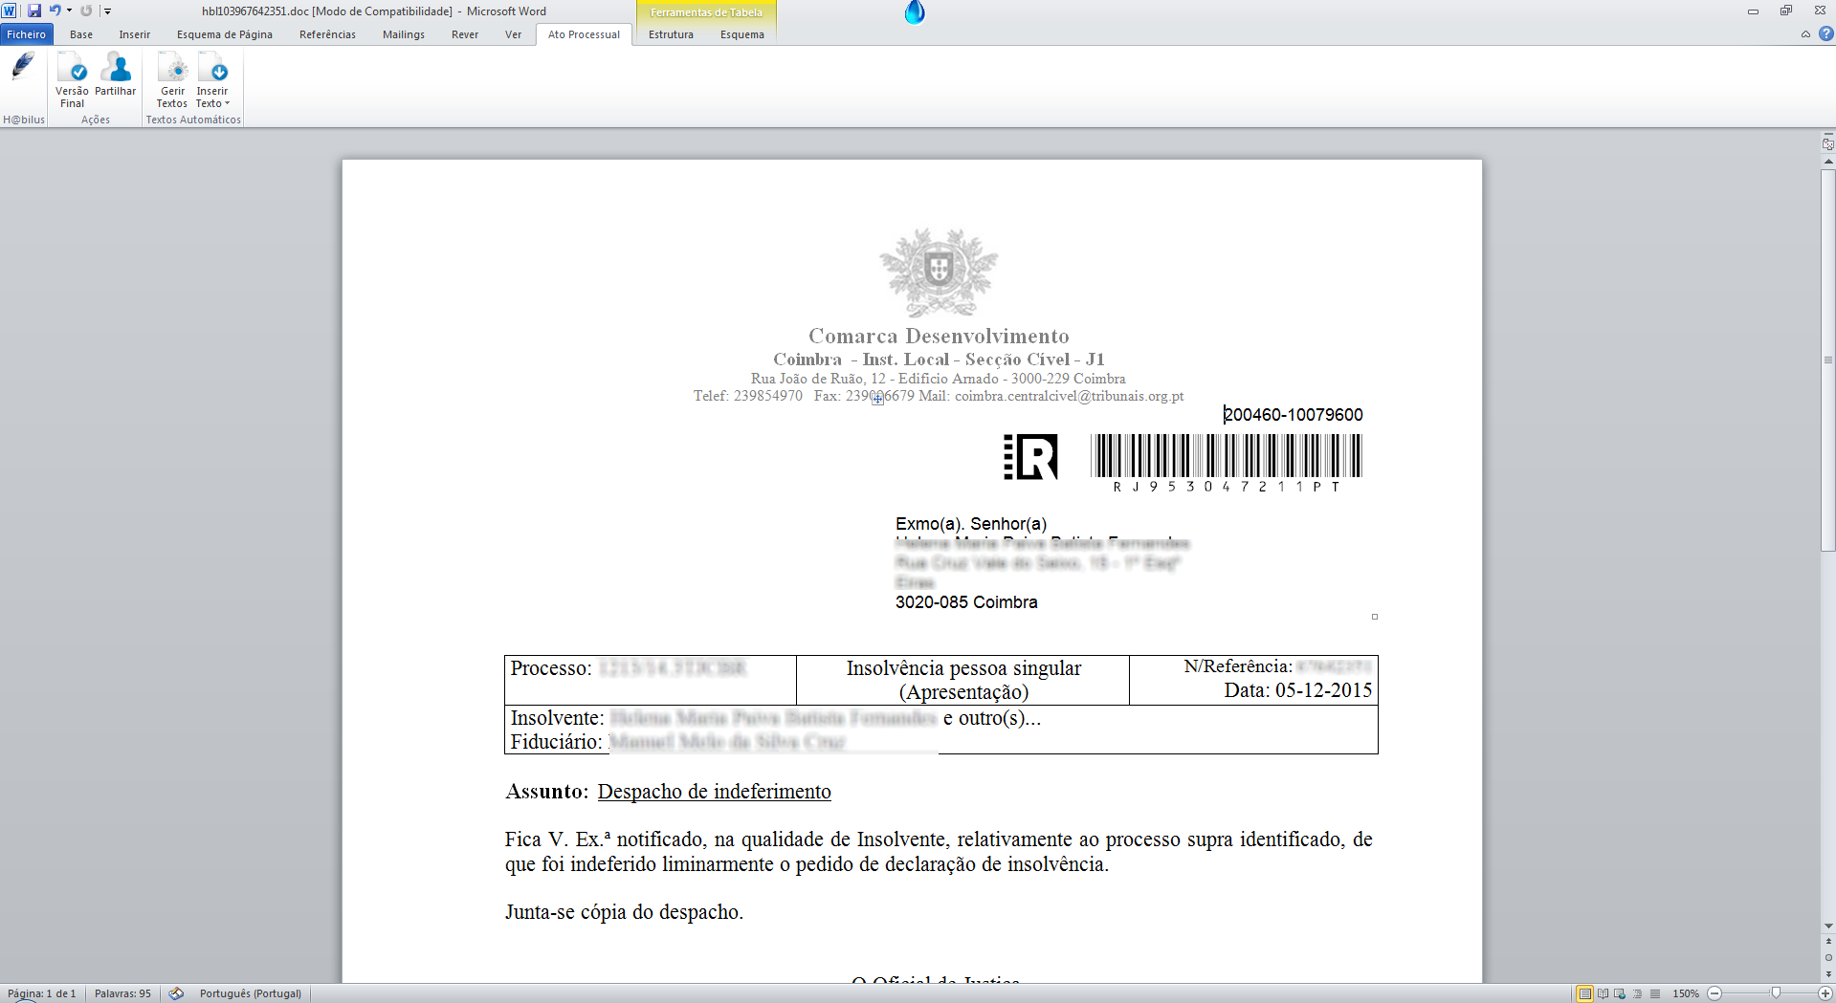
Desktop application : The court secretary generates the notification
Notes:
The court secretary enforces the decision (Add-in Word)

Slide 25
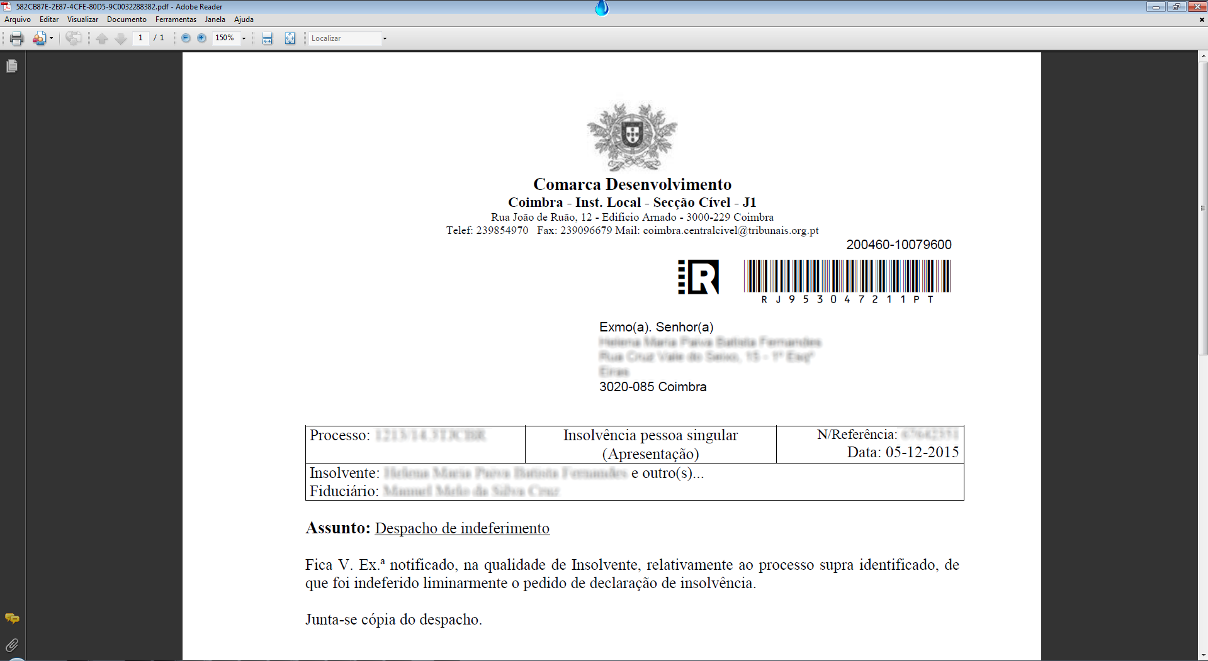
Desktop application : Notification’s final version
Notes:
The court secretary converts the document into its final version

Slide 26
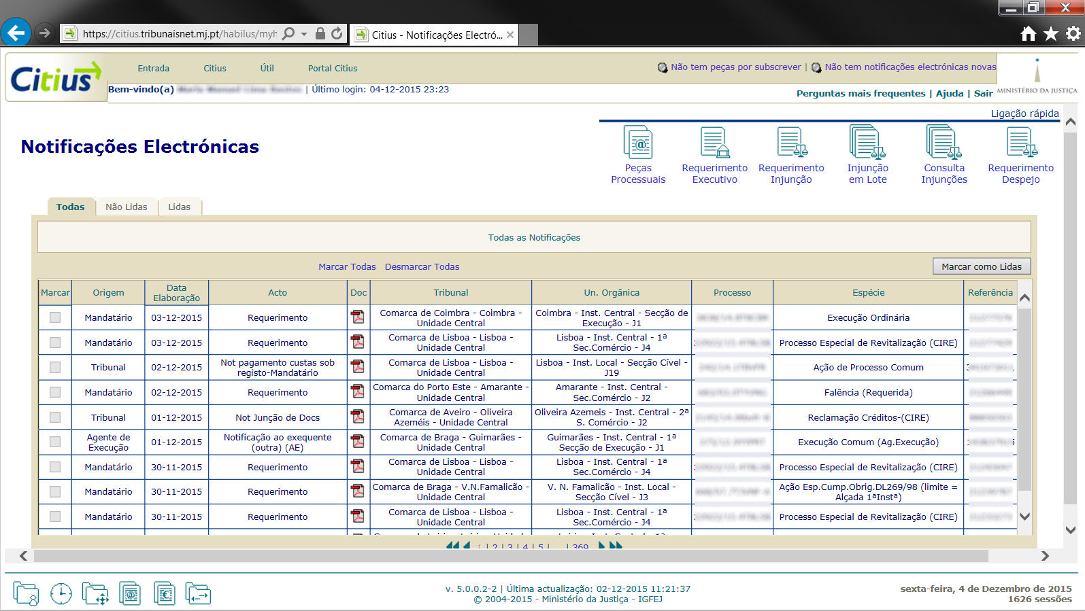
Web application : The lawyer is notified electronically
Notes:
Lawyers’ electronic notifications area (cases in which he is proxy)

Slide 27
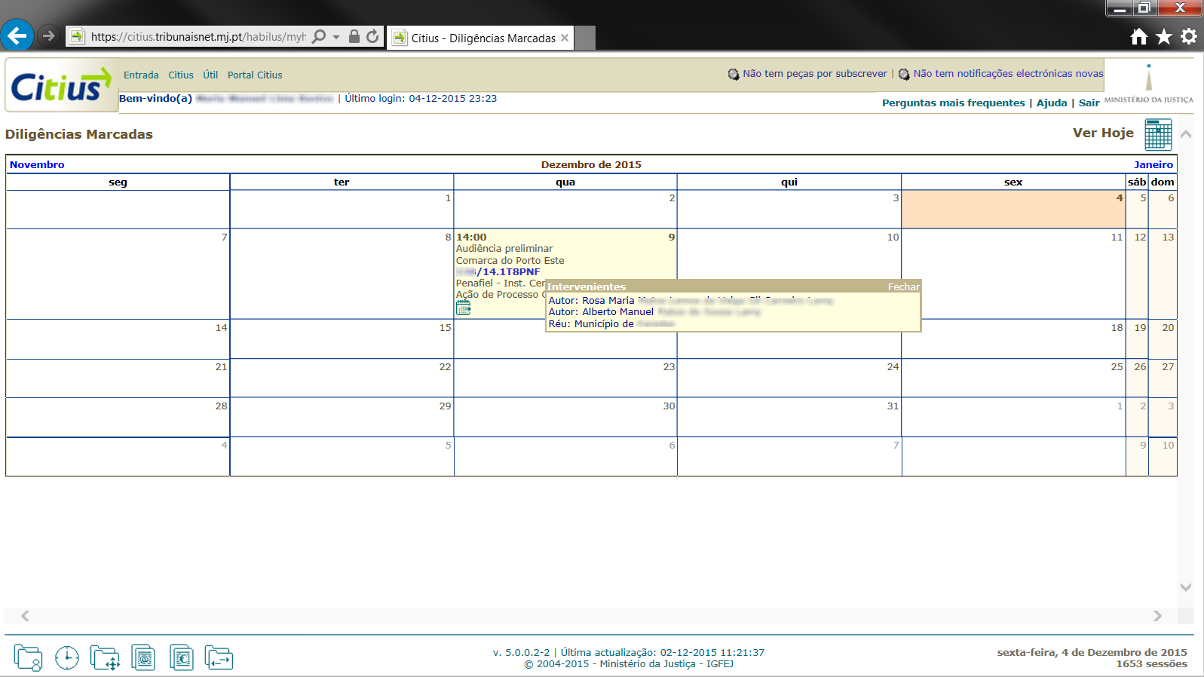
Web application : The lawyer consults his agenda
Notes:
Lawyers’ agenda (court diligences)

Slide 28
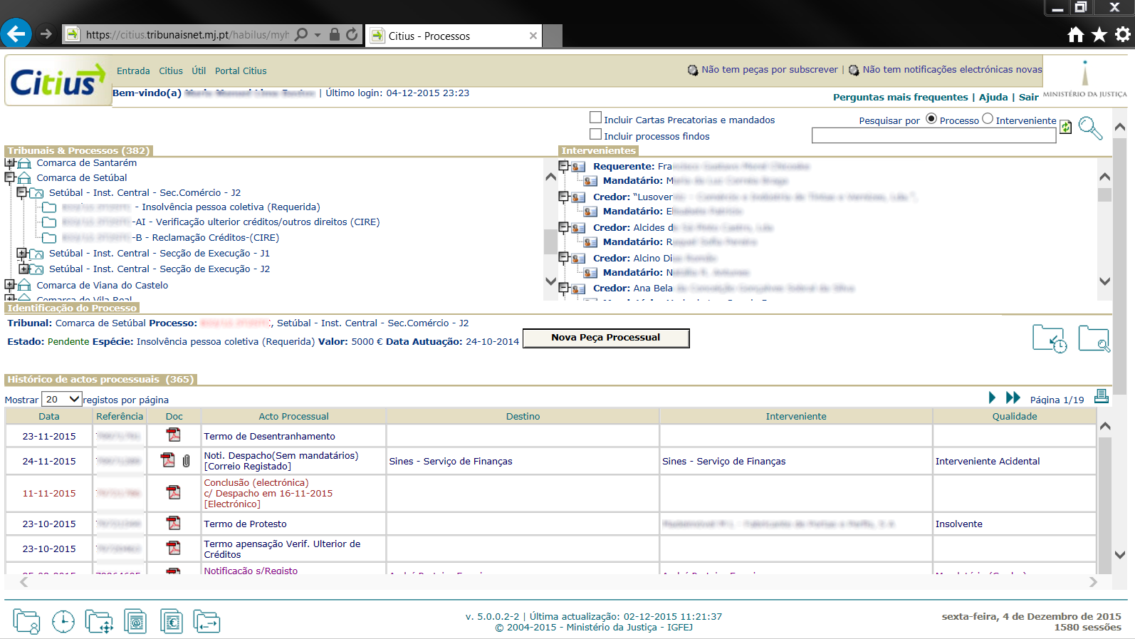
Web application : The lawyer consults the case
Notes:
Lawyer’s work area (consult of his cases)

Slide 29
Some figures
In the first nine months of 2015 (January 1 to September 30):
Cases distributed (considering the inquests): 818.199
Procedural documents delivered: 2.602.695
Electronic notifications issued: 5.702.425
Notes:
Excluding the inquests the number lowers by half.
The number of notifications in paper produced in the system (penal area, etc.) is not inferior

Slide 30
The next steps
Availability of the web application to the judicial administrators within the insolvency (pilot, awaiting completion of the legislative process);
Implementation of the electronic judicial certificate (online request and reception);
Strengthening of the integration with the Public Security Police (in the electronic reception of complaints and documents);
Notes:
Please click to add notes

Slide 31
The next steps
Integration with the tax authority (exchange of tax and judicial information);
Integration with the Registrations and Notary's (commercial area);
Strengthening integration with the social security (family and minors area).
Notes:
Please click to add notes

Slide 32
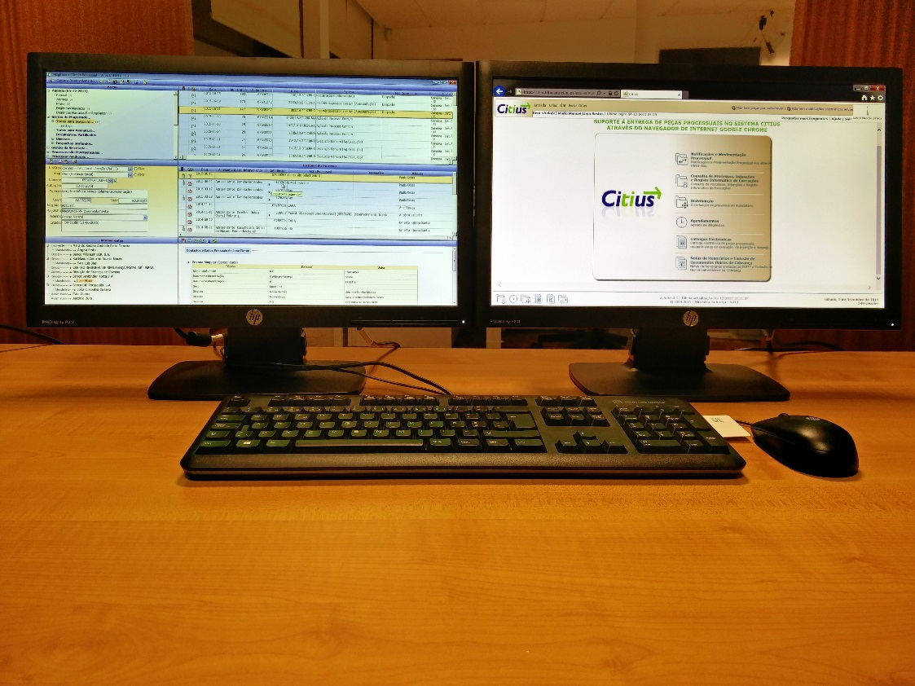
Thank you
Notes:
Please click to add notes

