Slide 1
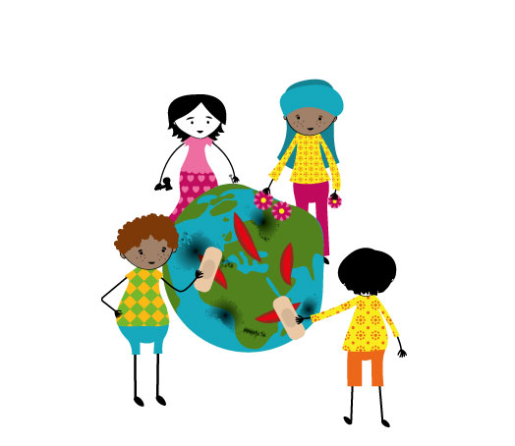
Universal declaration of Human Rights (UDHR)
1948
European Convention on Human Rights (ECHR)
1950
The Convention of the Rights of the Child (CRC)
1989

Slide 2
Universal declaration of Human Rights (UDHR)
“All human beings are born free and equal in dignity and rights. “
first time that it was articulated that these rights were for all people - regardless of age, sex, background etc, only because you are human.
= universal
all rights are equally important (= Indivisible)
You can not lose your right (=Inalienable).
Minimum standard for what it is to live in dignity as a human

Slide 3
Article 26
Everyone has the right to education.
sees children mainly as a group in society that needs extra protection
Article 25
Motherhood and childhood are entitled to special care and assistance. All children, whether born in or out of wedlock, shall enjoy the same social protection
Article 23
Everyone has the right to work, to free choice of employment, to just and favourable conditions of work and to protection against unemployment.

Slide 4
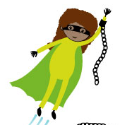
CRC!?
The UDHR sees children mainly as a group in society that needs extra protection, but the CRC adopted by the UN in 1989 sees children as rights-holders with their own human rights
Civil, cultural, economic, political and social rights to all children!
“Children have the right to a family, instead of families having the right to a child” (Hague Convention on Intercountry Adoption)
How do you say CRC in your own language?

