Slide 1
CERU
European Centre on Urban Risks
Activities developed in 2022
Activities planned to 2023
Manuel Ribeiro
(manuel.ribeiro@iseclisboa.pt; ceru.europa@gmail.com)
Paris – 17 and 18 November 2022

Slide 2
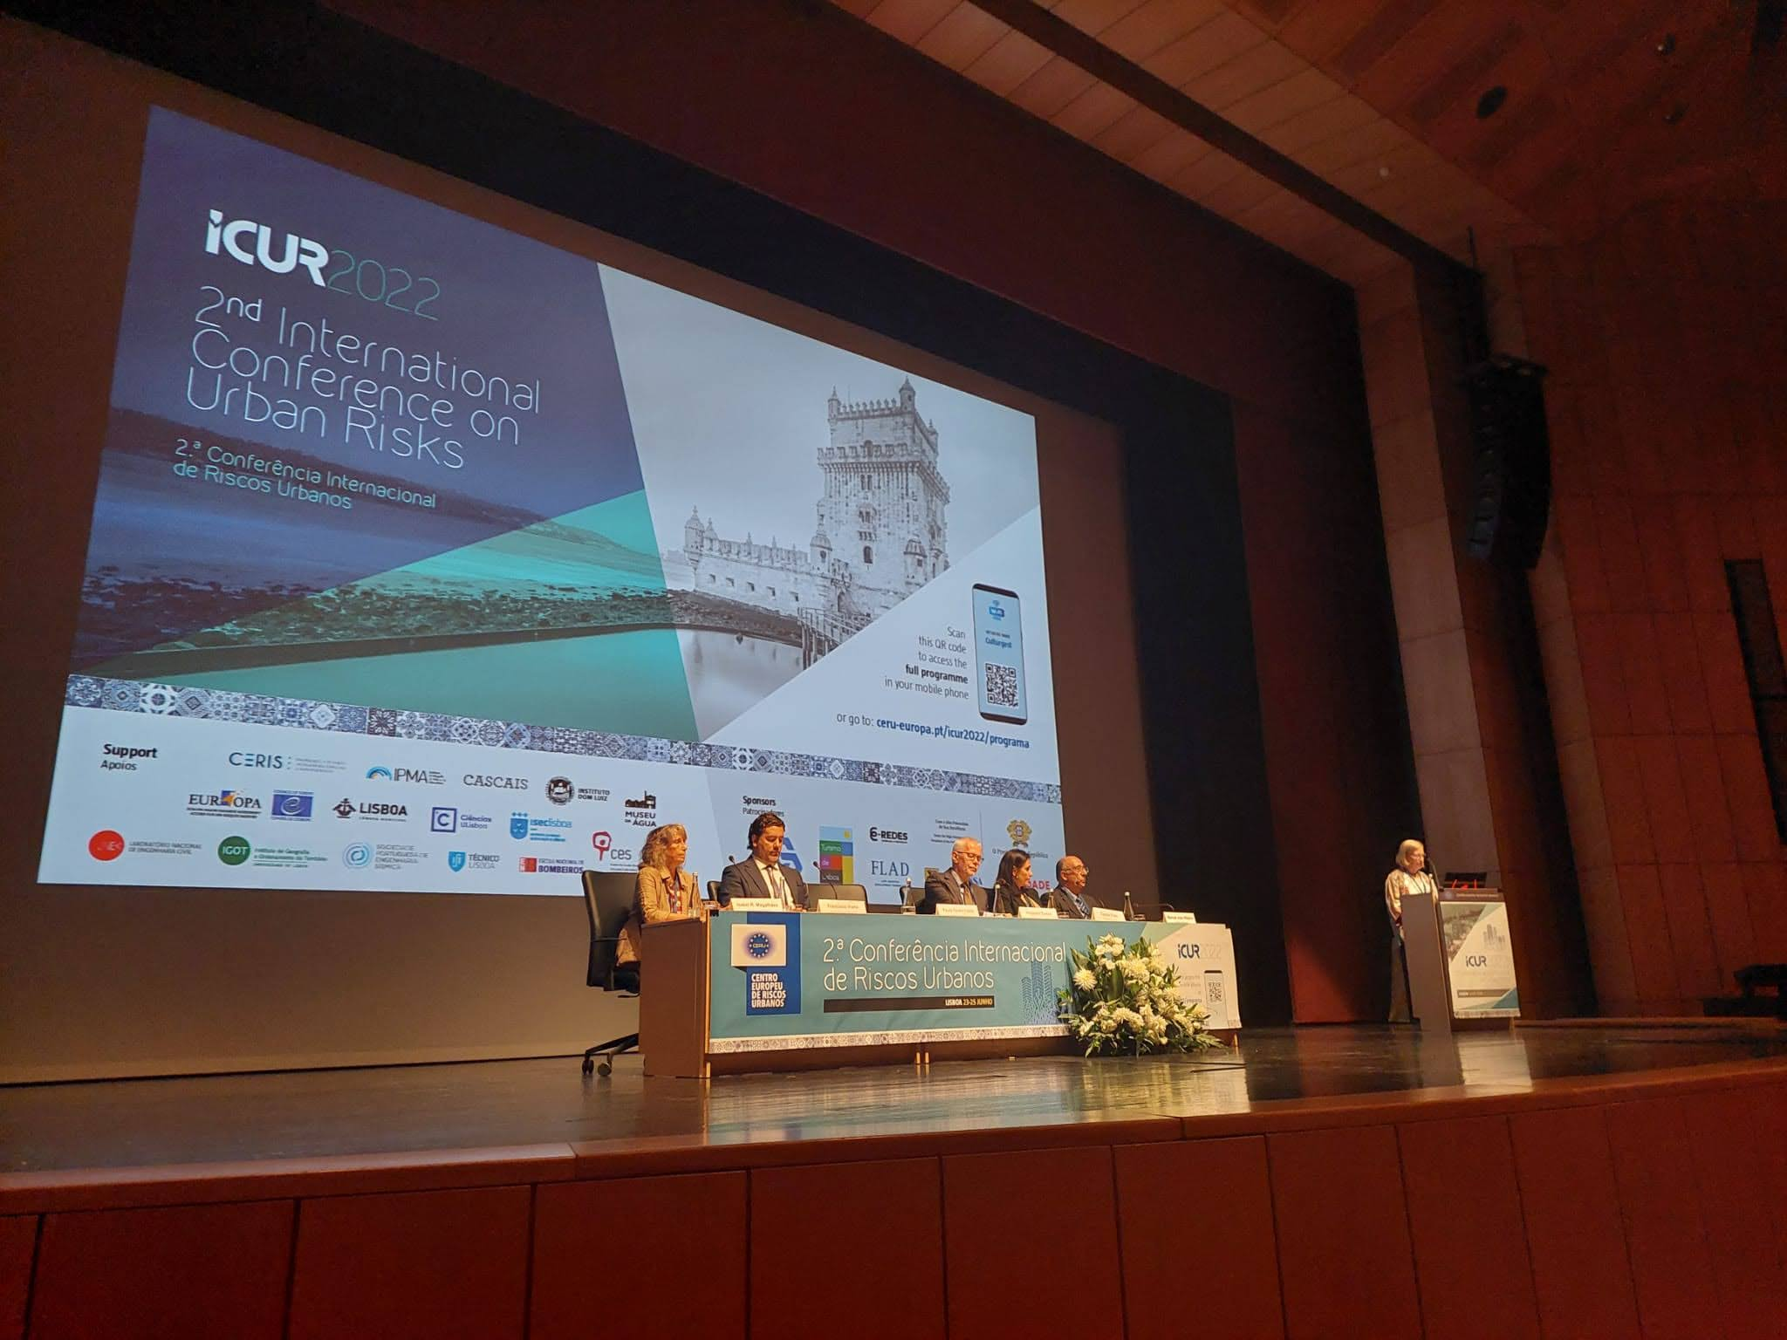
2nd International conference
on urban risks
ICUR 2022 – Lisbon 23-25 june

Slide 3
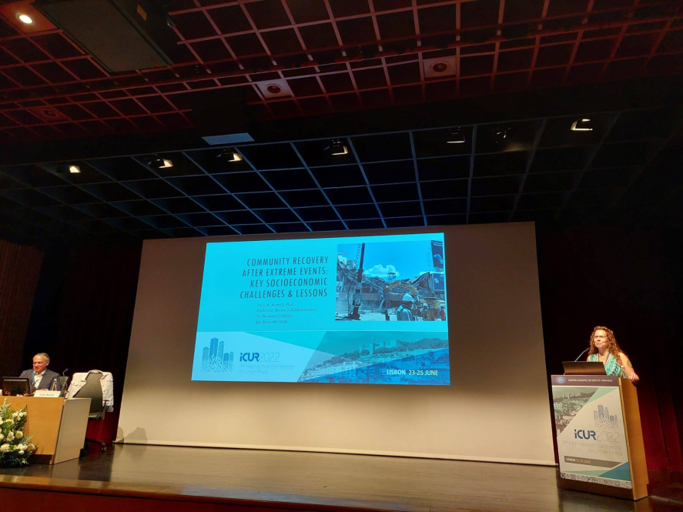
Topics
Results
Risk and emergency management
Urban risks induced by natural hazards
Critical infrastructures and cascading effects
Urban environmental health risks and sustainability
Risk protection on cultural heritage and historical centres
Societal risks in a changing world
Citizen engagement and risk communication
SS: Multi-hazard risk assessment for resilient and sustainable urban areas
100 participants (from 8 countries)
90 communications
4 keynote speakers
4 technical visits
https://www.ceru-europa.pt/icur2022/en

Slide 4
ProjeCt POPIRIM
Population involvement on risk management and mitigation
- Testing in small communities

Slide 5
goal of the project
POPIRIM – Population involvement on risk management and mitigation - Testing in small communities
Test public participation in governance and disaster risk reduction in different communities that present susceptibilities to one or more risks in different countries:
Portugal (CERU – Encosta da Luz, Odivelas)
France (CERG – City of Barcelonnette, South Alps)
Italy (CUEBC - Amalfi)

Slide 6
In Portugal it will be applied to a peripheral area of the city of Lisbon, (Serra da Luz, Odivelas),
Project POPIRIM

Slide 7
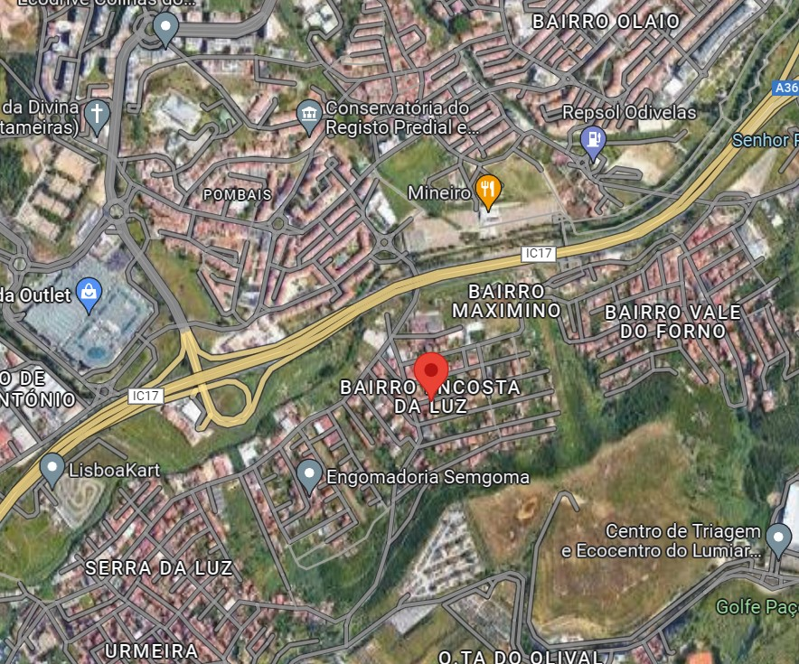
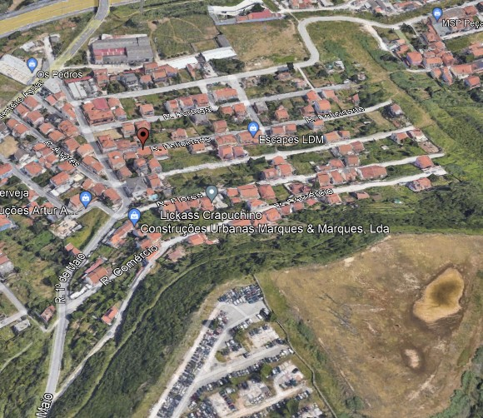
POPIRIM 2022
Odivelas
Area of Study
Pontinha
Loures
Fieldwork
Lisbon

Slide 8
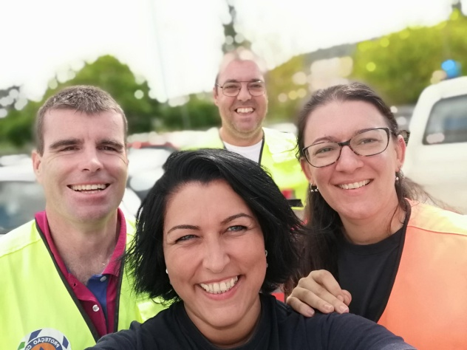
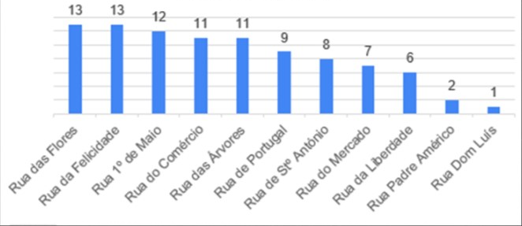
POPIRIM 2022
19 Sept 2022
to
24 Sept 2022
Fieldwork
Number of Questionnaires per Street

Slide 9
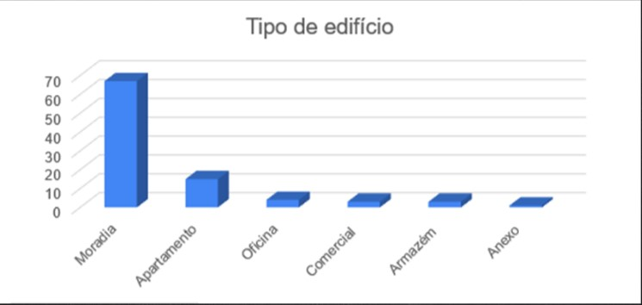
POPIRIM 2022
Results
Type of building
67
Type of buiding | %
T0 | 1,08
T1 | 4,30
T2 | 23,66
T3 | 45,16
T4 | 8,60
>T4 | 7,53
Comercial | 9,68
15
4
3
3
1

Slide 10
POPIRIM 2022
Results
Household equipment
97,8% of respondentes said they had:
Piped Water
Sanitation
Electricity
Bottle gas

Slide 11
POPIRIM 2022
Results
Knowledge about risks
- Landslides
- Fires
- Security (vandalism, thefts, drug trafficking, abandoned cars)

Slide 12
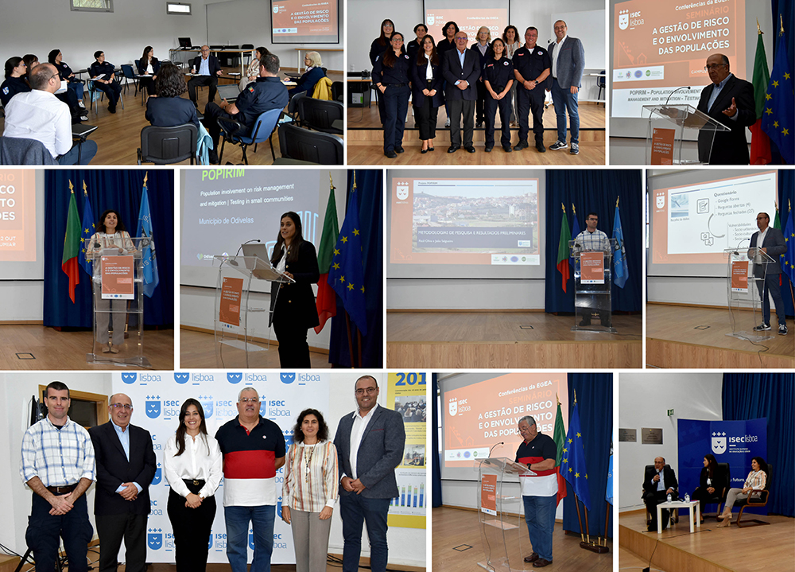
POPIRIM – Population involvement on risk management and mitigation - Testing in small communities
Lisbon – October 2022

Slide 13
Expected results - 2023
POPIRIM – Population involvement on risk management and mitigation - Testing in small communities
Definition of local mechanisms for public participation of residents in the management of their security, enhancing the creation of groups of volunteers to support the subsequent development of the project
Synchronization of the action of the Civil Protection local department, in order to develop a concerted intervention with the population of the studied areas, to identify the main risks and establish measures for their management – mitigation, reduction and elimination.
Training exercises for the population on the management of the main risks.

Slide 14
Schools against domestic and urban risks
SADUR
Coordinator Centre: CUEBC(Italy)
2022 CERU Developed activities:
Analysis of data on domestic accidents at national level in Portugal (explosions, fires, poisoning by gas)
Updating and maintenance of the Urban Risks webpage developed for a pilot municipality. Inclusion of domestic accidents
Participation in videoconferences promoted by the coordinator centre
Project presentation and awareness sessions on domestic accidents in selected schools

Slide 15
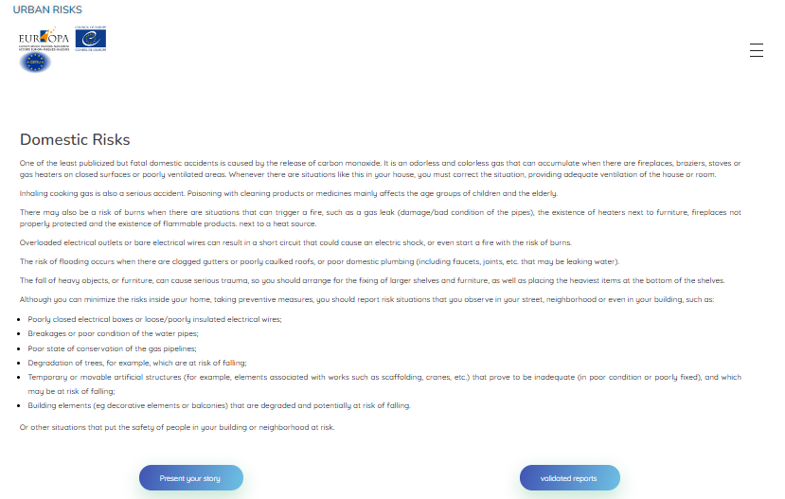
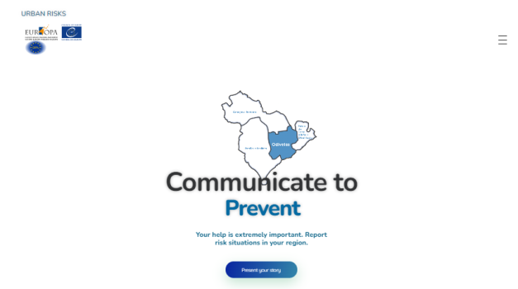
Schools against domestic and urban risks
SADUR
Update of the Urban Risks webpage: Inclusion of domestic accidents
Analysis of data on domestic accidents:
Classification / selection of domestic accidents occurences
Data compilation for two different councils
Comparison of data considering the different demographic conditions of the two councils (still in progress)
Description
Enhancing household hidden risks

Slide 16
Schools against domestic and urban risks
SADUR
2023 CERU Planned activities:
Project presentation and awareness sessions on domestic accidents in selected schools
Contribution to finalize the Detection of Hidden Household Risks Manual (DHDR)
Manual
Participation in Video conference and conference promoted by the coordinator centre

