Slide 1
RECENT SEISMIC ACTIVITY IN NORTHERN MOROCCO by: Nacer Jabour CEPRIS - Rabat - Morocco

Slide 2
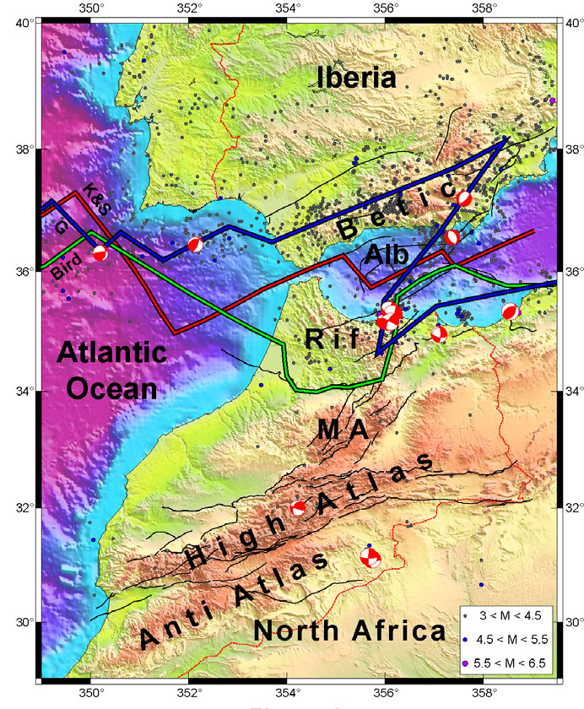
STRAIT OF
GIBRALTAR
TECTONIC
PLATES BOUNDARIES
K&S; Klitgord & Schouten (1986)
G; Gutscher (2004)
Bird (2003)
(In Fadil et al. 2006)

Slide 3
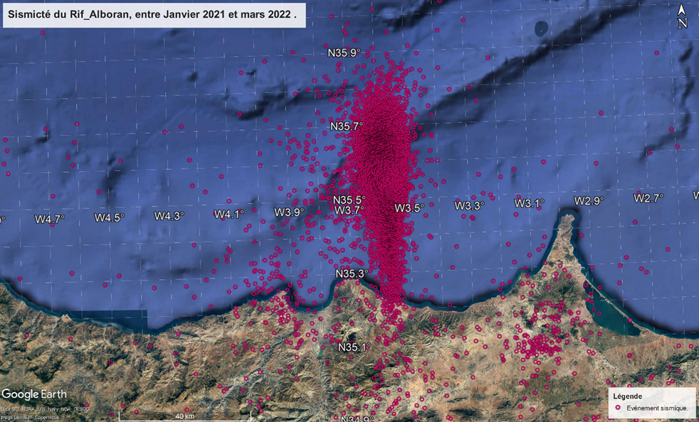
SEISMIC ACTIVITY RECORDED BETWEEN JANUARY 2021 AND MARSH 2022
Notes:
AND

Slide 8
ALHASSAN ALMARRAKCHI VESSEL ROAD MAP – 7 SAMPLING PROFILES

Slide 9
ALHASSAN ALMARRAKCHI VESSEL

Slide 10
SAMPLES FROM THE SEA BOTTOM

Slide 11
IN SITU RECORDS CONTROL

Slide 12
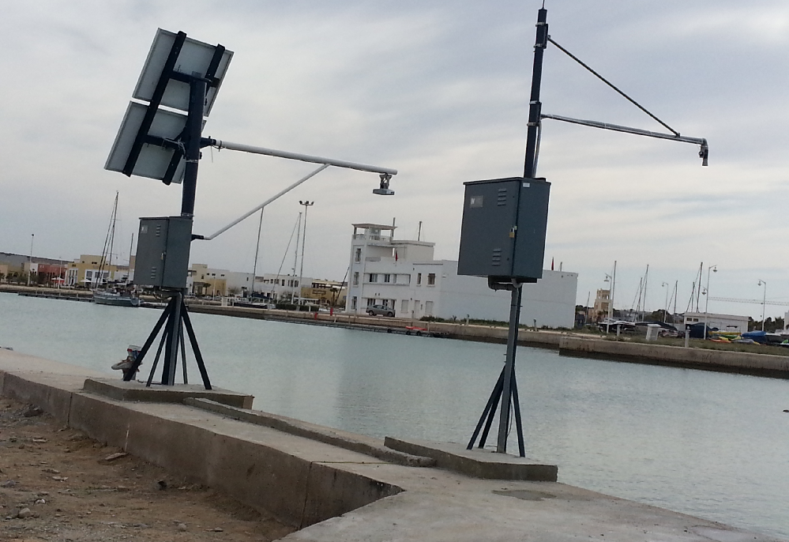
TIDE GAUGES IN SAIDIA MARINA

Slide 13
RISING TSUNAMI AWARNESS AMONG CIVIL PROTECTION TEAMS

