Slide 1
USER MANUAL
BASICS
How to login/logout
Description of the home page
Campaigns: definition and concepts
Content of the questionnaire dashboard
Sorting and filtering a table
Display a section
Record answers in a section
Functions of the different tabs
Validation of the answers
Status of a section
Automatic discrepancy control
Export Data
HOW TO FILL
THE ANSWERS
OTHER

Slide 2
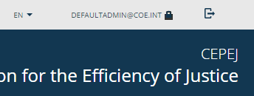
HOW TO LOGIN/LOGOUT
THE LOGIN BUTTON CAN BE
FIND IN THE UPPER PART OF THE SCREEN
← MAIN MENU
1 | CLICK HERE TO LOGIN
2 | LOG OUT
YOUR EMAIL ACCOUNT HAVE TO BE RECORDED IN THE CoE DATABASE TO ALLOW YOU AN ACCESS
YOU CANNOT USE THE CREDENTIALS OF ANOTHER PERSON TO ACCESS TO CEPEJ-COLLECT – REQUEST OTHER ACCESS CODES IF NEEDED
CONTACT THE CEPEJ SECRETARIAT FOR ANY ISSUE

Slide 3
DESCRIPTION OF THE HOME PAGE
← MAIN MENU
ACCESS TO THE AVAILABLE CAMPAIGNS
USER MANUAL DOCUMENTATION
LOG OUT
EDIT CURRENT USER DETAILS
HOME PAGE
ACCESS
EXPORT DATA MENU ACCESS
SWITCH BETWEEN
LANGUAGES (EN/FR)
DIRECT ACCESS TO THE ALREADY RUNNING CAMPAIGNS

Slide 4
CAMPAIGNS: DEFINITION AND CONCEPTS
← MAIN MENU
THE CAMPAIGNS CONTAIN THE QUESTIONS THAT NEED TO BE ANSWERED. AS A USER, YOU CAN ACCESS THE CAMPAIGNS THAT YOU HAVE BEEN INVITED TO PARTICIPATE TO.
STATUS : IN PROGRESS → A CAMPAIGN THAT IS ACTIVE, FOR WHICH YOU CAN FILL THE QUESTIONNAIRE
STATUS : COMPLETED → A CAMPAIGN THAT IS FINISHED, FOR WHICH YOU CAN SEE THE ANSWERS YOU HAD PROVIDED
FOR SORTING OR FILTERING DIFFERENT CAMPAIGNS SEE TABLE SORTING AND FILTERING
CLICK ON THE LINE TO ACCESS THIS CAMPAIGN’S QUESTIONNAIRE DASHBOARD

Slide 5
SORTING AND FILTERING A TABLE
← MAIN MENU
CLICK ON A COLUMN TITLE TO SORT
USE THE DROP DOWN MENU TO FILTER
TYPE AND PRESS "ENTER" TO FILTER

Slide 6
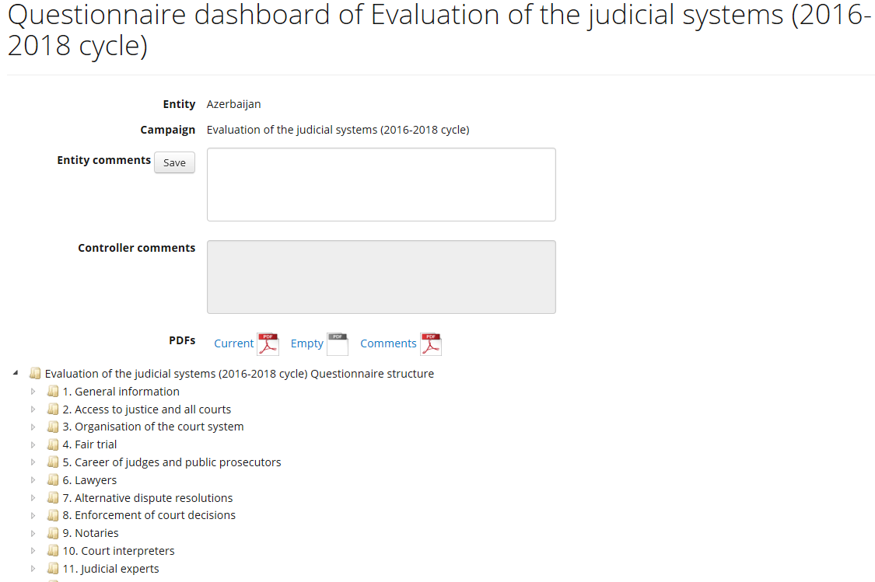
CONTENT OF THE QUESTIONNAIRE DASHBOARD
← MAIN MENU
YOUR COMMENTS AND COMMENTS HISTORY
THIS AREA COULD BE USED TO EXCHANGE
GENERAL INFORMATION ABOUT THE CAMPAIGN WITH THE CEPEJ SECRETARIAT
COMMENTS FROM THE CEPEJ SECRETARIAT
PDFs DOWNLOADS:
Questionnaire with your current answers
Empty questionnaire without your answers
Questionnaire with comments
CLICK ON A CHAPTER TO DISPLAY ITS SECTIONS (CONTINUED ON THE NEXT PAGE)

Slide 7
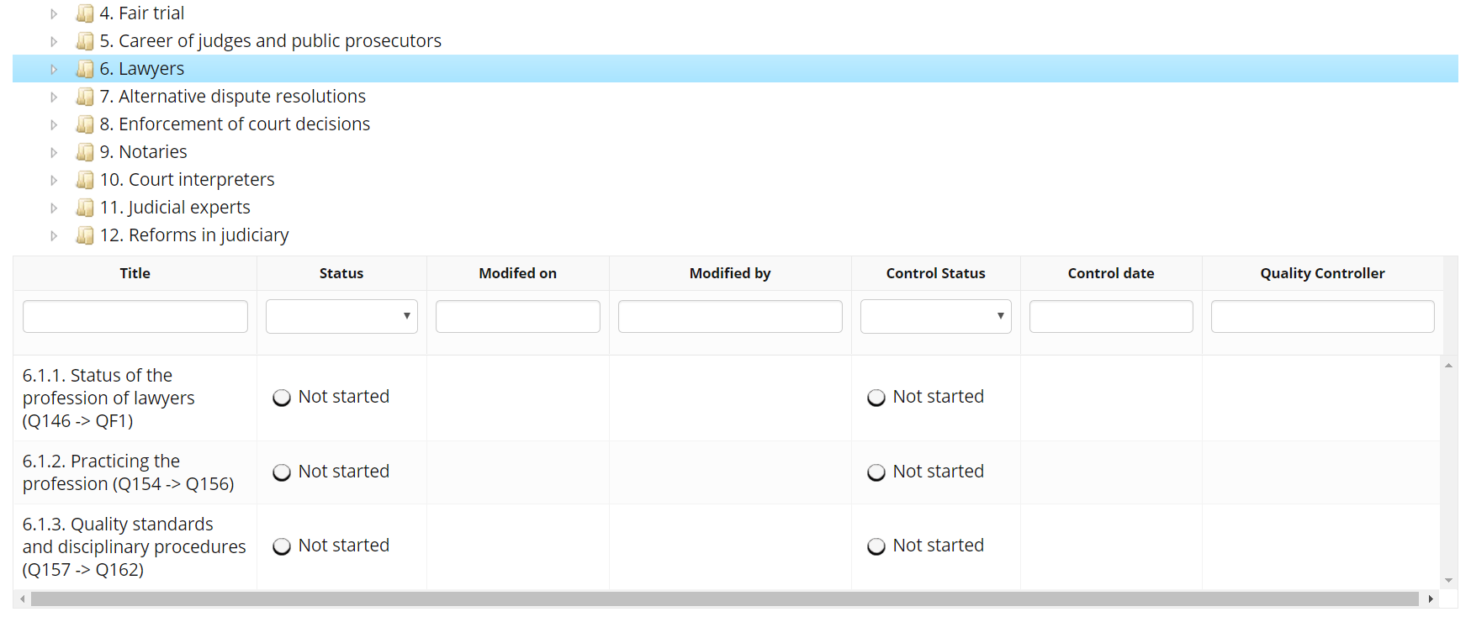
DISPLAY A SECTION
A SECTION CONTAINS SEVERAL QUESTIONS (SHOWN BETWEEN BRACKETS WITH « Qxxx -> Qxxx»)
← MAIN MENU
CLICK ON CHAPTER TO DISPLAY ITS SECTIONS BELOW
STATUS OF THE QUALITY CONTROL OF THE CEPEJ SECRETARIAT
STATUS OF YOUR ACTIVITY IN THIS SECTION
CLICK ON ANY ROW TO ENTER THAT SECTION AND ANSWER ITS QUESTIONS

Slide 8
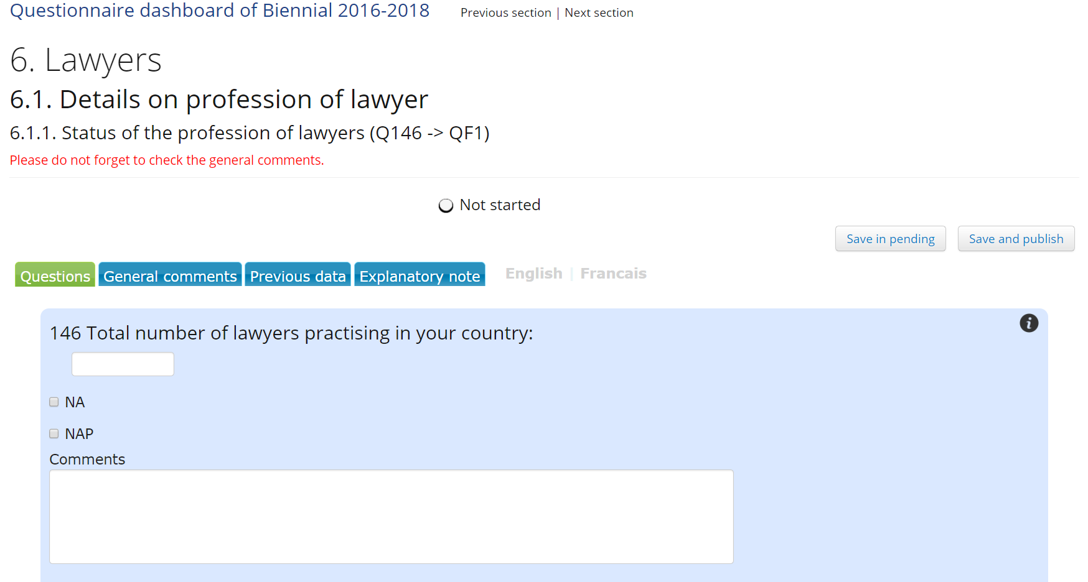
RECORD ANSWERS IN A SECTION
4 | Links to navigate in the questionnaire
3 | Save your answers
← MAIN MENU
BACK TO QUESTIONNAIRE DASHBOARD
NAVIGATE BETWEEN SECTIONS
SAVE CURRENT PROGRESS
Use “Save in pending” if you are not finished answering to all questions. All your work will be saved but not send to the CEPEJ Secretariat.
STATUS OF YOUR ACTIVITY IN THIS SECTION
PUBLISH YOUR ANSWERS FOR VALIDATION
Use “Save and publish” to send officially your answers to the CEPEJ Secretariat.
NO CHANGE IS POSSIBLE AFTER THAT ACTION.(until quality control)
1 | Choose which tab to display
Green tab is the selected one
Blue tabs are the other options available
SWITCH LANGUAGE
INDICATOR OF “LINKED QUESTION”
A question in a campaign could be linked to another campaign. For example, the questions in the framwork the EC Scoreboard could be linked to the questions for the biennial CEPEJ report.
IF YOU ANSWER TO THAT QUESTION IN ONE CAMPAIGN, ITS ANSWERS ARE AUTOMATICALLY COPIED OVER TO THE OTHER CAMPAIGN, UNLESS THIS QUESTION IS ALREADY PUBLISHED IN THE OTHER CAMPAIGN..
2 | Answer the question(s)
It is mandatory to enter an answer for all the questions (a value or NA or NAP, according to the context).

Slide 9
VALIDATION OF THE ANSWERS
← MAIN MENU
EXPLANATIONS ABOUT HOW TO ANSWER THE QUESTIONS
THE OTHER TABS :
COMMENTS FOR EACH QUESTION, THEY NEED TO BE FILLED
ACCESS TO ANSWERS PROVIDED TO THE PREVIOUS CYCLE QUESTIONNAIRE
IF A SECTION IS CONTROLLED AS BEING NOT VALID, YOU WILL FIND THE CEPEJ SECRETARIAT COMMENTS AT THE BOTTOM OF THE PAGE
SECTION STATUS WHEN MARKED AS NOT VALID:
LAST CEPEJ SECRETARIAT COMMENT
ACCESS TO ALL CEPEJ SECRETARIAT COMMENTS

Slide 10
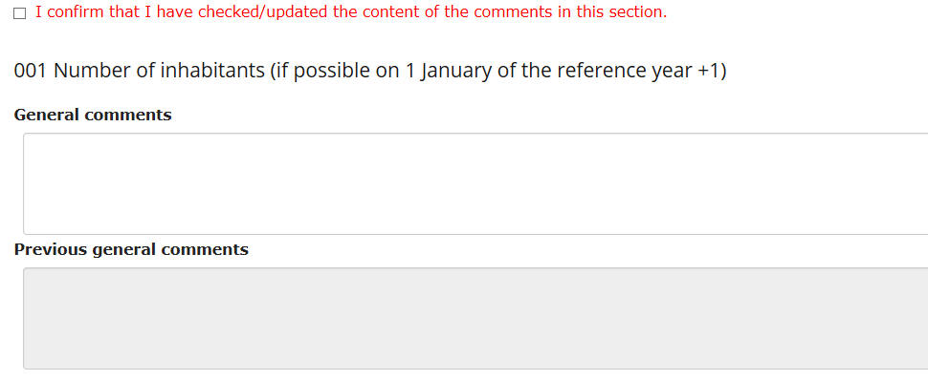
FUNCTIONS OF THE DIFFERENT TABS
EXPLANATIONS ABOUT HOW TO ANSWER THE QUESTIONS
← MAIN MENU
THE OTHER TABS :
THE SELECTED TAB APPEARS IN GREEN
ACCESS TO THE ANSWERS PROVIDED FOR THE PREVIOUS CYCLE QUESTIONNAIRE
COMMENTS RELEVANT TO ALL CYCLES HAVE TO BE PROVIDED
IN “GENERAL COMMENTS” TAB.
“CONFIRM checkbox” THIS BOX MUST BE CHECKED WHEN YOU WANT TO SAVE AND PUBLISH THE ANSWERS
(to secure that comments were reviewed)
“PREVIOUS GENERAL COMMENTS” SHOWS THE PREVIOUS GENERAL COMMENTS RECORDED DURING THE PREVIOUS CAMPAIGN

Slide 11
AUTOMATIC DISCREPANCY CONTROL
DISCREPANCY CONTROL : WHEN THE ANSWER PROVIDED VARIES TOO MUCH COMPARED TO THE PREVIOUS CAMPAIGN’S ANSWER TO THE SAME QUESTION THE APPLICATION WILL ASK YOU TO CORRECT YOUR ANSWER OR TO ADD A COMMENT TO EXPLAIN THE DISCREPANCY
← MAIN MENU
THIS MECHANISM IS AIMED AT CATCHING DATA ENTRY MISTAKES OR TYPOS, AND TO HELP EXPLAINING SPECIFIC CASES WHERE THE NUMBERS HAVE EVOLVED SIGNIFICANTLY FROM ONE YEAR TO THE OTHER.
1 | ENTER A VALUE
2 | IF THE DISCREPANCY MECHANISM IS ACTIVATED, THIS VALUE WILL BE CHECKED DURING THE SAVING
3 | IF THE DISCREPANCY IS TOO IMPORTANT, THE DISCREPANCY COMMENT BOX WILL APPEAR AFTER YOU “SAVE AND PUBLISH” FOR YOU TO ADD AN EXPLANATION
YOU CAN EITHER MODIFY THE VALUE, OR ENTER A COMMENT
BEFORE SAVING AND PUBLISHING YOUR ANSWER AGAIN

Slide 12
STATUS OF A SECTION
SECTION STATUS
(National Correspondent side)
CONTROL STATUS
(CEPEJ quality control side)
← MAIN MENU
NOT STARTED – no data entry has been initiated by NC
NOT STARTED – data still not posted by NC and quality control did not start yet
IN PROGRESS – after data has been saved (using “save in pending”). The data entry is still in progress.
TO BE CONTROLLED – data posted by NC but quality control did not start yet
POSTED –using “save and published”. Data entry is finalised by NC and locked (ready for quality control)
?
PENDING – quality control is in progress
POSTED WITH DISCREPANCIES – same as above but some data contains discrepancies with previous cycle
IN PROGRESS – after data has been posted and then invalidated during quality control.
NOT VALID –quality control asked for correction or explanation on data
VALIDATED – data are validated by the CEPEJ Secretariat quality control (finished)
VALIDATED – data are validated by the CEPEJ Secretariat quality control (finished)
CEPEJ-COLLECT USER MANUAL

Slide 13
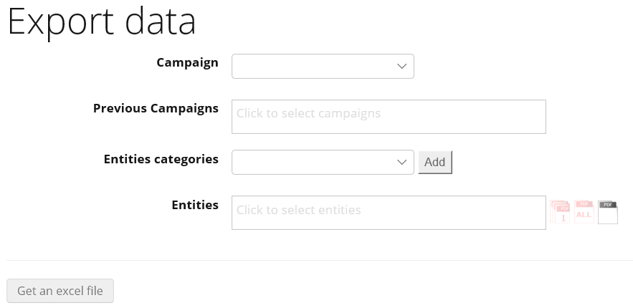
EXPORT DATA
← MAIN MENU
SELECT THE CAMPAIGN YOU WANT TO EXPORT DATA FROM
PARENT CAMPAIGNS OF THE SELECTED CAMPAIGN
SELECT ENTITY CATEGORY TO ADD ALL ENTITIES BELONGING TO THIS GROUP
DOWNLOAD PDF OF COUNTRIES
ANSWERS : ONE COUNTRY PER PDF
DOWNLOAD PDF OF COUNTRIES ANSWERS : ALL COUNTRIES IN THE SAME PDF
DOWNLOAD PDF OF THE CURRENT QUESTIONNAIRE OF THE SELECTED CAMPAIGN WITHOUT COUNTRIES ANSWERS
CLICK HERE TO DOWNLOAD THE EXCEL FILE CONTAINING THE SELECTED DATA
SELECT ENTITIES
TO EXPORT ANSWERS FOR
A USER CAN EXPORT DATA FOR HIS OWN ENTITY FOR ALL IN PROGRESS CAMPAIGNS, BUT WILL ONLY BE ABLE TO EXPORT DATA FOR OTHER ENTITIES FOR COMPLETED CAMPAIGNS.

