Slide 1

Engaging Learners’ Plurilingual and Pluricultural Competence in Secondary and Tertiary Language Classrooms
Angelica Galante

Slide 2

Engaging Learners’ Plurilingual and Pluricultural Competence
Outline
The repertoire
Plurilingual and pluricultural competence
3 Research projects in language classrooms
Photo created by drobotdean - www.freepik.com
Using CEFRCV descriptors to develop language tasks
Working groups in breakout rooms
Pre-tasks and wrapping up

Slide 3

Engaging Learners’ Plurilingual and Pluricultural Competence
Target Language
In language programs, students’ repertoires
are often reduced to the target language only
Photo copyright free from Freepik

Slide 4
Engaging Learners’ Plurilingual and Pluricultural Competence
English
Spanish
This is Zuco
French
Quechua
Mandarin
Photo copyright free from Freepik
Language Education has recently witnessed a multi/plural turn, which requires an inclusive and integrated view of language.
(Cenoz & Gorter, 2013; Kubota, 2016; Lin, 2020; May, 2014; Ortega, 2014; Piccardo, 2020)

Slide 5

Engaging Learners’ Plurilingual and Pluricultural Competence
body
cultures
languages
varieties
semiotic resources
multimodality
Photo copyright free from Freepik Video by Pixabay.com

Slide 6
Engaging Learners’ Plurilingual and Pluricultural Competence
The importance of plurilingualism in Language Education can be seen in the recent explosion of conference presentations, webinars hosted by educational organizations, and publications.

Slide 7
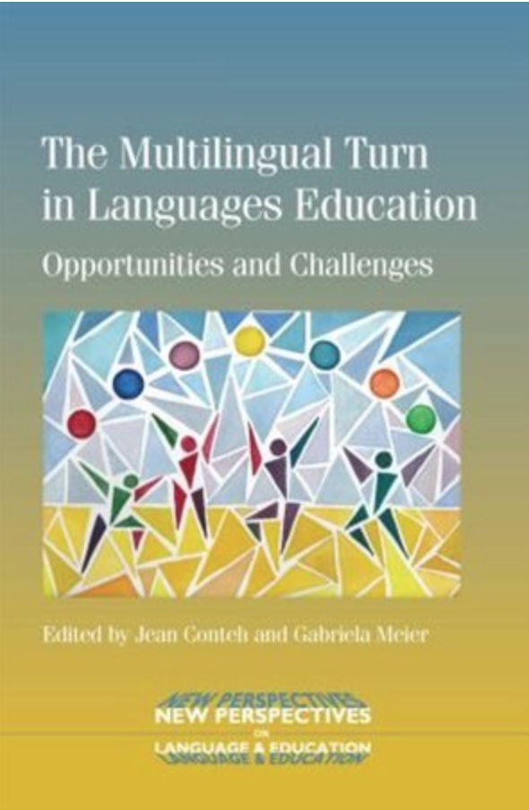
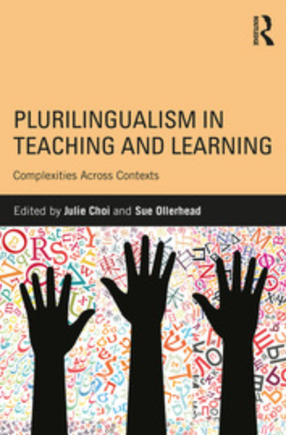

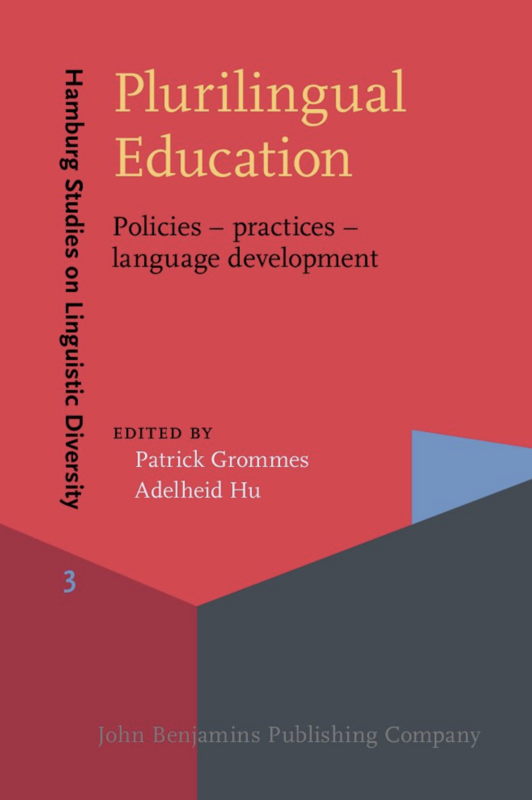
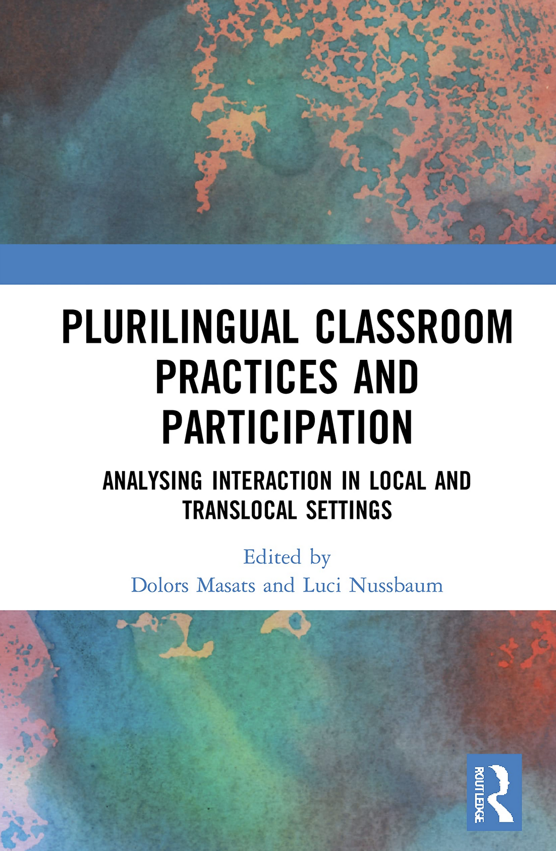
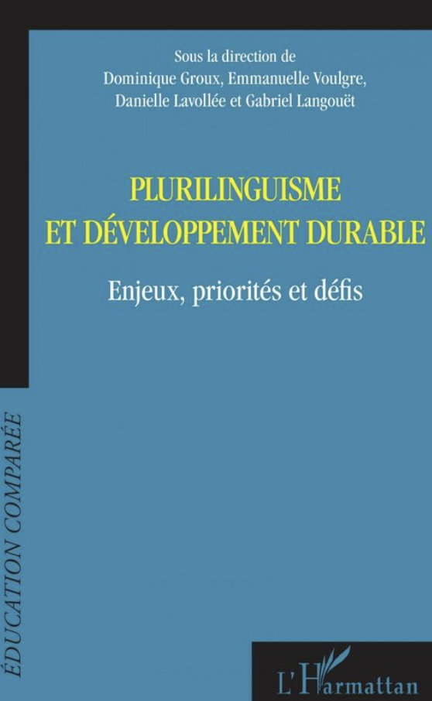
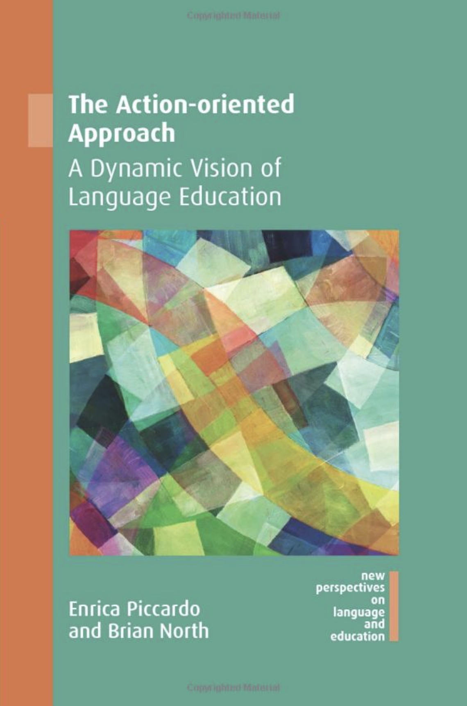



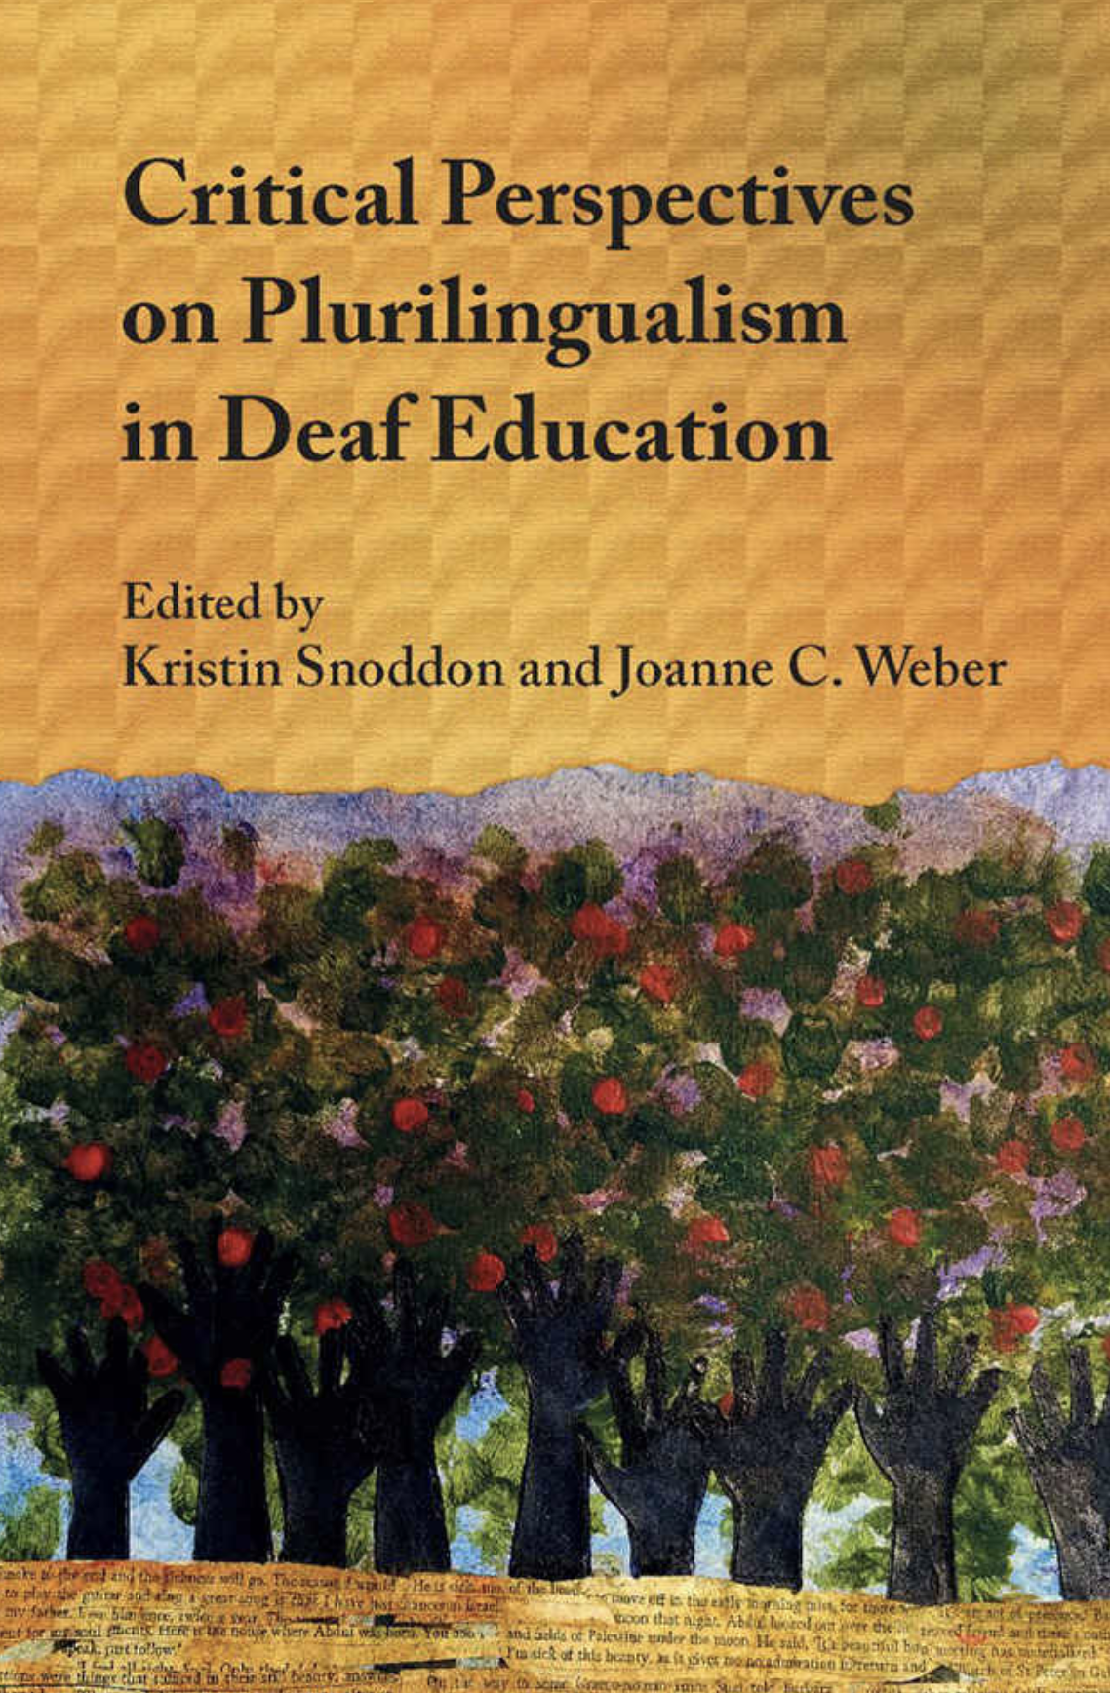

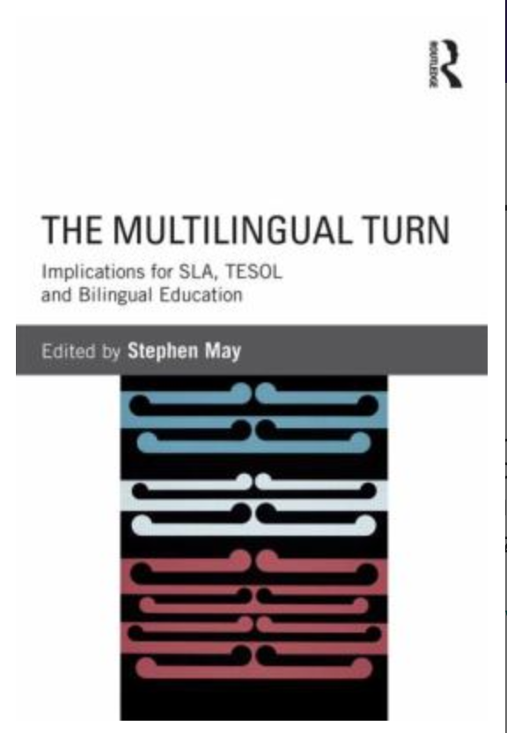

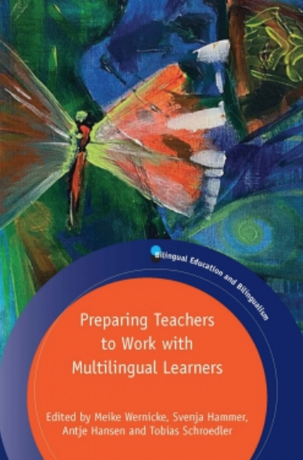
Engaging Learners’ Plurilingual and Pluricultural Competence

Slide 8
Engaging Learners’ Plurilingual and Pluricultural Competence
Plurilingualism
Introduced by Council of Europe studies in the 1990s, which helped inform the CEFR.
Core concept in the CEFR (2001) and the CEFRCV (2020).
The repertoire is a key concept of plurilingualism.

Slide 9
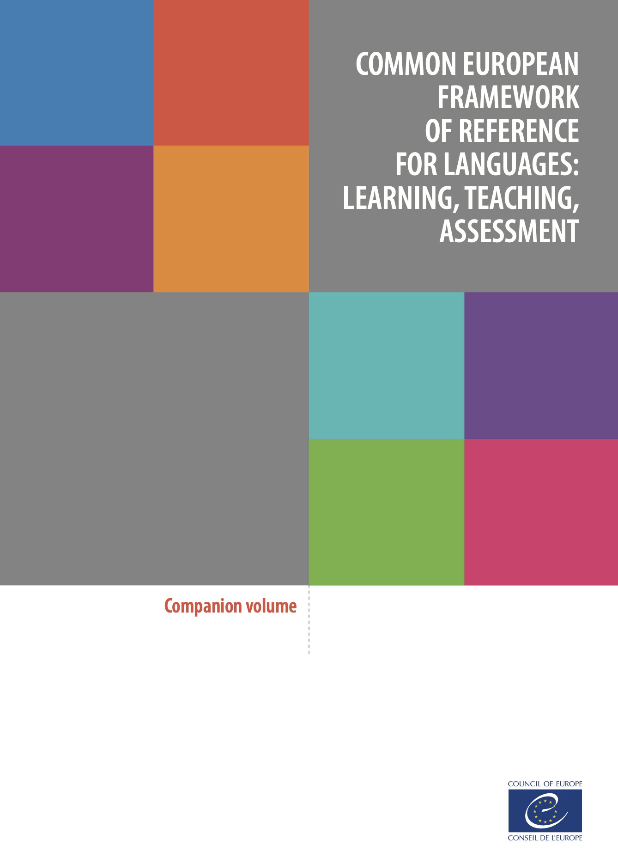
Engaging Learners’ Plurilingual and Pluricultural Competence
Plurilingual and Pluricultural Competence
“Ability to call flexibly upon an interrelated, uneven, plurilinguistic repertoire to:
switch from one language or dialect (or variety) to another;
express oneself in one language (or dialect, or variety) and understand a person speaking another;
call upon the knowledge of a number of languages (dialects, or varieties) to make sense of a text;
recognize words from a common international store in a new guise;
mediate between individuals with no common language (dialect, or variety), even if possessing only a slight knowledge oneself;
bring the whole of one’s linguistic equipment into play, experimenting with alternative forms of expression;
exploit paralingusitics (mime, gesture, facial expression, etc.)”
(CEFRCV, 2020, p. 30)

Slide 10
Engaging Learners’ Plurilingual and Pluricultural Competence
CEFRCV Plurilingual and Pluricultural Competence | Sample of Descriptors
Building on plurilingual repertoire | Can use simple words/signs and phrases from different languages in their plurilingual repertoire to conduct a simple, practical transaction or information exchange. (A2)
Building on pluricultural repertoire | Can explain their interpretation of the cultural assumptions, preconceptions, stereotypes and prejudices of their own community and of other communities that they are familiar with. (B2)
Facilitating plurilingual space | Can support communication across cultures by initiating conversation, showing interest and empathy by asking and answering simple questions, and expressing agreement and understanding. (B1+)
Plurilingual comprehension | Can recognize similarities and contrasts between the way concepts are expressed in different languages, in order to distinguish between identical uses of the same word/sign and “false friends”. (B1)

Slide 11

Engaging Learners’ Plurilingual and Pluricultural Competence
Plurilingual Strategies
Cross-linguistic Approaches (Auger, 2005)
Cross-cultural and Intercultural Approaches (Byram, 1996)
Translanguaging (Li, 2017; Otheguy, García & Reid, 2015)
Intercomprehension (Doyé, 2005; Melo-Pfeifer, 2014)
Linguistic Landscaping (Shohamy & Gorter, 2009)
Translation (Carreres & Noriega-Sánchez, 2011)
Pluriliteracies (García, Bartlett & Kleifgen, 2007; Meyer & Coyle, 2017)
Multimodality (Kress, 2000; Krumm & Jenkins, 2001)
Image by mettegertrud0 from Pixabay

Slide 12
Engaging Learners’ Plurilingual and Pluricultural Competence
3 Classroom Projects with Adult Learners and Different Modes of delivery
Study 1: face-to-face
EAP program in a university in Toronto, Canada
Study 2: synchronous via Zoom
English, Spanish and French programs in São Paulo, Brazil
Study 3: asynchronous via VoiceThread
English, French, Spanish, and Arabic programs in São Paulo, Brazil

Slide 13

Engaging Learners’ Plurilingual and Pluricultural Competence
Study 1 – Plurilingual vs. English-Only Instruction
7 Teachers (English for Academic Purposes) and 127 students in a university in Canada
Teachers applied plurilingual tasks to one group and English-only tasks to another group
They delivered the tasks once a week, face-to-face
Funded by

Slide 14
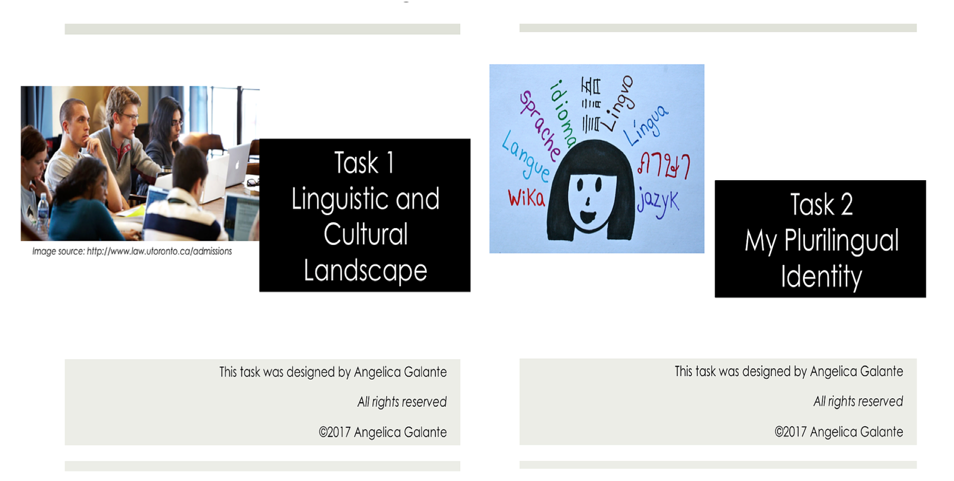
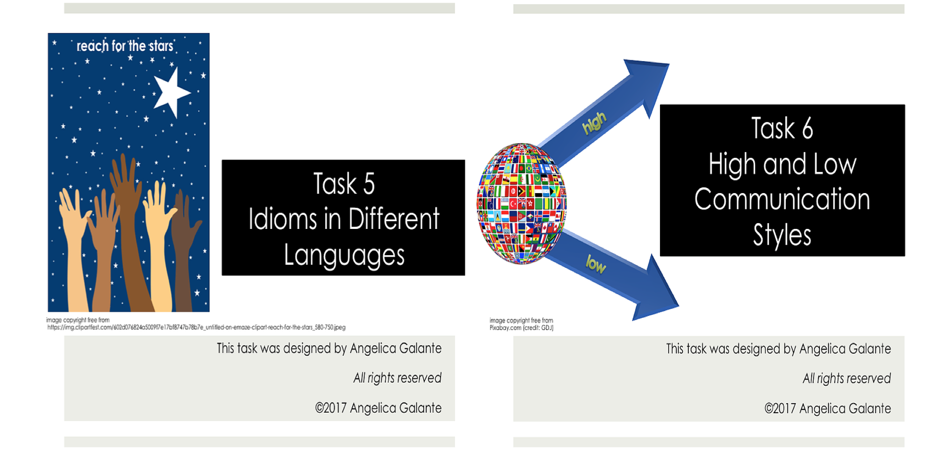
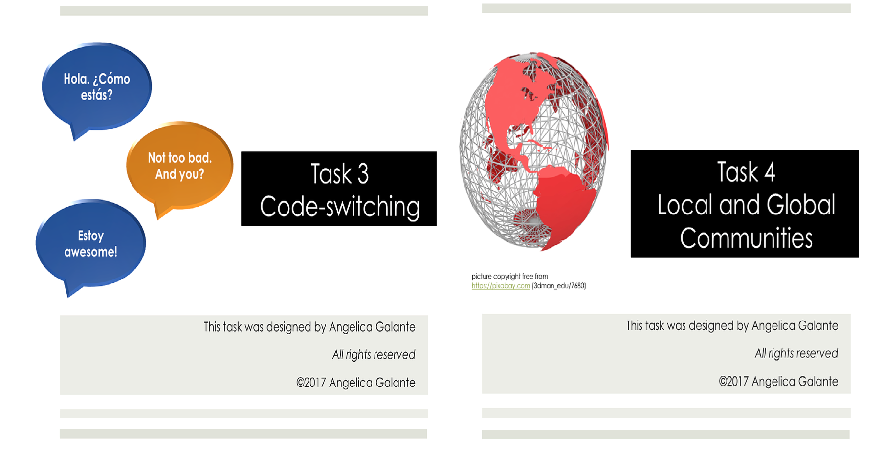
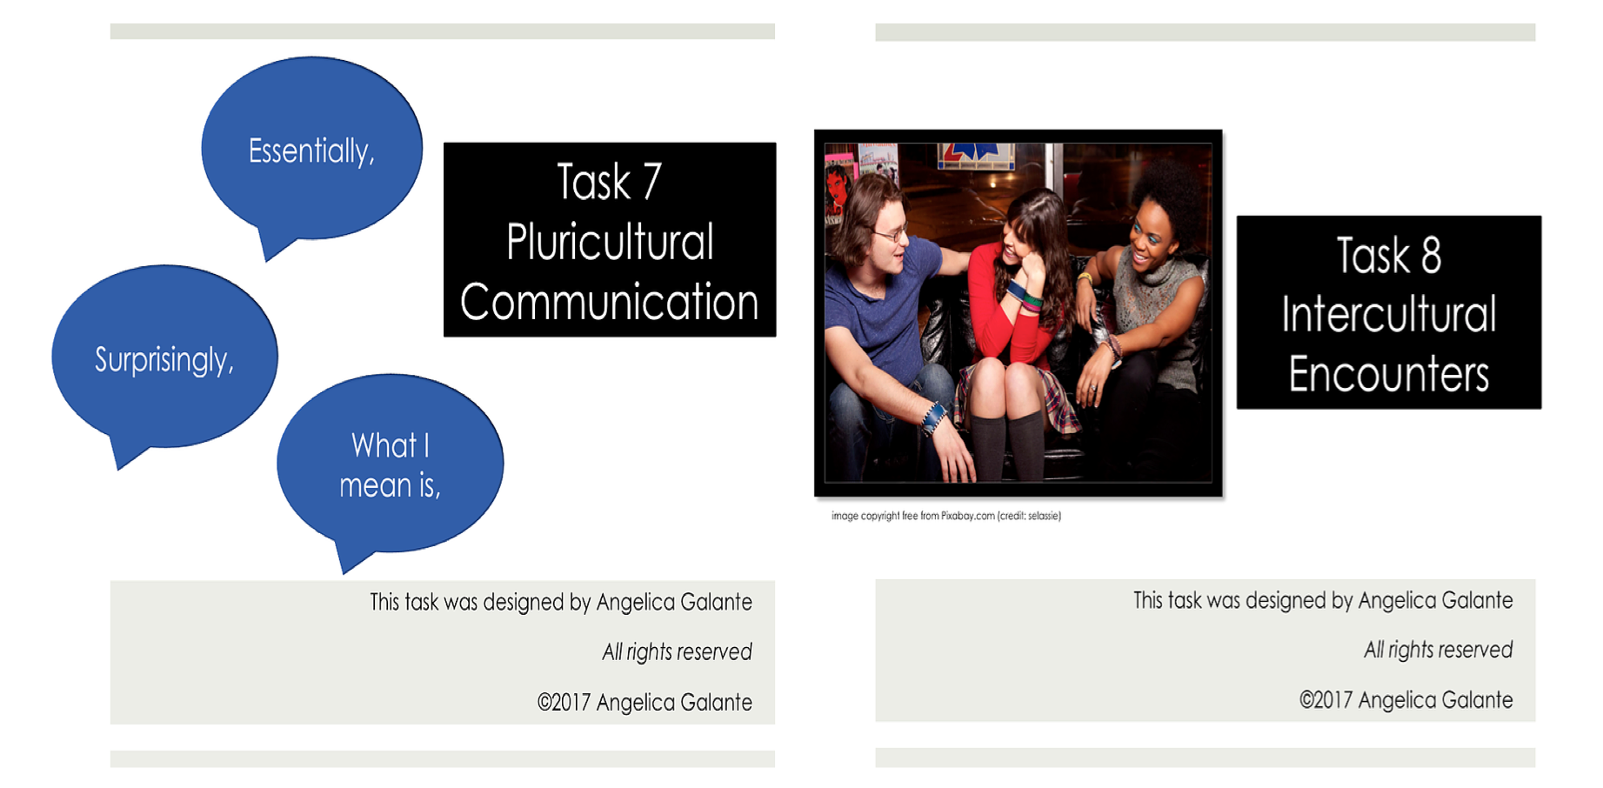
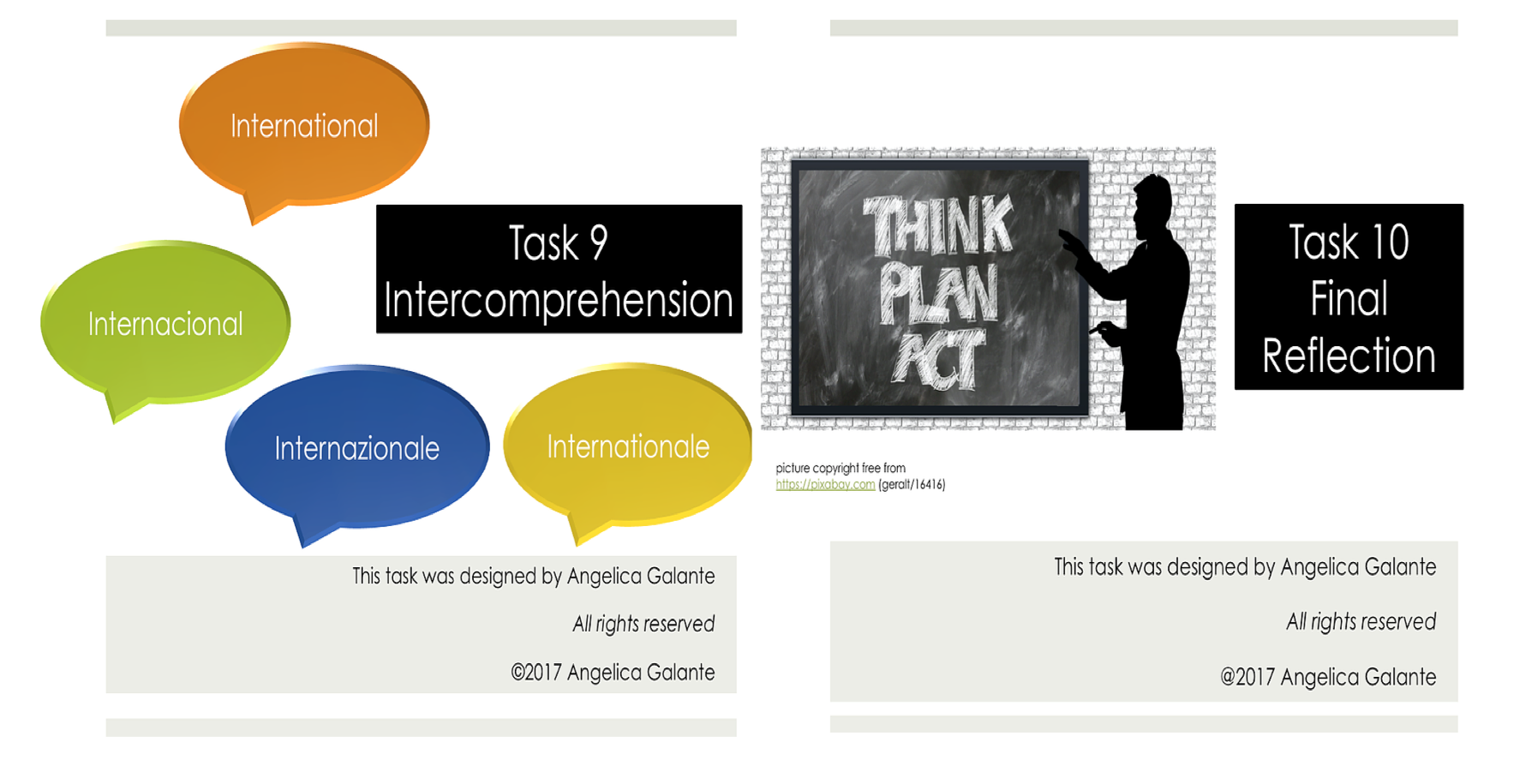
Engaging Learners’ Plurilingual and Pluricultural Competence
Tasks inspired by CEFRCV descriptors
www.breakingtheinvisiblewall.com

Slide 15
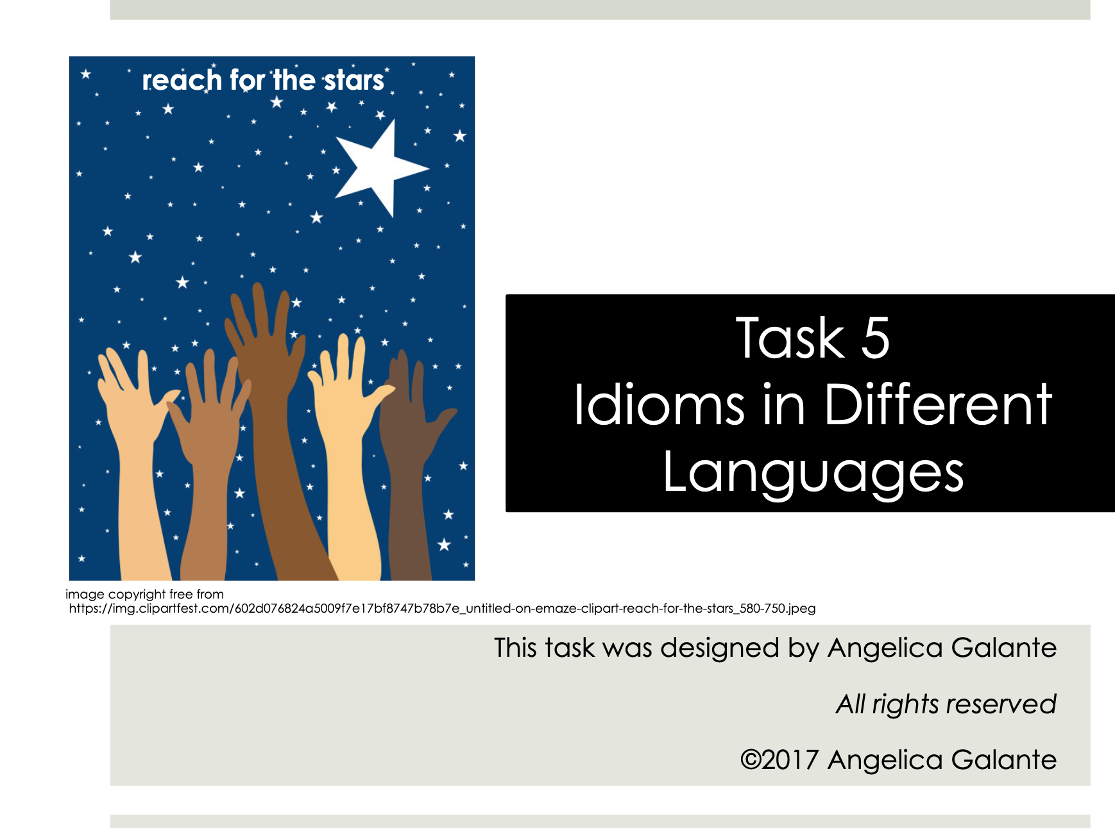
Engaging Learners’ Plurilingual and Pluricultural Competence

Slide 16
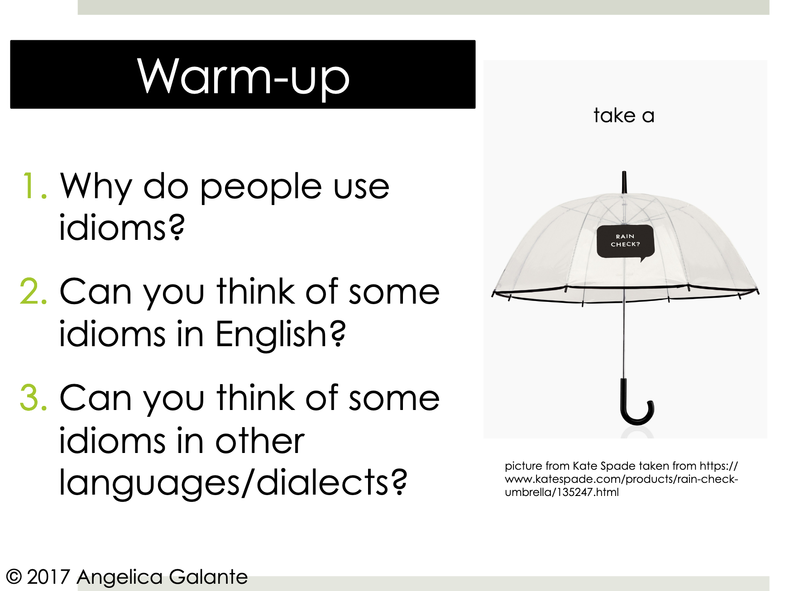
Engaging Learners’ Plurilingual and Pluricultural Competence

Slide 17
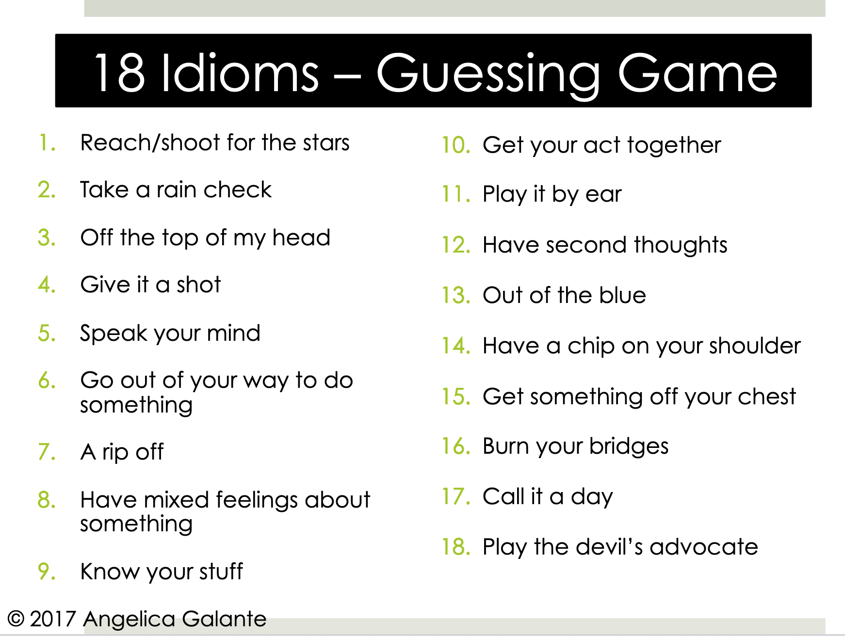
Engaging Learners’ Plurilingual and Pluricultural Competence

Slide 18
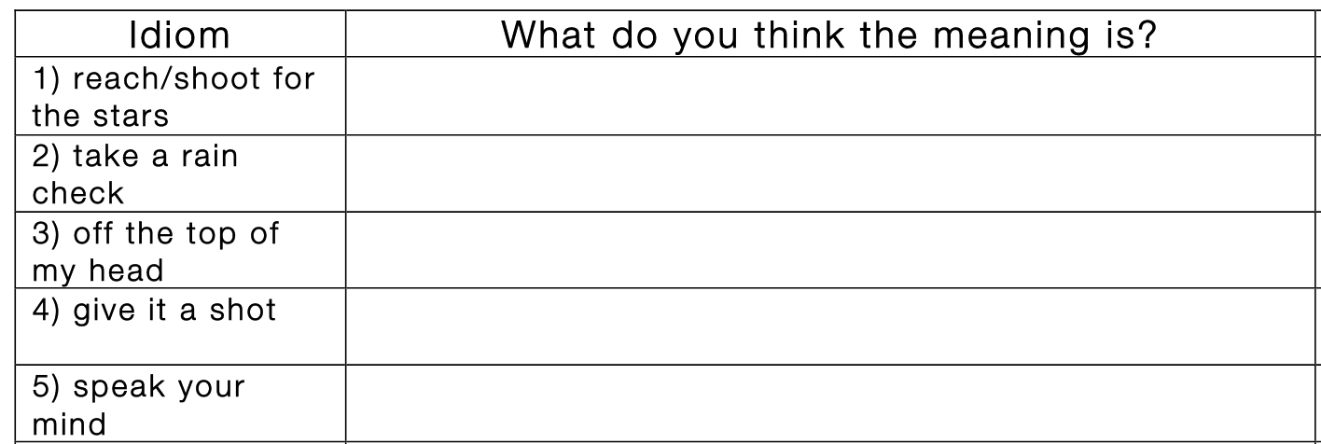
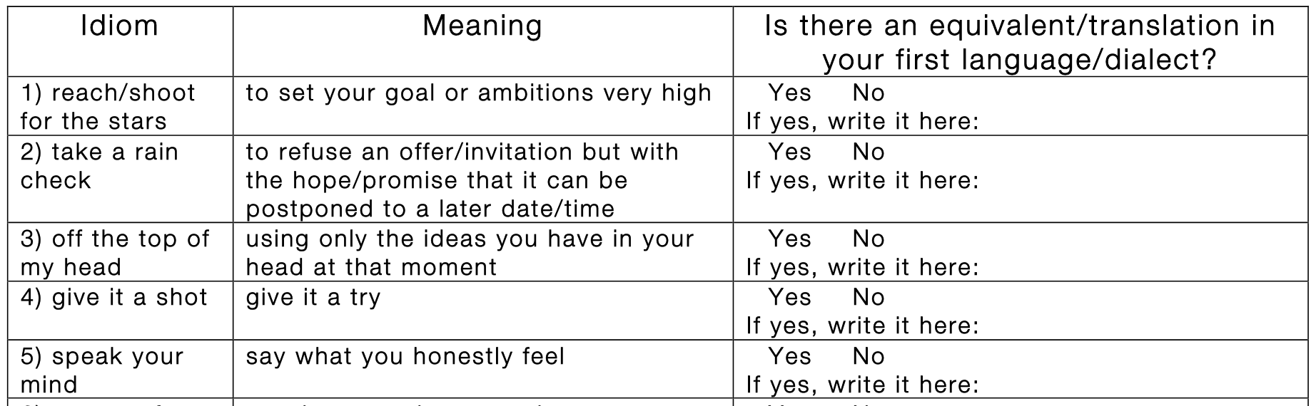
Engaging Learners’ Plurilingual and Pluricultural Competence

Slide 19
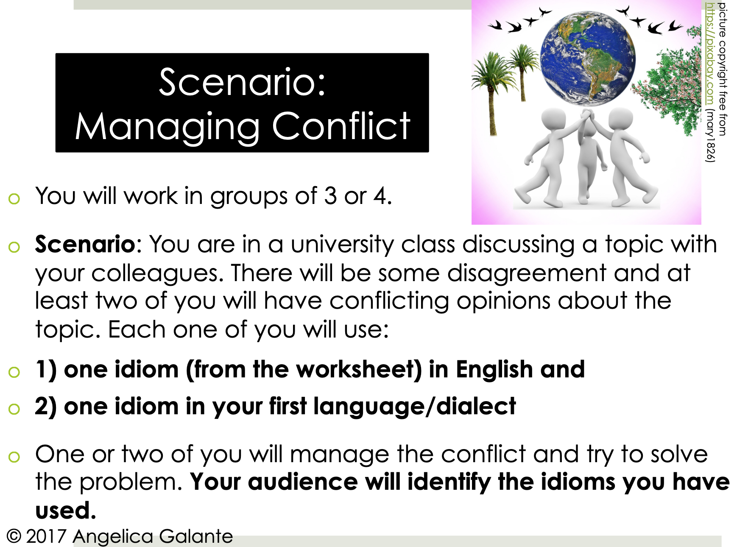
Engaging Learners’ Plurilingual and Pluricultural Competence

Slide 20
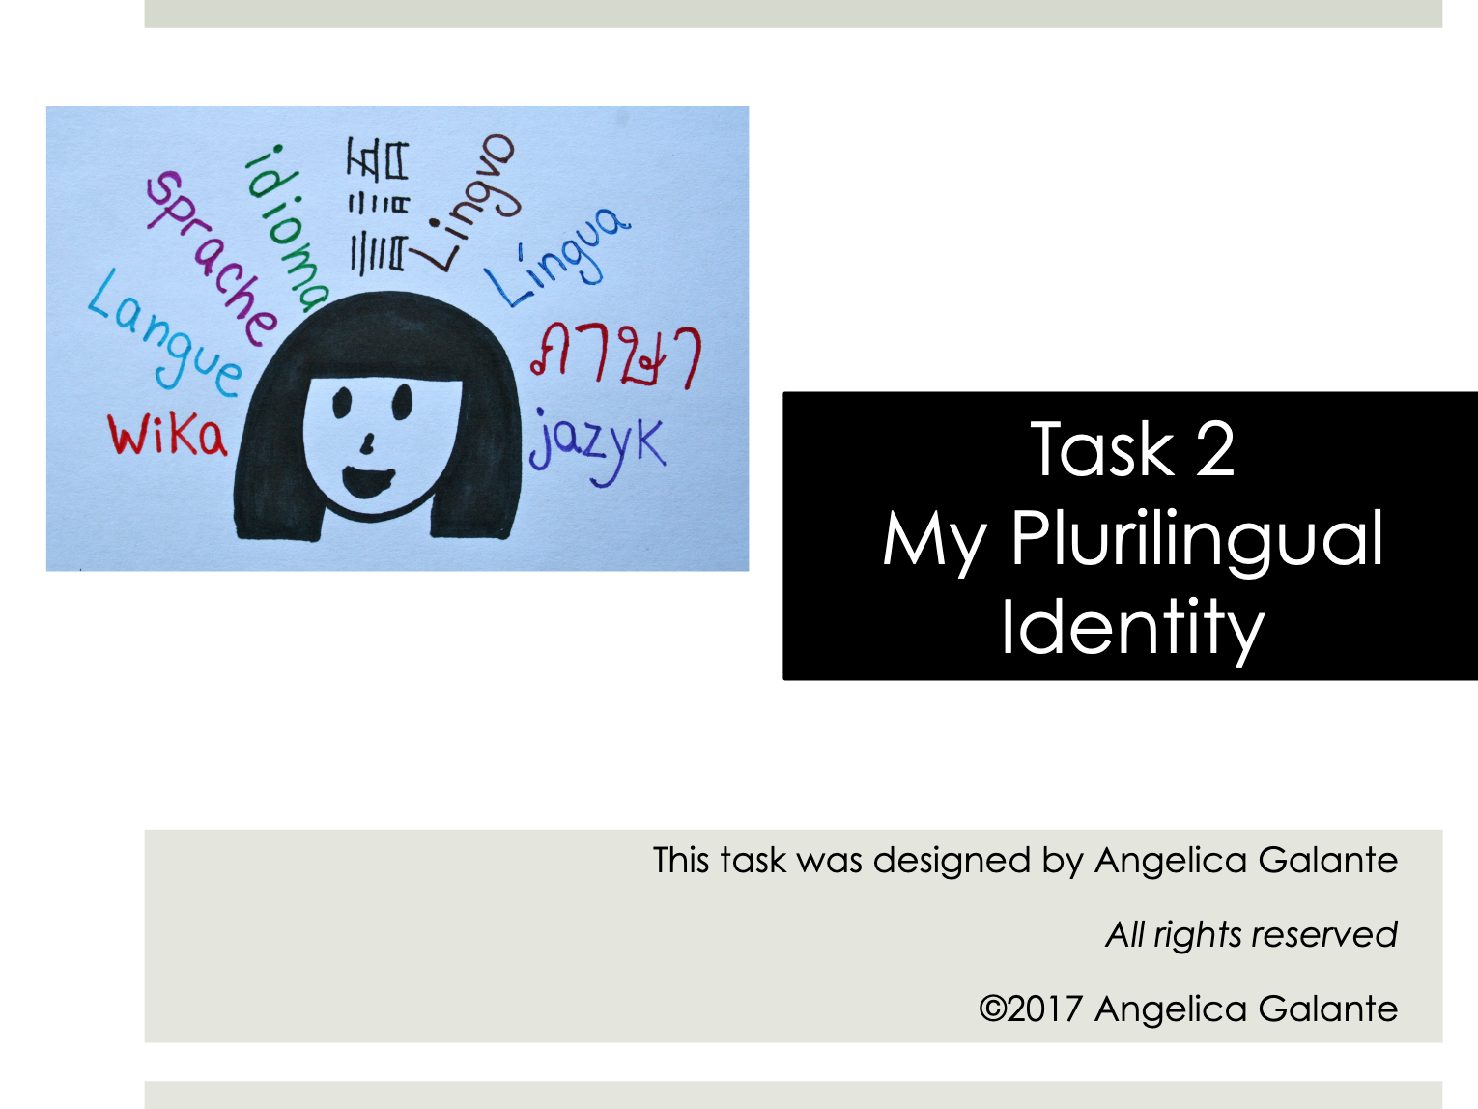
Engaging Learners’ Plurilingual and Pluricultural Competence

Slide 21
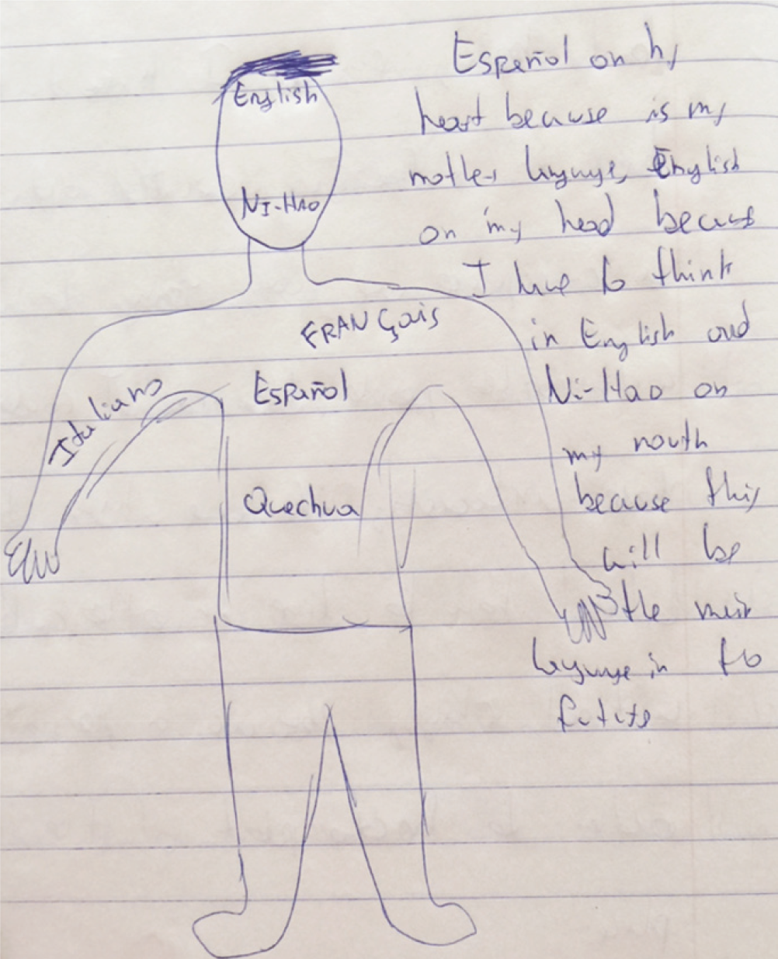
Engaging Learners’ Plurilingual and Pluricultural Competence
This is Zuco
Galante, 2020, p. 569

Slide 22

Engaging Learners’ Plurilingual and Pluricultural Competence
4 Months of Instruction
1. Demographic Questionnaire 2. Weekly Learner Diary 3. Classroom Observations 4. Plurilingual and Pluricultural
Competence Scale
5. Focus Groups 6. Teacher Interviews 7. Vocabulary Test
Image by Peggy und Marco Lachmann-Anke from Pixabay

Slide 23
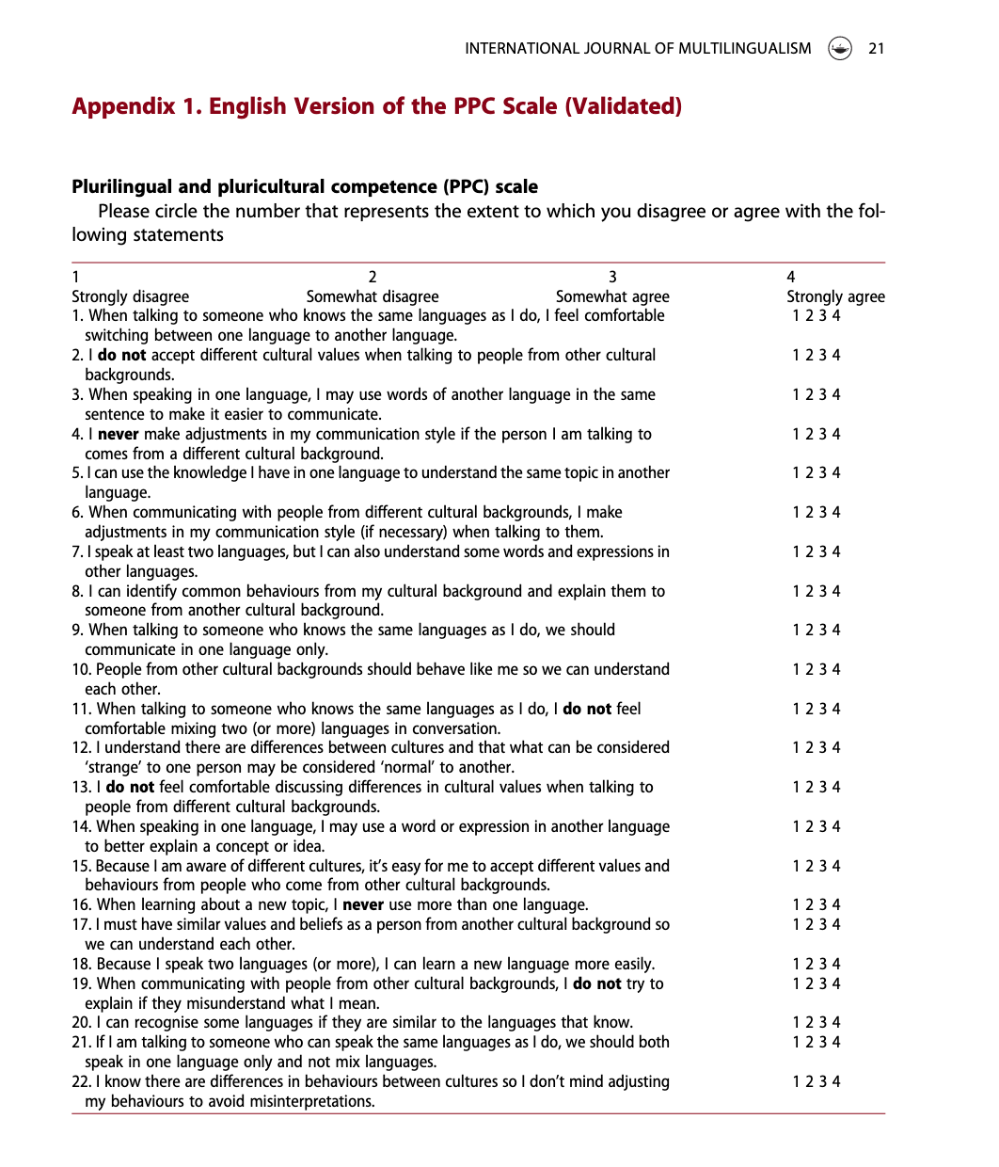
Engaging Learners’ Plurilingual and Pluricultural Competence
PPC Scale
Designed based on CEFRCV descriptors
Validated
Applied at T1 and T2 for both groups
Galante, 2020

Slide 24
Engaging Learners’ Plurilingual and Pluricultural Competence
What Were the Main Benefits of a Plurilingual Approach?

Slide 25
Engaging Learners’ Plurilingual and Pluricultural Competence
9 Main Affordances

Slide 26

Engaging Learners’ Plurilingual and Pluricultural Competence
Cognition
In Canada, I use please/could you please, do you mind…to the teacher and Prof. Also, in Chinese culture, I use Nin (您) instead of Ni (你) when we talk to the Prof.
Image by Gerd Altmann from Pixabay
These two words have the same meaning but Nin (您) is high level.

Slide 27

Engaging Learners’ Plurilingual and Pluricultural Competence
Language & Cultural Learning
Photo created by rawpixel.com - www.freepik.com
Speaking in another language made me feel so smart no matter if I am not (jaja). It was really interesting to know from other languages and understand other people say thank you in other languages, especially in Spanish. I’ve learned some words in Chinese and in other languages such as Russian.

Slide 28
Were there any changes in PPC between groups and over time?

Slide 29
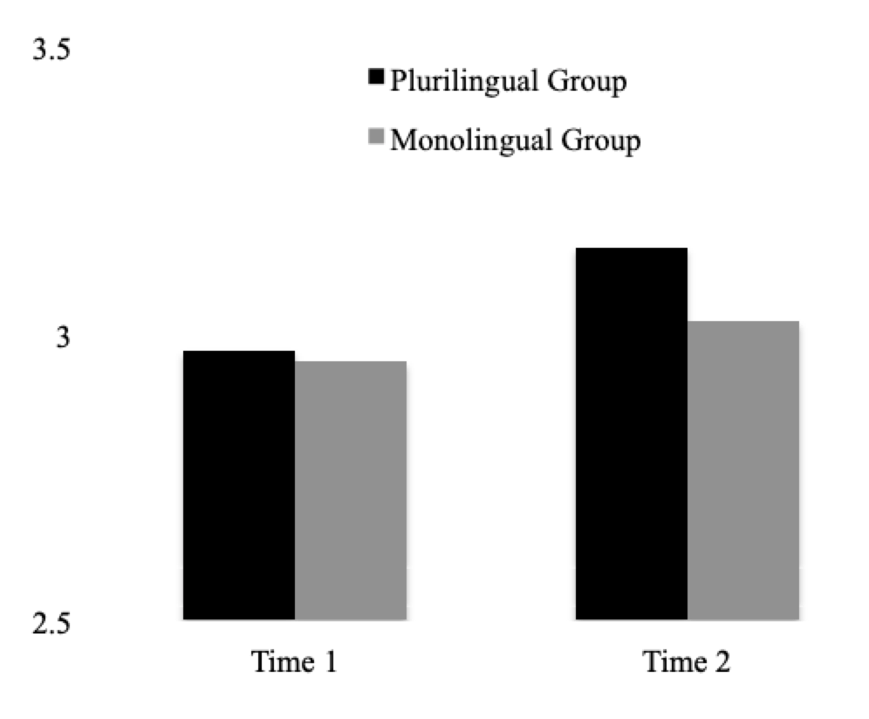
Engaging Learners’ Plurilingual and Pluricultural Competence
Plurilingual
Students in the plurilingual group had increased plurilingual and pluricultural competence scores over time
English-only
T1: no significant difference between plurilingual (M = 2.97, SD = .30) and English-only groups (M = 2.95, SD = .32), t(127) = .33, p =.74.
T2: significant difference between plurilingual (M = 3.15, SD = .28) and English-only groups (M = 3.02, SD = .32), t(127) = 2.52, p = .013

Slide 30
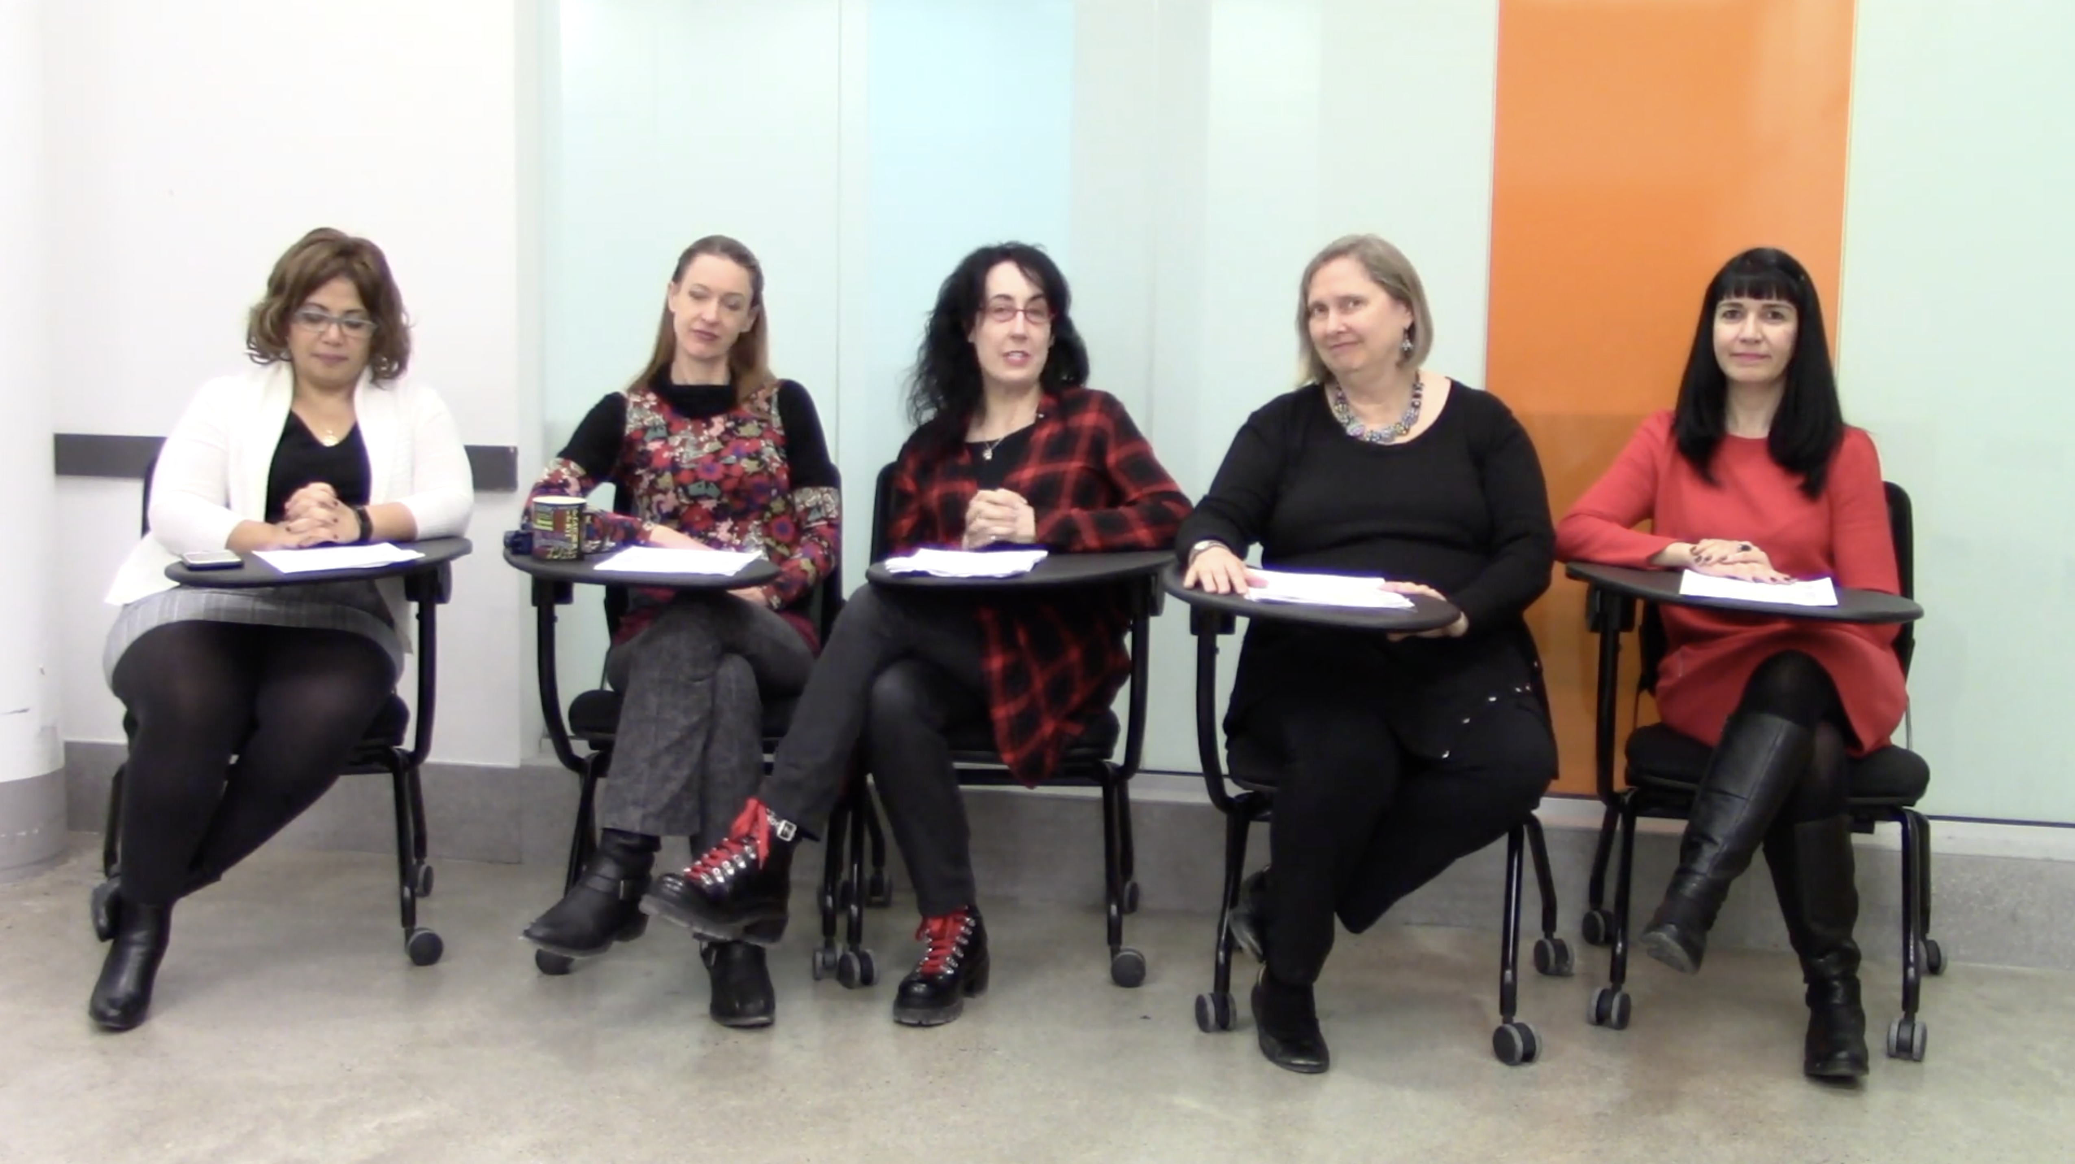
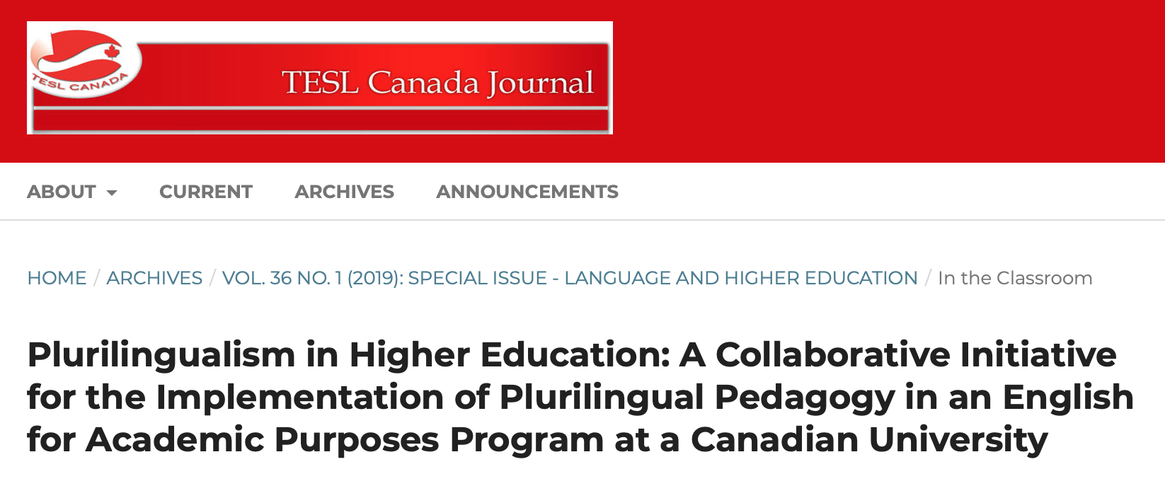
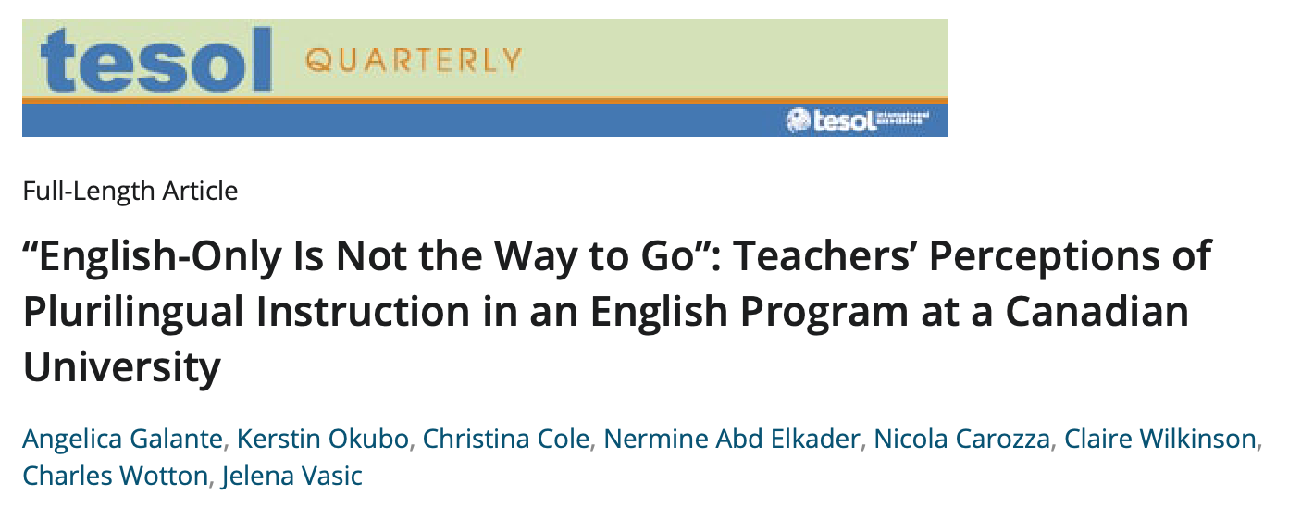

Engaging Learners’ Plurilingual and Pluricultural Competence
https://youtu.be/4SpPWUPjrBA

Slide 31

Engaging Learners’ Plurilingual and Pluricultural Competence
Study 2 - Plurilingual Shift Project
3 Teachers (English, French, and Spanish) in an NGO in Brazil
Teachers received teacher education on plurilingual practices
They co-designed tasks and taught them via Zoom in their classes
Funded by

Slide 32



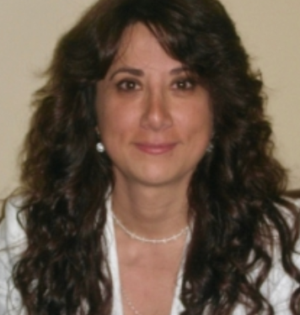


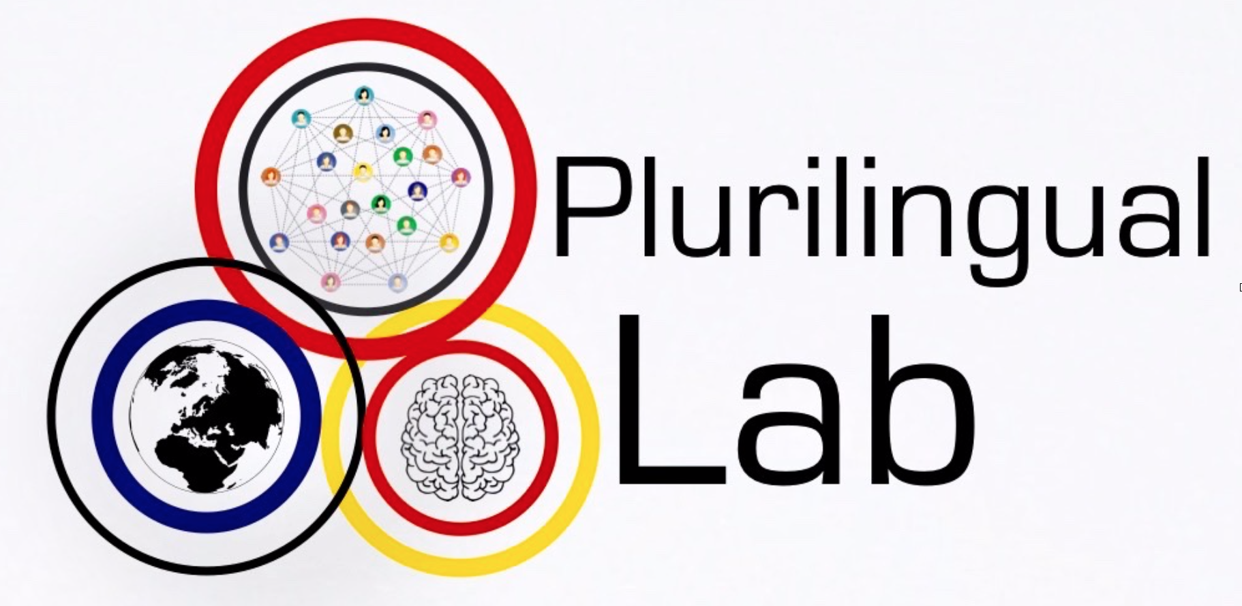
Engaging Learners’ Plurilingual and Pluricultural Competence
Research Team
Angelica Galante Principal Investigator
John N. Wayne deal Cruz Research Assistant
Lana F. Zeaiter
Research Assistant
Maria Chiras
Research Assistant
Jade LaFointaine Research Assistant
For more info
https://www.mcgill.ca/plurilinguallab/research-projects/plurilingual-shift

Slide 33
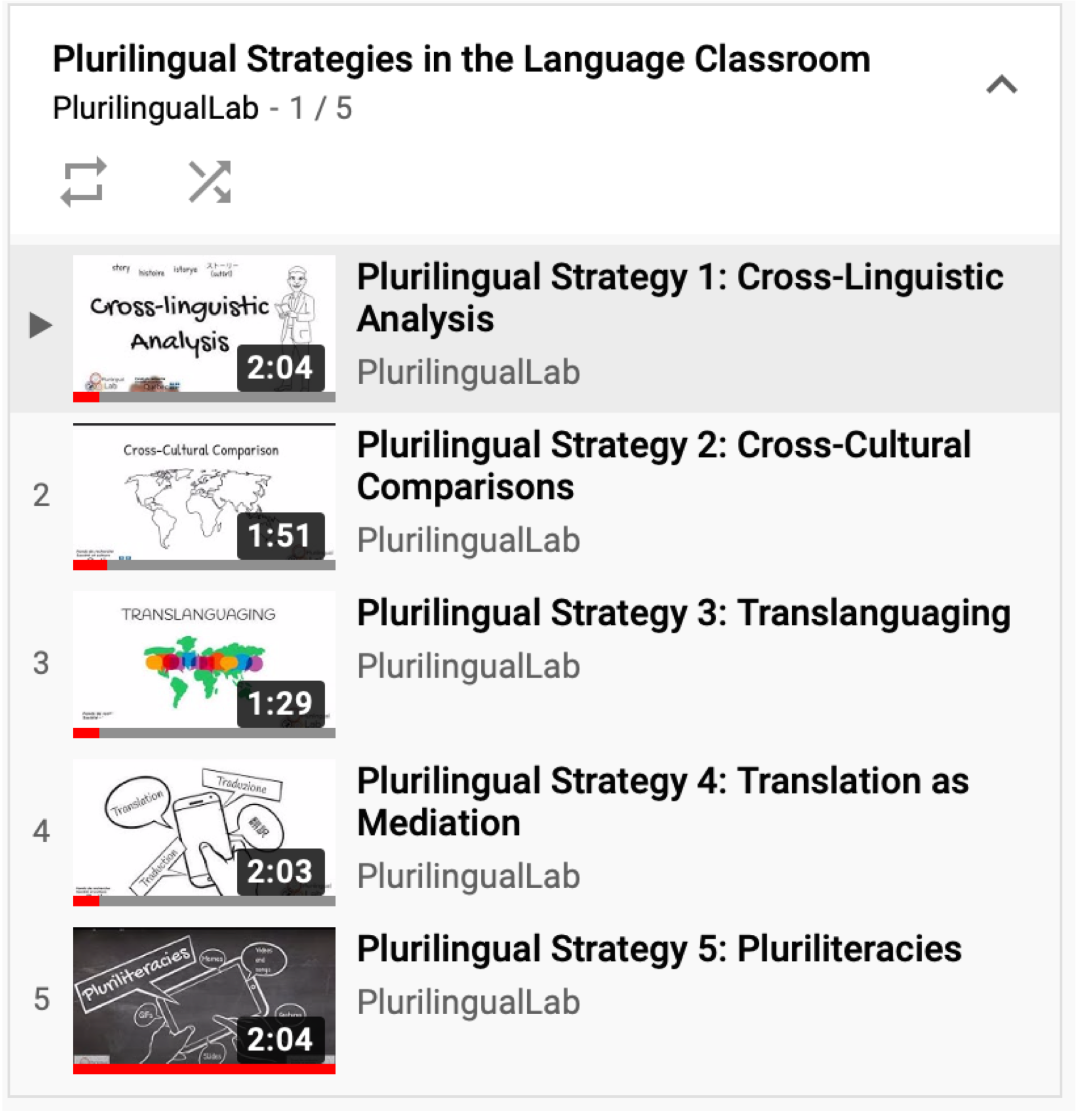
Engaging Learners’ Plurilingual and Pluricultural Competence
Playlist
https://youtube.com/playlist?list=PLRZo5YABmOi6Dr7RRRaXbxLYp4A2x_FdO

Slide 34
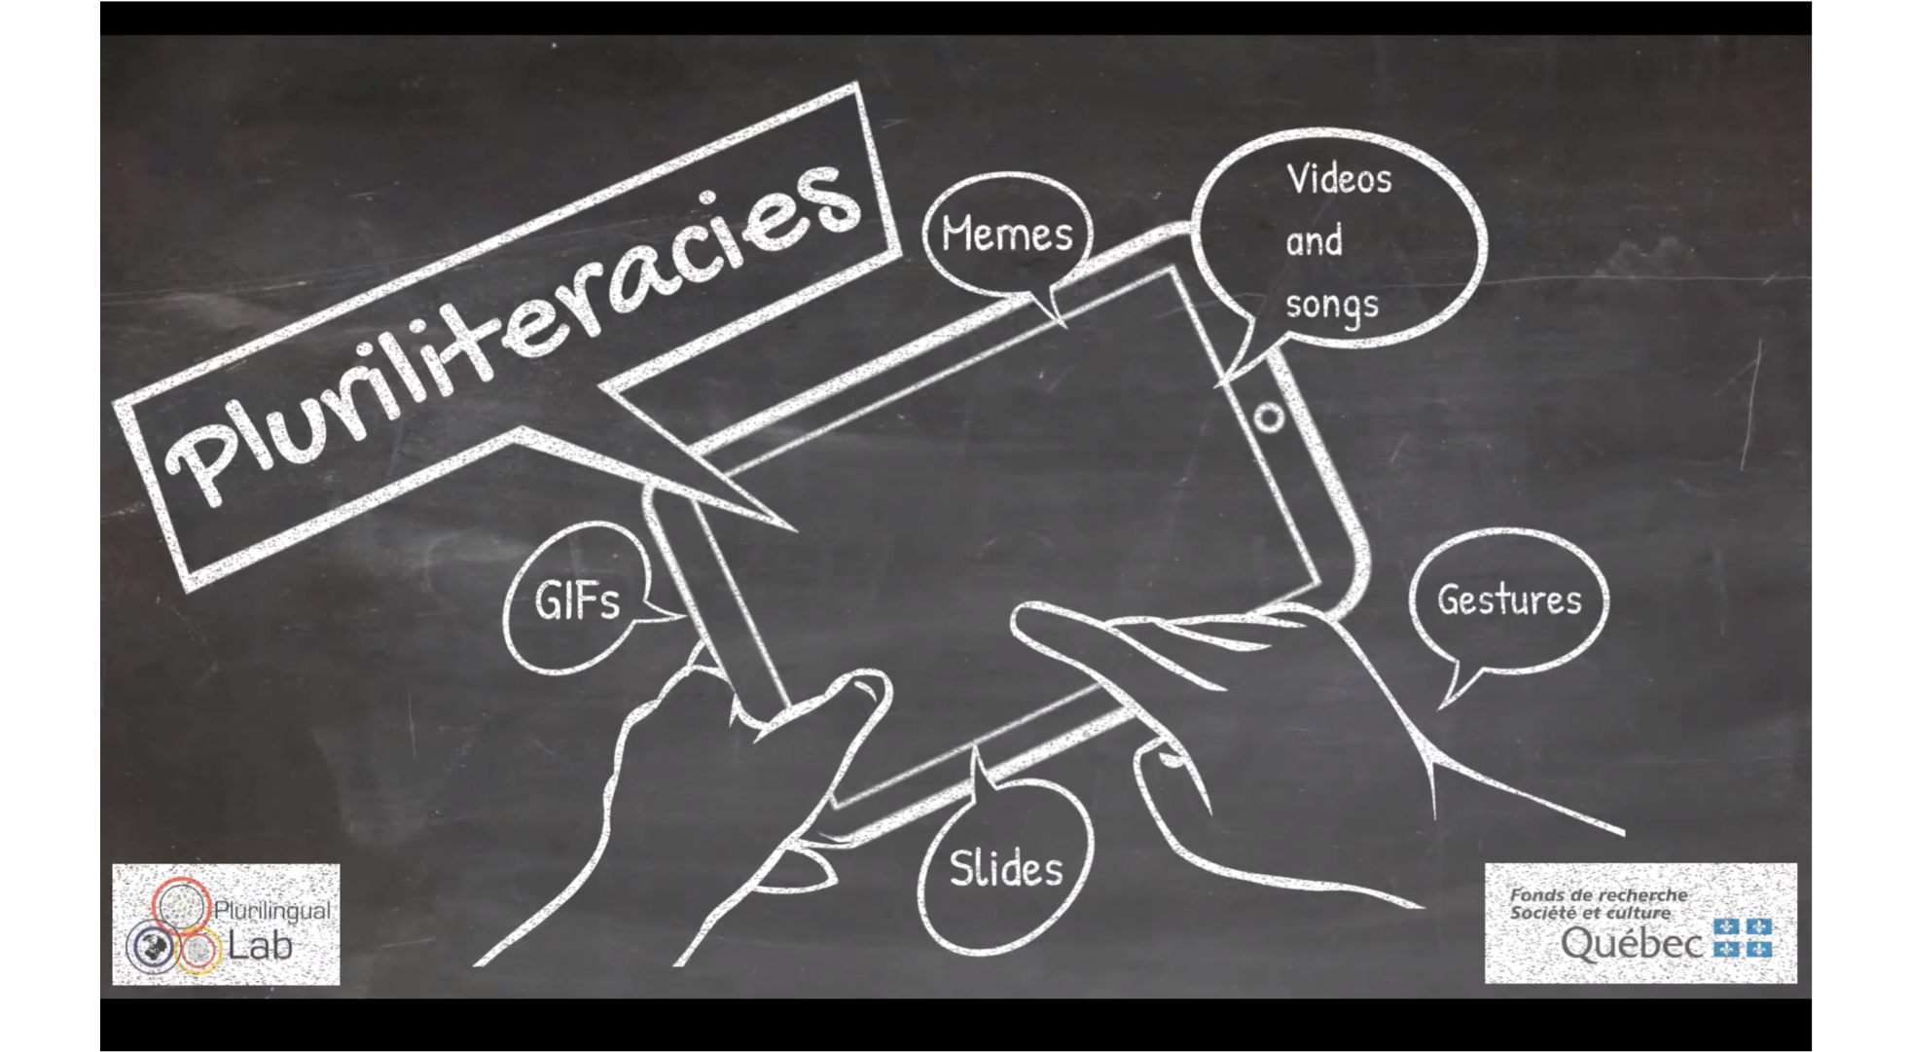
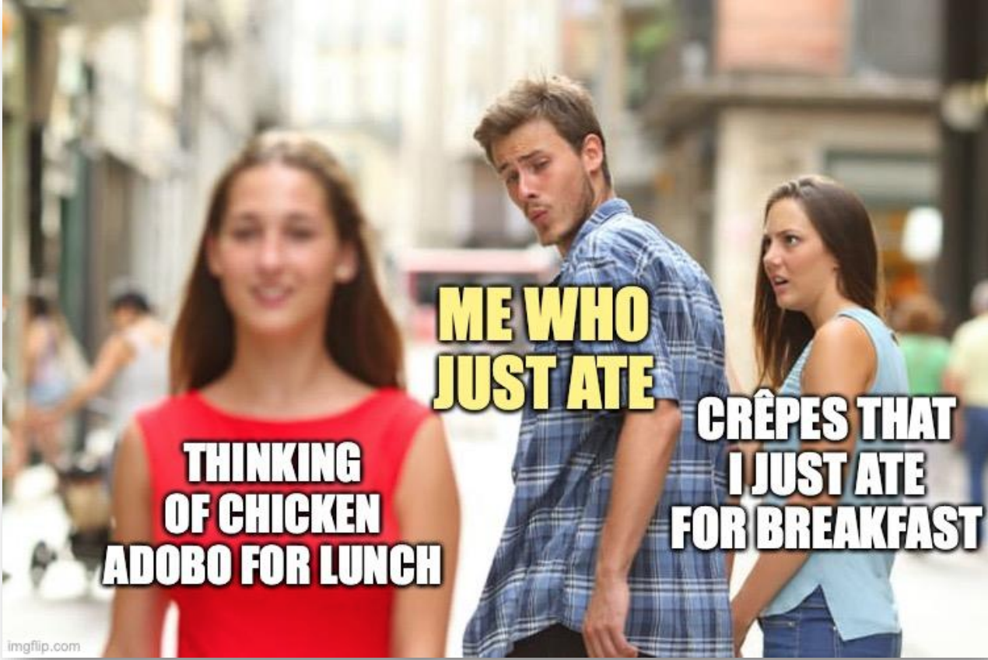
Engaging Learners’ Plurilingual and Pluricultural Competence
Students created memes
Used meme generator
Creative use of language
Creative use of images

Slide 35
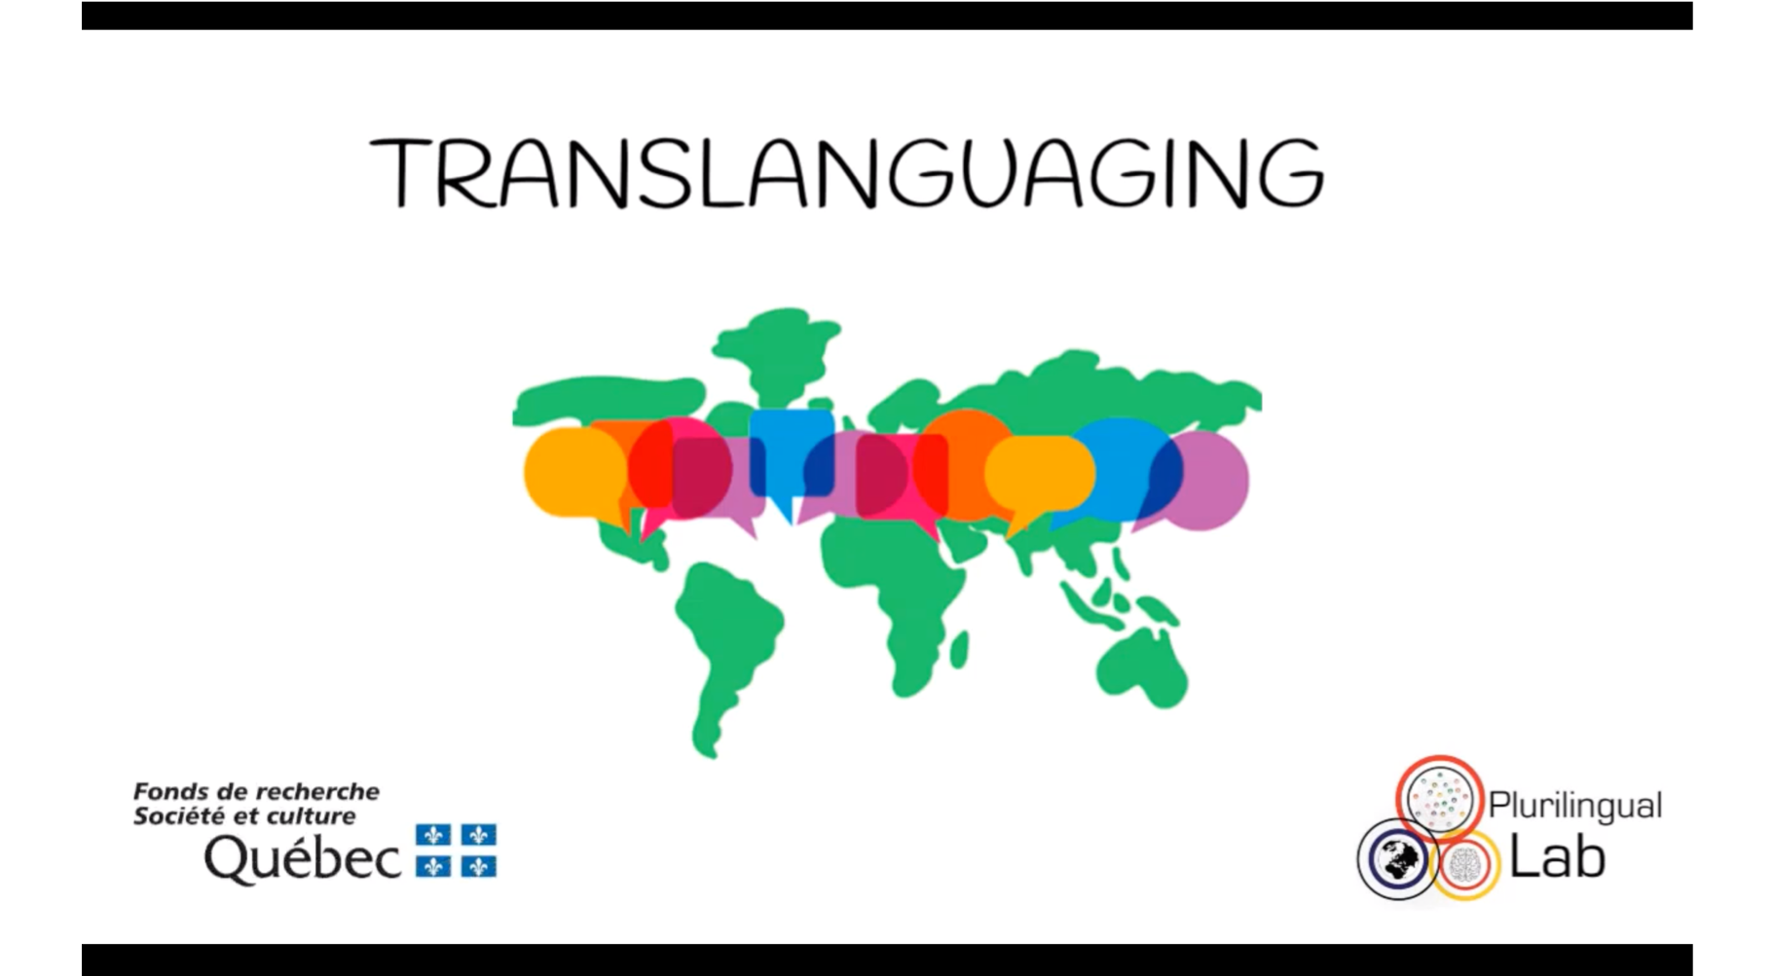
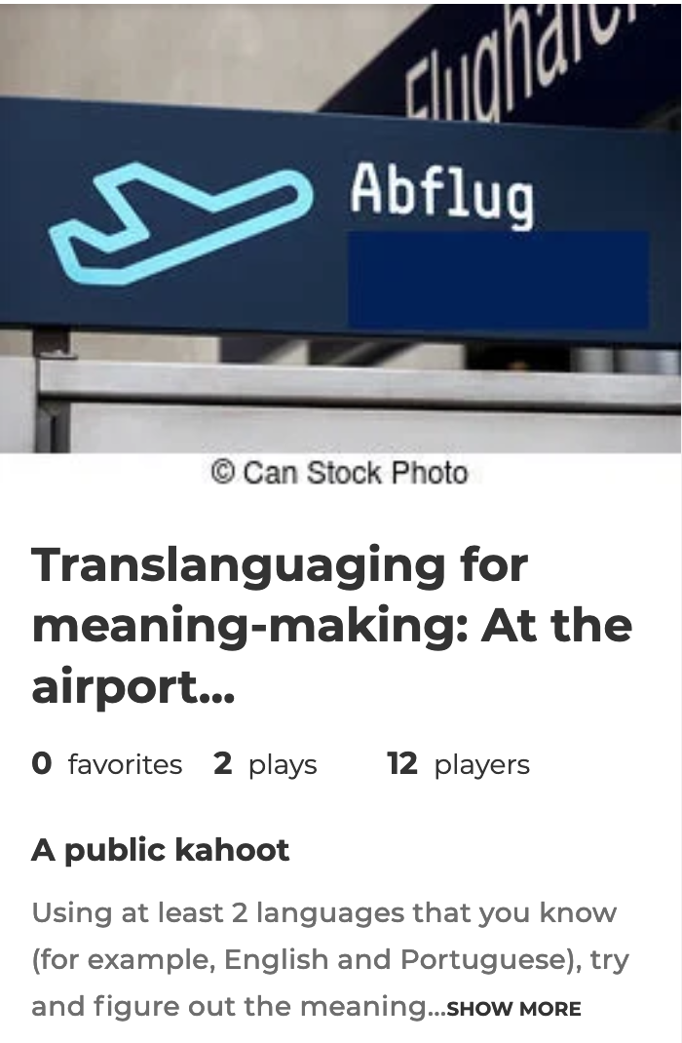
Engaging Learners’ Plurilingual and Pluricultural Competence
Students used their entire repertoire
Talked about expression used at the airport in different languages
Were free to speak in any language
Used their repertoire to make sense of expressions in English on Kahoot

Slide 36
Engaging Learners’ Plurilingual and Pluricultural Competence
What Were the Main Benefits?

Slide 37
Engaging Learners’ Plurilingual and Pluricultural Competence
Teachers showed much excitement about the notion of the repertoire.
Once teachers were equipped with strategies, implementation was easy.
Results show that several linguistic (e.g., cross-linguistic comparisons) and nonlinguistic (e.g., culture, emojis, GIFs) resources facilitated language learning.
Students’ semiotic resources were awakened and embraced in pedagogical practices, and empowered students to claim their “voice” even if their proficiency level in the target language was limited.
Photo created by wayhomestudio - www.freepik.com

Slide 38
Engaging Learners’ Plurilingual and Pluricultural Competence
Study 3 - PluriDigit Project
NGO in São Paulo, Brazil
12 teachers (English, Spanish, French, and Arabic) and 102 students
Teachers received workshops on plurilingual practices
They implemented 5 bi-weekly PluriDigit Tasks
Funded by

Slide 39



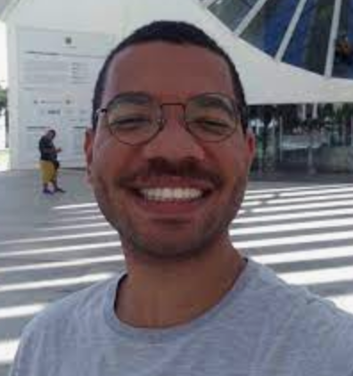




Engaging Learners’ Plurilingual and Pluricultural Competence
Research Team
Angelica Galante Principal Investigator
Enrica Piccardo
Co-PI
Faith Marcel Collaborator
Débora de Oliveira Collaborator
José-André Teodoro Torres Collaborator
John N. Wayne deal Cruz Research Assistant
Lana F. Zeaiter Research Assistant
Paul J. Meighan-Chiblow Research Assistant
For more info
https://www.mcgill.ca/plurilinguallab/research-projects/pluridigit

Slide 40

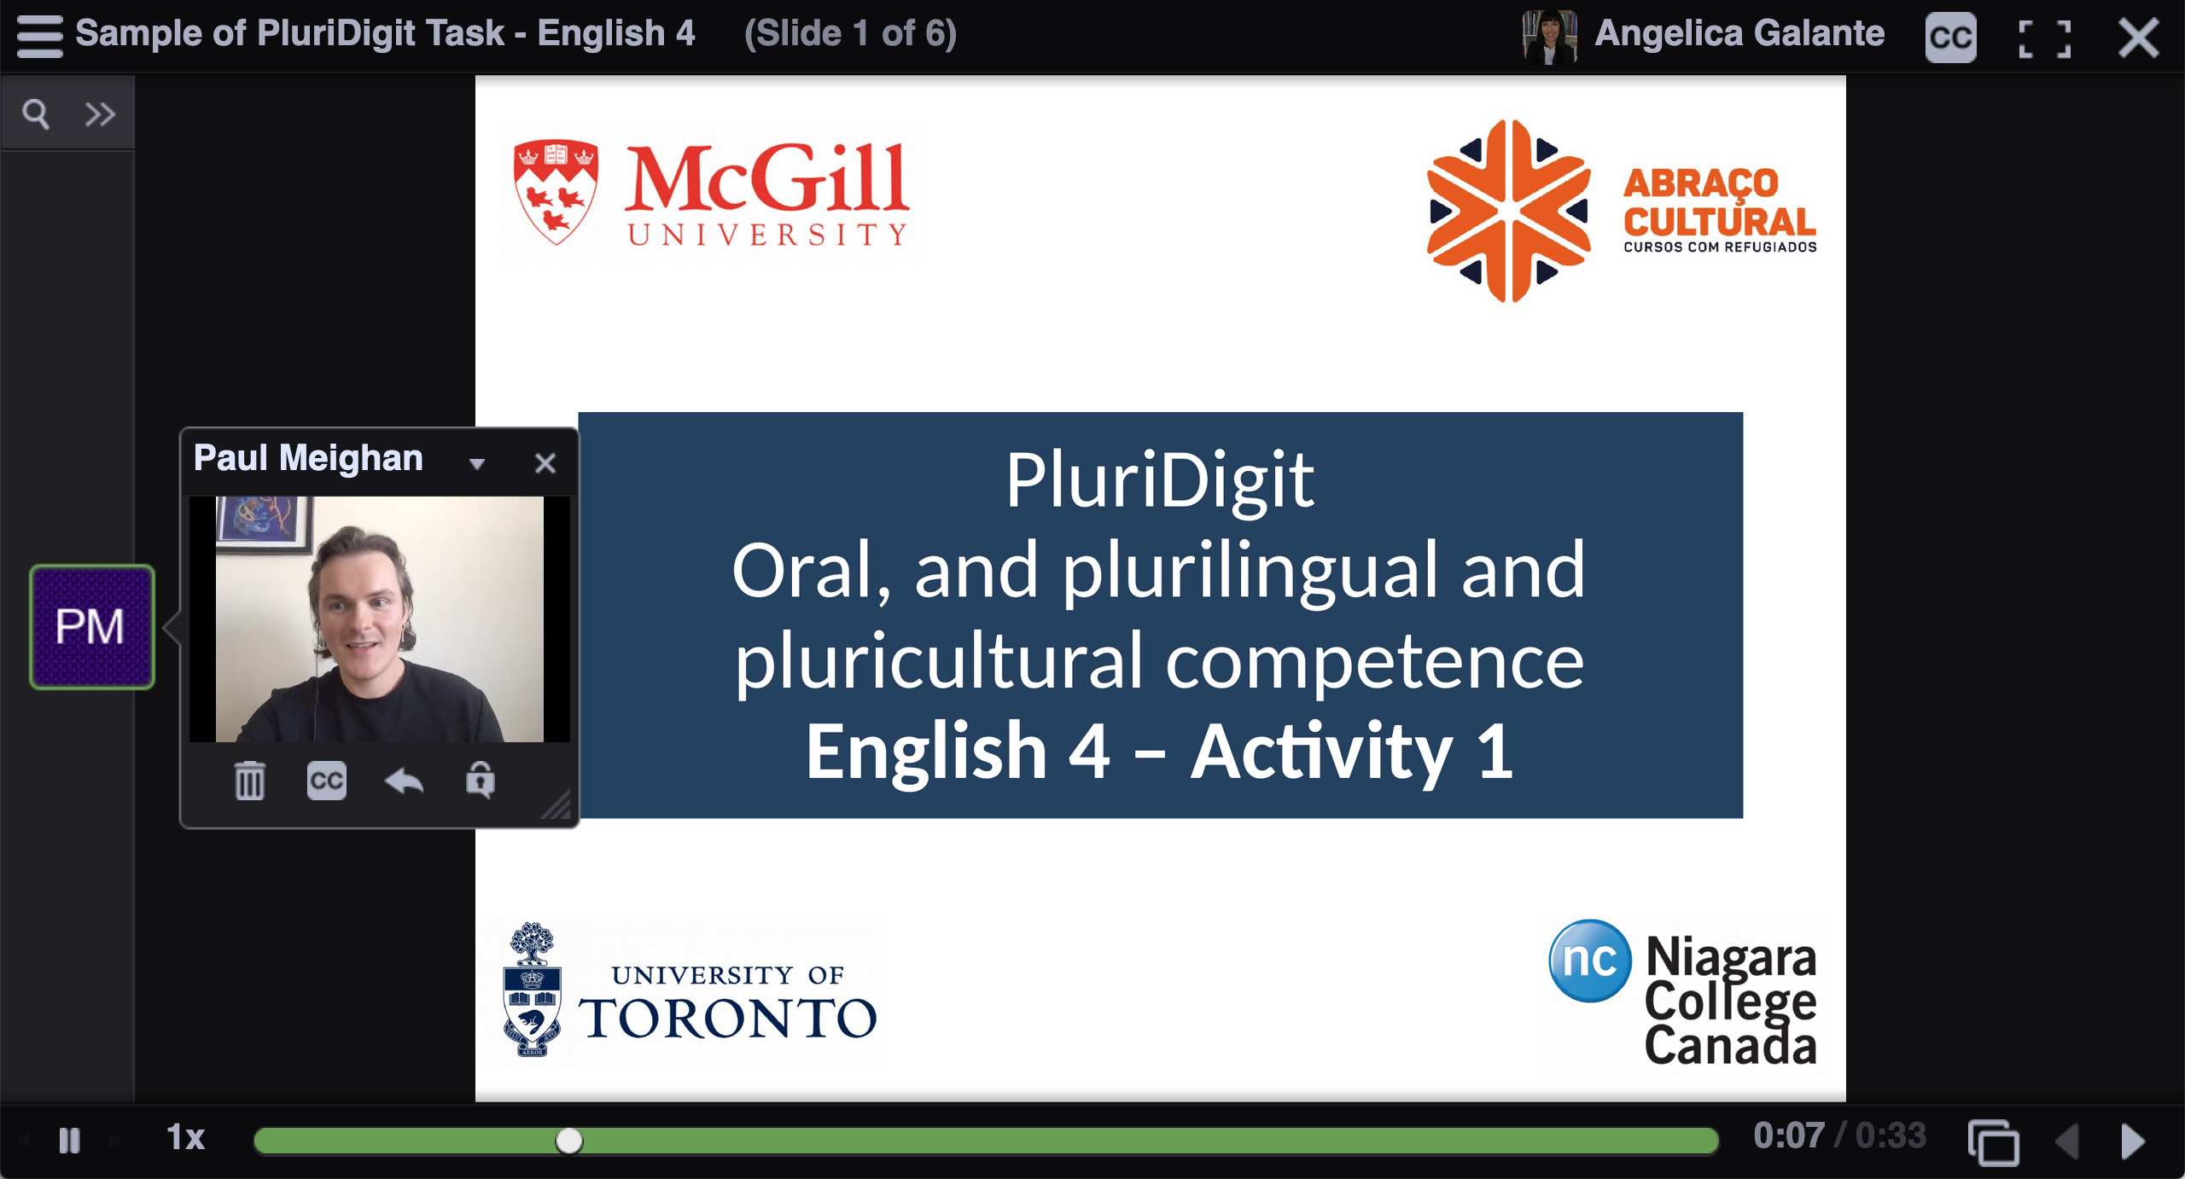
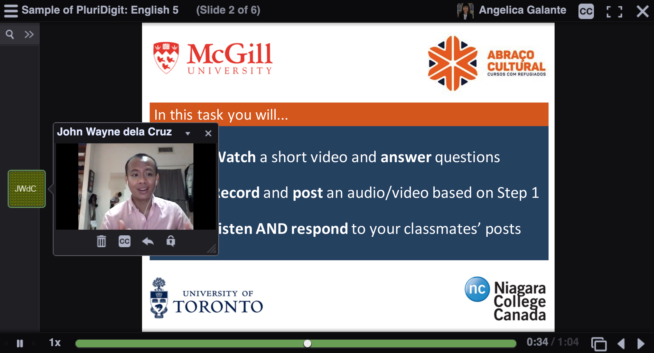
Engaging Learners’ Plurilingual and Pluricultural Competence
We collaborated with pedagogical coordinators and teachers to design tasks with a focus on oral, and plurilingual and pluricultural competence
Each task had three steps which were clearly explained to students

Slide 41
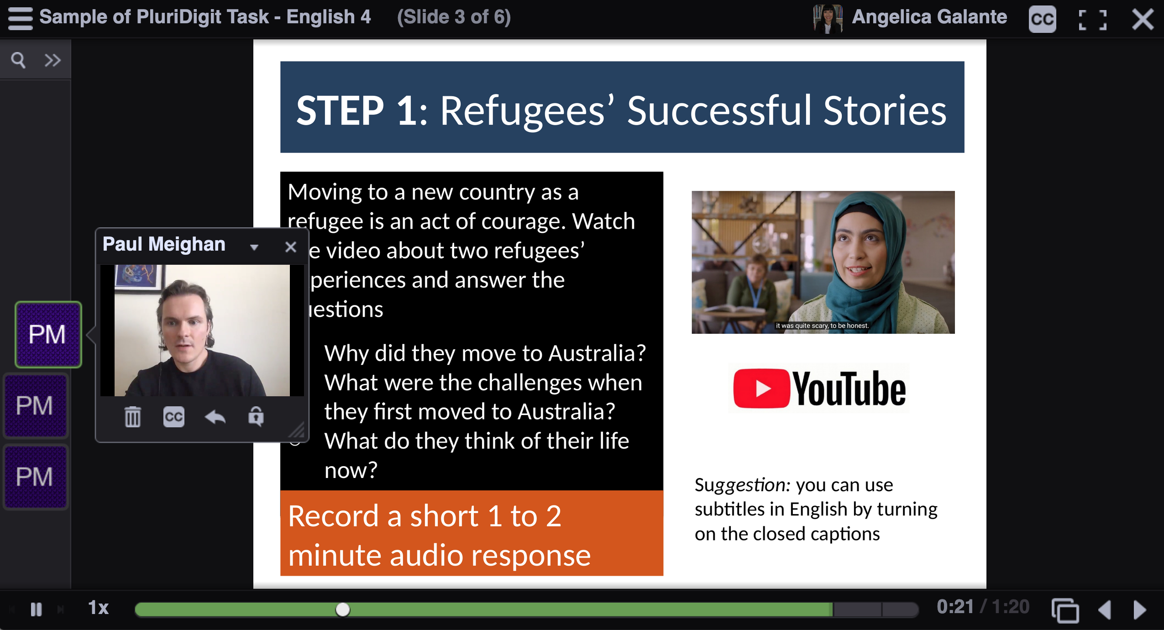
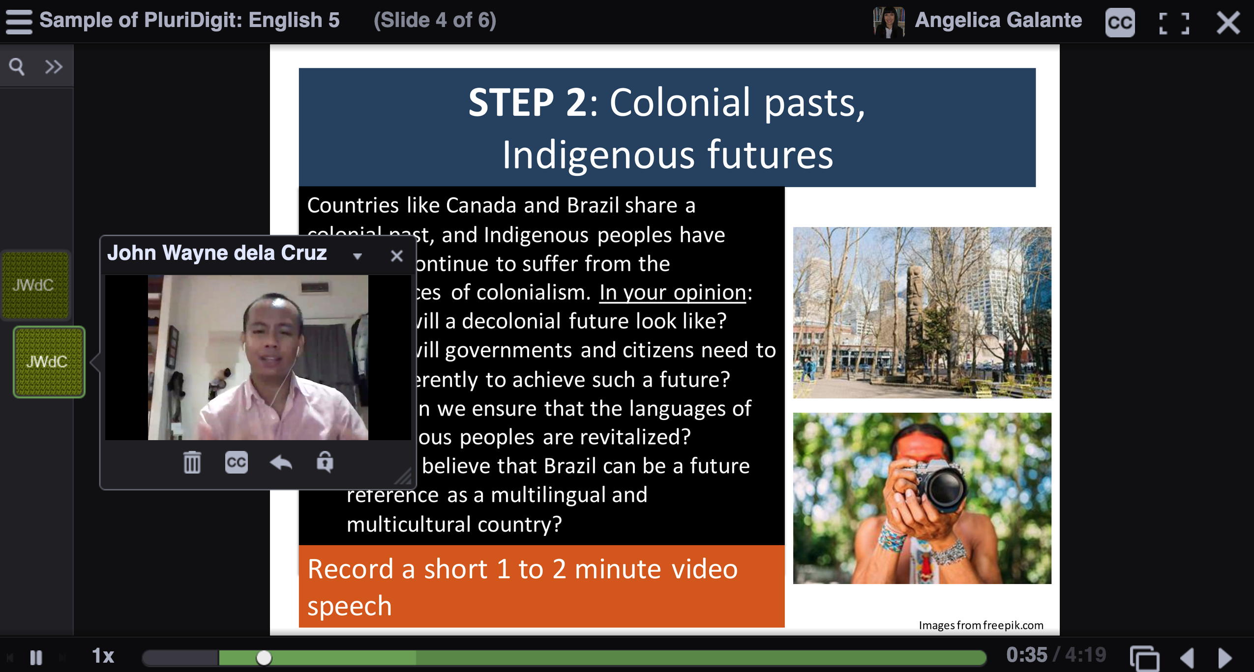
Engaging Learners’ Plurilingual and Pluricultural Competence
Critical topics (e.g., racism, migration, COVID-related issues) that built upon knowledge learned in class
Each student posted audio and video files, and used language to discuss their lived experiences in relation to the context

Slide 42
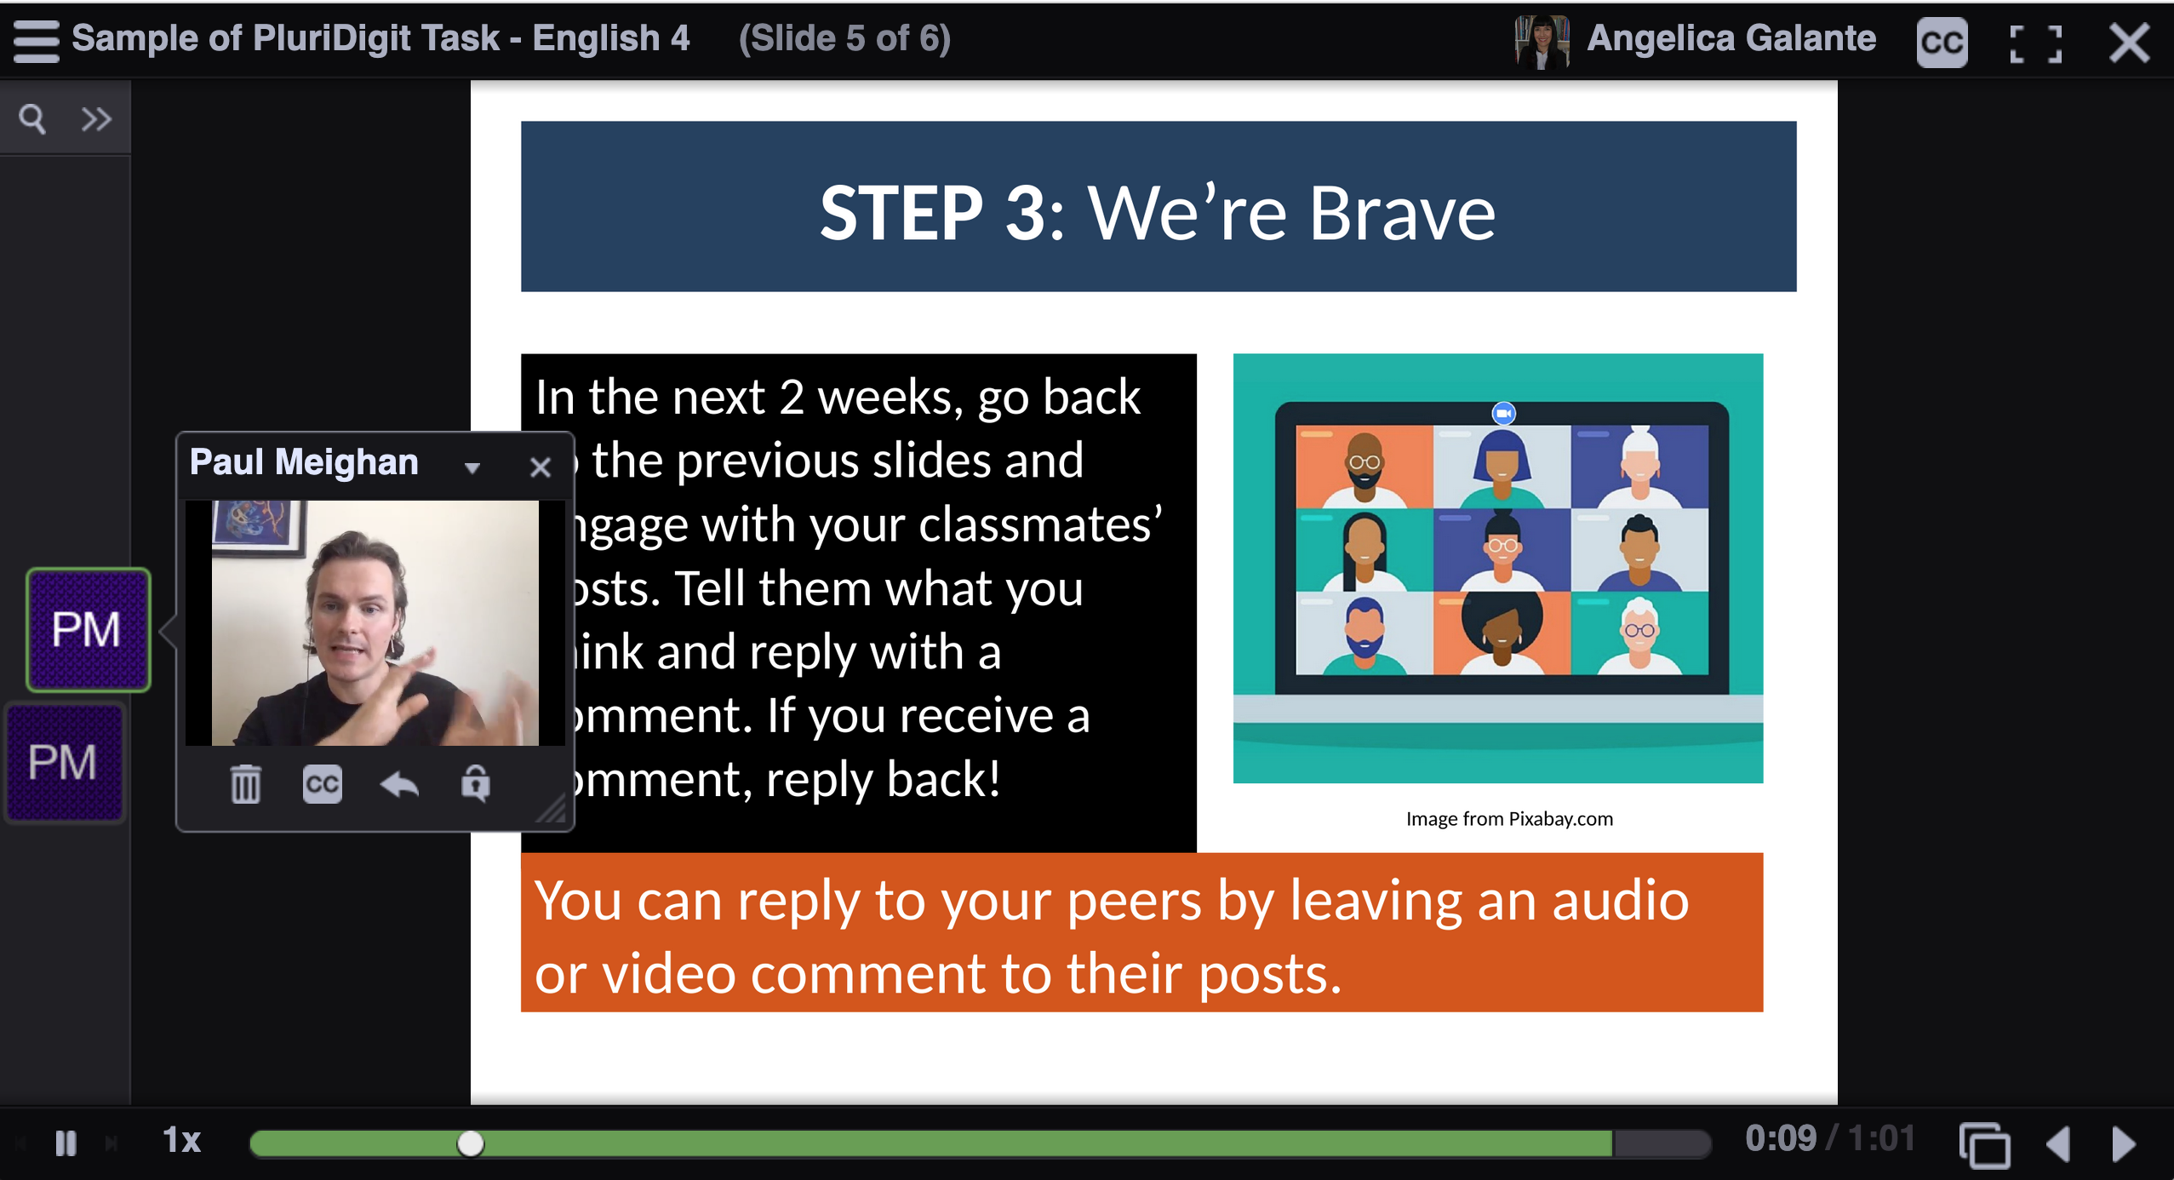
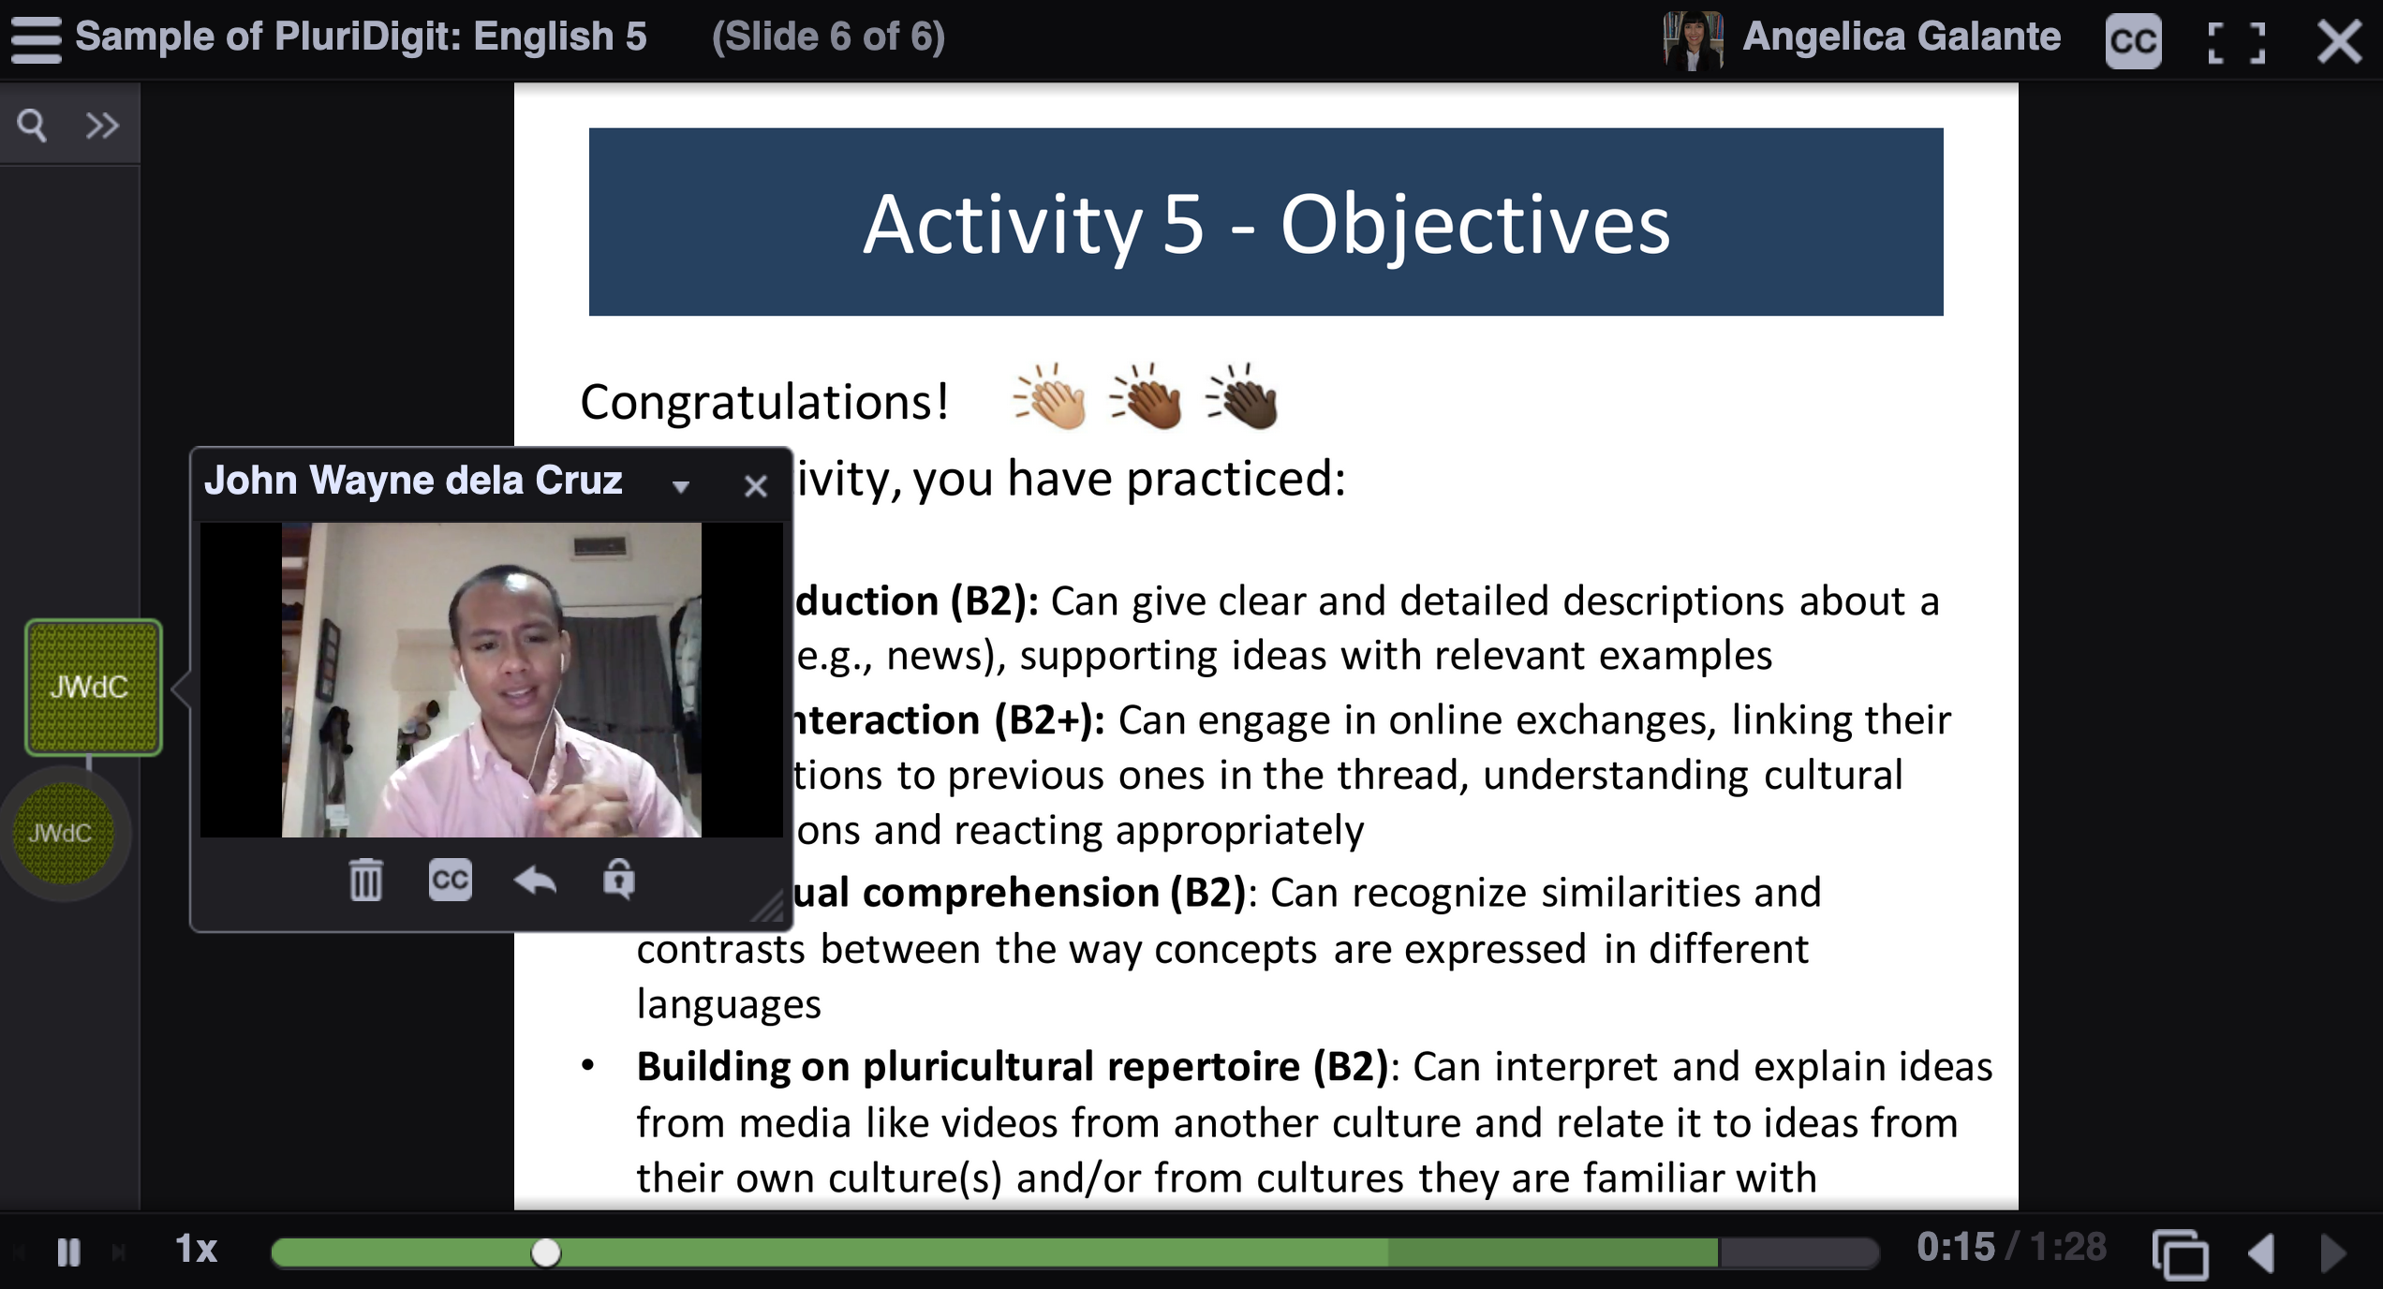
Engaging Learners’ Plurilingual and Pluricultural Competence
The process of recording audio and video posts contributed to students’ investment in their language learning since they had an audience (other students, their teacher and a research assistant)
At the end of the task, the goals were presented. They were inspired by the CEFRCV descriptors, adapted to the context and translated. They focused on what students were able to accomplish by the end of the task (rather than what they could not do)

Slide 43
Engaging Learners’ Plurilingual and Pluricultural Competence
What Were the Main Benefits?

Slide 44

Engaging Learners’ Plurilingual and Pluricultural Competence
Students gained much confidence as English speakers
Pedagogical practices ensured that students viewed themselves as plurilingual users
All of the teachers reported that they will continue to use the PluriDigit tasks as part of their course, and create new tasks to exploit students’ repertoires
Image by Gerd Altmann from Pixabay

Slide 45
Engaging Learners’ Plurilingual and Pluricultural Competence
To Conclude

Slide 46

Engaging Learners’ Plurilingual and Pluricultural Competence
A move from one-language-only to the inclusion of students’ repertoires has several benefits
Image by Here and now, unfortunately, ends my journey on Pixabay from Pixabay
The use of CEFRCV descriptors for plurilingual and pluricultural competence can be used along with other descriptors for task design

Slide 47
Engaging Learners’ Plurilingual and Pluricultural Competence
References
Cenoz, J., & Gorter, D. (2013). Towards a plurilingual approach in English language teaching: Softening the boundaries between languages. TESOL Quarterly, 47(3), 591–599.
Council of Europe (2020). Common European framework of reference for languages: Learning, teaching, assessment. https://rm.coe.int/common-european-framework-of-reference-for-languages-learning-teaching/16809ea0d4
Galante, A. (2021). Affordances of plurilingual instruction in higher education: A mixed methods study with a quasi experiment in an English language program. Applied Linguistics. http://doi.org/10.1093/applin/amab044
Galante, A. (2020). “The moment I realized I am plurilingual”: Plurilingual tasks for creative representations in EAP at a Canadian university. Applied Linguistics Review, 11(4), 551–580. https://doi.org/10.1515/applirev-2018-0116
Galante, A. (2020). Plurilingual and pluricultural competence (PPC) scale: The inseparability of language and culture. International Journal of Multilingualism. https://doi.org/10.1080/14790718.2020.1753747
Galante, A., Okubo, K., Cole, C., Abd Elkaber, N., Carozza, N., Wilkinson, C., Wotton, C. & Vasic, J. (2019). Plurilingualism in higher education: A collaborative initiative for the implementation of plurilingual tasks in an English for Academic Purposes program at a Canadian university. TESL Canada Journal, 36(1), 121–133.
Galante, A., Okubo, K., Cole, C., Abd Elkader, N., Wilkinson, C., Carozza, N., Wotton, C. & Vasic, J. (2020). ‘English-only is not the way to go:’ Teachers’ perceptions of plurilingual instruction in an English program at a Canadian university. TESOL Quarterly Journal, 54(4), 980–1009.
Kubota, K. (2016). The multi/plural turn, postcolonial theory, and neoliberal multiculturalism: Complicities and implications for Applied Linguistics,’ Applied Linguistics, 37(4), 474–494.
Lin, A. M. Y. (2020). From deficit-based teaching to asset-based teaching in higher education in BANA countries: Cutting through ‘either-or’ binaries with a heteroglossic plurilingual lens. Language, Culture and Curriculum, 33(2), 203–212.
May, S. (2014). The multilingual turn. Implications for SLA, TESOL, and bilingual education. Routledge.
Ortega, L. (2014). Ways forward for a bi/multilingual turn in SLA. In S. May (Ed.), The multilingual turn. Implications for SLA, TESOL and bilingual education (pp. 32–53). Routledge.
Piccardo, E. (2020). Plurilingualism: Vision, conceptuatlization, and practices. In P. P. Trifonas and T. Aravossitas (Eds.), Handbook of research and practice in heritage language education (pp. 207–225). Springer.
Piccardo, E., Germain-Rutherford, A., & Lawerence, G. (2021). The Routledge handbook of plurilingual education. Routledge.

Slide 48
Engaging Learners’ Plurilingual and Pluricultural Competence
Breakout Rooms

Slide 49
Engaging Learners’ Plurilingual and Pluricultural Competence
You will have 30 minutes to:
Generally state what you think of the activities.
Talk about how they relate to the concept of repertoire and plurilingual and pluricultural competence.
Discuss how you could adapt the activities to other contexts and what CEFRCV descriptors could be used.
Write your answers on the Padlet.
Group 1: Discuss Activities 1 & 2
Group 2: Discuss Activities 2 & 3
Group 3: Discuss Activities 3 & 4
Group 4: Discuss Activities 4 & 5
Group 5: Discuss Activities 5 & 6
Group 6: Discuss Activities 6 & 7
Group 7: Discuss Activities 7 & 8
Group 8: Discuss Activities 1 & 8
https://padlet.com/angelicagalante1/9aglkl6phj9yo7t5

Slide 50
Engaging Learners’ Plurilingual and Pluricultural Competence
Wrap-up

Slide 51
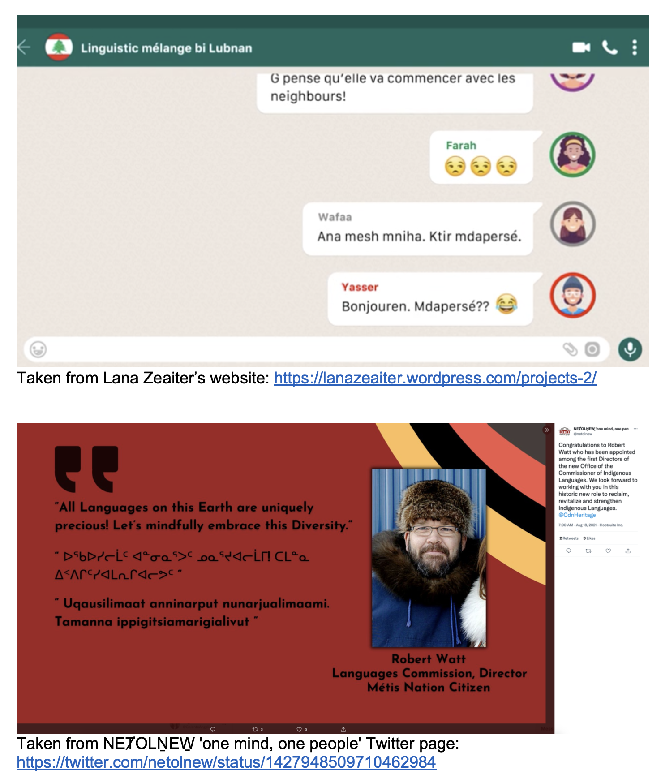
Engaging Learners’ Plurilingual and Pluricultural Competence
You will have 10 minutes to:
Post the screen shot (photo) of your pre-task to the Padlet.
Write about the choice of languages, semiotic resources, and/or modalities used. For example, why did you use this language? Why did you switch to another language? Why did you use hashtags? Why did you use emoticons?
https://padlet.com/angelicagalante1/jjbaltuolx4uessm

Slide 52

Engaging Learners’ Plurilingual and Pluricultural Competence
Thanks to the Council of Europe for hosting the CEFRCV Webinar Series
Thanks to all team members and participants in the research projects
For pedagogical resources, visit:
breakingtheinvisiblewall.com
www.mcgill.ca/plurilinguallab
Image by Tumisu from Pixabay

