Slide 1

OSCE Project Co-ordinator in Ukraine: promoting human rights education and training
Natalia Betsa, National Project Officer,
Rule of Law and Human Rights
Natalia.betsa@osce.org
Notes:
Some 10 years ago I had a privilege to undergo a traineeship at the CoE, the then Directorate General on Social Cohesion, and now I am honored to present the activities of the CoE – friend/partner organization – Organization for Security and Co-operation in Europe – Project Co-ordinator in Ukraine in the area of HRE.
As it is stated in the objectives and principles of the Council of Europe Charter on Education for Democratic Citizenship and Human Rights Education,
j. Given the international nature of human rights values and obligations and the common principles underpinning democracy and the rule of law, it is important for member states to pursue and encourage international and regional co-operation in the activities covered by the present Charter and the identification and exchange of good practice.
Moreover, the OSCE activities in the area of HRE in Ukraine have been acknowledged by the government of Ukraine and provided in Ukraine’s reply to the Charter questionnaire for the 2016 Report on the State of Citizenship and Human Rights Education in Europe

Slide 2

OSCE – comprehensive concept of security
politico-military
economic and environmental
human dimensions
Within the human dimension the OSCE
helps its participating States:
strengthen democratic institutions;
hold genuine and transparent democratic elections;
promote gender equality;
ensure respect for human rights, media freedom, the rights of persons belonging to national minorities and the rule of law;
and promote tolerance and non-discrimination.
Notes:
Lasting security cannot be achieved without respect for human rights and functioning democratic institutions.
Education plays an essential role in the promotion of democracy, human rights and the rule of law, as well as in the prevention of human rights violations.
Through human rights education, young people should be able to practice skills and attitudes that empower them to enjoy and exercise their rights, and to respect and uphold the rights of others.
“Human rights education” means education, training, awareness raising, information, practices and activities which aim, by equipping learners with knowledge, skills and understanding and developing their attitudes and behaviour, to empower learners to contribute to the building and defence of a universal culture of human rights in society, with a view to the promotion and protection of human rights and fundamental freedoms.

Slide 3
OSCE HRE Commitments
The Helsinki Final Act (1975) affirmed the right of individuals to know their rights
The Copenhagen Document (1990) stressed on the importance of observing human rights and fundamental freedoms and developing and discussing ideas for improved protection of human rights and better means for ensuring compliance with international human rights standards
The Moscow Document (1991) was the first OSCE document that explicitly mentioned human rights education, stressing its fundamental role and the importance of educating people on human rights and fundamental freedoms

Slide 4
OSCE HRE Commitments
The Helsinki Document (1992) stated that the OSCE participating States “will consider developing programmes to create the conditions for promoting non-discrimination and cross-cultural understanding which will focus on human rights education, grass-roots action, cross-cultural training and research”
The OSCE Strategy to Address Threats to Security and Stability in the Twenty-first Century (MC.DOC/1/03, Maastricht) encouraged the participating States to take on a stronger role in the field of HRE aimed at the younger generation, in order to build up understanding of the need for tolerance and the importance of reconciliation and peaceful coexistence
Final Report of the Supplementary Human Dimension Meeting on “Human Rights Education and Training” (ODIHR.GAL/33/04, Vienna) emphasized that “effective human rights education contributes to combating intolerance, religious, racial and ethnic prejudice and hatred, including against Roma, xenophobia and anti-Semitism”

Slide 5
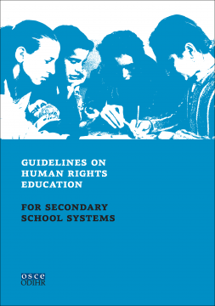
OSCE HRE Commitments
Ministerial Council Decision No. 11/05 on “Promotion of Human Rights Education and Training in the OSCE Area” recognized that the “promotion of human rights through education and training in the whole OSCE area could be viewed in the context of the OSCE’s comprehensive concept of security and is vital for the strengthening of respect for human rights and fundamental freedoms”.
OSCE ODIHR Guidelines on human rights education
for secondary school systems (2012) presented approaches
to be adopted when planning or implementing human rights
education for secondary schools related to such structural
areas as: the human rights-based approach to education;
core competencies; curricula; teaching and learning
processes; evaluation; and professional development and
support of educational personnel.
Notes:
The only OSCE document to date which is dedicated specifically to HRE. The decision encouraged the OSCE community to increase its efforts in co-operating with other international organizations and non-governmental organizations to take necessary measures aimed at promoting human rights education and training, with special emphasis on young people in the OSCE area.
ODIHR Guidelines
For secondary school systems – translated into Ukrainian
For human rights defenders
For law enforcement officials
For human rights activists
Compendium of Good Practices in HRE in Central Europe, South Caucasus…

Slide 6
OSCE Project Co-ordinator’s approach to HRE
MULTI-STAKEHOLDER APPROACH Ukrainian project partners: Ministry of Education and Science Ministry of Justice Parliament’s Commissioner for Human Rights (Ombudsperson) International partners: Council of Europe The European Wergeland Centre Amnesty International | DIFFERENT TARGET AUDIENCE School kids School teachers University students University professors Civil society representatives Civil servants Judges
VARIOUS THEMATIC AREAS Children’s rights Fundamental human rights and international protection mechanisms ECHR and the case law of the ECtHR Gender equality, tolerance and non-discrimination Conflict prevention and dialogue Human rights education tools (developed by UN, CoE, OSCE) Teaching methodology and critical thinking | DIFFERENT FORMS OF INTERVENTION Action Plan on HRE Practical Proposals on Developing Competences for Democratic Citizenship in New Ukrainian School (jointly with the CoE, European Wergeland Centre and others) Recommendations on the introduction of HRE into school curriculum New school and university courses New in-service training programs for school teachers, university professors, judges, including online courses Capacity building (trainings, summer schools)
Notes:
Multi-dimensional approach
Various projects
Different levels of intervention – policy and reform level, university and school level
Action Plan within the framework of implementation of the National Strategy on Human Rights, adopted by the Decree of the President of Ukraine in 2015
An essential element of all education for democratic citizenship and human rights education is the promotion of social cohesion and intercultural dialogue and the valuing of diversity and equality, including gender equality; to this end, it is essential to develop knowledge, personal and social skills and understanding that reduce
conflict, increase appreciation and understanding of the differences between faith and ethnic groups, build mutual respect for human dignity and shared values, encourage dialogue and promote non-violence in the resolution of problems and disputes.
Conflict in and around Ukraine

Slide 7
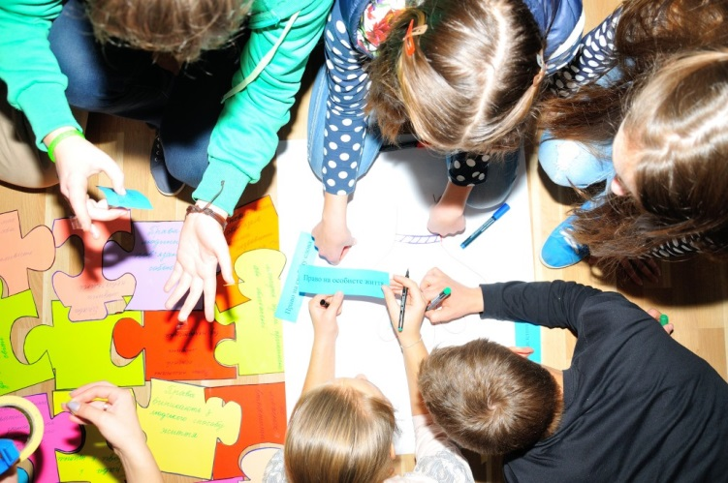
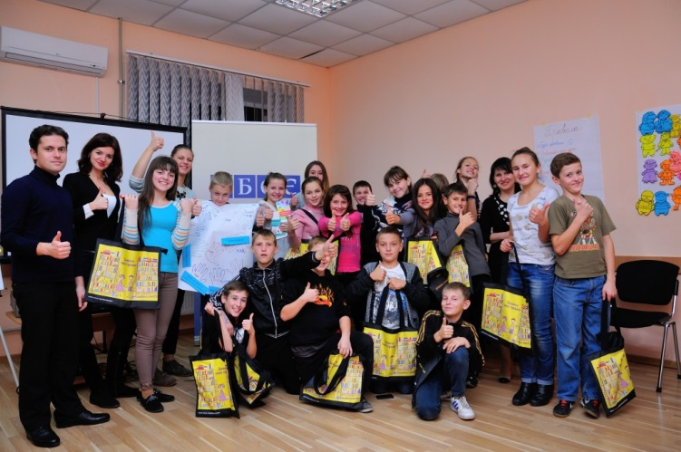
ANNUAL HUMAN RIGHTS SCHOOL FOR KIDS
Launched jointly with Ombudsperson in 2015
Initiated as annual and evolved into semi-annual: dedicated to International Day for the Protection of Children (1 June) and to Universal Children’s Day (20 November)
Creates a discussion platform for kids from different social and economic backgrounds
Targets different age groups
Notes:
Request from the Ombudsperson to provide assistance for kids in light of the current situation in Ukraine
UNICEF's Ukraine: The conflict in Ukraine has deeply affected the lives of 580,000 children living in non-government controlled areas and close to the front line in eastern Ukraine. Of these, 200,000 – or one in three – need psychosocial support.
More than 215,000 children are internally displaced from the conflict-affected areas.
Children in eastern Ukraine require urgent and sustained support to help them come to grips with the daily trauma of war. Children live in a state of constant fear and uncertainty. The trauma has taken a huge emotional and psychological toll.
Need education kits and school supplies

Slide 8
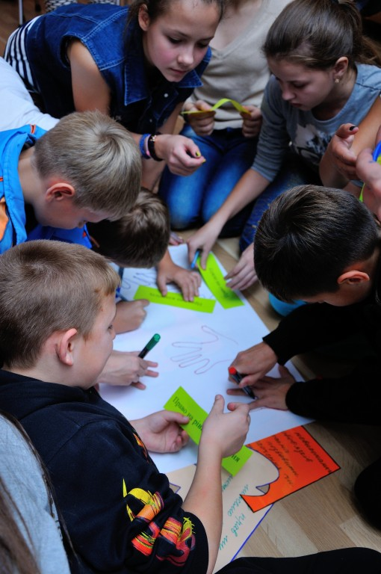
ANNUAL HUMAN RIGHTS SCHOOL FOR KIDS
Participants from all across Ukraine, including from conflict-affected areas in eastern Ukraine
Training methodology – interactive
and engaging
Topics include inter alia:
human rights and children’s rights
security and conflict prevention
tolerance and non-discrimination
domestic violence
gender equality
social inclusion (with the focus on internally
displaced population, mostly women and kids)
Number of kids trained through
human rights schools - 300,
through spill over effect – more than 1000
Notes:
SKILLS
- Identify human rights violations, including their root causes and consequences;
- Apply human rights principles in resolving interpersonal conflicts;
- Take an active part in discussions and debates, participating sensitively and constructively on controversial human rights topics;
- Identify and apply strategies for opposing all forms of discrimination and bullying;
Methods: quests, quizzes, case studies, mini-presentations, demonstration of short films on human rights, group work
Examples of practical exercises on non-discrimination, IDPs, stereotypes

Slide 9
OSCE PCU educational materials
Notes:
It is important to help teachers and educators working in school institutions through including specific HRE programs in pre- and in-service training. This is an ambitious goal requiring a whole educational reform process, which is currently underway. Therefore, we provide assistance in raising their awareness on HRE through training and equipping them with tools necessary for promoting the HRE culture.
Ukrainian and Russian versions of the UN Convention on the Rights of the Child
Promotional materials
HRE toolkits for teachers
Schools should be places where the dignity of every child is upheld and where knowledge about human rights is connected to the opportunity to
experience human rights in everyday school life. Through human rights education, young people should be able to practice skills and attitudes that
empower them to enjoy and exercise their rights, and to respect and uphold the rights of others.

Slide 10
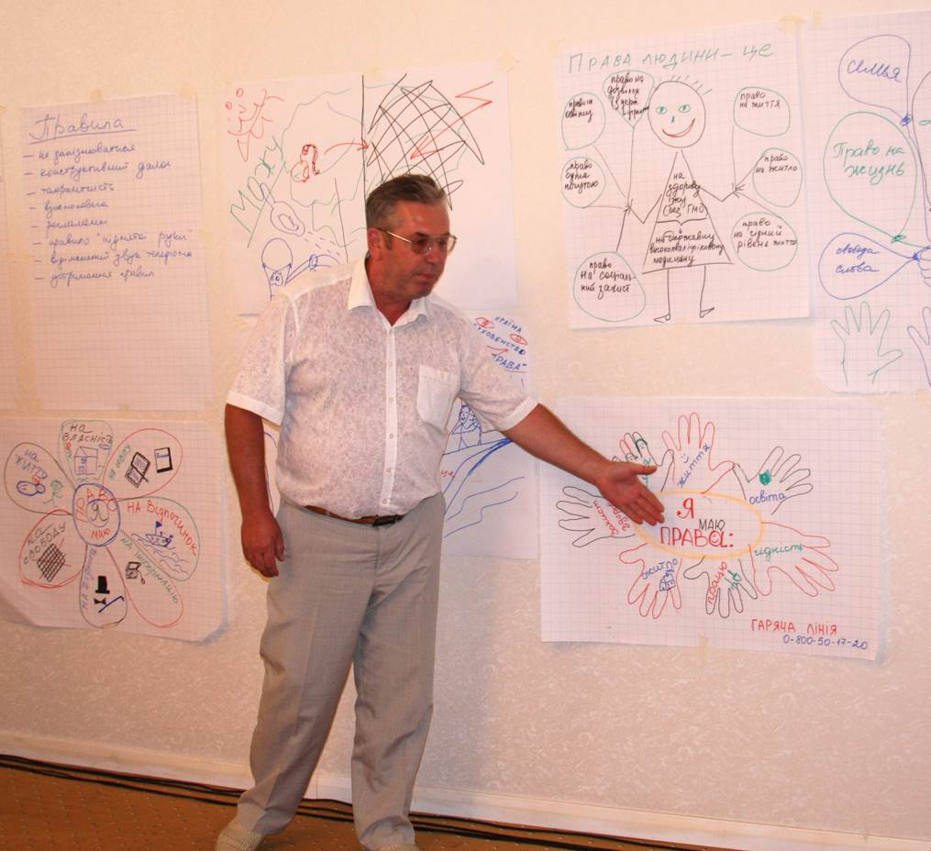
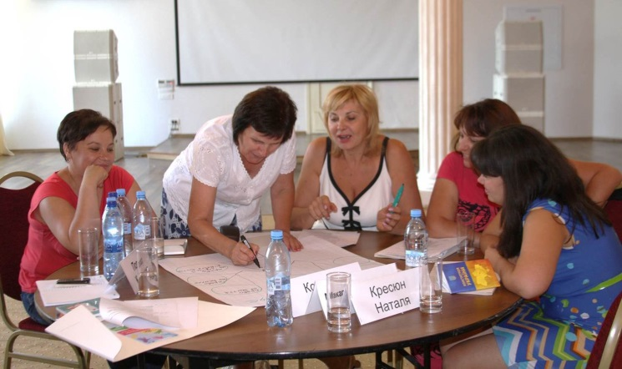
Human rights education trainings for school teachers
Launched jointly with the Ministry of Education in 2013
700 teachers trained through 3-day intensive trainings (many more through spill-over effect – evaluation is in process)
Topics include inter alia:
fundamental human rights
international standards of human rights protection
gender equality, tolerance
and non-discrimination
teaching methodology and tools
critical thinking
competence-based teaching and learning
Notes:
The role of teachers in promoting democratic values through active, participatory teaching is widely acknowledged.
Focus on:
- HRE knowledge and understanding;
- Sharing values
- teaching and learning activities that develop HRE competencies in the classroom and school (planning, class management, teaching and assessment);
Follow up – 450 k teachers in Ukraine – a need to develop an online human rights course to provide wider access to HRE practices
More and more educators in Europe and in the world are trying to come up with suggestions on how to equip learners with competences for living in democracy
PRACTICAL PROPOSALS
Developing Competences for Democratic Citizenship in the New Ukrainian School:
Democratic competences can be developed best when this task is not limited to one discipline or extra-curricular activities only, but rather embarked on via a set of combined efforts across the whole teaching and learning process at school.
Schools would benefit if the teaching and learning process is planned and carried out in the following way:
– the cross-curricular and transversal approach is used to develop democratic competences;
– active and interactive teaching methods are used in classroom;
Training methods – discussions, case studies, simulations, screening of short documentary films on human rights

Slide 11

Human rights education trainings for school teachers
Voice of stakeholders:
“OSCE materials on human rights education are
very helpful and provide necessary tools and
techniques to work with school students,”
Natalia Dnistrianska, trainer and lyceum teacher
from Lutsk, north-west Ukraine.
“After I completed the OSCE PCU course last year, I introduced a course on human rights, based on the methodology developed by the OSCE at my lyceum, which was very well received. I will continue to share my knowledge and expertise with other teachers from all around Ukraine.”

Slide 12
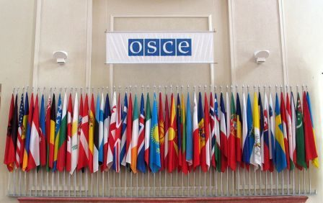
Thank you!
http://www.osce.org/ukraine

