Slide 1
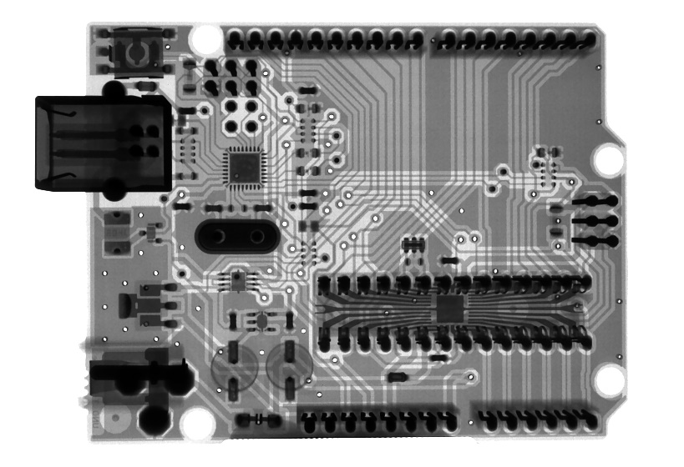
Critical perspectives on AI in education
Photo by Mathew Schwartz on Unsplash
Ben Williamson | @BenPatrickWill

Slide 2
Source: https://www.vice.com/en/article/m7g5yq/students-are-using-ai-to-write-their-papers-because-of-course-they-are

Slide 3
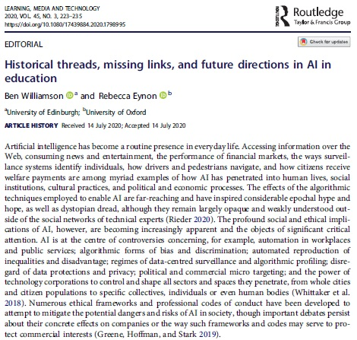
Histories of AI in education

Slide 4
Defining AI
Instead, the Privacy Center will:
(1) Be as specific as possible about what the technology in question is and how it works
(2) Identify any obstacles to our own understanding of a technology that result from failures of corporate or government transparency
(3) Name the corporations responsible for creating and spreading the technological product
(4) Attribute agency to the human actors building and using the technology, never to the technology itself

Slide 5
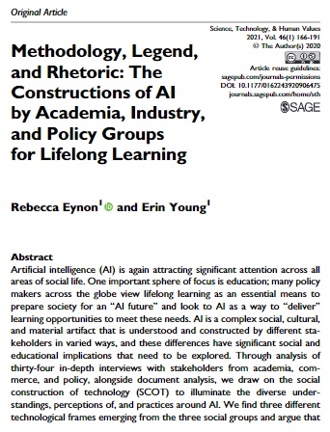
Defining the “AI” in AIED
AI is a complex social, cultural, and material artifact that is understood and constructed by different stakeholders in varied ways, and these differences have significant social and educational implications

Slide 6
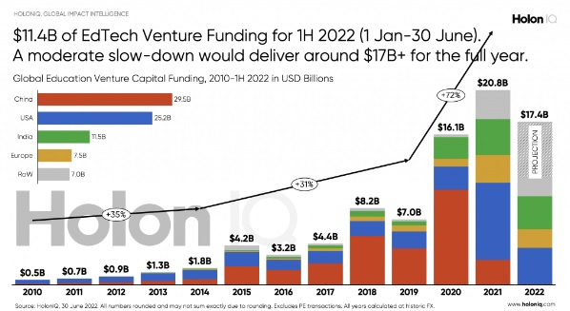
The political economy of AIED
AIED development and deployment is situated in political and economic contexts, shaped by both policy and market imperatives, which determine how AIED gets made, legitimized and used
Source: holoniq.com

Slide 7
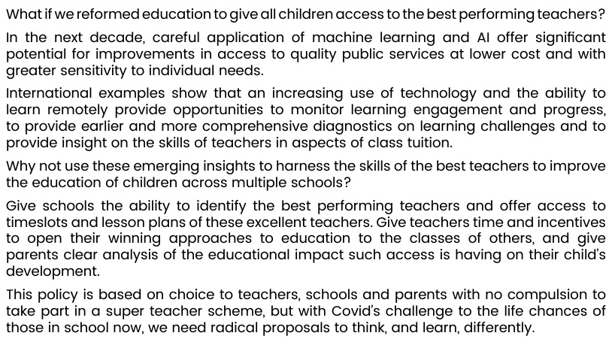

Slide 8
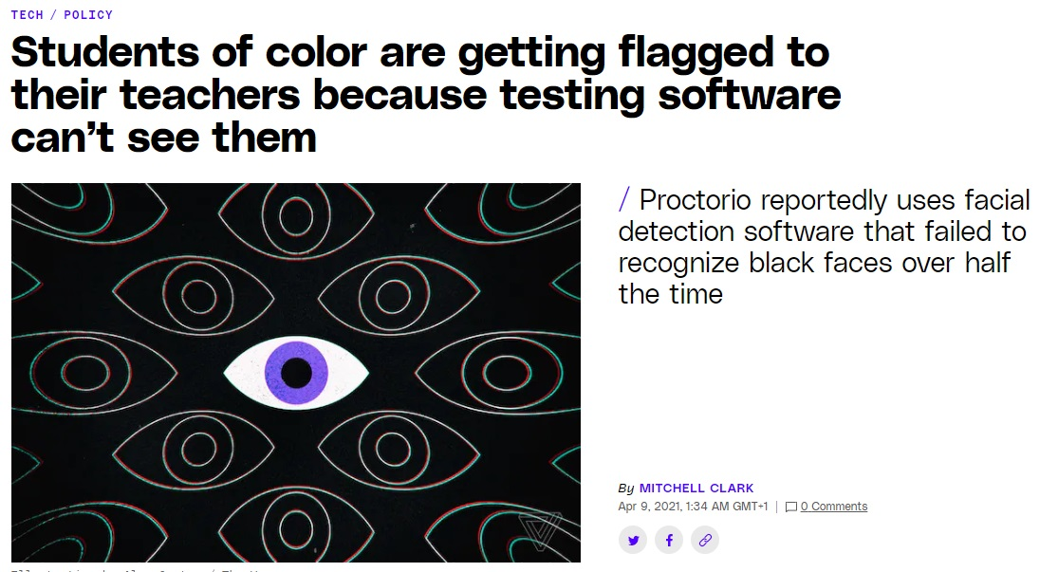
Risks of discrimination through AIED
AIED raises profound risks of reproducing socioeconomic inequalities and/or generating new forms of data injustice
Source: https://www.theverge.com/2021/4/8/22374386/proctorio-racial-bias-issues-opencv-facial-detection-schools-tests-remote-learning

Slide 9
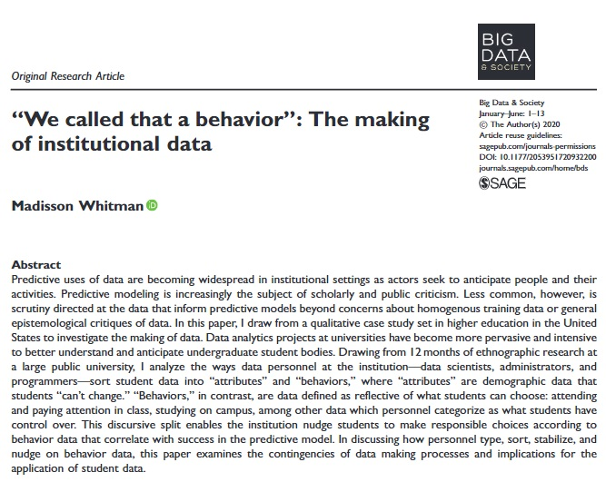

Slide 10
The commercialization of AIED
AI-based business plans are key ways the commercial EdTech and Big Tech industries are penetrating and transforming public education systems

Slide 11
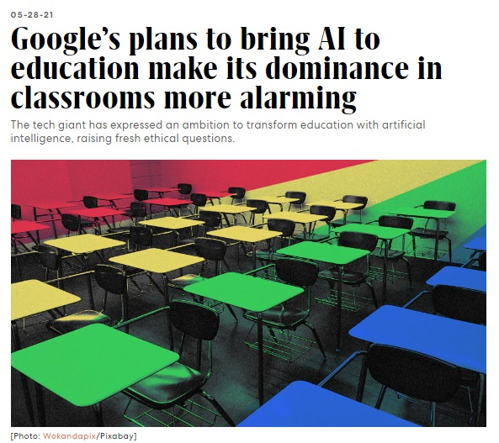
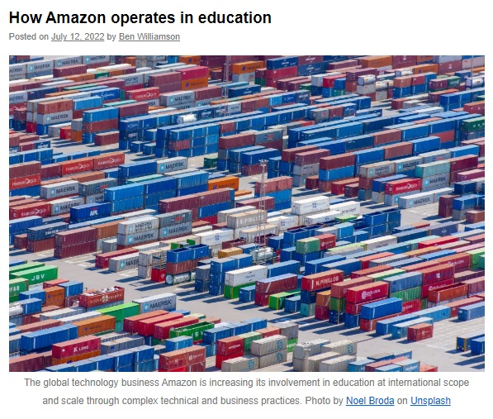
Source:
https://www.fastcompany.com/90641049/google-education-classroom-ai
Source: https://codeactsineducation.wordpress.com/2022/07/12/how-amazon-operates-in-education/

Slide 12
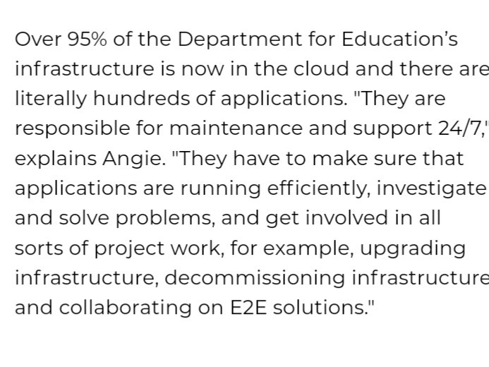
Governance through AIED
AIED provides new computational and data processing capacities to monitor education systems, institutions and individuals, representing a shift from governing through numbers to digital governance
Source:
https://www.qa.com/about-qa/our-thinking/case-study-qa-talent-department-for-education/

Slide 14
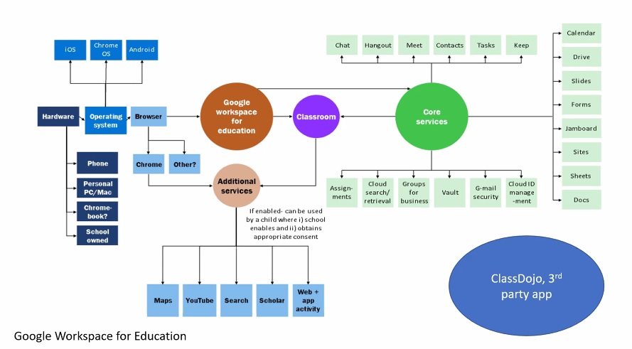
Ethics and regulation of AIED
Frameworks of ethical regulation of AI in education, from the EU to the White House, offer important signals of ethical and regulatory intent but may be hard to enforce
Source:
https://digitalfuturescommission.org.uk/blog/whats-the-problem-with-regulating-edtech-towards-power-with-responsibilities/

Slide 15
ben.williamson@ed.ac.uk | @BenPatrickWill
https://codeactsineducation.wordpress.com/2020/08/18/social-life-artificial-intelligence-education/

