Slide 1
Quality and impact of youth work in youth centers - the Finnish experience
The situation in Finland and how we got where we are now
Starting with the legislation and the structures and roles
Case Kanuuna and the biggest municipalities in the country
Presentation of the Finnish youth centres
Presentation of Villa Elba
Quality and impact in the youth centres
Scorecard
Next step: a new system
Final remarks

Slide 2
Youth Work and Youth Policy in Finland
Young people started to found youth associations 1881
A part of the national awakening – an self governing area 1809 and independence 1917
First youth legislation 1972 ; aim to create possibilities for young people at their free time
Present legislation is from 2016 http://minedu.fi/en/legislation-youth
support young people’s free-time pursuits and engagement in civic society
promote the social inclusion of young people
improve young people’s growth and living conditions

Slide 3
Definitions for the purpose of the legislation
young people: under 29 years of age
youth work: the efforts to support the growth, independence and social inclusion of young people in society
youth policy: coordinated actions to improve young people's growth and living conditions and interaction between the generations
youth activities: spontaneous action taken by young people themselves
national youth work organisation means a registered association or foundation providing activities or services based on the principles of this Act http://minedu.fi/en/youth-organisations
national youth work centre of expertise means an entity that seeks to develop and promote competence and expertise in youth-related issues on a nationwide basis
youth centres to provide services and to develop methodologies for youth work http://minedu.fi/en/national-youth-centres

Slide 4
Definitions for the purposes of the legislation 2
Youth Policy Programme for the period of running (four years)
specifies more detailed objectives for the national youth work and policy and the support to be provided for these efforts
prepared by the Ministry of Education and Culture and young people and key actors engaged in youth work and policy are to be consulted http://minedu.fi/en/policies-and-development-youth
Key objectives 2017
Statistics and more http://www.nuorisotilastot.fi (also in English)
All children and young people will have a possibility to engage in at least one free-time hobby of their choice;
Young people’s employability skills will be reinforced;
More opportunities for participation and exerting influence will be created for young people;
Fewer young people will suffer from mental health problems, thanks to preventive work; and
Young people will be provided with sufficient guidance and other support for independent living.

Slide 5
Structures and responsibilities
The Ministry of Education and Culture is responsible for the overall administration, coordination and development of the national youth policy, and for the creation of favourable conditions for the pursuit of this policy within the central government www.minedu.fi/en
Regional state administrative agencies are responsible for:
developing the national youth work and policy in the local context
granting state aid and assessing the impact of the aid granted
issuing informative guidelines
gathering information on youth work and policy
assessing the quality and accessibility of the services intended for young people https://www.avi.fi/en/web/avi-en/

Slide 6
Structures and responsibilities 2
Local governments (municipalities) have the task to create the conditions for local youth work and activities by:
providing services and premises for young people
supporting their civic engagement in cooperation with others
establish a cross-sectoral steering and service network to address issues related to young people https://www.kokkola.fi/etusivu/en_GB/etusivu/
Youth Centres
Eligibility given by the Ministry of Education and Culture (for state aid)
Preconditions for the financing:
the centre pursues the objectives and promotes the principles set out in the Act
the youth centre’s main activity is to offer young people guided adventures, nature- or environment-related or cultural or camping activities
the youth centre shall seek to promote the international orientation of young people and sustainable development http://www.snk.fi/finnish-youth-centre-network.html and
http://www.villaelba.fi/en/en_GB

Slide 7
Structures and responsibilities 3
State Youth Council
working together with the Ministry of Education and Culture, members appointed by the Government
task to address issues, make initiatives and proposals, keep up-to-date information on young people and their living conditions, issue statements and monitor international development and cooperation in the sector
Local Youth Council
Local Government Act (2015) made it mandatory to have Youth Councils in every municipality in Finland; at the moment 70% of municipalities have a local youth council
task to represent young people in municipality and make young people’s voices heard
co-operate with each other under the umbrella of the Union of Finnish Youth Councils

Slide 8
Structures and responsibilities 4
Allianssi is a national organisation for youth work services and influence
125 members: national youth and educational organisations
The Finnish Youth Research Society
purpose of promoting multidisciplinary youth research in Finland and providing information and expertise on matters relating young people - studies, perspectives, interpretations and political stands https://www.youthresearch.fi/

Slide 9
Structures and responsibilities 5
Youth workshops
support young people aged under 29 in tackling issues related to education and training, working life and life management
work-oriented and learning environments
these activities are organised by municipalities, associations and foundations among other things ant are available in over 90% of all municipalities https://www.tpy.fi/jarjesto/briefly-in-english/
Outreach youth work
assists young people under the age of 29 who are excluded from education and working life or who need support in accessing the services they need
municipalities decide whether or not to organise outreach youth work, today these activities cover more or less the entire country

Slide 10
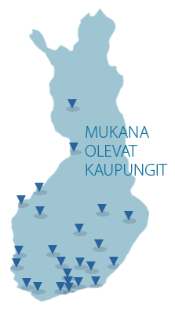
Quality Youth Work in Finland, case Kanuuna
The Kanuuna (Cannon) Network
Finnish network of local youth work
a national youth work centre of expertise
27 biggest cities and 60% of the young people
main activities:
support peer learning in youth work and youth policy
carry out research and development projects and
function to stand for and be an expert of youth work and young people
http://www.nuorisokanuuna.fi/what

Slide 11
Quality Youth Work in Finland: case Kanuuna 2
indicators and quality assessment
Why: increasing pressure to prove its outcomes and its quality
Opponent: some strongly oppose ‘the measurement tendency”
Kanuuna network has developed a set of indicators to make its youth work transparent, to assess and develop it
statistical indicators on key activities (number of visits, group work activities, long-term support of youth at risk, camping activities, on-line contacts, camps, number of youth organizations and their members etc.)
statistical info about the youth services of the member cities
key indicators of the welfare of young people based on a large national School Health Survey
quality assessment data of open youth work using the tool described next

Slide 12
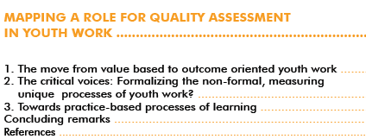
Quality youth work in Finland: case Kanuuna 3 ”youth work quality assessment” - publication
http://www.nuorisokanuuna.fi/sites/default/files/filedepot/youth_work_quality_assessment_verkkoversio.pdf

Slide 13
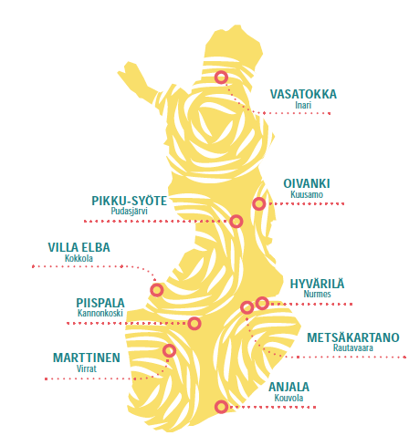
Finnish Youth Centres
Start: the Conference for Security and Cooperation in Europe in 1975: How to support national and international mobility of youth?
established between 1982 and 2000, today 9 centres
centres are specialised: e.g. Villa Elba international youth work and environmental education
good quality services and facilities at reasonable prices
experts in non-formal education

Slide 14
Finnish Youth Centres 2
Youth centre pedagogy: a common educational approach to work with children and young people
based on humanistic idea of man and experimental learning in surroundings characteristic for youth centres:
welcoming, respectful, nature-loving with excellent facilities for experimental learning in groups
Common for the centres:
Services related to camp schools, nature schools and environmental education, youth camps and youth events, family and recreational holidays, safe environment
Social youth work – Nuotta coaching for the youth workshops and outreach youth work
regional and national development projects on youth work
international youth work
each centre have its own administration and economy and offers services based on local strengths

Slide 15
Youth Center Villa Elba
Location
History
summer house tradition area since 1860's
1960’s summer camp area
international youth centre since 1991
Organisation
owned by the municipality of Kokkola
staff: 15 permanent and person-years approx. 19
expert, service and administration teams

Slide 16
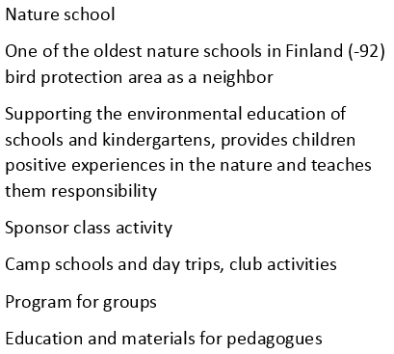
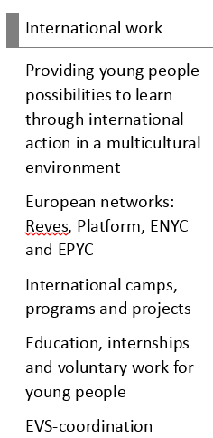
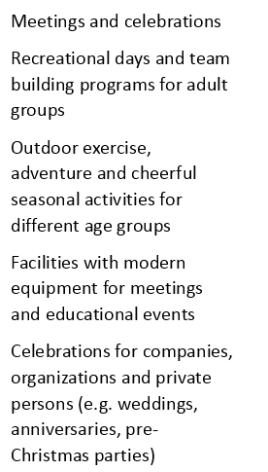
Youth Centre Villa Elba 2: activities

Slide 17
Quality and impact of youth centres
Overall level
youth work in the centers in Finland and also in municipal youth work traditionally more doing than theory and documents
in youth centers difficult to define what result comes from what action (school, family etc.) because of the nature of the activity and the duration
easier to measure quantity and these indicators are well developed
no clear demand from the decision makers and the ministry to also measure impact and quality of the work

Slide 18
Finnish Youth Centres Quality Work
started in 2016 when the Ministry of Education and Culture initiated this work (also in other networks)
all centres represented by “quality persons” in the working group; also staff from the association, me technical chairperson
the models in the beginning was:
Quality Label for Youth Centres criteria
Kanuuna networks (at that time) level descriptions
aim to create own tool for the quality work with three levels: excellent, good and satisfying
this to encourage the centres to develop the satisfying parts
also a tool for the Ministry in decision-making and evaluation

Slide 19
Finnish Youth Centres Quality Work 2
unrealistic time schedule
staff (association) did not have enough know-how (1 administrator, 1 intern)
the members representing the centres did not have enough know-how (instructors, janitor etc.)
difficulties to find common ground within the working group
different ways of working
lack of know-how
2017 new direction for the work (new staff at the association) → scorecard
Initial phase: the level descriptions were a solid part of it
Final phase: a minimum level scorecard was achieved, based on the legislation’s requirements

Slide 20
Finnish Youth Centres Scorecard
Areas
Good quality camp activities
International youth work
Sustainable development and environmental responsibility
Regional development of youth work
Impact in society and ability to serve
How to make youth centres better known and communication
Economy in youth work
Matrix
objectives; evaluation criteria & indicators; means; results; development actions, responsible person & time schedule

Slide 21
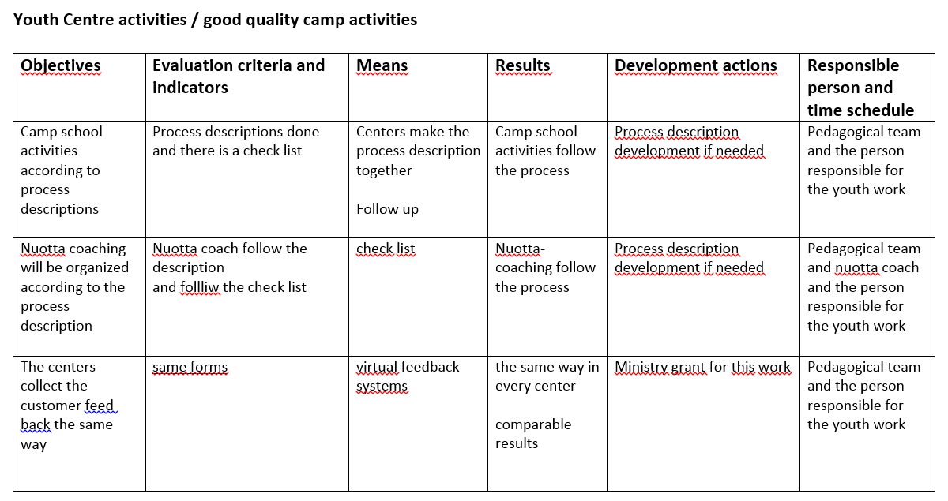
Finnish Youth Centres Scorecard Not an official translation!

Slide 22
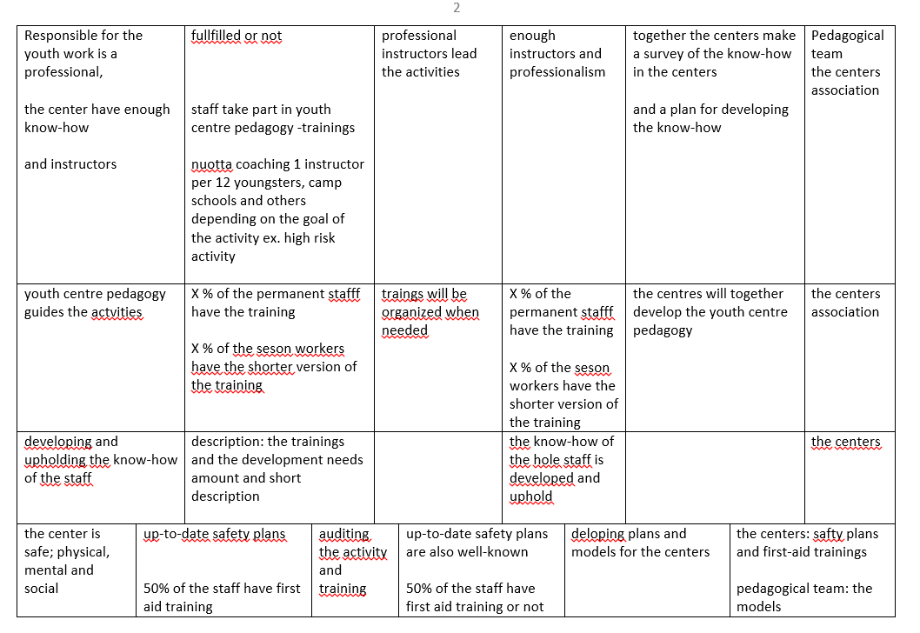

Slide 23
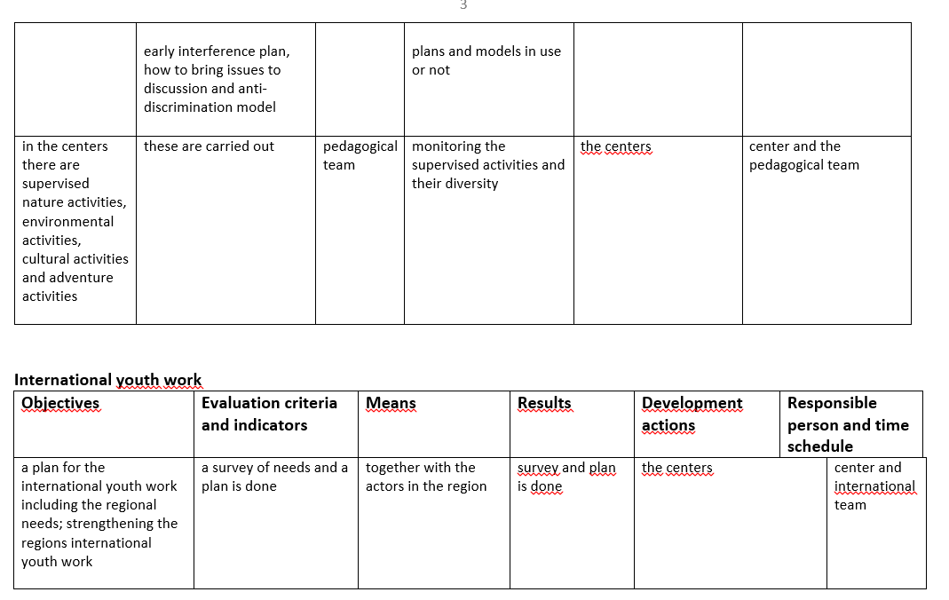

Slide 24
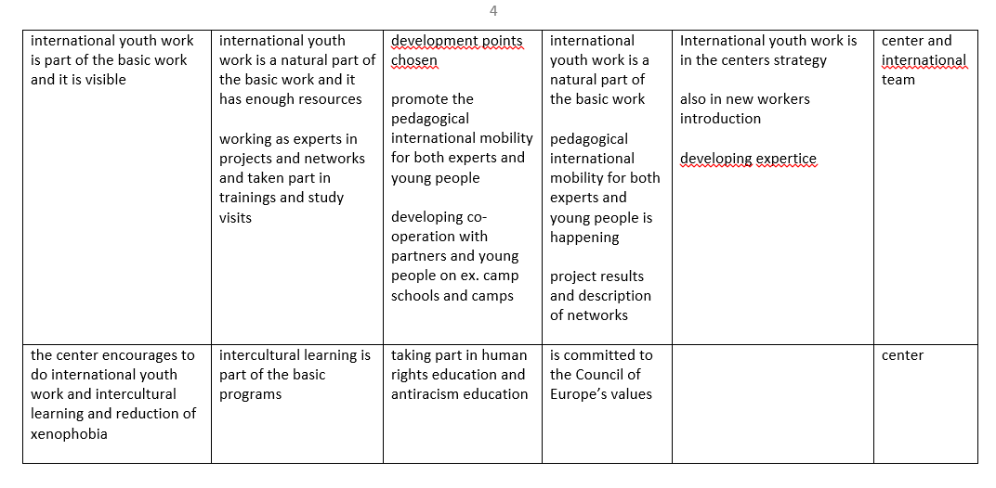

Slide 25
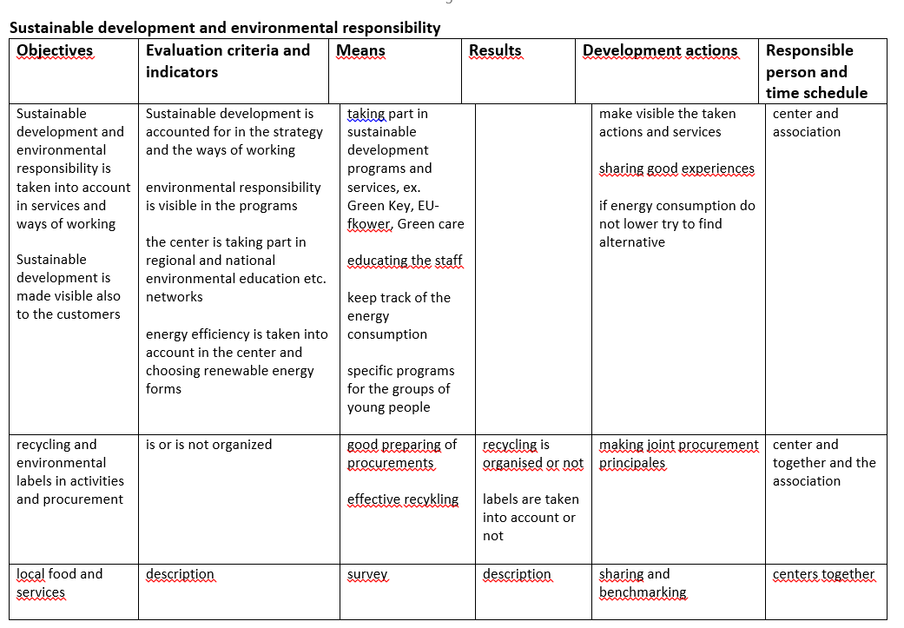

Slide 26
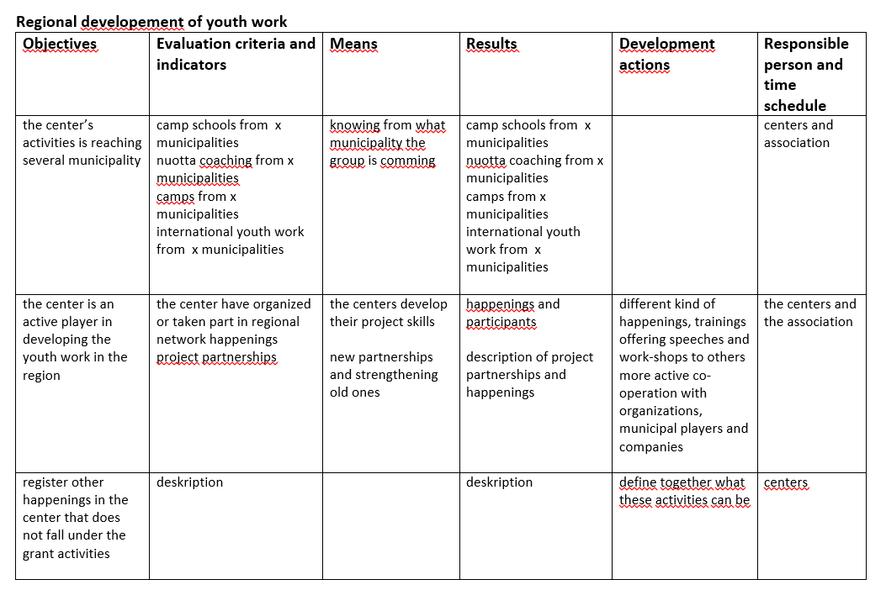

Slide 27
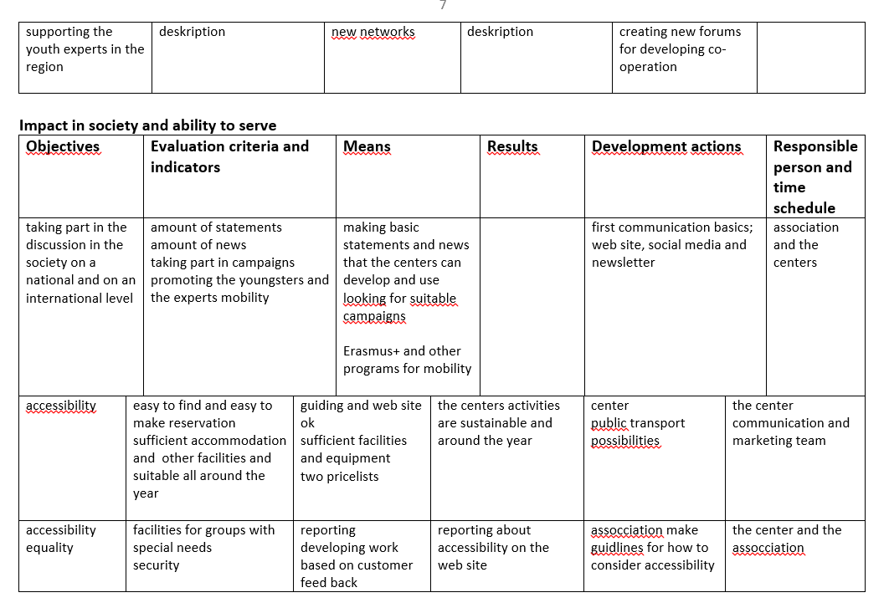

Slide 28
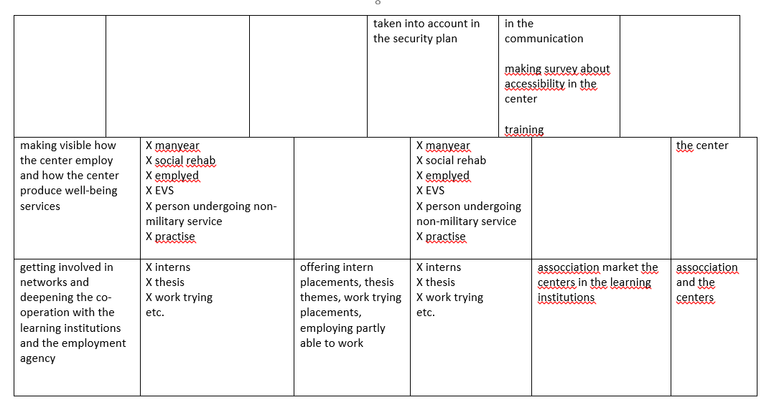

Slide 29
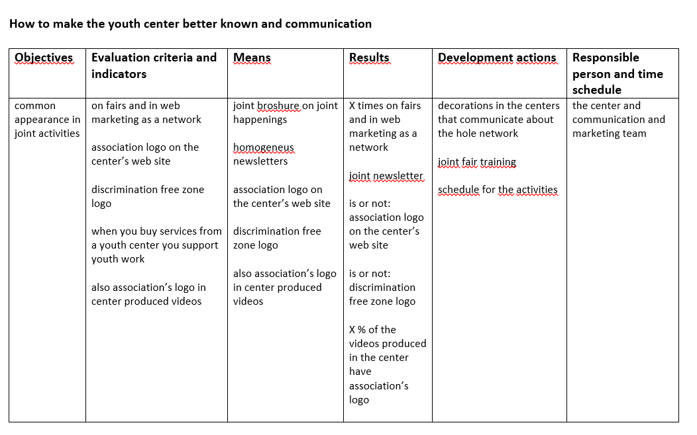

Slide 30
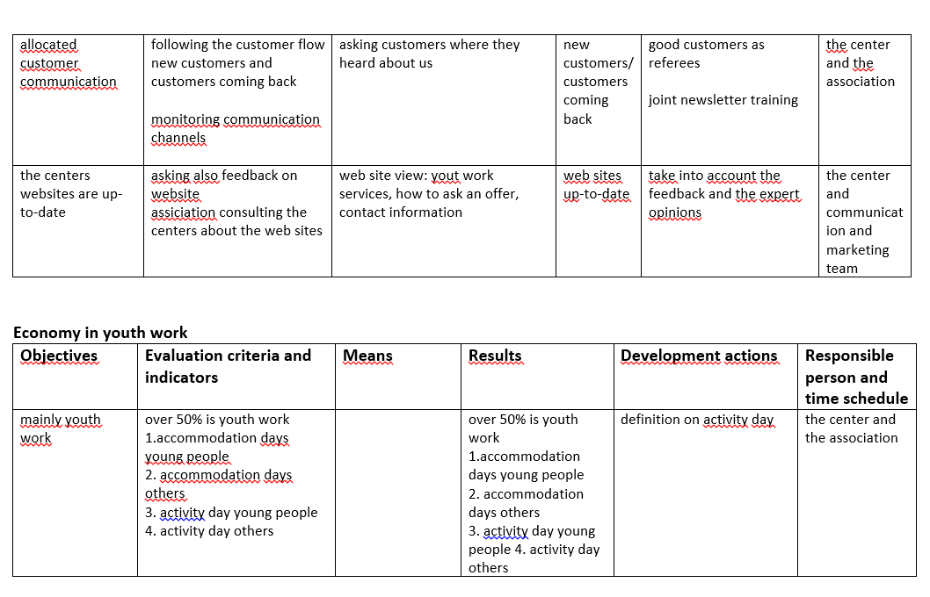

Slide 31
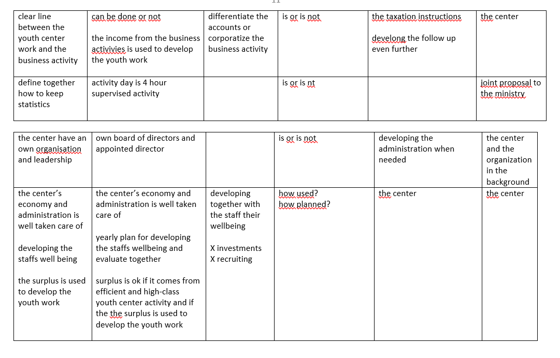

Slide 33
Next step: a new system for monitoring & evaluation of youth centres activities
Ministry outsourcing the work to the Youth Centre Association → project
Why?: the need for monitoring and evaluation is increasing in all activities
Public financing – how is it used and what does it bring
The new Youth Act and the Government’s Decree state that centres need to have a system in place for monitoring and assessing its own activities
Non-profit activities and business activities (with revenue) are kept apart
Competition neutrality
Digitalization
The current system is old fashioned and takes a lot of time
Requirements:
- Easy to use and cloud computing
- Easy to develop when new demand arise
- Might be integrated with other systems in the future e.g. reservation systems

Slide 34
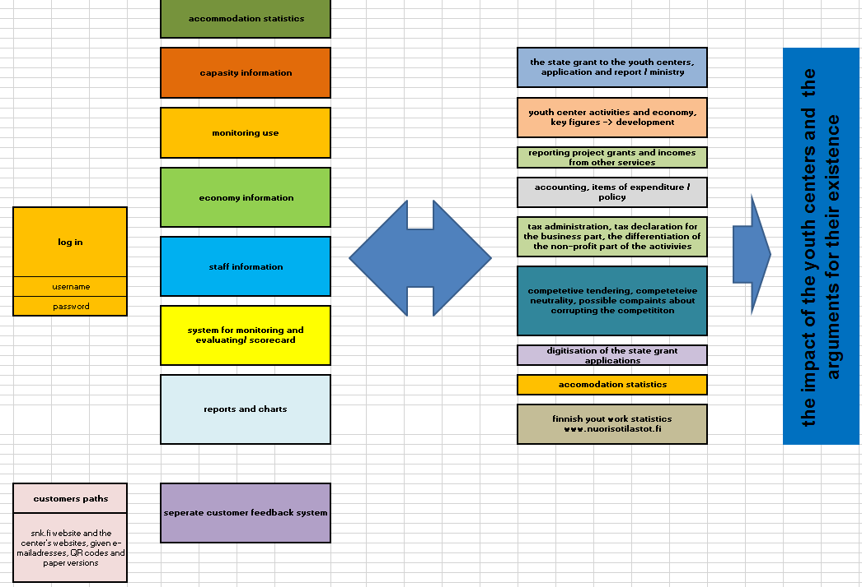
Not an official translation!

Slide 35
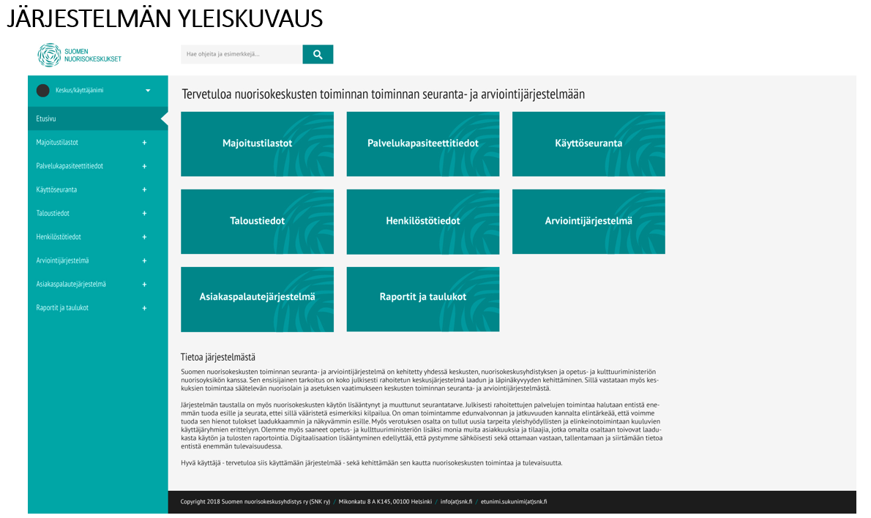

Slide 36
Final remarks
youth centres are very good at measuring quantity; the association have an exel for every possible question
youth centres do not seem to have interest in measuring quality of the work at group and youngster/individual level
is there a belief that if you measure quantity the quality is measured at the same time?
the chief operating managers often do not have a background in youth work – is there enough know-how?
the quality label criteria were not embraced
the instructions from the Ministry were not generous
the view is often some kind of “average thinking”
the new system does not have a quality aspect
i

Slide 37
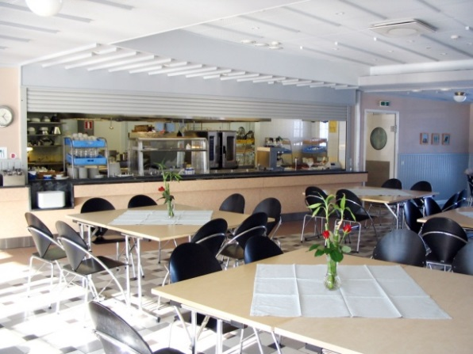
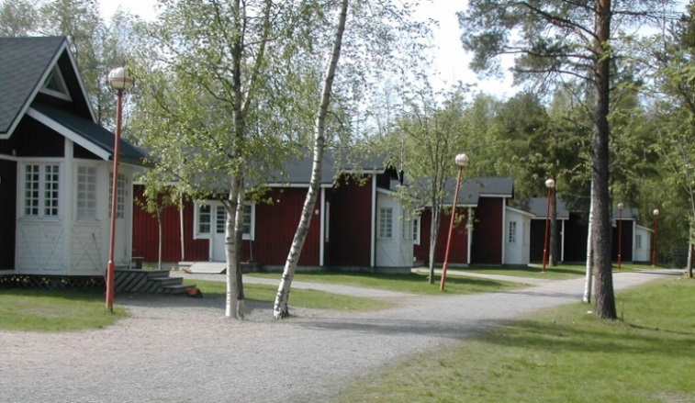
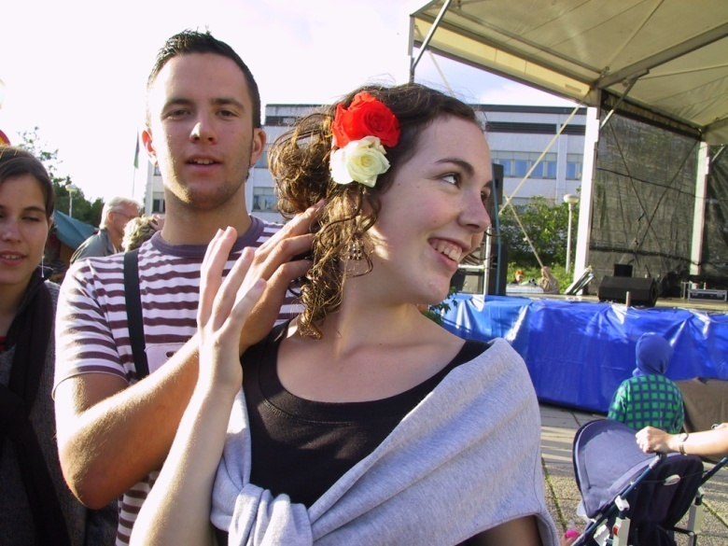
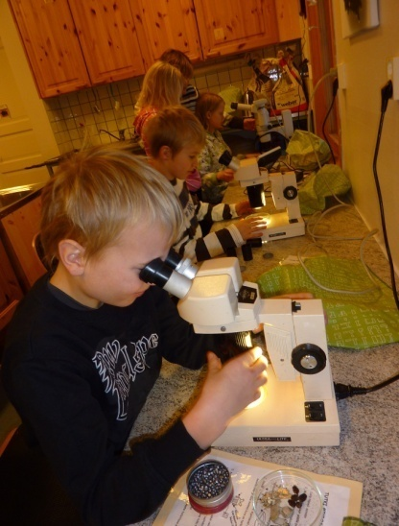
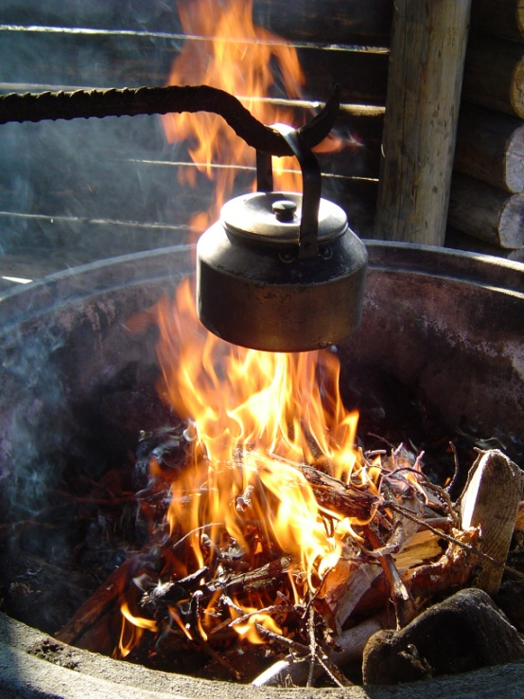
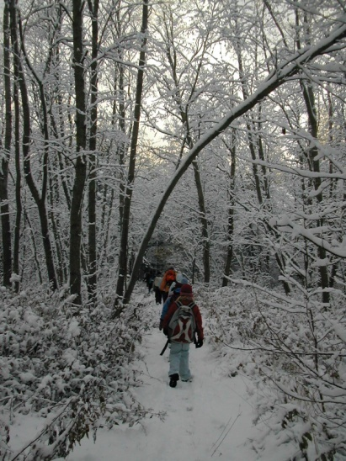
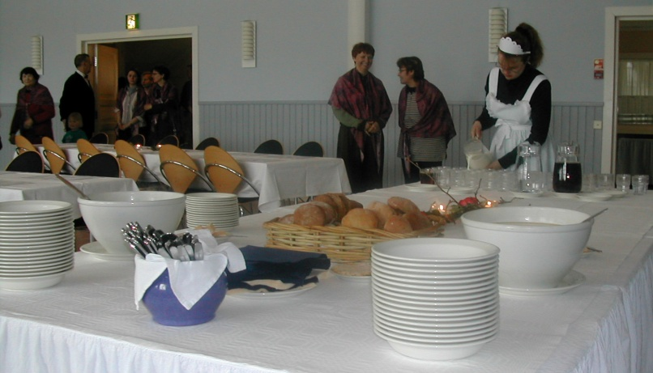
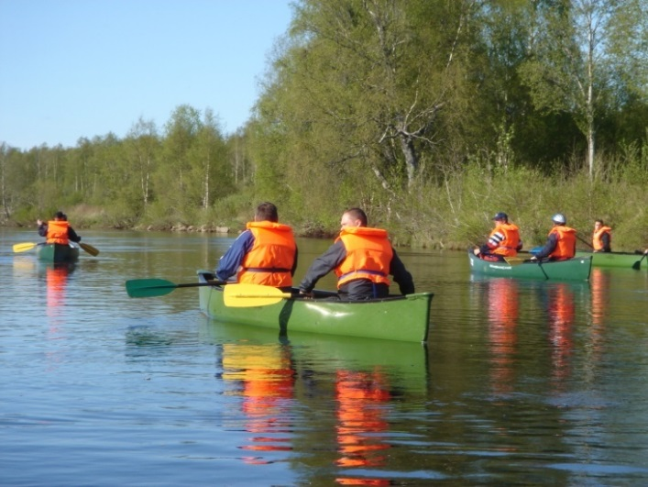
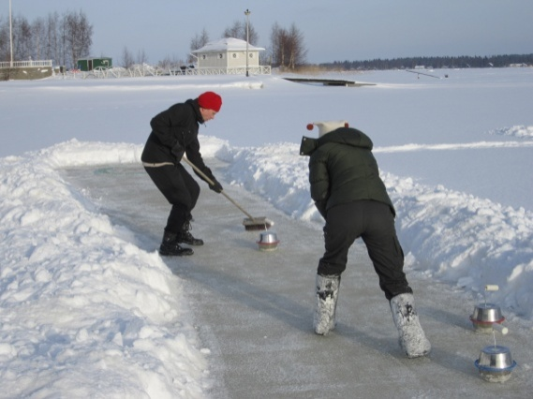
Thank you!

